Slide 1




Putting Innovation at the heart of ODL: what are the possibilities?
Professor Asha Kanwar
COL President & CEO
2023 International Conference on
Open and Innovative Education, Hong Kong Metropolitan University, 4-6 July 2023

Slide 2

Plan
Context
Innovation in education
Is ODL a disruptive innovation?
Status of research in open learning
Refresh, Rethink, Redesign

Slide 3
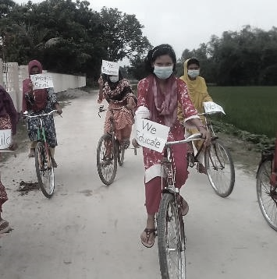



Age of Disruptions
COVID-19 PANDEMIC
TECHNOLOGY
CLIMATE CHANGE

Slide 4






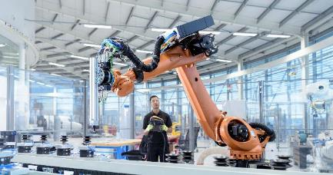

Context Today
Global recession
Phenomenal adoption of technology
By 2025, 85 million jobs may be displaced but 97 million more jobs may emerge
Skills for the green and blue economies
Life expectancy: half the people born after 1997 could live up to 100
Source: The Future of Jobs Report 2020, WEF, Oct 2020. McKinsey Quarterly, Beth Davies, Connor Diemand-Yauman, Nick van Dam, ‘Competitive advantage with a human dimension: from lifelong learning to lifelong employability’

Slide 5

United Nations, New York, 16, 17 & 19 September 2022
Address ‘learning loss’
1
Promote equity and inclusion
2
Achieve digital transformation
3
Review curricula and pedagogies
4
Support psycho-social well-being
5

Slide 6
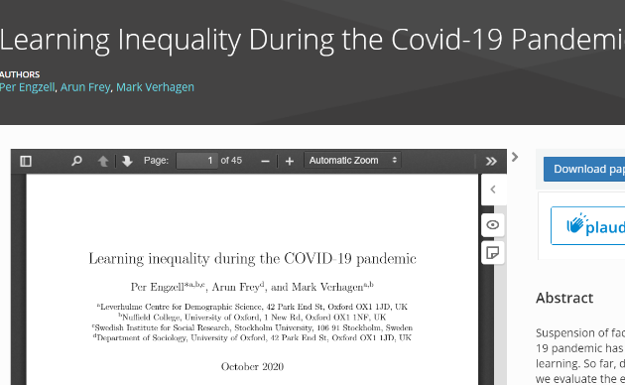
Learning Loss during Covid-19
Learning loss of about three percentile points
Learners from less educated home 55% more prone to learning loss
Source: https://osf.io/preprints/socarxiv/ve4z7/
Notes:
In Netherlands, during the COVID19 pandemic, learning loss of about 3 percentile points or 0.08 standard deviations was recorded in a study. Losses are up to 55% larger among students from less-educated homes.

Slide 7

AI Revolution
New essays, short articles, Tweets etc
Language translation
Text summarisation
Image generation from Text
Microlearning courses from text
Image Source: https://securitymea.com/2023/02/24/new-malware-stealing-social-media-credentials-under-chatgpt-app-disguise/
Notes:
An AI-based service that uses Natural Language Processing technology
A Large Language Model (LLM)
Trained on massive quantities of data
To generate human-like text
G(enerative) P(re-trained) T(ransformer)
Transformer is an advanced AI technology developed in 2017- an example is language translation
Much wider capabilities in May 2023 through plugins

Slide 8
Curriculum and Pedagogy
Curricular needs
Pedagogical considerations
General education to employment-oriented education
Any skills to Green skills
From STEM to STEAM
From digital literacy to AI fluency
Learnability
Blended learning design
Virtual reality
AI supported teaching
Feedback and learning analytics

Slide 9

Social Emotional Learning
Teachers social and emotional skills are key
Years after students participated in SEL, their academic performance was an average of 13 percentile points higher than students who didn’t participate.
Source: https://casel.org/fundamentals-of-sel/what-does-the-research-say/, retrieved on 1 June 2023
Notes:
Department of Education (UK) https://files.eric.ed.gov/fulltext/EJ1145076.pdf
Hundreds of studies involving more than 1 million students worldwide across PreK-12 offer consistent evidence that SEL has a positive impact on students’ academic achievement.
SEL interventions that addressed the five core competencies increased students’ academic performance by 11 percentile points, compared to students who did not participate.
The positive impact on academics lasts long-term: Years after students participated in SEL, their academic performance was an average of 13 percentile points higher than students who didn’t participate.
SEL enhances young people’s coping skills, resiliency, and emotion identification, which can help reduce symptoms of depression and anxiety in the short term.
SEL contributes to reductions in bullying and aggression.

Slide 10
Innovation in education

Slide 11
“Measuring Innovation in Education” by OECD between 2003-2011
Increases in innovative pedagogic practices…
Innovations in assessments and accessibility
Creation of professional learning communities for teachers and parents
‘…countries with greater levels of innovation have seen increases in certain educational outcomes, including higher… mathematics performance, more equitable learning outcomes for students of all abilities and more satisfied teachers’.
Source: https://www.oecd.org/education/ceri/GEIS2016-Background-document.pdf
Notes:
in areas such as relating lessons to real life, higher order skills, data and text interpretation, and personalisation of teaching.
evaluation and analytics, and building relationships with external stakeholders, such as

Slide 12
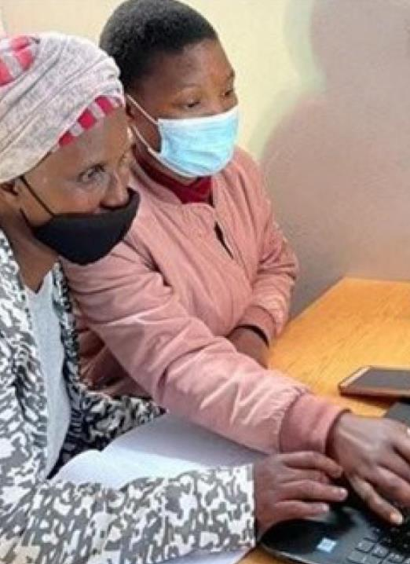
Educational Innovations during Covid-19
Use of TV and Radio (e.g., several countries in the Commonwealth)
Use of digital platforms (e.g., DIKSHA and SWAYAM in India)
Free SIM cards and free data to access internet (e.g., St Lucia, Sri Lanka)
Sharing OER (e.g., Fiji, Nigeria, South Africa)
Curriculum aligned digital content for K-12 (e.g., Fiji, Samoa, Vietnam)
Online and alternative examinations (e.g., India (open book examination), South Africa (use of mobile app))
Sources: (i) https://www.gse.harvard.edu/news/22/03/harvard-edcast-global-innovations-education-during-pandemic
(ii) http://hdl.handle.net/11599/3592
(iii) https://www.oecd-ilibrary.org/education/how-learning-continued-during-the-covid-19-pandemic_149b4e72-en
Notes:
During the pandemic, the education sector responded very fast and collaborated to create innovative solutions. Governments promoted the use of technologies and provided opportunities to train teachers online through various platform.

Slide 13




Types of Innovation
N
E
W
Architectural
Radical
D
E
M
A
N
D
E
X
I
S
T
I
N
G
Incremental
Disruptive
EXISTING
NEW
Modified from : Kennedy, Reed. (2020) Strategic Management. Blacksburg, VA: Virginia Tech Publishing. https://doi.org/10.21061/strategicmanagement CC BY NC-SA 3.0
TECHNOLOGY & FRAMEWORK
Notes:
The type of innovation is dependent on two factors:
Demand – does the innovation create a new demand, or address the existing demand in education?
“Technology & Framework – does the innovation use a new technology and framework or an existing technology and framework?”

Slide 14
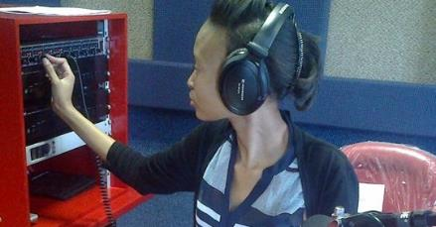


Incremental Innovation
Within existing demand and within existing technology and framework improving a product or service or practice
Mobile phones, community radio, camera are some of the examples of incremental innovation.

Slide 15
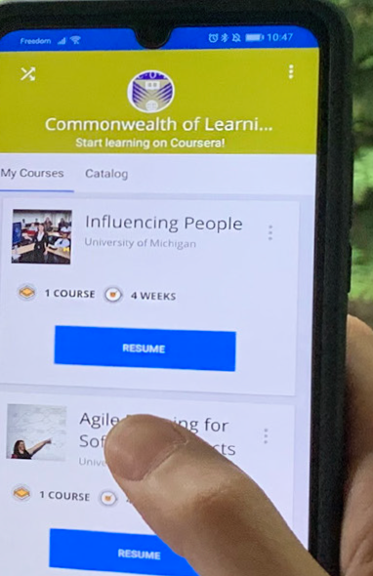
Disruptive Innovation
A new product or service or practice addressing the existing demand with new technology or framework
From campus-based to distance learning

Slide 16

Architectural Innovation
When new products or services or practices with existing technology or framework, address new demand or market.
From Pedagogy to Andragogy to Heutagogy for Lifelong Learning
From e-Learning to MOOCs

Slide 17

Radical Innovation
New products, services or practices with new technology or framework to reach create or reach new demand
Radical Innovation in Education is weak.
Can we reach 773 million illiterates and millions of semi-literates?

Slide 18
Is ODL a disruptive innovation?

Slide 19
Disruptive Innovation
‘…describes a process by which a product or service takes root initially in simple applications at the bottom of a market and then relentlessly moves up market, eventually displacing established competitors.’
C. Christensen
Source: http://www.claytonchristensen.com/key-concepts/

Slide 20
Characteristics of Disruptions
It is a process, not a product or service
Perceived lower quality in the beginning
Takes time to disrupt existing business
New business model/s emerge
Not all disruptions succeed

Slide 21
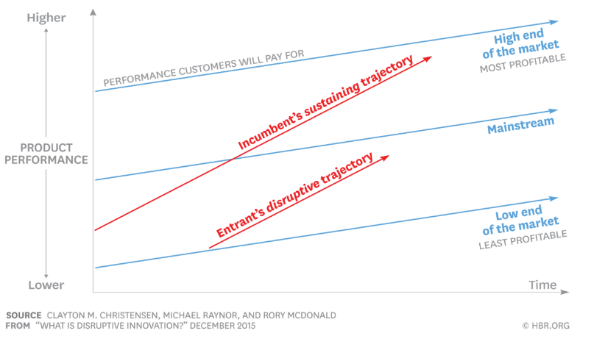
Disruptive Innovation Model
Source: https://hbr.org/2015/12/what-is-disruptive-innovation

Slide 22
Disruption in Higher Education
Top-tier F2F Higher Education institutions
High-end
MOOCs
Face-to-face teaching: sustaining trajectory
Mainstream F2F Higher Education
Online and blended courses
ODL as innovation
Open Universities and Dual-mode institutions
Low-end
Time

Slide 23
Disruptive Innovations Happen
Demands of a learning society
When new technologies emerge
New providers emerge

Slide 24





Generations of Distance Education
Correspondence model (printed-text)
Multi-media model (Radio, TV)
Tele-learning model (Interactive television)
Flexible learning model (WWW)
Intelligent flexible learning model (WWW+)
Gen 1
Gen 2
Gen 3
Gen 4
Gen 5
(Taylor, 2001)

Slide 25
ODL in Higher Education
Face-to-Face Courses
Blended Courses
Distance/Online Courses
MOOC
Mobile learning
ICT integration in teaching and learning
Open and Distance Learning

Slide 26
Inclusion: ODL for Persons with Disabilities
CONVENIENT
Study at your own pace, place, time
FLEXIBLE
Option to listen, watch or read lecture in different formats
AFFORDABLE
ANONYMOUS
Don’t require to travel to campus or accommodation
Costs less than F2F
Engage with professors and classmates without feeling discriminated
Notes:
People with disabilities are often disadvantaged in terms of access to tertiary education. Of the 18 countries for which data is available, 15 report disability prevalence under 3 per cent and half report rates under 2 per cent.
No info on students with disabilities in tertiary education.

Slide 27

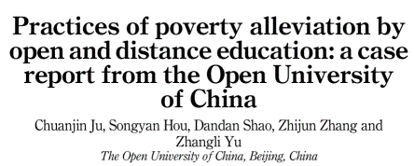
ODL for poverty alleviation
Targeted to 50,000 rural villagers
Evidence of increase in income, enterprise profit, employment opportunities
Source: https://www.emerald.com/insight/content/doi/10.1108/AAOUJ-09-2021-0110/full/html

Slide 28
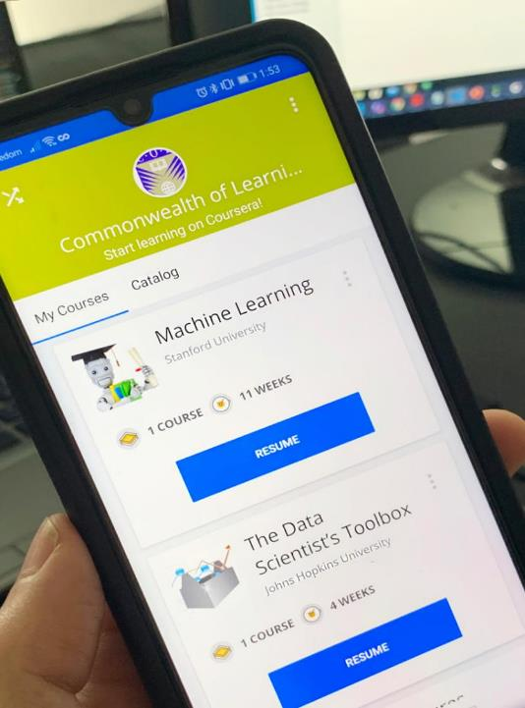

ODL for skilling
and reskilling
Learning to learn online
Providing just-in-time training for livelihoods
Learner support essential

Slide 29


National University for the Aged,
China

Slide 30
Status of research in open learning

Slide 31
Distance Education: 35 years
1980-84
1985-89
1990-94
1995-99
2000-04
2005-09
2010-14
Professional-ization and institutional consolidation
instructional design and educational technology
quality assurance
student support and early stages of online learning
emergence of virtual universities
collaborative learning and online interaction
MOOCs and OER
Zawacki-Richter, O., & Naidu, S. (2016) Mapping research trends from 35 years of publications in Distance Education, Distance Education, 37:3, 245-269, DOI: 10.1080/01587919.2016.1185079

Slide 32
Key Research Trends (2014-2019)
Issues related to open education
Design, support, and quality assurance of online DE
Implementation and use of educational technology, media, and digital tools
Bozkurt, A., & Zawacki-Richter, O. (2021). Trends and Patterns in Distance Education (2014–2019): A Synthesis of Scholarly Publications and a Visualization of the Intellectual Landscape. The International Review of Research in Open and Distributed Learning, 22(2), 19-45. http://www.irrodl.org/index.php/irrodl/article/view/5381/5517

Slide 33


Technology and Learning: meta-analysis
In-Class Technology Integration: estimated 11.5% improvement in knowledge/skills
Online Learning: “as good as” studying in-class; 2.4% improvement in learning outcomes.
Blended Learning: 10.7% average improvement in learning outcomes compared to face-to-face instruction.
Notes:
“The meta-analysis found that, on average, students in online learning conditions performed modestly better than those receiving face-to-face instruction. The advantage over face-to-face classes was significant in those studies contrasting blended learning with traditional face-to-face instruction but not in those studies contrasting purely
online with face-to-face conditions.”

Slide 34


Research Trends during Covid-19
68% post-secondary focus,
only 10% K-12
Subject category focus: social science (64%), medicine and health science (32%), computer science (31%).
Over one-third of papers descriptive; 43% adopted quantitative approach
Mishra, S., Sahoo, S., & Pandey, S. (2021). Research trends in online distance learning during the COVID-19 pandemic. Distance Education, 42(4), 494-519
Notes:
“The meta-analysis found that, on average, students in online learning conditions performed modestly better than those receiving face-to-face instruction. The advantage over face-to-face classes was significant in those studies contrasting blended learning with traditional face-to-face instruction but not in those studies contrasting purely
online with face-to-face conditions.”

Slide 35

Critical Issues in Open and
Distance Education (ODE) Research
Scarcity of longitudinal research
Preference for success over failure
Lack of socio-cultural sensitivity
Scant attention for the disadvantaged
Insufficient research on ODE policy
Disinterest in revisiting ODE theories
Junhong Xiao, IRRODL, Vol 24, No 2, May 2023

Slide 36

Research on AI in online distance education
Data mining, Learning analytics for adaptive and personalized learning
Algorithmic online spaces, ethics, human agency
Recognising and predicting student behaviours
Murat Ertan Dogan, Tulay Goru Dogan, Aras Bozkurt
The use of AI in online learning and distance education processes: a systematic review of empirical studies
Special Issue Artificial Intelligence in Online Higher Educational Data Mining
Applied Sciences/Vol 13/Issue 5 27Feb, 2023
.

Slide 37


Trends in JL4D
2014-2022

Slide 38
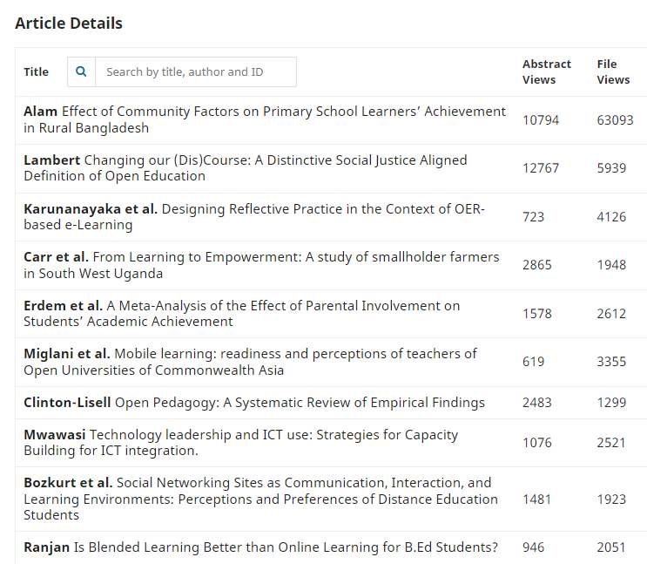
Themes and innovations
2019-2023
Notes:
Readers engage with JL4D papers in many different ways. This slide shows the top 10 most engaged with papers since the journal started. It will be noted that there is a strong interest among JL4D readers in the concept of learning for development and what this means in multiple contexts. There is also interest in the ways in which technology can be harnessed in innovative ways to address the needs of these multiple contexts.

Slide 39

Recent journal themes
Technology and Pedagogy for Learning and Capacity Building
Capacity Building for New Modes of Learning and Teaching
Lessons from Diverse Contexts and Perspectives
Research on Technology-Enabled Learning
Learning for Development – Discourse and Practice
Researching Technology-Enabled Teaching, Learning and Training
Technology-Enabled Learning: OER, MOOCs, and other TEL Designs

Slide 40

The fundamental problem lies in educational research… not much concerned with learning productivity and efficiency
Educational Technology –
is it alone a sine qua non of innovation?
ODL Research –where is the discourse on innovation theories?
(Serdyukov, 2017)
Serdyukov, P. (2017), "Innovation in education: what works, what doesn’t, and what to do about it?", Journal of Research in Innovative Teaching & Learning, Vol. 10 No. 1, pp. 4-33. https://doi.org/10.1108/JRIT-10-2016-0007
Notes:
Technology an invention—when technology is ‘domesticated’, innovations happen

Slide 41

Taking ODL Research to the next level
Technologies | Implications
Artificial intelligence | Big data supported learning analytics to customize and improve student learning
Blockchain | Tamper proof certification of skills for mobility
AR/VR | Master skills using technology before actually applying in real life.
Robotics | Teaching assistants to scale training
Notes:
This has three implications for teaching and learning as the future of jobs are more or less dependent on these technologies: (i) everyone in the workforce needs to be trained to use some of these technologies; (ii) prepare teachers who can teach with the technologies of 4th IR, and (iii) prepare technologists who can support these.

Slide 42
Refresh, Rethink, Redesign

Slide 43
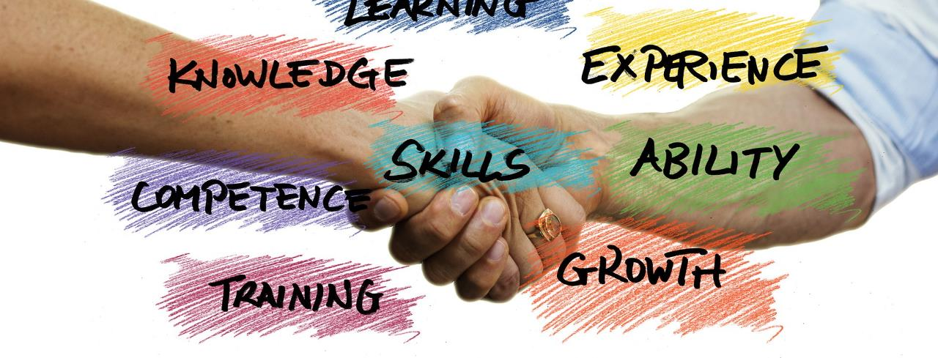
Innovation happens…
Involve stakeholders like communities, parents, teachers and labour market
Foster participation
Transform creativity into innovation

Slide 44

Innovations are not about technology alone but relate to:
Products
Processes
Models
Methods
Workplace organisation
https://stats.oecd.org/glossary/detail.asp?ID=6865

Slide 45

In addition, we need to ask:
Innovations for whom?
Innovations for what?
How will scale be achieved?
How ethical are the innovations?
What will be the impact?

Slide 46

Skills for Innovation
Questioning
Observing
Networking
Experimenting
The Innovator's DNA: Mastering the Five Skills of Disruptive Innovators
by Jeffrey H. Dyer, Hal B. Gregersen, Clayton M. Christensen, Harvard Business Press
Notes:
Asking ‘why?’ or ‘what if?’
ODL Leaders must encourage a spirit of inquiry and a culture of research
Exposure to new technologies and environments to assess what works and what doesnt and why
Interactions of a social and intellectual nature with people from different disciplines/sectors
ODL Leaders must promote
interdisciplinary exchanges so that by connecting different disciplines and sectors, innovative ideas emerge
ODL Leaders must enable staff to visit other institutions and expose them to emerging technology developments
Try out new ideas by creating prototypes and launching pilots
ODL Leaders must encourage staff to construct interactive experiences and provoke out of the box solutions

Slide 47
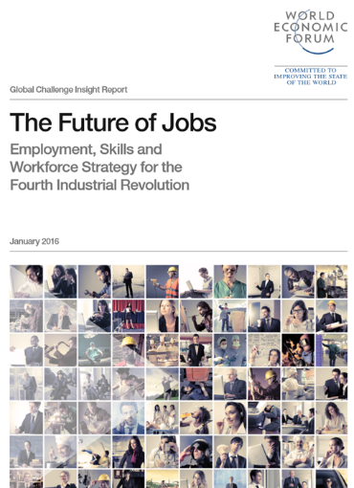
Refresh:
Towards Lifelong learning
Simply reforming current education systems …to meet future skills requirements is not going to be enough….
Ageing countries …will need wholesale reskilling of existing workforces throughout their life
Notes:
https://www.weforum.org/agenda/2016/01/the-10-skills-you-need-to-thrive-in-the-fourth-industrial-revolution/

Slide 48



“To enhance access to high quality, affordable and relevant education…and ensure lifelong learning opportunities to face challenges in a knowledge society."
" To widen access to quality education and provide lifelong learning opportunities by leveraging on technology… providing a conducive…learning environment at…affordable cost"
Sukhothai Thammathirat Open University aims to be a world-class open university utilizing a distance education system to provide lifelong learning for all
Source: http://www.ou.ac.lk/home/index.php/2013-12-19-09-04-42/introducing-ousl
Source: http://www.oum.edu.my/?q=node/1
Source: http://www.stou.ac.th/Eng/Vision.aspx

Slide 49


Rethink: Employability
Balance between theory and practice; hard and soft skills
Engage industry: internships; apprenticeships
Link QA to employability
Career support
Measure capability rather than
number of hours
Credit Hour
Range of skills

Slide 50

Rethink: Green learning agenda
Skills for green jobs
Green life skills
Skills for a green transformation
Skills aimed at fulfilling the requirements of green jobs and supporting the transition to a low-carbon green economy
Cross-cutting skills that serve both technical, instrumental, and adaptive, transformative ends
Adaptive skills aimed at transforming unjust social and economic structures
Source: https://www.brookings.edu/wp-content/uploads/2021/01/Brookings-Green-Learning-FINAL.pdf

Slide 51
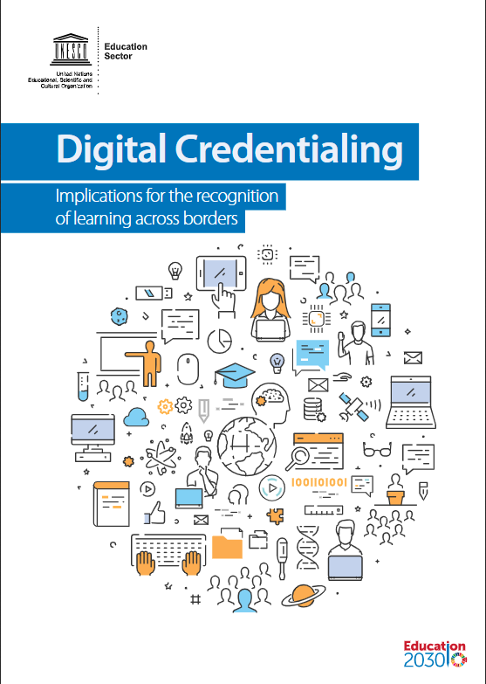
Redesign: Assessment
New methods
Recognition of prior learning
Transnational qualifications frameworks for mobility
Notes:
https://unesdoc.unesco.org/ark:/48223/pf0000264428?posInSet=4&queryId=N-e4559bf5-0bec-40c7-91a9-5cdea42e1ca4

Slide 52
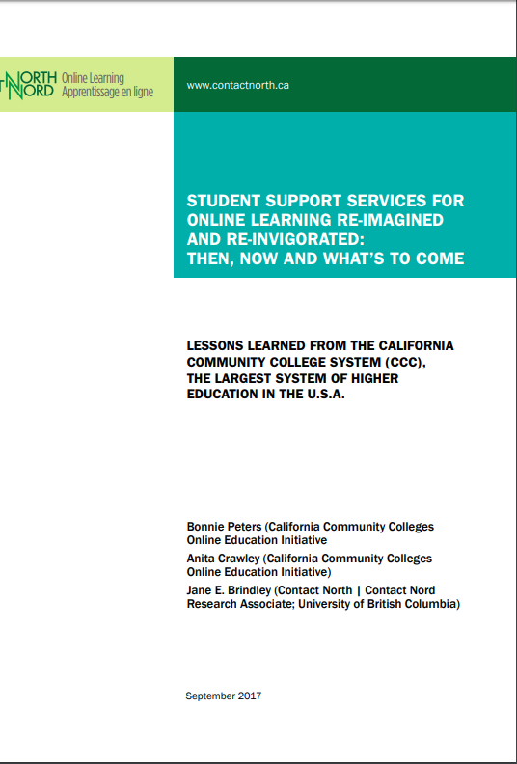
Redesign:
Learner Support
Online support hubs
Use of learning analytics
Keep the human touch
One Chatbot per learner?
Notes:
https://teachonline.ca/sites/default/files/tools-trends/insights/pdf/student_support_services_for_online_learning_re-imagined_and_re-invigorated.pdf

Slide 53

Towards an Innovation Mindset
Regard every challenge as an opportunity
Take risks and learn from failure
Adopt collaboration as a strategy
Source: http://www.claytonchristensen.com/key-concepts/

Slide 54


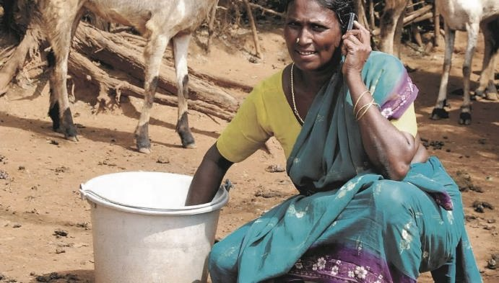

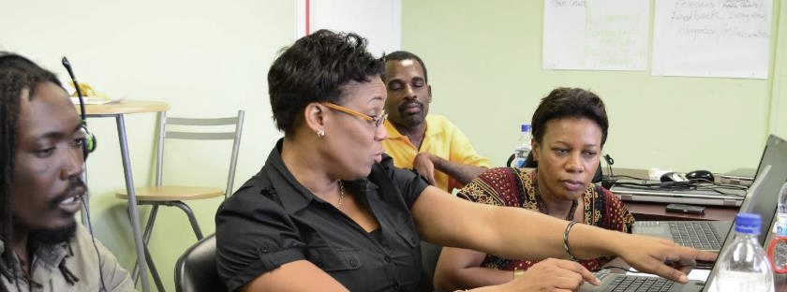

Thank you
www.col.org
The contents of this presentation, with the exception of logos and graphics which are the property of the respective owners, is made available under Attribution-ShareAlike 4.0 International (CC BY-SA 4.0).

