Slide 1

Commonwealth of Learning
Promoting Learning for Sustainable Development
Professor Asha Kanwar
President & CEO
COMSEC Annual Board Meeting
18 May 2022

Slide 2
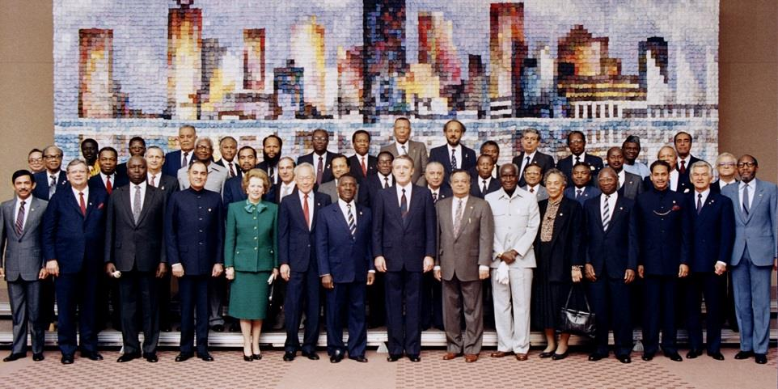

Commonwealth Heads of Government Meeting
Vancouver, 1987

Slide 3
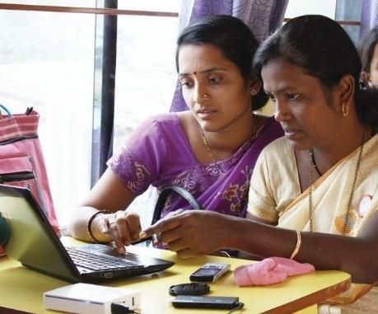
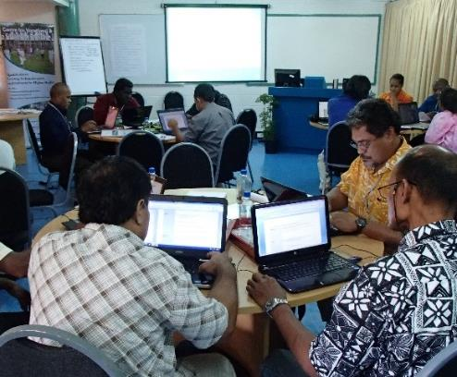
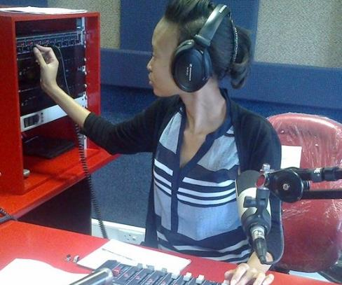
To help Commonwealth governments and institutions use technologies to improve and expand access to education and training

Slide 4

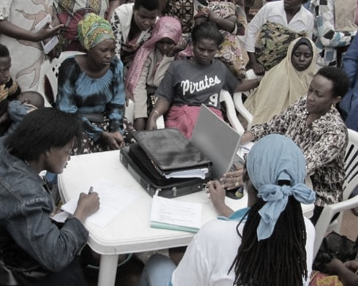
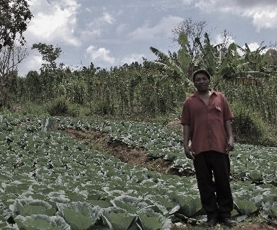


ECONOMIC EMPOWERMENT
SOCIAL
INCLUSION
ENVIRONMENTAL CONSERVATION
$
Notes:
COL continues to promote ‘learning for sustainable development’. Learning must lead to economic growth, social inclusion and environmental conservation.

Slide 5

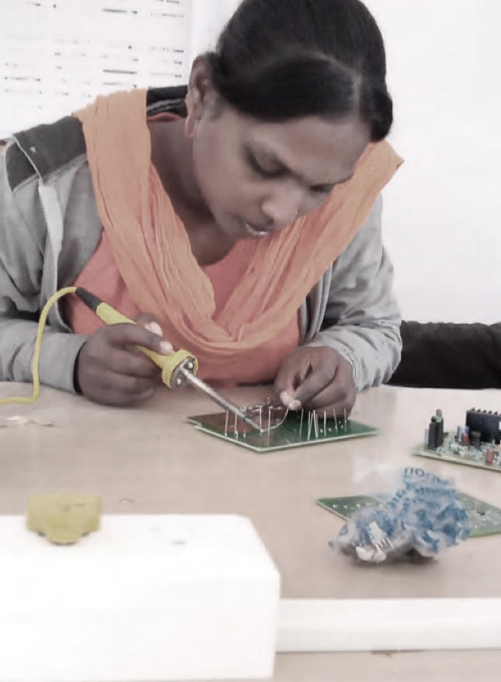
PROGRAMME SECTORS
Education
Skills
Gender Equality

Slide 6
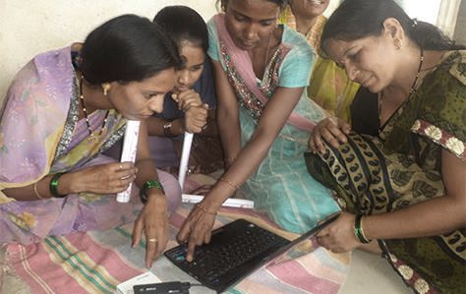
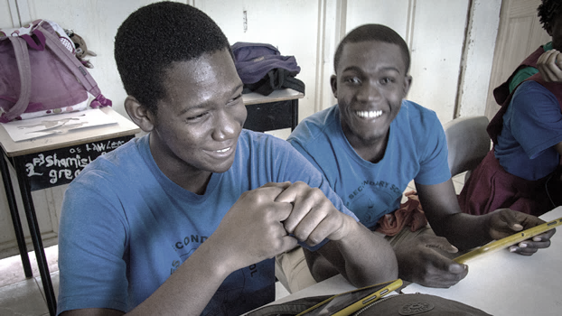
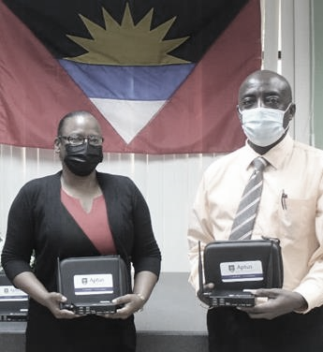
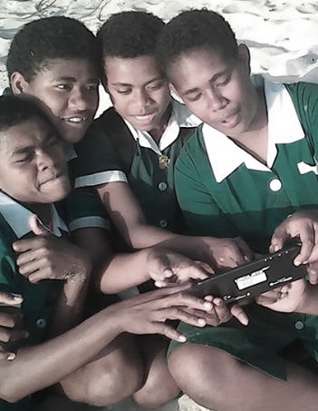
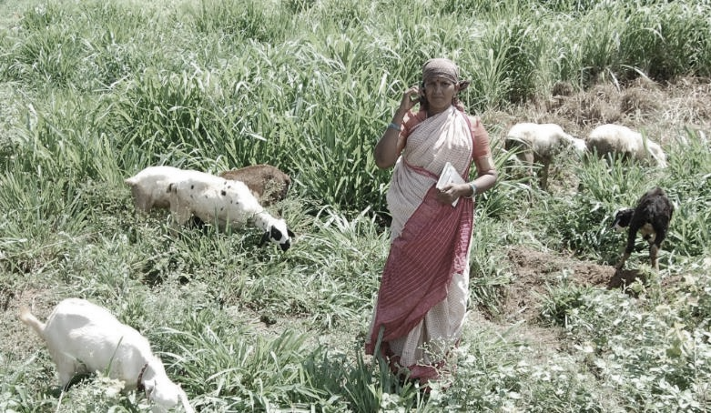
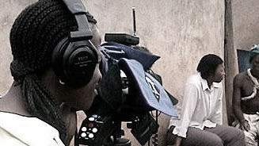
Leveraging new and existing technologies

Slide 7

Rethinking education for innovation, growth,
sustainability

Slide 8
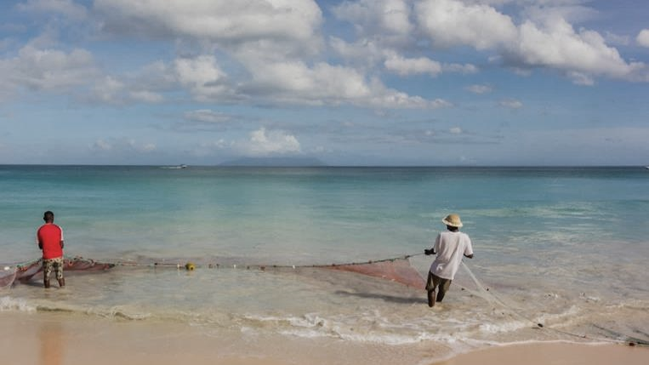
SUSTAINABILITY
Notes:
COL's mission is to help Commonwealth Member States and institutions to use technologies for expanding access to quality education and training.
COL believes that learning is the key to sustainable development: Learning must lead to economic growth, social inclusion and environmental conservation.

Slide 9
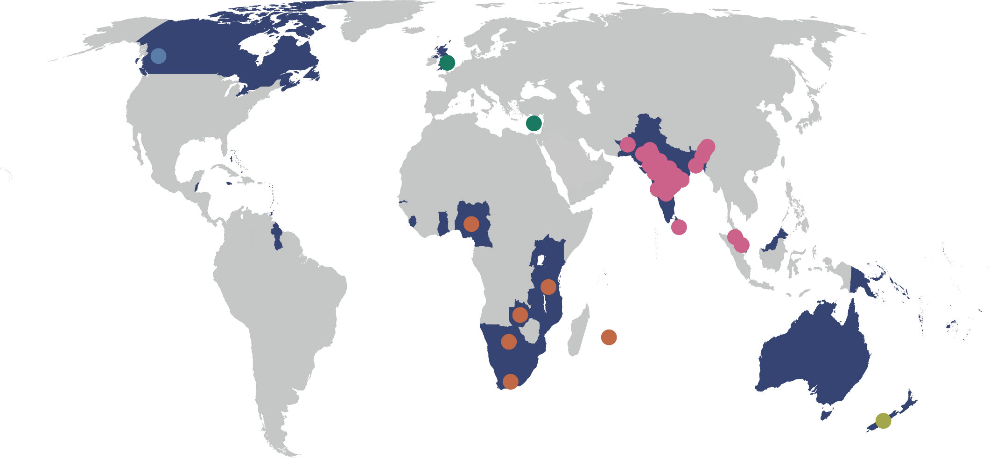
BANGLADESH
  Bangladesh Open University
INDIA
  Dr. Babasaheb Ambedkar Open University
  Dr. B.R. Ambedkar Open University
  Indira Gandhi National Open University
  Jagat Guru Nanak Dev Punjab State Open University
  Karnataka State Open University
  Krishna Kanta Handiqui State Open University
  Madhya Pradesh Bhoj University
  Nalanda Open University
  Netaji Subhas Open University
  Odisha State Open University
  Pandit Sundarlal Sharma (Open) University
  Sreenarayanaguru Open University
  Tamil Nadu Open University
  Uttarakhand Open University
  Uttar Pradesh Rajarshi Tandon Open University
  Vardhman Mahaveer Open University
  Venkateshwara Open University (Private)
  Yashwantrao Chavan Maharashtra Open University
MALAYSIA
  Open University Malaysia
  Wawasan Open University
PAKISTAN
  Allama Iqbal Open University
SRI LANKA
  Open University of Sri Lanka
CYPRUS
Open University of Cyprus
UNITED KINGDOM
The Open University
CANADA
Athabasca University
33 Commonwealth Open Universities
(2021)
BOTSWANA
Botswana Open University
MAURITIUS
Open University Mauritius
NIGERIA
National Open University of Nigeria
SOUTH AFRICA
University of South Africa
TANZANIA
Open University of Tanzania
ZAMBIA
Zambian Open University
NEW ZEALAND
Open Polytechnic of New Zealand

Slide 10

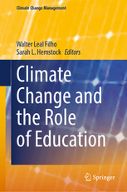





Research on Emissions and ODL
3x less carbon emissions
Travel – greatest contributor
Mode of delivery - determinant
Source: Carr et.al. Delivery Mode and Learner Emissions: Comparative Study from Botswana. W. Leal Filho and S. L. Hemstock (eds.), Climate Change and the Role of Education, Springer Nature. In Production.
Notes:
Perhaps the most comprehensive project assessing the environmental impacts of different modes of delivery in higher education is the SusTEACH project, supported by the Open University, UK. The project compared the carbon emissions of ICT-enhanced courses with online courses and mainly face to-face taught courses. The findings showed that online and blended ICT-enhance distance teaching models had significantly lower environmental impacts than face-to-face teaching modes (Caird et al. 2013; Caird et al. 2015). This study used a comprehensive methodology that considered multiple contributors to emissions for both students and the institutions.
Using the SusTeach methodology COL conducted a study in Botswana, to determine whether there was a difference between the carbon emissions of CD-based ODL and face-to-face learners, as well as the main sources of learners’ emissions.
The comparison of learner carbon emissions data from both face-to-face and CD based students in Botswana revealed that the average learning-related carbon footprint of the face-to-face group is nearly three times greater than that of the ODL group, and the difference was statistically significant. Within the overall carbon footprint, emissions from travel were by far the greatest contributor to this disparity. This suggests that regardless of the exact mechanism of delivery, ODL or blended modes can decrease emissions by reducing face-to-face contact hours. Institution, as a proxy for delivery mode, was the most significant predictor of learning related emissions.

Slide 11
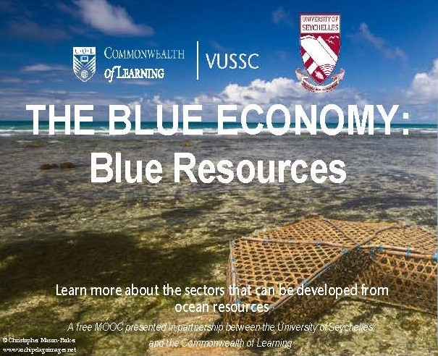
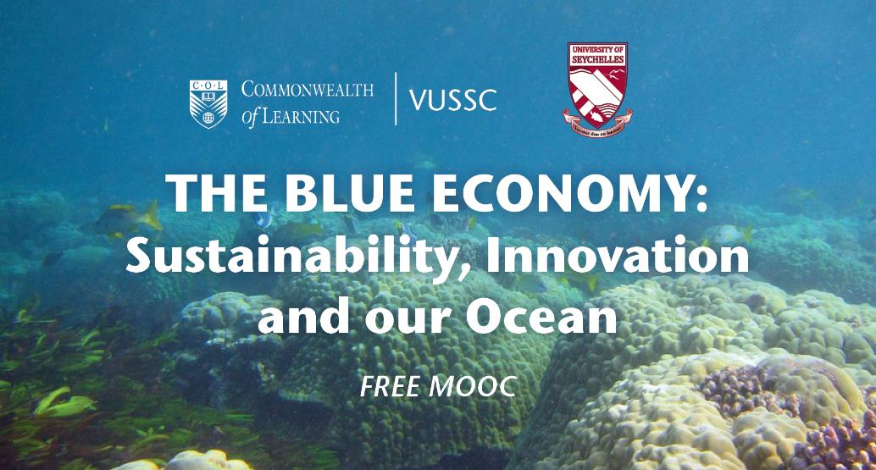

COL supports a Virtual University for Small States of the Commonwealth (VUSSC) to strengthen existing tertiary institutions. All 32 small states are members and collaborate on course development and delivery.
Worked with the University of Seychelles to offer MOOCs on the Blue Economy and all resources developed are available to VUSSC members.

Slide 12
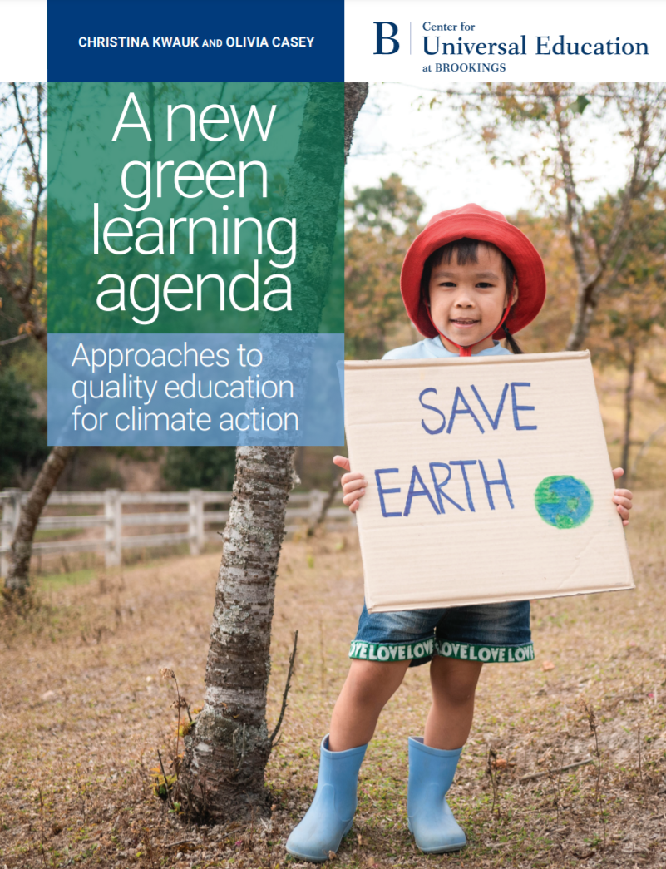
Green learning agenda
Skills for green jobs
Green life skills
Skills for a green transformation
Skills aimed at fulfilling the requirements of green jobs and supporting the transition to a low-carbon green economy
Cross-cutting skills that serve both technical, instrumental, and adaptive, transformative ends
Adaptive skills aimed at transforming unjust social and economic structures
Source: https://www.brookings.edu/wp-content/uploads/2021/01/Brookings-Green-Learning-FINAL.pdf

Slide 13
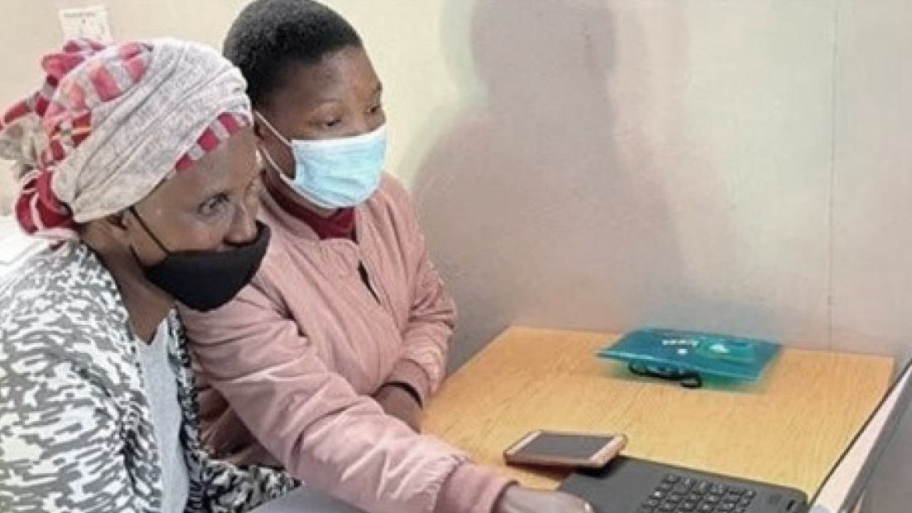

GROWTH
Notes:
COL's mission is to help Commonwealth Member States and institutions to use technologies for expanding access to quality education and training.
COL believes that learning is the key to sustainable development: Learning must lead to economic growth, social inclusion and environmental conservation.

Slide 14
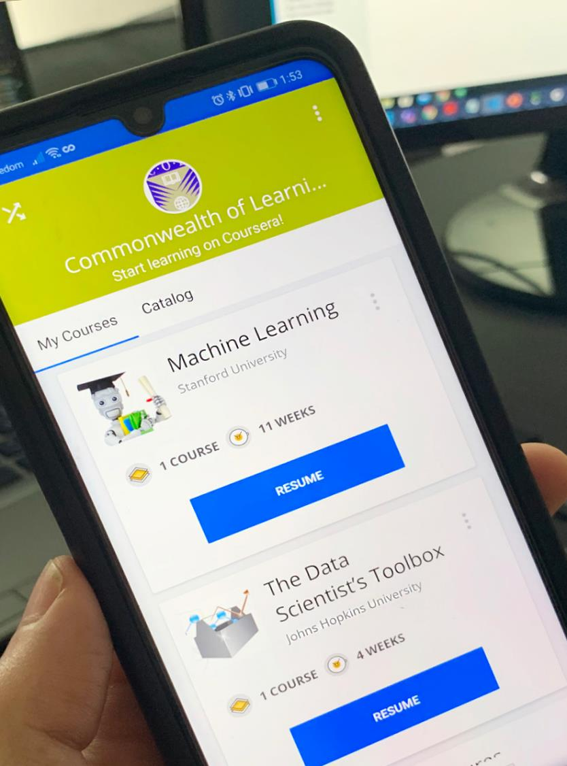


Economic growth:
Skilling and re-skilling
COL admitted over 151,133 citizens of the Commonwealth to gain skills to regain employment, with more than 42,000 of them completed

Slide 15









Empowering Women

Slide 16




Benefits: Commonwealth Executive MBA/MPA
Graduates saw on increase of 38% in monthly income
For every $1 invested, learners received $3.40 in direct returns
1:3.4
Notes:
10 countries/flags?

Slide 17

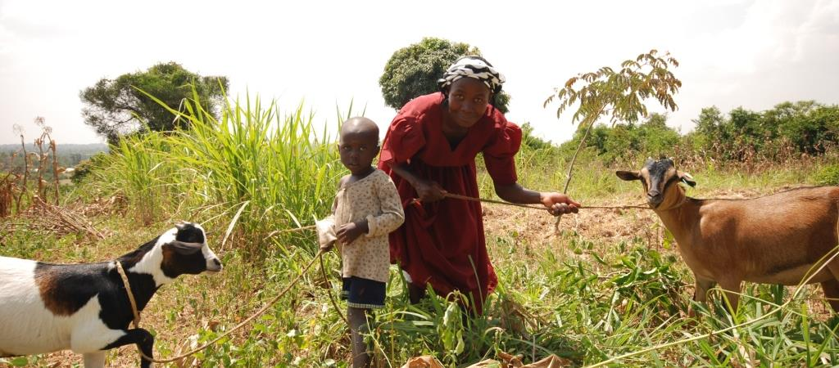


Lifelong Learning for Farmers (Kenya, Tanzania, Uganda)
1% increase in empowerment 2.3% increase in profit
Notes:
Belize
Benefits: skills, expected income
Social Return on Investment of an Open School showed that every US$ invested resulted in US$8 worth of benefits to students.

Slide 18
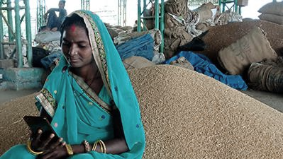
INNOVATION
Notes:
COL's mission is to help Commonwealth Member States and institutions to use technologies for expanding access to quality education and training.
COL believes that learning is the key to sustainable development: Learning must lead to economic growth, social inclusion and environmental conservation.

Slide 19
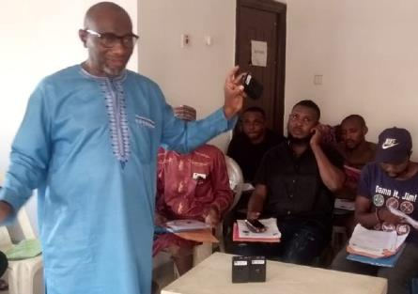
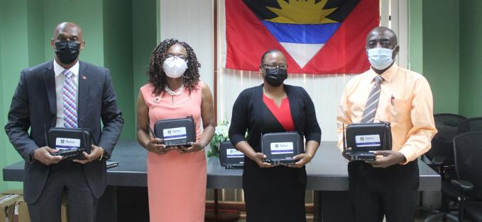
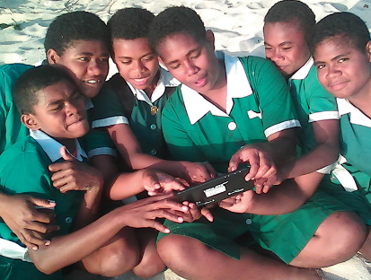









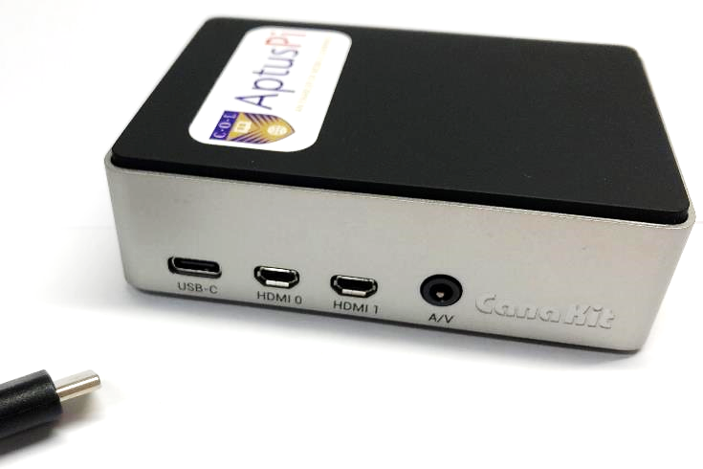





ANTIGUA & BARBUDA
BAHAMAS, THE
FIJI
INDIA
KIRIBATI
MALDIVES
MOZAMBIQUE
NIGERIA
PAKISTAN
SAMOA
TONGA
VANUATU
ZAMBIA
A low-cost device that allows educators and learners to connect to digital learning platforms and content without the need for grid electricity or Internet access.
Notes:
COL developed Aptus a low-cost offline virtual classroom that provides learners in remote locations with access to digital resources. It’s a server that works with a solar charger and a wireless router and costs approximately $ 150.
Maldives (2021)
Zambia, Ministry of General Education (2021)
Antigua and Barbuda, Ministry of Education, Sports and Creative Industries (2021)
Bahamas, Ministry of Education (2020)
Mozambique, Ministry of Education and Human Development (2018)
Tonga, Ministry of Education/Tonga Institute of Higher Education (2018)
Samoa, Ministry of Education (2018)
India, Mann Deshi Foundation (2016)
Samoa, National University Samoa (2016)
Pakistan, Qatar Foundation/ROTA (2016)
Fiji, Ministry of Education (2015)
Vanuatu, Ministry of Education (2015)
Kiribati, Ministry of Education (2015)

Slide 20
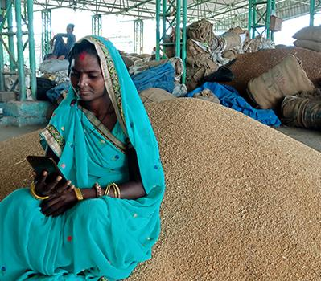
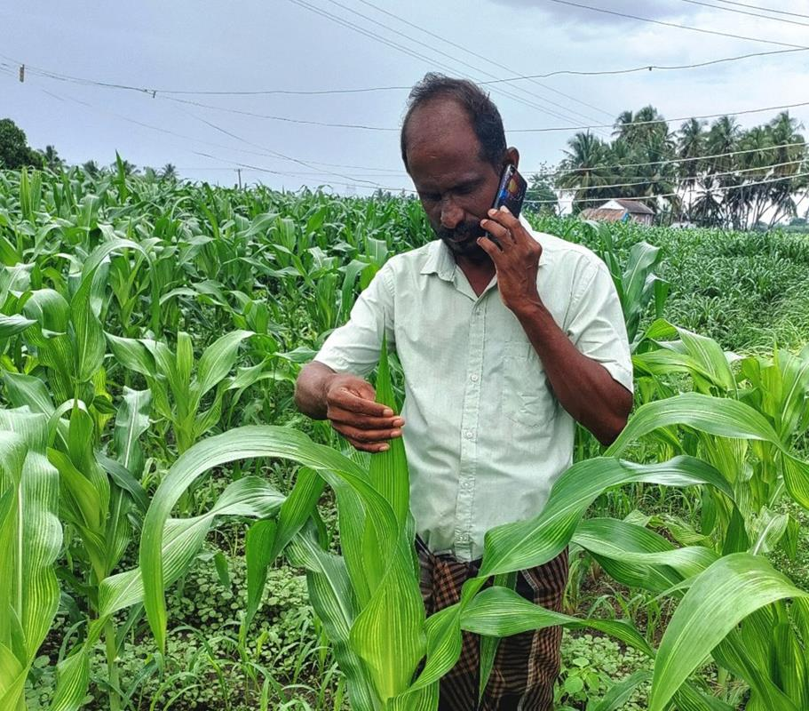
MobiMOOC- Online learning - Food and Agriculture sector underserved.
COL’s innovation helps farmers access learning using basic phones
Notes:
Belize
Benefits: skills, expected income
Social Return on Investment of an Open School showed that every US$ invested resulted in US$8 worth of benefits to students.

Slide 21
Virtual Labs

Slide 22

ICT Augmentation for Small States/LDCs
Addressing ICT resources and capacities
Build national resilience for education by supporting disaster preparedness in small states
Introduce and model the use of environmentally sustainable green technologies

Slide 23

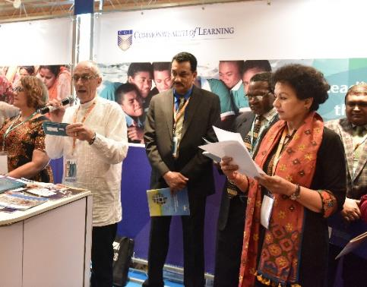
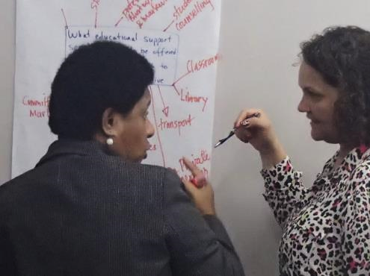
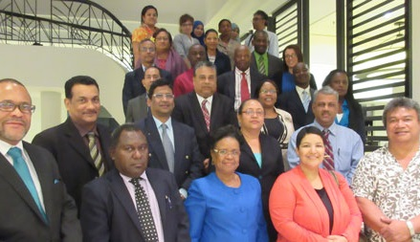
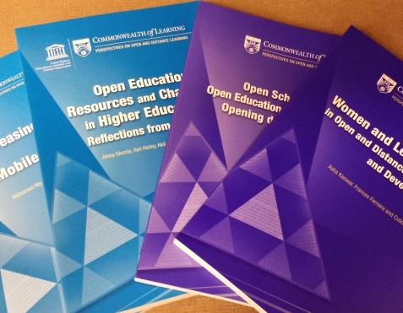




@35 COL offers
World Class Expertise
Innovative Models
Capacity Building
Resources
CC0 1.0 Universal - Pixabay
Notes:
We invite you to engage us; tap into our thought leadership, expertise, networks and resources

Slide 24


pcf10.org
Innovations for Educational Resilience
14 – 16 September 2022

Slide 25

Thank you
www.col.org
The contents of this presentation, with the exception of logos and graphics which are the property of the respective owners, is made available under Attribution-ShareAlike 4.0 International (CC BY-SA 4.0).

