Slide 1
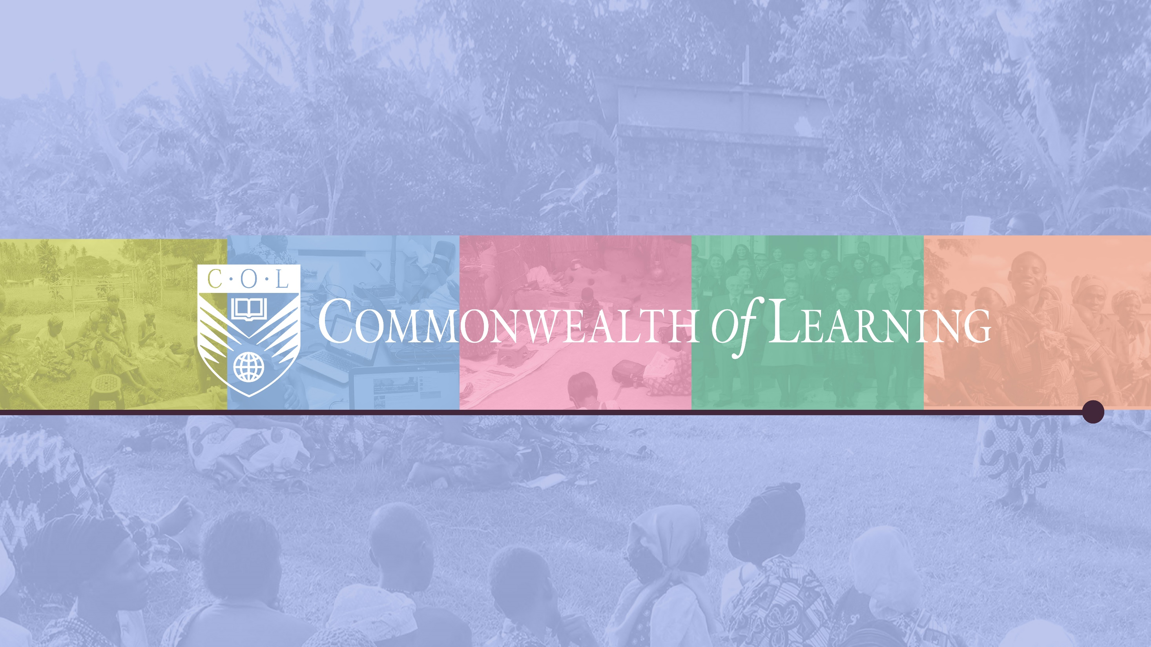






















































Promoting Learning for Sustainable Development
ANTIGUA & BARBUDA
AUSTRALIA
BAHAMAS
BANGLADESH
BARBADOS
BELIZE
BOTSWANA
BRUNEI DARUSSALAM
CAMEROON
CANADA
CYPRUS
DOMINICA
ESWATINI
FIJI
THE GAMBIA
GHANA
GRENADA
GUYANA
INDIA
JAMAICA
KENYA
KIRIBATI
LESOTHO
MALAWI
MALAYSIA
MALDIVES
MALTA
MAURITIUS
MOZAMBIQUE
NAMIBIA
NAURU
NEW ZEALAND
NIGERIA
PAKISTAN
PAPUA NEW GUINEA
RWANDA
ST KITTS & NEVIS
SAINT LUCIA
ST VINCENT & GRENADINES
SAMOA
SEYCHELLES
SIERRA LEONE
SINGAPORE
SOLOMON ISLANDS
SOUTH AFRICA
SRI LANKA
TONGA
TRINIDAD & TOBAGO
TUVALU
UGANDA
UNITED KINGDOM
TANZANIA
VANUATU
ZAMBIA

Slide 2
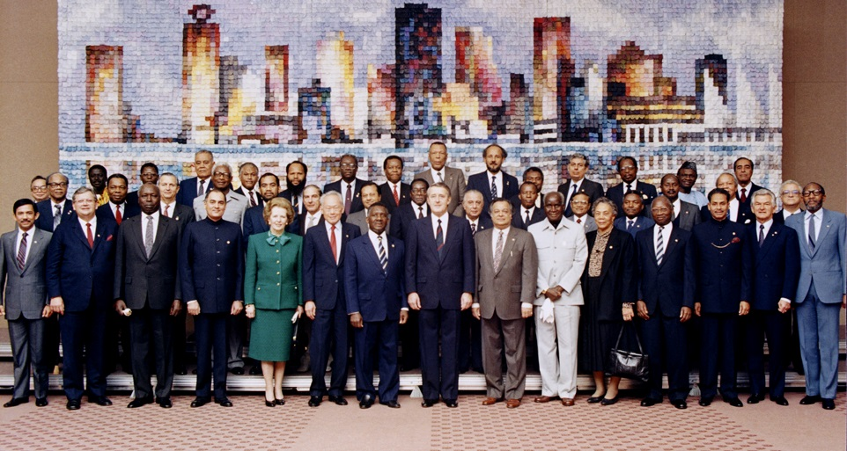
Commonwealth Heads of Government Meeting
Vancouver, 1987

Slide 3

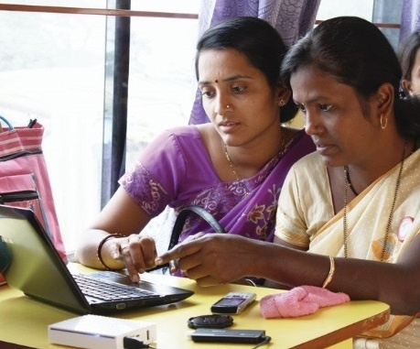
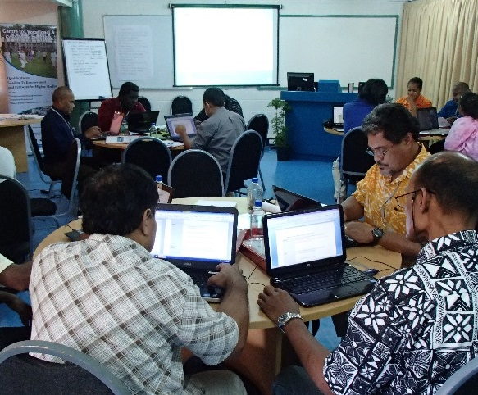
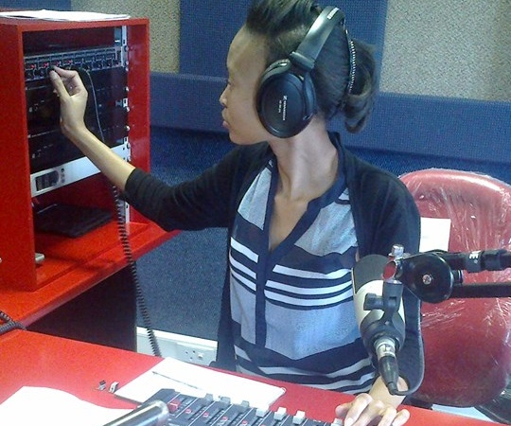
To help Commonwealth governments and institutions use technologies to improve and expand access to education and training

Slide 4
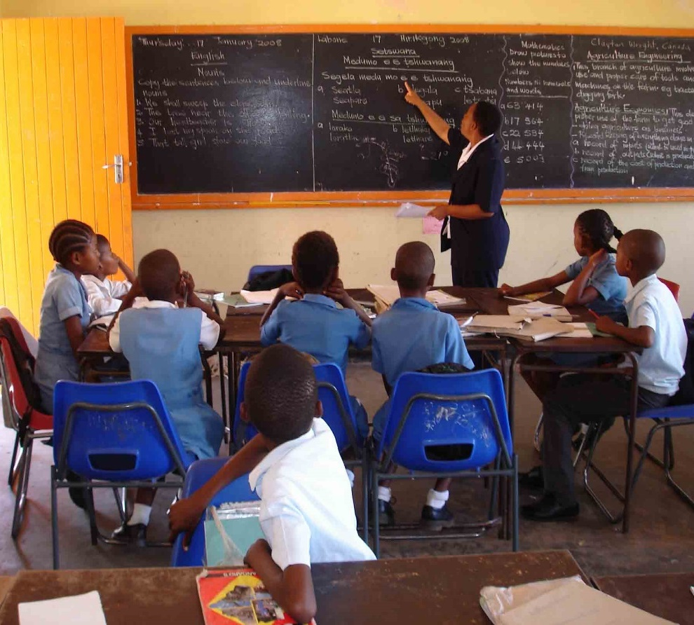
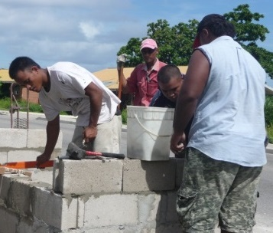
EDUCATION
SKILLS
GENDER

Slide 5
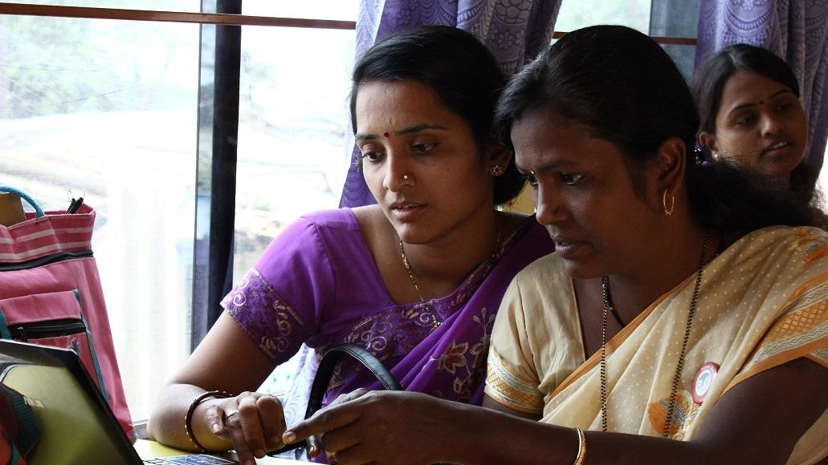
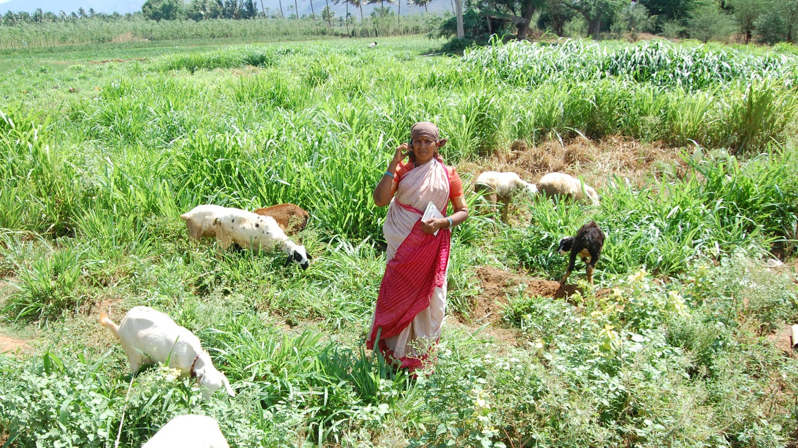
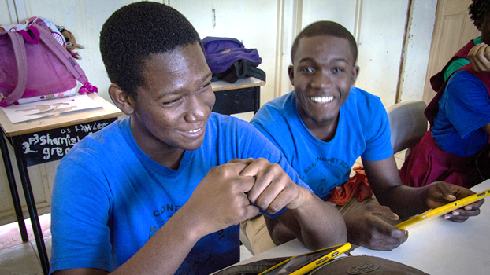
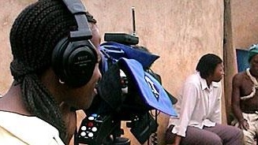
Leveraging
new and existing
technologies

Slide 6







Who supports COL?
Canada
India
UK
Australia
New Zealand
Nigeria
South Africa
The number of countries contributing increased
from 23 in 2003-06 to 47 currently

Slide 7

Building Back Better
Ensure girls don’t drop
out of school
Skill women for employment
Address gender-based violence

Slide 8
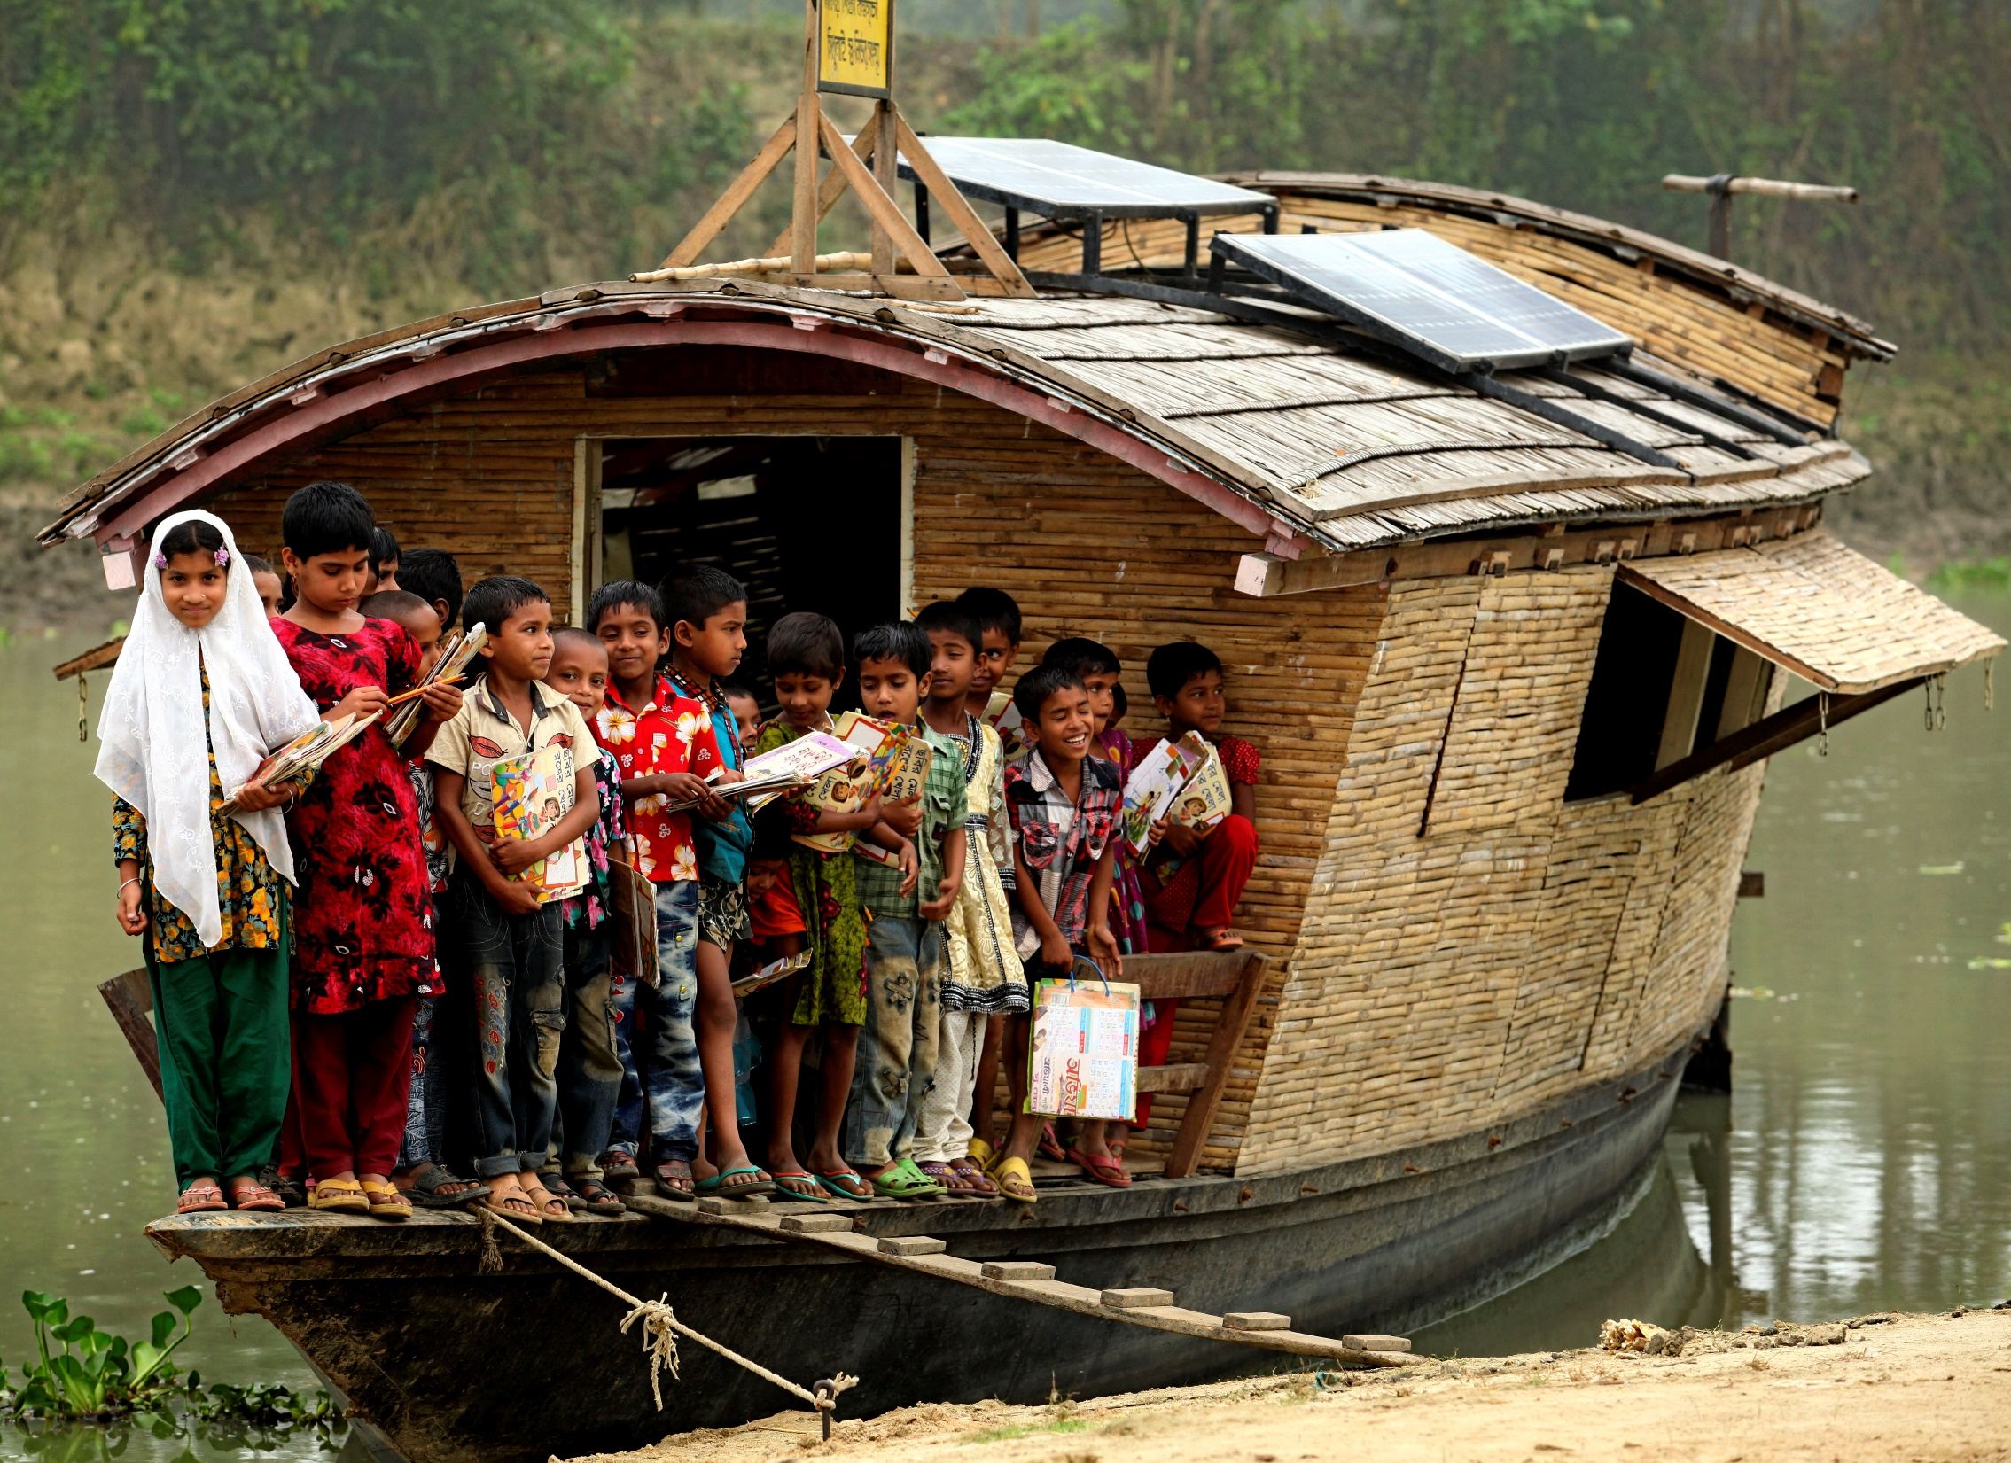
Photo credit: Shidhulai Swanirvar Sangstha

Slide 9
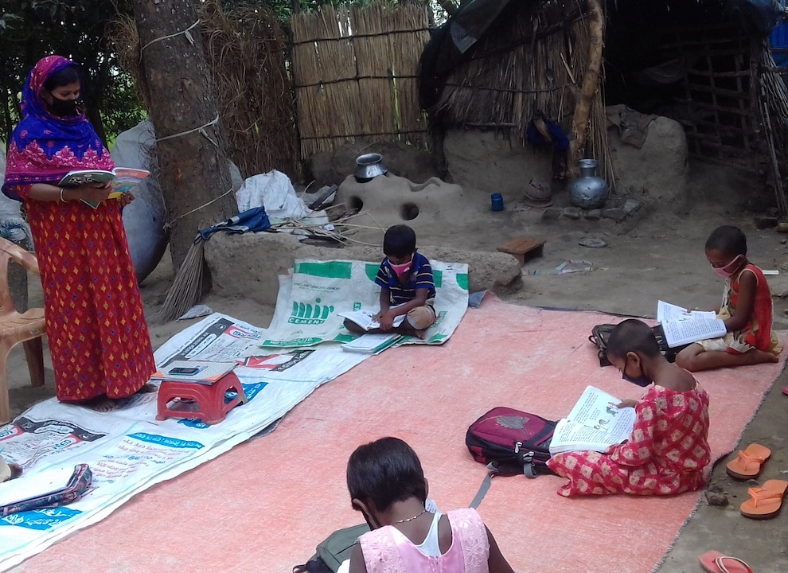

Slide 10
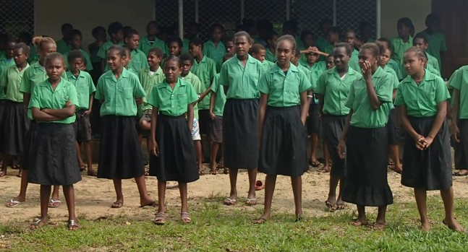

Open schools use distance learning for increasing access and reducing the costs of quality secondary education
Notes:
Belize
Benefits: skills, expected income
Social Return on Investment of an Open School showed that every US$ invested resulted in US$8 worth of benefits to students.

Slide 11
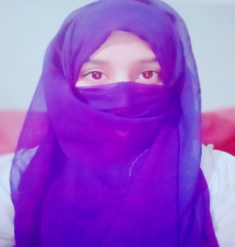
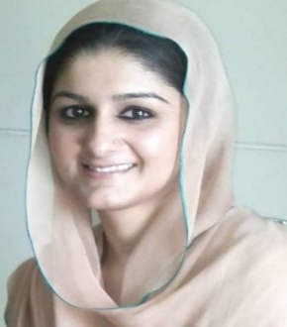
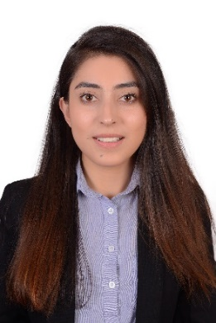
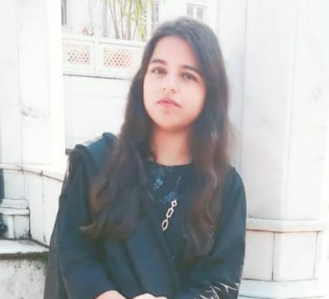
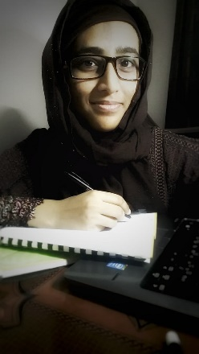
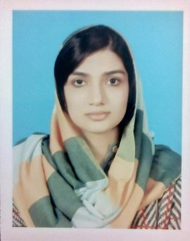

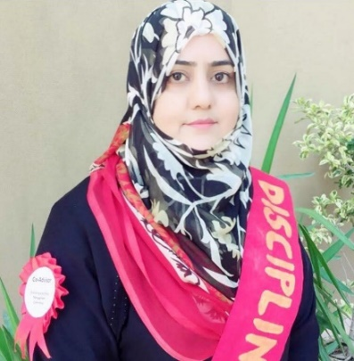


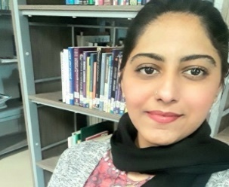
Notes:
.

Slide 12
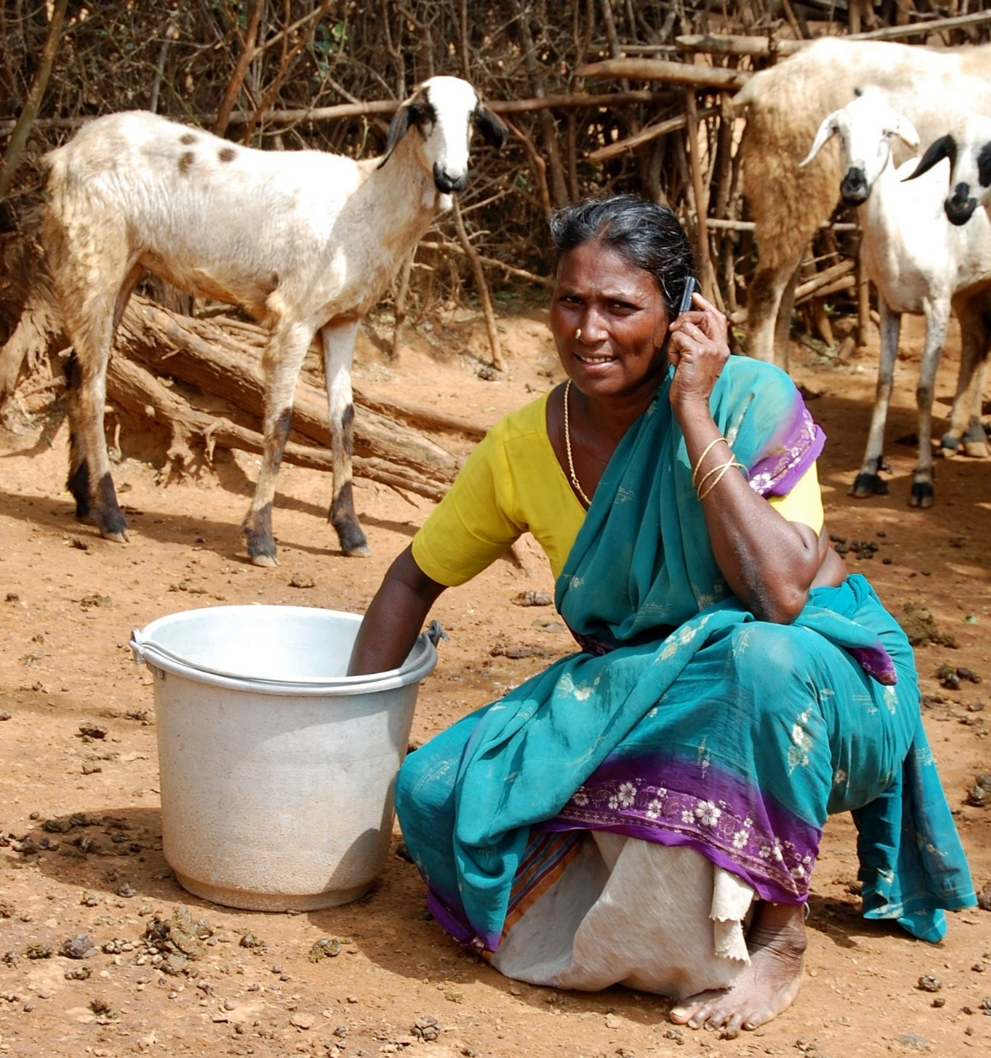
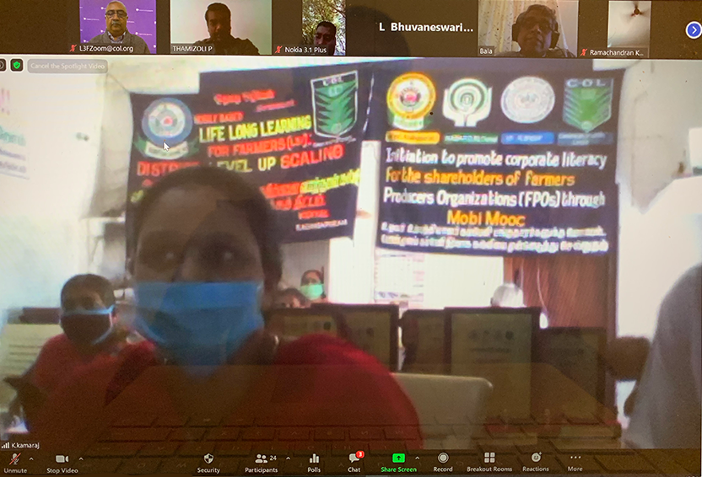
Audio-based
MobiMOOCs

Slide 13
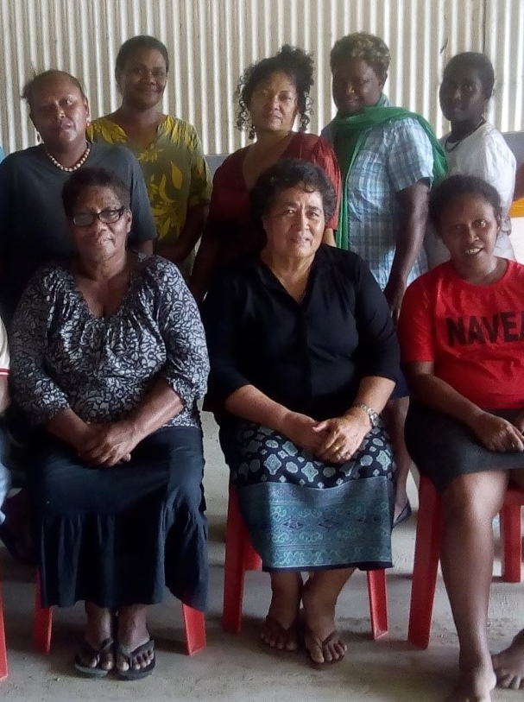
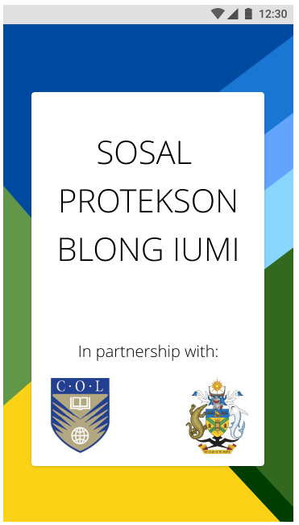
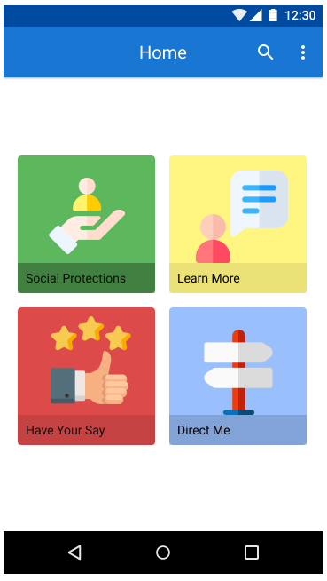
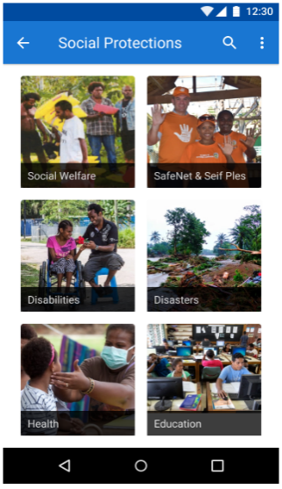
Mobile Apps
SOCIAL SAFETY NETS AND GENDER BASED VIOLENCE
Solomon Islands

Slide 14
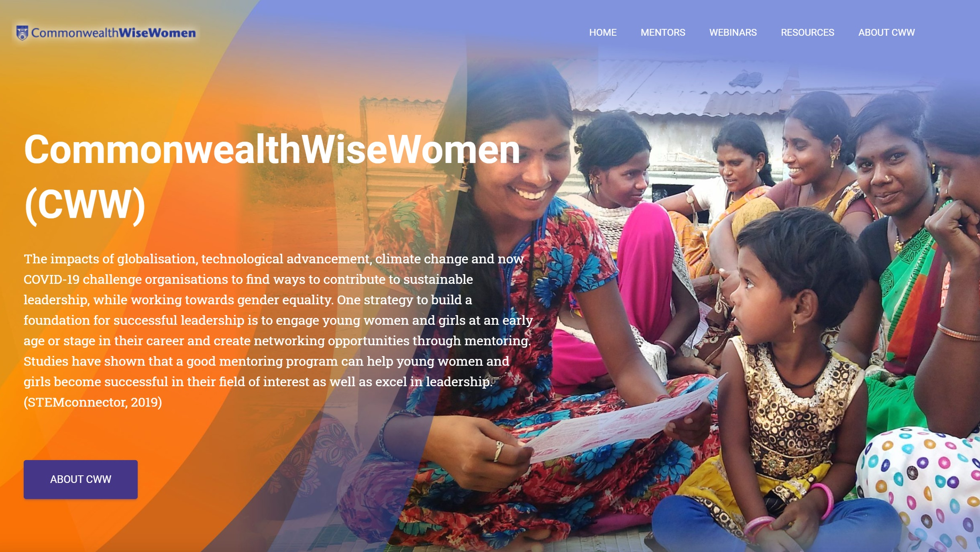
CommonwealthWiseWomen.org

Slide 15








Empowering Women

