Slide 1

Open Educational Resources for Sustainable Development
January 29-30, 2020
Castries, St Lucia
Professor Asha Kanwar
President & CEO, Commonwealth of Learning

Slide 2
Plan
Context
Open Educational Resources
OER in Practice
OER Global Report 2017
COL Contributions
OER for Sustainable Development

Slide 3
Access to Secondary Education
Source: data.worldbank.org, retrieved on 17 January 2020

Slide 4
Access to Tertiary Education
Source: data.worldbank.org, retrieved on 17 January 2020

Slide 5
Growth of ICTs: Internet use
Source: data.worldbank.org, retrieved on 17 January 2020

Slide 6
Growth of ICTs: Mobile subscriptions
Source: data.worldbank.org, retrieved on 17 January 2020

Slide 7
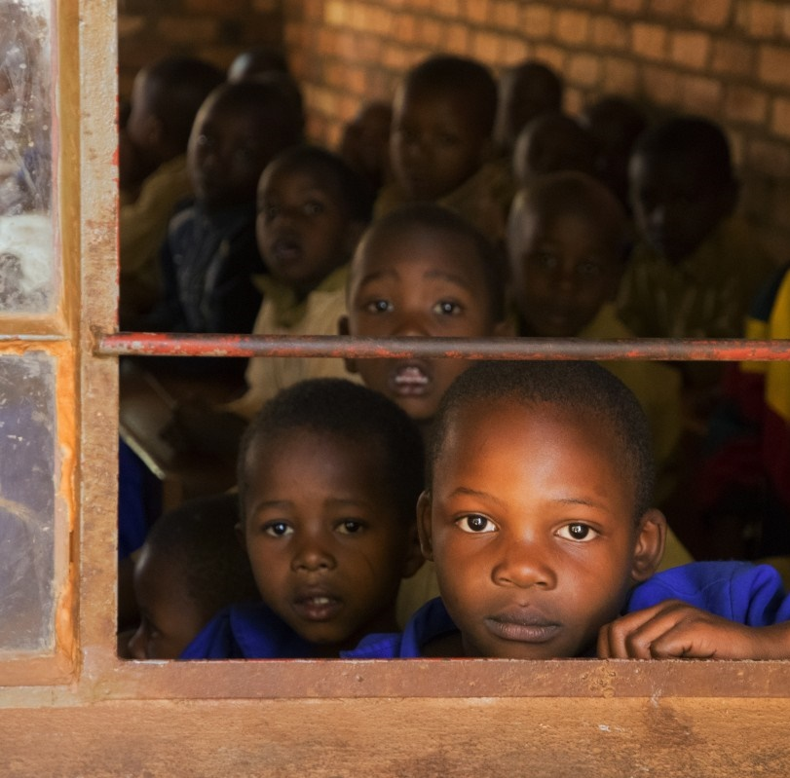
The ‘Learning Crisis’
In West and Central Africa, less than 45% students in Grade 6 achieved competency level in maths and reading
In South Africa, majority of Grade 4 students displayed the capacity of Grade 1
(World Bank, 2018)
Teacher absenteeism and ‘presenteeism’
Notes:
According to estimates by UNICEF, in 2015, over 115 million children did not attend primary school
56% of children in school are not learning (World Bank)
In West & Central Africa, less than 45% students in Grade 6 achieved competency level in maths and reading
In SA, majority of Grade 4 students displayed the capacity of Grade 1 (World Bank, 2018)
Teacher absenteeism and ‘presenteeism’
World Bank (2018). Learning: To Realize Education’s Promise. Washington: The World Bank. Retrieved from https://www.worldbank.org/en/publication/wdr2018

Slide 8
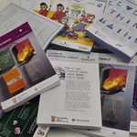
1. Access to Learning Materials
In grade 2, there were 3 students for every reading textbook, compared with 8 students for every mathematics textbook in Togo.
Data from 22 sub-Saharan African countries shows that providing one textbook to every student in a classroom increased literacy scores by 5–20% (Fehrler et al., 2009).
Source: https://www.flickr.com/photos/121935927@N06/40148782281
Notes:
http://data.uis.unesco.org/?ReportId=184&IF_Language=eng#
No information for Singapore

Slide 9
2. Cost of Tertiary Education
Costs Prohibit Access to TE
In the USA, 65% students do not buy textbooks because of high costs (USD 1200 annually)
In Malaysia, 76% do not buy textbooks because of high costs. (MYR 190 annually)

Slide 10
Cost of Educational Materials
Source: http://oasis.col.org/handle/11599/3479
Notes:
In a recent study on access to learning materials in the Commonwealth, we found that leaners are spending way above their affordability on textbooks. For example, in St Lucia, the average spending on textbooks is about ECD700.

Slide 11

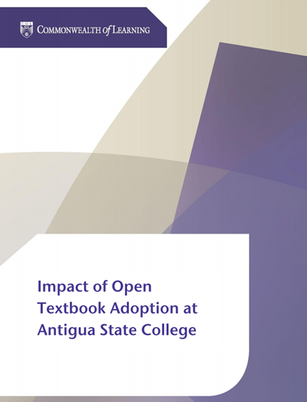
3. Improving Learning Outcomes
Students saved between 75 to 88 ECD per course per semester by using open textbooks
Supplementing textbooks with OER improved student performance by 5.5%
Source: http://oasis.col.org/handle/11599/2750

Slide 12


Open Educational Resources can
Increase access to education
Reduce costs
Enhance learning outcomes

Slide 13
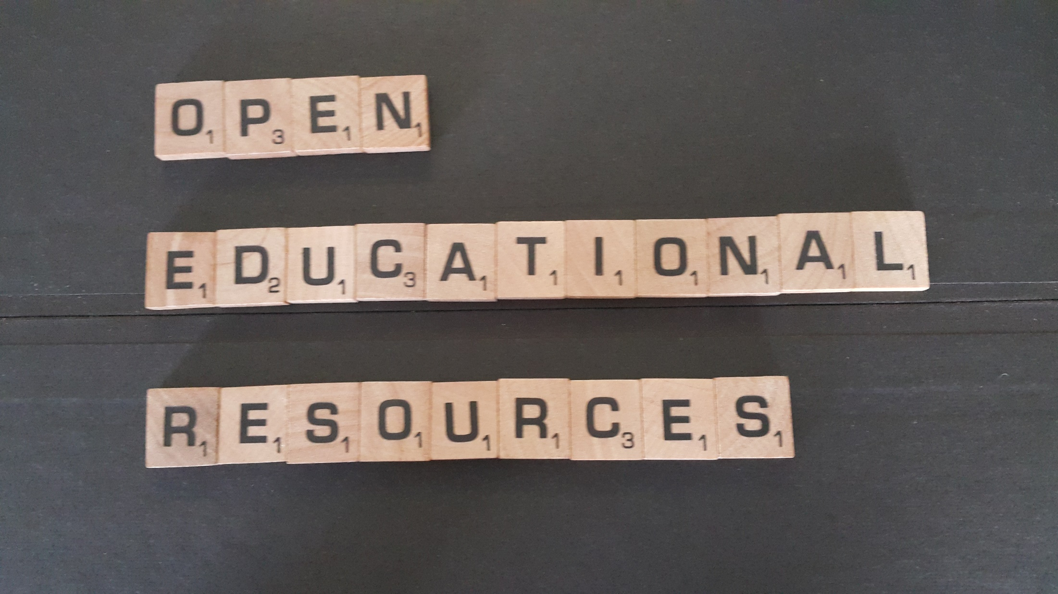
Open Educational Resources

Slide 14

Defining OER
Open Educational Resources (OER) are learning, teaching and research materials in any format and medium that reside in the public domain or are under copyright that have been released under an open license, that permit no-cost access, re-use, re-purpose, adaptation and redistribution by others.
(UNESCO OER Recommendation, 2019)
Notes:
Materials that are
Free and freely available
Suitable for all levels of education
Reusable
Digital

Slide 15

What is Open?
5R
It’s about open license used to share educational material
No permission required as long as the open license is respected
Reuse
(copy verbatim)
Revise
(adapt and edit)
Remix
(combine with other materials)
Redistribute
(share with others)
Retain
(make, own and control copies)

Slide 16
History: In brief
UNESCO Forum on the Impact of Open Courseware for Higher Education in Developing Countries, 2002
2012 OER World Congress
2nd World OER Congress, 2017
UNESCO Recommendation on OER, 2019

Slide 17
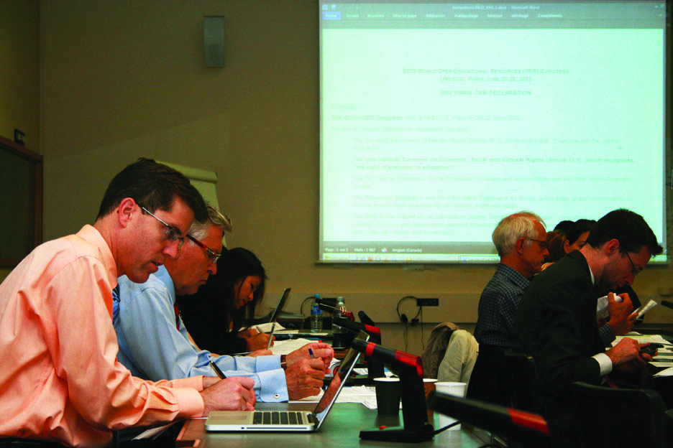

Paris Declaration on OER
Foster awareness and use of OER
Encourage the development and adaptation of OER in a variety of languages and cultural contexts
Encourage the open licensing of educational materials produced with public funds.
The 2012 Paris OER Declaration drafting group at UNESCO Headquarters, Paris, France
^{Photo: CC-BY Davide Storti}

Slide 18


OER for Inclusive and Equitable Quality Education
From Commitment to Action
Ljubljana OER Action Plan 2017
2nd World OER Congress| 18-20 September, 2017 | Ljubljana, Slovenia

Slide 19
UNESCO OER Recommendation
Building capacity of stakeholders to create, access, use, adapt and redistribute OER
Developing supportive policy
Encourage inclusive and equitable quality OER
Nurturing the creation of sustainability models for OER
Facilitating international cooperation
UNESCO Recommendation 2019

Slide 20
OER in Practice

Slide 21
Openness:
An Evolving Concept
ACCESS
CONTENT
TECHNOLOGY
Notes:
ACCESS: Open means open entry, easier access to study, increased enrollment since 1960s.
CONTENT: Open availability of content and resources since 2000s,
TECHNOLOGY: MOOCs in 2010s

Slide 22

Open Education
Open access to courses or programmes
OER
Open textbooks
Open research
Open data
(Bates, 2015)
Source: http://www.tonybates.ca/2015/02/16/what-do-we-mean-by-open-in-education/
Notes:
Open education is a philosophy, and can be adopted by both conventional education system and distance teaching open universities. Open Education, envisages that ‘no one should be left behind’. Everyone has the right to education, and should be given opportunity to learn irrespective of their location, economic and social condition. It believes in developing capacities of the people from whatever stage they are and open to use of different learning modes and technologies. Bates (2015) emphasises this to state that Open Education is a concept that takes many different forms.

Slide 23
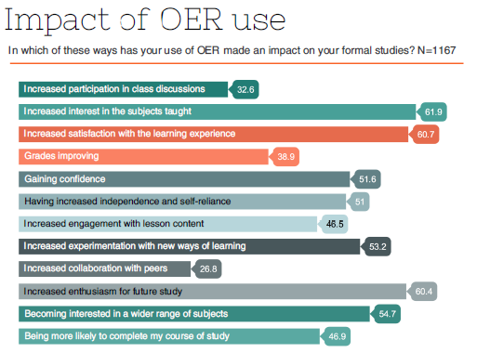
Source: OER Hub, OER data report 2013-2015.
Notes:
Students also reported that use of OER led to increased interest in the subjects taught.

Slide 24
Impact on Learning
Students who used open textbooks scored
.65 points higher
on end-of-year state standardized science tests than students using traditional textbooks.
Source: (Robinson et al, 2014)

Slide 25
OER Impact on Teaching
93.8% of K12 teachers used a broader range of teaching and learning methods
89.7% used a wider range of multimedia
88.6% reflected more on the way they taught.
Source: De Los Arcos, B. (2014) ‘Flipped Learning and OER: Survey Results’. https://oscailte.wordpress.com/2014/03/13/research-findings-on-flipped-learning-and-oer/ [Accessed 31 August 2015]

Slide 26
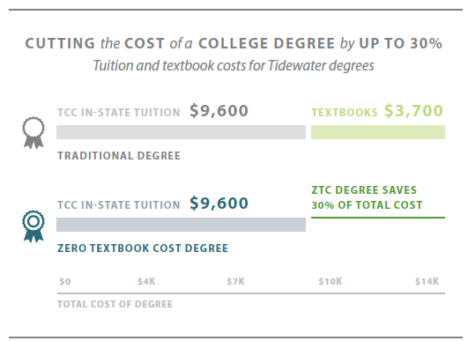
Source: Hewlett Foundation (2015)

Slide 27






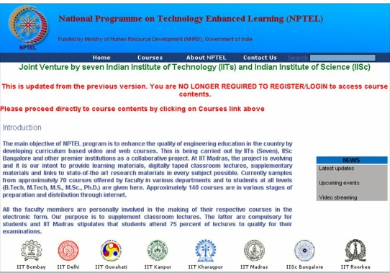




Open Educational Resources (OER)

Slide 28

Trends
More developing countries join the OER movement
From policy to practice
Open Textbooks
Multi-lingual OER
Use of OER in MOOC4D

Slide 29
OER Global Report 2017

Slide 30
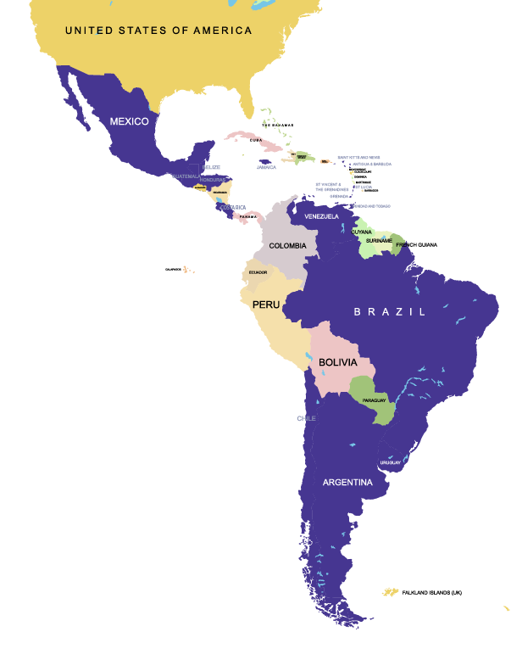

LATIN AMERICA & THE CARIBBEAN
18
Notes:
48 participants from 24 countries participated, including 20 countries from Asia.

Slide 31
Highlights: Latin America & the Caribbean
Public funded educational materials openly licensed (Antigua and Barbuda)
Institutional policy for Open Access and Open Data (Brazil and Chile)
Commitment to OER at provincial and city level
(Sao Paulo)
A general awareness and willingness to pursue OER (Grenada, Guatemala, Honduras, Mexico)

Slide 32
Priorities: Latin America & the Caribbean
Need for OER in national languages
Better connectivity
Accessible content required for people with disabilities
Increased capacity to use and contribute to OER
National policies needed to guide OER

Slide 33
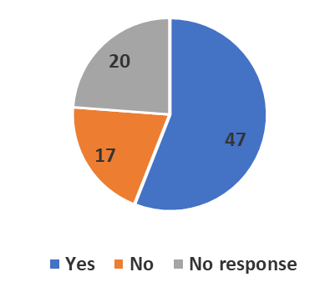
Government Responses: Policies
Considering National OER Policy Development
Notes:
47 countries reported considering OER policy development.

Slide 34
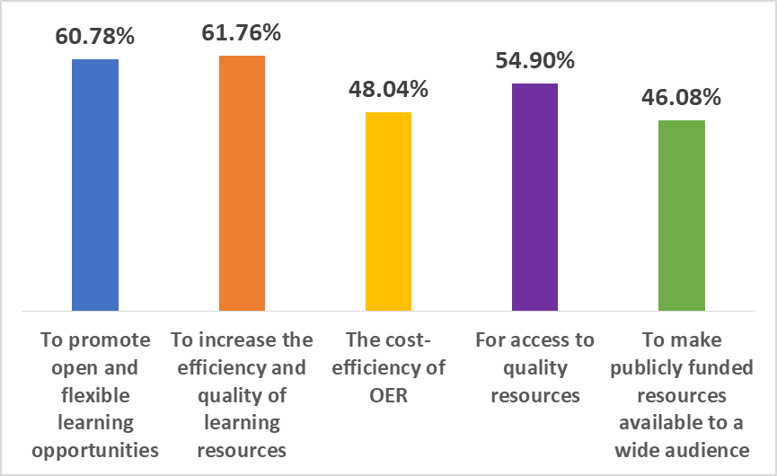
Government Responses:
Benefits
Increased efficiency and quality of resources
Promote flexible learning
Improve access to resources

Slide 35
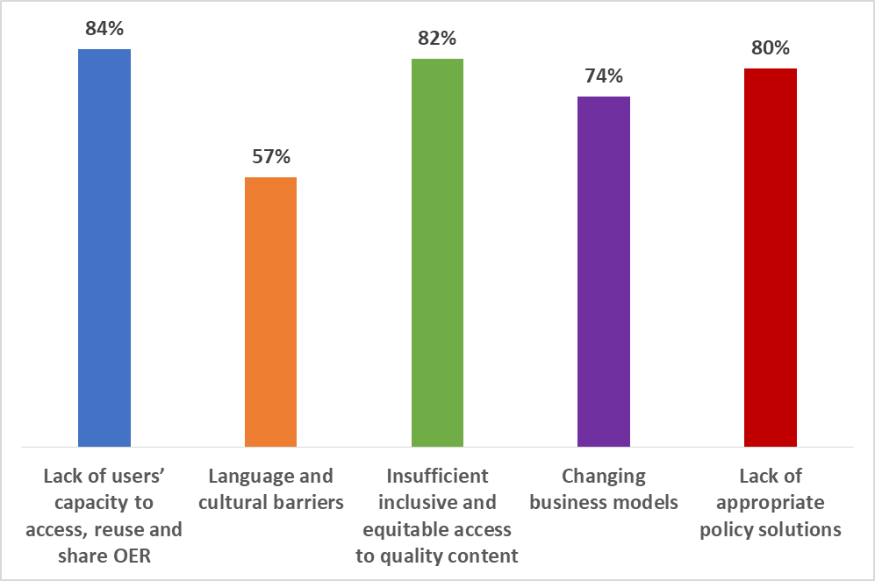
Government Responses:
Barriers
Lack of users’ capacity
Insufficient access to quality content
Lack of appropriate policies
Changing business models
Language and cultural barriers
Notes:
Government Survey Barriers

Slide 36
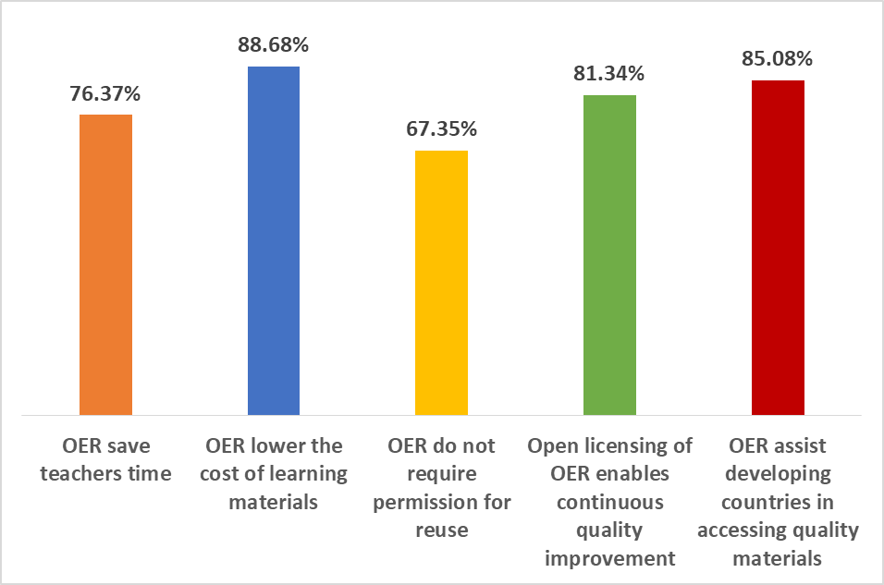
Stakeholder Responses:
Benefits
Reduced costs of learning materials
Provides access to quality materials
Enables continuous quality enhancement
Save teachers time

Slide 37
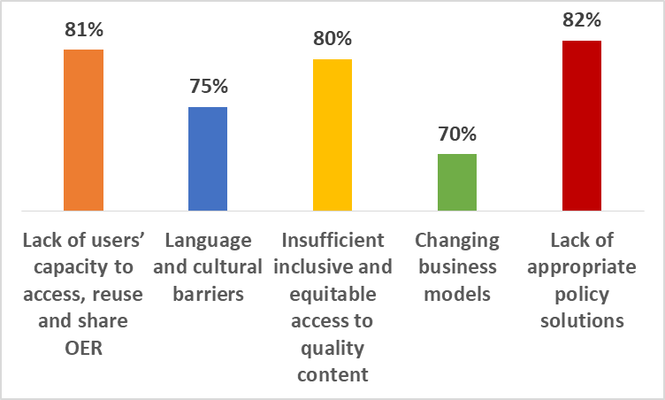
Stakeholder Responses:
Barriers
Lack of policy
Lack of capacity
Lack of quality content
Language and culture
Changing business models

Slide 38
Governments and Stakeholders:
Commonalities
Lack of appropriate policies
OER provides access to quality materials
Poor awareness and capacity of users

Slide 39

Global Trends
Policies
More support, not accompanied by policies
Despite lack of national OER policies, institutional policies have grown
Regions with extensive OER activities, not always reliant on national policy as the driving force

Slide 40
Global Trends
Repositories
OER repositories created in the global north more used than those from the global south
Majority of the repositories are at tertiary level
Repositories are available in diverse fields, including early childhood education

Slide 41
Global Trends
Awareness
Many governments and stakeholders not clear about OER
Increased focus on open textbooks has led to neglect of OER for lifelong learning
Governments are supporting MOOCs, which are not necessarily “open”

Slide 42
COL Contribution

Slide 43

Advocacy
Open Textbook Forum, October 2015 (Eastern Caribbean countries)
KL Declaration, 2016
OER Regional Consultations, 2017
Advocacy

Slide 44
Policy Development
ICT in Education policy with OER at Antigua and Barbuda, Seychelles
ICT in Education with OER policy and strategy in Belize and St Lucia
Support for national OER policy: Bangladesh, India, Malaysia, Mauritius, Malta, Nigeria, Zambia
Provincial OER policy development: Botswana, Cameroon, Sri Lanka

Slide 45



Impact of OER Policy
170+ universities committed to OER curation, development and sharing

Slide 46
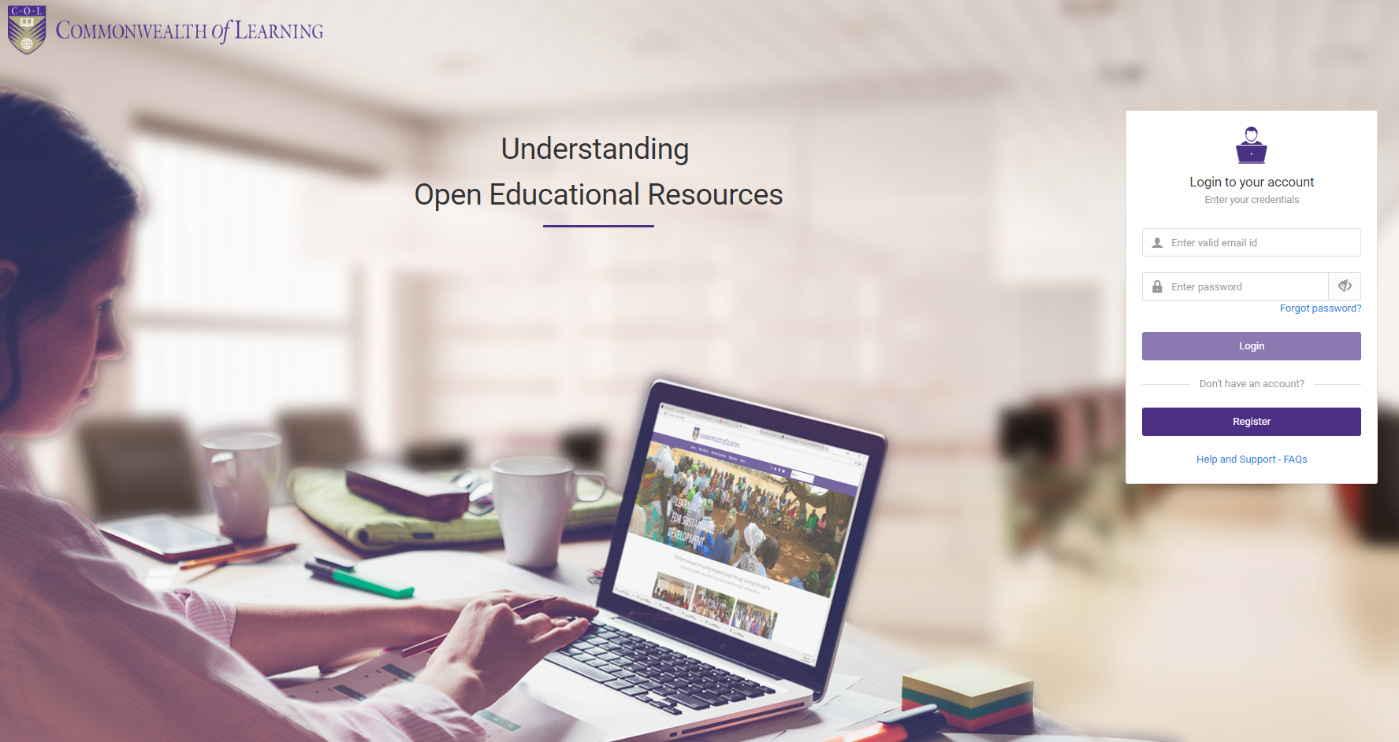
Capacity building: Online Course
https://learnoer.col.org

Slide 47
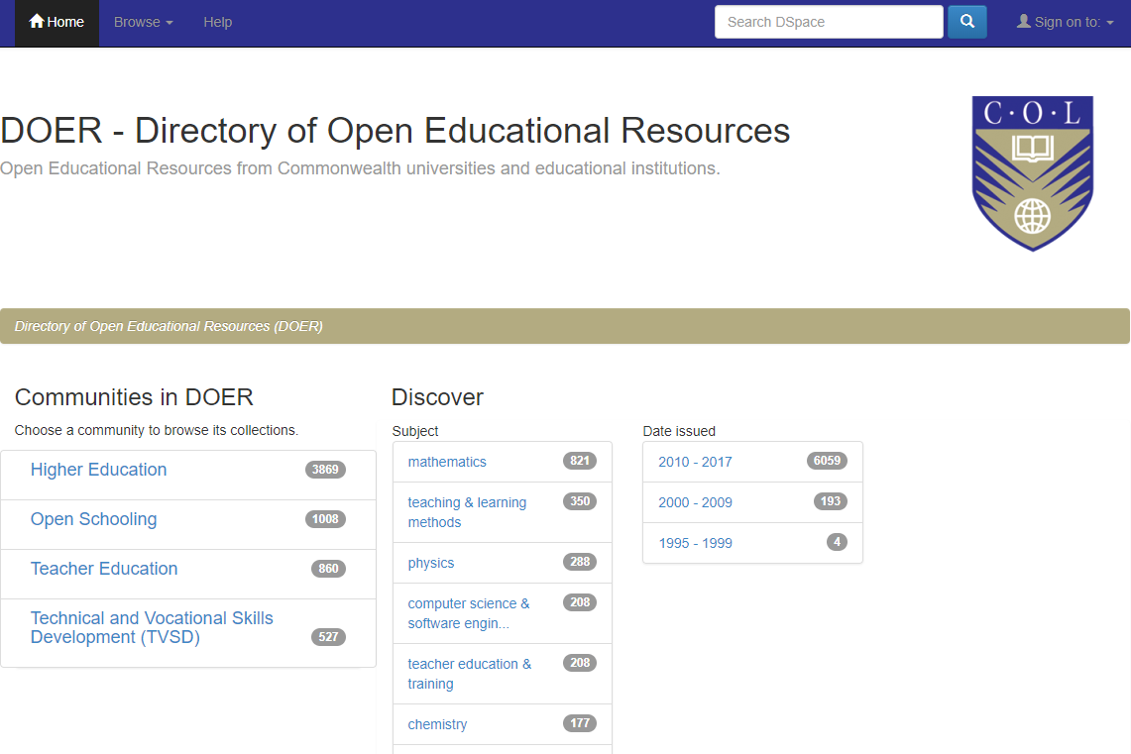
Resources: Directory of OER (DOER)
Open Educational Resources directory service
Only full courses catalogued
A service provided by COL
Over 6,000 resources
http://doer.col.org/

Slide 48






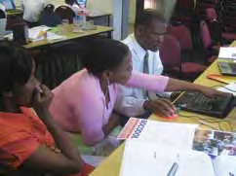
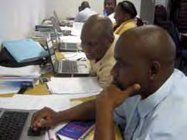
OER for open schooling (OER4OS)
Ministries
of Education
Schools
Teachers
Consultants

Slide 49
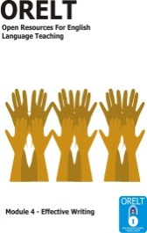
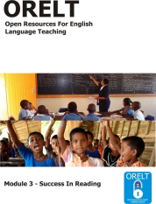
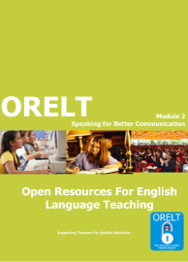
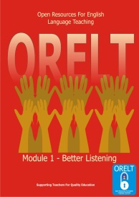
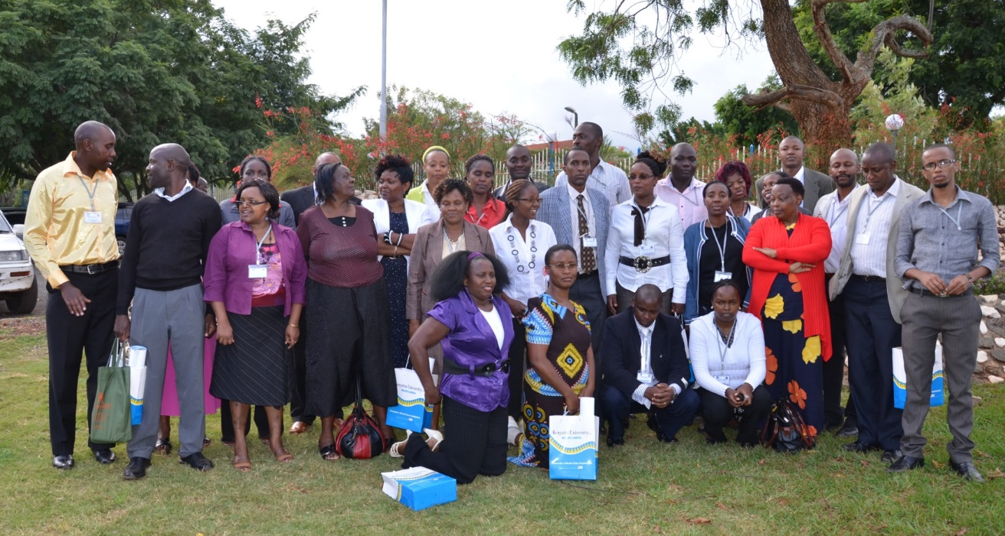
ORELT in Kenya
orelt.col.org

Slide 50
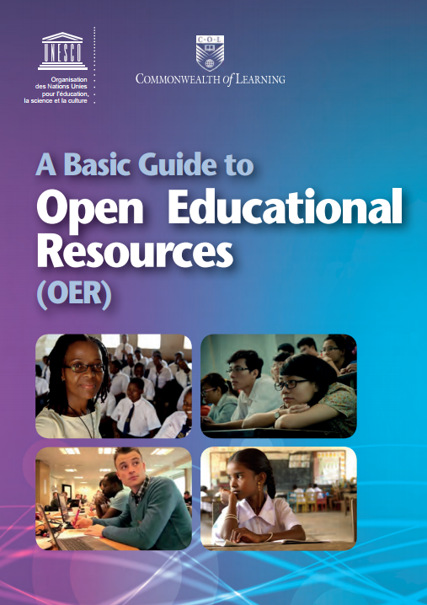
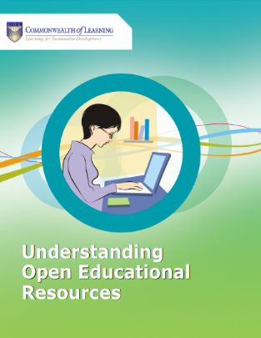

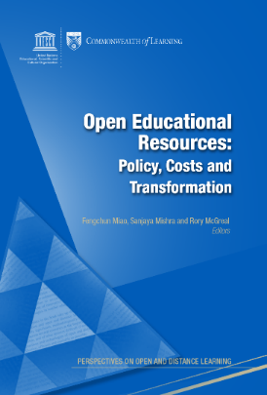
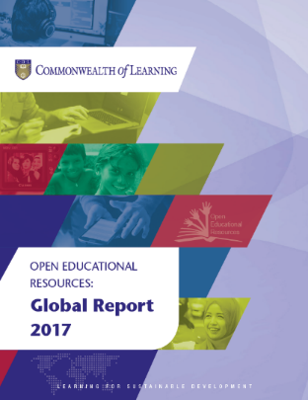
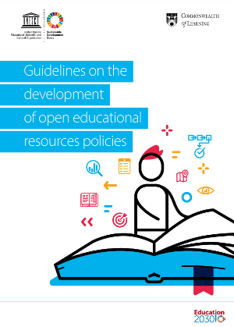
Publications
http://oasis.col.org/

Slide 51
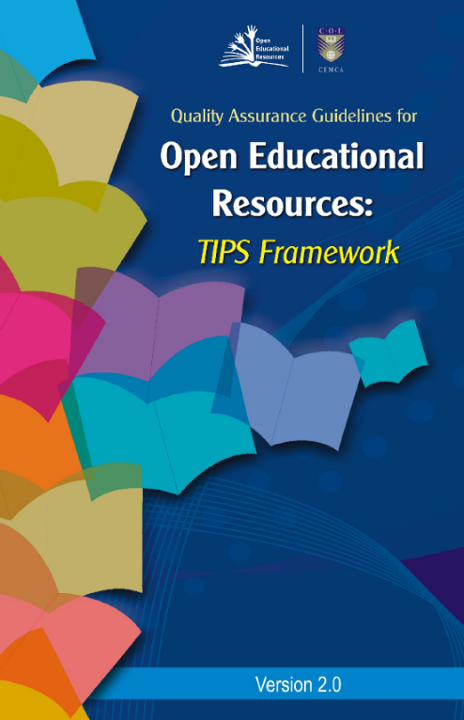
Quality Guidelines for OER
Teaching and learning processes
Information and material contents
Presentation, products and formats
System, technical and technology
http://oasis.col.org/handle/11599/562

Slide 52
Hewlett- ORS Impact Report
Focused on implementation of frameworks or policies
Institutional and grassroots focus
Able to go deep within institutions to reach broad array of staff and other stakeholders
Focused on partnership
Focused on pedagogy
Source: ORS Impact (2015). Evaluation of the William and Flora Hewlett Foundation’s Investment in International Policy Advocacy for Open Educational Resources.

Slide 53
OER for Sustainable Development

Slide 54
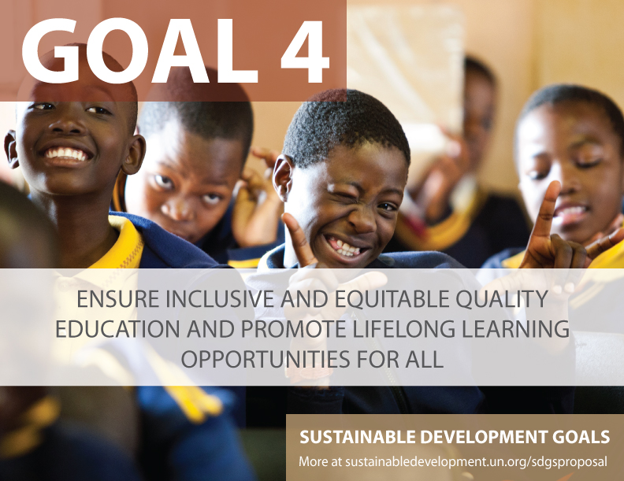

Slide 55

OER cannot be viewed only from the economic and technology perspective
What of Social Dimensions?

Slide 56

1. OER for People with Disability
Using accessible technologies for OER creation
Researching new ways of sharing OER for people with disabilities
Providing affordable, low-cost options for learning
Notes:
‘Born Digital’ should be ‘Born Accessible’ is a movement promoted by an technology non-profit – Benetech that hosts the largest accessible library Book Share (https://benetech.org/our-work/born-accessible/)

Slide 57
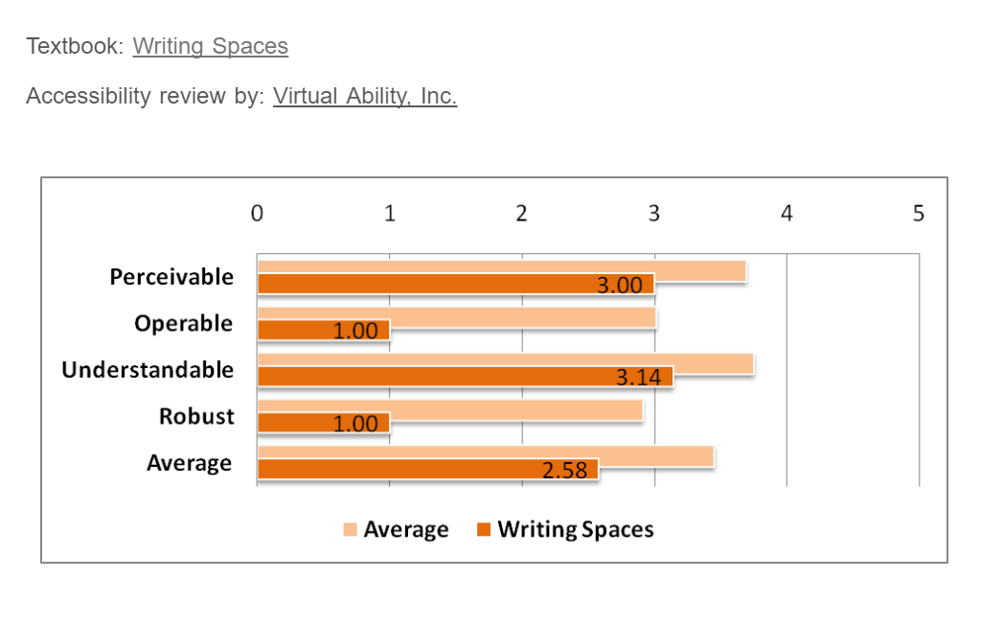
How Accessible are OER?
Source: http://www.collegeopentextbooks.org/textbook-listings/accessibility-reviews
Notes:
The College open textbook site in the USA reviews open textbooks for accessibility, and on an average, the POUR score is about 3.5 in a scale of 5. The major problem is with the robustness criteria, which has score below 3, which means that OER are less amenable to the use of assistive technologies.

Slide 58
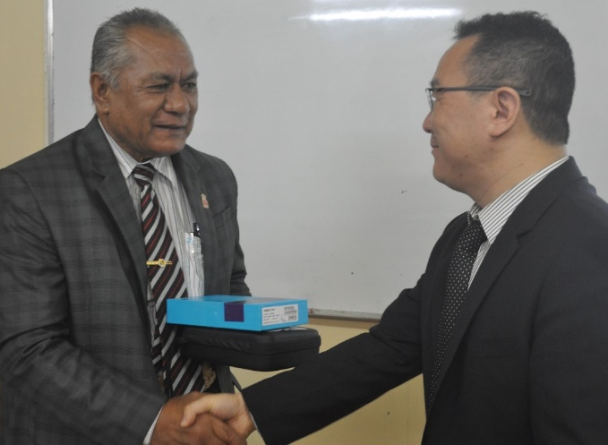



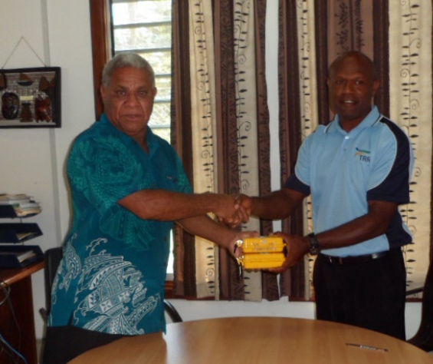
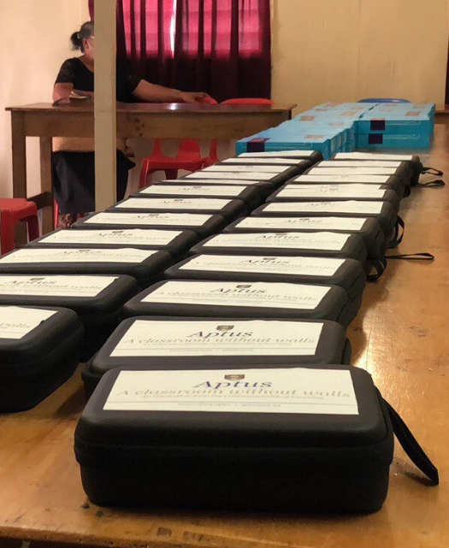


2. Equitable Access
An off-grid, off-line virtual classroom that allows learners in regions with no connectivity to benefit from digital resources and learning networks
Notes:
COL's innovation, Aptus, is also known as the classroom without walls. The device enables students affected by natural disaster to resume their learning by accessing curated digital resources through the device and simple tablets or smartphones. The device allows educators and learners to connect to digital learning platforms and content without the need for grid electricity or Internet access and requires only battery power, which can be recharged via grid power or solar charger, as needed.
COL deployed 25 Aptus devices and 250 high-quality tablet computers in Tonga in 2018, following Cyclone Gita. The storm destroyed power grids and schools, causing a disruption in teaching schedules. It also affected routine teaching in some schools and forced children to take classes in tents.

Slide 59
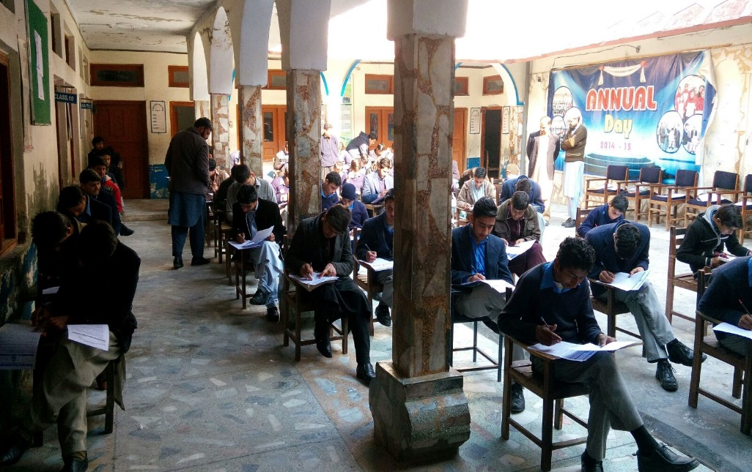

Improved Learning Outcomes
Aptus: Allama Iqbal Public School and College in the Swat District, Pakistan
Photo Credit: Qatar Foundation/ROTA
Notes:
Test scores demonstrate significant improvement in students’ academic performance.
Teachers’ attitude toward mobile learning improved: teachers agreed that using mobile technologies in the classroom make it easier for students to learn.
Students take interest in this technology because there is multimedia option using Aptus and Tablets. Students can watch animated videos on each topic

Slide 60

3. OER for Lifelong Learning
OER for personal interest
For personal/professional development
For skilling and reskilling
Life Stages by Nazrul Islam Ripon from https://commons.wikimedia.org/wiki/File:Life-stages.jpg

Slide 61

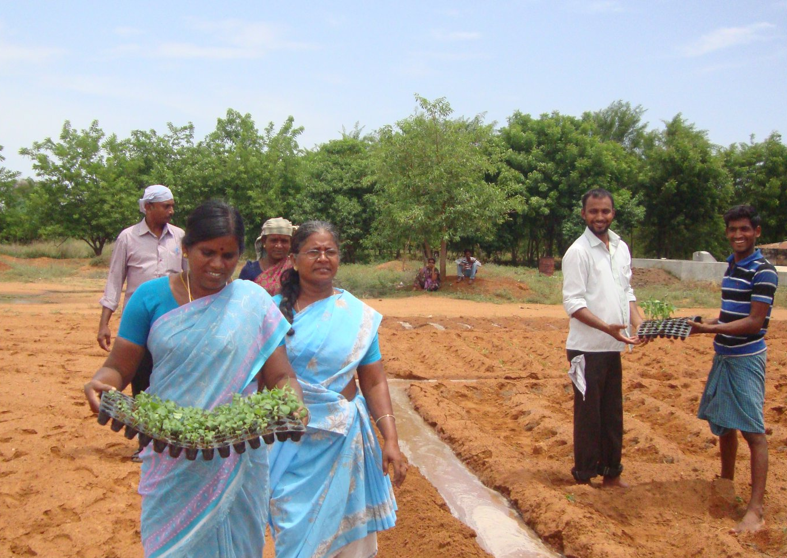
Arogya Mary - a school dropout , a grandmother, who never knew about internet
Content and Web Manager for a Farmer’s Organization
Facebook content: 600 different content uploaded
Youtube: 500 videos of farmers field experiences
Whatsapp: 150 organic agriculture based content
Trained: over 1000 farmers

Slide 62

OER for Sustainable Development means…
Use of OER as an empowerment process, facilitated by technology in which various types of stakeholders are able to interact, collaborate, create and use materials and pedagogic practices, that are freely available, for enhancing access, reducing costs and improving the quality of education and learning at all levels.

Slide 63
Thank you
www.col.org

