Slide 1


A Green Learning Agenda
Professor Asha Kanwar
COL President & CEO
Fourth Pan-Commonwealth Women and Leadership in ODL Training
August 3, 2022 | Penang, Malaysia

Slide 2
Climate Crisis in the Commonwealth
Disproportionately affects the Commonwealth
32 small states most vulnerable to climate change
8 of the top 10 countries
prone to natural disasters are in the Commonwealth:
  1.Vanuatu
  2.Solomon Islands
  3.Tonga
  4.Dominica
  5.Antigua and Barbuda;
  6.Brunei Darussalam;
  7.Guyana;
  9.Papua New Guinea
Source: https://weltrisikobericht.de/wp-content/uploads/2021/09/WorldRiskReport_2021_Online.pdf
Notes:
The climate crisis is one of the defining issues of our world today. The science is clear: the drastic changes in global climate patterns starting in the mid-to-late twentieth century are attributable to the increasing level of greenhouse gases in our atmosphere, produced by human activities. The result of this change in climate patterns is apparent in the devastating storms, floods, and other natural disasters that have become a regular occurrence across the globe today.
The Commonwealth, which comprises 53 countries, is disproportionately affected by climate change, as many of its members are amongst the small or least developed states.
According to the World Risk Index, calculated by the United Nations University Institute for Environment and Human Security (UNU-EHS) and featured in the 2016 World Risk Report (WRR 2016), 9 out of the top 20 countries most at risk for natural disaster are Commonwealth countries.

Slide 3
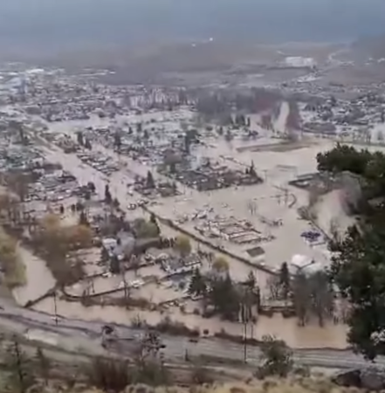
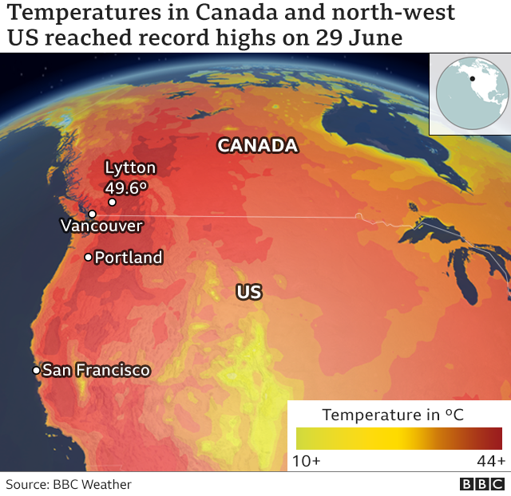
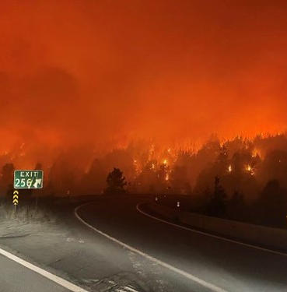

https://commons.wikimedia.org/wiki/File:Meritt_BC_Flooding_November_2021.png
Source: https://www.bbc.com/news/world-us-canada-57668738
Coquihalla on fire - BC Ministry of Transport https://www.flickr.com/photos/tranbc/51382748573
At the current rate there will be larger and more frequent climate related disasters
Source: The Commonwealth Secretariat. 'Climate Change'. https://thecommonwealth.org/climate-change
Notes:
As temperatures continue to rise, so will the number of disasters, and the number of countries impacted by these disasters. Studies show that heat waves are becoming more common, more severe and longer-lasting as global temperatures warm in response to human activities. The global hot weather record was broken in 2016, and this past summer saw records in Europe shattered by a blistering heat wave affecting multiple countries, with temperatures reaching all-time highs. Over the past 40 years, the number of climate related disasters globally has tripled, a trend that is expected to continue.

Slide 4
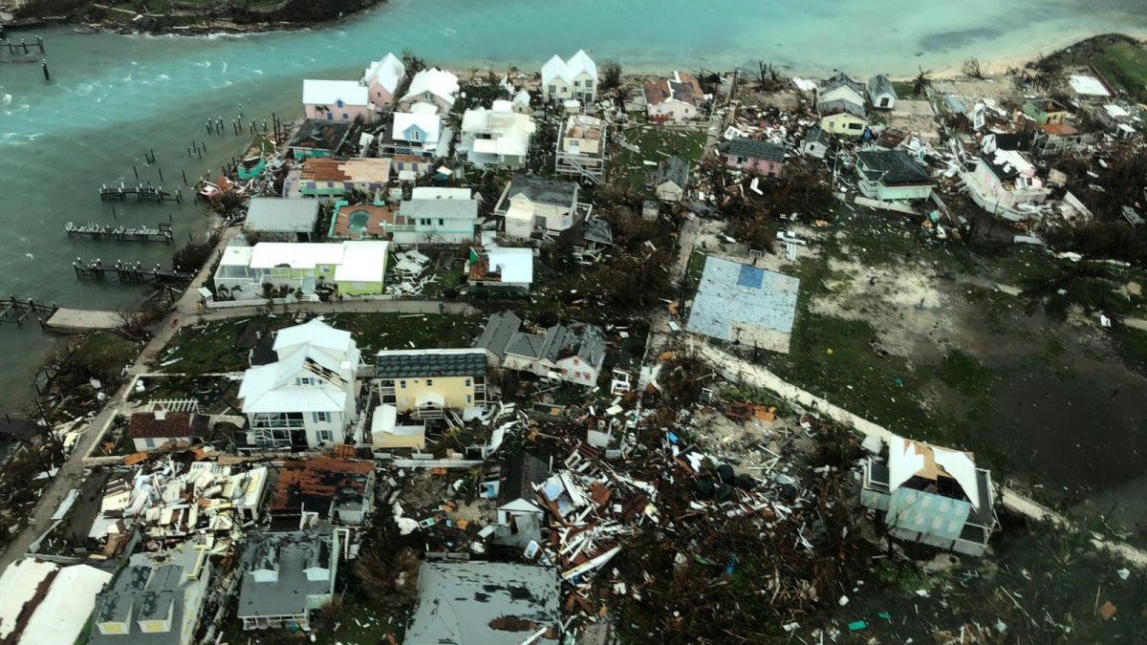
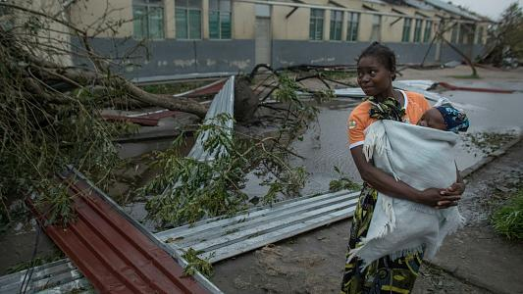


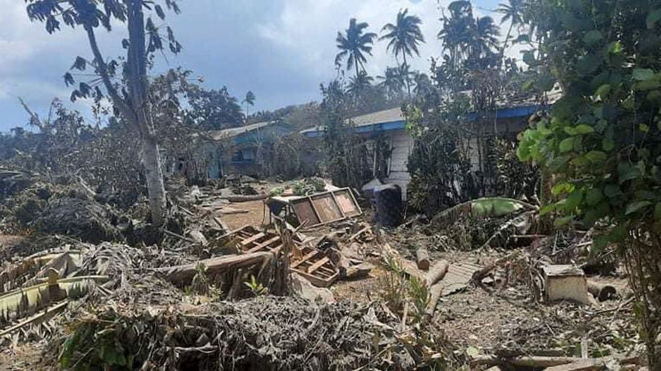
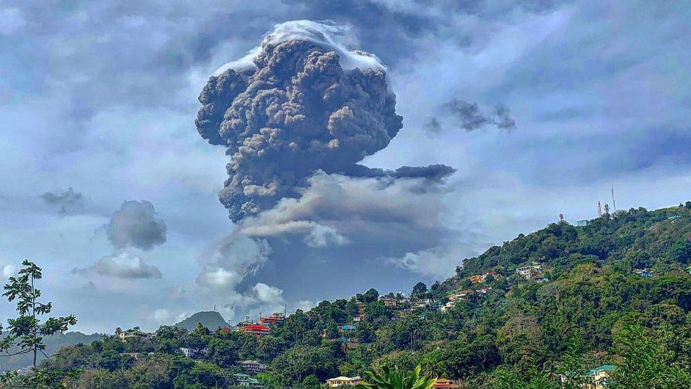


Cyclone Idai, Mozambique
Classrooms affected: 3,504; Students affected: 335,132
Hurricane Dorian, The Bahamas
Devastated schools on Grand Bahama and Abacos Islands
CARE; Retrieved from https://www.care.org/emergencies/cyclone-idai |
UNICEF, 2019. https://www.unicef.org/mozambique/en/cyclone-idai-and-kenneth
80 per cent of Tonga population impacted by eruption and tsunami
Volcanic eruption leaves ‘entire population’ of Saint Vincent without clean water
UN News, https://news.un.org/en/story/2022/01/1110162
UN News, https://news.un.org/en/story/2021/04/1089592
Notes:
How does the climate crisis effect the education sector specifically?
In recent years, Commonwealth countries have experienced severe impacts to their education systems as the result of climate related natural disasters.
Cyclone Idai, which hit eastern Mozambique on March 14, 2019 was the worst natural disaster to hit southern Africa in twenty years. According to UNICEF, from July 2019, more than 3000 classrooms and 330,000 students were affected by the Hurricane (https://www.unicef.org/mozambique/en/cyclone-idai-and-kenneth)
On September 1 2019, the eye of Hurricane Dorian made landfall on the Abaco Islands, reaching the island of Grand Bahamas the next day. It was the strongest hurricane on record to hit the Bahamas.
According to Mercy Corps, the Abaco Islands were the most affected with approximately 90 percent of housing and infrastructure left damaged or destroyed in its wake. In Grand Bahama, satellite data revealed that anywhere from 76 to 100 percent of buildings in certain areas were destroyed. The week after Hurricane Dorian hit was supposed to be the first week of classes in the Bahamas. Many families had just paid school fees and purchased uniforms, which were lost due to the hurricane. Many schools were deemed to be unsafe for students, halting classes.

Slide 5





Impact of the climate crisis on education
Infrastructural damage
Damage to resource and materials
Loss of data and records
Collapse of systems = Out of school youth
Notes:
Climate related natural disasters have major, detrimental impacts on education. Events such as hurricanes, storms and floods can have catastrophic effects on the infrastructure, resources and systems of the education sector. Entire schools can be destroyed or irreparably damaged, leading to thousands of displaced students, unable to continue their education. Critical data and student records may be wiped out entirely, leaving the system in shambles, and learners and institutions in the dark. These impacts can effectively lead to the collapse of the education system in disaster affected areas.

Slide 6

Education: Impact on Climate
DIRECT
Emissions from construction of schools/infrastructure
Emissions from energy use in schools
Learner emissions
INDIRECT
Emissions from ‘development’ and economic growth associated with higher levels of education in a country
Notes:
The education sector, from primary to tertiary, contributes to both direct and indirect emissions, which impact on climate change, and environmental degradation, as well as incur associated economic costs. If we look strictly at contributions to emissions, the achievement of SDG4, under the current paradigm, could potentially worsen the climate crisis.

Slide 7
COL Approach
Notes:
COL's mission is to help Commonwealth Member States and institutions to use technologies for expanding access to quality education and training.
COL believes that learning is the key to sustainable development: Learning must lead to economic growth, social inclusion and environmental conservation.

Slide 8
Reduction of carbon emissions
Raising awareness on disaster preparedness
Reskilling people for a greener future
Resilience for the education sector
Notes:
The next section will outline COL’s work in the following four areas:
Reduction of carbon emissions
Raising awareness on disaster preparedness
Reskilling people for a greener future
Resilience for the education sector

Slide 9

Co2
Reduction:
Decreasing the carbon emissions
of education sector through ODL
Notes:
While the education sector has a growing carbon footprint, Open and distance learning may actually be able to reduce learner-generated emissions

Slide 10

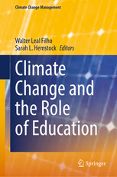





Research on Emissions and ODL
3x less carbon emissions
Travel – greatest contributor
Mode of delivery - determinant
Source: Carr et.al. Delivery Mode and Learner Emissions: Comparative Study from Botswana. W. Leal Filho and S. L. Hemstock (eds.), Climate Change and the Role of Education, Springer Nature. In Production.
Notes:
Perhaps the most comprehensive project assessing the environmental impacts of different modes of delivery in higher education is the SusTEACH project, supported by the Open University, UK. The project compared the carbon emissions of ICT-enhanced courses with online courses and mainly face to-face taught courses. The findings showed that online and blended ICT-enhance distance teaching models had significantly lower environmental impacts than face-to-face teaching modes (Caird et al. 2013; Caird et al. 2015). This study used a comprehensive methodology that considered multiple contributors to emissions for both students and the institutions.
Using the SusTeach methodology COL conducted a study in Botswana, to determine whether there was a difference between the carbon emissions of CD-based ODL and face-to-face learners, as well as the main sources of learners’ emissions.
The comparison of learner carbon emissions data from both face-to-face and CD based students in Botswana revealed that the average learning-related carbon footprint of the face-to-face group is nearly three times greater than that of the ODL group, and the difference was statistically significant. Within the overall carbon footprint, emissions from travel were by far the greatest contributor to this disparity. This suggests that regardless of the exact mechanism of delivery, ODL or blended modes can decrease emissions by reducing face-to-face contact hours. Institution, as a proxy for delivery mode, was the most significant predictor of learning related emissions.

Slide 11

Raising Awareness:
Public education campaigns
for resilience
Notes:
Technology can also be used for awareness raising campaigns and to sensitise people about climate change and disaster prepardness

Slide 12


Dominica on a path to becoming a climate-resilient nation
Notes:
Following the devastation of Hurricane Maria and the estimated USD $930 million of damage to the economy in September 2017, Dominica is on a path to becoming a climate-resilient nation. With support from COL, Dominica’s Ministry of Education and Human Resource Development (MEHRD) has embarked on a public education project to create locally-produced audio and video clips designed to educate citizens about climate change and empower them to mitigate the risks and be better prepared for climate related disasters.
ODL can sensitise people and raise awareness about the risks and responses to climate related disaster, and can reach larger numbers than traditional face-to-face awareness raising sessions.

Slide 13

Re-skilling:
Training people for the green jobs
of tomorrow
Notes:
To address the climate crisis there will need to be a shift in industry: A move toward more sustainable practices, and environmentally friendly business
This will require new skills, for large numbers of people ; ODL can help achieve skilling at scale for the jobs necessary to address climate change.

Slide 14
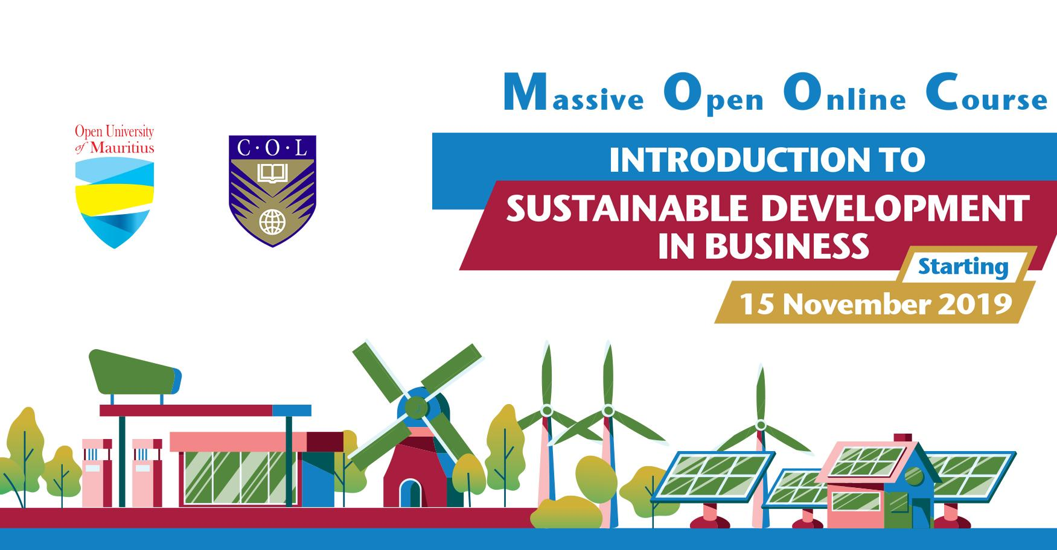
Notes:
COL in collaboration with The Open University of Mauritius have developed a MOOC (Massive Open Online Course): Introduction to Sustainable Development in Business. The course is being run for the second time, with participants from across the Commonwealth.

Slide 15

Resilience:
Making the education sector
more resilient
Notes:
As we saw earlier, the impact of climate related disasters on the education sector can be catastrophic. COL supports ministries of education in countries that have been affected by natural disasters to continue or resume classes, even when infrastructure has been damaged.

Slide 16
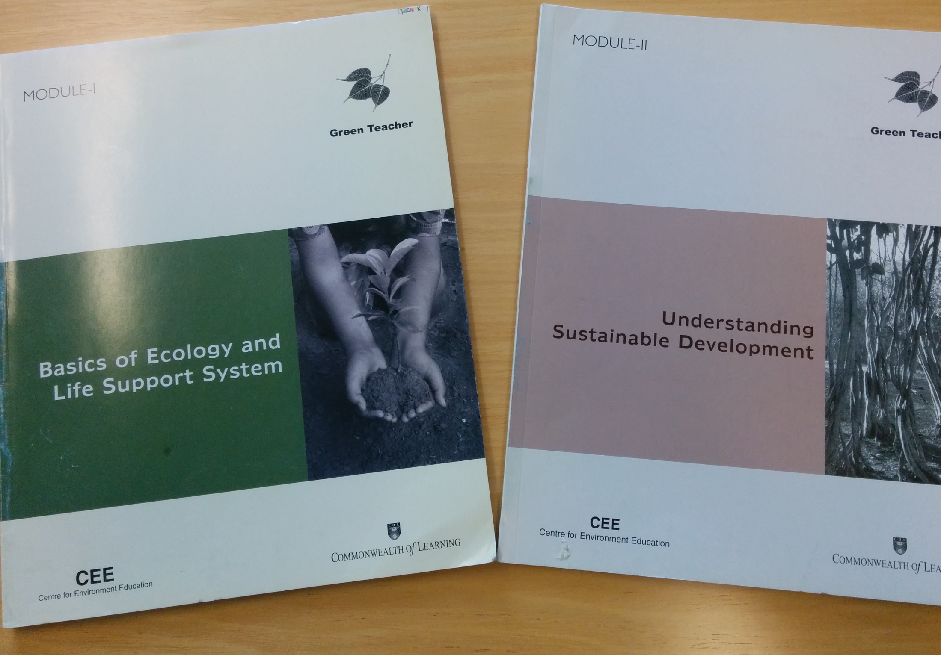


Green Teacher
Notes:
COL is also supporting resilience of the education sector by developing the skills and capacities of teachers in environmental education.
COL supported the National Teachers Institute, Nigeria, which has an annual enrolment of 50,000 trainee teachers, to develop a Green Teacher programme to help teachers to integrate environmental concerns into the classroom from a very early age. This is now being offered online to teachers in the country.

Slide 17
Towards a Green Learning
Agenda

Slide 18

Views from the Commonwealth:
26 countries
Integrating climate literacy in the curriculum
Aligning climate change policies with education policies and better coordination between ministries
Building the capacity of teachers
Digitising and sharing indigenous knowledge related to environmental conservation
Developing ICT infrastructure—access to devices and connectivity

Slide 19
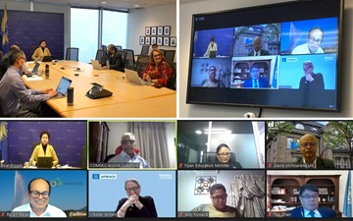

COL’s High-Level Panel on Climate Change and Education met
24 January 2022 to map course of actions
Notes:
Identify a concrete action plan
Explore areas for collaboration and partnership
Develop a Report for Commonwealth Education Ministers

Slide 20
Views of the High-Level Panel
Urgent action required
Need for behavioural change for climate action
Engage and empower youth
Promote disaster response and recovery through education and lifelong learning
Promote collaboration esp with the private sector

Slide 21
Green Learning Agenda for the Commonwealth
Climate Change and the Commonwealth
Equity and Inclusion: small states, LDCs, vulnerable communities
Greening Commonwealth Education Systems
A new Green Learning Agenda for the Commonwealth
Role of Technology
Recommendations for Action

Slide 22
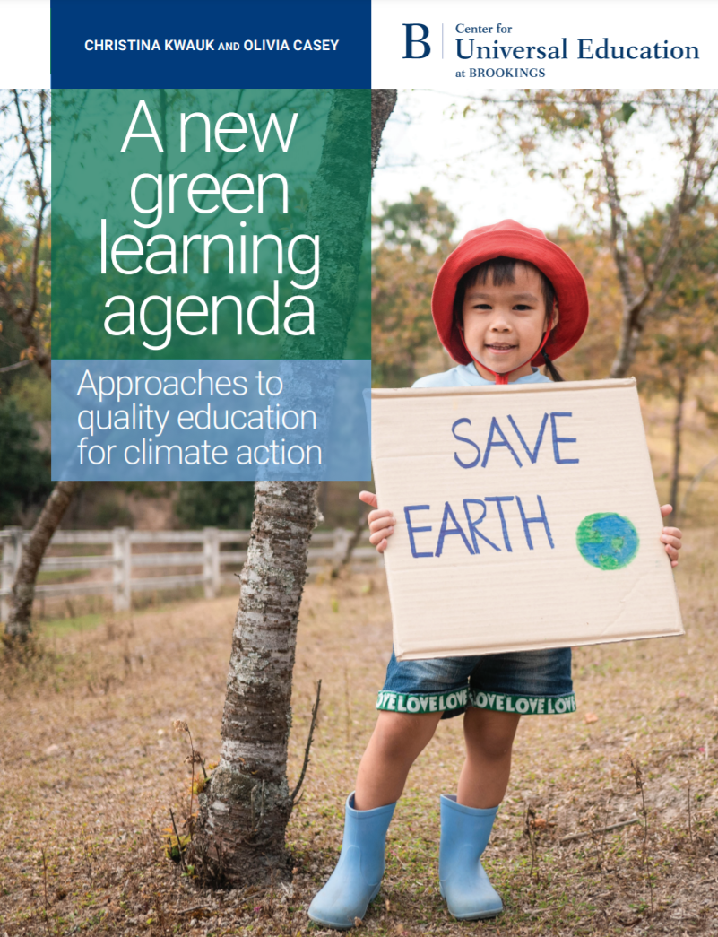
Green learning agenda
Skills for green jobs
Green life skills
Skills for a green transformation
Skills aimed at fulfilling the requirements of green jobs and supporting the transition to a low-carbon green economy
Cross-cutting skills that serve both technical, instrumental, and adaptive, transformative ends
Adaptive skills aimed at transforming unjust social and economic structures
Source: https://www.brookings.edu/wp-content/uploads/2021/01/Brookings-Green-Learning-FINAL.pdf

Slide 23
Climate Justice: addressing inequalities
Countries with harmful gender norms, gender discriminatory education policies are also countries with low levels of climate resilience and high levels of vulnerability to climate disasters.
Women and girls more vulnerable to disasters
Girls typically excluded from technical fields and STEM required by the green economy
Source: C Kwauk & O Casey, ‘A Green Learning Agenda: approaches to quality education for climate action’, Brookings, 2021. pp22-23

Slide 24
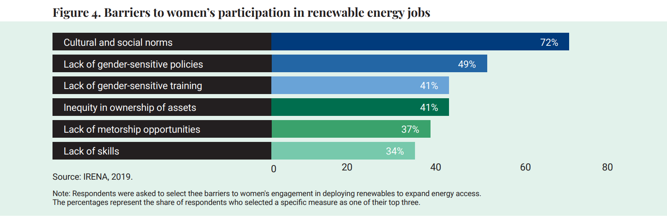
Barriers to women’s participation in renewal energy jobs
Source: C Kwauk & O Casey, ‘A Green Learning Agenda: approaches to quality education for climate action’, Brookings, 2021. pp32, Figure 4.

Slide 25

Towards fairness, justice, equity
Make TVET more gender transformative—break stereotypes and target skills from caring to coding to construction
Prioritise ‘care’ in green jobs—uphold care for women’s rights and care for the environment
Create a supportive ecosystem for women and girls in the green economy.
Source: Kwauk & Casey, pp 37-40

Slide 26

Gender-equal education
Equip girls with the skills and competencies to respond to the challenges of climate change to build resilience
Access to contraception and ability to exercise reproductive rights can reduce the rate of global warming
More girls in STEM can contribute to a low-carbon economy
Gender-equal values can transform relationships with people and the planet
Source: ‘A Greener, fairer future; why leaders need to invest in climate and girls’ education’ Malala Fund, 2021, pp. 18-21.

Slide 27


Thank you
www.col.org
The contents of this presentation, with the exception of logos and graphics which are the property of the respective owners, is made available under Attribution-ShareAlike 4.0 International (CC BY-SA 4.0).

