Slide 1
Innovations in Higher Education: re-imagining learning
Professor Asha Kanwar President & CEO
Prof Romeela Mohee, ES: HE
ACHEA 17th Annual Conference, July 12-14, 2018

Slide 2
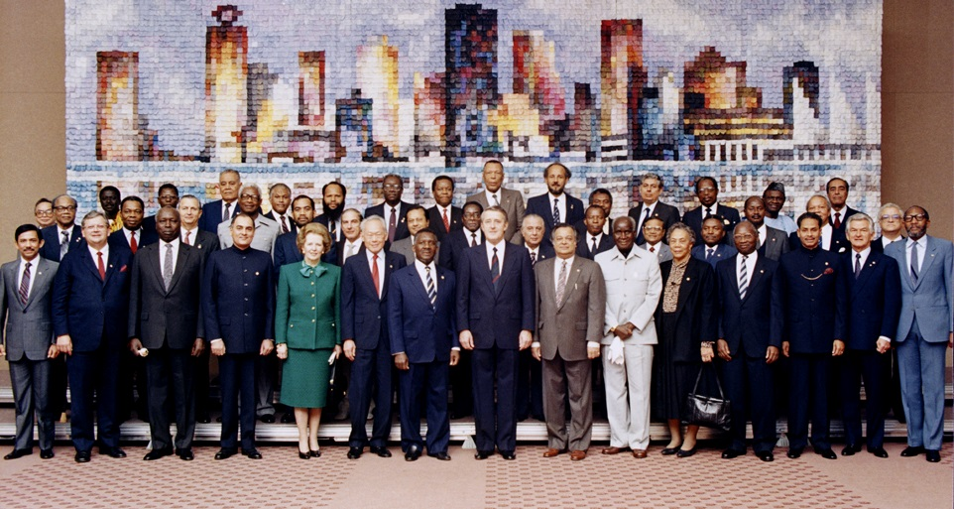
Commonwealth Heads of Government Meeting Vancouver, 1987
Notes:
We invite you to engage us; tap into our thought leadership, expertise, networks and resources

Slide 3

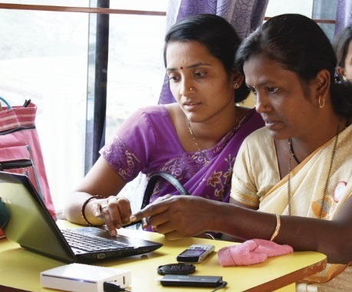
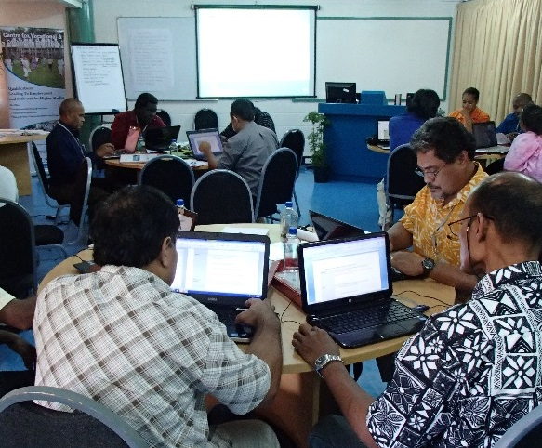
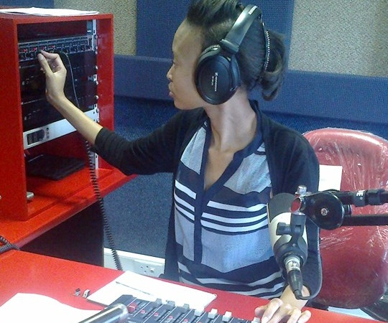
To help Commonwealth governments and institutions use technologies to improve and expand access to education and training

Slide 4

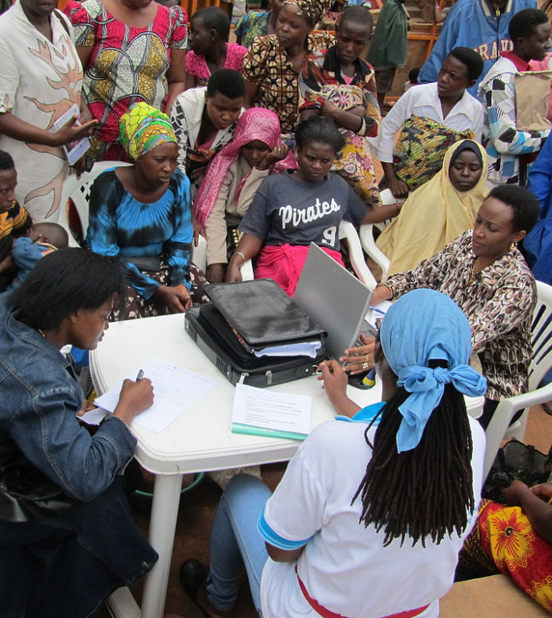




Learning for Sustainable Development
ECONOMIC
GROWTH
SOCIAL
INCLUSION
ENVIRONMENTAL CONSERVATION

Slide 5
Plan
Context
Innovations in Higher Education
Decade of digital transformation
Emerging trends
Re-imagining Learning

Slide 6
Context

Slide 7
GER Tertiary Education- Global
Source: UNESCO Institute for Statistics, Retrieved on 7 February 2018.

Slide 8
GER Tertiary Education- Caribbean Small States (2006 – 2016)
Source: UNESCO Institute for Statistics, Retrieved on 12 June 2018.

Slide 9
GER Tertiary Education- Trinidad and Tobago (1999 – 2004)
Source: UNESCO Institute for Statistics, Retrieved on 12 June 2018.
Notes:
In the context of Trinidad and Tobago, the following factors were established for 2009-2010: · Total post secondary and tertiary education enrolment – 52,6203 · Secondary school leaving age (Form 5) – 16 years old · Five-year age group following secondary school leaving age – 17-21 years old · Population of 17-21 years old in Trinidad and Tobago (2010 projection) – 112,1434

Slide 10
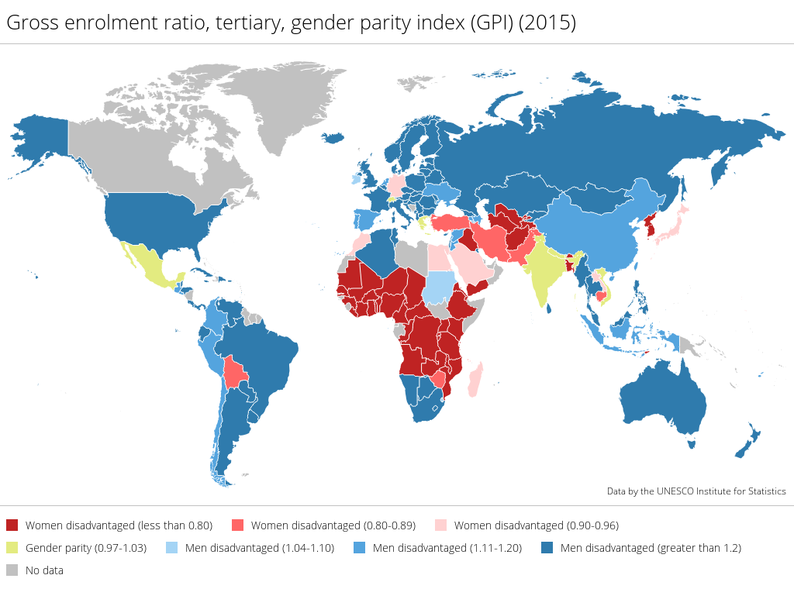
Women in HE
Source: https://tellmaps.com/uis/gender/#!/tellmap/79054752/2

Slide 11
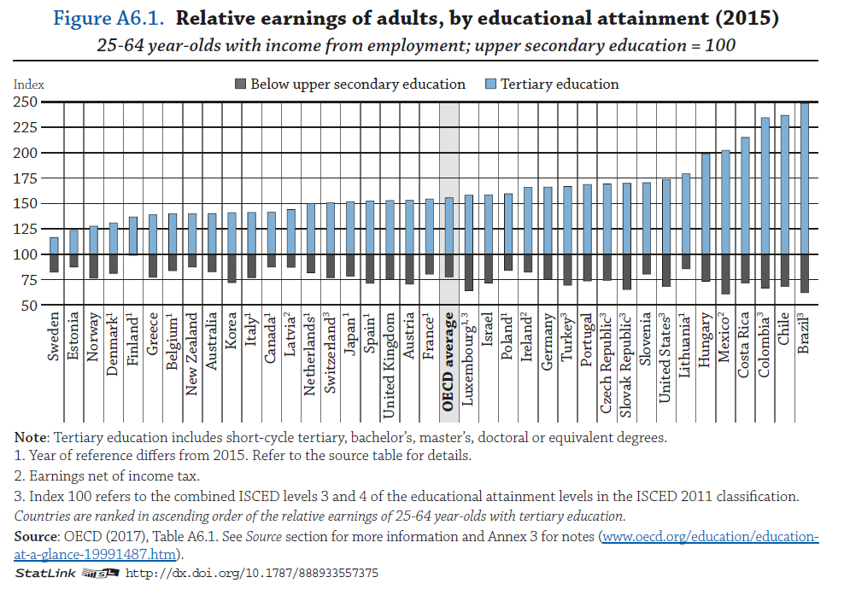
Graduate Premium

Slide 12
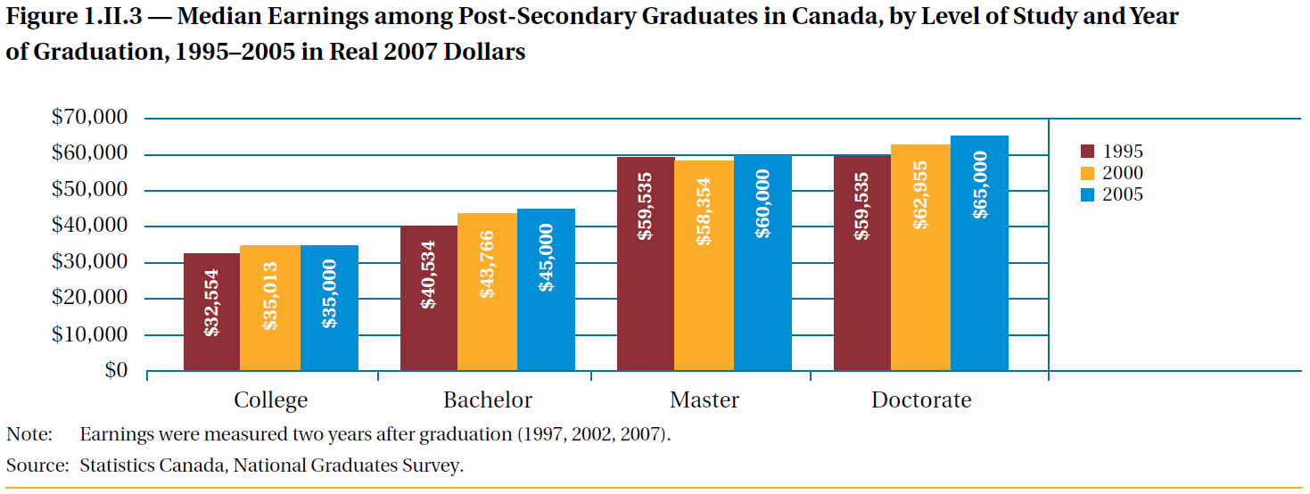
Canadian example
Source: Berger, Joseph (2009). The Price of Knowledge: Access and Student Finance in Canada
Notes:
.

Slide 13



Some Countries with High GERs
93.26
88.34
57.29

Slide 14
Skills Shortage
‘Countries have skills shortages, not degree shortages’
Andreas Schleicher

Slide 15
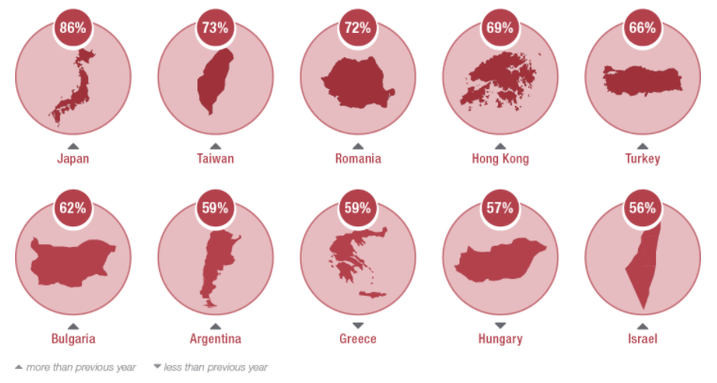
Skills Gap Countries where employers have the most difficulty filling roles
Source: https://www.manpowergroup.com/talent-shortage-2016
Notes:
Employers are reporting difficulty in filling roles.

Slide 16
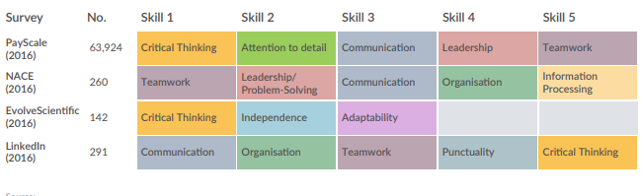
Skills in Demand
Source: http://www.reimagine-education.com/wp-content/uploads/2018/01/RE_White-Paper_Global-Skills-Gap-Employability.pdf
Notes:
Critical thinking, communication, leadership and teamwork

Slide 17
Innovations in HE

Slide 18
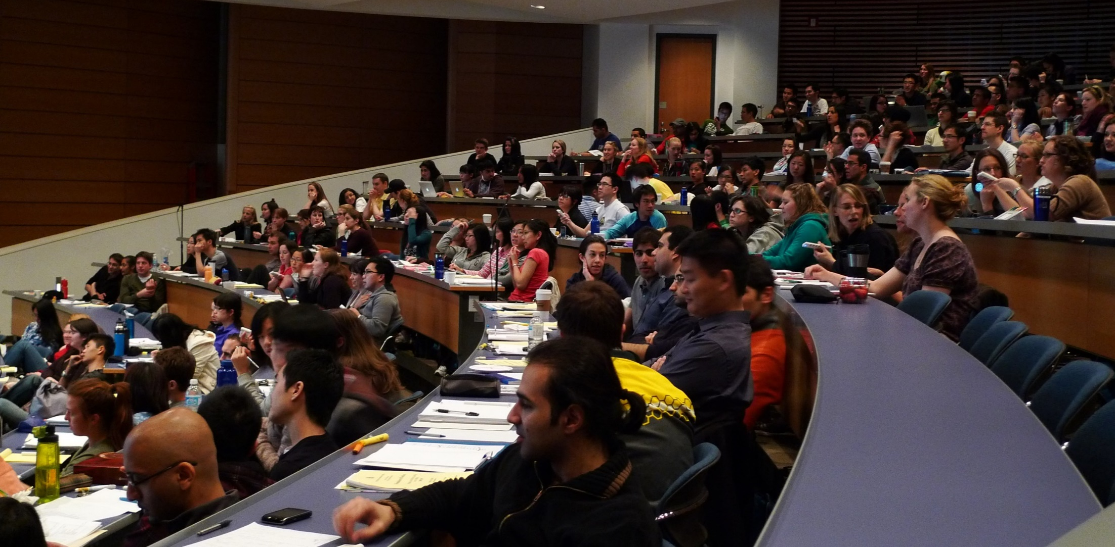
Typical Classroom
Source: https://www.flickr.com/photos/velkr0/3472576304 (CC BY)

Slide 19
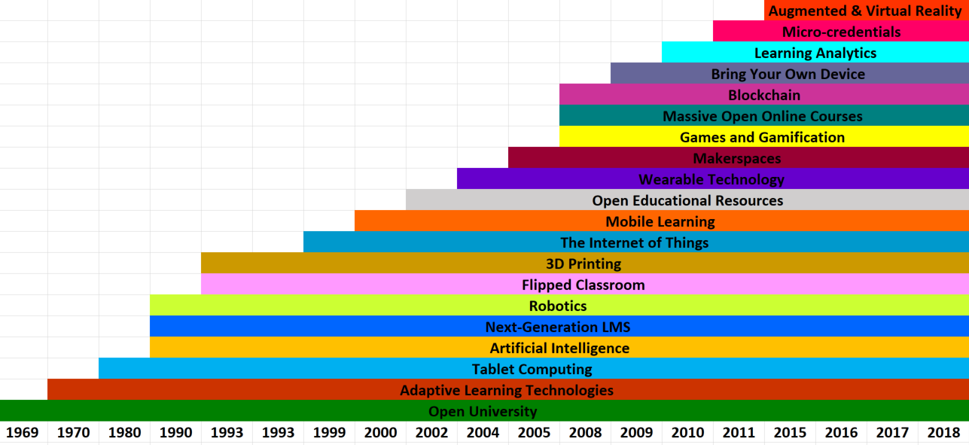
Innovations in Higher Education?
Slow pace of diffusion of innovation

Slide 20
Innovations Happen
Demands of a learning society
When new technologies emerge
New providers emerge

Slide 21
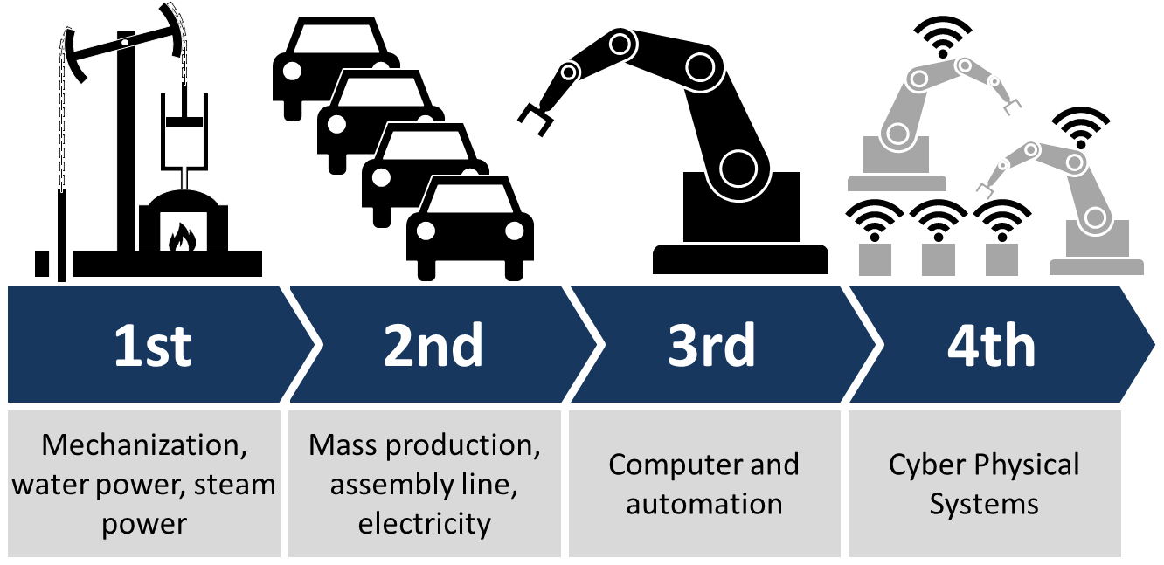
Fourth Industrial Revolution
CC BY-SA Source: https://commons.wikimedia.org/wiki/File:Industry_4.0.png (User:ChristophRoser)

Slide 22


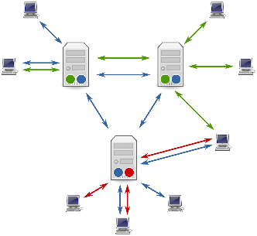

Tertiary Education Over Four Stages
From elite to mass
Correspondence model
Multi-media model
Intelligent flexible learning model
Gen 1
Gen 2
Gen 3
Gen 4
Notes:
CC BY-SA by David Right https://commons.wikimedia.org/wiki/File:E_II_R_Postbox,_Burgate,_Barton_Upon_Humber_-_geograph.org.uk_-_1064916.jpg

Slide 23
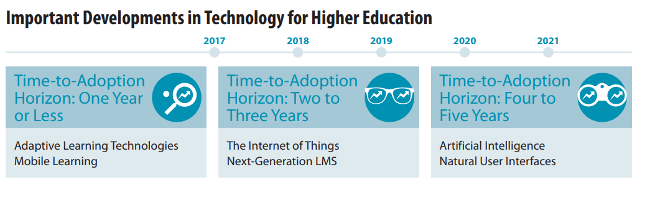
NMC Report 2018
2018
2019
2020
2021
2022
Analytic Technologies
Makerspaces
Adaptive Learning Technologies
Artificial Intelligence
Mixed Reality
Robotics
Source: https://library.educause.edu/resources/2018/4/nmc-horizon-report-preview-2018

Slide 24
Rise of Messaging

Slide 25

Impact of Technology
The effect of today’s technology on tomorrow’s jobs will be immense
- The Economist
47% of today’s jobs could be automated in the next 20 years
- Oxford University Study
Notes:
http://www.economist.com/news/leaders/21594298-effect-todays-technology-tomorrows-jobs-will-be-immenseand-no-country-ready
Jan 18th , 2014
Source: http://www.oxfordmartin.ox.ac.uk/downloads/academic/The_Future_of_Employment.pdf

Slide 26
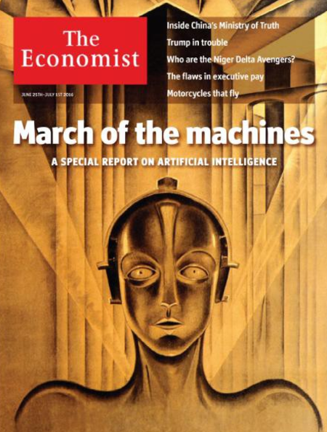
Re-educating Rita
Technological progress, and artificial intelligence in particular, will require big changes in the way education is delivered….
Automation could have a much bigger impact in developing economies …because much of what they provide is …embodied labour.
Notes:
Source: http://www.economist.com/news/special-report/21700760-artificial-intelligence-will-have-implications-policymakers-education-welfare-and

Slide 27
Scenario for Automation Adoption 2016-2030 (source: McKinsey Global, 2017)
Country | work that can be automated (%)
India | 9
China | 16
United States | 23
Germany | 24
Global | 15
Workers that may be displaced | 400 Million
Notes:
McKinsey Global Study (Dec 2017)

Slide 28
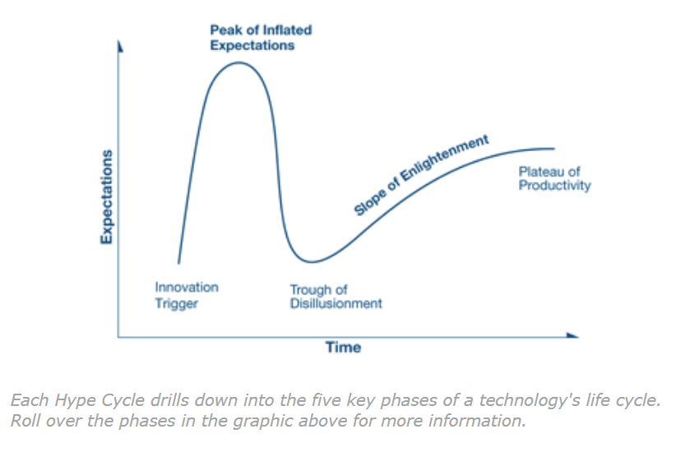
Gartner Hype Cycle
Source: https://www.gartner.com/technology/research/methodologies/hype-cycle.jsp
Notes:
Interpreting Technology Hype

Slide 29
Decade of digital transformation

Slide 30
Digital Innovations in TE
Innovation | Dominant mode
MOOC/Blended learning | Classroom/Lecture
Blockchain | Accreditation authority/ Degree mills?
Micro-credentials/Badges | Degree?
Open Education/OER | For-profit colleges/ copyrighted course materials?

Slide 31
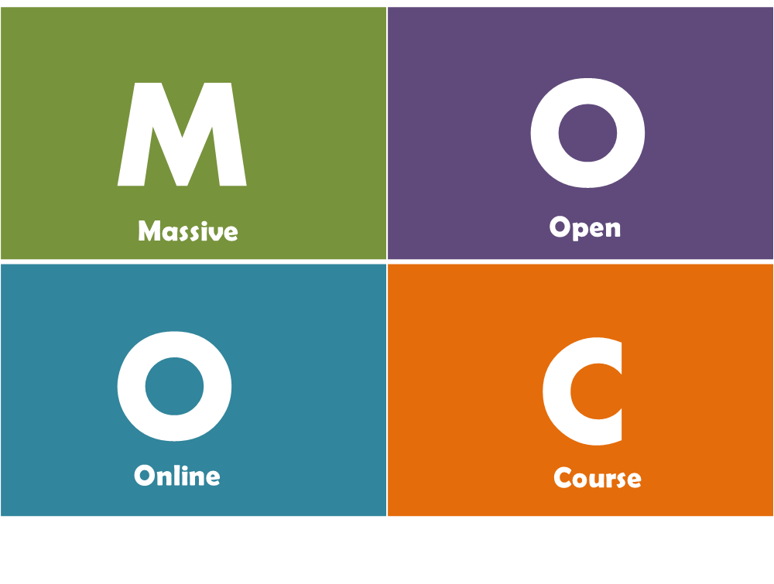
Massive Open Online Course
“MOOCs are online courses designed for large numbers of participants, that can be accessed by anyone, anywhere as long as they have an Internet connection, are open to everyone without entry qualifications and offer a full/complete course experience online for free”
- Mulder & Jansen, 2015

Slide 32
Implications for HE
Present
Future
National or provincial jurisdiction
Global classroom
Interaction at the campus
Increased use of Peer2Peer learning and social media
Print+ (audio, video, online)
Online+ (increased use of adaptive learning)
Notes:
Openness was the other plank of this movement. This could have been defined in very many ways but the most appropriate expression is attributed to Crowther, the founding chancellor of British OU. His statement touches upon various facets of openness that continue to be important in today’s context cross the generations

Slide 33
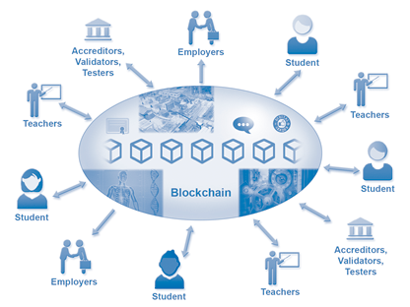
Blockchain: Quality & Mobility

Slide 34
Implications of Blockchain for HE
Present
Future
Paper certificates
Digital permanent certificates
Verification challenge
Complete online verification
Manual authentication of work (such a portfolios
E-Authentication of work (ePortfolios)

Slide 35

Micro-credentials: skilling and reskilling
Industry-Academic Partnership
Online Learning
Proctored Test
Credits for formal learning and/or Employment
Short duration
Modular approach
Skills based
Community learning
Self-paced
Mentoring support
Verifiable credential
Project-based
Job-ready
Reduced cost
Blended with F2F for formal degree

Slide 36
Implications of Micro-credentials for HE
Present
Future
Semester courses
Shorter courses
Less flexibility
Bundling/
accumulation of credits
Limited mobility
Transferability of credentials

Slide 37




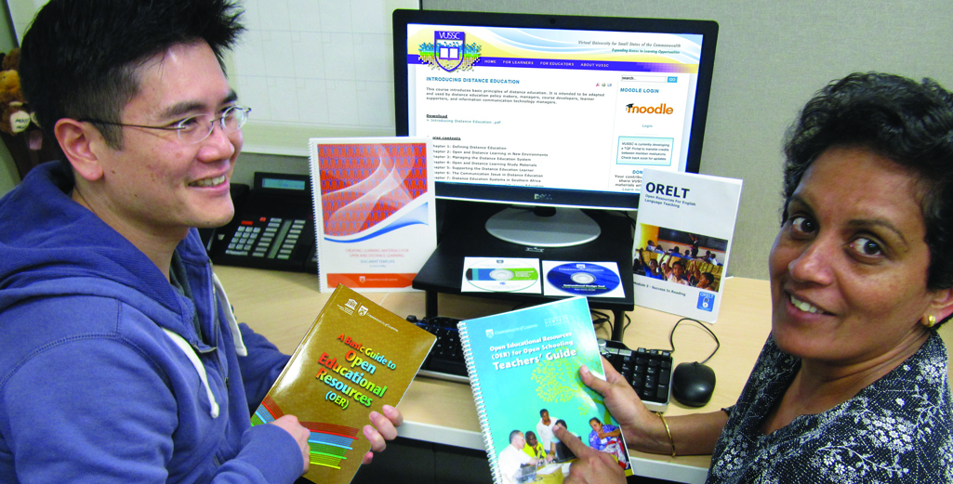


Open Educational Resources (OER): Costs
Materials that are:
Free and freely available
Suitable for all levels
Reusable
Digital

Slide 38
Implications of OER for HE
Present
Future
High costs of textbooks
Free quality content
Institutional Teams
Global Teams of course developers
Student as consumer
Student as producer

Slide 39
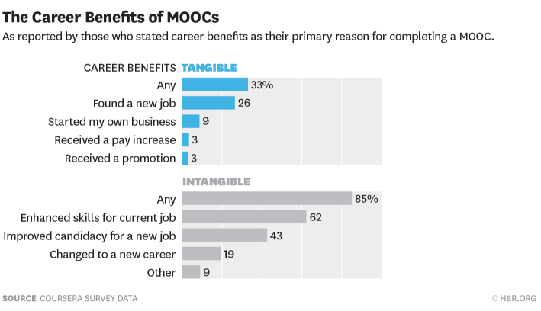
Technology & Employability
Source https://hbr.org/2015/09/whos-benefiting-from-moocs-and-why

Slide 40
Emerging Trends

Slide 41
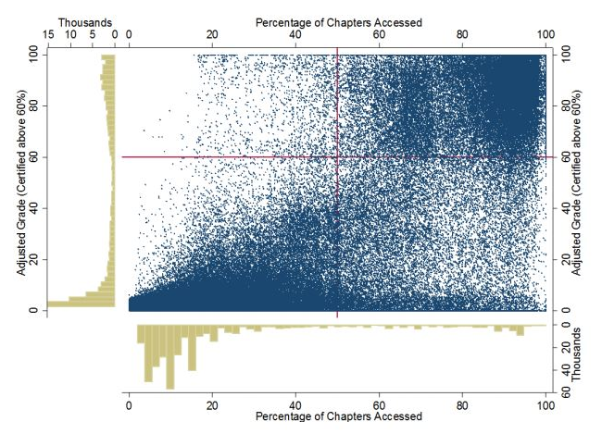
Rise of Big Data in Learning
Source: https://papers.ssrn.com/sol3/papers.cfm?abstract_id=2381263
Notes:
The rise of Big Data is a critically important trend in learning with far-reaching consequences. Operations of individuals and organizations in the cyberspace is known to result in extraordinarily large masses of data. For example, there are over a billion smartphone users in the world who work with Apps several times a day. Each time a certain amount of data will be created, transmitted and stored. This can amount to terabytes in a short time. Analysis of data on such a scale is vitally important for the functioning of many services in the cyberspace. Industries such as banking, insurance or airlines are critically dependent on such data. With the rise of MOOCs, Big Data is making its impact felt in learning as well. One can see, for example, data on learners that access particular segments of the course can be correlated with grades. The graph here is from a paper published by a group in Cambridge, USA,. This group has used data from a MOOC in 2012 that had over a hundred thousand students. When the number of students in a single offering is massive like 100 000, analysis requires use of special techniques that are part of the science of big data.

Slide 42
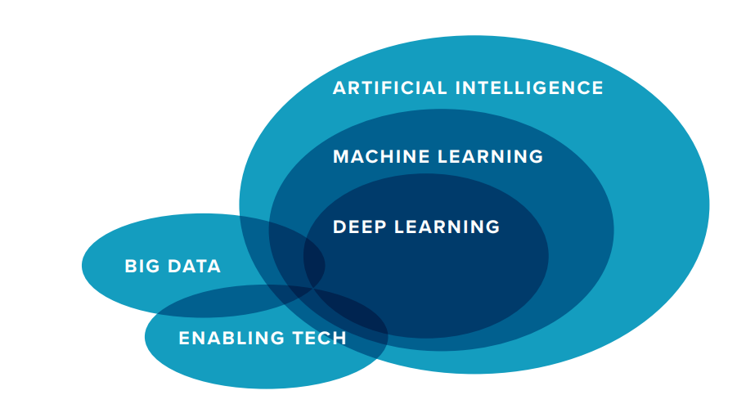
Source: Tom Vander Ark (Nov 2017) www.gettingsmart.com
Notes:
AI today is actually a set of technologies. The more general set is Artificial Intelligence. A more specific set of Machine learning. In fact, some experts prefer the term Machine Learning over AI. Deep Learning is an even more specific set of technologies under AI. ​
Big Data is the fuel for AI. Big Data when combined with enabling technologies such as Cloud Computing can generate AI services. Machine Learning can be called Big Data with algorithms. Machine Learning is the suite of technologies in self-driving cars. Big Data, one could say, is the fuel for AI-based services today.

Slide 43





AI in Daily Life
Notes:
We do use AI-based services in our daily lives,. We might not be aware of them. Some examples can be given, such as spam filters in Email; tagging of faces- e.g. Facebook; or the Google translate online service; or when you notice the Estimated time for travel in the Uber App in your phone; or when you come across personalised suggestions in Amazon

Slide 44


AI in Education
Can provide an intelligent, personal tutor for every learner
Encourage intelligent support for collaborative learning
Adaptive group formation
Expert facilitation
Source: https://www.ibm.com/watson/advantage-reports/ai-social-good-education.html
Notes:
AI already has a presence in education. The number of examples is not large. One of them is the Intelligent Tutoring System or ITS. These systems use AI techniques to simulate one-to-one human tutoring, delivering learning activities best matched to a learner’s cognitive needs. They are able to provide targeted and timely feedback, all without an individual teacher having to be present. With large student numbers working in multiple collaborative groups, it can be impossible for a person to make any sense of the large volume of data that the participants are generating in their discussions. AI, in particular, Machine Learning, can help analyse and summarise the discussions to enable a human tutor to guide the students towards fruitful collaboration.
AI-enabled systems are useful in designing a grouping of students all at a similar cognitive level and of similar interests. AI has been used to train systems to recognise when students are having trouble understanding the concepts that they are sharing with each other.

Slide 45
Jill Watson: World Famous Teaching Assistant
Deployed in four offerings of an online course in Computer Science in Georgia Tech (Instructor: Ashok Goyal)
A conversational chatbot built on AI
Three versions built and deployed:
Jill Watson
Stacy Sisko
Liz Duncan
Source: http://hdl.handle.net/1853/59104
Notes:
A popular example of AI in education is the Virtual Teaching Assistant. During 2014-16, Professor Goyal at the Gerogia Inst of Technology offered an online course in computer science. He designed and deployed a virtual teaching assistant called Jill Watson who became famous globally. This Ai-powered assistant is an example of a chatbot that converses using text. In subsequent offerings of the same course, he and his team refined the chatbot and the new versions were called by different names. Jill Watson conversed with students like a real life TA. So much as that many students thought that Jill Watson was a human.

Slide 46
Inferences for Education
“…for highly focused technical domains… it is difficult for humans to distinguish between the responses of AI and human experts.”
-Georgia Tech
Notes:
Professor Goyal, who analysed data from four offerings of the course with AI-powered chatbots concluded that in specific domains and topics, it would not always be easy for humans to tell the difference between the responses of AI and human experts.

Slide 47
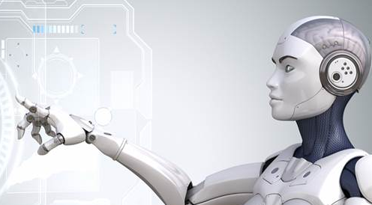
Robots: From Teaching to Oversight
Robots will replace teachers in the next ten years…..robots will enable pupils to learn new material at their own pace, rather than as part of a class…teachers would adopt the role of “overseers”, monitoring the progress of individual pupils, leading non-academic activities and providing pastoral support.
--Anthony Seldon, VC, Buckingham U (Sep 2017)
Notes:
Ai-powered systems can be deployed as robots that are similar to the ones in popular imagination. They can visualize things and can synthesise their programmed outputs to create human-like speech. According to Anthony Seldon, robots will quite likely play a role in teaching. The role of teachers may be transformed into one of an overseer.

Slide 48
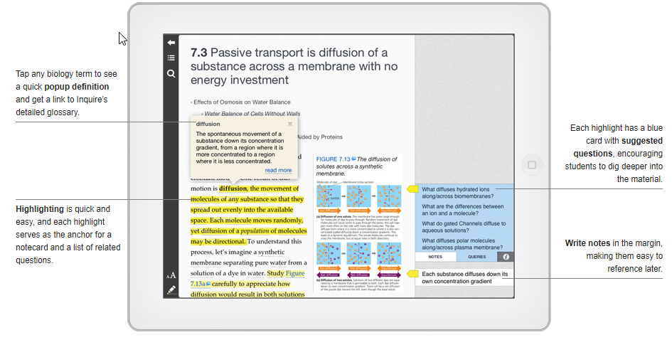
Example of AI in Education
Inquire: an intelligent textbook
Source: http://inquireproject.com
Notes:
Let’s continue with some more examples of AI in education. Inquire is an ipad App that combines a popular Biology textbook with an AI system that answers students’ questions about the material.
Science textbooks are complex: a typical college-level biology textbook introduces thousands of new concepts and tens-of-thousands of relationships between them. Inquire provides quick, factual answers. Through this, Inquire repeatedly exposes students to the patterns and relationships among concepts that are fundamental to human learning, This was part of a research project at SRI International in Stanford University.

Slide 49
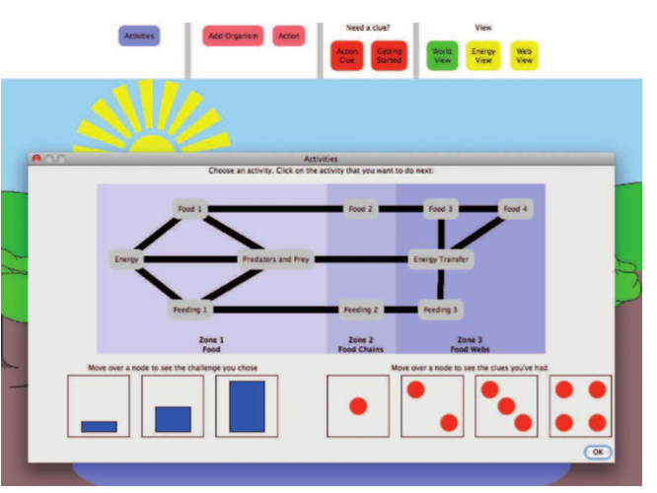
Open Learner Model in Assessment
Example of AI in Education
Source: http://dx.doi.org/10.1038/s41562-016-0028
Notes:
According to Professor Rose Lucking at the Knowledge Lab at the prestigious UCL in London, “stop and test” assessments do not rigourously evaluate a student’s understanding of a topic. AI-based assessment constantly provides feedback to learners, teachers and parents about how the student learns, the support they need and the progress they are making towards their learning goals.

Slide 50
The Future of Work
Digitalisation can make professions disappear
Rise of AI can lead to elimination of many high-skilled jobs leaving just the highest skilled ones for operations by humans
Notes:
The most critical impact of AI is on “work” which nearly every expert has said would be drastically transformed. Whole professions could disappear. Jobs that do not yet exist might become mainstream in a short time. The strong middle order in a hierarchy of skills might get hollowed out. This transformation will have far-reaching consequences on education sector as a whole.

Slide 51



Implications for Higher Education
Rise of the Multi-Versity network …learners can move from education to society and back
Micro-qualifications: rapid acquisition of highly specific knowledge and skills rather than a degree
The Faculty to become Lifelong Learners -- focus on new modes of delivery and pedagogy
Multi-versity: term introduced by Clark Kerr (1963) http://openvault.wgbh.org/catalog/A_0DF915F352B044EFB1A31CCC71E8F9BF
Notes:
In this scenario, learner mobility part of the landscape, not an exception. “Build-it-they-will-come” model not practical in this context. To help learners sustain their skills and thus livelihoods for longer than a generation there should be adequate pathways for learners to move back and forth from society to education. Mobilty is thus not limited to mobility across institutions. It is also about unlimited freedom and opportunities to move back and forth between education and employment. The concept of a unitary institution must be transformed into a network of mulit-versities. The term owes its origin to the wellknown educator Clark Kerr who was the President of the University of California system

Slide 52



Three Key Literacies in the Age of AI
Human
Data
Technological
Literacies
Source: Joseph Aoun (2017): Robot-proof, MIT Press, https://mitpress.mit.edu/books/robot-proof

Slide 53
Re-imagining Learning

Slide 54
The New Learner: 1980’s
adult learner who looked for new education, training and/or skills for personal development, promotion, change in career, and/or enhanced job requirements

Slide 55
Digital Native: C21
Technology-savvy learners, usually young school-leavers
The Emerging Ultimate Learner
Notes:
Has the means to learn
The mindset and motivation
Lifelong learner
Multidisciplinary, analtyical, ethical, innovative, disciplined, respectful, collaborative

Slide 56
The Learner in 2035
Broadened classrooms & Blended
courses: linking of multiple f-f classes via technology (mega-pixel walls)
Artificial Intelligence: Holographic Advisor Bot
Advanced Communication: Language
translation implants
Division of Learning:“Maker, Doer,Thinker”
Learning at home: Immers- A-Casts
Micro-courses
Reference: BIG SHIFTS ARE COMING! LOOKING BACK FROM 2035 .
www.contactnorth.ca

Slide 57


Slide 58
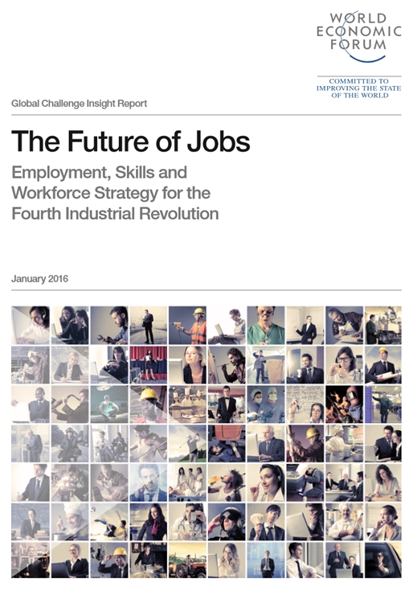
Lifelong learning
Simply reforming current education systems …to meet future skills requirements is not going to be enough….
Ageing countries …will need wholesale reskilling of existing workforces throughout their life
Notes:
https://www.weforum.org/agenda/2016/01/the-10-skills-you-need-to-thrive-in-the-fourth-industrial-revolution/

Slide 59


Integrating Employability
Balance between theory and practice; hard and soft skills
Engage industry: internships; apprenticeships
Link QA to employability
Career support
Measure capability rather than number of hours
Credit Hour
Range of skills

Slide 60
Employability pathway in TE
Sensitisation
Career Counselling
Evaluation Drills
Career Support
Before Admission
After Induction
Penultimate Year
Upon Graduation

Slide 61
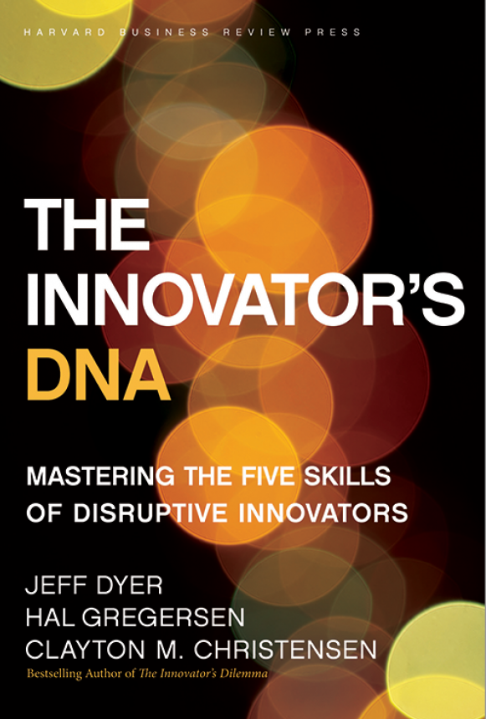
Skills for Innovation
Questioning
Observing
Networking
Experimenting
The Innovator's DNA: Mastering the Five Skills of Disruptive Innovators by Jeffrey H. Dyer, Hal B. Gregersen, Clayton M. Christensen, Harvard Business Press
Notes:
Asking ‘why?’ or ‘what if?’
ODL Leaders must encourage a spirit of inquiry and a culture of research
Exposure to new technologies and environments to assess what works and what doesnt and why
Interactions of a social and intellectual nature with people from different disciplines/sectors
ODL Leaders must promote
interdisciplinary exchanges so that by connecting different disciplines and sectors, innovative ideas emerge
ODL Leaders must enable staff to visit other institutions and expose them to emerging technology developments
Try out new ideas by creating prototypes and launching pilots
ODL Leaders must encourage staff to construct interactive experiences and provoke out of the box solutions

Slide 62
Learning in an Era of Digital Transformation
Empathy
Ethics
Equity

Slide 63
Thank you
www.col.org

