Slide 1























































Regional Focal Points Meeting : Africa
ANTIGUA & BARBUDA
AUSTRALIA
BAHAMAS
BANGLADESH
BARBADOS
BELIZE
BOTSWANA
BRUNEI DARUSSALAM
CAMEROON
CANADA
CYPRUS
DOMINICA
ESWATINI
FIJI
THE GAMBIA
GHANA
GRENADA
GUYANA
INDIA
JAMAICA
KENYA
KIRIBATI
LESOTHO
MALAWI
MALAYSIA
MALTA
MAURITIUS
MOZAMBIQUE
NAMIBIA
NAURU
NEW ZEALAND
NIGERIA
PAKISTAN
PAPUA NEW GUINEA
RWANDA
ST KITTS & NEVIS
SAINT LUCIA
ST VINCENT & GRENADINES
SAMOA
SEYCHELLES
SIERRA LEONE
SINGAPORE
SOLOMON ISLANDS
SOUTH AFRICA
SRI LANKA
TONGA
TRINIDAD & TOBAGO
TUVALU
UGANDA
UNITED KINGDOM
TANZANIA
VANUATU
ZAMBIA
Professor Asha Kanwar
President & CEO, Commonwealth of Learning
28-29 April, 2020

Slide 2
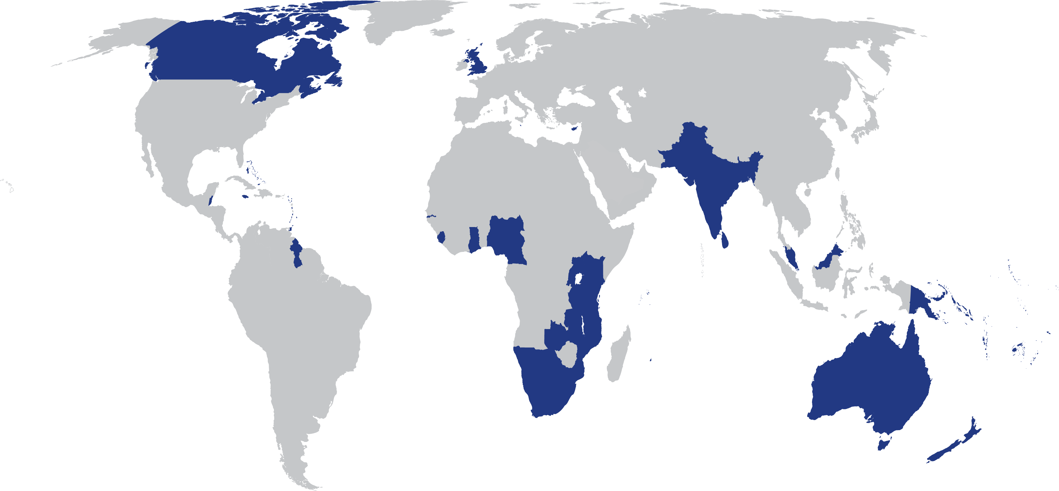
Our Commonwealth
Population 2.4 billion,
more than 60% under 30
Youth
unemployment high
60% of the Commonwealth=small states: affected by climate change

Slide 3
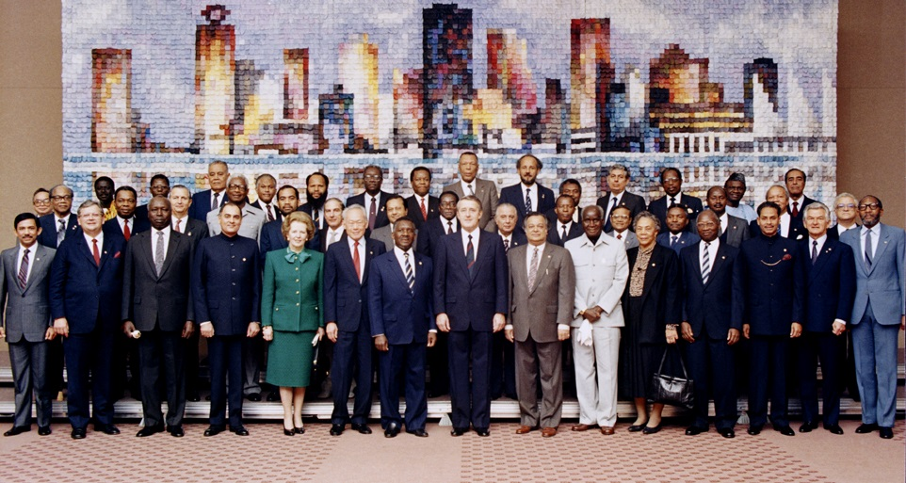
Commonwealth Heads of Government Meeting
Vancouver, 1987
Notes:
We invite you to engage us; tap into our thought leadership, expertise, networks and resources

Slide 4

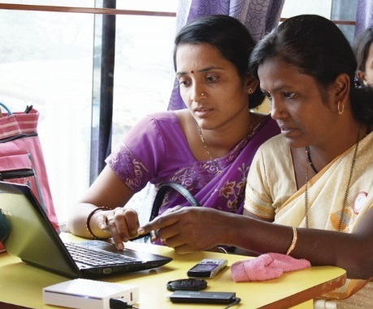
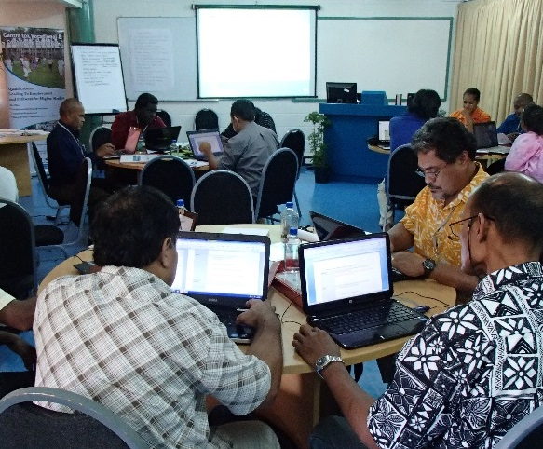
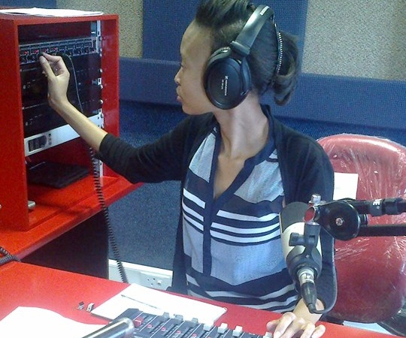
To help Commonwealth governments and institutions use technologies to improve and expand learning for sustainable development

Slide 5
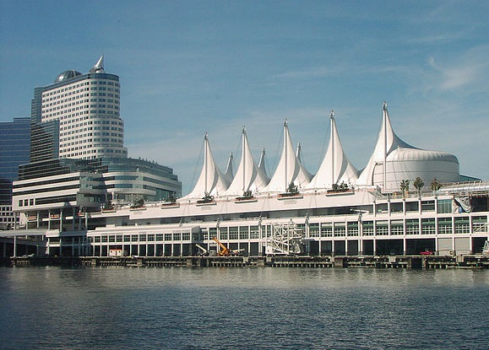


Where is it?
Metro Vancouver
(HQ)
New Delhi
(CEMCA)

Slide 6



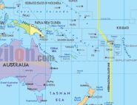
Regional Support
Southern African Development Community Centre for Distance Education (SADC-CDE)
Regional Training and Research Institute for Open and Distance Learning (RETRIDOL)
Commonwealth Centre for Connected Learning (CCCL)
Pacific Regional Centre (PACFOLD)

Slide 7
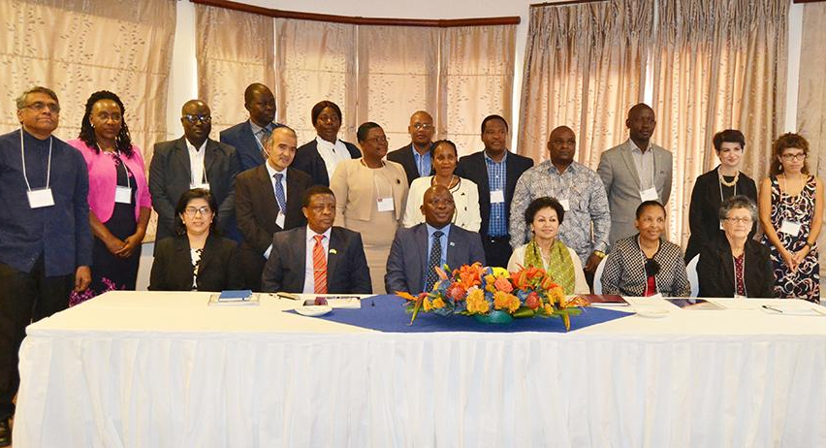
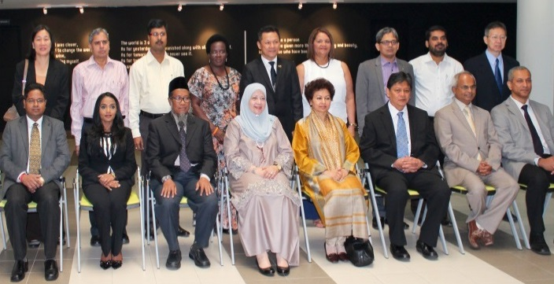
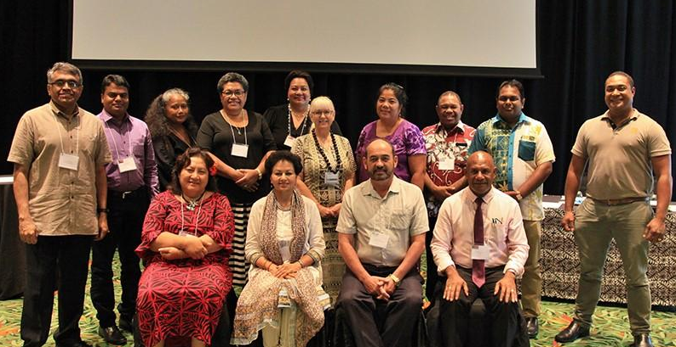
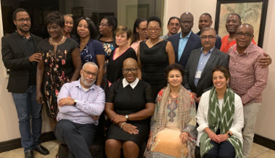
COL Focal Points
Our direct link to each country
Africa and Europe
Asia
Pacific
Caribbean
Notes:
Last updated: October 10, 2018

Slide 8
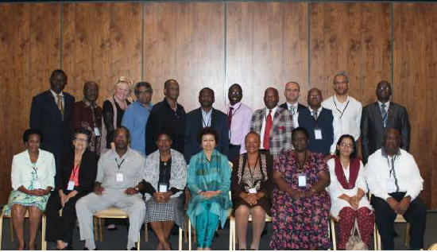
Africa Focal Points
2015-2021 Strategic Plan Input
Strengthening skills sector to support economic empowerment of marginalised groups
Institutions supported to leverage ODL to provide quality higher education
More learners have quality education through Open learning.
ODL methodologies are used to provide quality training of larger numbers of teachers and instructors.

Slide 9
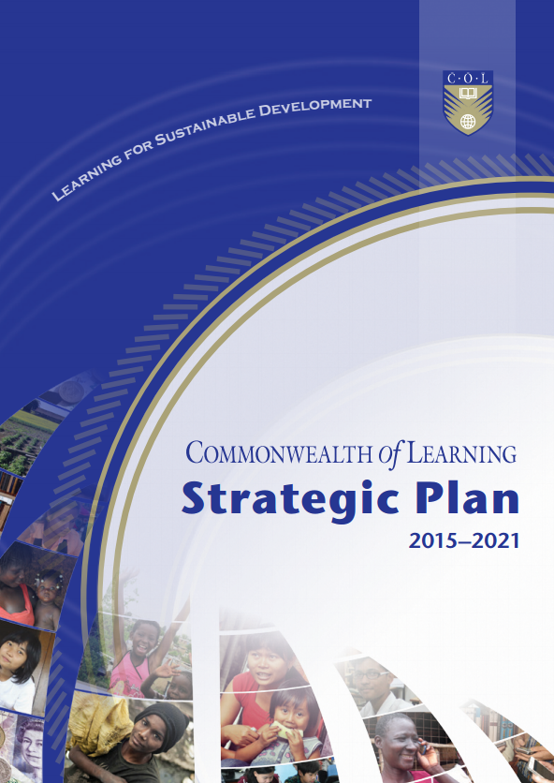

Slide 10
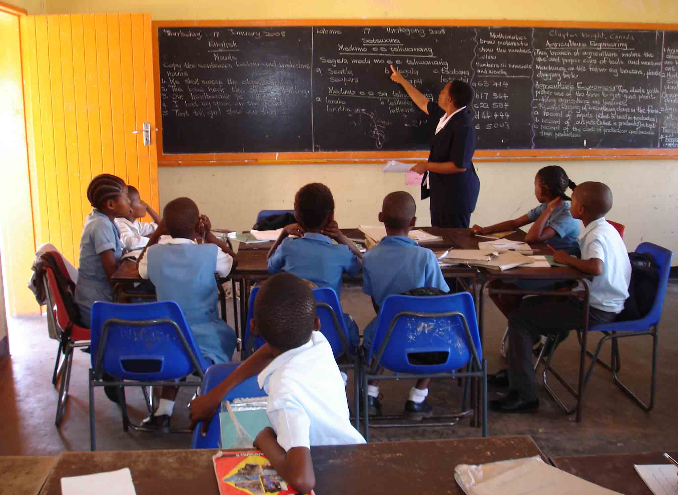
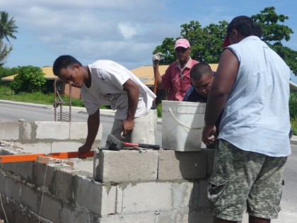
Two Sectors
EDUCATION
SKILLS
GENDER

Slide 11

Strategies

Slide 12
COL’s Five Paradigm Shifts

Slide 13


1
If the child cannot go to school,
the school comes to the child
PARADIGM
SHIFT

Slide 14
Open Schooling
The physical separation of learner from the teacher
The use of unconventional teaching methodologies, and information and communications technologies (ICTs) for scale
Flexible approach
Foster innovation
(e.g. on-demand exams; uses of ICT)

Slide 15

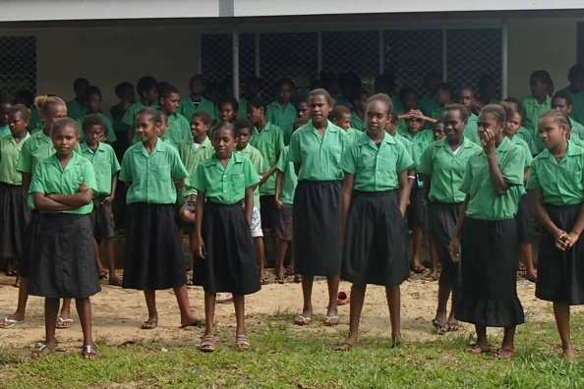

In Belize , Social Return on Investment in open schooling showed that every US$ invested resulted in US$8 worth of benefits to students.
Notes:
Belize
Benefits: skills, expected income
Social Return on Investment of an Open School showed that every US$ invested resulted in US$8 worth of benefits to students.

Slide 16
2
Technology-enabled learning can break open the ivory towers of tertiary education
PARADIGM
SHIFT

Slide 17
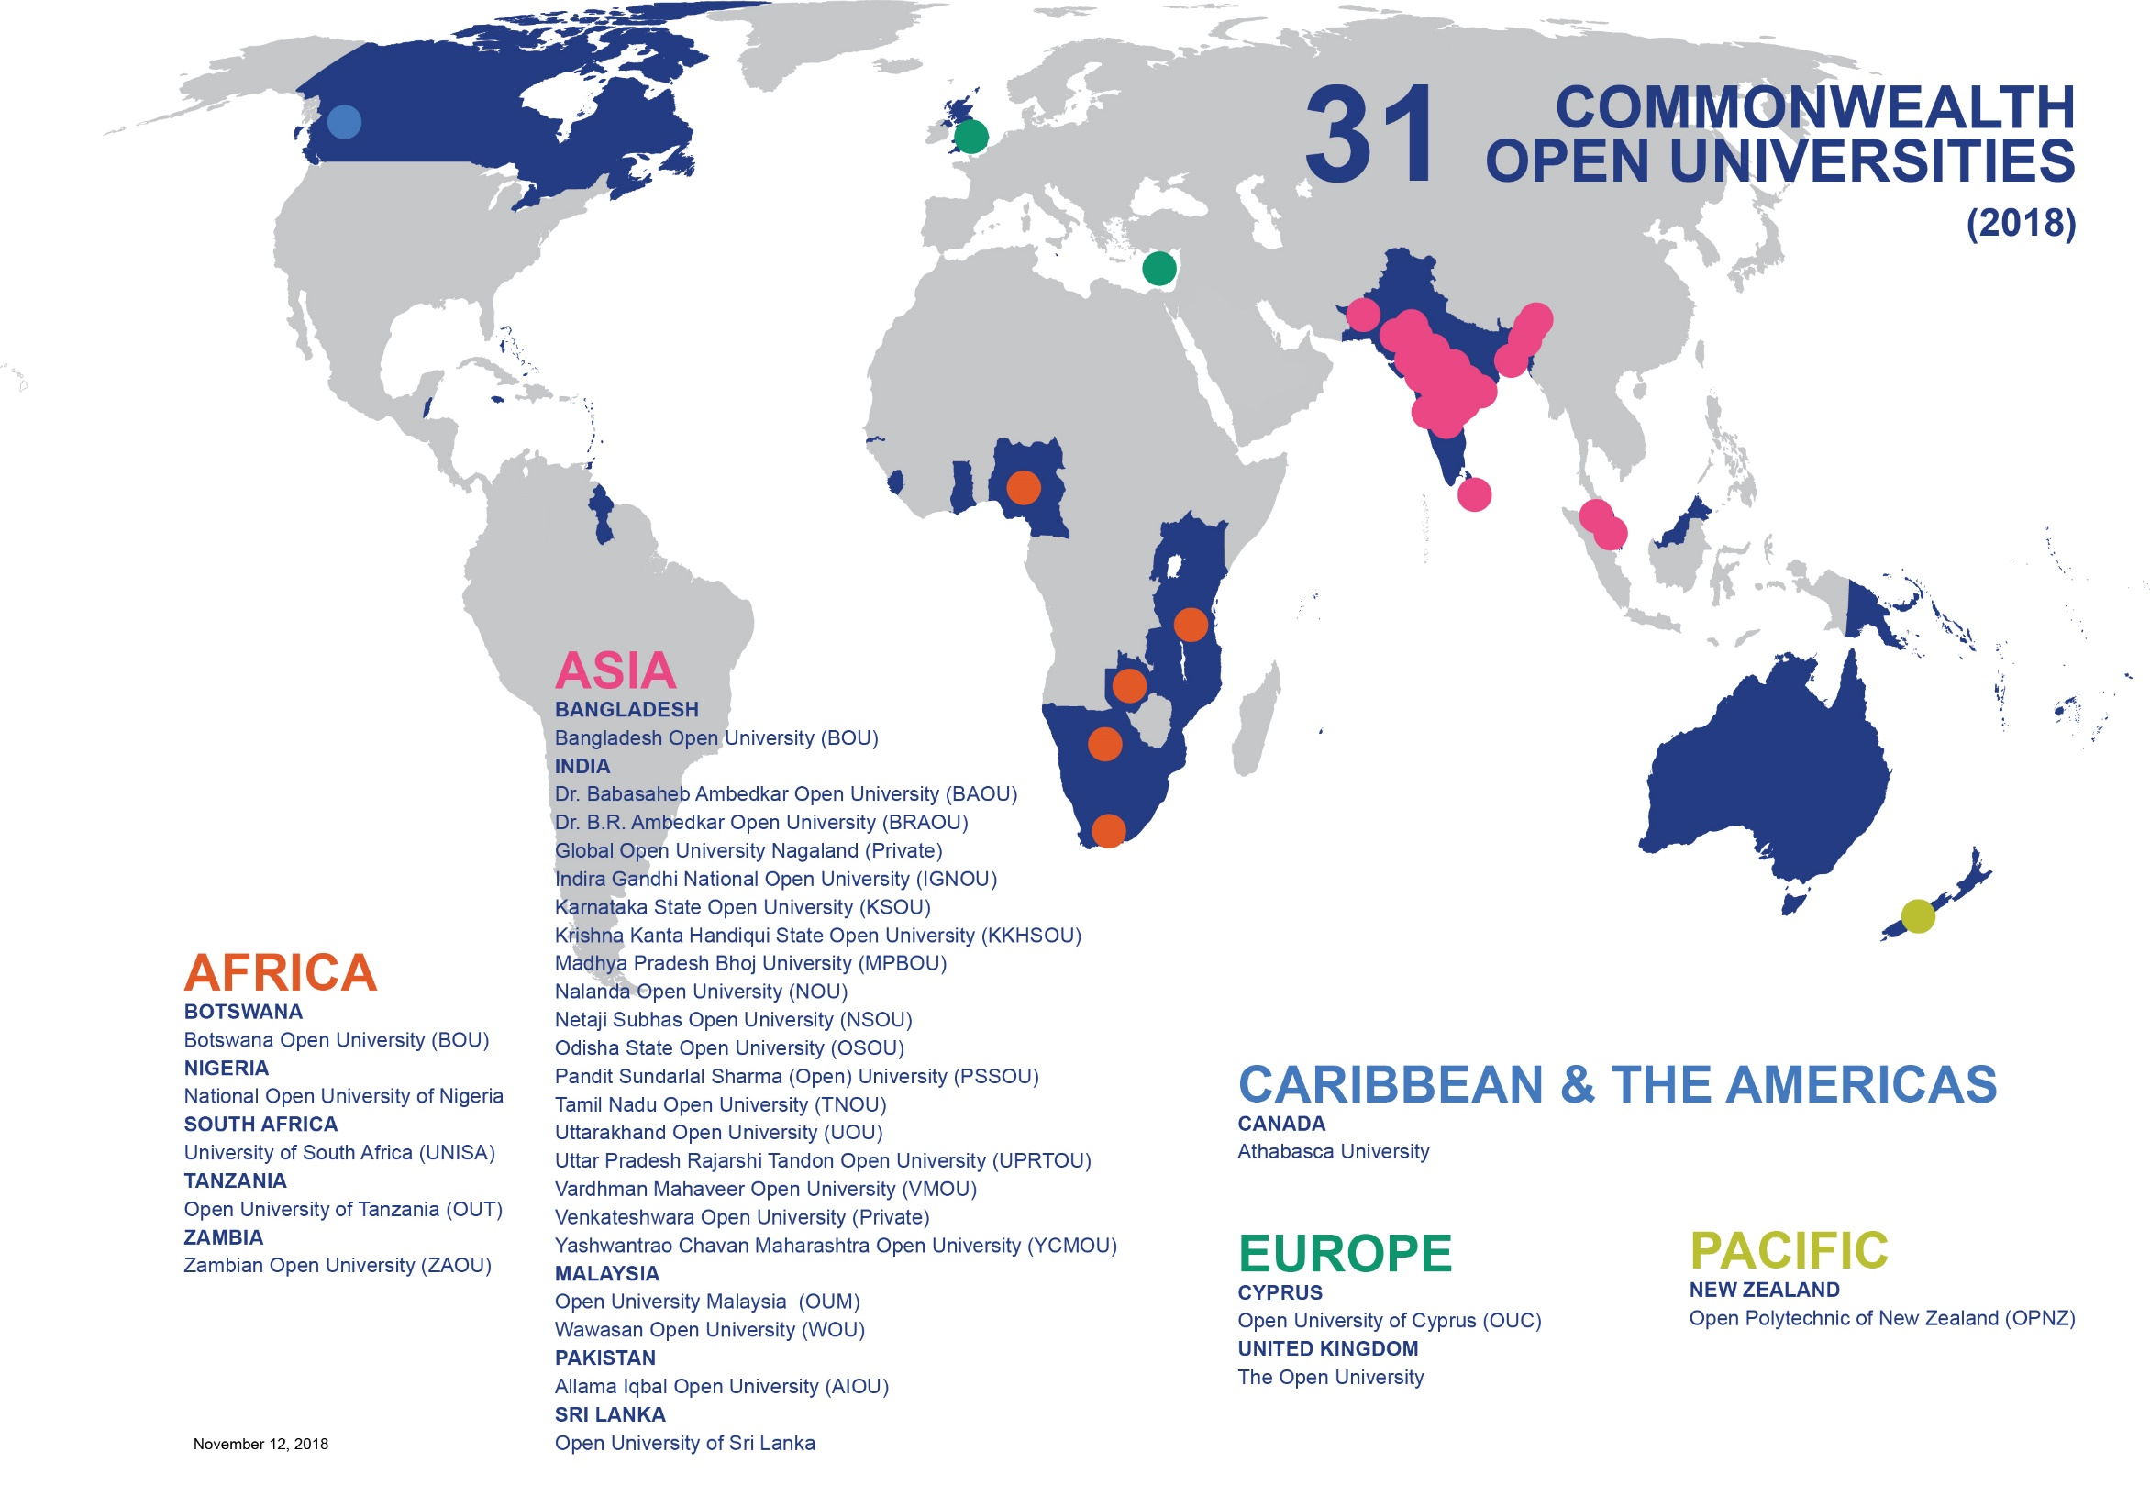


Slide 18
3
Open Educational Resources (OER) are the answer to closed and costly textbooks
PARADIGM
SHIFT

Slide 19




One Textbook per Child?
1 reading textbook for 12 students
1 math textbook for 14 students

Slide 20



Impact of OER Policy
170+ universities participate in the OER curation, development and sharing

Slide 21
4
The digital divide can be transformed into a digital dividend
PARADIGM
SHIFT

Slide 22

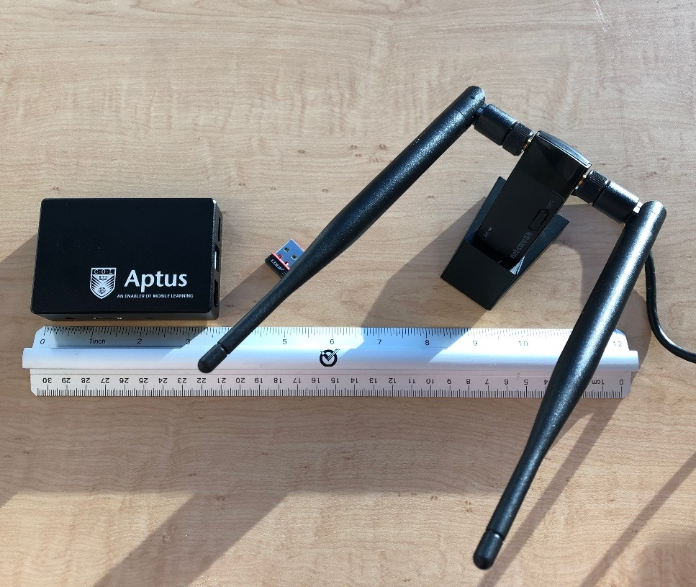
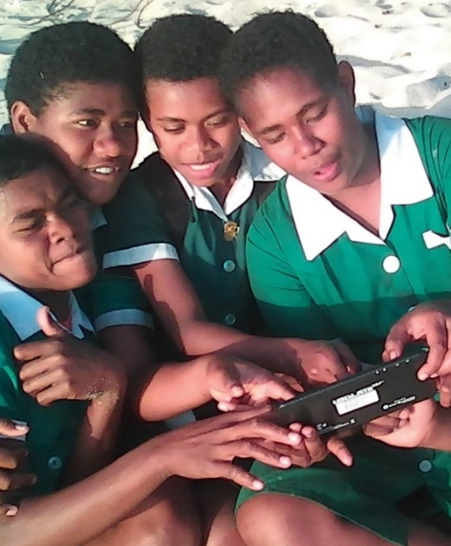

Slide 23



Understanding the Blue Economy
Blue Economy
Research Institute

Slide 24
5
Literacy is not always a precondition for Learning
PARADIGM
SHIFT

Slide 25

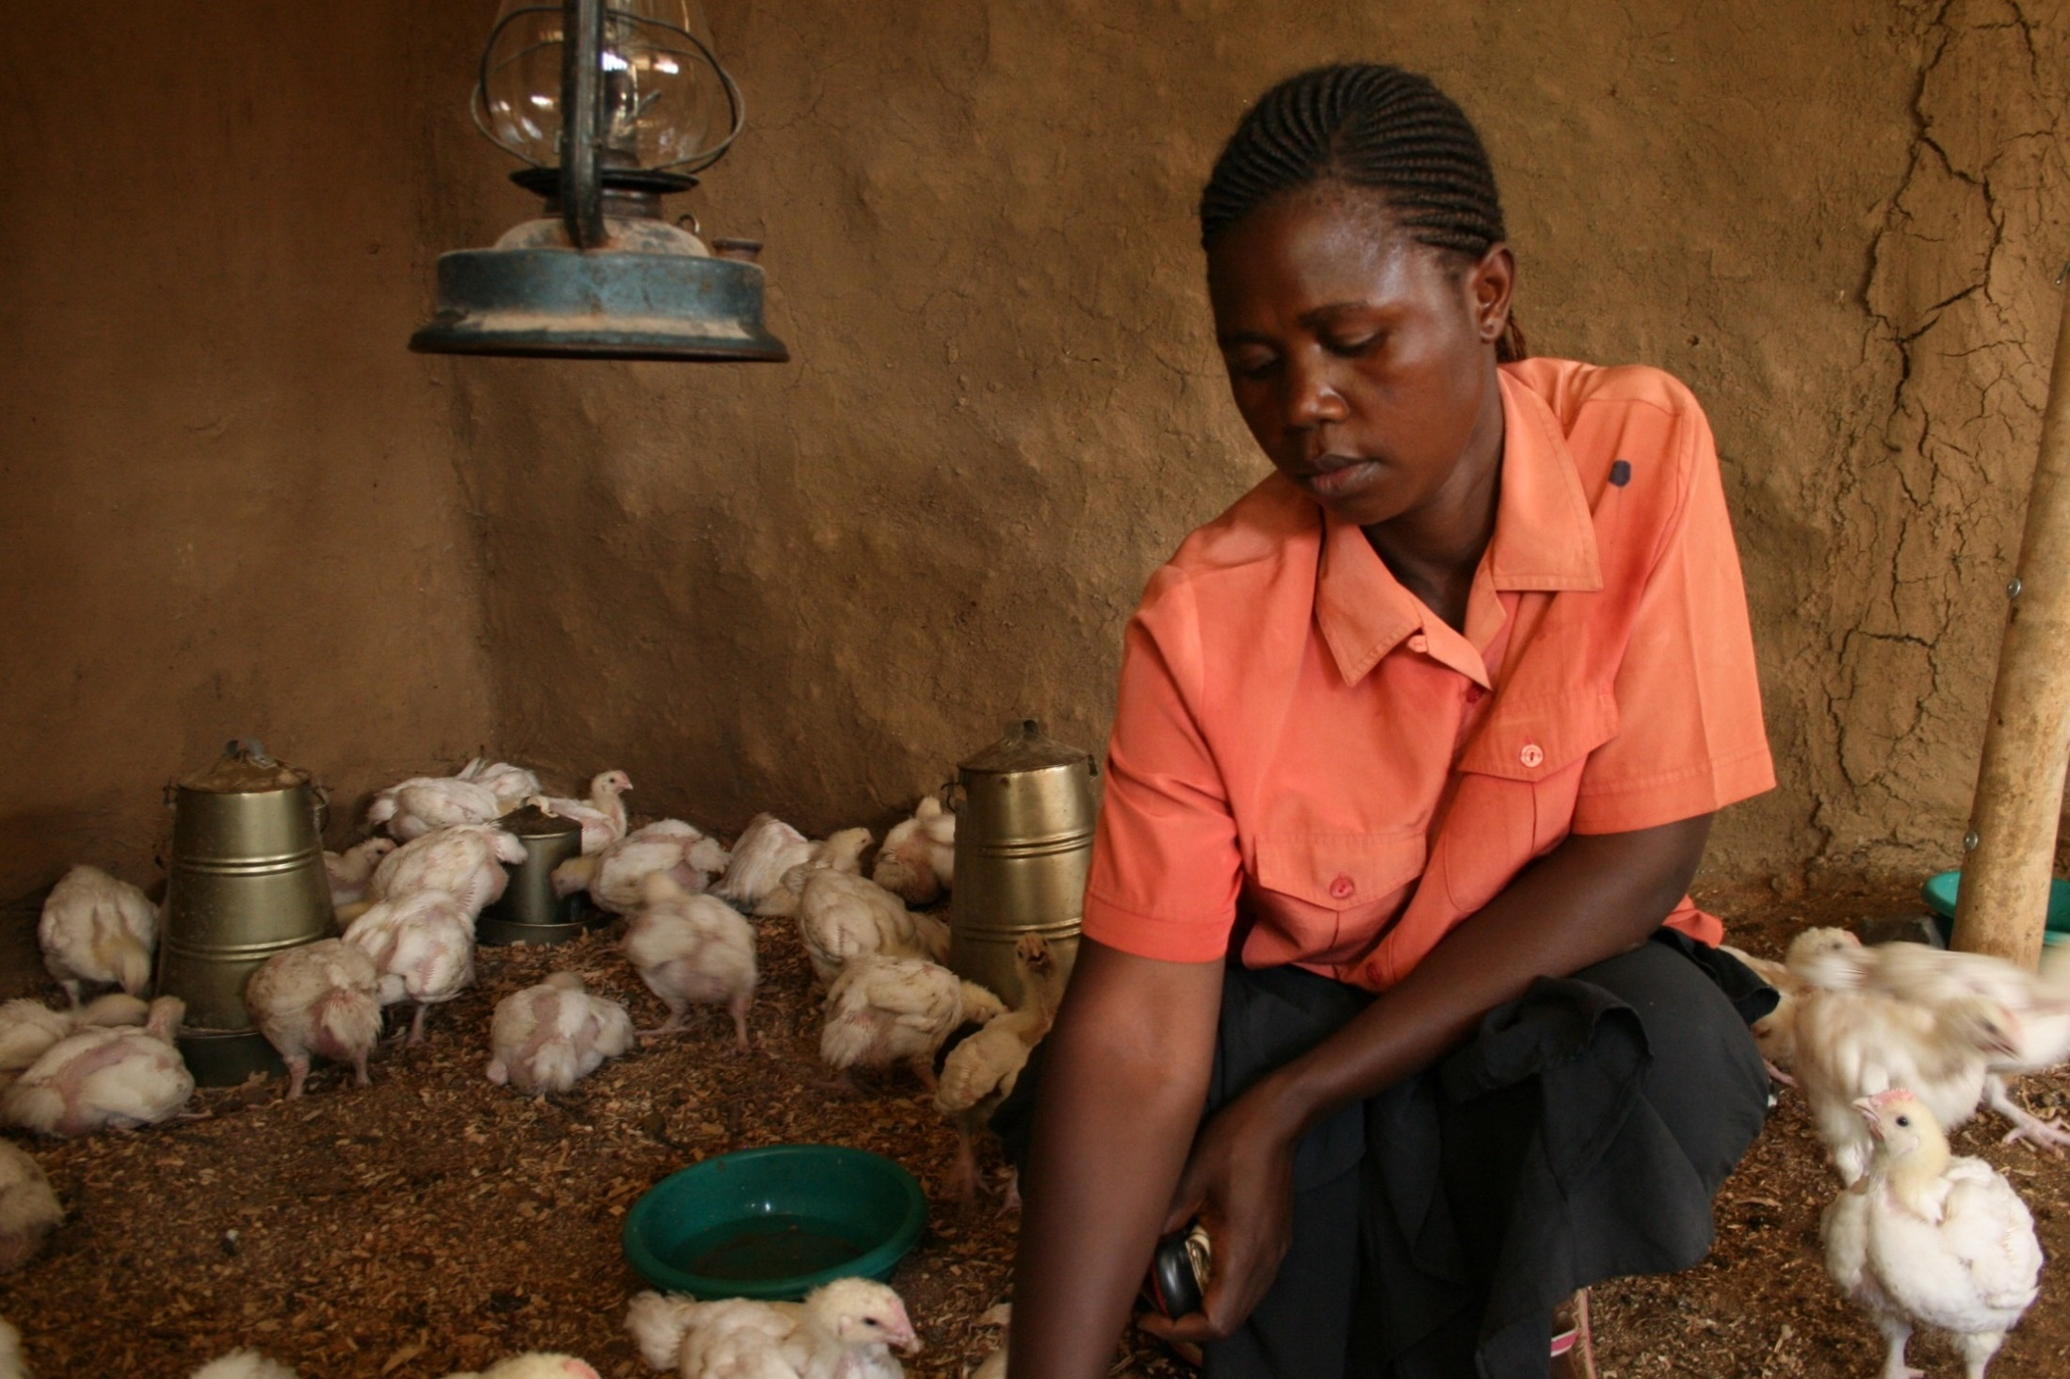
1% increase in empowerment 2.3% increase in profit.
Notes:
KENYA
This L3F project runs in 11 Commonwealth countries. Studies have found that learning leads to empowerment and that for 1% increase in women’s empowerment in Kenya, there was a 2.3% profit in agri-enterprises

Slide 26








Notes:
Thanks to grants from the governments of Australia and Canada, COL will train 45000 girls and women in five countries: Bangladesh, India Pakistan, Mozambique and Tanzania. You’ll be pleased to note that in the first eighteen months alone, over 29,000 girls have been trained in various skills and 5, 260 girls have found new sources of income generation.

Slide 27

Strategic Plan 2021-2027

Slide 28
Inputs to the planning process
Global trends
Inputs from the Board/partners/ stakeholders
Evaluation
Feedback from Focal Points

Slide 29
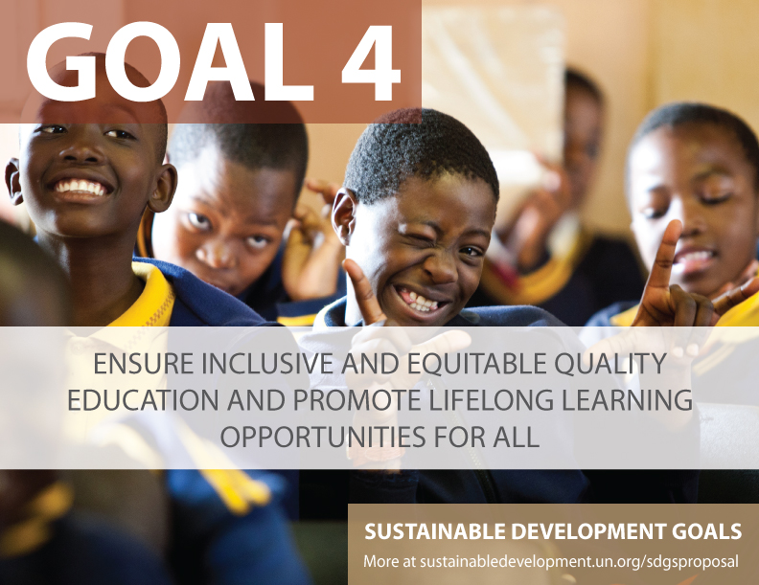

Slide 30

Over 90% of student population
>1.5 billion
Affected by school closure

Slide 31
SSA: Internet users and mobile subscriptions 2007 - 2017
Source: data.worldbank.org, retrieved on 16 April 2020

Slide 32



COVID 19—online learning
Connectivity and electricity
Access to platforms
Content
Capacity of teachers

Slide 33
Protests against eLearning
Zimbabwe: Student bodies say e-learning is unaffordable and elitist.
Everton Mutsauri, the president of the student command of the little-known Economic Freedom Fighters-Zimbabwe, has berated Great Zimbabwe University for using “Google class” and the Midlands State University for adopting WhatsApp to conduct lessons, describing the new methods as elitist.
South Africa: Calls for a national boycott of online learning.
The South African Students Congress (SASCO) has called for a national boycott of online learning, arguing that it is not equally available to all students.
Source: University World News – Student bodies say e-learning is unaffordable and elitist, published on 22 April 2020

Slide 34
‘New’ Normal
Increased learning crisis: more drop-outs
Wider digital divide
Unemployment

Slide 35

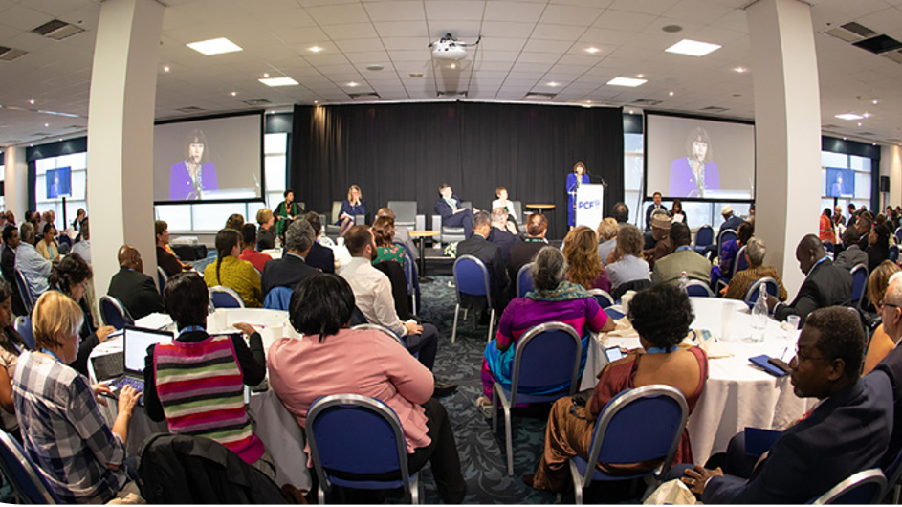
Stakeholder Survey

Slide 36
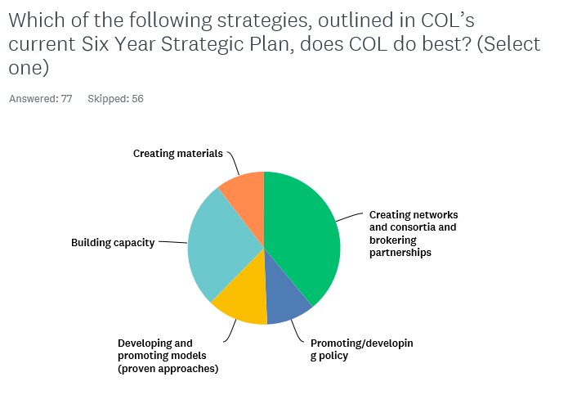
Highlights of Findings

Slide 37
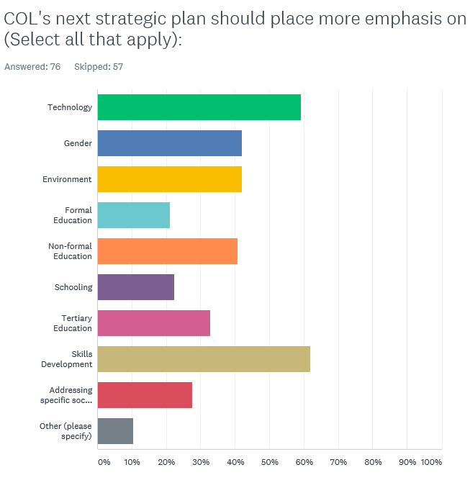
Highlights …

Slide 38
Focal Points: Caribbean, Jan 2020
Integrating ICTs in education
Building the capacity of teachers
Developing ODL and OER Policies
Addressing boys’ underperformance
Promoting sustainable agriculture
Skills development

Slide 39
Questions
How can COL help you respond to the COVID crisis?
What are the new development trends?
How can COL further your national agenda—give three priorities?

Slide 40

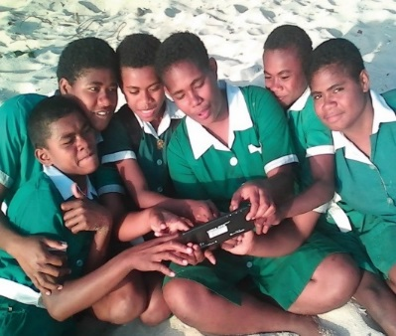
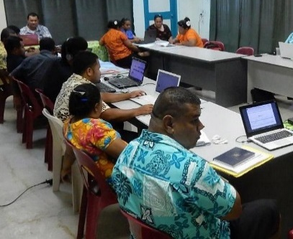
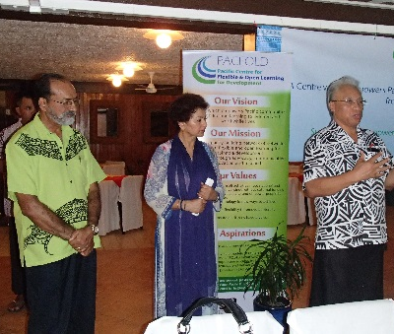
Thank You
for your contributions
col.org

