Slide 1
Pacific Partnership for Open, Flexible and Distance Learning:
Two Case Studies
Ms Terry Neal: ES Technical and Vocational Skills Development
Dr Tony Mays: ES Open Schooling
Dr Betty Ogange: ES Teacher Education
NZVET Research Forum
September 09, 2021
Notes:
This is the first of several presentations each of which summarises the key issues in different chapters of COL’s new publication Addressing the Needs of Out of School Children through Expansion of Open Schooling. This first presentation discusses Chapter 1 by Tony Mays.

Slide 2

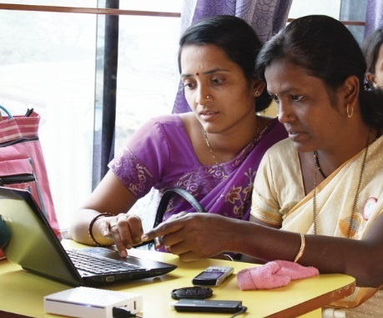
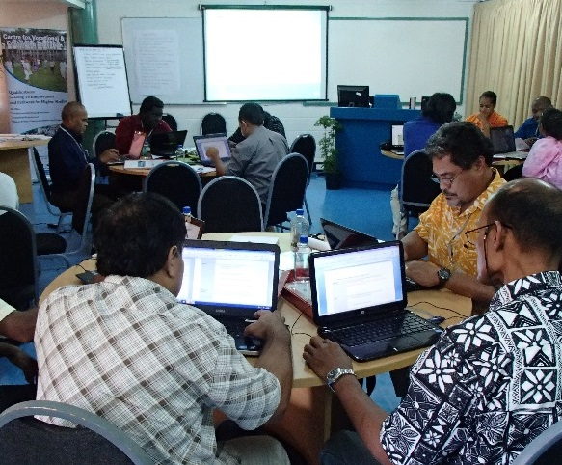
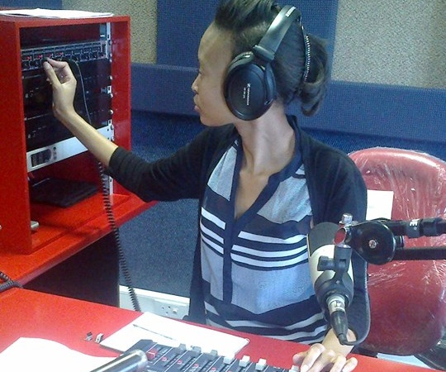
To help Commonwealth governments and institutions use distance and open learning for sustainable livelihoods

Slide 3
WORKSTREAMS & PROJECTS
1: Immediate response to COVID-19
1.1. Access to OER to support distance learning
1.2 Professional development for teachers in distance learning
2: Supporting Youth Employment
2.1 Professional development of TVET providers/educators
2.2 Skills and leadership training for youth, women and PwD
3: Building Resilience in Pacific Education Systems
Midterm and Final Evaluations
Action Research
Policy briefs based on research
Crosscutting: Research and M&E
3.2 Building teachers’ and officials’ capacity in ODFL
3.1 Building technical resilience with cloud-based computing
3.3 Supporting the development and management of regional tools (eLearning for Science repository)

Slide 4
TVET Professional Development Toolkit:
COL’s experience and approach in participatory design
Ms Terry Neal: ES Technical and Vocational Skills Development
NZVET Research Forum
September 09, 2021
Notes:
This is the first of several presentations each of which summarises the key issues in different chapters of COL’s new publication Addressing the Needs of Out of School Children through Expansion of Open Schooling. This first presentation discusses Chapter 1 by Tony Mays.

Slide 5
TVET Professional Development
Engage with stakeholders
Develop online toolkit
Projects to apply toolkit

Slide 6
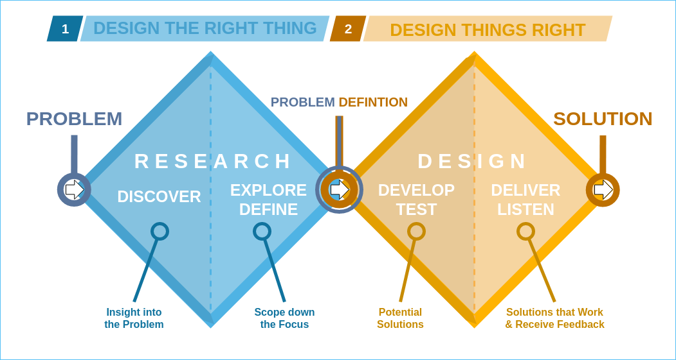
Double diamond process
Image from: https://commons.wikimedia.org/wiki/File:Double_diamond.png

Slide 7
In practice
Desktop research
TVET agencies
TVET post secondary
Industry
TVET schools
NGOs and churches
Communities
Draft details of what Toolkit will include
Survey to understand priorities
Stakeholder Group
Guiding principles
Feedback on prototypes
Link to Pacific stories
Review content

Slide 8
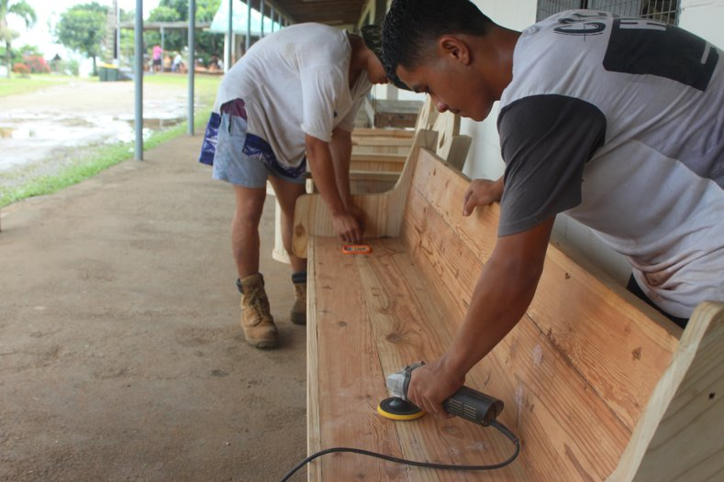
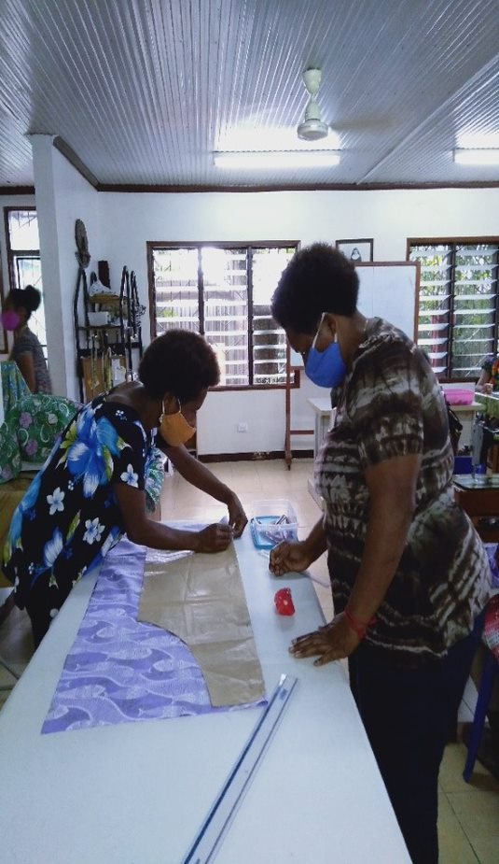
Research - Discover
Three priority audiences
TVET teachers and trainers​
TVET institution managers​
Employers who train and employ TVET learners
Six key problem statements
Lack of financial resources ​
Lack of TVET teaching resources ​
Challenges implementing competency-based learning and assessment ​
Lack of professional development opportunities for TVET trainers and teachers​
Lack of clear pathways into and through TVET ​
Stereotypes related to TVET​

Slide 9
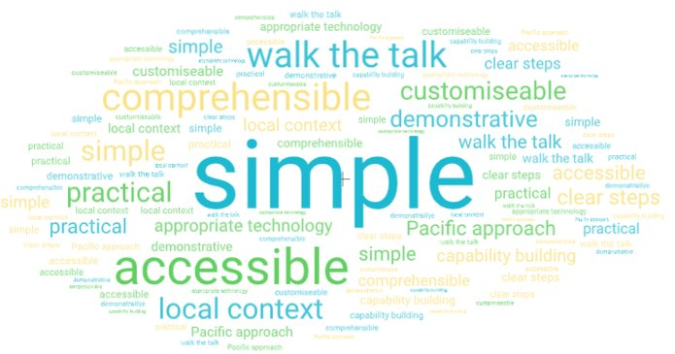
Research – Explore and Define
Guiding principles
Notes:
simple, intuitive, and easy to use​
accessible and reflect the technologies of the Pacific​
practical by nature with clear advice and step-by-step processes​
familiar to users by using real images, examples, and stories from all countries​
open and allow user customisation​
helpful in the ‘now’ but also build capability for the future ​
In English and will use an appropriate level of language​
visual where appropriate​
representative of Pacific values

Slide 10
Research – Define Priorities
 | TVET teachers and trainers | TVET institution managers | Employers of TVET learners
Higher | Competency based learning and assessment Working with limited resources Industry connection Teaching practical skills | Better professional development for staff Stronger links to industry and workplace learning Promote benefits of TVET to parents and community | Stronger links to TVET institutions Effective workplace learning Support learners to find work after training Promote benefits of TVET to parents and community
Lower | Teaching industry relevant skills Teaching online | Address gender stereotypes in TVET | Address gender stereotypes in TVET

Slide 11
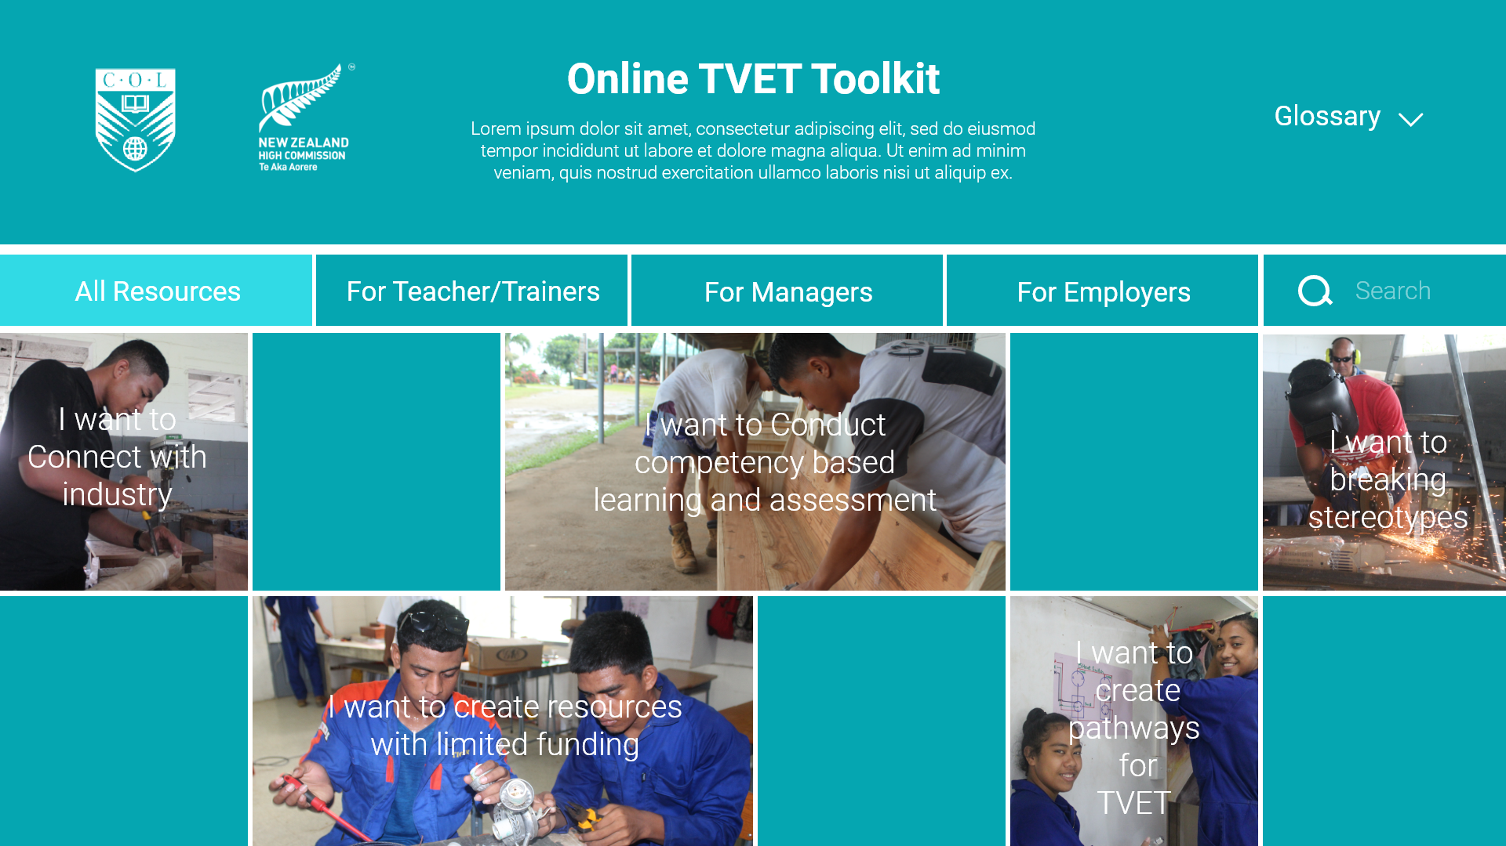
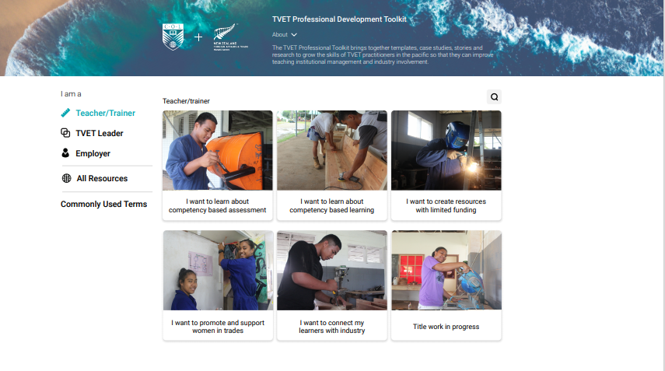
Design – Develop and Test

Slide 12
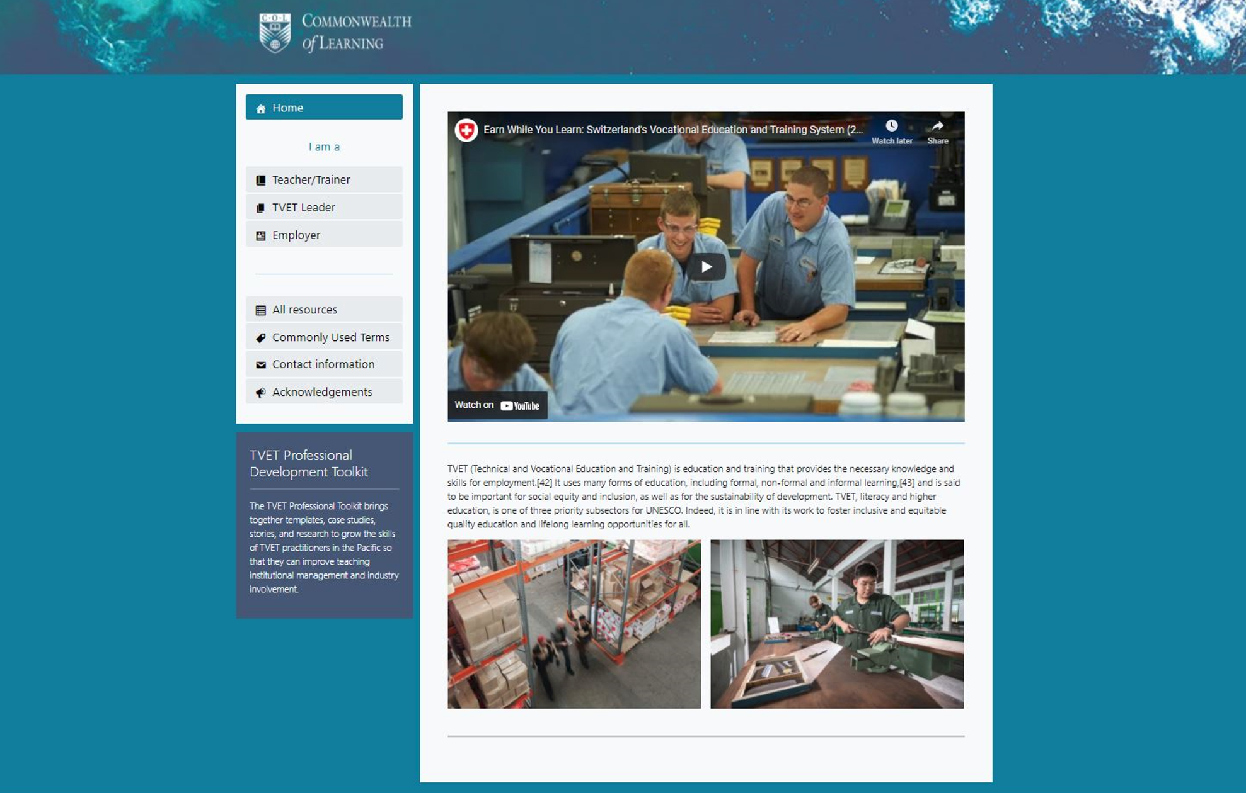
Design – Develop and Test
Develop using guiding principles
Finding local videos and stories has had its challenges
Stakeholder group feedback
Support TVET practitioners to use through projects
Improve iteratively

Slide 13
Skilling Teachers in the Pacific to Teach Online:
COL’s experience and approach in scalable training
Dr Tony Mays: ES Open Schooling
Dr Betty Ogange: ES Teacher Education
NZVET Research Forum
September 09, 2021
Notes:
This is the first of several presentations each of which summarises the key issues in different chapters of COL’s new publication Addressing the Needs of Out of School Children through Expansion of Open Schooling. This first presentation discusses Chapter 1 by Tony Mays.

Slide 14
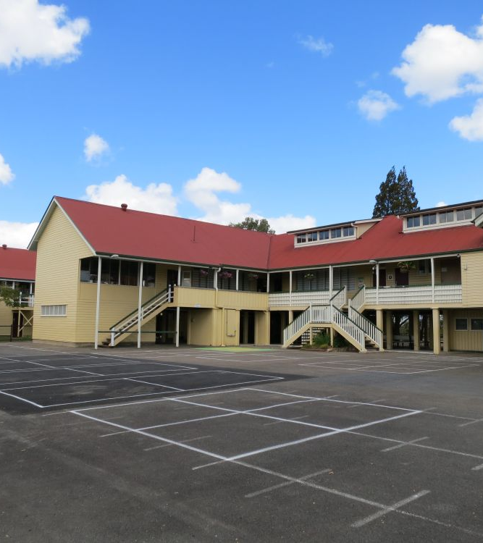
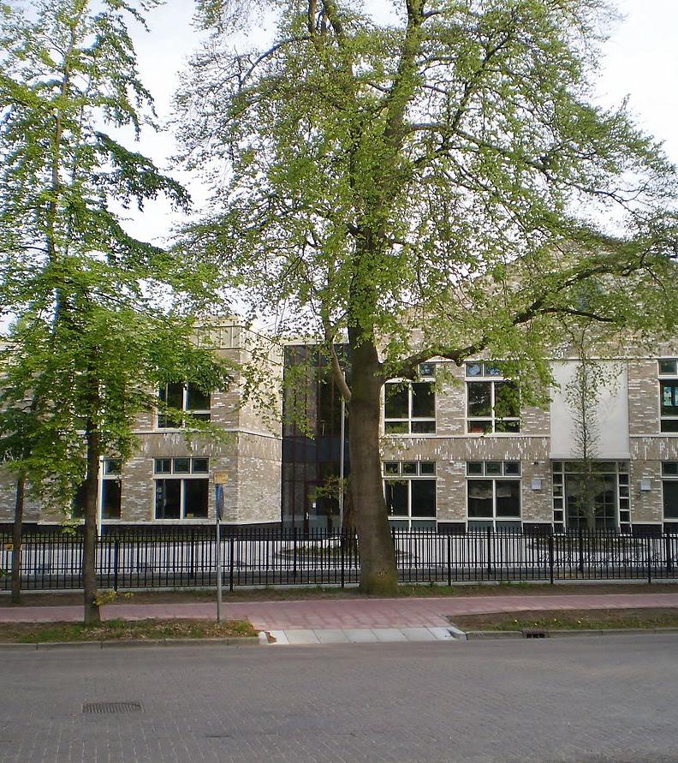
Using Open Educational Resources for Online Learning: An Introduction
Commonwealth of Learning
Toowong State School CC-BY 4.0
Nieuwe_Baarnsche_School by Atsje CC-BY-SA 4.0
Notes:
COVID-19 closed schools
Ministry of Education in Fiji requested support to begin to move teaching online
Followed by Ministry of Education in Trinidad and Tobago
Three iterations: over 11,500 participants; of which about 1,000 from the Pacific

Slide 15
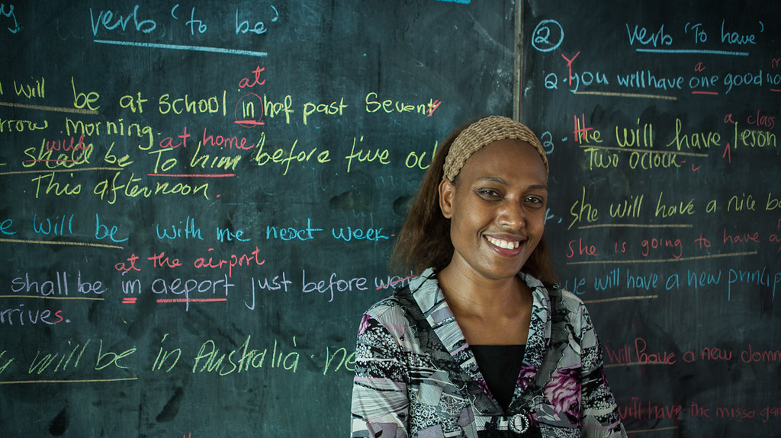

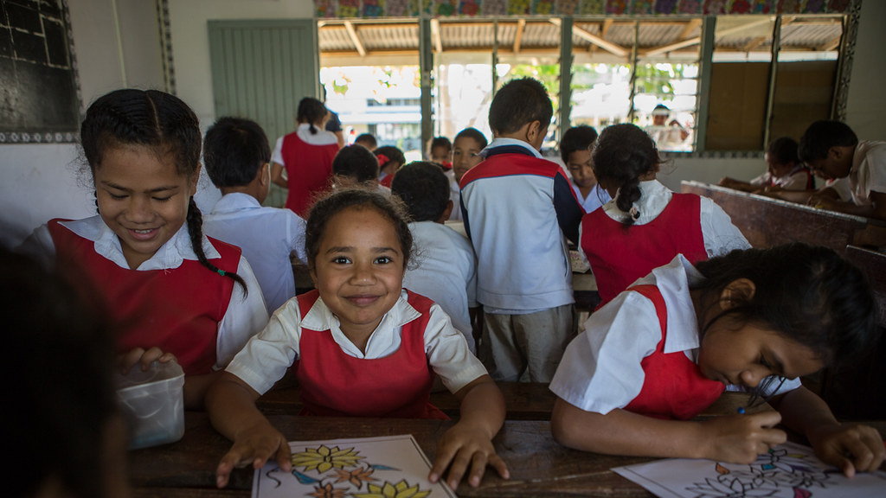

What did the short course explore?
Annette: Vanuatu Teacher by Connor Ashleigh for AusAID CC-BY 2.0
OER Global Logo by Jonathas Mello is licensed under CC-BY 3.0
Students from Fasi Moi Afi Government primary school by Connor Ashleigh is licensed under CC BY
Film camera by Andrew McLaren is licensed under CC BY 4.0
Notes:
OER for Online Learning: An introduction
Planning for remote learning using prescribed resources
Finding, adapting and integrating OER
Communicating and supporting using digital tools
Assessing and providing feedback using digital tools

Slide 16
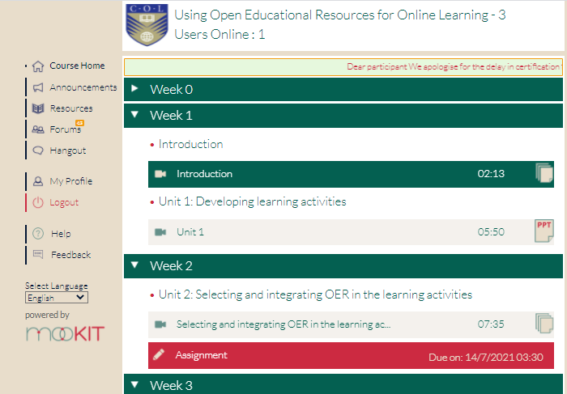
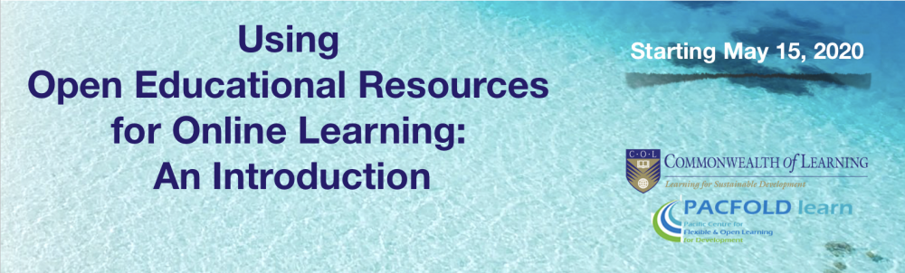
Why use a MOOC?
Notes:
Need for scale (Moon, 2010)
Need for speed (Kanwar & Balaji, 2014)
Cost-effective (Hollands and Tirthali, 2014)
Variety of evolving models (Bonk, et al, 2015; Zhang, et al, 2019) but activity-based/socio-constructivist
Suitable for professional development (Kilgore, et al, 2015)
Success when MOOC combined with other support (Kharbanda, 2018; Rajabalee, Dundas & Singh, 2020) e.g. regional mentors

Slide 17

Underpinning approach: learning through professional sharing
A new approach to professional development is needed – one which conceives of development as “learning”. Framing professional development as learning privileges the idea of teachers as members of a profession worthily engaged in continuous development of skills and knowledge throughout their professional career. This frames development as within the agency of teachers who not only identify what they need, but also what is appropriate to their own learning (Sayed and Bulgrin, 2020, p. v).

Slide 18
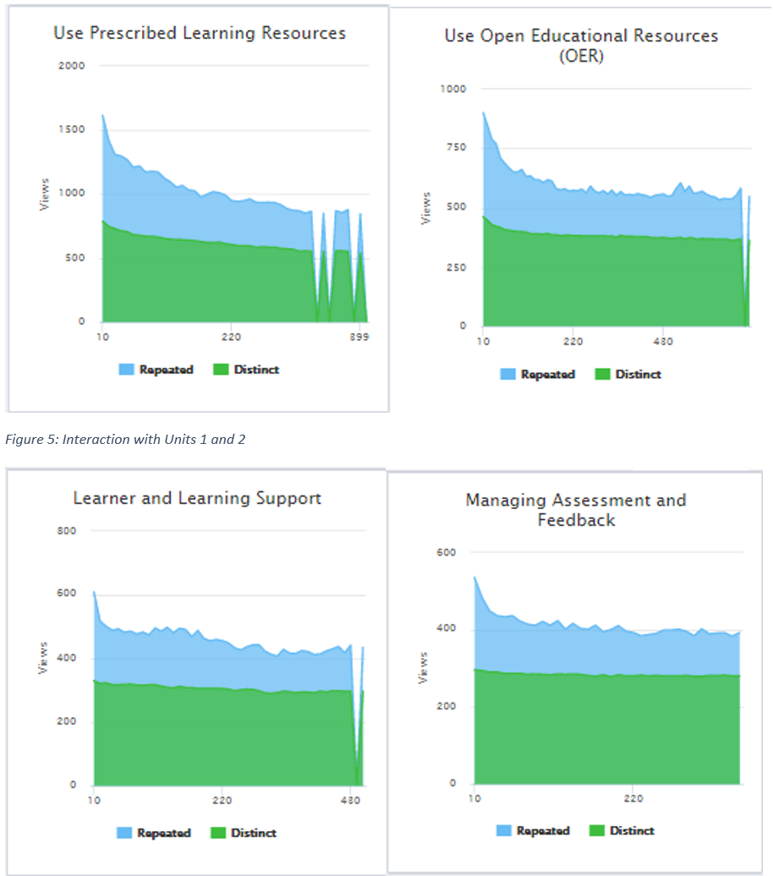
What was involved?
Notes:
Watching a short introductory overview of the content
Downloading a slideshow with key activities and embedded links to useful resources
Sharing lessons of experience in one or more discussion forums
Sharing a summary of key lessons and sharing of an additional consolidating resource, such as a reworked OER, an example lesson plan, or a set of guidelines for remote/online teaching.
Mentor support

Slide 19
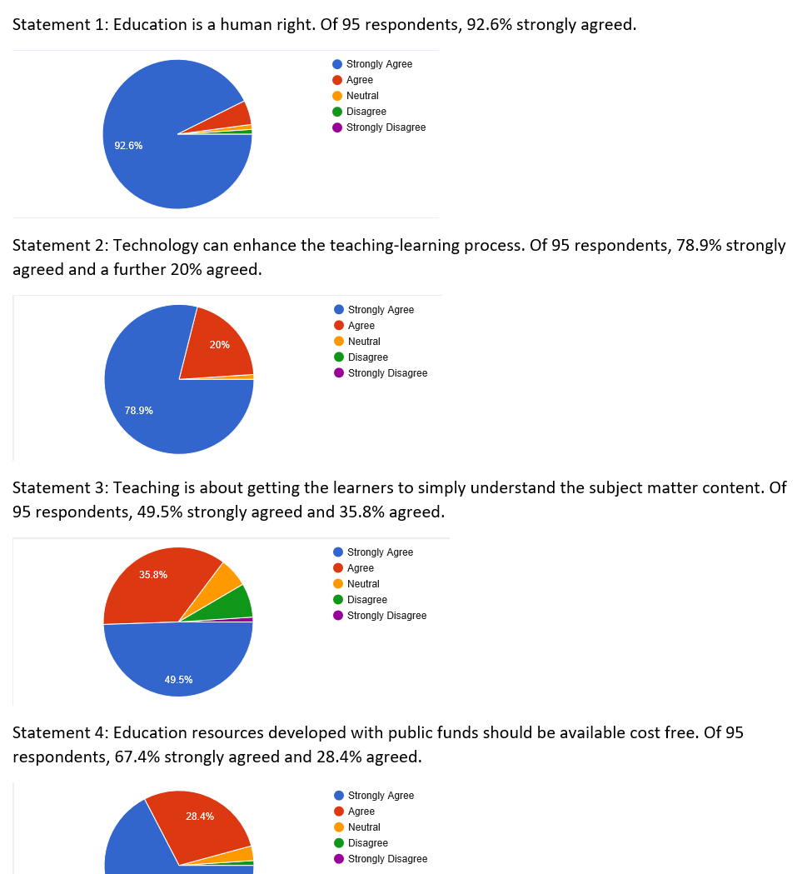
How did we evaluate impact?
Pragmatic: action and change (Goldkuhl, 2012)
In platform data analytics
Surveys: pre-, mid-, end-
Teachers’ guided reflections
Forum postings
Review of artefacts created and shared
Unsolicited emails

Slide 20
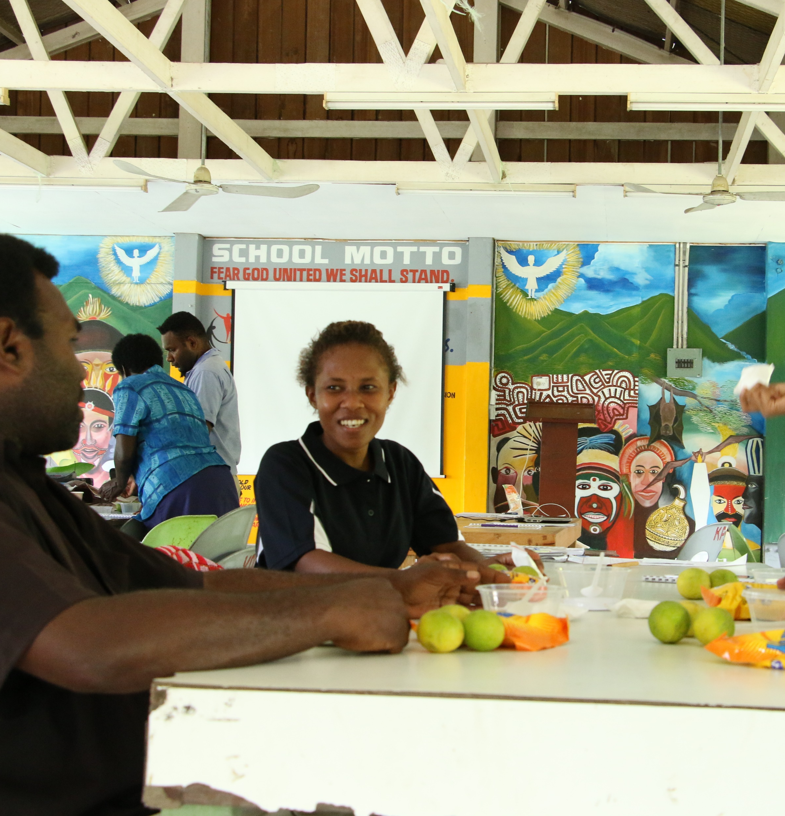
What did we find?
The best decision that l took in 2020 was to take this course. It has been so fulfilling and enjoyable. I have started to use all the skills learnt in preparing my worksheets and using OER wisely, ensuring that it is not copied but open for use.
~ Mrs. Nazmeen Raju, Teacher Educator, Sabeto College, FIJI
OER is something that I hadn’t heard of before the course and the resources we used were mostly plagiarized. However, being exposed to OER for online learning course, has taught me how to find relevant resources that can be reused, remixed etc without infringing copyright law.
~ Manasa Naeqe, Science Teacher, FIJI
I am now more knowledgeable in searching for OER and its correct use for my courses, especially for supplementary items in my assessment books and exam writing like graphs, maps, images, drawings, articles, among other things.
~ Geraldine Cabañero, Teacher, PAPUA NEW GUINEA
University of Canberra. Centre for Sustainable Communities by Unknown Author is licensed under CC BY-SA-NC
Notes:
Of course there were also some less positive feedback which we were able to use for review and improvement …

Slide 21
Key message
Content
Assessment
Support
There are many factors which impact on teaching remotely/ online at a distance.
At the core is ensuring:
Teachers and learners have access to appropriate content (units 1 and 2)
Learners have a variety of ways to access learning support (Unit 3)
Assessment is designed to encourage learning and the feedback provided is both quick and constructive (Unit 4)
Notes:
Having followed this course, we have highlighted that effective online learning requires teachers to be able to manage assessment in ways that support and promote learning. In designing such learning, decision-making about assessment should be guided by the content, learning support and assessment options.
The assessment feedback should be both quick and constructive.
If you have found this introductory short course interesting, then follow the link provided to explore more.
More reference material will be provided in the Resources section of the course
Thank you and all the best!

Slide 22
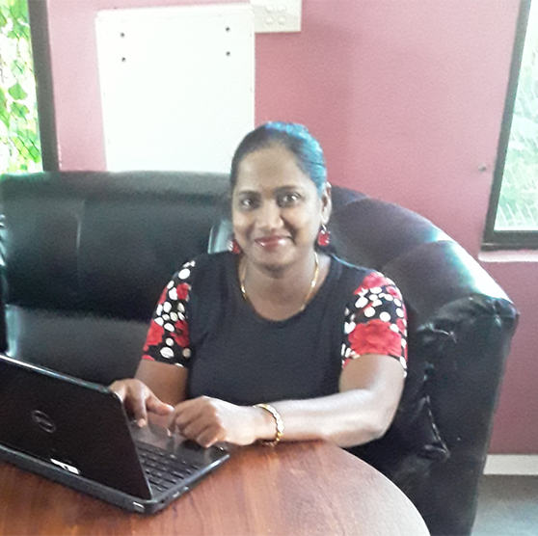
How did we respond to feedback from participants?
Formal review by OERF
Regional mentors
Updated version flighted June/July 2021;
But retained focus on collaboration and sharing; in many ways the content of the course is constructed by the learners themselves
Mrs Nazmeen Raju - Fiji - Completed OER4OL short course

Slide 23
Initial response to new version …
Fiji: I am glad I joined this course. I was just browsing through our education website here in Fiji FEMIS and I came across this course which was suggested by them. Out of curiosity and trying to adapt from a classroom based teacher to an online teacher which I think will be the new norm now, I wanted to upgrade my internet skills and finding resources online. Today IO learnt about the CCs copyright and I've never been taught that at University 18 years ago when I achieved my degree and 5 years ago for post grad. We have just been taught to always acknowledge in the bibliography section but did not go into further details on copyright.

Slide 24
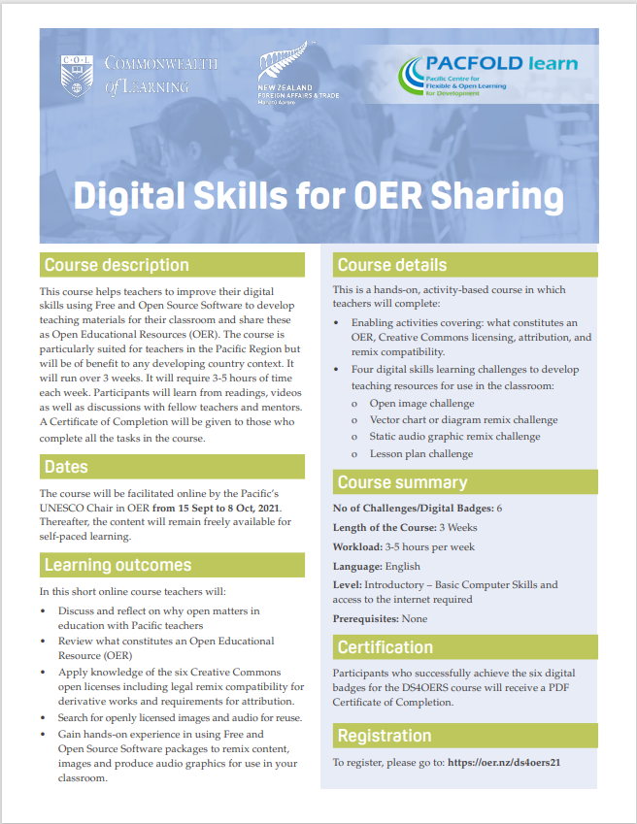
Future plans
6-month follow up on impact on practice
New course Digital Skills for OER Sharing: OER Foundation
The course will be facilitated online by the Pacific’s UNESCO Chair in OER from 15 Sept to 8 Oct, 2021. Thereafter, the content will remain freely available for self-paced learning
In development: Communication Skills for ODFL
Planned: Assessment skills for ODFL

Slide 25
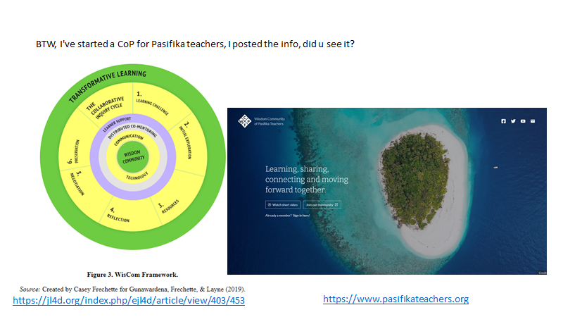

Slide 26
References
Bonk, C. J., Lee, M. M., Reeves, C. T., & Reynolds, T. H. (Eds.). (2015). MOOCs and Open Education around the world. Routledge.
Gunawardena, C.N. (2020). Culturally Inclusive Online Learning for Capacity Development Projects in International Contexts. Journal of Learning for Development, 7(1), 5-30.
Hollands, F. M., & Tirthali, D. (2014). MOOCs: expectations and reality. Full report. Center for Benefit-Cost Studies of Education,Teachers College, Columbia University, NY. http://cbcse.org/wordpress/wp-content/uploads/2014/05/MOOCs_Expectations_and_Reality.pdf
Kanwar, A., & Balaji, V. (2014). To MOOC or not to MOOC: That is the Question. Lecture given at Wawasan Open University, Malaysia, 17 September 2014. http://oasis.col.org/handle/11599/754
Kharbanda, A. (2018). NIOS to Train All Untrained Teachers by 2019. COMOSA-connect, Blog, 1st March 2018. https://comosaconnect.org/nios-to-train-all-untrained-teachers-by-2019/
Kilgore, W., Bartoletti, R., & Freih, M. A. (2015). Design Intent and Iteration: The #HumanMOOC. Experience Track: Proceedings of the European MOOC Stakeholders Summit 2015, 7-12. https://www.academia.edu/12440762/Design_intent_and_iteration_The_HumanMOOC?email_work_card=view-paper
Moon, B. (2010). Time for radical change in teacher education guidelines: Using Open and Distance Learning. Connections February, Vol. 15, No. 1. Commonwealth of Learning.
Rajabalee, Y. B., Dundas, D., & Singh, C. Kr. (2020). Chapter 4: TEL and Open Schooling in T. Mays & R. K. Singh (Eds). Addressing the Learning Needs of Out of School Children and Youth through Expansion of Open Schooling. Commonwealth of Learning (COL).
Sayed, Y., & Bulgrin, E. (2020). Teacher professional development and curriculum: Enhancing teacher professionalism in Africa. Education International. https://issuu.com/educationinternational/docs/2020_ei-osf_research_enhancingteachingprofessionaf
Zhang, K., Bonk, C. J., Reeves, T. C., & Reynolds, T. H. (2019). MOOCs and open education in the Global South: Challenges, Successes, and opportunities. Routledge.

Slide 27


Thank You
The contents of this presentation, except logos/ graphics which are property of the respective owners,
is made available under Attribution-ShareAlike 4.0 International (CC BY-SA 4.0).

