Slide 1

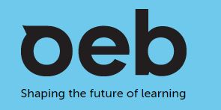
Brave New World
That Has Such Education Futures!
December 1, 2020
Professor Asha Kanwar
President & CEO, Commonwealth of Learning

Slide 2
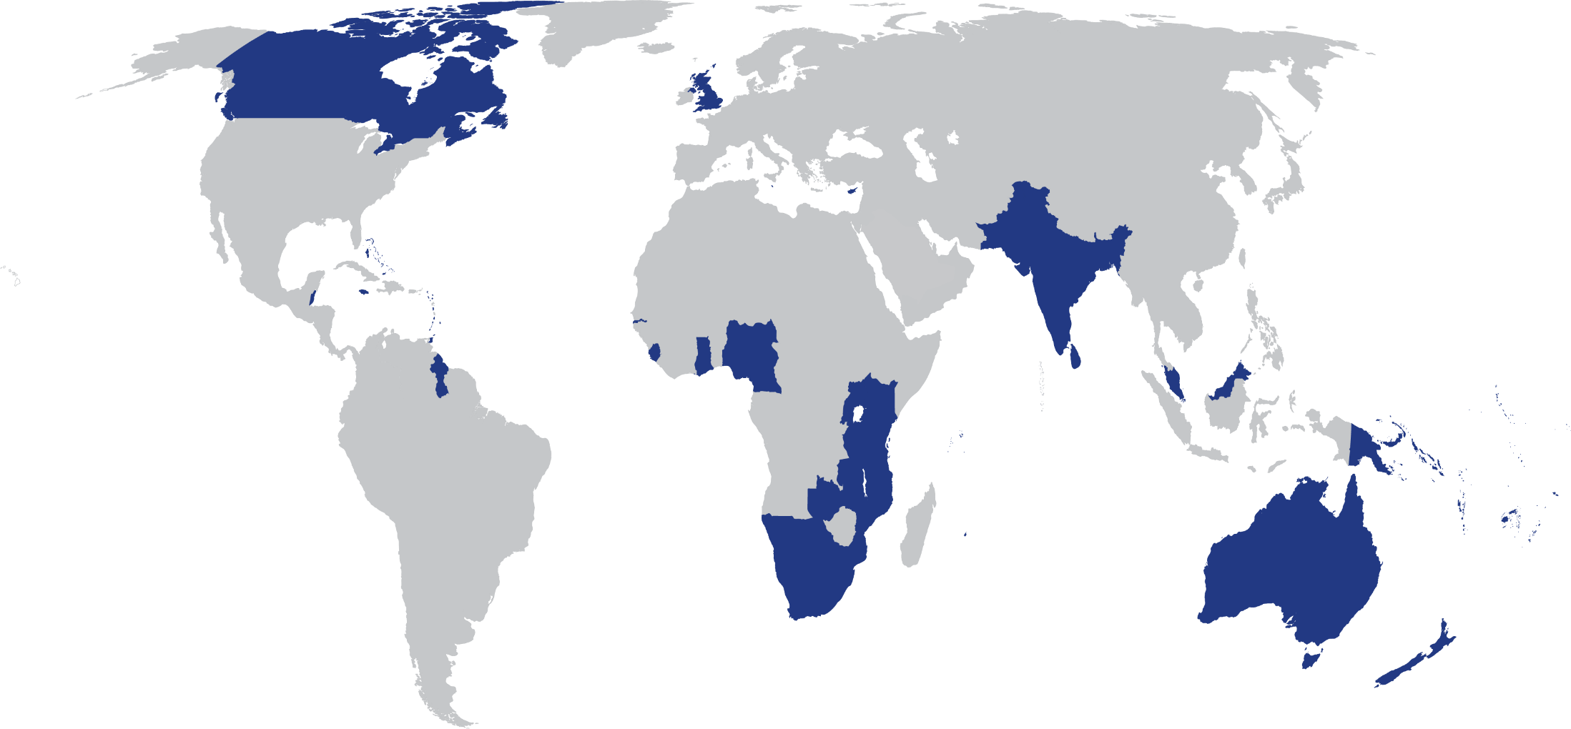
The Commonwealth
54 developed and developing nations around the world

Slide 3

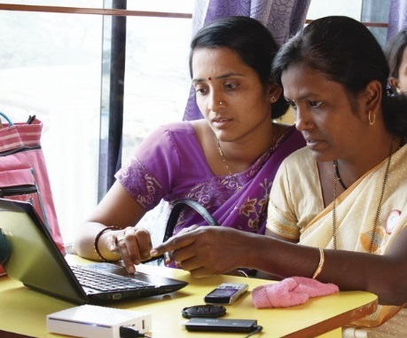
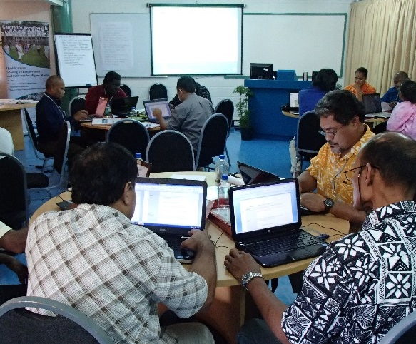
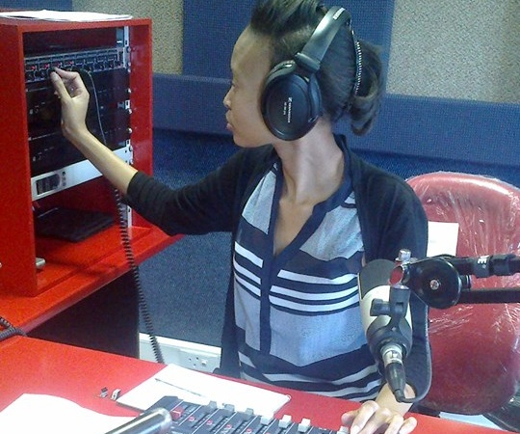
To help Commonwealth governments and institutions use technologies to improve and expand access to education and training

Slide 4
Plan
Issues during COVID-19
COL response
Futures of Learning
The Future we want

Slide 5
Issues during COVID-19

Slide 6

COVID-19 and Education
Technology (Connectivity, costs and electricity)
Teacher Capacities
Inequalities

Slide 7
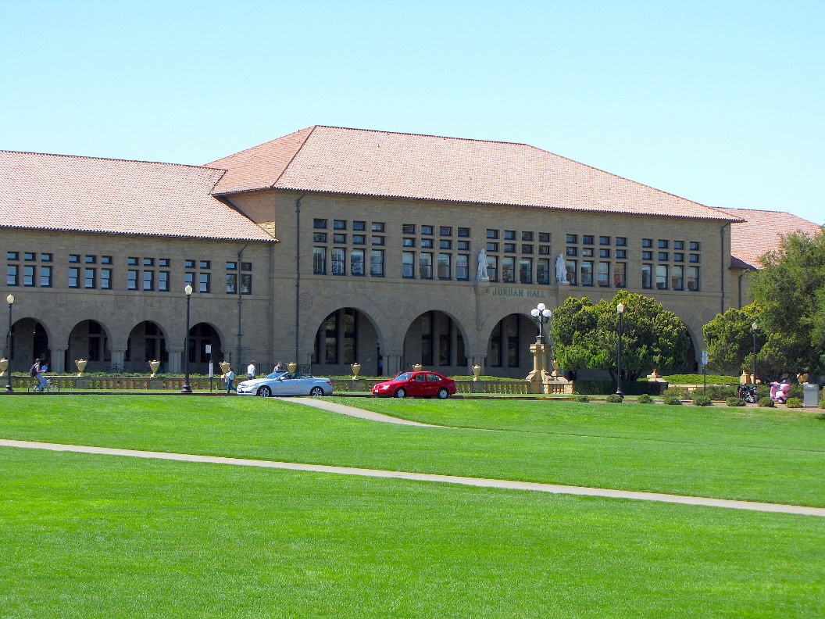
1 Technology issues: Stanford University
16% undergraduates did not have access to internet for half the time
60% of low-income students did not have a private place to study
Source: https://www.tonybates.ca/2020/08/30/lessons-from-stanford-universitys-move-to-remote-learning/

Slide 8

University of Hyderabad
40% students indicated “unreliable connectivity
30% worried about cost of data
18% can’t access online classes at all.
Source: https://www.newindianexpress.com/cities/hyderabad/2020/apr/20/covid-19-lockdown-digital-divide-among-students-forces-university-of-hyderabad-to-drop-e-classes-2132571.html

Slide 9
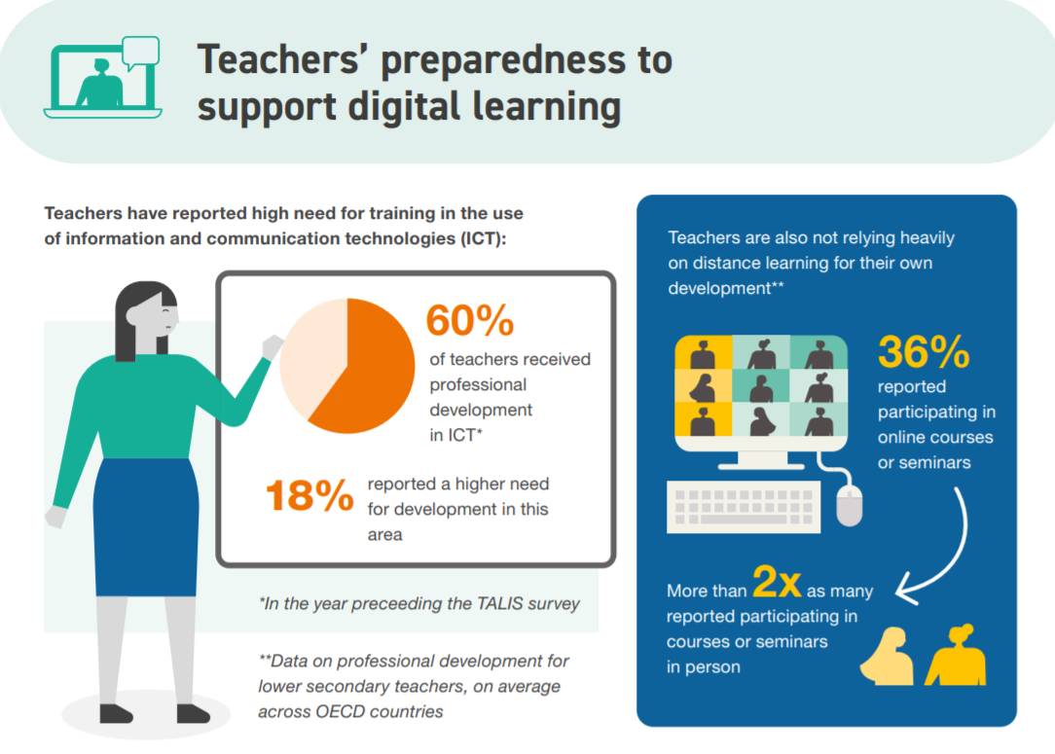
2. Teacher Capacities
ICT for teaching and learning
Assessment of learning outcomes
Access to technology
Source: https://www.oecd.org/education/the-impact-of-covid-19-on-education-insights-education-at-a-glance-2020.pdf

Slide 10
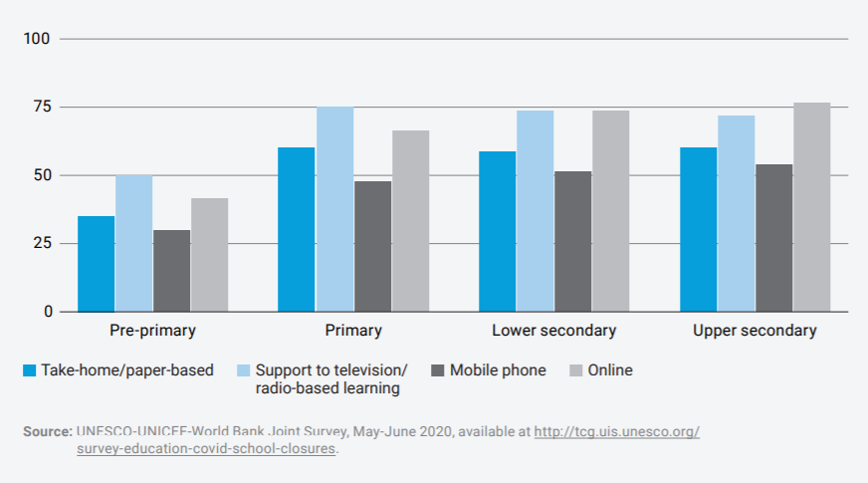
Teachers engaged in alternative teaching

Slide 11
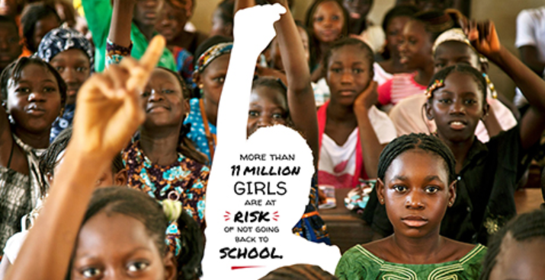
3. Inequalities
Source: https://en.unesco.org/covid19/educationresponse/girlseducation

Slide 12
Youth unemployment
Source: data.worldbank.org, retrieved on 11 June 2020
Notes:
Youth unemployment rates in the Commonwealth countries from 2007 – 2019. It is compiled with latest data from World Bank open data (https://data.worldbank.org/indicator/SL.UEM.1524.ZS) and using arithmetic mean method.
“Global labour income is estimated to have declined by 10.7 per cent, or US$ 3.5 trillion, in the first three quarters of 2020, compared with the same period in 2019.” https://www.ilo.org/global/about-the-ilo/newsroom/news/WCMS_755875/lang--en/index.htm

Slide 13
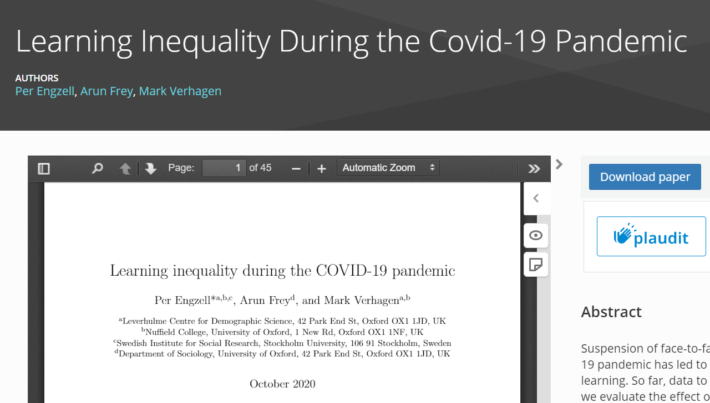
Learning Inequality during COVID-19
Learning loss of about 3%
Learners from less educated home 55% more prone to learning loss
Source: https://osf.io/preprints/socarxiv/ve4z7/
Notes:
In Netherlands, during the COVID19 pandemic, learning loss of about 3 percentile points or 0.08 standard deviations was recorded in a study. Losses are up to 55% larger among students from less-educated homes.

Slide 14
COL Response

Slide 15
COL’s multi-pronged Approach
Guidance & Advice
Capacity building for Teachers
Responding to country-specific needs
Promoting
collaboration

Slide 16
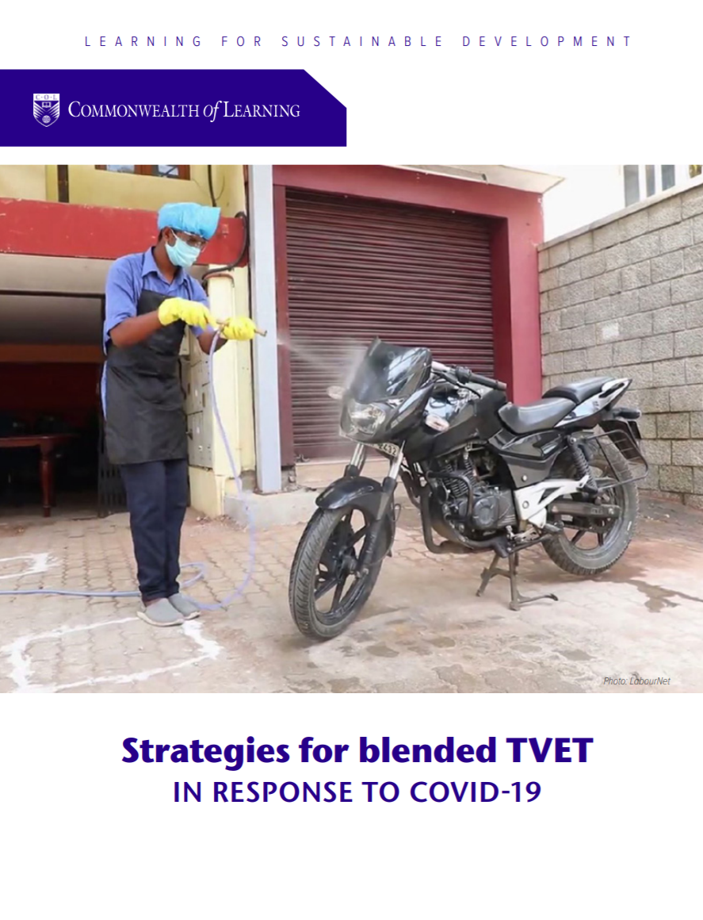
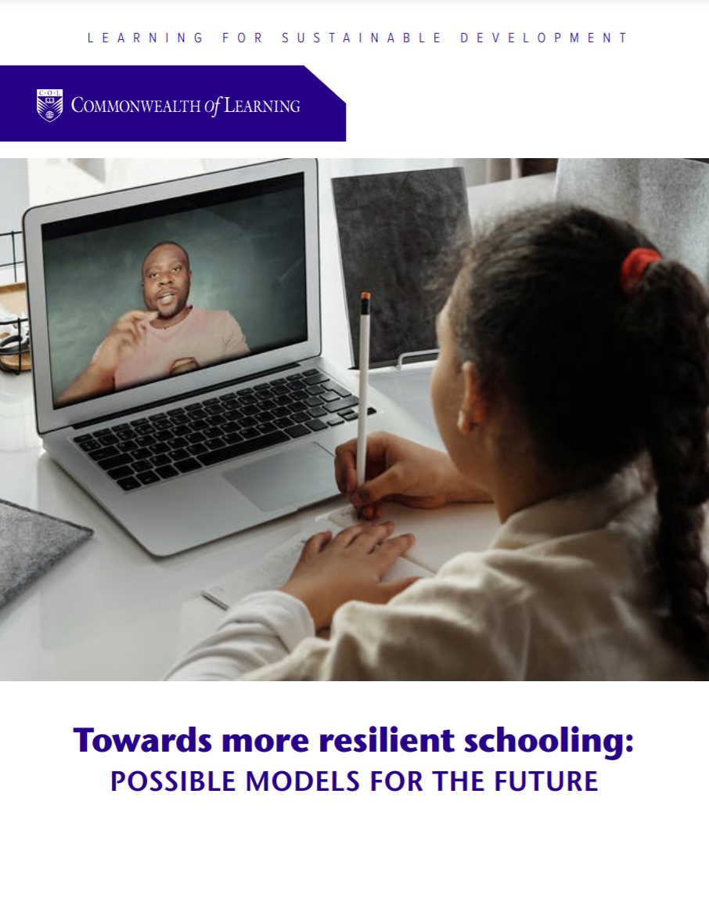
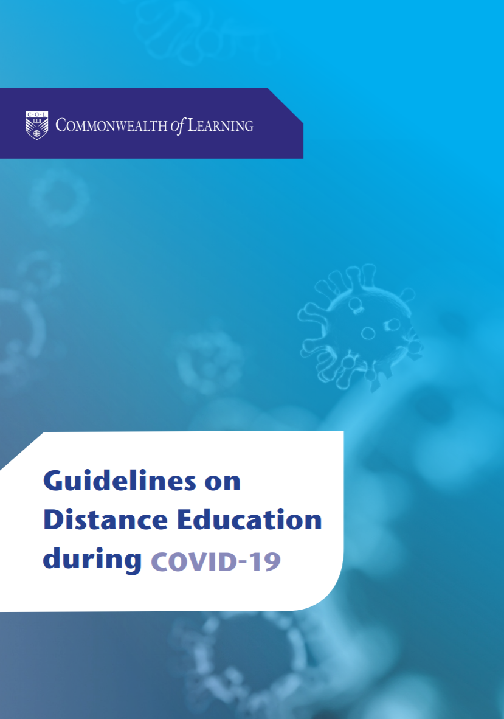
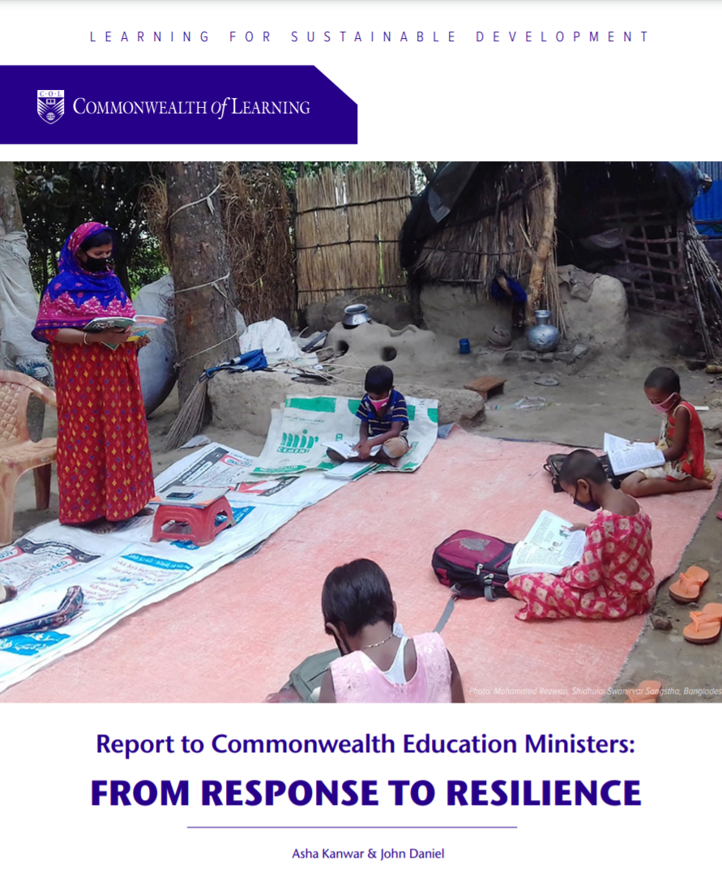
Guidelines

Slide 17
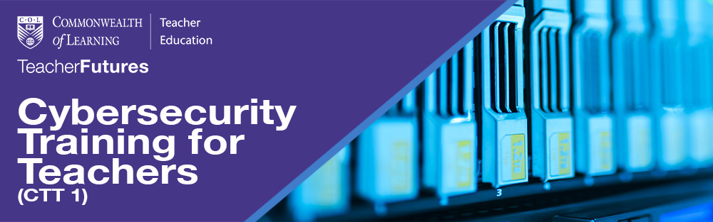
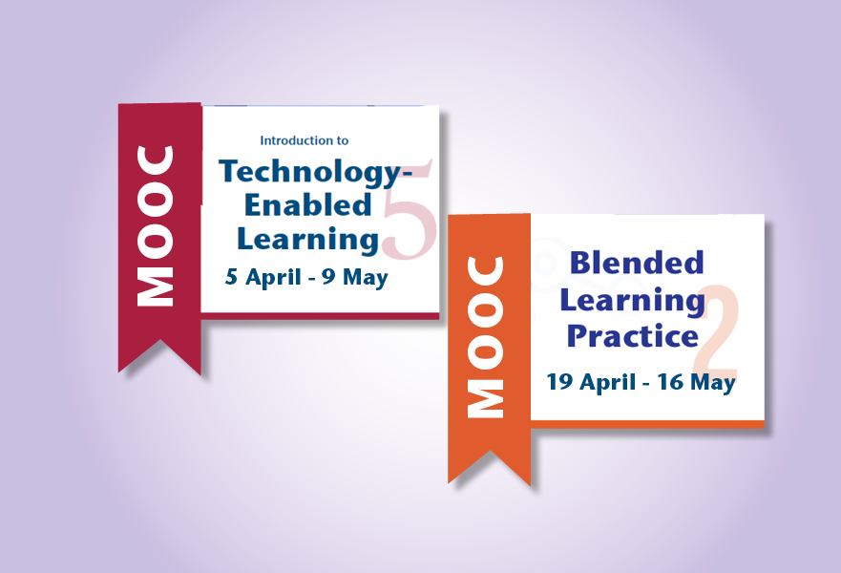
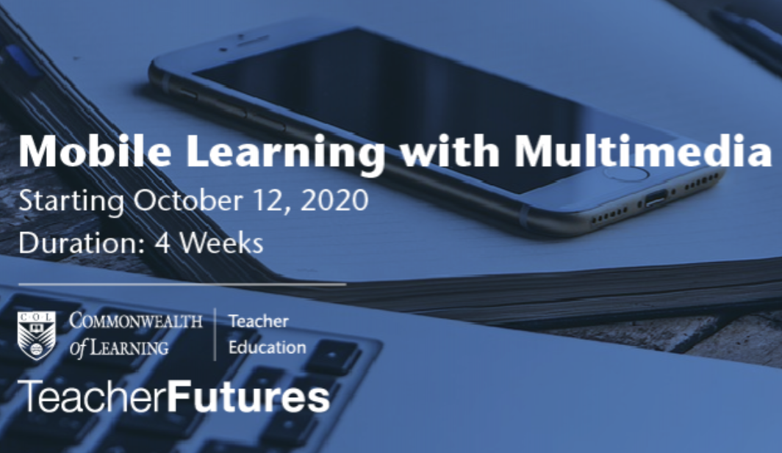
Capacity Building of Teachers
https://www.mooc4dev.org/CyberSecurity4Teachers1
http://www.telmooc.ca/
https://www.blpmooc.org/
https://www.mooc4dev.org/MLM_1

Slide 18
Support during the Pandemic
Nigeria: dual mode
Antigua and Barbuda, Kenya and Malaysia: Integrating technology
Zambia: Integrating employability skills
Rwanda: Online safety and privacy policy

Slide 19
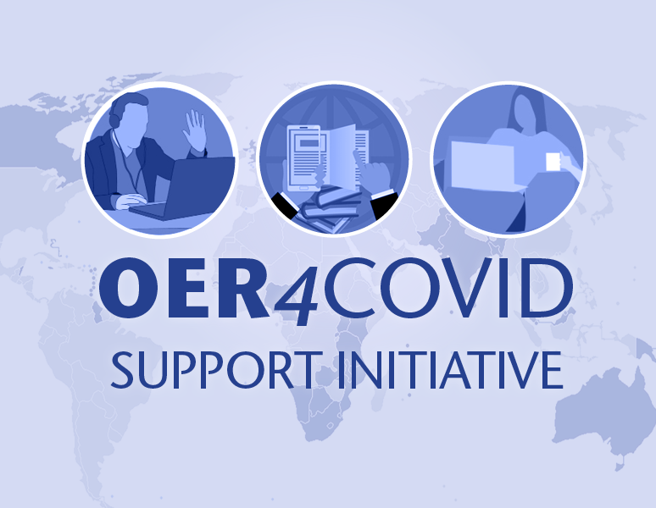
Promoting OER-based Online Learning
Support network for educators
Share online courses
Provide open technology tools
Build capacity
https://oer4covid.oeru.org/
Notes:
OER4Covid support initiative with OER Foundation, New Zealand attracted 1,349 participants from 89 Countries with
participation from 32 Commonwealth Countries including: Australia, Bangladesh, Barbados, Belize,
Botswana, Canada, Eswatini, Fiji, Ghana, India, Jamaica, Kenya, Kiribati, Malawi, Malaysia, Namibia,
New Zealand, Nigeria, Pakistan, Papua New Guinea, Saint Lucia, Samoa, Singapore, South Africa, Sri
Lanka, Tanzania, Tonga, Trinidad and Tobago, Uganda, United Kingdom, Vanuatu, and Zambia)
Zimbabwe.
when registering.)

Slide 20


Content aligned to curriculum
Video-on-demand: Fiji, Nauru, Samoa
STEM courses
VOD
https://pacificregionalchannel.org/

Slide 21
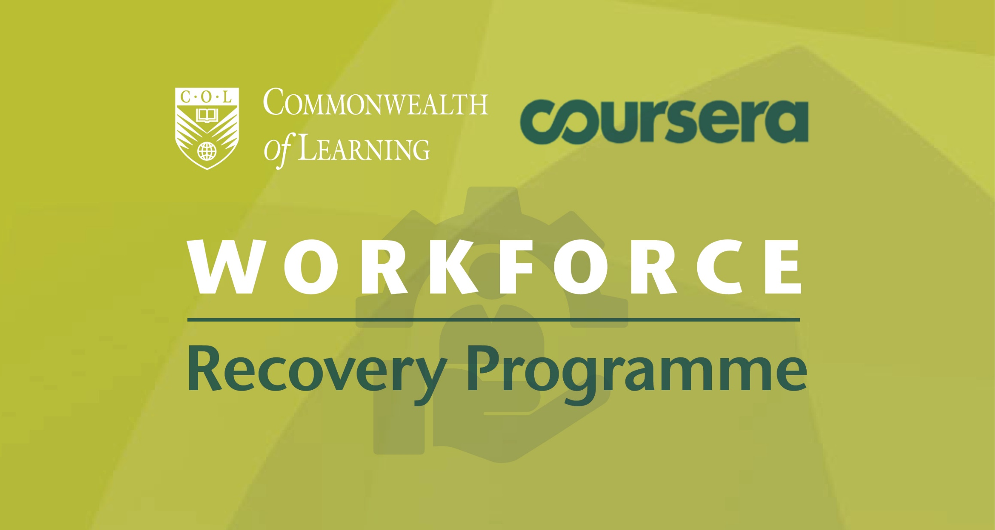

Skilling and re-skilling

Slide 22
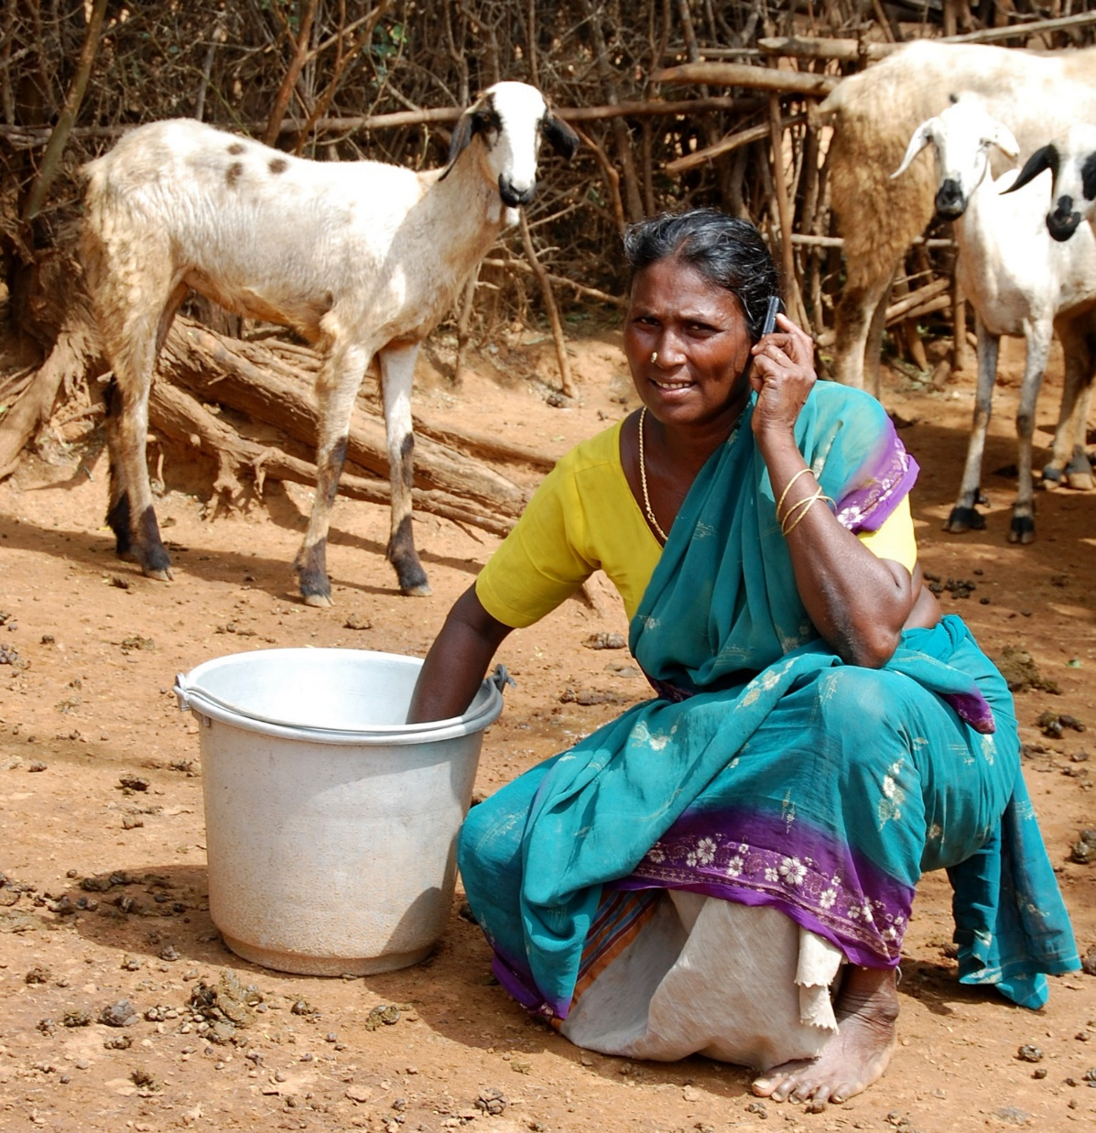
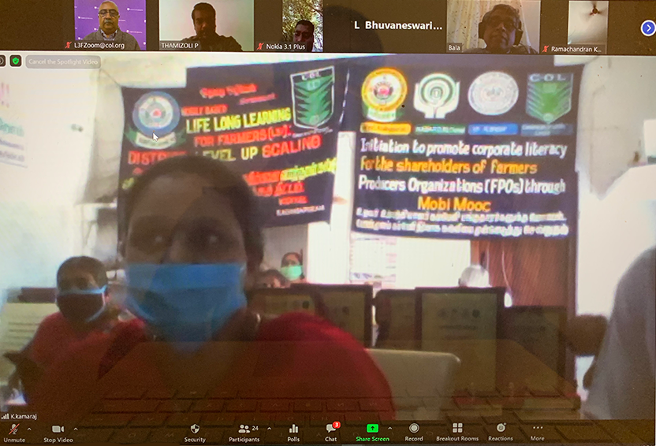
Audio-based mobiMOOCs

Slide 23
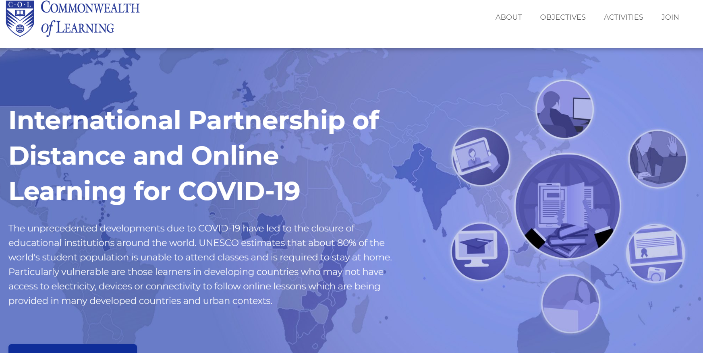
60+
https://opendoor.col.org/
Intergovernmental organisations
Universities and educational institutions
Associations and networks
Notes:
bring together institutions/organisations committed to supporting learning at this time of crisis;
share open educational resources (OER) and learning content;
provide tools for implementing affordable learning;
identify concrete collaborative activities;
build capacity in institutions offering distance and online learning; and
develop innovative technology solutions for reaching the unreached

Slide 24
Futures of Learning

Slide 25
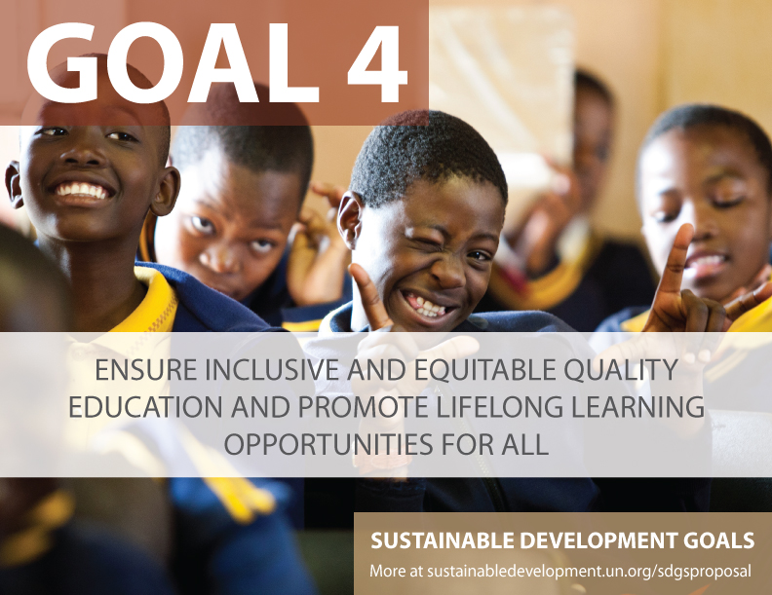
1. Preferrable Future
Universal primary completion will be achieved in 2042
Universal lower secondary completion in 2059
Universal upper secondary completion in 2084
Source: UNESCO (2016). Global Education Monitoring Report. https://unesdoc.unesco.org/ark:/48223/pf0000245752

Slide 26

Inclusion
Access to HE
Canada: 10.7%
India: .56%
South Africa: 1% . For example, in South Africa 80% of disabled people aged 20-24 are not in tertiary education.
Notes:
Mean year of schooling for persons with disabilities in select 49 countries in the UNESCO report is 4.8, whereas in general is 7 years. For female PWD, the mean years of schooling reduces to 4.3. ( see UIS, 2018: http://uis.unesco.org/sites/default/files/documents/ip49-education-disability-2018-en.pdf
People with disabilities are often disadvantaged in terms of access to tertiary education. Of the 18 countries for which data is available, 15 report disability prevalence under 3 per cent and half report rates under 2 per cent.
No info on students with disabilities in tertiary education.
United states
Source: https://nces.ed.gov/fastfacts/display.asp?id=60
11.1% (students with disabilities enrolled in post-secondary institutions) in 2011-2012
Canada
Source: http://publications.gc.ca/collections/collection_2009/rhdcc-hrsdc/HS61-1-2009E.pdf
10.7%
Australia:
Source: https://www.cdu.edu.au/sites/default/files/the-northern-institute/10.18793-lcj215.17.02.pdf
5.5%
India
https://timesofindia.indiatimes.com/home/education/news/Disabled-get-only-0-56-of-seats-in-higher-education/articleshow/46810639.cms
0.56%
South Africa
https://www.dailymaverick.co.za/article/2017-08-15-students-with-disabilities-disadvantaged-at-higher-education-level/#.WhSt_lWnGUk
http://www.statssa.gov.za/publications/Report-03-01-59/Report-03-01-592011.pdf
According to Stats SA, 80% of disabled people aged 20-24 are not attending tertiary education. Put another way, around 7,5% of South Africans have a disability. Yet the number of disabled students at tertiary institutions is far from representative: just 1%.

Slide 27
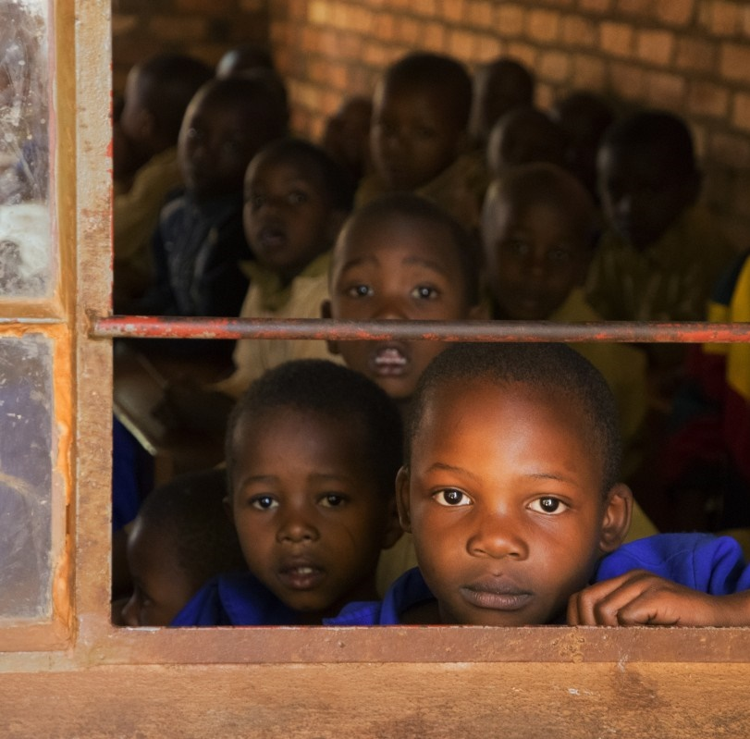
The ‘Learning Crisis’
In West and Central Africa, less than 45% students in Grade 6 achieved competency level in maths and reading
In South Africa, majority of Grade 4 students displayed the capacity of Grade 1
(World Bank, 2018)
Notes:
According to estimates by UNICEF, in 2015, over 115 million children did not attend primary school
56% of children in school are not learning (World Bank)
In West & Central Africa, less than 45% students in Grade 6 achieved competency level in maths and reading
In SA, majority of Grade 4 students displayed the capacity of Grade 1 (World Bank, 2018)
Teacher absenteeism and ‘presenteeism’
World Bank (2018). Learning: To Realize Education’s Promise. Washington: The World Bank. Retrieved from https://www.worldbank.org/en/publication/wdr2018

Slide 28




Preferable Future of Education
Equity
Inclusion
Quality
Lifelong

Slide 29
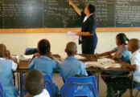
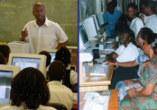
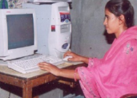
2. Probable Future
Face-to-Face Courses
Blended Courses
Distance/Online Courses
ICT integration in teaching and learning
MOOC
Mobile learning
Open and Distance Learning
Blended Learning

Slide 30


More Personalized Teaching: AI
Can provide an intelligent, personal tutor for every learner
Encourage intelligent support for collaborative learning
Adaptive group formation
Expert facilitation
Source: https://www.ibm.com/watson/advantage-reports/ai-social-good-education.html

Slide 31
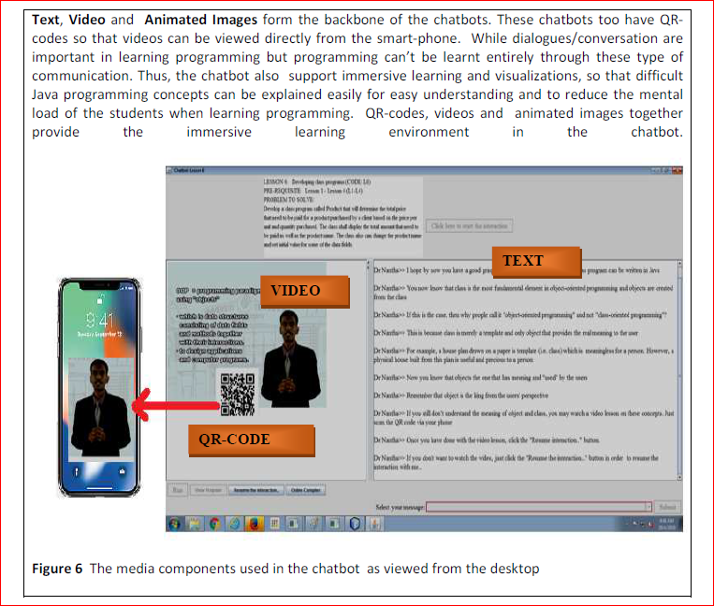
Use of Chatbots
Example of AI in Education

Slide 32
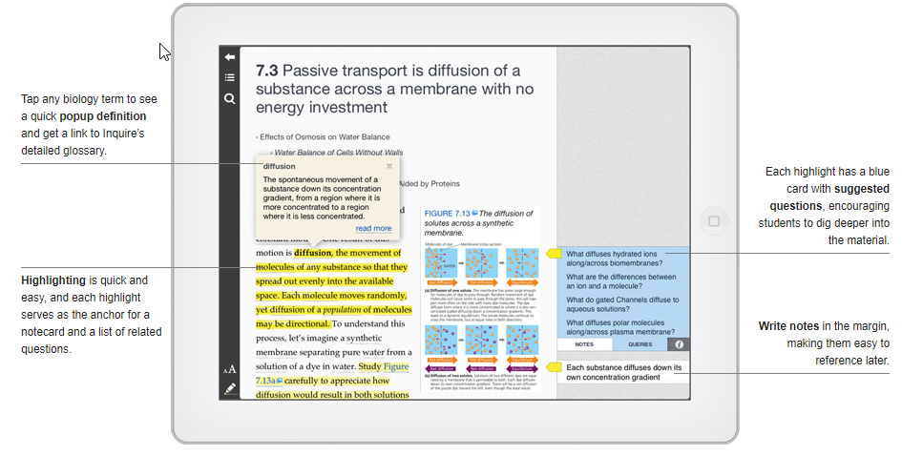
Example of AI in Education
Live experience: AR/VR
Inquire: an intelligent textbook
Source: http://inquireproject.com

Slide 33
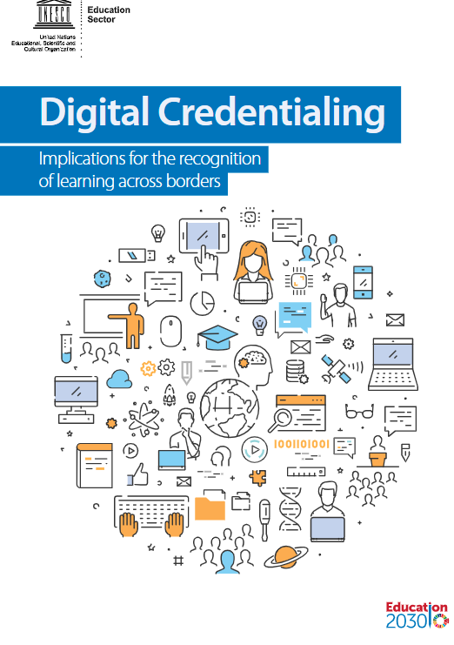
Assessment
Badges & micro-credentials
Recognition of prior learning
Transnational qualifications frameworks for mobility
On-demand examination
Authentic, project-based assessment
https://unesdoc.unesco.org/ark:/48223/pf0000264428?posInSet=4&queryId=N-e4559bf5-0bec-40c7-91a9-5cdea42e1ca4

Slide 34


3. Possible Future
Trends
Globally, the number of climate disasters has tripled since 1980, while, hot weather in 2016 broke the historic record set in 2015
At the current rate there will be larger and more frequent climate related disasters
Source: The Commonwealth Secretariat. 'Climate Change'. https://thecommonwealth.org/climate-change
This Photo by Unknown Author is licensed under CC BY-SA
Notes:
The climate crisis is one of the defining issues of our world today. The science is clear: the drastic changes in global climate patterns starting in the mid-to-late twentieth century are attributable to the increasing level of greenhouse gases in our atmosphere, produced by human activities. The result of this change in climate patterns is apparent in the devastating storms, floods, and other natural disasters that have become a regular occurrence across the globe today.
The Commonwealth, which comprises 53 countries, is disproportionately affected by climate change, as many of its members are amongst the small or least developed states.
According to the World Risk Index, calculated by the United Nations University Institute for Environment and Human Security (UNU-EHS) and featured in the 2016 World Risk Report (WRR 2016), 9 out of the top 20 countries most at risk for natural disaster are Commonwealth countries.

Slide 35
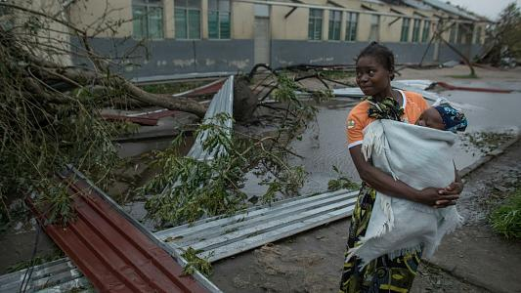




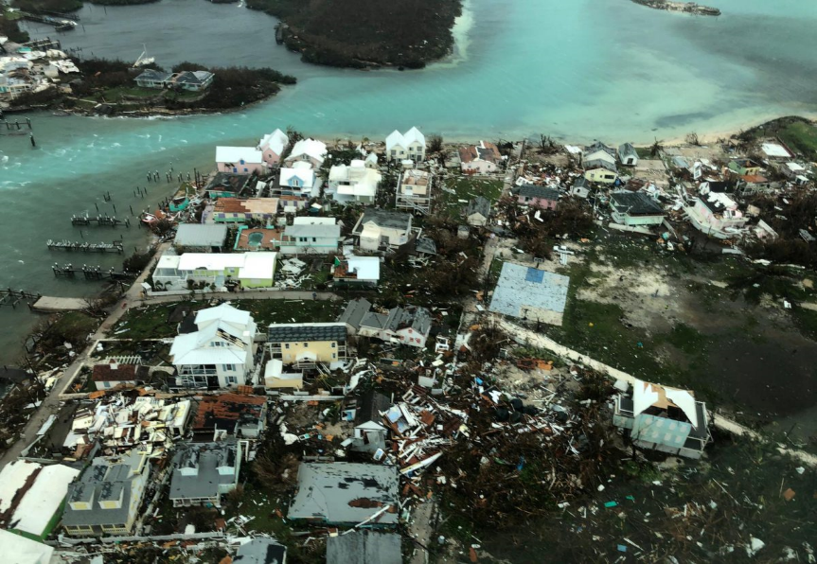

Classrooms affected: 3,504
Students affected: 335,132
Cyclone Idai
Mozambique
Source: CARE; Retrieved from https://www.care.org/emergencies/cyclone-idai
Source: UNICEF, 2019. https://www.unicef.org/mozambique/en/cyclone-idai-and-kenneth
Devastated numerous schools on Grand Bahama and Abacos Islands
Hurricane Dorian
The Bahamas
Notes:
How does the climate crisis effect the education sector specifically?
In recent years, Commonwealth countries have experienced severe impacts to their education systems as the result of climate related natural disasters.
Cyclone Idai, which hit eastern Mozambique on March 14, 2019 was the worst natural disaster to hit southern Africa in twenty years. According to UNICEF, from July 2019, more than 3000 classrooms and 330,000 students were affected by the Hurricane (https://www.unicef.org/mozambique/en/cyclone-idai-and-kenneth)
On September 1 2019, the eye of Hurricane Dorian made landfall on the Abaco Islands, reaching the island of Grand Bahamas the next day. It was the strongest hurricane on record to hit the Bahamas.
According to Mercy Corps, the Abaco Islands were the most affected with approximately 90 percent of housing and infrastructure left damaged or destroyed in its wake. In Grand Bahama, satellite data revealed that anywhere from 76 to 100 percent of buildings in certain areas were destroyed. The week after Hurricane Dorian hit was supposed to be the first week of classes in the Bahamas. Many families had just paid school fees and purchased uniforms, which were lost due to the hurricane. Many schools were deemed to be unsafe for students, halting classes.

Slide 36






The impact of the climate crisis on education
Infrastructural damage
Damage to resource and materials
Loss of data and records
Collapse of systems = Out of school youth
Notes:
Climate related natural disasters have major, detrimental impacts on education. Events such as hurricanes, storms and floods can have catastrophic effects on the infrastructure, resources and systems of the education sector. Entire schools can be destroyed or irreparably damaged, leading to thousands of displaced students, unable to continue their education. Critical data and student records may be wiped out entirely, leaving the system in shambles, and learners and institutions in the dark. These impacts can effectively lead to the collapse of the education system in disaster affected areas.

Slide 37


Education and emissions
Direct
Emissions from construction of schools/infrastructure
Emissions from energy use in schools
Learner emissions
Indirect
Emissions from ‘development’ and economic growth associated with higher levels of education in a country
Notes:
The education sector, from primary to tertiary, contributes to both direct and indirect emissions, which impact on climate change, and environmental degradation, as well as incur associated economic costs. If we look strictly at contributions to emissions, the achievement of SDG4, under the current paradigm, could potentially worsen the climate crisis.

Slide 38
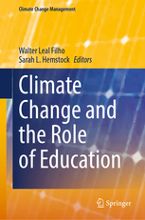







Research on Emissions and ODL
Travel – greatest contributor
Mode of delivery - determinant
Source: Carr et.al. Delivery Mode and Learner Emissions: Comparative Study from Botswana. W. Leal Filho and S. L. Hemstock (eds.), Climate Change and the Role of Education, Springer Nature. In Production.
Notes:
Perh

Slide 39
The future we want

Slide 40

1. The future is blended
Use of appropriate technologies to create more blended learning opportunities
Mobile Messaging can foster development of new genre of learning management systems that can integrate social media and Chatbots
Certification based on Blockchains and Open Standards will enable independent verification of learning to strengthen lifelong learning
Source: https://commons.wikimedia.org/wiki/File:1K6F_Crystal_Structure_Of_The_Collagen_Triple_Helix_Model_Pro-_Pro-Gly103_04.png

Slide 41

2. Leaving no one behind
For persons with disabilities
Women and disadvantaged groups
People in remote areas
Policy by Nick Youngson CC BY-SA 3.0 Alpha Stock Images

Slide 42
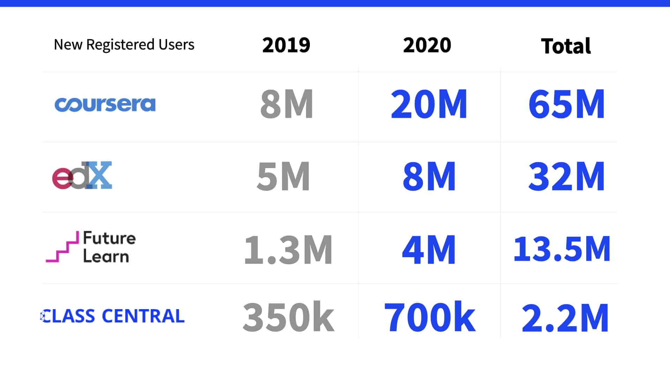
3. Lifelong learning for all
Learning to learn online
Creating an ecosystem for lifelong learning
Providing just-in-time training for livelihoods
Source: https://www.classcentral.com/report/mooc-stats-pandemic/

Slide 43
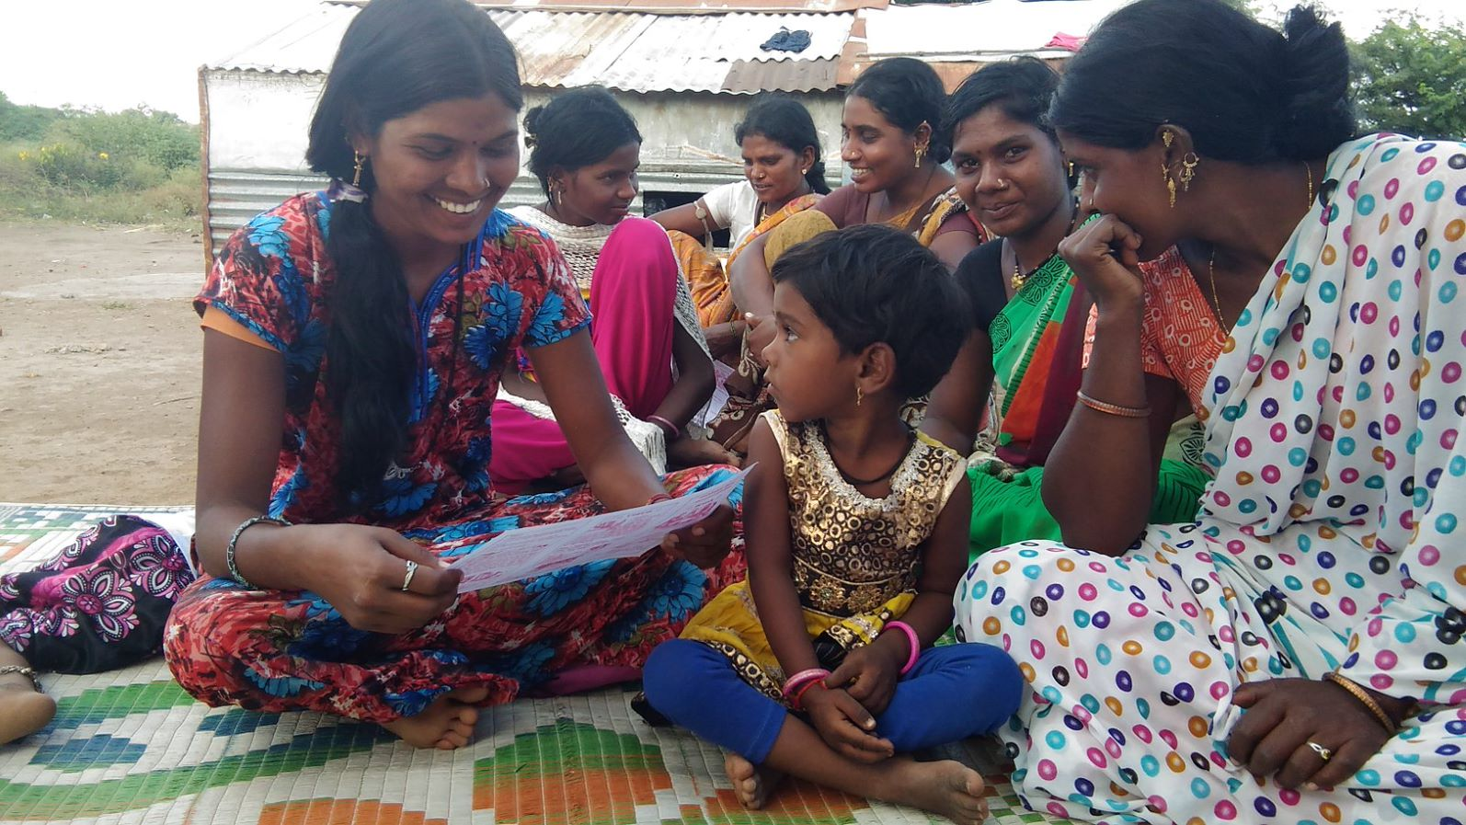
4. Respecting the planet
4. Respecting the planet
Community-based learning instills a sense of interdependence and responsibility which is crucial to behavioral change for environmental conservation.
Notes:
Studies have shown that countries where individualist orientations are stronger tended to have higher per capita CO2 emissions. Adger et al. (2013) and Chuang et al. (2016) reported that people having ‘interdependent selves’ were more likely to engage in pro-environmental behaviors than ‘independent selves’
By linking learners to their communities, we can build this sense of interdependence. Community-based learning gives meaning, relevance and context to learning, and helps to inculcate a sense of responsibility in learners for their neighbors.

Slide 44
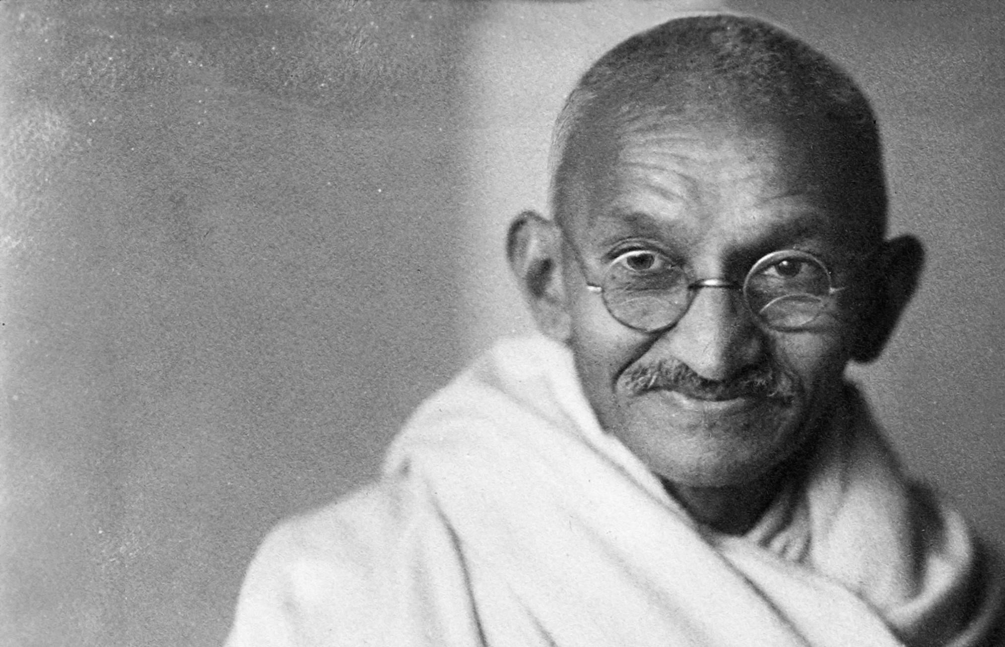
5. Learning to live together
“Relationships are based on four principles: respect, understanding, acceptance and appreciation.”
— Mahatma Gandhi
Notes:
Human rights, peace and non-violence
Global citizenship
Appreciation of cultural diversity
4.7 By 2030, ensure that all learners acquire the knowledge and skills needed to promote sustainable development, including, among others, through education for sustainable development and sustainable lifestyles, human rights, gender equality, promotion of a culture of peace and non-violence, global citizenship and appreciation of cultural diversity and of culture’s contribution to sustainable development

Slide 45
Transformation for a ‘brave new world’
Typical Approach:
Transformative Approach:
Skills /Competencies
Employability and Entrepreneurship
Achievement
Empowerment for Change
Environmental Conservation and Global Citizenship
Accomplishment
Notes:
According to Marc Prensky, the dominant educational paradigm emphasizes individual achievement, which is defined as “A person doing something that benefits only (or principally) him or her (=an achievement).” In the current paradigm, the focus is on the Acquisition of Skills and Competencies as well as Employability and Entrepreneurship – individualistic goals.
Under a transformative approach, the focus is on bettering soceity as a whole, what Prensky calls “real, world-improving accomplishment”. In contrast to an achievement an accomplishment is “A person doing something (or being a part of something) that benefits others and the world outside of that person (=an accomplishment).”
And Prensky claims that this model “is far better for us because it liberates huge amounts of unused potential – the potential of our students – to improve our communities and our planet.
Under the transformative approach, the focus is on Empowerment, Environmental Conservation, and Social Cohesion/Peace.

Slide 46

Thank you
www.col.org
The contents of this presentation, except logos/ graphics which are property of the respective owners, is made available under Attribution-ShareAlike 4.0 International (CC BY-SA 4.0).

