Slide 1


Towards Resilient Skills Development Systems: Challenges & Opportunities
Professor Asha Kanwar
President & CEO
World Bank Webinar on Skills Development during a Pandemic: Challenges and Opportunities
June 16, 2020

Slide 2
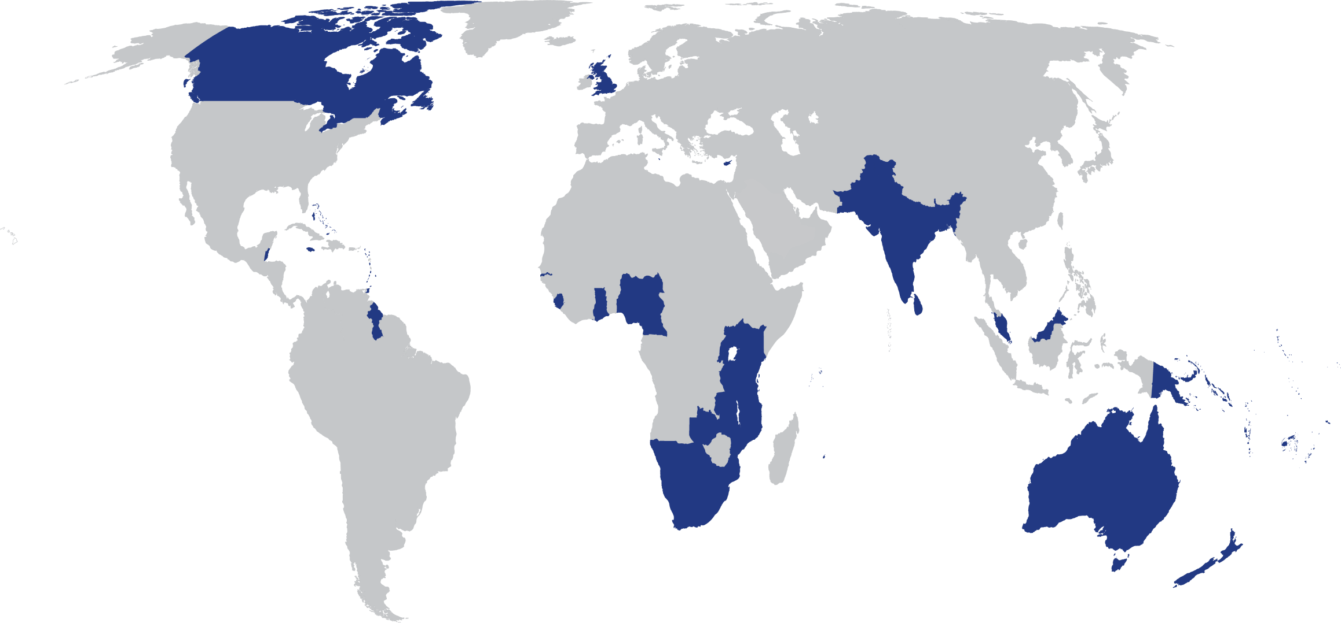
The Commonwealth
54 developed and developing nations around the world
Notes:
Maldives rejoined Commonwealth in 2020.

Slide 3

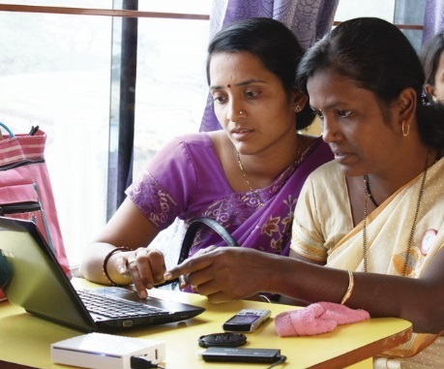
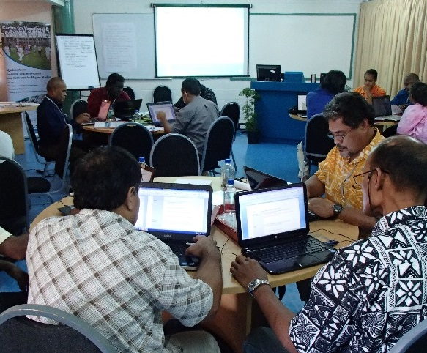
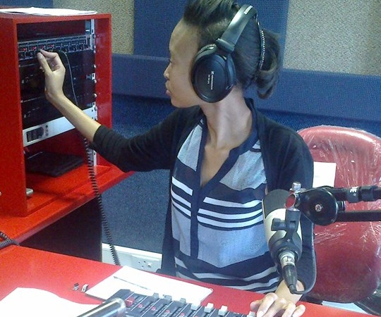
Helping Commonwealth governments and institutions use distance learning and technologies to expand access to education and training

Slide 4
Outline
Context
COL Response
Opportunities

Slide 5
Context

Slide 6


>1.2 billion globally
574 million: Commonwealth
(Update 15 May 2020)

Slide 7
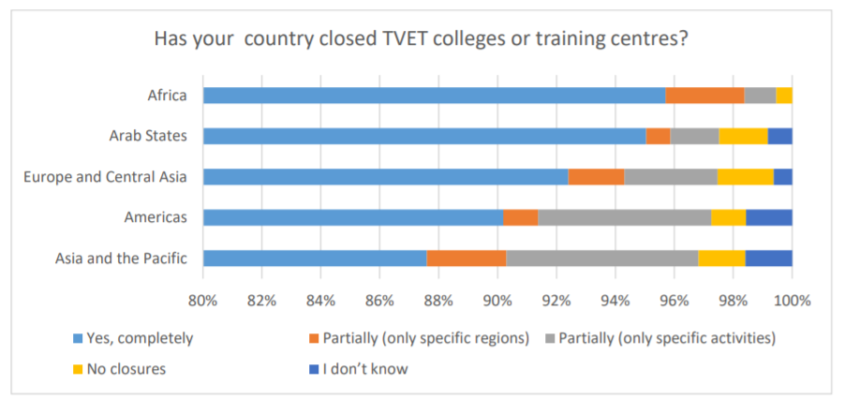
Closure of TVET institutions
Over 90% Institutions closed
Students in TVET come from lower social –economic backgrounds (Kenya and Ghana)
Source: UNESCO-ILO (2020). https://www.oitcinterfor.org/sites/default/files/unesco_ILO_survey.pdf
Source: Hoftijzer, Margo; Levin, Victoria; Santos, Indhira; Weber, Michael. 2020. TVET Systems’ Response to COVID-19 : Challenges and Opportunities. World Bank, Washington, DC. World Bank. https://openknowledge.worldbank.org/handle/10986/33759

Slide 8
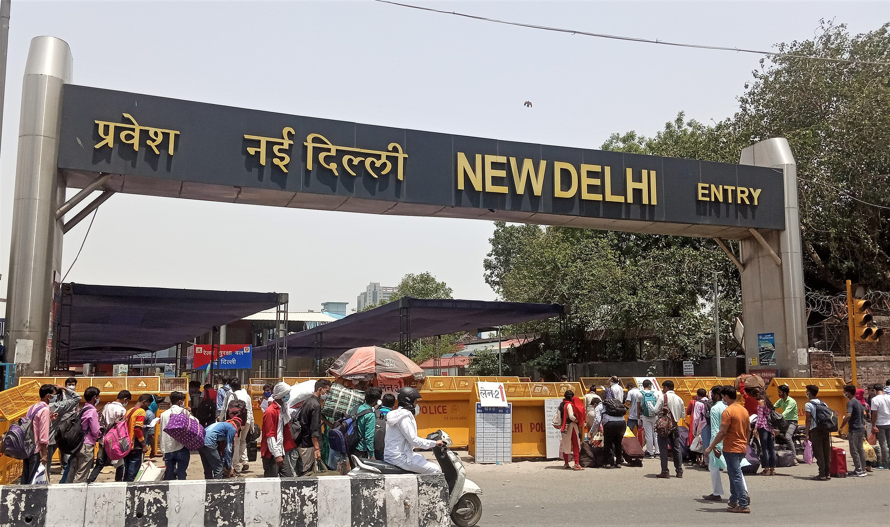
India: 453 million migrant workers
Source: Wikipedia, photo by Soumita Roy Dutta CC BY-SA
Notes:
India has 453 million migrant workers (inter and intra state movement) as per 2011 Census. (Source: https://indianexpress.com/article/explained/coronavirus-india-lockdown-migran-workers-mass-exodus-6348834/

Slide 9
Youth unemployment
Source: data.worldbank.org, retrieved on 11 June 2020
Notes:
Youth unemployment rates in the Commonwealth countries from 2007 – 2019. It is compiled with latest data from World Bank open data (https://data.worldbank.org/indicator/SL.UEM.1524.ZS) and using arithmetic mean method.

Slide 10
Internet users per 100 inhabitants in 2017
Source: data.worldbank.org, retrieved on 17 January 2020

Slide 11
Mobile subscriptions per 100 inhabitants in 2017
Source: data.worldbank.org, retrieved on 17 January 2020

Slide 12
Challenges
Lack of acceptance of online mode of training
Lack of readiness and capacity to transition
Lack of training content as OER

Slide 13
COL Response

Slide 14
COL’s experience
Partnerships
Reaching the unreached
Training teachers
Curated content
Notes:
Consider renaming to COL’s experience

Slide 15
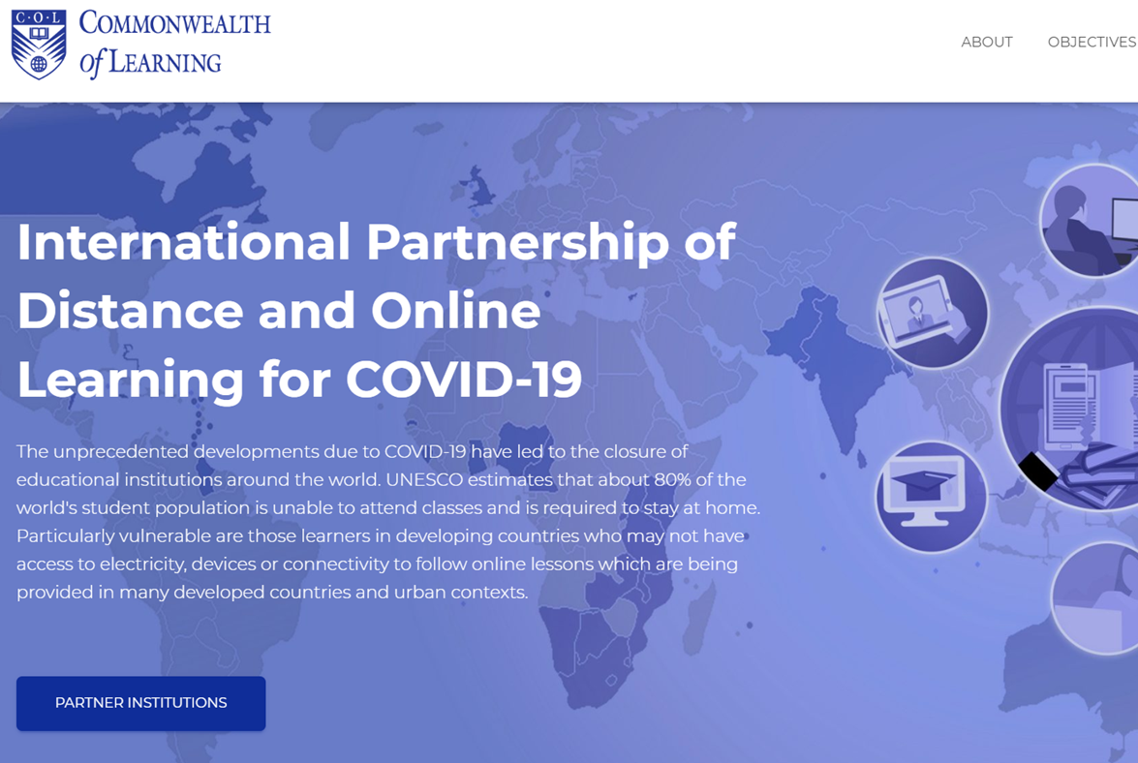
1. Partnerships
https://opendoor.col.org/
55+
Intergovernmental organisations
Universities and educational institutions
Associations and networks

Slide 16
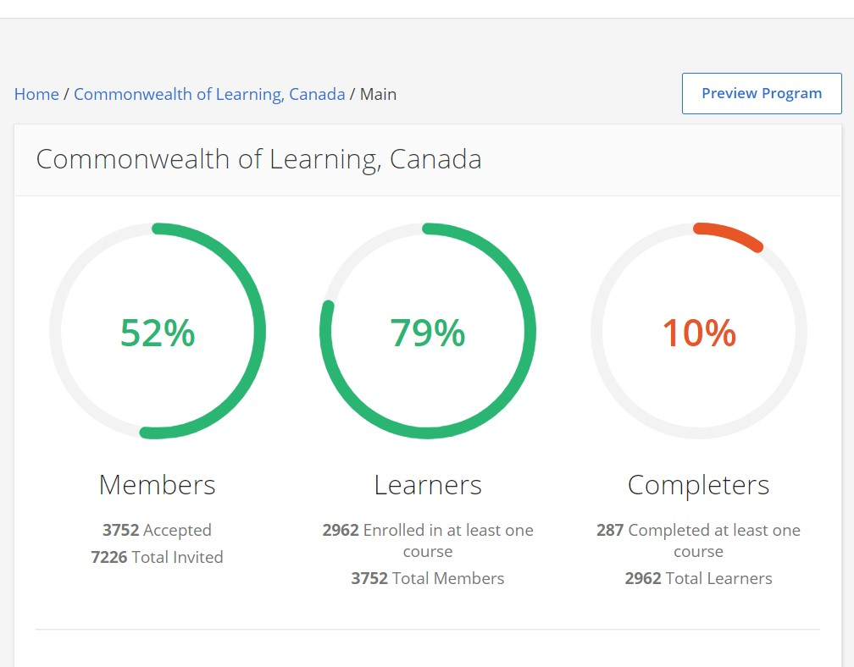

Slide 17
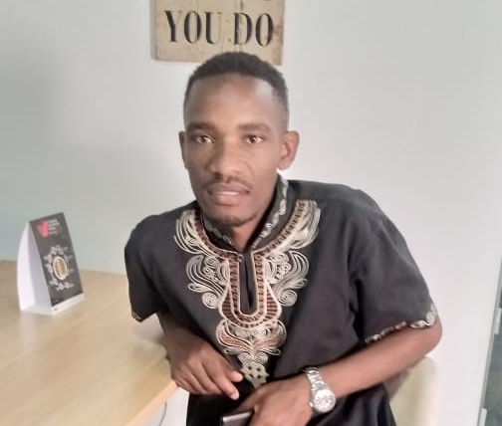
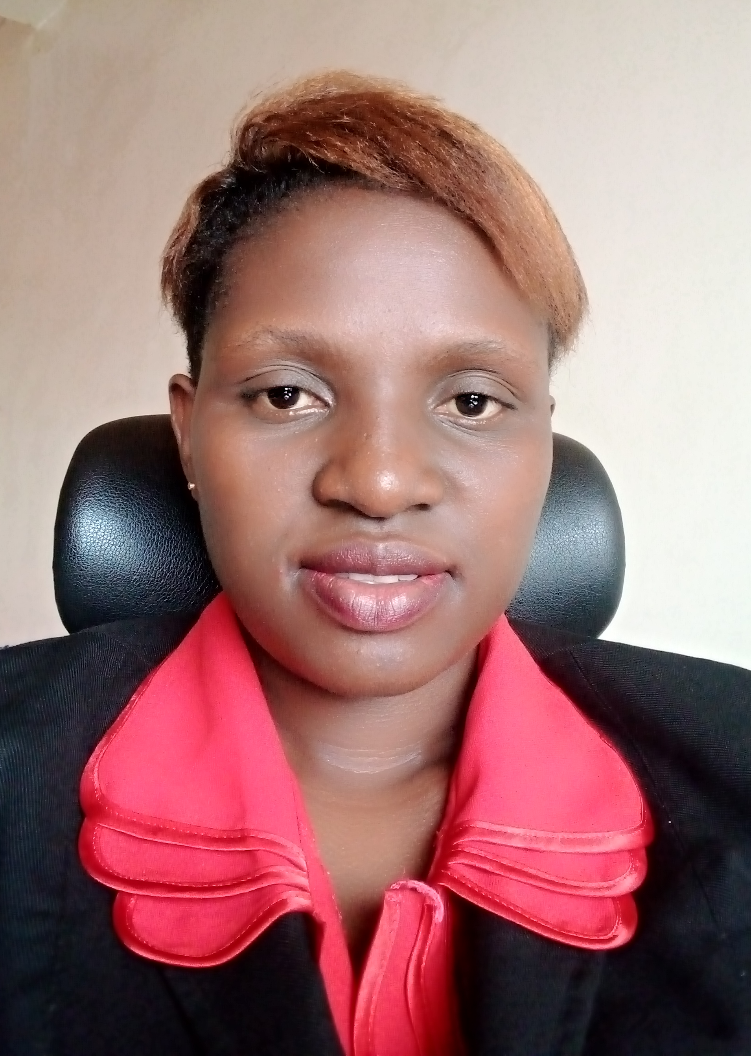
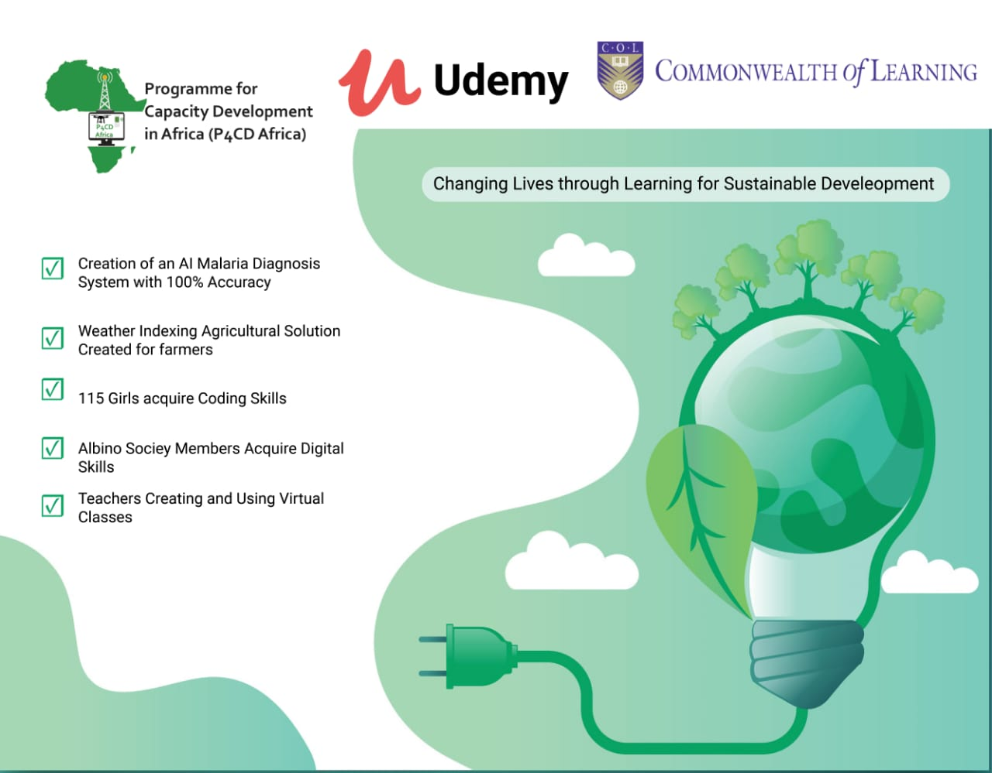

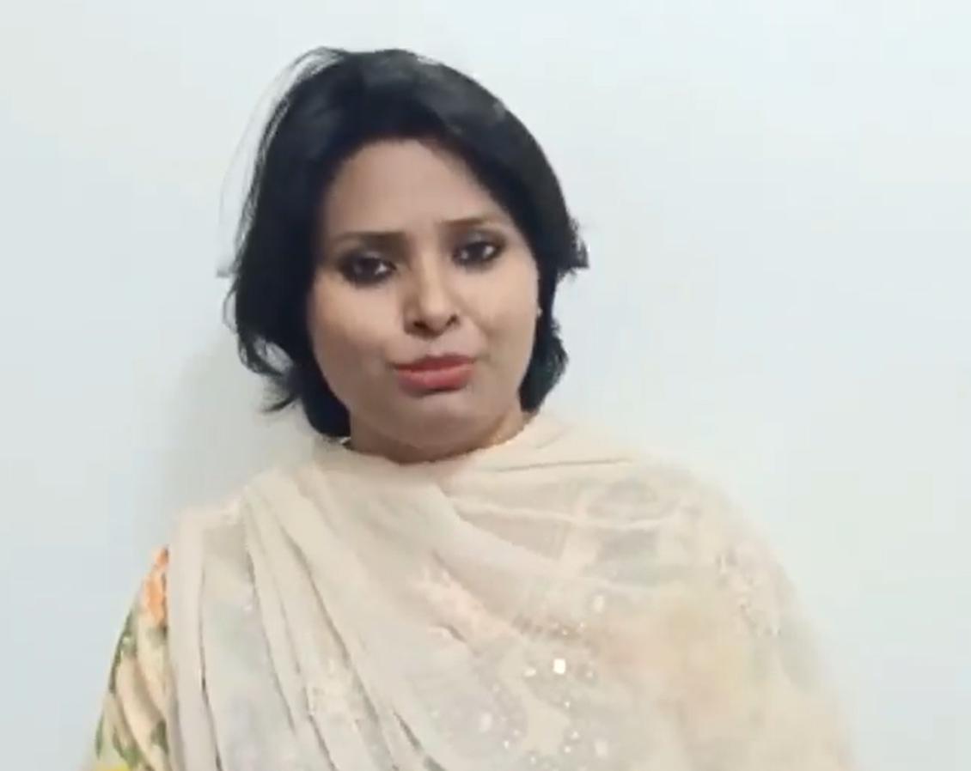
Bravin Mugangasia, Kenya
Martine Benemariya, Rwanda
Ghana Library Authority’s access online courses
Layla Nur Kaly, Bangladesh
Notes:
Employability skills among 6000 people since December 2019
Currently operational in Bangladesh, Ghana, Kenya and Rwanda
Free and unlimited access to over 4000 curated courses
Graduates of the program have been able to use AI for Malaria Diagnosis; Created weather indexing; over 115 girls from Kenya alone have acquired coding skills
Reaches out to very marginalised communities such as the Albinos in Kenya; Teachers, including TVET teachers are acquiring online teaching skills
A hybrid model for Skill Development
A pilot among economically weak, remote and rural learners who are supported by local partners with access facilities, academic support, mentorship and job counselling
Early results show good impact among the learners

Slide 18
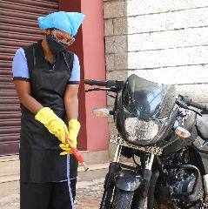
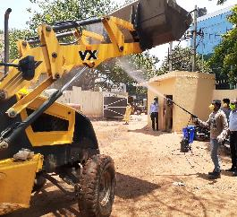
COL’s Partnership with LabourNet in India
Notes:
An immediate response to migrant labour crisis in India; the pilot is among 2100 workers (auto-mechanics, tailors and beauticians) to reskill them for regaining employment; The initiative aims to create Sanitization and Hygiene Entrepreneurs.
Opportunity to provide livelihoods to 300,000 people across the country.
Enable safe and hygienic environment at all levels.
Jobs related to sanitisation of public places and vehicles have emerged as an immediate solution for creating new employment opportunity; Ministry of Panchyati Raj; National Skills Development Corporation, GoI’s Skill India initiatives have formally come on board; and, a good number of corporates are behind the effort. A small funding and collaboration with networks can be very powerful at the time of a Pandemic. Use of ODL for training; Uberisation efforts (app for booking & executing job orders) and transparency (through technology) prove impactful

Slide 19
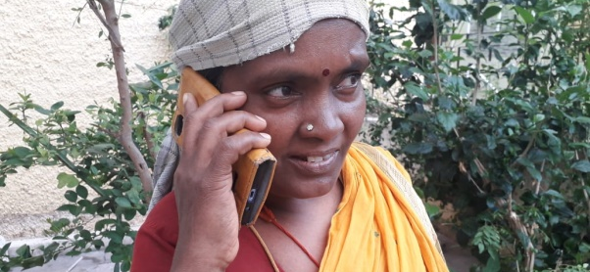
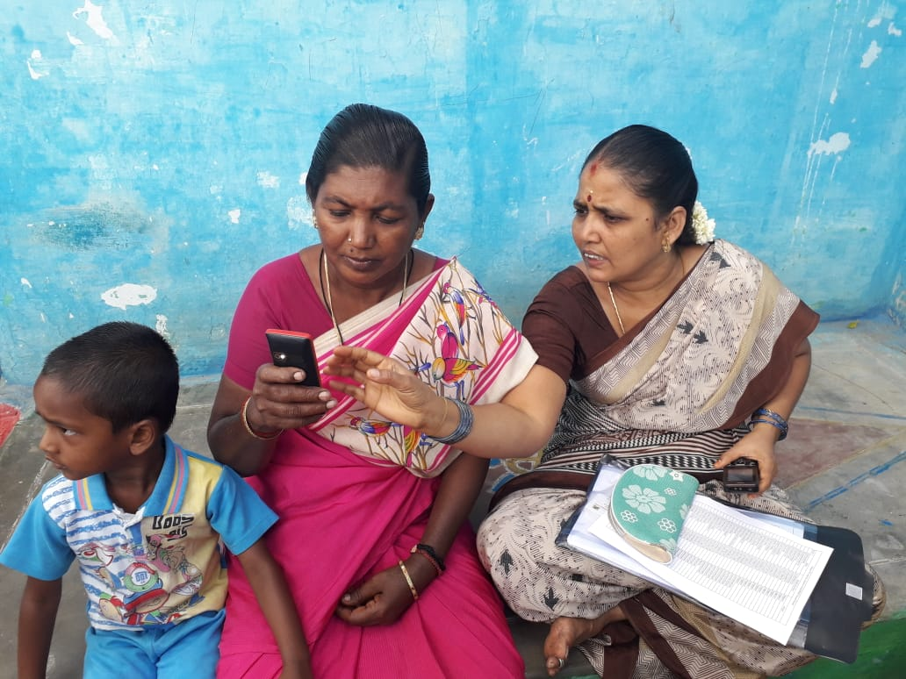
2. Reaching the unreached
https://mobi.mookit.co/
Notes:
MobiMOOCs - Land Preparation and Soil Fertility
Total registration: 1942
Total completion: 540
Mobi MOOCs use voice connections to deliver educational content where bandwidth is low and data connections are expensive
When a user calls up a number (can be toll-free), an Interactive Voice Response System takes over and guides the user through learning objects

Slide 20
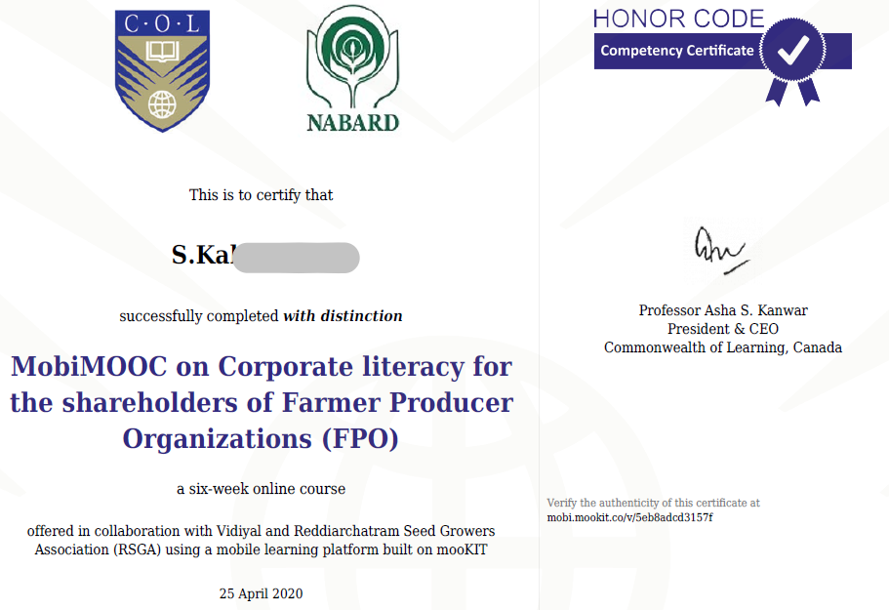
MobiMOOCs
Rapid Development of Corporate Literacy

Slide 21
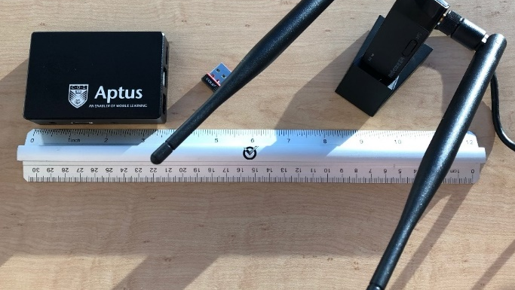
Aptus: Last mile access
Notes:
COL developed Aptus a low-cost offline virtual classroom that provides learners in remote locations with access to digital resources. It’s a server that works with a solar charger and a wireless router and costs approximately $ 150.

Slide 22
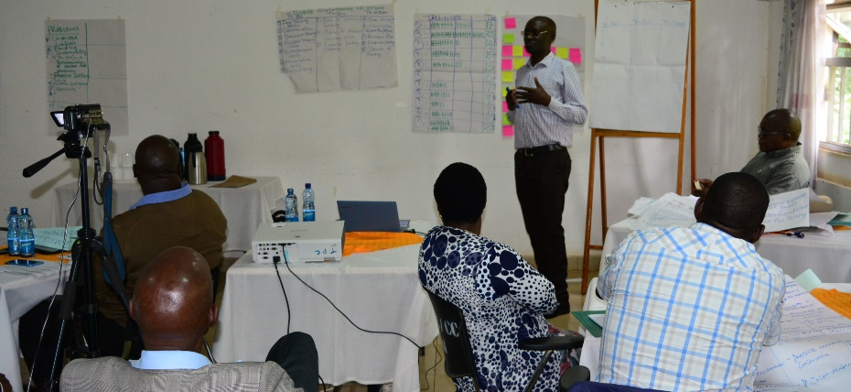
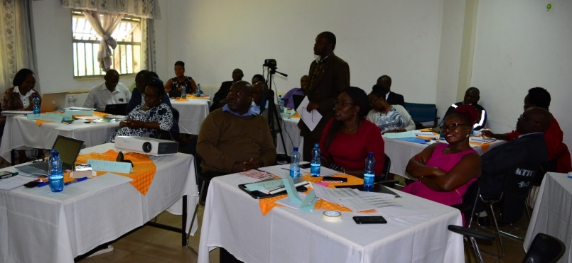
Kenya Master Craftsperson training
KTTC, NITA, KNFJKA, COL partnership
Train MCs in pedagogy
Aptus devices based in jua kal sheds
Audio/Video OER for Aptus
Notes:
It is estimated that Kenya’s informal apprenticeship system trains approximately 1 million learners, under the guidance of an estimated 300,000 master craftsmen and women. For comparison, only approximately 60,000 apprentices train each year through the formal system. Improving the quality of informal training is essential for upskilling Kenya's workforce. COL is partnering with Kenya’s Technical Teachers College, Kenya’s National Industrial Training Authority (NITA), a government agency responsible for industrial training in Kenya, and Kenya’s National Federation of Jua Kali Association (KNFJKA) to train master craftsmen and women in pedagogy to improve the apprenticeship training, using a blend of workplace and jua kali sheds-based learning and e-learning. The programme targets MCs who are unable to access pedagogical training due to work and family commitments, inability to travel and limited funds. The design will take advantage of the growing uptake of smartphones. Phase 1 – 4,500 MCs, 21,000 apprentices
About 400 primary jua kali associations have designated work sites (jua kali sheds) on land the association owns, held in trust by the government. While the MCs tend to have smartphones, the cost of data is high and internet quality is poor in rural areas where some of them work. To solve this challenge, COL’s Aptus devices at the jau kali sheds mean that MCs can come to the sheds and download the digital resources and learn from them back in their workplaces or homes. KTTC regularly synchronises the devices with their learning management system so that they can still track learner progress and update the materials. As well as increasing the quality of the informal training system, MCs increase their income through running small certified training centres and being paid to conduct workplace assessments for NITA.
The initial pilot will train 1,000 MC learners in six Kenyan counties, followed by a second cohort across 24 Kenyan counties (3,500 MC learners). Each MC is assumed to then go on to train six apprentices i.e. 21,000 apprentices trained.
The OER will also be made available to support MC training in other countries.
(Two pictures are from KTTC proejct design workshop with KTTC staff and NITA and KNFJKA representatives – not brilliant, but in case you want to use them)

Slide 23
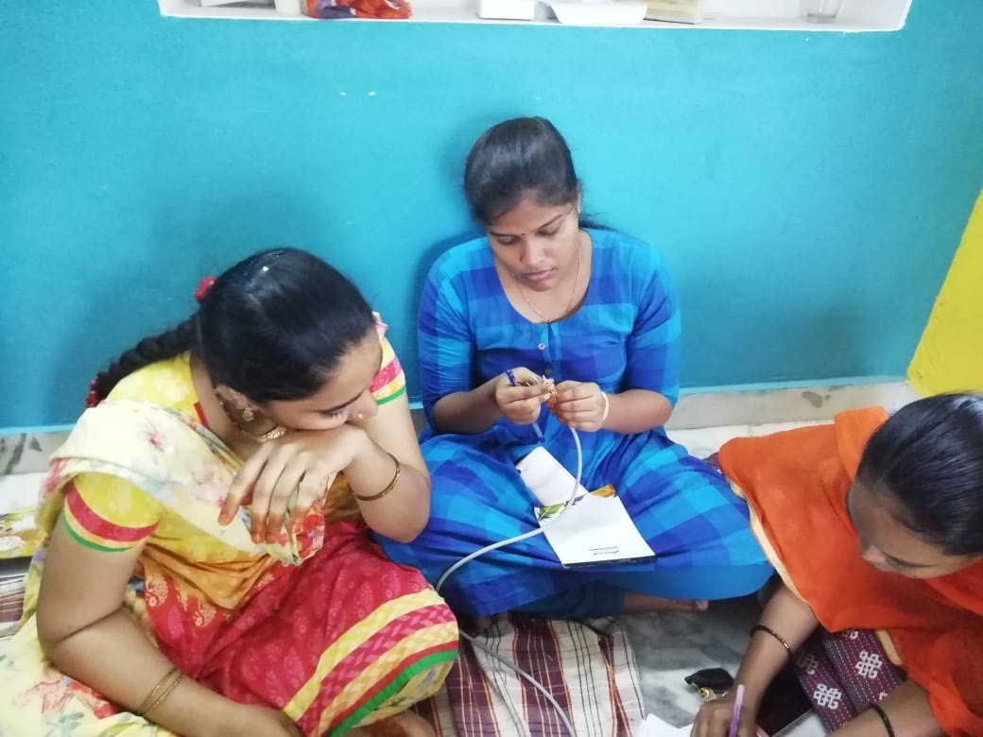
Barefoot Wireless Engineers Training for Girls

Slide 24
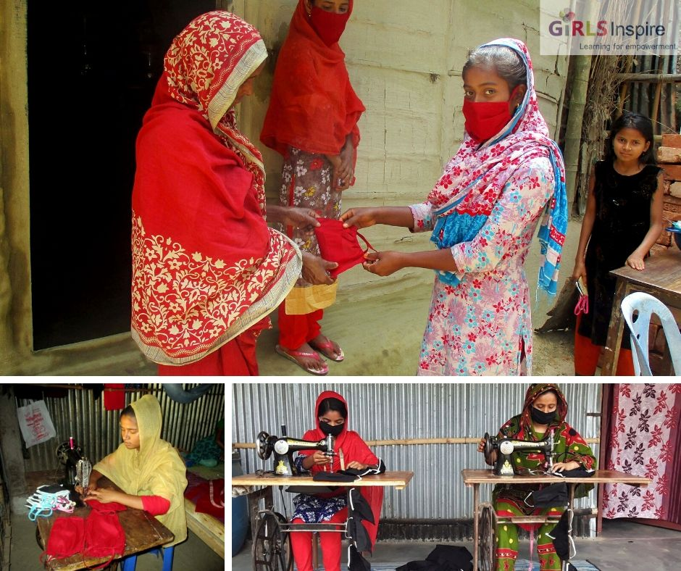
Skills development for vulnerable communities
Notes:
Skills training of vulnerable groups: Left photo is from our Partner Digital Empowerment Foundation. The girls in the picture are receiving training on Wireless Engineering under the “Barefoot Wireless Engineer” project.
Right photo is of the Bangladesh boat schools

Slide 25

3. Teacher training
MOOCs for Teacher Professional Development

Slide 26
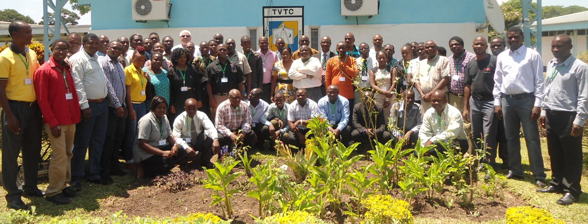
Zambia TVET teacher training
Ministry of Higher Education request in response to COVID 19
Three TVTC mentors, 28 online facilitators, 840 TVET teachers
On the job training
COL online OER available
Notes:
In response to COVID 19, Zambian’sMoHE approached COL to support them to train TVET teachers in online learning. COL has been partnering with Zambia’s Technical and Vocational Teachers College for ten years to build their capability in distance and online learning. TVTC has its own learning management system and trained staff.
With COL’s support, three of the capable people are presently training one person from each of the 28 public TVET institutes in how to facilitate online. In a few weeks, once these 28 have been trained, the existing experts will mentor the 28 facilitators to apply their leanring as they each teach 30 TVET teachers using COL’s Flexible Skills Development course. 840 TVET teachers will be quickly trained, and Zambia will have 28 new trainers who can independently train many more TVET teachers. Both the Facilitating Online Courses course and the Flexible Skills Development course are COL OER which COL has been using to train others across the Commonwealth, and could be easily sent to TVTC and installed in their learning management system ready to go.

Slide 27
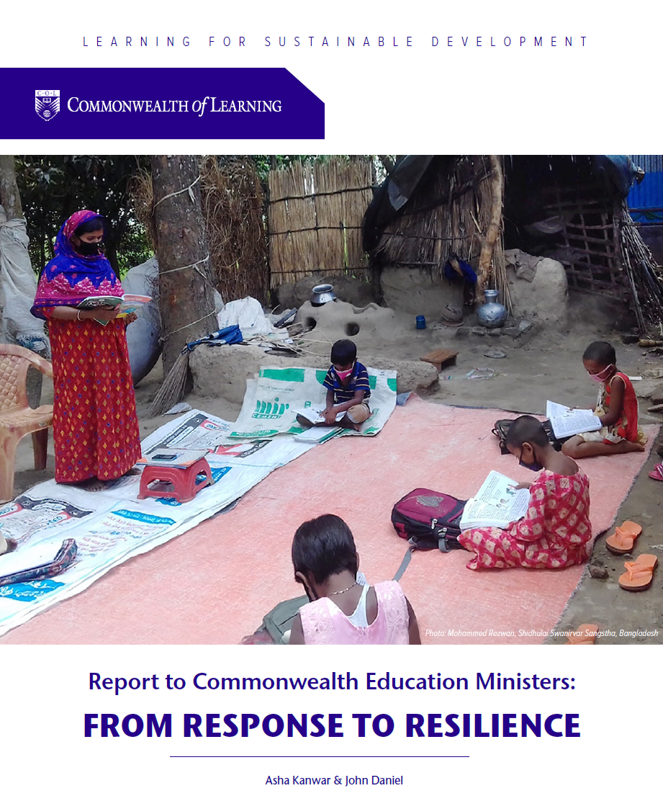


Deploying DE pedagogy and assessment resources

Slide 28

4. Open Educational Resources: curated content
OAsis: http://oasis.col.org/
COLVEE: https://www.colvee.org/
DOER: http://doer.col.org/
3300+
100+
OER for skills development
7000+

Slide 29
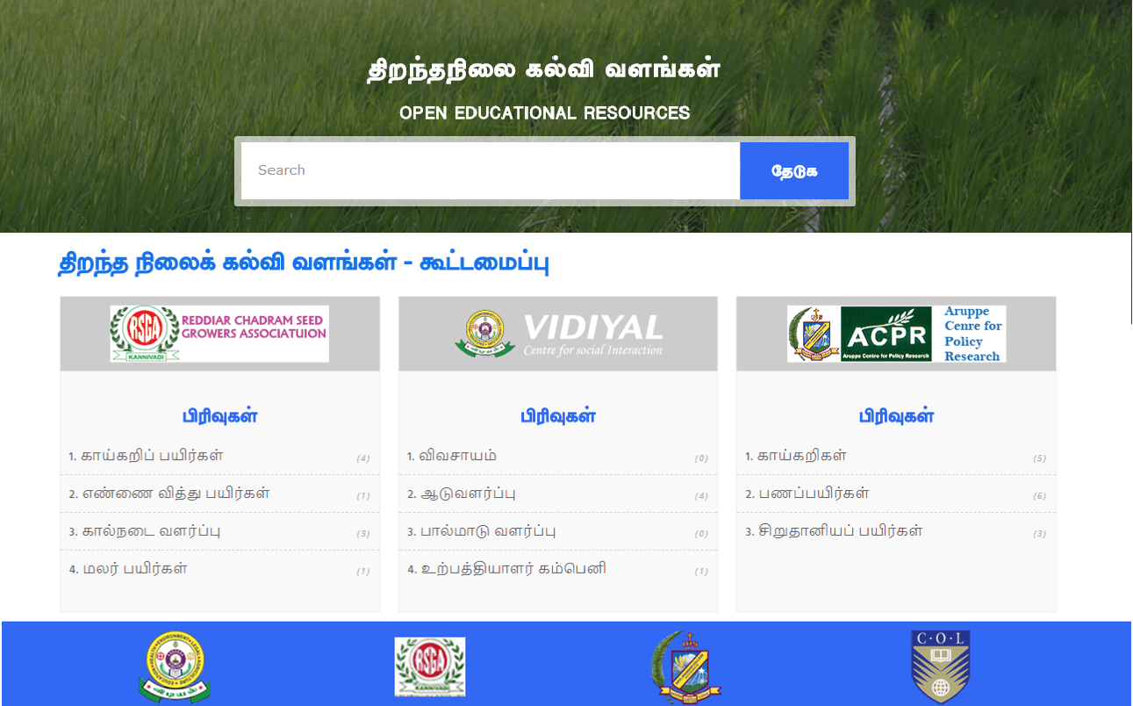
OER for Farmers

Slide 30
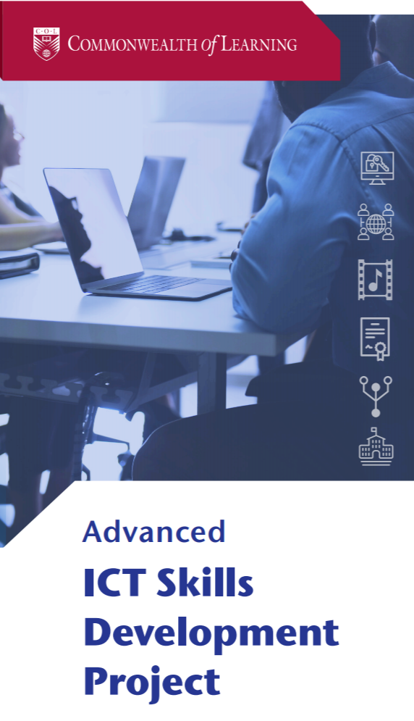
30 courses downloaded over 115,000 times

Slide 31
Opportunities

Slide 32

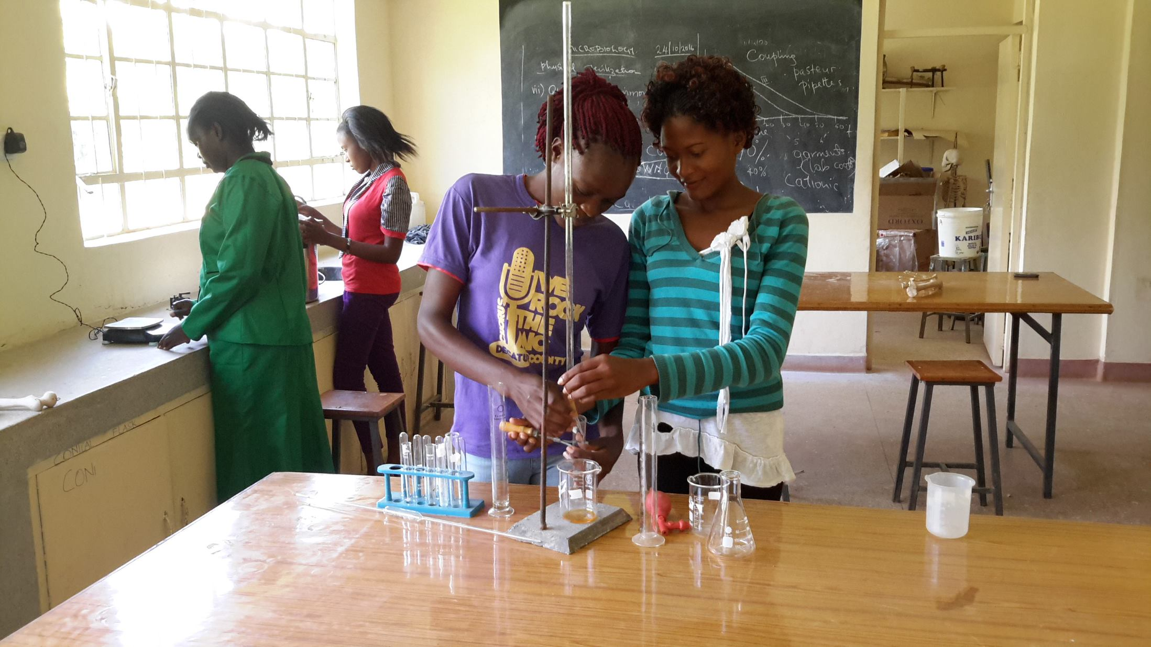
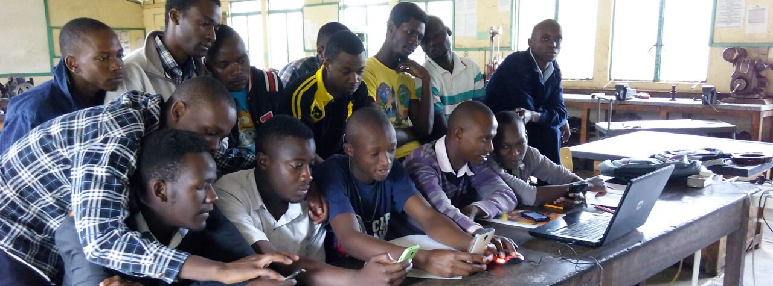
Connectivity
Content
Capacity

Slide 33

Connectivity
Increasing access to broadband
Access to devices
Zero rating of educational platforms

Slide 34

Content
Multiple media
Simulations, Augmented and Virtual Reality
Artificial Intelligence

Slide 35
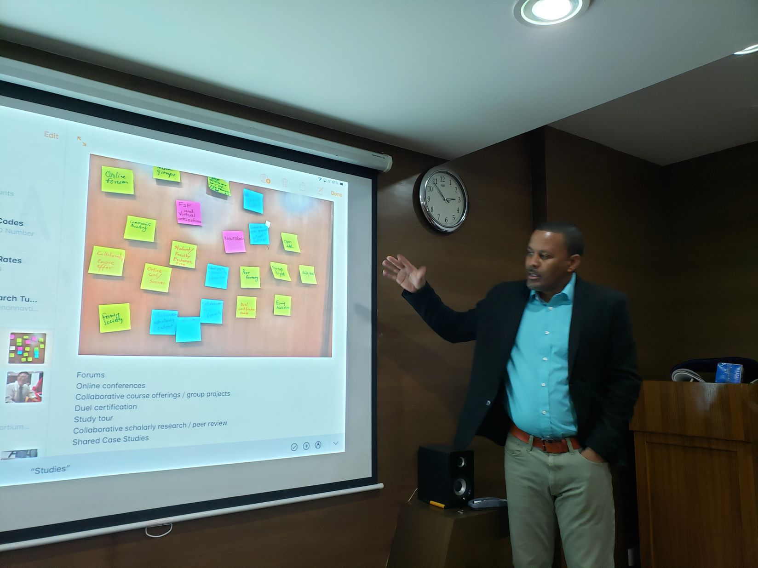
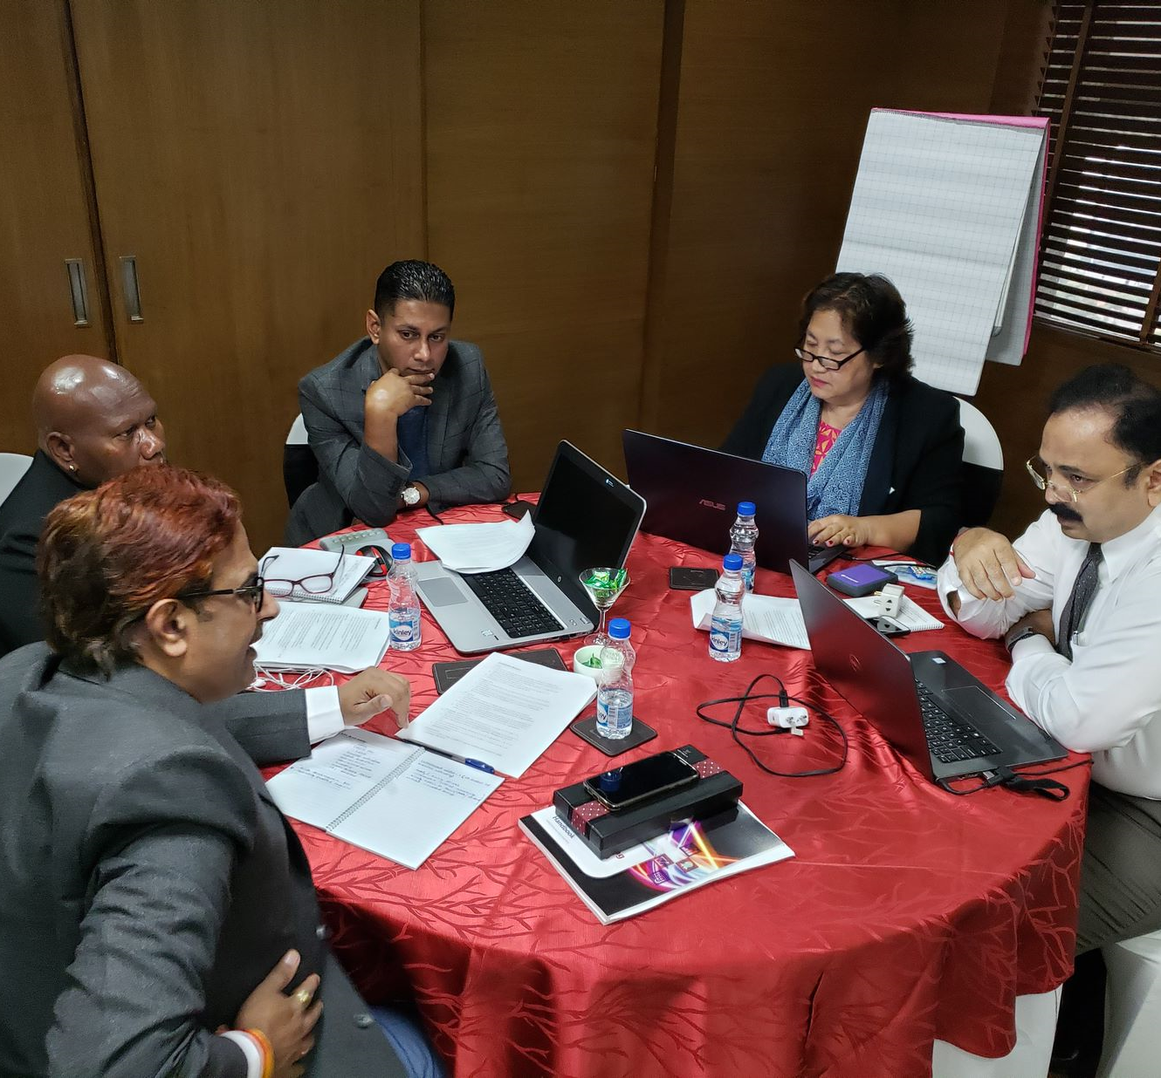
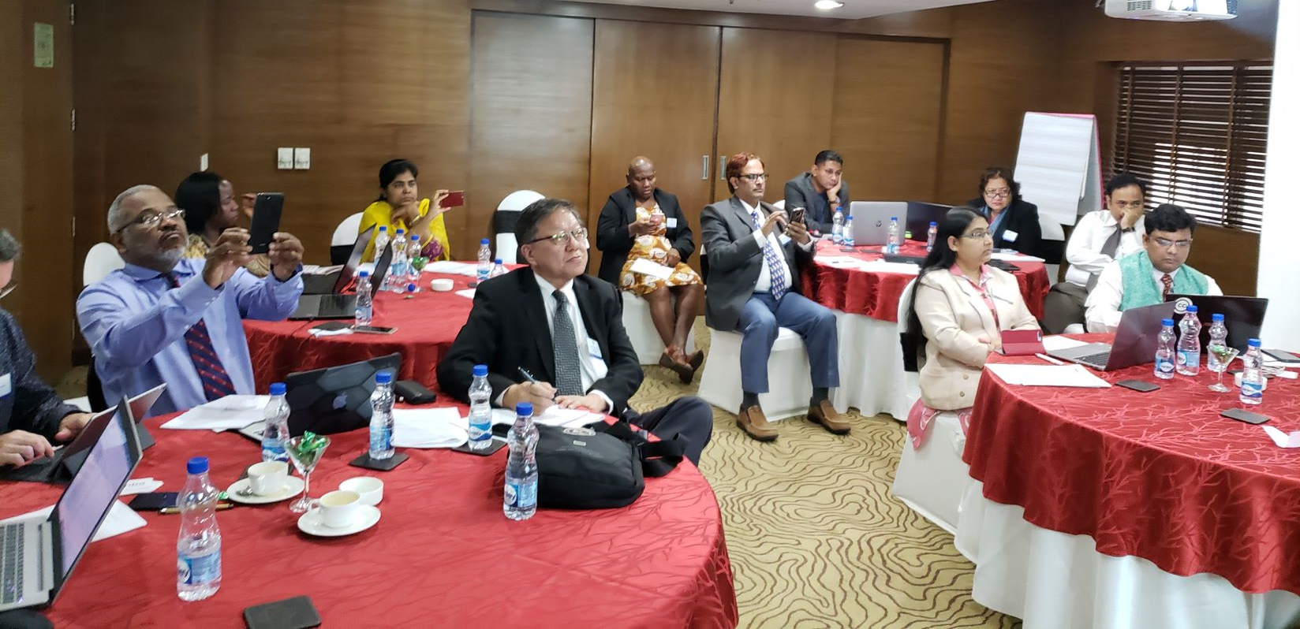
Capacity
Building capacities of policy-makers
Developing capacity of teachers for blended learning
Preparing learners for self-directed lifelong learning

Slide 36

Thank You www.col.org
The contents of this presentation, except logos/ graphics which are property of the respective owners, is made available under Attribution-ShareAlike 4.0 International (CC BY-SA 4.0).

