Slide 1


Towards Innovative
Leadership
Professor Asha Kanwar
COL President & CEO
Fourth Pan-Commonwealth Women and Leadership in ODL Training
August 1, 2022 | Penang, Malaysia

Slide 2

Outline
Key issues of our time
Reflecting on Women’s leadership
Dimensions of leadership
Innovative leadership

Slide 3
Key issues of our time

Slide 4
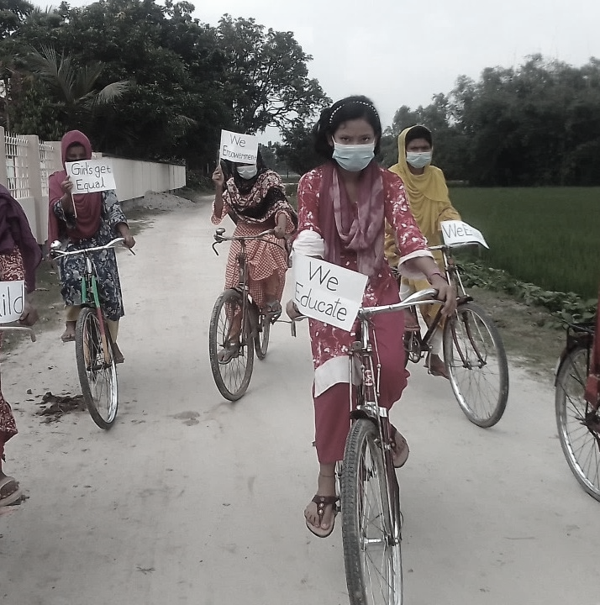


Key issues of our times
COVID-19 PANDEMIC
ACHIEVING SDG4
CLIMATE CHANGE

Slide 5

Covid-19
Technology
Teacher Capacities
Disproportionate impact on women and girls

Slide 6



Slide 7
Climate Crisis in the Commonwealth
Disproportionately affects the Commonwealth
32 small states most vulnerable to climate change
8 of the
top 10 countries
prone to natural disasters are in the Commonwealth:
1. Vanuatu; 2. Solomon Islands; 3. Tonga; 4. Dominica;
5. Antigua and Barbuda; 6. Brunei Darussalam; 7 Guyana;
9. Papua New Guinea
Source: https://weltrisikobericht.de/wp-content/uploads/2021/09/WorldRiskReport_2021_Online.pdf
Notes:
The climate crisis is one of the defining issues of our world today. The science is clear: the drastic changes in global climate patterns starting in the mid-to-late twentieth century are attributable to the increasing level of greenhouse gases in our atmosphere, produced by human activities. The result of this change in climate patterns is apparent in the devastating storms, floods, and other natural disasters that have become a regular occurrence across the globe today.
The Commonwealth, which comprises 53 countries, is disproportionately affected by climate change, as many of its members are amongst the small or least developed states.
According to the World Risk Index, calculated by the United Nations University Institute for Environment and Human Security (UNU-EHS) and featured in the 2016 World Risk Report (WRR 2016), 9 out of the top 20 countries most at risk for natural disaster are Commonwealth countries.

Slide 8

Are we equipped to address these issues and provide leadership?

Slide 9
Women’s leadership

Slide 10
Gender Gap in Commonwealth Countries (2021)
  New Zealand (4)
  Namibia (6)
  Rwanda(7)
  South Africa (18)
HIGH Ranking
  Pakistan (153)
  Vanuatu (141)
  India (140)
  Nigeria (139)
LOW
Ranking
Source: World Economic Forum – The Global Gender Gap Report 2021.
Notes:
2021 ranking. Out of 156 countries.
https://lordslibrary.parliament.uk/international-womens-day-2022-gender-gaps-across-the-world/

Slide 11
Gender gaps in ICT
Cloud Computing, women make up 14% of the workforce; Engineering, 20%; Data and AI, 32%
Of the estimated 3.7 billion unconnected, the majority are women and girls; use the Internet 12.5 per cent less than men and boys;
Source: World Economic Forum, Global Gender Gap Report 2021, published on 30 March 2021
Source: ITU, Bridging the gender divide, retrieved on 24 March 2022

Slide 12
Women and education in Canada
25-34 year olds with a university degree
44%
women
33%
men
15%
women
15.6%
men
1990
2019
Source: Statistics Canada, Study: Youth and education in Canada, published on 4 October 2021.
Notes:
Old reference: Women in Canada at a Glance Statistical Highlights 2012
Study: Youth and education in Canada https://www150.statcan.gc.ca/n1/daily-quotidien/211004/dq211004c-eng.htm

Slide 13



Vice-Chancellors: Gender Statistics
Country | % of Female Vice-chancellors of Public Universities
 | 29%
 | 15%
 | 7%
Sources:
WomenCount: Leaders in Higher Education 2018, published on 28 November 2018.
Mail & Guardian: Few women leaders in academia, published on 20 August 2020.
SSRN: Women in Leadership: A Scenario in Indian Higher Education Sector, published on 10 January 2018
Notes:
https://www.timeshighereducation.com/academic/press-releases/women-lead-20-percent-worlds-top-universities-first-time
Old reference: British Council, Going Global 2015, Defined by absence: the Invisible women in HE Leadership

Slide 14
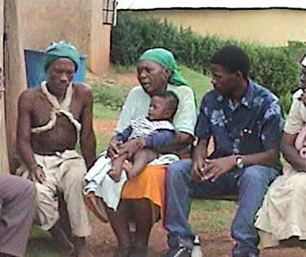
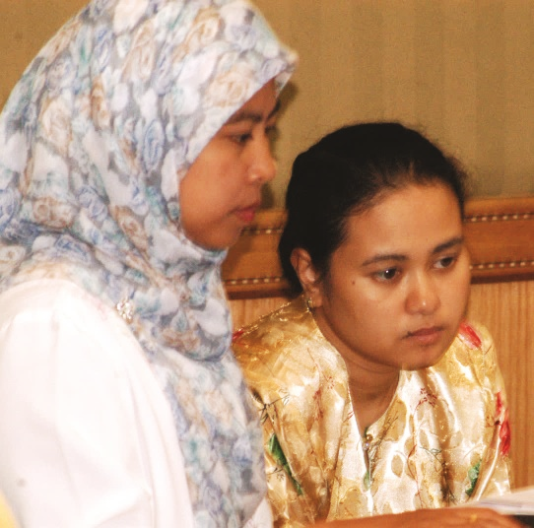
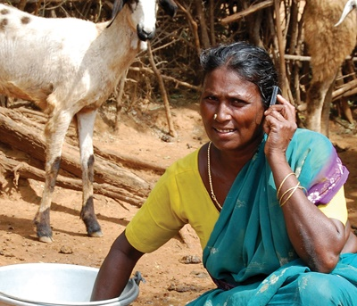
Why so few women reach the top?
Family responsibilities
Social norms
Desire to be liked

Slide 15

The Gender Bias: Howard/Heidi
Heidi Roizen: successful by using her ‘outgoing personality…and vast personal and professional network [that] included many of the most powerful business leaders in the technology sector’
Impressions
Howard: appealing colleague
Heidi: selfish
Source: Sandburg, 2013, pp. 39-40

Slide 16
Are Women Leaders Preferred?
40% prefer male managers
20% prefer women
44% women preferred male managers
Only 23% preferred women
Source: Ranstad, 2011

Slide 17

Preparing ourselves
How do we build our capacity to make choices and to transform those choices into desired actions and outcomes?
Source: World Bank, Empowerment, http://go.worldbank.org/S9B3DNEZ00

Slide 18
Dimensions of
leadership

Slide 19


Slide 20
1. Structural Frame
Assumptions
Goals get results
Rules & policies; chains of command, specialisation
Analysis and data
Accountability
Behaviours: goal setting; evaluation; budgeting; developing management & control systems

Slide 21
2. Human Resources Frame
Assumptions
People valued as important resource
Focus: meeting human needs; relationships
Facilitation & empowerment: consensus
Help employees fit into the organisation
Behaviours: recruiting; training workshops and retreats; participative management; communication skills; coaching

Slide 22
3. Political frame
Assumptions
Conflict and competition are a fact of life
Focus: securing critical resources
Reach agreement by negotiation
Need to understand ‘power’ relationships
Behaviours: negotiating agreement; managing conflict; networking; creating coalitions; building a power base; managing the agenda

Slide 23



Canada: 2005
Télé-université du Québec (TÉLUQ)
Université du Québec à Montréal (UQAM).
British Columbia Open University (BCOU) combined with University College of the Cariboo to become Thompson Rivers University

Slide 24
Lessons
the primordial importance of relationships with governments
the importance of relationship building with other institutions
the importance of cultivating communities of students and alumni
  Source: Strategic Issues in Single and Dual Mode Distance Education: the organizational blending of two Canadian distance universities with campus-based institutions Dominique A.M.X. Abrioux, Ph.D, 2006

Slide 25
4. Symbolic frame
Assumptions
Reality socially constructed: ‘multiple realities’
Focus: creating shared meaning
Organisational culture: use of symbolism; vision, mission, identity
Behaviours: formal ceremonies; slogans; songs; images; rituals; visioning

Slide 26

Will a combination of these frames lead to ‘innovative leadership’?

Slide 27
Innovative leadership

Slide 28
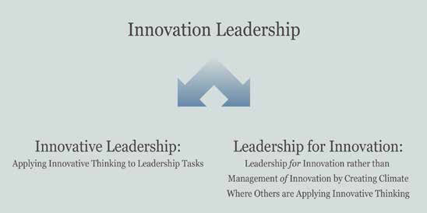
Source: David Horth and Dan Buchner, “Innovation Leadership: How to use innovation to lead effectively, work collaboratively, and drive results”, Centre for Creative Leadership, 2014 in http://insights.ccl.org/wp-content/uploads/2015/04/InnovationLeadership.pdf

Slide 29

The Case of Steve Jobs
Do what you love
Make a difference
Creativity is connecting things
‘Say no to a thousand things’
Create insanely great experiences
Master the message
Sell dreams not products
Carmine Gallo, Forbes
Source: http://www.forbes.com/sites/carminegallo/2011/01/04/the-7-success-principles-of-steve-jobs/#56a9375a5bb7

Slide 30
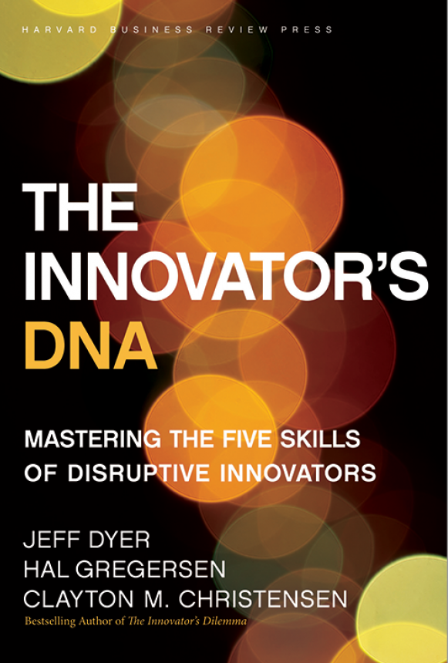
Skills for Innovation
Questioning
Observing
Networking
Experimenting
The Innovator's DNA: Mastering the Five Skills of Disruptive Innovators
by Jeffrey H. Dyer, Hal B. Gregersen, Clayton M. Christensen, Harvard Business Press
Notes:
Asking ‘why?’ or ‘what if?’
ODL Leaders must encourage a spirit of inquiry and a culture of research
Exposure to new technologies and environments to assess what works and what doesnt and why
Interactions of a social and intellectual nature with people from different disciplines/sectors
ODL Leaders must promote
interdisciplinary exchanges so that by connecting different disciplines and sectors, innovative ideas emerge
ODL Leaders must enable staff to visit other institutions and expose them to emerging technology developments
Try out new ideas by creating prototypes and launching pilots
ODL Leaders must encourage staff to construct interactive experiences and provoke out of the box solutions

Slide 31
What drives Research and Innovation in Industry?
http://www.arcusgroup.ca/CEO_view_strategic_planning.html

Slide 32
ODL Leaders
Philosophy
People
Processes
The Innovator's DNA: Mastering the Five Skills of Disruptive Innovators by Jeffrey H. Dyer, Hal B. Gregersen, Clayton M. Christensen, Harvard Business Press

Slide 33
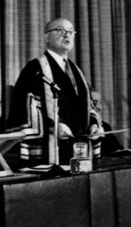
I. Philosophy of ‘Open-ness’
Open as to people,
Open as to places,
Open as to methods, and, finally,
Open as to ideas
Lord Crowther

Slide 34
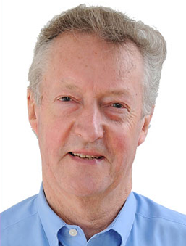
Inspire future leaders
Sir John Daniel
Enrolling in the courses of his own university and promoting technology integration
Notes:
Believe in the social mission of ODL
Have a vision
Review mission statements
Keep abreast of new development in technologies

Slide 35
Are we effective advocates for ODL?

Slide 36
II. People
Motivate and inspire staff: be empathetic
Engage policy makers and stakeholders
Proactively support women leaders
Provide incentives

Slide 37
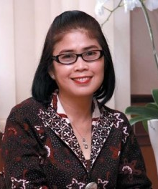

Universitas Terbuka
1995 internet came to Indonesia
1997 online courses
incentives
Tian Belawati

Slide 38
Do we cultivate Champions for Change?

Slide 39


III. Processes
Create policies and systems
Encourage discussion and debate
Targeted approach

Slide 40
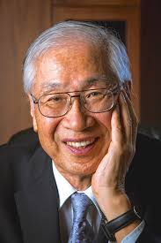

The Open University of Japan
One fourth of the students over 60
Declining government support
Cater to the Third Age
Yoichi Okabe

Slide 41
Are we evolving to remain relevant to the needs of stakeholders?

Slide 42

Women Leaders
Evolve through non-formal and informal processes
No structured roadmap for the evolution of leadership
Leadership is issue-based and not (necessarily) institution-based

Slide 43
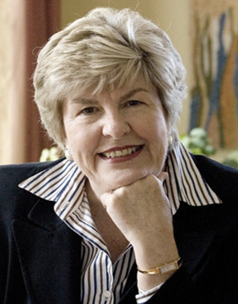
Brenda Gourley
Reflecting on the women I’ve worked with…I’ve found them to be less hierarchical, have more empathy with those who work for them and seem more caring in the process.
Source: http://hdl.handle.net/11599/24, Page 58
Notes:
“walk with people, they talk with people, they learn from people and they lead by example. Let me end with a quote from Albert Einstein: ‘Setting an example is not the main means of influencing others, it is the only means.”

Slide 44
Reflection
What are my strengths?
What do I need to work on to become a better leader?

Slide 45
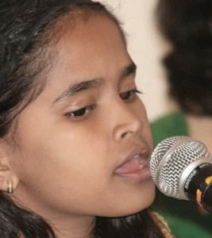
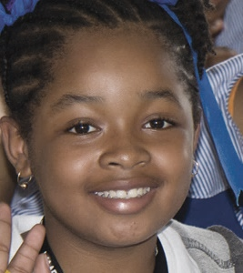
Key Message
Leadership is a skill and must be promoted among women if we need innovative leaders in ODL.

Slide 46


Thank you
www.col.org
The contents of this presentation, with the exception of logos and graphics which are the property of the respective owners, is made available under Attribution-ShareAlike 4.0 International (CC BY-SA 4.0).

