Slide 1

What must we do to effectively prepare teachers for tomorrow?
Dr. Jessica N. Aguti
Education Specialist: Teacher Education
jaguti@col.org | www.col.org

Slide 2

Global Predictions on Populations
Populations will grow from
7.2 billion to 8.3 billion
60% living in urban
areas
Migration will
also increase
further

Slide 3
Implications of a growing population
Increased demand for education
Need for increased investments
Need for more & better quality teachers
Need for lifelong education for varied ages of the populations
Need to specifically address education for peri-urban and slum populations

Slide 4
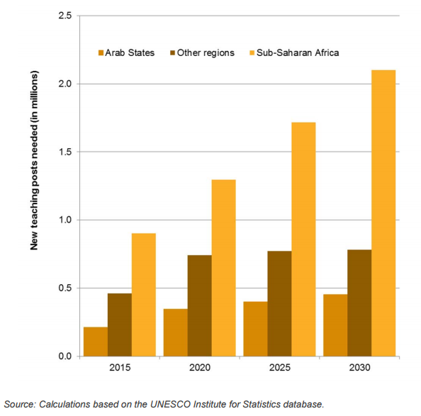
Teachers needed by 2030
New teaching posts needed (m)
3.3m extra primary school teachers
5.1m extra lower secondary teachers
SSA will need 2.1m new teachers
2.6m teachers to cater for attrition
http://bit.ly/1LWF1XB

Slide 5
Re-train and train more teachers
Use of flexible methodologies
Increase efficiencies in teacher education
Completion rates in TEIs
Teacher retention
Teacher development and career paths
Support and supervision of teachers
Provision of adequate resources during training and after training

Slide 6
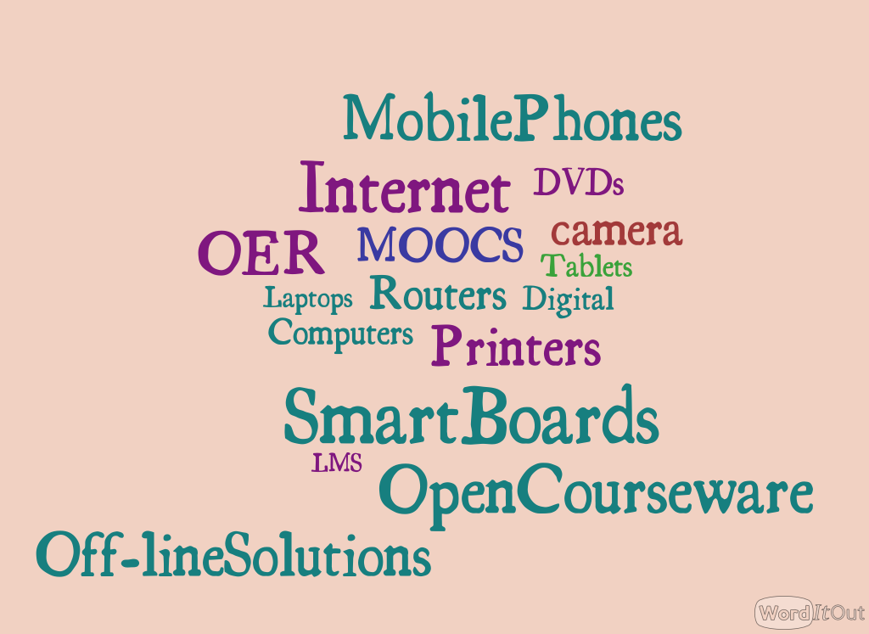


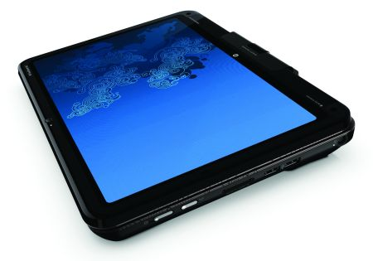

Global predictions on Technology
Variety of technologies increasingly available

Slide 7
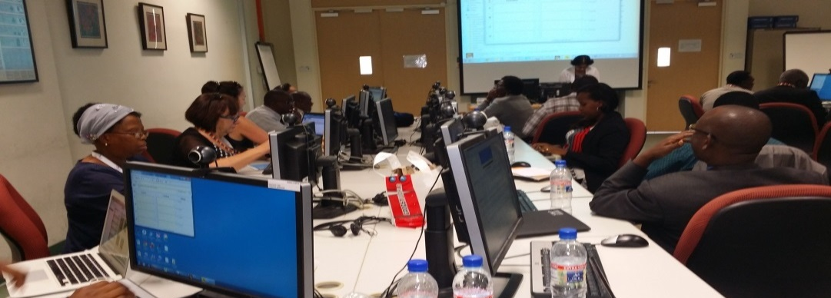
Technology…
Education business as the largest Internet company
Online education will flourish further
But software will never replace teachers’
Teachers must be adept with technologies

Slide 8
Global Predictions on Jobs
2 billion jobs will disappear
Most will come back in different forms
Most jobs will be freelance projects rather than full-time jobs
New skills and competences needed
  Learning and innovative skills
  Information media and technology skills
  Life and career skills

Slide 9
21st Century skills…
Creativity and Innovation
Critical Thinking and Problem Solving
Communication and Collaboration
Learning and Innovative Skills
SPECIFIC PROFESSIONAL SKILLS
HOW DO WE BALANCE?
Flexibility & Adaptability
Initiative & Self-Direction
Social & Cross-Cultural Skills
Productivity & Accountability
Leadership & Responsibility
Information Literacy
Media Literacy
ICT Literacy
Life and Career Skills
Information, Media and Technology Skills
Notes:
Skills as given by Thoughtful learning http://www.thoughtfullearning.com/resources/what-are-21st-century-skills

Slide 10
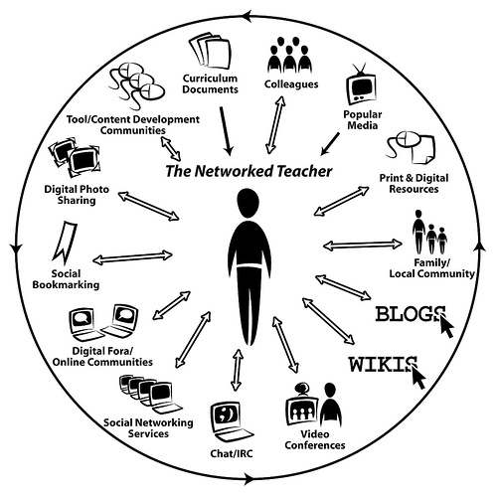
How can teacher education prepare for changes in skills?
Foundation for skills laid in schools
Need teacher educators with these skills
Transform curricula
Integrate technology
Prepare teachers to be global citizens

Slide 11
COL Teacher Education Activities
Integration of ICTs in teaching and learning
Supporting institutions to convert programmes into e learning programmes
Integration of OERs
MOOCs for capacity building
Revision of curricula; and
Development of various policies and guidelines

Slide 12
Conclusion
Teaching shifting from teaching to learning mode
Current programmes & strategies will not prepare teachers effectively for tomorrow
Population in Africa is exploding, technology is here to stay; and the market place has new demands
Teacher education must change.
There are already many innovations, can we expand and institutionalize these

Slide 13
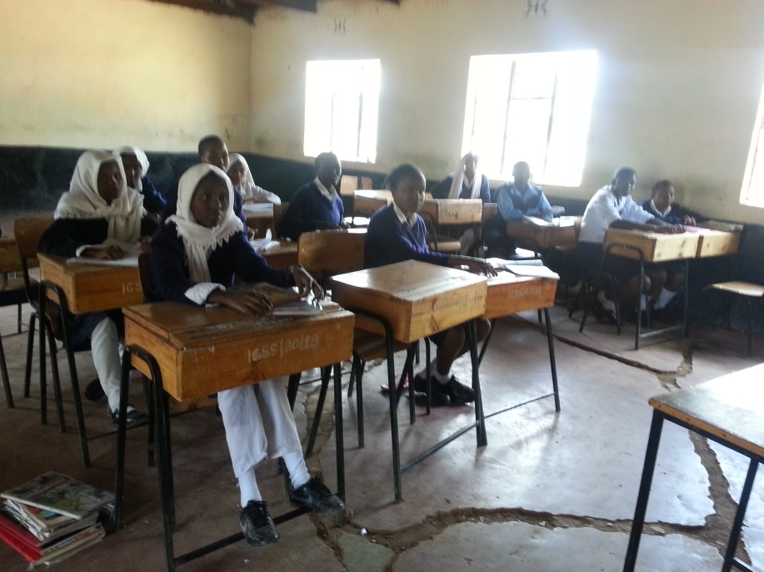
Food for thought…
“We need to prepare students for THEIR future not OUR past
Ian Jukes, educator and Futurist http://bit.ly/V57C5P

Slide 14
Clicker Questions
The best way of covering soft skills in teacher education is to:
a) Integrate the skills in subject content YES NO
b) Integrate the skills in methods of teaching YES NO
c) Integrate the skills in assessment YES NO
d) Create a new course for these soft skills YES NO

