Slide 1



Technology
Empowered
Education: the promise of AI
Professor Asha Kanwar
President and CEO
Commonwealth of Learning
29 November 2023 | Guyana

Slide 2

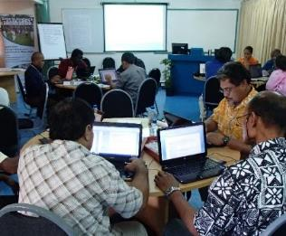
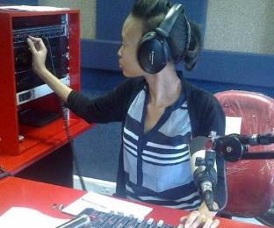
To help Commonwealth governments and institutions use technologies to improve and expand access to education and training
Notes:
What do we do? Our mission is to help Commonwealth member states and institutions to use technologies for expanding access to quality education and training.

Slide 3

Teacher Professional Development (2012)
Professional development of teachers using UNESCO ICT competency framework for teachers.
COL supported OER development
Learning resources released on CD
http://hdl.handle.net/11599/279

Slide 4

Hon. Priya D. Manickchand
Minister of Education

Slide 5
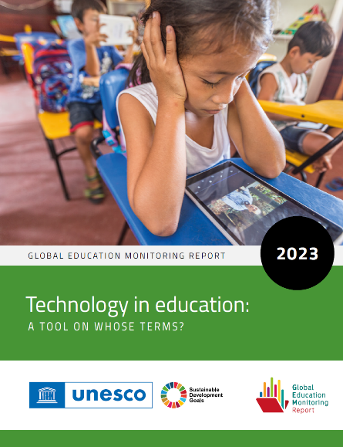
Technology Applications
In Guyana, lessons from the government’s radio programme in mathematics are sometimes pre-recorded onto CDs or in MP3 format and delivered with accompanying audio players to classrooms
(Guyana Ministry of Education, 2020).
Source: https://unesdoc.unesco.org/ark:/48223/pf0000385723

Slide 6

ICT in Education Policy
The 2021 ICT in education policy and master plan aims to provide computer labs and smart classrooms in primary and secondary schools.
Through the Support for Educational Recovery and Transformation Project more support being provided for interactive screens and projectors in grades 2 to 6
(Guyana Ministry of Education, 2021:2022).
Source: https://unesdoc.unesco.org/ark:/48223/pf0000385723

Slide 7


OUTLINE
AI in Education
Actions

Slide 8

AI in Education

Slide 9



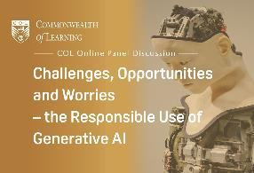
AI in Education
Institution
Teacher
Learner
Notes:
COL has recently hosted a Webinar series to sensitise partner institutions and individual educators in our network
Research and publications on AI
MOOC on AI
AI-driven Helpdesk on Moodle, GPT-for-Moodle where a pilot deployment received an overwhelmingly positive response (about 77% rating it as highly useful).

Slide 10
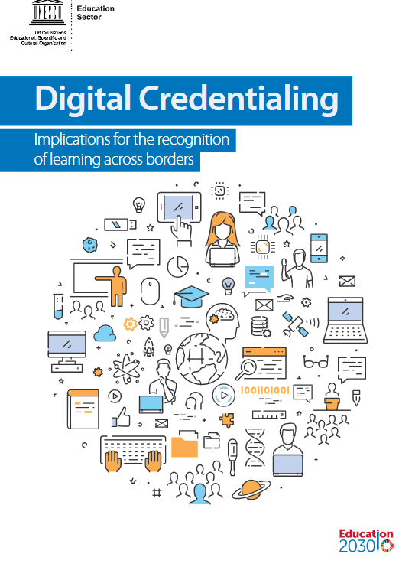
Institution
Increased productivity
Reduced costs of content
Assessment
Transfer of Credits
https://unesdoc.unesco.org/ark:/48223/pf0000264428?posInSet=4&queryId=N-e4559bf5-0bec-40c7-91a9-5cdea42e1ca4
Notes:
These can also be termed “system facing” applications. Scheduling in large institutions is a complex exercise. It can be simplified using AI, and can be helpful in generating university-wide schedules that are also personalised for each student. Using AI, literally thousands of OER can be curated for adaptation, thus reducing cost of content development. When AI technologies are applied on learning analytics, institutions can create profiles of learners to help understand where they may face challenges in particular learning situations.

Slide 11


Teacher
Lesson plans
Test Items
Language translation
Text summarisation
Image generation from text
Microlearning courses
Image Source: https://securitymea.com/2023/02/24/new-malware-stealing-social-media-credentials-under-chatgpt-app-disguise/
Notes:
An AI-based service that uses Natural Language Processing technology such as ChatGPT can reduce teacher’s time spent on mundane tasks. Can help the teacher with improved monitoring can serve as an assistant to the teacher in generating lesson plans or to create tests; can create images for teaching from text commands of the teacher. Using new AI services, micro-courses can be created using simple textual description.
A Large Language Model (LLM)
Trained on massive quantities of data
To generate human-like text
G(enerative) P(re-trained) T(ransformer)
Transformer is an advanced AI technology developed in 2017- an example is language translation
Much wider capabilities in May 2023 through plugins

Slide 12


Learner
Provide an intelligent, personal tutor for every learner
Support for collaborative learning
Adaptive group formation
Expert facilitation
Source: https://www.ibm.com/watson/advantage-reports/ai-social-good-education.html
Notes:
Personalised coaching or mentoring using AI services is piloted by MOOC providers like Coursera. Besides Coursera Chatbot, there is now Coursera Coach available in a limited number of courses on a pilot basis. AI support for collaborative learning is an area of research. Expert level and personalised support on specific subjects is available in a limited number of services such as Coursera Coach.

Slide 13

Impact of AI in Education
AI generated videos as engaging as human videos
AI helps to personalise content
AI supports automated grading
AI Tools can generate learning materials at lower costs.
RASK, AI in Education Report 2023
Notes:
At this stage, one can anticipate that there will be positive impacts of AI, especially generative AI, in education. Generating videos, images and micro-courses from simple text commands or prompts will be a game changer for institutions and teachers. Personalised content and tutoring will bring new advantages to learners. Analytics-based assessments can give new advantages to students as well as teachers. The greatest advantage is the use of human language to give instructions to the software!

Slide 14
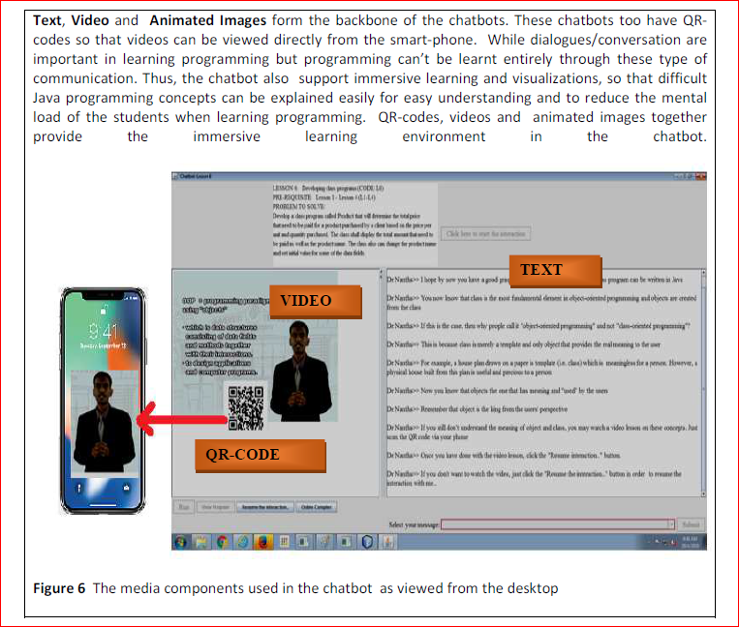
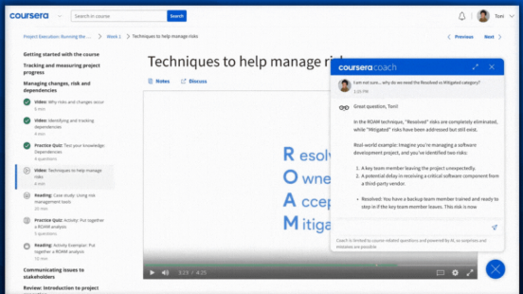
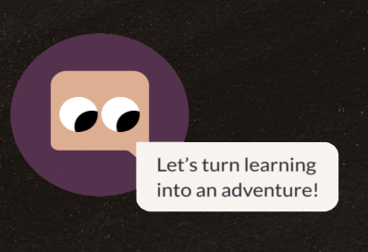
Use of
Chatbots
ChatGPT: Generates Essays, Test Items, Scripts, proposals
Synthesia. IO: Video creation
RASK.AI and Aloud-YouTube: Translation, video dubbing
Khanmigo:
Notes:
ChatGPT is a popular service with millions of active users. As of now, Google Bard, Claude 2 from Anthropic are also gaining popularity. There are more efforts under way to build open-source language models which can power econtext-sensitive chatbots. An example is Falcon 40B in the UAE. This is a dynamic area with new developments almost daily.

Slide 15
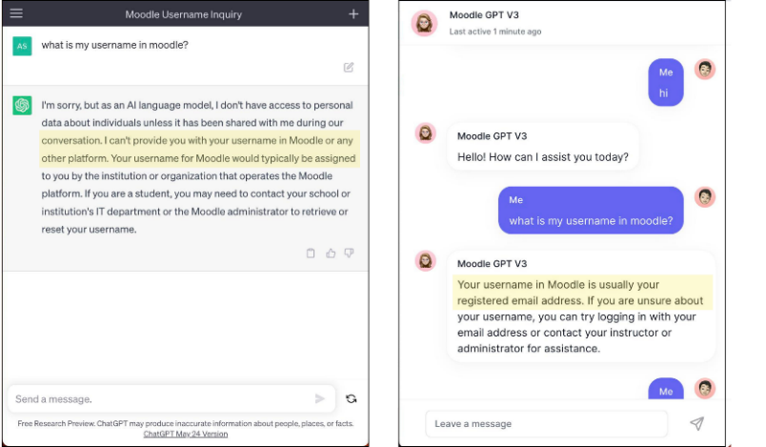
AI/GPT-powered Learner support on Moodle - a COL pilot in Samoa

Slide 16
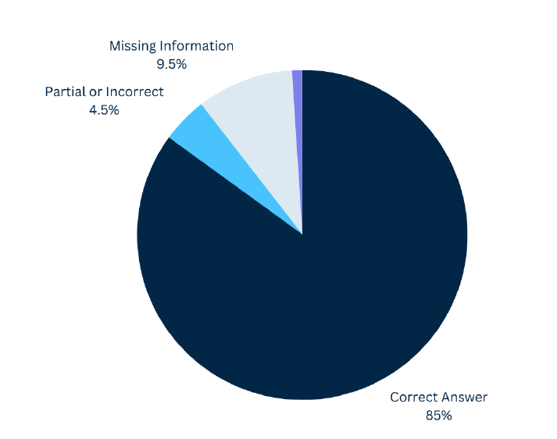
Quality of responses
Users rated GPT4Moodle highly for giving correct answers 85% of the time.
With one more iteration, the response quality can reach 95%

Slide 17
Actions

Slide 18


Digital divide
Internet usage (2021)¹
Globally: 63% | Guyana: 85%
Mobile Cellular
Subscriptions (2021)²
Globally: 106% | Guyana: 106%
Men: 69% | Women: 63% ³
259 million more men than women were using the internet last year.
Women are 12% less likely to own a mobile phone than men.
    Sources:
    The World Bank Data: https://data.worldbank.org/indicator/IT.NET.USER.ZS?locations=GY-1W
    The World Bank Data: https://data.worldbank.org/indicator/IT.CEL.SETS.P2?locations=GY-1W
    International Telecommunication Union (ITU) Statistics: https://www.itu.int/en/ITU-D/Statistics/Pages/stat/default.aspx
Notes:
The digital divide continues to be a significant challenge in Africa.
Many schools and educators lack the resources and training necessary to utilise technology effectively.
Generic data
. Internet usage:
In 2021, only 28.2% of individuals in Africa used the internet, compared to the global average of 53.6%. Source: International Telecommunication Union (ITU) - https://www.itu.int/en/ITU-D/Statistics/Pages/stat/default.aspx
b. Mobile broadband subscriptions:
In 2020, there were 82 mobile broadband subscriptions per 100 inhabitants in Africa, compared to the global average of 111. Source: International Telecommunication Union (ITU) - https://www.itu.int/en/ITU-D/Statistics/Pages/stat/default.aspx
c. Access to electricity:
In 2019, only 48% of the population in Sub-Saharan Africa had access to electricity. Source: World Bank - https://data.worldbank.org/indicator/EG.ELC.ACCS.ZS?locations=ZG
Even where access to mobile devices among adults has reached 100% in some African countries (e.g., South Africa, Namibia and Zimbabwe), although a rural-urban divide persists in most, and women and girls often have less access than men
Laurillard D, Kennedy E, Wang T. How could digital learning at scale address the issue of equity in education? (Learning at Scale for the Global South). Foundation for Information Technology Education and Development; 2018. http://dl4d.or g/wp-content/uploads/2019/03/Learning-at-Scale-for-the-Global-South-Main- Paper.pdf.

Slide 19

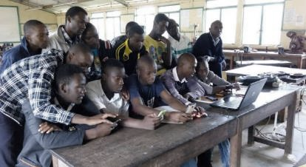
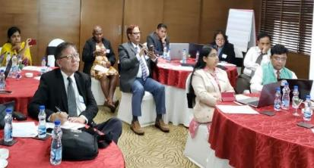
Closing the Divides: The 3Cs
Connectivity
Content
Capacity

Slide 20


Policies
Regulation at the international level
National strategies and legal provisions
Institutional policies
Image Credit: Policies by Nick Youngson CC BY-SA 3.0 Alpha Stock Images
Notes:
UN Multistakeholder Advisory Body on AI
China Regulations on Governing the Service of Generative AI; Japan, Guidelines on the use of AI in Schools and Universities
Monash University, Policy and Practice Guidance around acceptable and responsible use of AI Technologies
Australian National University; Chat GPT and other Generative AI Tools: what ANU academics need to know

Slide 21





Even with AI, the world will still need…
Blue collar
skills
Skills relating to empathy
Skills with Creativity and Innovation
Active listening, emotional intelligence, communication, cultural competence, patience and tolerance, and problem solving
complex problem solving, adaptability, curiosity, open mindedness, collaboration and entrepreneurship
Technical, physical,
spatial, time management, teamwork and safety
Notes:
Blue collar skills are required for jobs in industries that involve manual labor, such as construction, manufacturing, transportation, and agriculture (Technical, physical, spatial, time management, teamwork, and safety). As the workforce evolves and new technologies emerge, blue collar workers will need to continually update their skills to keep up with changing job demands.
Empathy skills enable workforce to build strong relationships, provide effective care and support, and to work collaboratively with others, especially in professions like healthcare, education, social work, counseling, and customer service (Active listening, emotional intelligence, communication, cultural competence, patience and tolerance, and problem solving).
Creativity and innovation – Creativity enable workforce to generate new and original ideas, while innovation enables them to turn the ideas created into practical solutions that add value (complex problem solving, adaptability, curiosity, open mindedness, collaboration and entrepreneurship).
While there are fears about large scale loss of jobs due to AI, the possibility of new job opportunities is not stressed adequately.

Slide 22



Three Key Literacies
Human
Data
Technological
Source: Joseph Aoun (2017): Robot-proof, MIT Press, https://mitpress.mit.edu/books/robot-proof

Slide 23

Our
Common Future
AI cannot replace teachers who embody ethics and empathy
Digital fluency is no longer an option
Since we are all interconnected more collaboration is needed
Notes:
Teacher professional development is central, especially to ensure that technology enhances the work of teachers

Slide 24


Thank you
www.col.org
The contents of this presentation, with the exception of logos and graphics which are the property of the respective owners, is made available under Attribution-ShareAlike 4.0 International (CC BY-SA 4.0).

