Slide 1


The Development of Open Education Resources (OER) for the Caribbean Vocational Qualification (CVQ) Assessor Training
Pauline Whiteman
NTATT
Dr. Alison Mead Richardson
Commonwealth of Learning

Slide 2
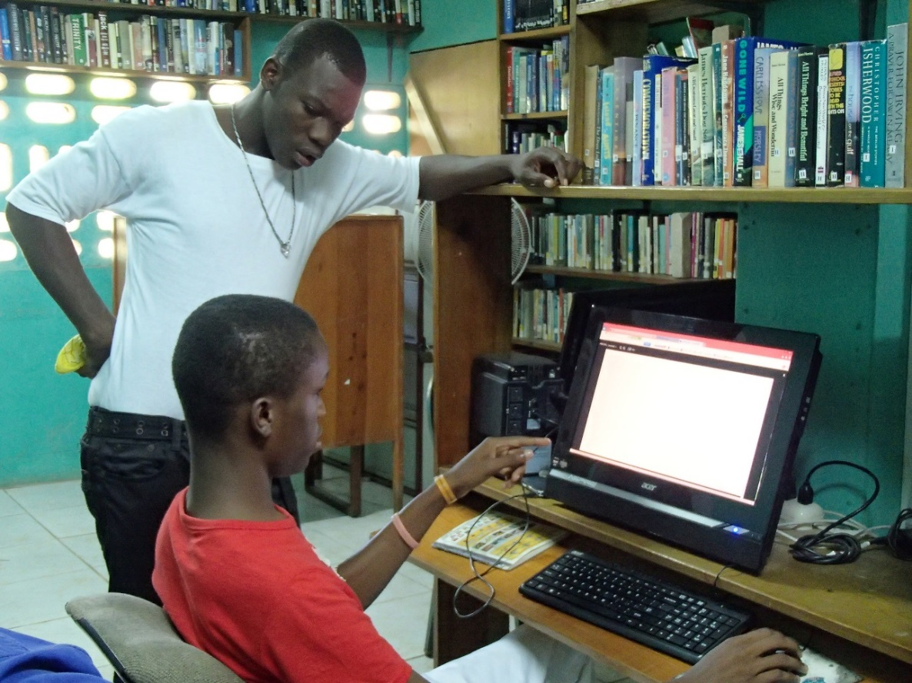
Contextual Framework
1
Regional TVET Strategy
2
Background
3
Challenges in the implementation of the CVQ
4
Programme Development
5
OER Design
6
Sustainability & Affordability
7
Benefits of the Programme
8
Conclusion
9

Slide 3
CONTEXTUAL FRAMEWORK
CANTA
CARICOM Skills Certificate
CSME
Freedom of Movement
CVQ
National Training Authorities

Slide 4
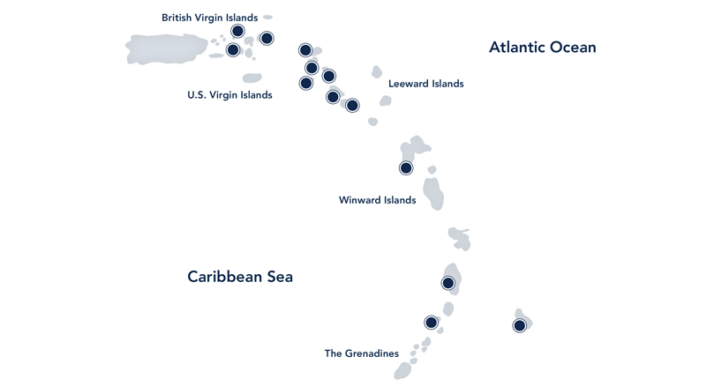

REGIONAL RESPONSE
REGIONAL TVET Strategy for Workforce Development and Economic Competitiveness
Windward

Slide 5
CVQ ASSESSOR TRAINING REQUIREMENTS
Assessor training and certification based on the Regional Competency Standard Assessment Level IV.
5 mandatory CVQ units of competency
      CSETDA0014A Plan Assessment
      CSETDA0044A Conduct Assessment
      CSETDA0054A Review Assessment
      CSETDA0034A Develop Assessment Tools
      CSETDA0024A Develop Assessment Procedures
30 hour in-service training for persons identified as assessors and verifiers for the CVQ are required to attend.
Certification within 6 months of training

Slide 6
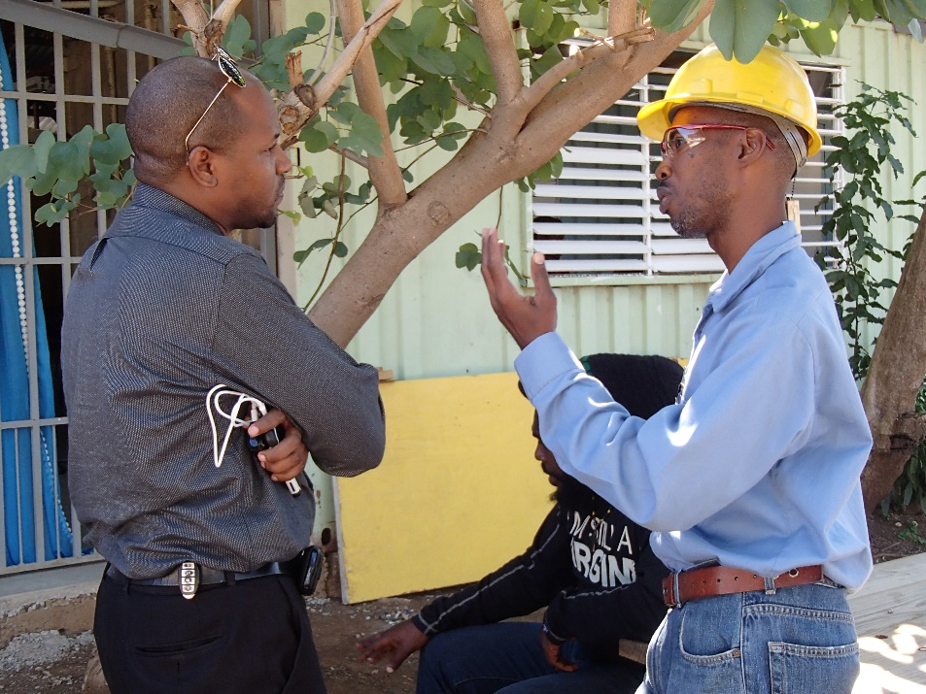
ASSESSOR TRAINING AND CERTIFICATION IN THE REGION
Approved NTAs across the region have been engaging TVET centres in assessor training and certification activities
NTAs not yet approved to award CVQs seek consultancies from the approved NTAs

Slide 7
CHALLENGES IN CVQ ASSESSOR TRAINING
Face to face training is costly requiring payments for training venue, tuition, travel, meals and materials
Costly for NTAs in countries not yet approved to award CVQs as they are required to seek consultancies from approved NTAs
Variation in methodology and content of Assessor Training programmes delivered by approved NTAs in the region

Slide 8
ONLINE CVQ ASSESSOR TRAINING
Aim is to harness the potential of open education resources (OER) for CVQ assessor training
Commonwealth of Learning (COL) and members of CANTA (Barbados, Grenada, Trinidad and Tobago)
OER are learning resources published under a Creative Commons license to be copied or adapted
Materials will be freely available for use by any institution in the Caribbean

Slide 9
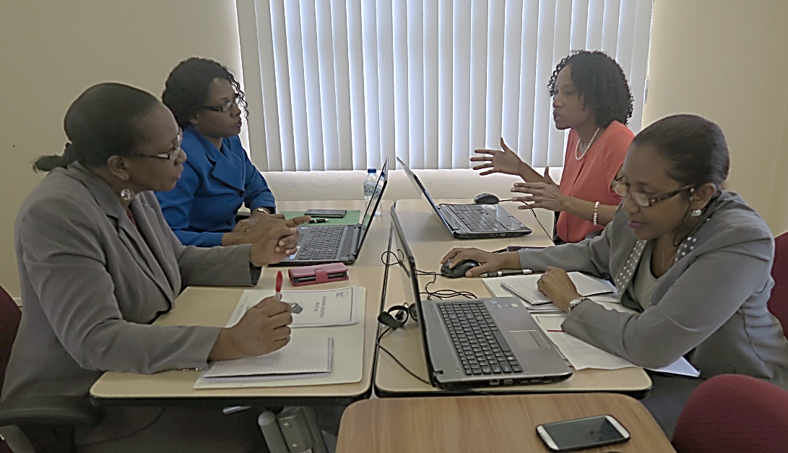

ONLINE PROGRAMME DEVELOPMENT
Adaptation of existing CVQ assessor training materials to online OER materials
Teams worked through workshops in Barbados and online meetings
Technology facilitated regular communication between the countries and advisors in Canada

Slide 10
OER DESIGN
OER design adhered to important factors regarding the quality of OERs as suggested by the Software and Information Industry Association (SIIA) Report of 2013 such as:
  Use of appropriate metadata
  Alignment to competency standards and assessments
  Ensuring that the content is free from bias
  Inclusion of both formative and summative assessments

Slide 11

ASSESSOR TRAINING MODULES
8 mandatory units as specified by CANTA quality assurance requirements
Grouped into 3 modules:
  Assessor Training Orientation
  Assessment Procedures and Tools
  Conduct Competency Based Assessment
Module 1 is currently being piloted in Barbados, Grenada and Trinidad and Tobago
Participants were recruited in each country and each enrolled online
Course is hosted on the COL Moodle learning management system to test delivery

Slide 12
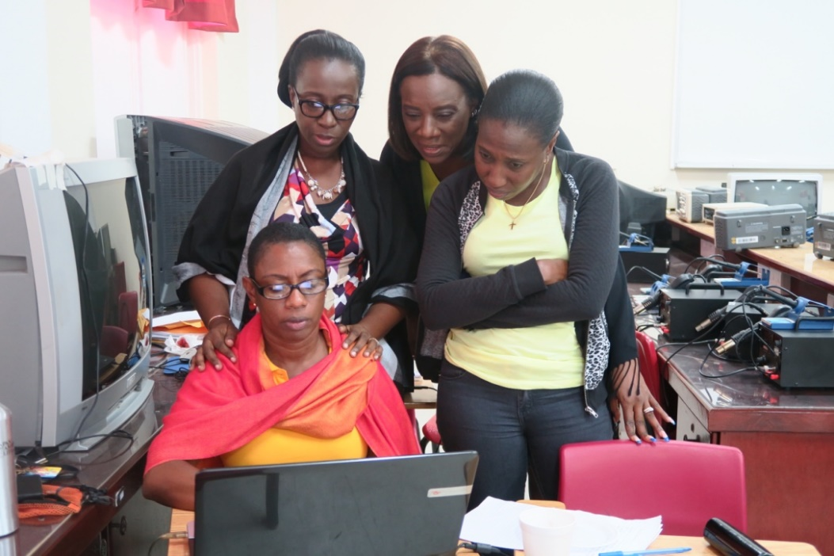
TARGET GROUP – ASSESSOR TRAINING
Intended CVQ or NVQ assessors
TVET instructors who conduct competency-based assessments
Teachers of the CXC CSEC and CAPE Technical subjects
Dual certification of candidates - CVQ as well as CSEC or CAPE

Slide 13
BUILDING THE CAPACITY OF ASSESSOR TRAINERS
The project offered an opportunity for assessor trainers to build capacity in delivering online courses
COL developed an online course ‘Facilitating Online Courses’ (FOC)
made available to assessor trainers from Barbados, Grenada and Trinidad and Tobago
FOC focused on enabling Assessor Trainers to use the various technologies available to effectively deliver in an online environment.
Nineteen CVQ assessor trainers successfully completed the training

Slide 14
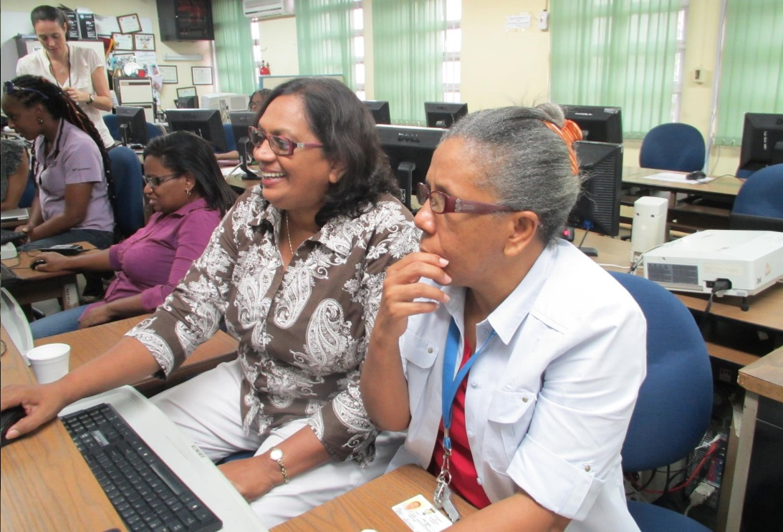
SUSTAINABILITY AND AFFORDABILITY
Sustainability is key
Development team has had initial discussions on pricing strategies and policies for students which will be documented and presented to CANTA for approval.
Documentation for the regional programme will be produced and shared with CANTA members
Plan to offer a region-wide programme in 2018

Slide 15
SUSTAINABILITY AND AFFORDABILITY
COL will make the materials for the course available as OER, which means anyone can study the materials on their own
To obtain certification, course participants must register with one of the approved NTAs and pay the required certification fee
The pilot cohort is being hosted on the COL Moodle platform, subsequently, COL will help to build capacity in Moodle hosting once a decision is taken regarding which countries will be utilising the online training
Countries will be able to host their own platform if they prefer

Slide 16

BENEFITS OF THE PROGRAMME
Has the potential to standardise and increase access to assessor training and certification
Can reduce costs associated with the implementation of the CVQ
Provides a level of flexibility – people can study at their convenience
Allows for consistency in assessor training throughout the region
Facilitates progress in the implementation of the CVQ

Slide 17
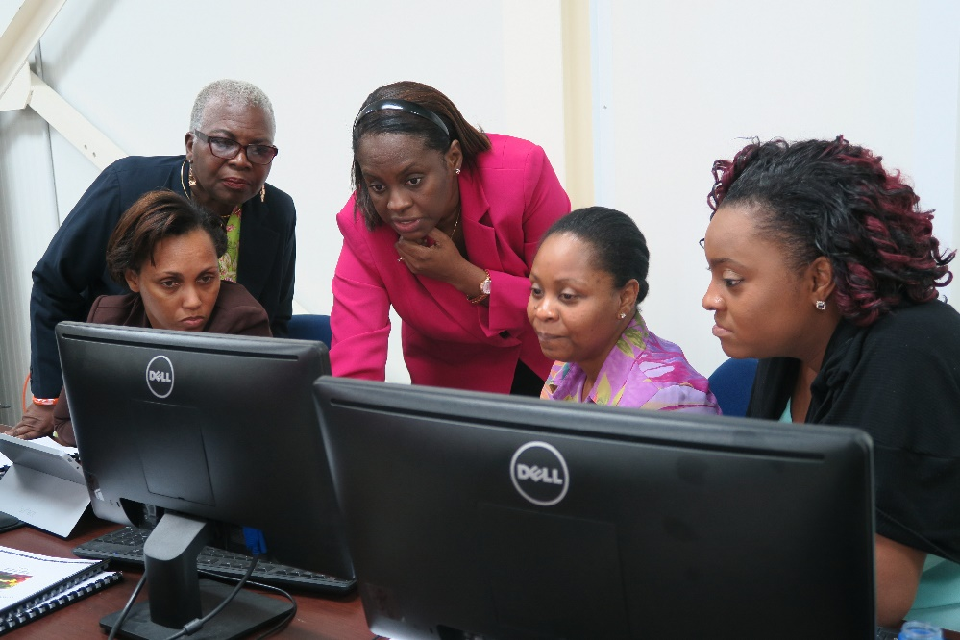
BENEFITS OF THE PROGRAMME
Allows countries with the capacity to do face to face training to set higher targets for certification of assessors and verifiers
Provides easy access to information both before and after assessors have been certified
Accessible and relevant to all training institutions that utilize the competency-based approach to assessment

Slide 18
IN CONCLUSION…
Many success stories regarding the use of OER
OER can enable the achievement of the goal as stated in the CARICOM Regional TVET Strategy in the very near future – the continuous professional development of instructors
The CARICOM Regional TVET Strategy focuses on the creation of a globally competitive region through a demand led education and training system
The use of OER is one of the viable means that should be considered to this end

Slide 19
Thank You

