Slide 1


A Green Learning Agenda
Professor Asha Kanwar
President & CEO, Commonwealth of Learning
Regional Focal Points Meeting - CARIBBEAN
Jamaica| 30-31 January 2023

Slide 2
Climate Crisis in the Commonwealth
Disproportionately affects the Commonwealth
32 small states most vulnerable to climate change
Source: https://weltrisikobericht.de/wp-content/uploads/2021/09/WorldRiskReport_2021_Online.pdf
Notes:
The climate crisis is one of the defining issues of our world today. The science is clear: the drastic changes in global climate patterns starting in the mid-to-late twentieth century are attributable to the increasing level of greenhouse gases in our atmosphere, produced by human activities. The result of this change in climate patterns is apparent in the devastating storms, floods, and other natural disasters that have become a regular occurrence across the globe today.
The Commonwealth, which comprises 53 countries, is disproportionately affected by climate change, as many of its members are amongst the small or least developed states.
According to the World Risk Index, calculated by the United Nations University Institute for Environment and Human Security (UNU-EHS) and featured in the 2016 World Risk Report (WRR 2016), 9 out of the top 20 countries most at risk for natural disaster are Commonwealth countries.

Slide 3
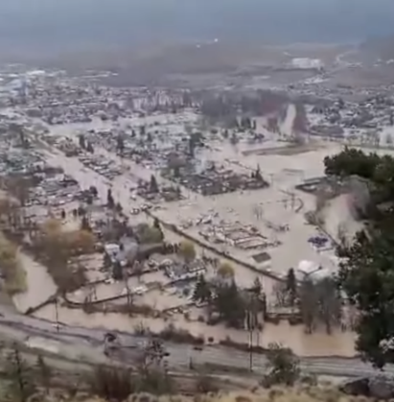
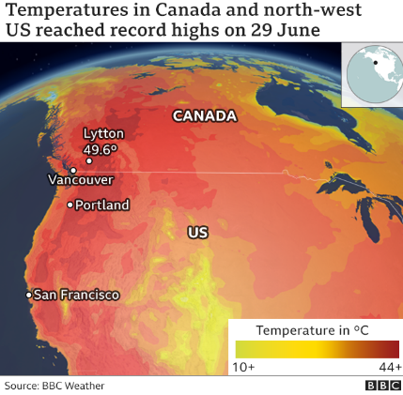
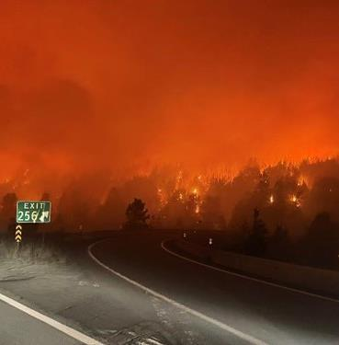

https://commons.wikimedia.org/wiki/File:Meritt_BC_Flooding_November_2021.png
Source: https://www.bbc.com/news/world-us-canada-57668738
Coquihalla on fire - BC Ministry of Transport https://www.flickr.com/photos/tranbc/51382748573
At the current rate there will be larger and more frequent climate related disasters
Source: The Commonwealth Secretariat. 'Climate Change'. https://thecommonwealth.org/climate-change
Notes:
As temperatures continue to rise, so will the number of disasters, and the number of countries impacted by these disasters. Studies show that heat waves are becoming more common, more severe and longer-lasting as global temperatures warm in response to human activities. The global hot weather record was broken in 2016, and this past summer saw records in Europe shattered by a blistering heat wave affecting multiple countries, with temperatures reaching all-time highs. Over the past 40 years, the number of climate related disasters globally has tripled, a trend that is expected to continue.

Slide 4
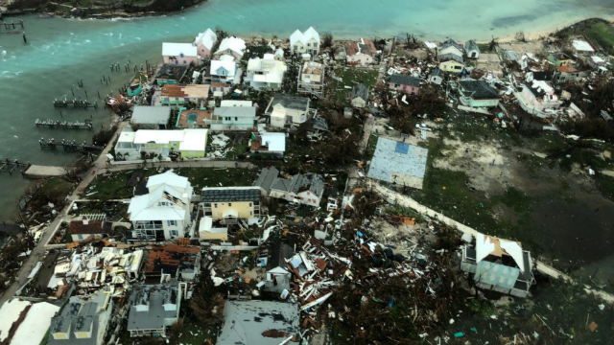
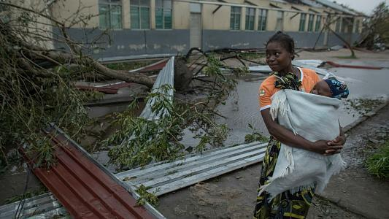


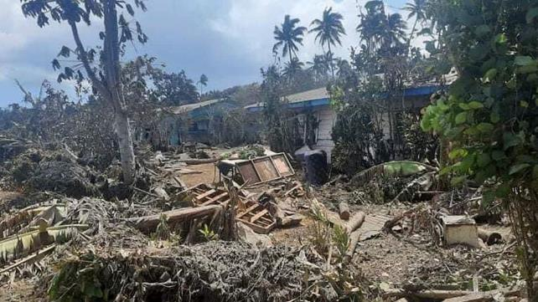
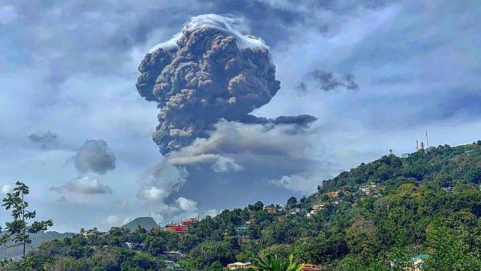


Helen we need to change one of the picture—Mozambique and put the floods in Pakistan instead
Cyclone Idai, Mozambique
Classrooms affected: 3,504; Students affected: 335,132
Hurricane Dorian, The Bahamas
Devastated schools on Grand Bahama and Abacos Islands
CARE; Retrieved from https://www.care.org/emergencies/cyclone-idai |
UNICEF, 2019. https://www.unicef.org/mozambique/en/cyclone-idai-and-kenneth
80 per cent of Tonga population impacted by eruption and tsunami
Volcanic eruption leaves ‘entire population’ of Saint Vincent without clean water
UN News, https://news.un.org/en/story/2022/01/1110162
UN News, https://news.un.org/en/story/2021/04/1089592
Notes:
How does the climate crisis effect the education sector specifically?
In recent years, Commonwealth countries have experienced severe impacts to their education systems as the result of climate related natural disasters.
Cyclone Idai, which hit eastern Mozambique on March 14, 2019 was the worst natural disaster to hit southern Africa in twenty years. According to UNICEF, from July 2019, more than 3000 classrooms and 330,000 students were affected by the Hurricane (https://www.unicef.org/mozambique/en/cyclone-idai-and-kenneth)
On September 1 2019, the eye of Hurricane Dorian made landfall on the Abaco Islands, reaching the island of Grand Bahamas the next day. It was the strongest hurricane on record to hit the Bahamas.
According to Mercy Corps, the Abaco Islands were the most affected with approximately 90 percent of housing and infrastructure left damaged or destroyed in its wake. In Grand Bahama, satellite data revealed that anywhere from 76 to 100 percent of buildings in certain areas were destroyed. The week after Hurricane Dorian hit was supposed to be the first week of classes in the Bahamas. Many families had just paid school fees and purchased uniforms, which were lost due to the hurricane. Many schools were deemed to be unsafe for students, halting classes.

Slide 5






Impact of the climate crisis on education
Infrastructural damage
Damage to resource and materials
Loss of data and records
Collapse of systems = Out of school youth
Notes:
Climate related natural disasters have major, detrimental impacts on education. Events such as hurricanes, storms and floods can have catastrophic effects on the infrastructure, resources and systems of the education sector. Entire schools can be destroyed or irreparably damaged, leading to thousands of displaced students, unable to continue their education. Critical data and student records may be wiped out entirely, leaving the system in shambles, and learners and institutions in the dark. These impacts can effectively lead to the collapse of the education system in disaster affected areas.

Slide 6



Education contributes to climate change
DIRECT
Emissions from construction of schools/infrastructure
Emissions from energy use in schools
Learner emissions
INDIRECT
Emissions from ‘development’ and economic growth associated with higher levels of education in a country
Notes:
The education sector, from primary to tertiary, contributes to both direct and indirect emissions, which impact on climate change, and environmental degradation, as well as incur associated economic costs. If we look strictly at contributions to emissions, the achievement of SDG4, under the current paradigm, could potentially worsen the climate crisis.
Climate related natural disasters have major, detrimental impacts on education. Events such as hurricanes, storms and floods can have catastrophic effects on the infrastructure, resources and systems of the education sector. Entire schools can be destroyed or irreparably damaged, leading to thousands of displaced students, unable to continue their education. Critical data and student records may be wiped out entirely, leaving the system in shambles, and learners and institutions in the dark. These impacts can effectively lead to the collapse of the education system in disaster affected areas.

Slide 7
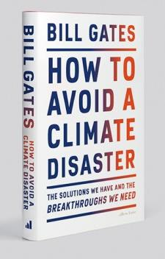
Construction: Cement, steel plastic: 31%
Electricity: 27%
Farming: plants and animals. 19%
Travel and transport: 16%
Airconditioning: 7%
BILL GATES

Slide 8

The COL Approach
Notes:
COL's mission is to help Commonwealth Member States and institutions to use technologies for expanding access to quality education and training.
COL believes that learning is the key to sustainable development: Learning must lead to economic growth, social inclusion and environmental conservation.

Slide 9
Reduction of carbon emissions
Raising awareness on disaster preparedness
Reskilling people for a greener future
Resilience for the education sector
Notes:
The next section will outline COL’s work in the following four areas:
Reduction of carbon emissions
Raising awareness on disaster preparedness
Reskilling people for a greener future
Resilience for the education sector

Slide 10


Co2
Reduction
Decreasing the carbon emissions
of education sector through ODL
Notes:
While the education sector has a growing carbon footprint, Open and distance learning may actually be able to reduce learner-generated emissions

Slide 11

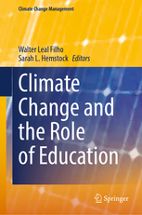





Research on Emissions and ODL
3x less carbon emissions
Travel – greatest contributor
Mode of delivery - determinant
Source: Carr et.al. Delivery Mode and Learner Emissions: Comparative Study from Botswana. W. Leal Filho and S. L. Hemstock (eds.), Climate Change and the Role of Education, Springer Nature. In Production.
Notes:
Perhaps the most comprehensive project assessing the environmental impacts of different modes of delivery in higher education is the SusTEACH project, supported by the Open University, UK. The project compared the carbon emissions of ICT-enhanced courses with online courses and mainly face to-face taught courses. The findings showed that online and blended ICT-enhance distance teaching models had significantly lower environmental impacts than face-to-face teaching modes (Caird et al. 2013; Caird et al. 2015). This study used a comprehensive methodology that considered multiple contributors to emissions for both students and the institutions.
Using the SusTeach methodology COL conducted a study in Botswana, to determine whether there was a difference between the carbon emissions of CD-based ODL and face-to-face learners, as well as the main sources of learners’ emissions.
The comparison of learner carbon emissions data from both face-to-face and CD based students in Botswana revealed that the average learning-related carbon footprint of the face-to-face group is nearly three times greater than that of the ODL group, and the difference was statistically significant. Within the overall carbon footprint, emissions from travel were by far the greatest contributor to this disparity. This suggests that regardless of the exact mechanism of delivery, ODL or blended modes can decrease emissions by reducing face-to-face contact hours. Institution, as a proxy for delivery mode, was the most significant predictor of learning related emissions.

Slide 12

Raising Awareness
Public education campaigns
for resilience
Notes:
While the education sector has a growing carbon footprint, Open and distance learning may actually be able to reduce learner-generated emissions

Slide 13


Dominica on a path to becoming a climate-resilient nation
Notes:
Following the devastation of Hurricane Maria and the estimated USD $930 million of damage to the economy in September 2017, Dominica is on a path to becoming a climate-resilient nation. With support from COL, Dominica’s Ministry of Education and Human Resource Development (MEHRD) has embarked on a public education project to create locally-produced audio and video clips designed to educate citizens about climate change and empower them to mitigate the risks and be better prepared for climate related disasters.
ODL can sensitise people and raise awareness about the risks and responses to climate related disaster, and can reach larger numbers than traditional face-to-face awareness raising sessions.

Slide 14

Re-skilling
Training people for the green jobs
of tomorrow
Notes:
While the education sector has a growing carbon footprint, Open and distance learning may actually be able to reduce learner-generated emissions

Slide 15
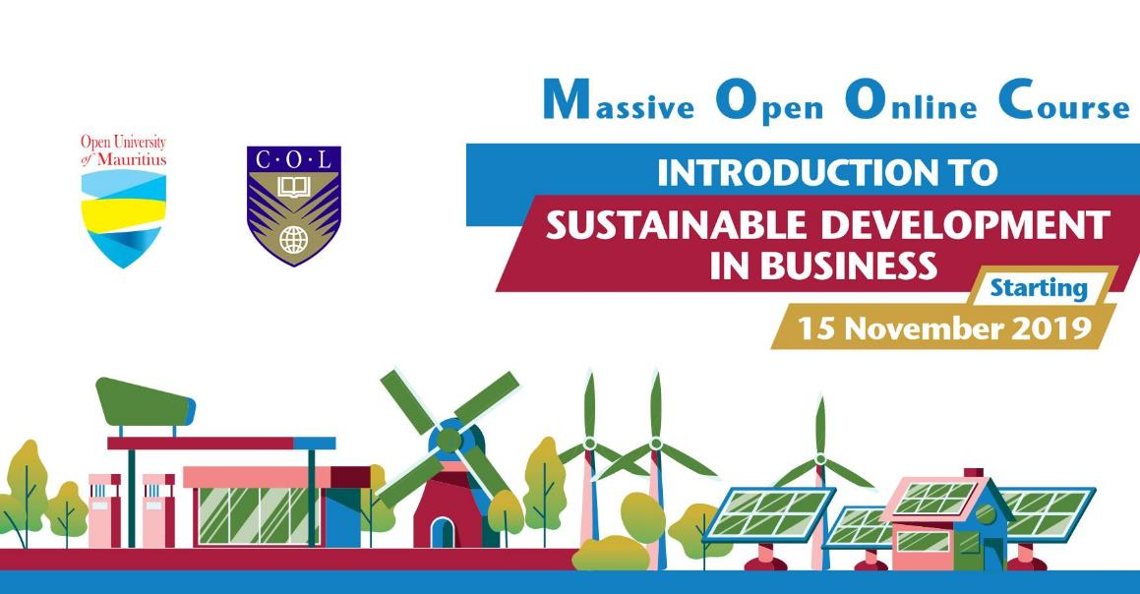
Notes:
COL in collaboration with The Open University of Mauritius have developed a MOOC (Massive Open Online Course): Introduction to Sustainable Development in Business. The course is being run for the second time, with participants from across the Commonwealth.

Slide 16

Resilience
Making the education sector
more resilient
Notes:
While the education sector has a growing carbon footprint, Open and distance learning may actually be able to reduce learner-generated emissions

Slide 17
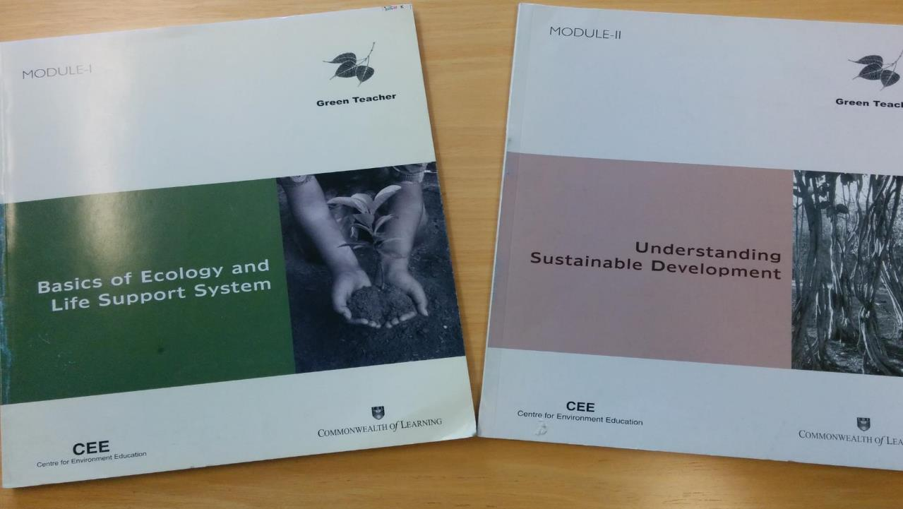


Green Teacher
Notes:
COL is also supporting resilience of the education sector by developing the skills and capacities of teachers in environmental education.
COL supported the National Teachers Institute, Nigeria, which has an annual enrolment of 50,000 trainee teachers, to develop a Green Teacher programme to help teachers to integrate environmental concerns into the classroom from a very early age. This is now being offered online to teachers in the country.

Slide 18
Models and
Approaches
Notes:
COL's mission is to help Commonwealth Member States and institutions to use technologies for expanding access to quality education and training.
COL believes that learning is the key to sustainable development: Learning must lead to economic growth, social inclusion and environmental conservation.

Slide 19
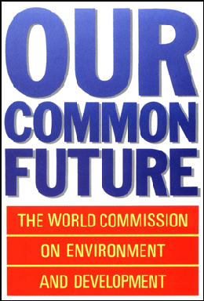
Did the world pay attention?
'Sustainable development seeks to meet the needs and aspirations of the present without compromising the ability to meet those of the future.’
BRUNDTLAND COMMISSION REPORT, 1987
Source: https://sustainabledevelopment.un.org/content/documents/5987our-common-future.pdf
Notes:
The concept of Human ecology was influential in shaping discourse on sustainable development. Zena's ideas prefigured some of the seminal works on sustainable development, such as the report of the Brundtland commission out of which comes the often cited definition of Sustainable Development as "development that meets the needs of the present without compromising the ability of future generations to meet their own needs"

Slide 20
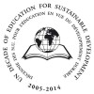
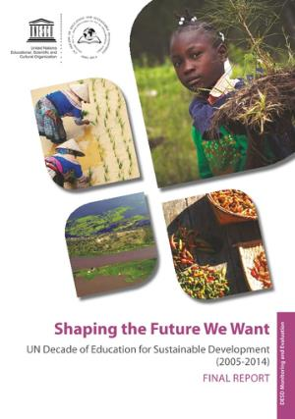
Education for Sustainable Development (2005-2014)
Increased visibility in national policies and international agreements
Ethos and values of ESD gaining acceptance, but not fully integrated into the education systems in most countries
Notes:
Education for Sustainable Development (ESD) aspires to be a holistic and transformational approach to education that addresses learning content and outcomes, pedagogy and the learning environment. The period 2005-2014 was dubbed the Decade of Education for Sustainable Development by the UN, and substantial efforts were made to mainstream the approach.
Has the aspiration been achieved?
Findings from a final report on the Decade of ESD suggest that ESD’s visibility in national policies and international agreements did indeed increase over the ten year period.
However, it also notes that "considerable challenges remain in realizing the full potential of ESD: the need for further alignment of education and sustainable development sectors; the need for more work towards institutionalizing ESD to ensure
strong political support for implementing ESD on a systemic level; and finally, the need for more research, innovation, monitoring and evaluation to develop and prove the effectiveness of ESD good practices. While much has been done
to advance the ethos and values of ESD, a full integration of ESD into education systems has yet to take place in most Countries."

Slide 21

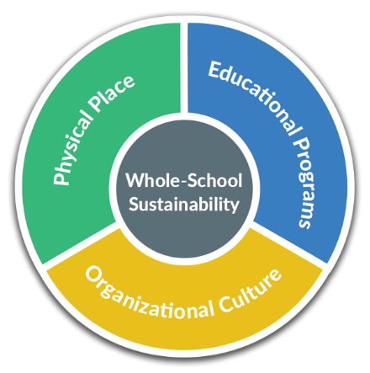
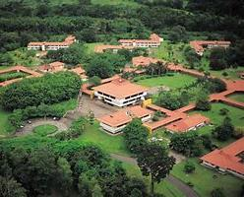
'Whole-School Sustainability'
Source: https://www.greenschoolsalliance.org/about
Notes:
Some schools and universities are taking a systems approach to addressing sustainability under a 'whole-school' model which addresses not only the content of education programmes, but also the organisational culture and the physical infrastructure.
Since 1990, EARTH University in Costs Rica has had the objective of preparing young people to contribute to the sustainable development of their home communities while constructing a prosperous and just global society. EARTH offers a scientific and technological education. emphasizing ethical entrepreneurship and strong socio-environmental commitment, all based out of a carbon neutral campus.
Other schools, including some elementary schools which are part of the "Green School Alliance" in the USA are using a similar 'whole school sustainaility approach' to integrate sustainability in the currciulum, culture and infrastructure of the school.

Slide 22
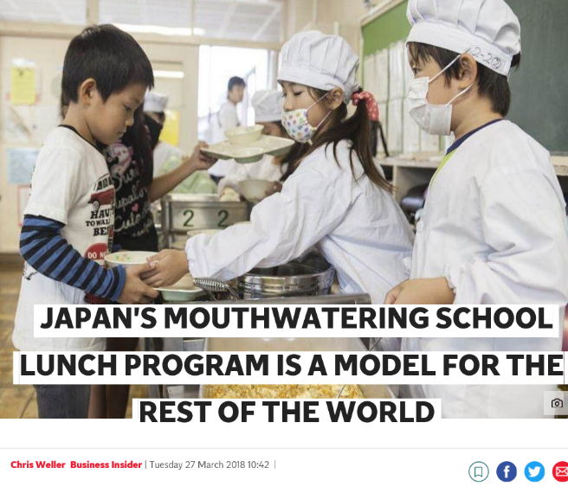
Linking activities to the environment and community
Fureai Lunches (Fureai means "interaction" in Japanese)
‘These enable school children to communicate directly with farmers over school lunch.’
Source: https://www.independent.co.uk/life-style/japan-school-lunch-program-children-food-model-countries-world-a8275616.html
Notes:
In Japan, there are numerous efforts to link students to the community and the environment through their daily experiences and interactions. One of the best examples of this approach is the school lunch programme, known as Fureai Lunches, or "interaction" lunches in Japanese. Through the lunchtime meal students are taught about where their food comes from. They also have a chance to speak directly to farmers from their communities to learn more about the process, and they serve one another, learning practical skills, responsibility and the importance of interdependence.

Slide 23
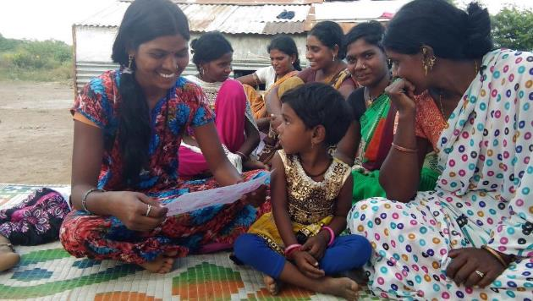
Community-based learning
Community-based learning instills a sense of interdependence and responsibility which is crucial to behavioral change for environmental conservation.
Notes:
Studies have shown that countries where individualist orientations are stronger tended to have higher per capita CO2 emissions. Adger et al. (2013) and Chuang et al. (2016) reported that people having ‘interdependent selves’ were more likely to engage in pro-environmental behaviors than ‘independent selves’
By linking learners to their communities, we can build this sense of interdependence. Community-based learning gives meaning, relevance and context to learning, and helps to inculcate a sense of responsibility in learners for their neighbors.

Slide 24
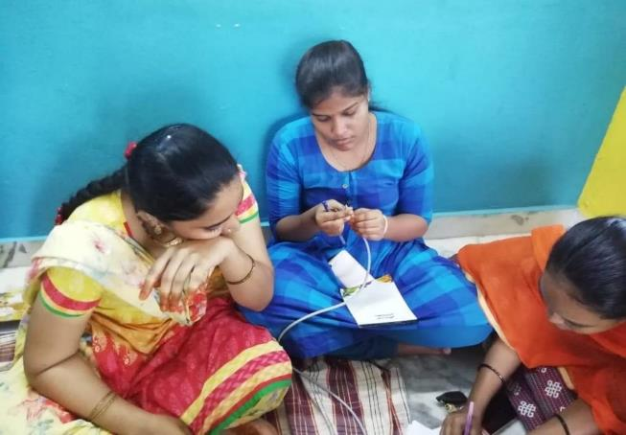
E-Apprenticeship Model
The majority of learning takes place in the learner's own community using technology
Barefoot wireless engineer training in India
Notes:
In Canada, community-based apprenticeship models have leveraged technology to improve the coordination of academic and experiential studies, track on the job learning, and allow students more time in a community-based setting. One such example is the E-Apprenticeship Alternate Delivery Design Initiative (EADDI) at Red River College in Manitoba. The learners attended an on-campus orientation session at the outset of the program. The learners then returned to their communities to work with an employer and simultaneously complete six months’ of part-time study (10– 12 hours a week) which incorporated online teaching (one half day per week, twice a week) and self-paced study. The learners were required to have access to a high-speed Internet connection, a computer, a headset/microphone and a webcam. At the end of the six-months they returned to the College to review their experience and take a final exam. Those who successfully completed were granted the same credentials as those given to apprentices who studied on campus (Little, 2017 ). The ICT-based instruction lowered the cost of study and allowed learners to stay in their communities and earn an income while working. More importantly, the model allowed learners to ‘ immediately apply what they learn online in their workplaces’ (Little, 2017 , p. 170). The apprentices were gaining valuable informal learning experiences through their day to day work, which they could connect to the theory they were learning. The simultaneous experience of learning on the job and in the classroom is a way to integrate informal/non-formal and formal learning,
while addressing the practical limitations and costs that extensive face-to-face learning in a formal environment can incur.

Slide 25
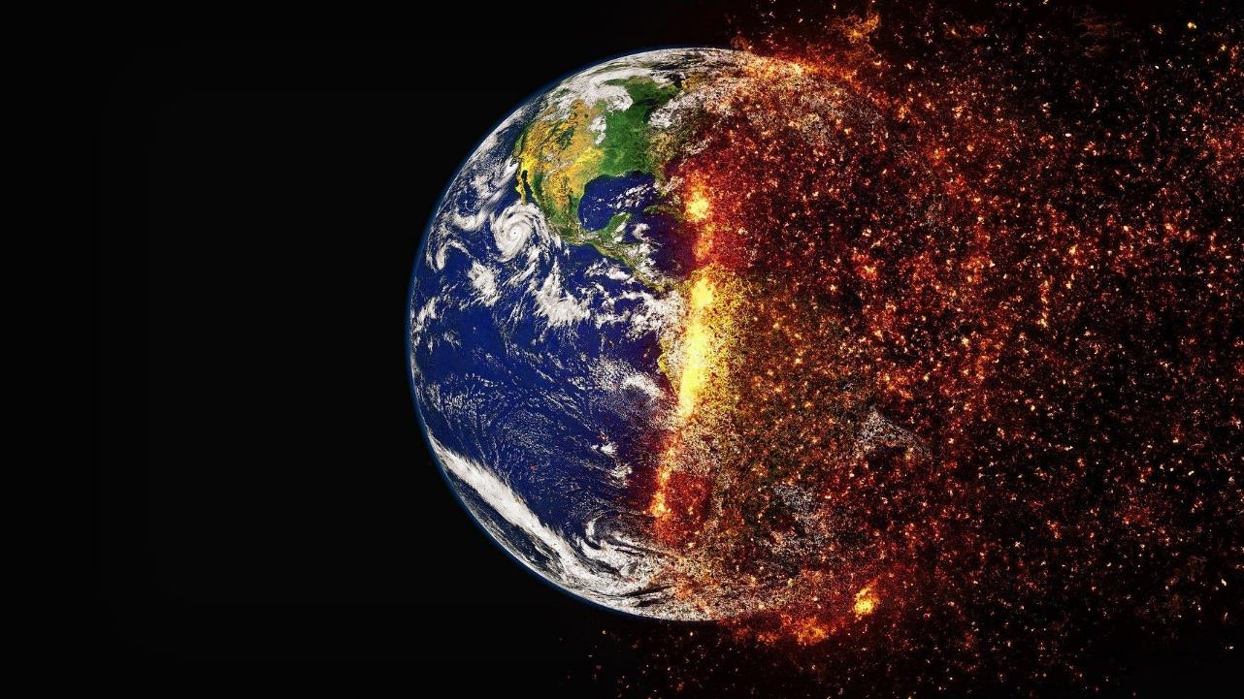
Key Approaches: Environmental Conservation
Greening the Curriculum to integrate ESD
Greening campus and site operations
Using distance and online learning
Sally Caird & Robin Roy
Notes:
Flexibility for what? – empowering of students, global citizens, leaving no one behind
Work integrated learning

Slide 26
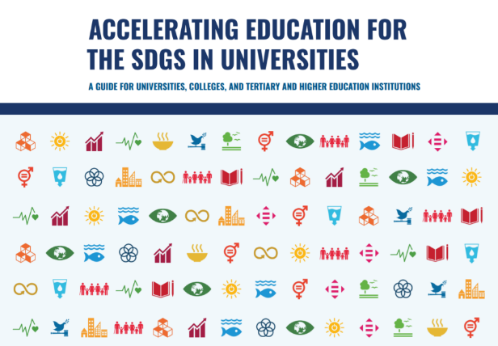
Greening the Curriculum
Environmental Literacy: SFU
Aligning with SDGs: University of Pretoria: trans-disciplinary approach to curriculum
Notes:
Higher education institutions are integrating sustainable development goals into their curriculum. For example, Simon Fraser University in Canada has an environmental literacy course that provides credits towards several programmes in the university. Sunway University in Malaysia has integrated SDGs into its mission and started the Sunway Smart Sustainable Campus Committee (SSCC) as part of its governing structure to brainstorm, innovate together and make recommendations to guide campus-wide policies and initiatives. The University of Pretoria as adopted a transdisciplinary approach to curriculum including next generation practices enhancing community-based learning experiences, using innovative audience interaction technologies, and the agile shift to virtual teaching for sustianbility.

Slide 27
Greening the Campus
Australian National University
Environmental Management Plan 2021—decrease carbon emissions by 30%; increase renewable energy generation by 50%; increase sustainable commuting to 80%
Groningen University
2015-2020 Roadmap to become carbon neutral through energy efficiency; renewable energy; water conservation

Slide 28

What have we learnt?
Sustainability needs to move from margins to centre
Dedicated resources, incentives, awards work
Partnerships and platforms
Leadership at both management, student and community levels

Slide 29


Towards a Green Learning
Agenda

Slide 30

Views from the Commonwealth:
26 countries
Integrating climate literacy in the curriculum
Aligning climate change policies with education policies and better coordination between ministries
Building the capacity of teachers
Digitising and sharing indigenous knowledge related to environmental conservation
Developing ICT infrastructure—access to devices and connectivity

Slide 31

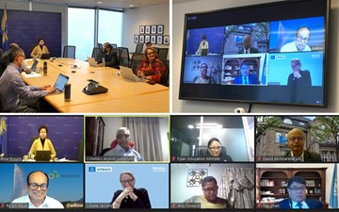

COL’s High-Level Panel on Climate Change and Education
Notes:
Identify a concrete action plan
Explore areas for collaboration and partnership
Develop a Report for Commonwealth Education Ministers

Slide 32
Views of the High-Level Panel
Urgent action required
Need for behavioural change for climate action
Engage and empower youth
Promote disaster response and recovery through education and lifelong learning
Promote collaboration esp with the private sector

Slide 33
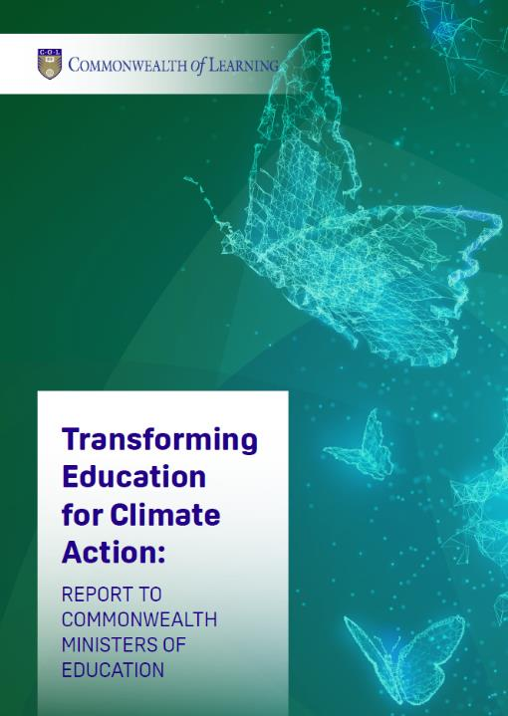

Recommendations
Resilient infrastructure
Skills for the blue and green economies
Promote climate justice

Slide 34
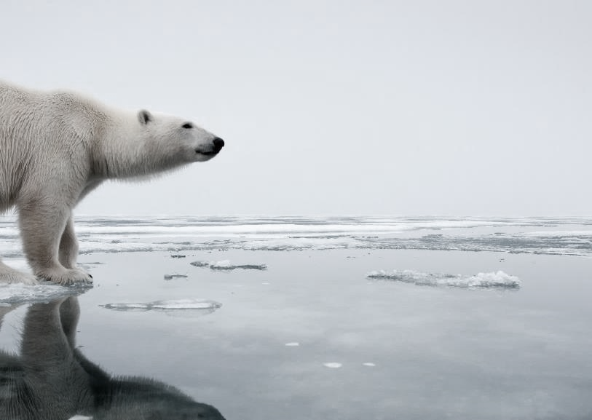
Climate Justice: addressing inequalities
Countries with harmful gender norms, gender discriminatory education policies are also countries with low levels of climate resilience and high levels of vulnerability to climate disasters.
Women and girls more vulnerable to disasters
Girls typically excluded from technical fields and STEM required by the green economy
Notes:
Make TVET more gender transformative—break stereotypes and target skills from caring to coding to construction
Prioritise ‘care’ in green jobs—uphold care for women’s rights and care for the environment
Create a supportive ecosystem for women and girls in the green economy.

Slide 35
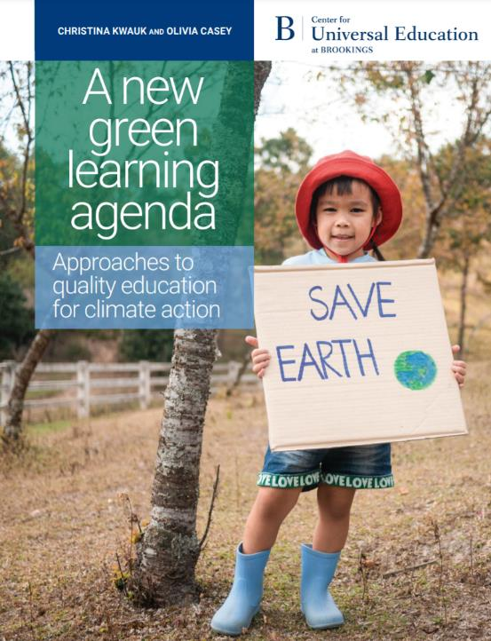
Green learning agenda
Skills for green jobs
Green life skills
Skills for a green transformation
Skills aimed at fulfilling the requirements of green jobs and supporting the transition to a low-carbon green economy
Cross-cutting skills that serve both technical, instrumental, and adaptive, transformative ends
Adaptive skills aimed at transforming unjust social and economic structures
Source: https://www.brookings.edu/wp-content/uploads/2021/01/Brookings-Green-Learning-FINAL.pdf

Slide 36

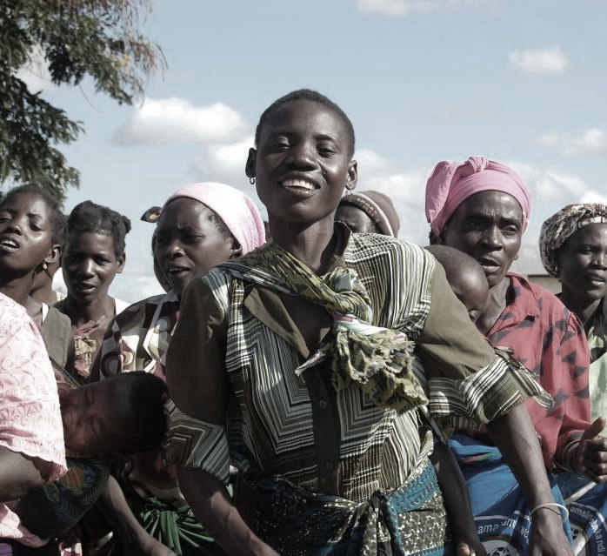
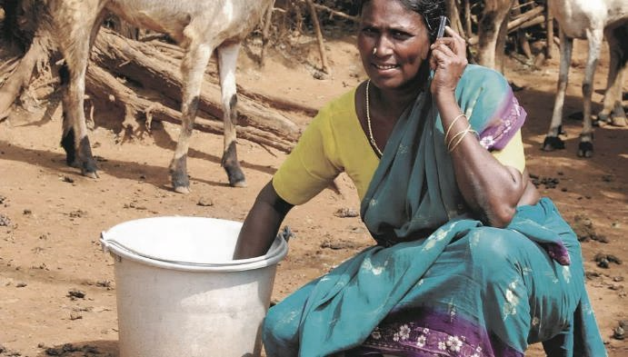

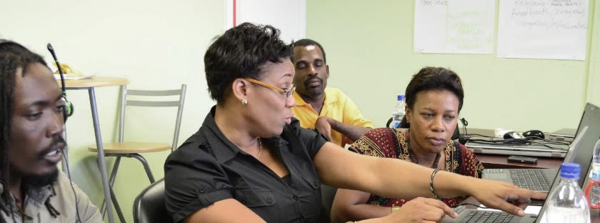

Thank you
www.col.org
The contents of this presentation, with the exception of logos and graphics which are the property of the respective owners, is made available under Attribution-ShareAlike 4.0 International (CC BY-SA 4.0).

