Slide 1
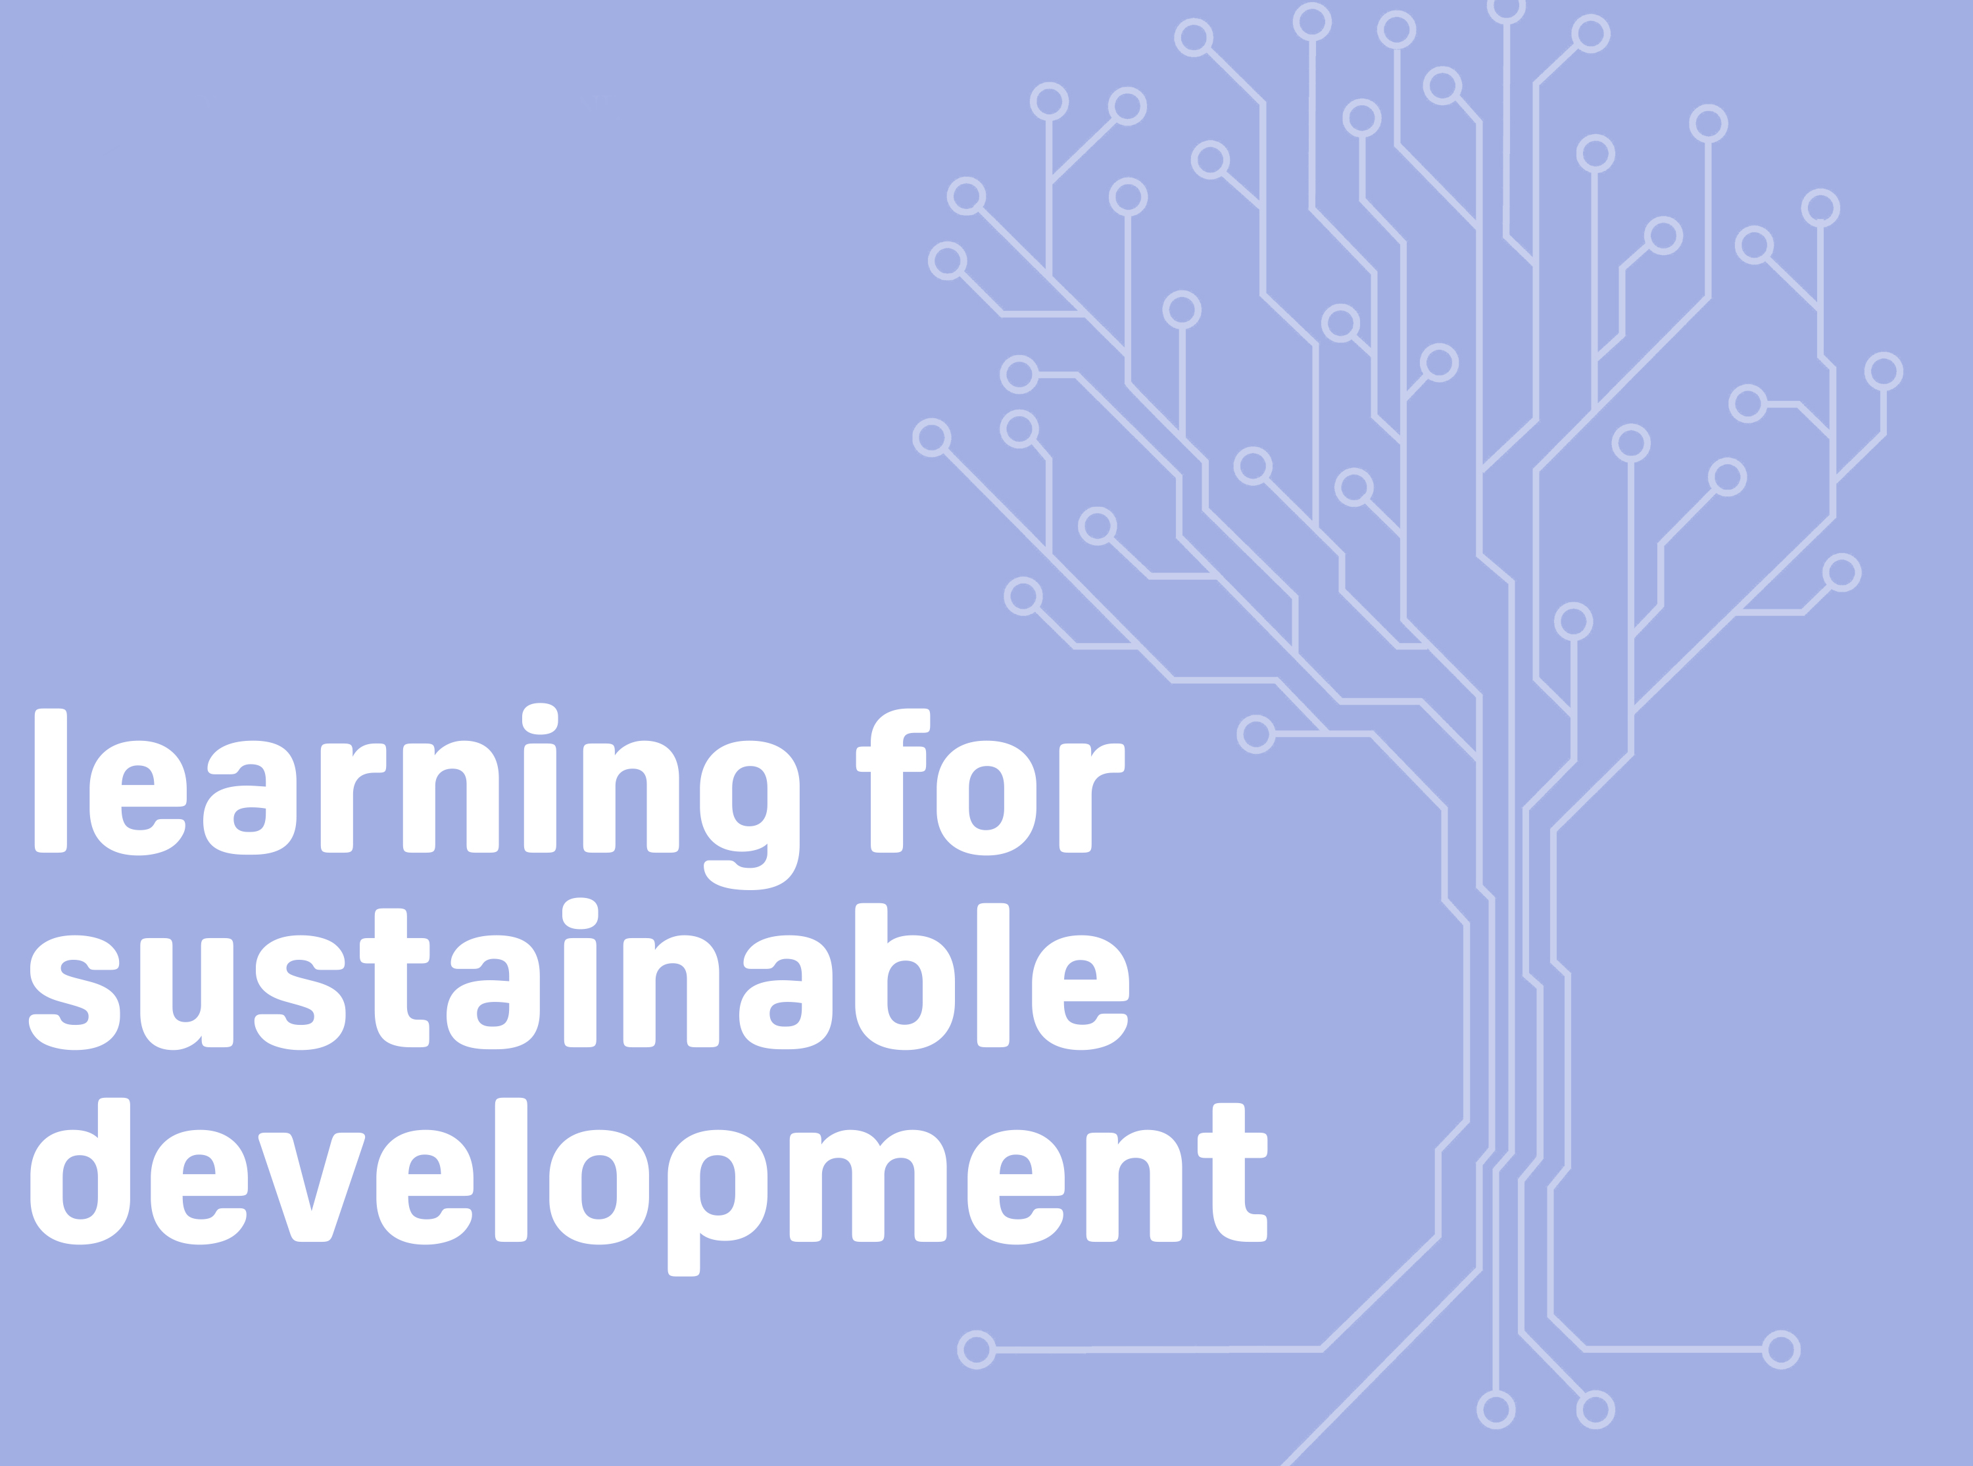
Professor Asha Kanwar
COL President & CEO
Committee of the Whole Meeting
10 May 2022

Slide 2
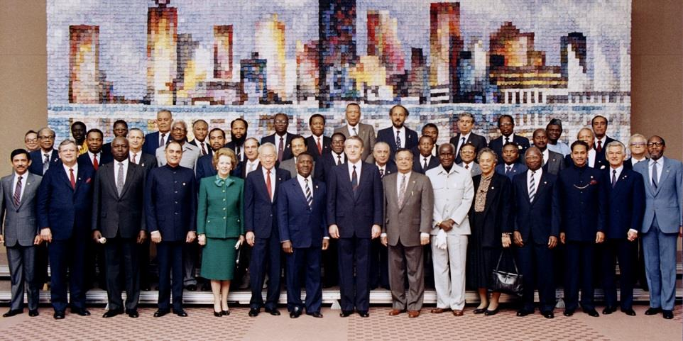

Commonwealth Heads of Government Meeting
Vancouver, 1987

Slide 3
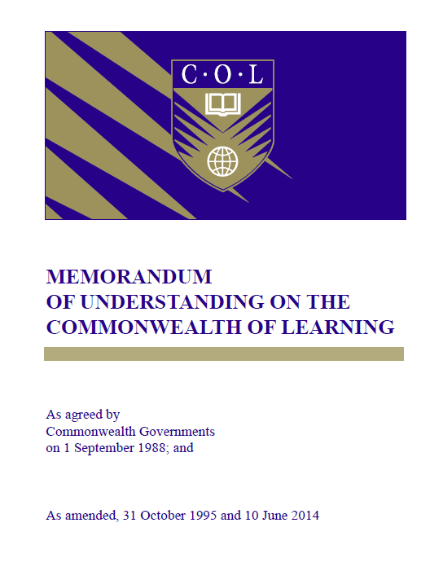
Signed on 1 September 1988

Slide 4
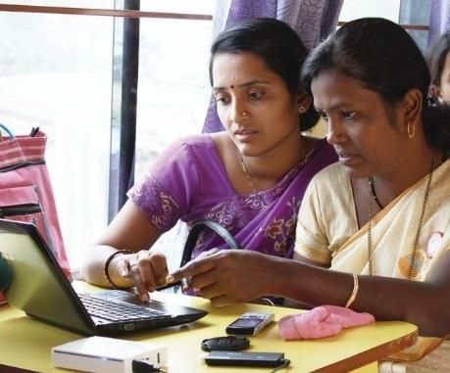
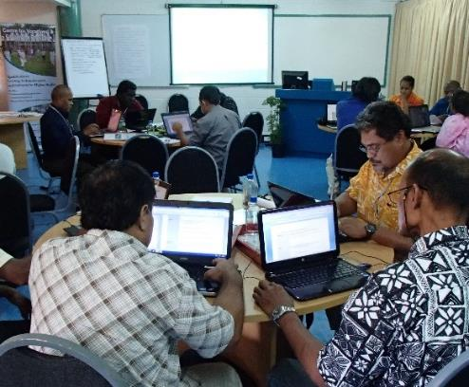
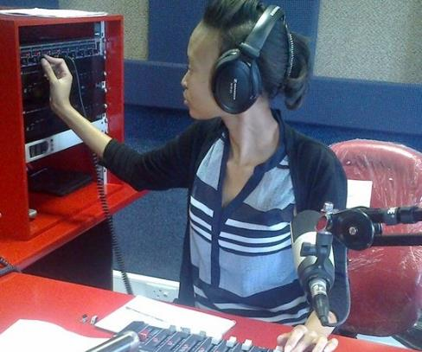
To help Commonwealth governments and institutions use technologies to improve and expand access to education and training

Slide 5

Regulatory Framework in Canada
Headquarters’ Agreement
Foreign Missions and International Organizations Act of Canada
Income Tax Act of Canada

Slide 6







Who supports COL?
Canada
India
UK
Australia
New Zealand
Nigeria
South Africa
The number of countries contributing increased from 23 in 2003-06 to 47 currently

Slide 7
Accountability
‘…in fulfilment of their accountability to member countries of the Commonwealth, reporting to meetings of Ministers of Education and Heads of Government on the activities of COL over the reporting period and its planned activities for the future….’
(MOU, 1988.6 (e), p.4)

Slide 8























































ACCOUNTABILITY
ANTIGUA & BARBUDA
AUSTRALIA
BAHAMAS
BANGLADESH
BARBADOS
BELIZE
BOTSWANA
BRUNEI DARUSSALAM
CAMEROON
CANADA
CYPRUS
DOMINICA
ESWATINI
FIJI
THE GAMBIA
GHANA
GRENADA
GUYANA
INDIA
JAMAICA
KENYA
KIRIBATI
LESOTHO
MALAWI
MALAYSIA
MALDIVES
MALTA
MAURITIUS
MOZAMBIQUE
NAMIBIA
NAURU
NEW ZEALAND
NIGERIA
PAKISTAN
PAPUA NEW GUINEA
RWANDA
ST KITTS & NEVIS
SAINT LUCIA
ST VINCENT & GRENADINES
SAMOA
SEYCHELLES
SIERRA LEONE
SINGAPORE
SOLOMON ISLANDS
SOUTH AFRICA
SRI LANKA
TONGA
TRINIDAD & TOBAGO
TUVALU
UGANDA
UNITED KINGDOM
TANZANIA
VANUATU
ZAMBIA
Reports to
COL Board of Governors
COMSEC Board
Education Ministers: CCEM
Foreign Ministers: CHOGM

Slide 9
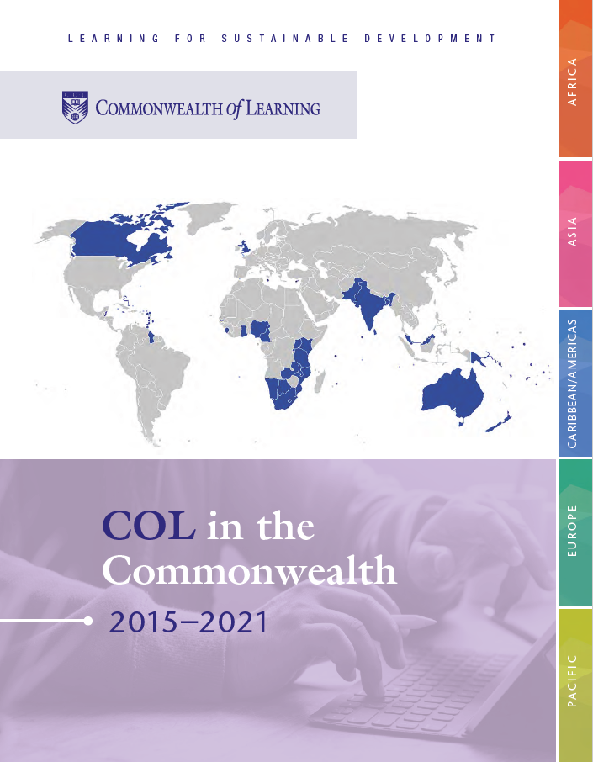
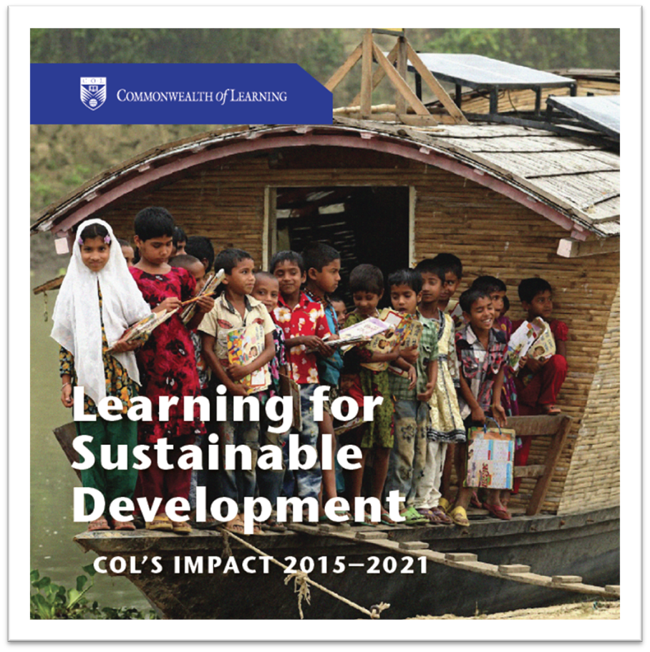

Slide 10

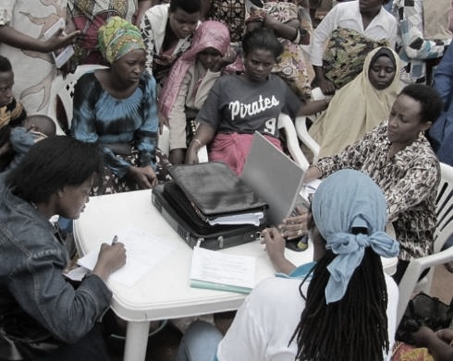
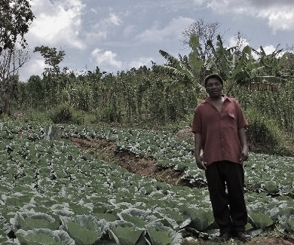


ECONOMIC EMPOWERMENT
SOCIAL
INCLUSION
ENVIRONMENTAL CONSERVATION
$
Notes:
COL continues to promote ‘learning for sustainable development’. Learning must lead to economic growth, social inclusion and environmental conservation.

Slide 11

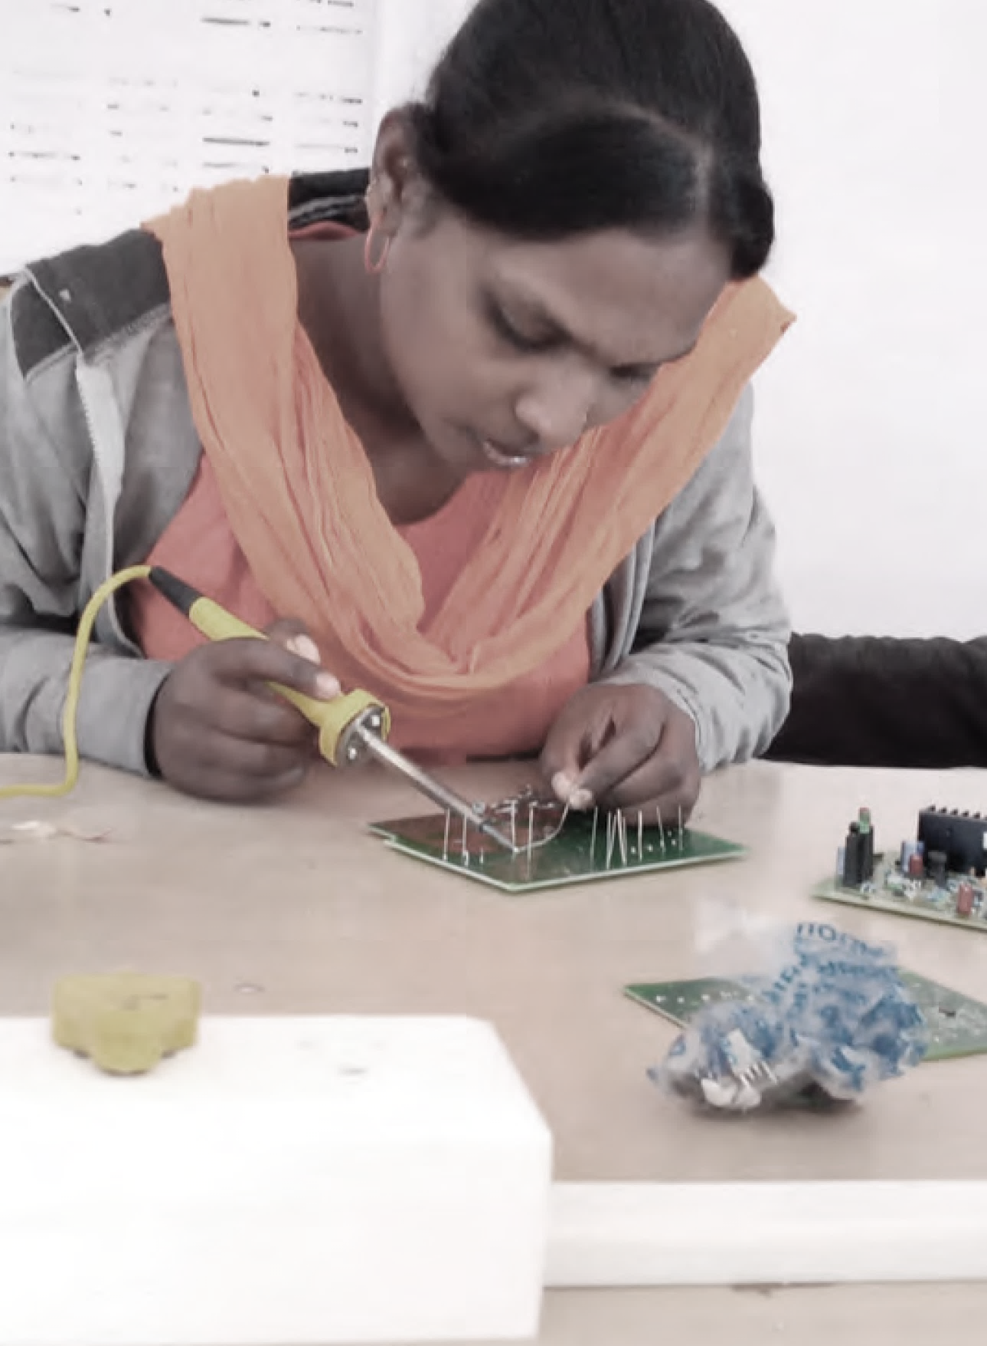
PROGRAMME SECTORS
Education
Skills
Gender Equality | Technology-Enabled Learning

Slide 12
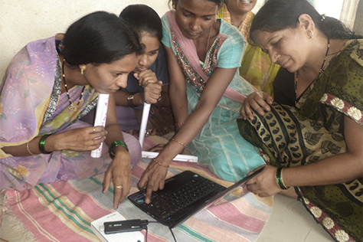
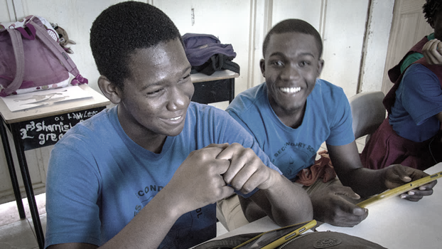
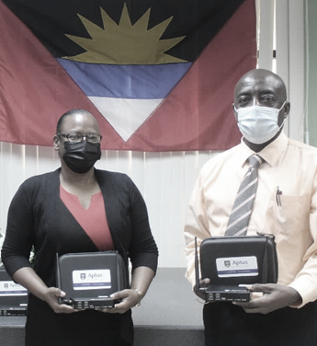
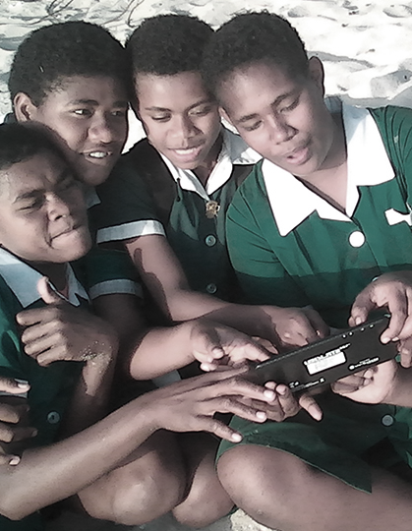
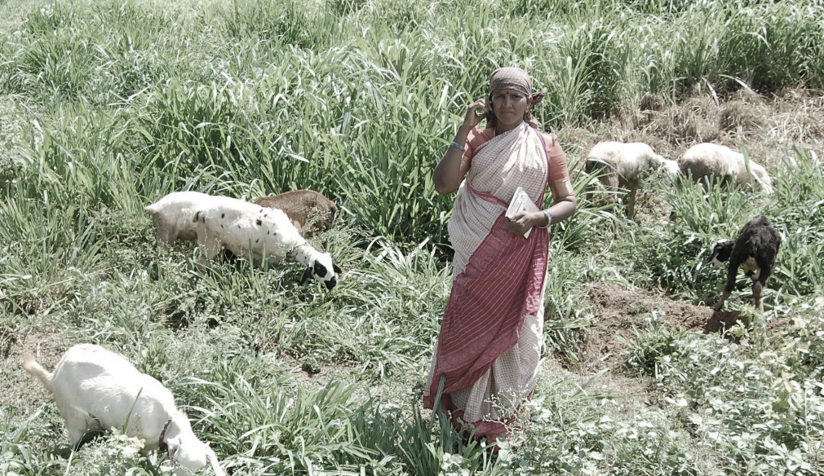
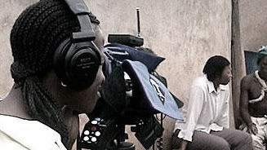
Leveraging new and existing technologies

Slide 13


Connecting

Slide 14
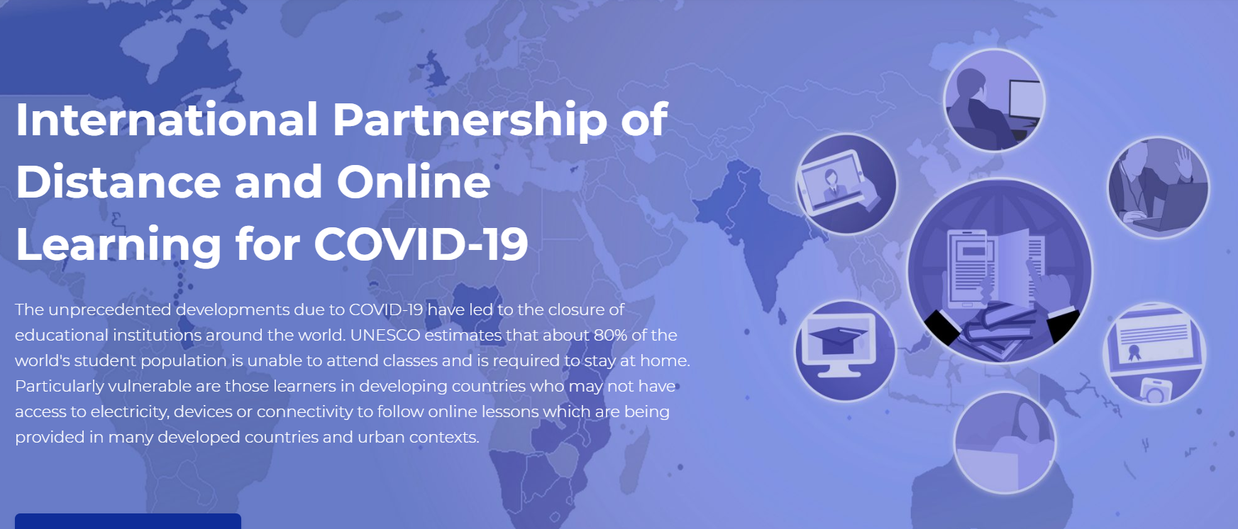
60+
Intergovernmental organisations
Universities and educational institutions
Associations and networks
opendoor.col.org
Notes:
bring together institutions/organisations committed to supporting learning at this time of crisis;
share open educational resources (OER) and learning content;
provide tools for implementing affordable learning;
identify concrete collaborative activities;
build capacity in institutions offering distance and online learning; and
develop innovative technology solutions for reaching the unreached

Slide 15
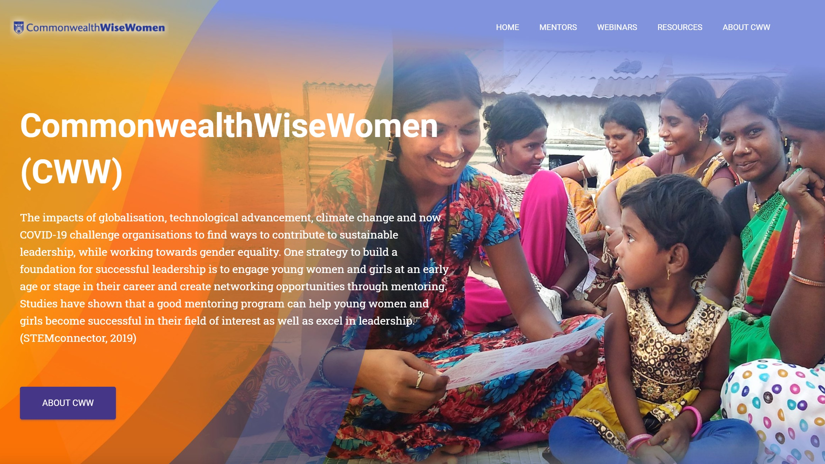
Mentoring
CommonwealthWiseWomen.org

Slide 16

Connecting
the Commonwealth
(32 small states)
Cyprus
Malta
Antigua & Barbuda, Bahamas, Barbados, Belize, Dominica, Grenada, Guyana, Jamaica, St.Kitts & Nevis, Saint Lucia,
St. Vincent and the Grenadines, Trinidad & Tobago
The Gambia
Fiji
Kiribati
Nauru
Papua New Guinea
Samoa
Solomon Islands
Tonga
Tuvalu
Vanuatu
Brunei
Darussalam
Botswana
Eswatini
Lesotho
Maldives
Mauritius
Namibia
Seychelles

Slide 17
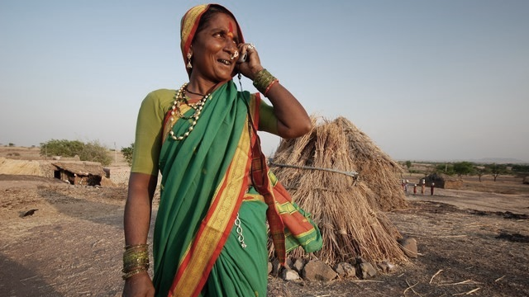
Innovating

Slide 18
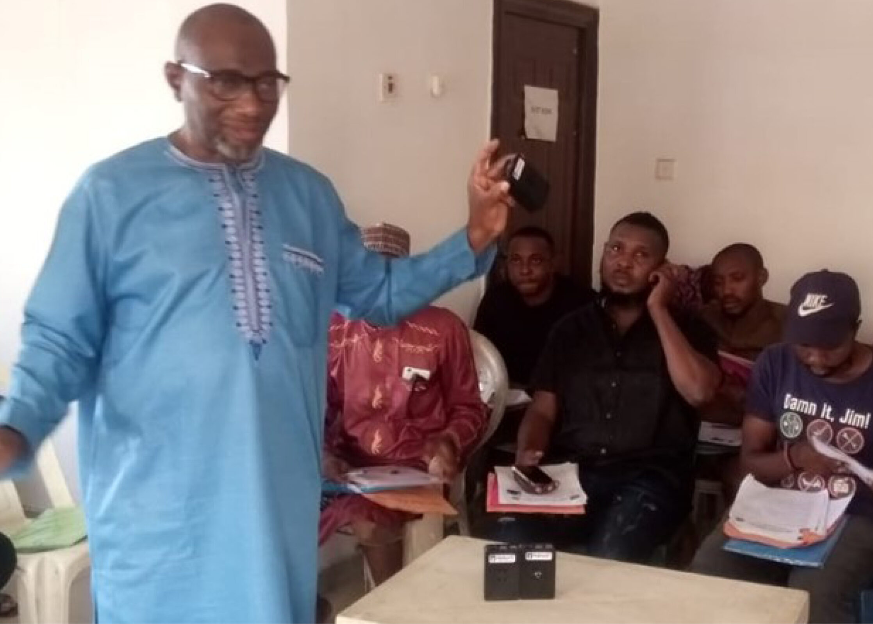
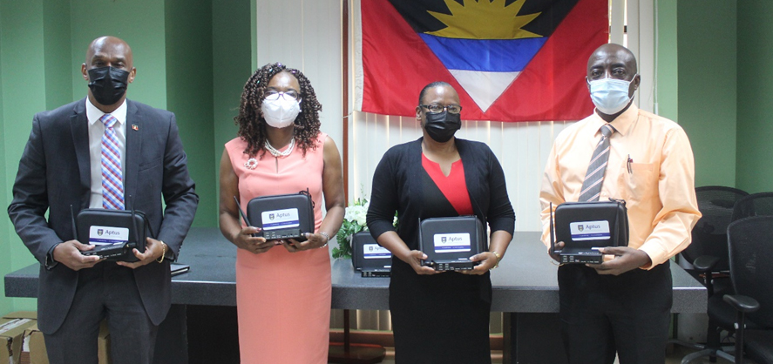
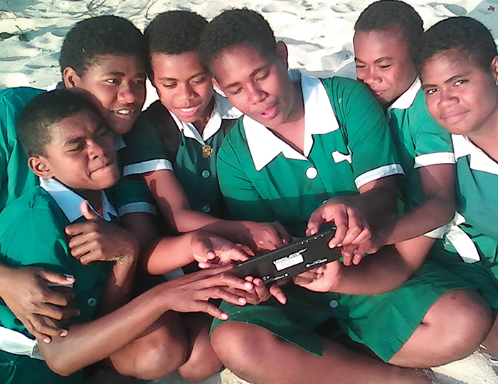







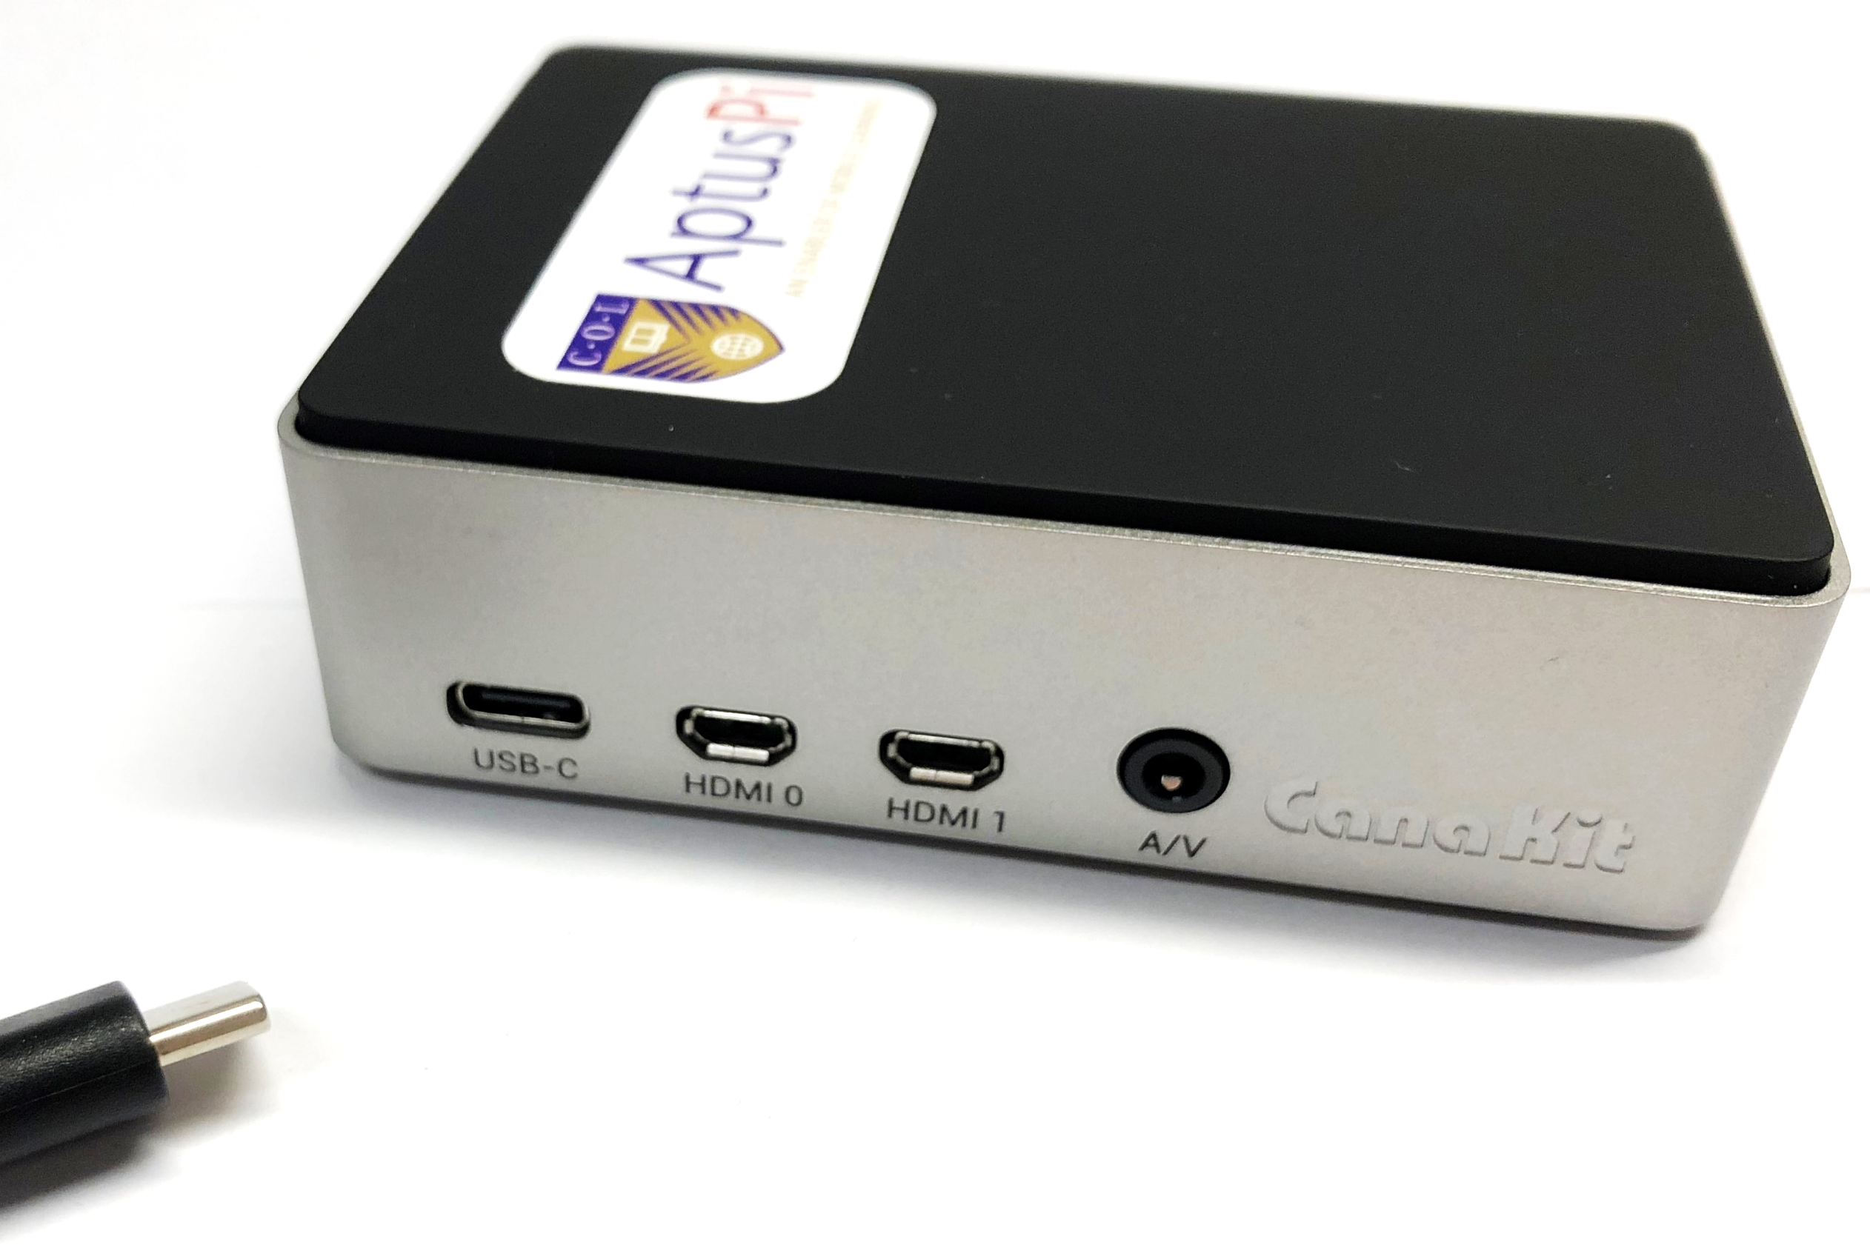


ANTIGUA & BARBUDA
BAHAMAS, THE
FIJI
INDIA
KIRIBATI
MALDIVES
MOZAMBIQUE
NIGERIA
PAKISTAN
SAMOA
TONGA
VANUATU
ZAMBIA
A low-cost device that allows educators and learners to connect to digital learning platforms and content without the need for grid electricity or Internet access.
Notes:
COL developed Aptus a low-cost offline virtual classroom that provides learners in remote locations with access to digital resources. It’s a server that works with a solar charger and a wireless router and costs approximately $ 150.
Maldives (2021)
Zambia, Ministry of General Education (2021)
Antigua and Barbuda, Ministry of Education, Sports and Creative Industries (2021)
Bahamas, Ministry of Education (2020)
Mozambique, Ministry of Education and Human Development (2018)
Tonga, Ministry of Education/Tonga Institute of Higher Education (2018)
Samoa, Ministry of Education (2018)
India, Mann Deshi Foundation (2016)
Samoa, National University Samoa (2016)
Pakistan, Qatar Foundation/ROTA (2016)
Fiji, Ministry of Education (2015)
Vanuatu, Ministry of Education (2015)
Kiribati, Ministry of Education (2015)

Slide 19
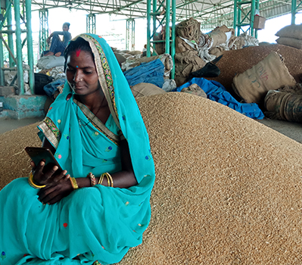
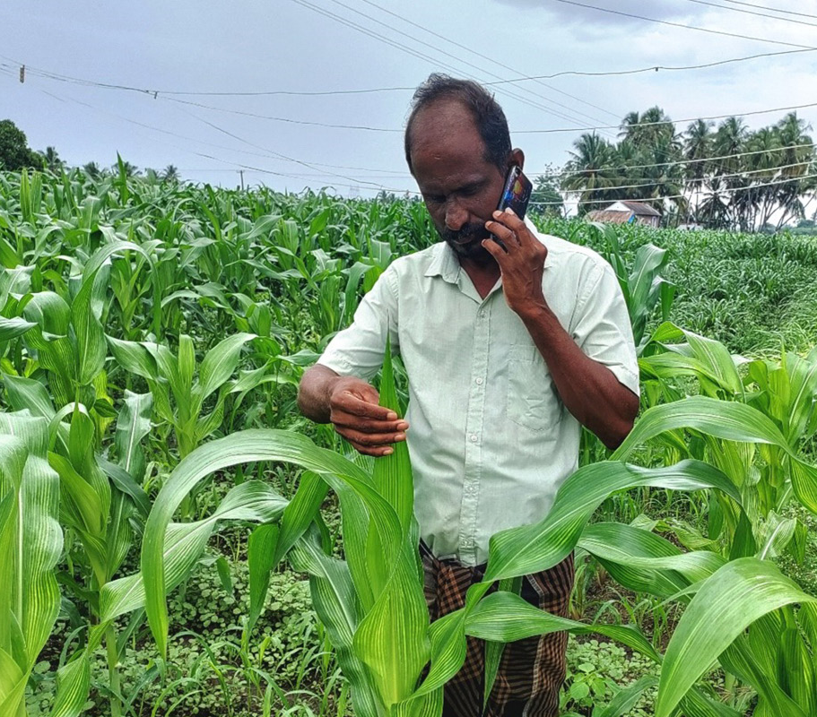
MobiMOOC- Online learning - Food and Agriculture sector underserved. COL’s innovation helps farmers access learning using basic phones
Notes:
Belize
Benefits: skills, expected income
Social Return on Investment of an Open School showed that every US$ invested resulted in US$8 worth of benefits to students.

Slide 20
Virtual Labs

Slide 21

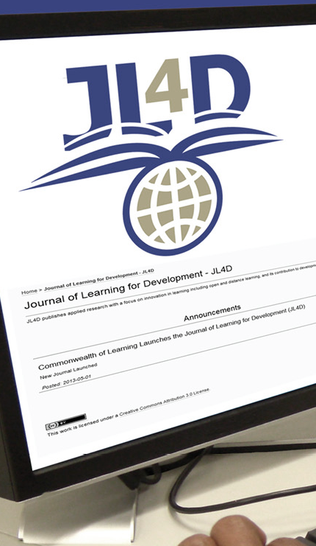
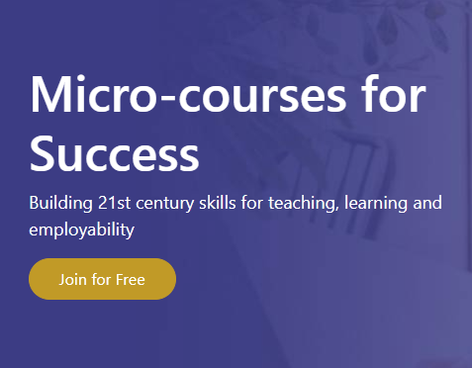
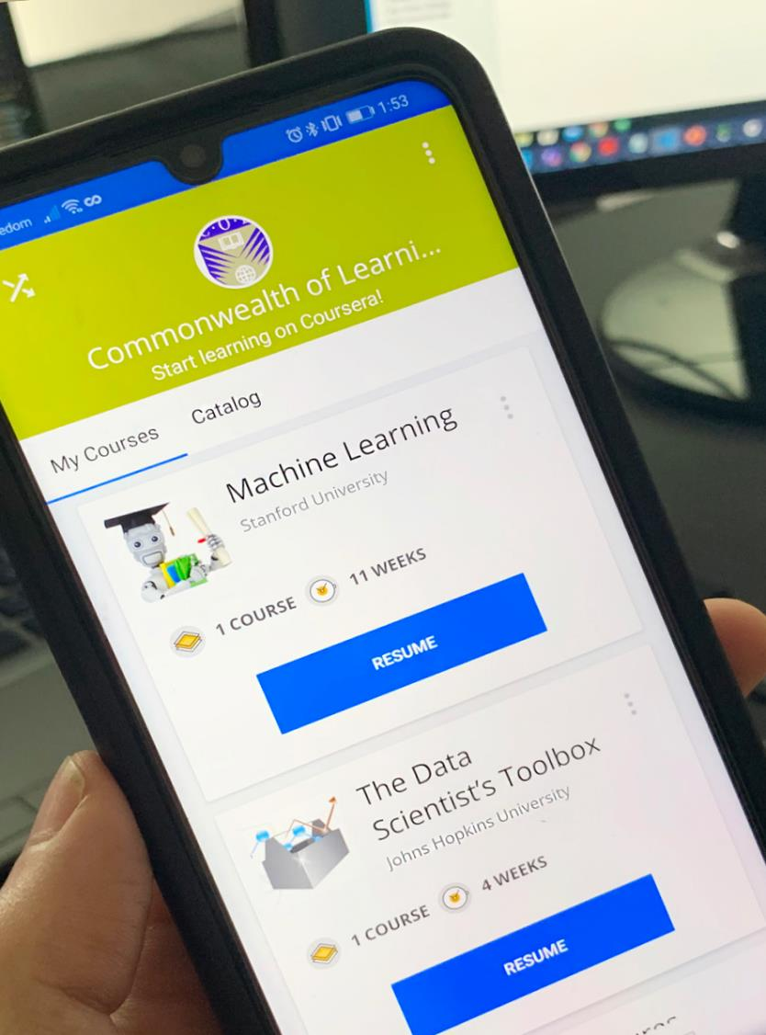
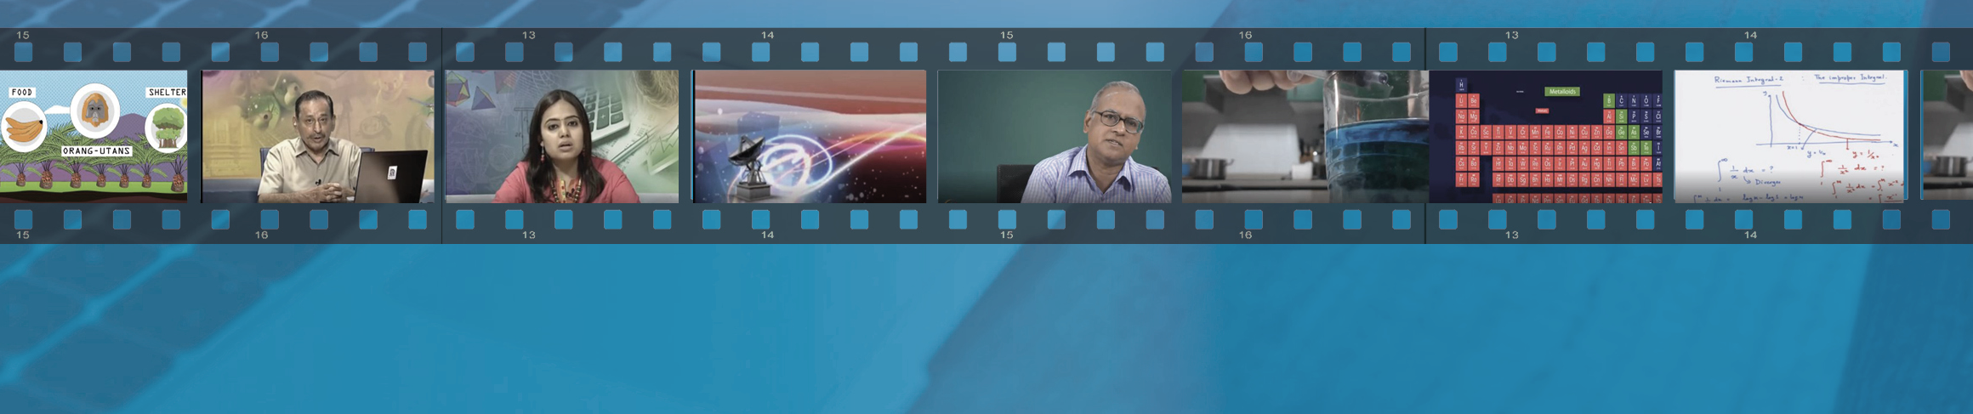
Transforming

Slide 22


Economic growth:
Skilling and re-skilling
COL admitted over 151,133 citizens of the Commonwealth to gain skills to regain employment, with more than 42,000 of them completed

Slide 23









Empowering Women

Slide 24

ICT Augmentation for Small States/LDCs
Addressing ICT resources and capacities
Build national resilience for education by supporting disaster preparedness in small states
Introduce and model the use of environmentally sustainable green technologies

Slide 25
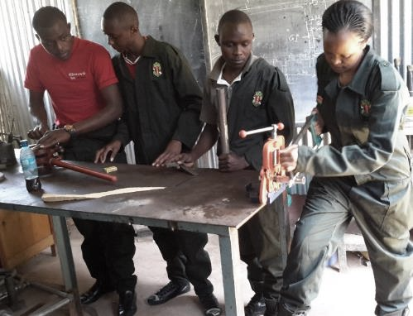
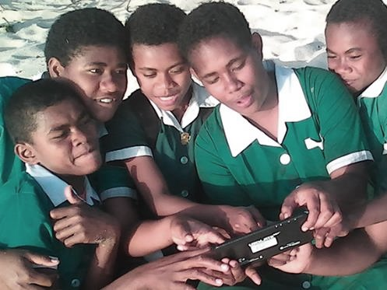

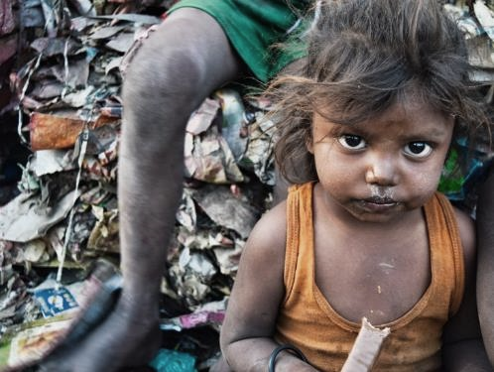
Promoting ‘learning for sustainable development’
Supporting innovations for affordable and accessible technologies
Serving the last person
in the queue
CC0 1.0 Universal - Pixabay
Notes:
We invite you to engage us; tap into our thought leadership, expertise, networks and resources

Slide 26


pcf10.org
Innovations for Educational Resilience
14 – 16 September 2022

Slide 27
Thank you
www.col.org
The contents of this presentation, with the exception of logos and graphics which are the property of the respective owners, is made available under Attribution-ShareAlike 4.0 International (CC BY-SA 4.0).

Slide 28

Delivering a Common Future:
Connecting, Innovating, Transforming

