Slide 1
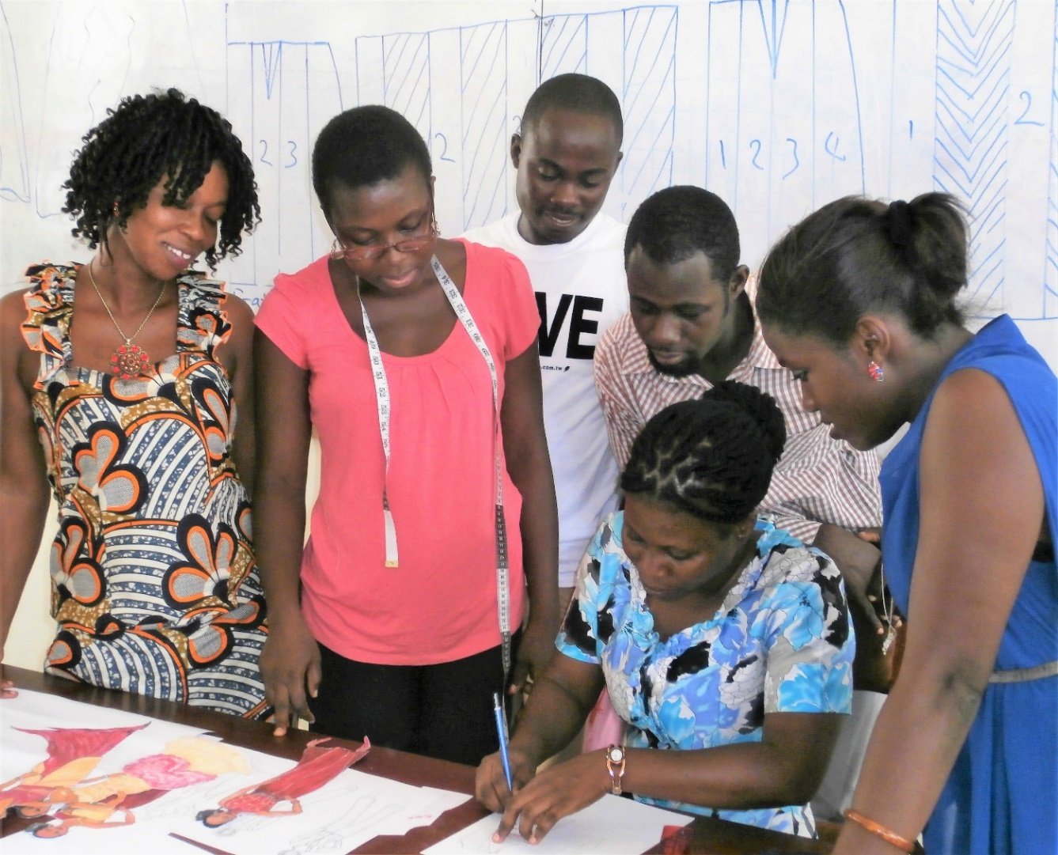
Gender and access to TVET: Challenges and progress
Terry Neal, Education Specialist Technical, Vocational and Skills Development
Notes:
I am pleased to talk to you today about challenges in achieving and progress towards equal access to TVET for women.

Slide 2

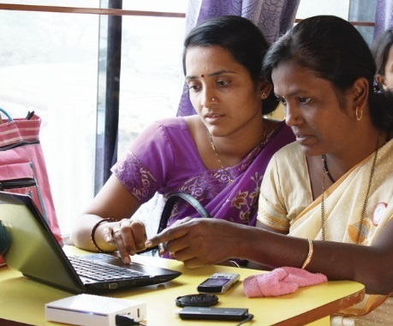
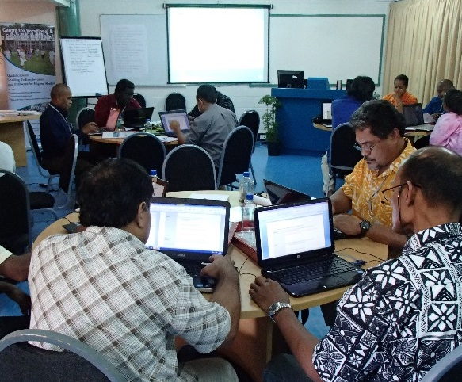
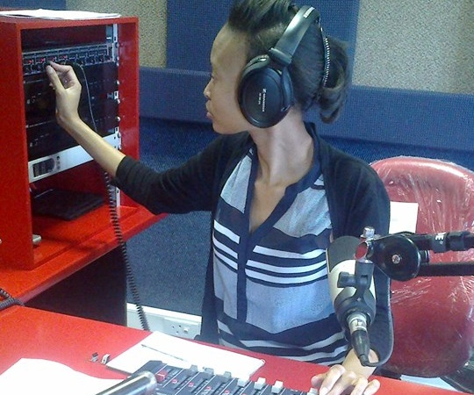
To help Commonwealth governments and institutions use distance and open learning for sustainable livelihoods
Notes:
I lead the technical and vocational skills development work at the Commonwealth of Learning. COL is an intergovernmental organisation created by Commonwealth Heads of Government in 1987. We work across 48 Commonwealth countries, representing approximately one third of the world’s population. We promote the development and sharing of open learning and distance education knowledge, resources and technologies for sustainable livelihoods.

Slide 3
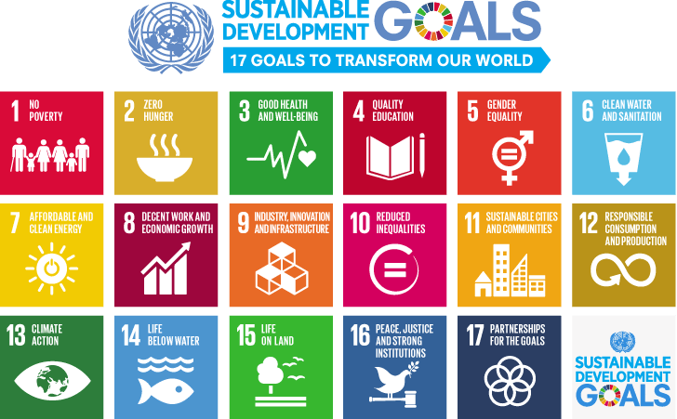
https://www.un.org/sustainabledevelopment/blog/2015/12/sustainable-development-goals-kick-off-with-start-of-new-year/
Notes:
As you probably know, there are 17 SDGs. Today I will focus on SDG 4 – quality education

Slide 4
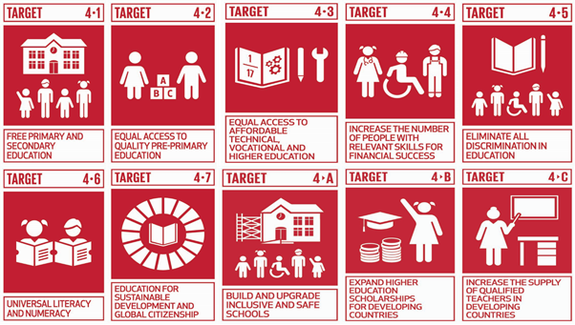
https://mishrapawan.wordpress.com/
Notes:
And within SDG 4, I am going to zero in on Target 4.3 – equal access to affordable technical, vocational and higher education - with an emphasis on TVET, which is my passion – for reasons that I trust will soon become apparent.

Slide 5


By Marcelllo55 - Own work, CC BY-SA 4.0, https://commons.wikimedia.org/w/index.php?curid=83659777
https://pixabay.com/photos/inspire-window-inspiration-2580579/
Notes:
My hope today is that I will both inform and inspire you. I want to inform you about the gender inequity within access to TVET and inspire you to act, or act even more, to change it.

Slide 6
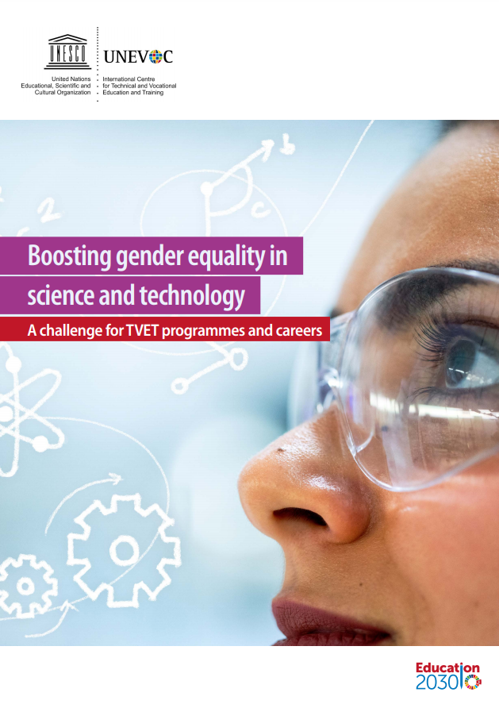
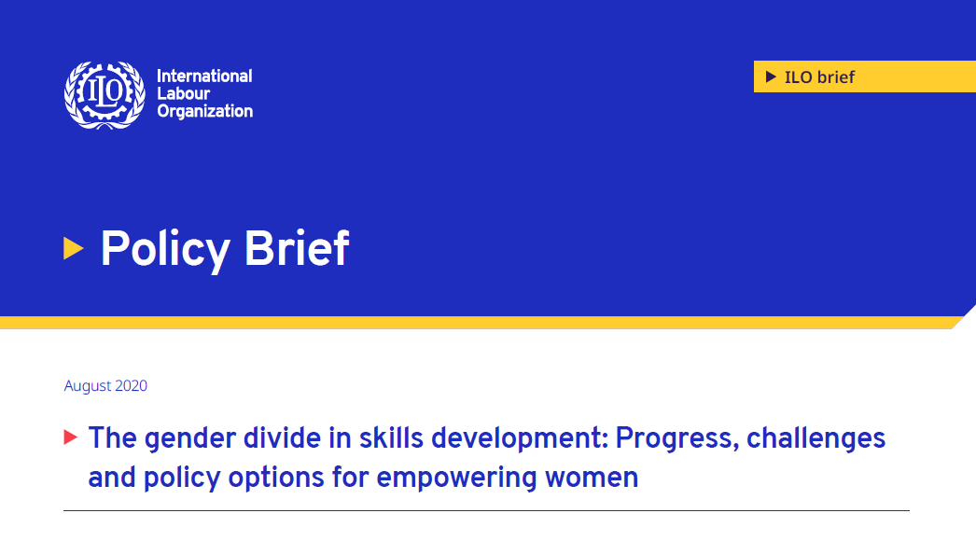
https://www.ilo.org/skills/pubs/WCMS_244380/lang--en/index.htm
https://unevoc.unesco.org/pub/boosting_gender_equality_in_science_and_technology.pdf
Notes:
Most of what I am informing you about comes from these two publications – one from UNESCO_UNEVOC and one from the ILO - both published this year. I have given the links here, so you can look at them later if you wish.

Slide 7
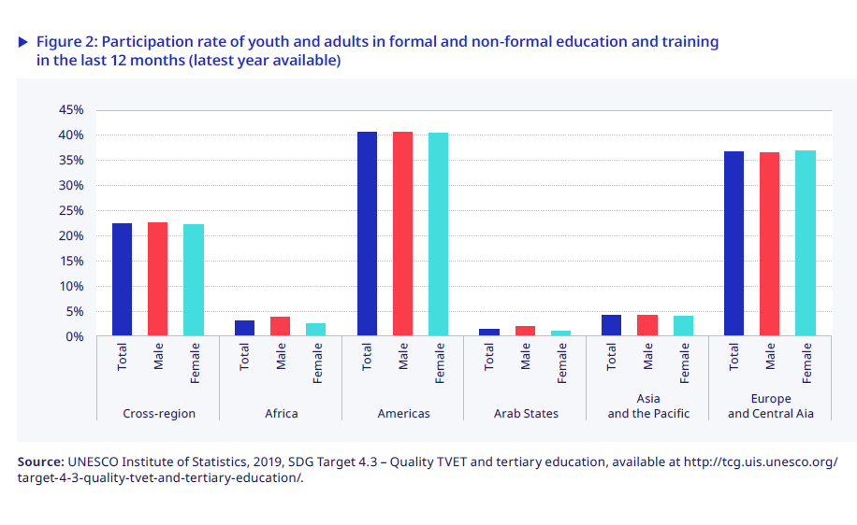
TVET participation comparable
https://www.ilo.org/skills/pubs/WCMS_244380/lang--en/index.htm
Notes:
Globally we have seen some success in equal participation in education, including TVET, between genders. Here you see that across different regions of the world, male and female participation is comparable. However, you can see that it is not equal between regions. For both genders the rate is significantly lower in Africa relative to developed countries. Yes, the rate for girls and women is slightly lower in some regions, but it is not here that the significant inequity exists.

Slide 8
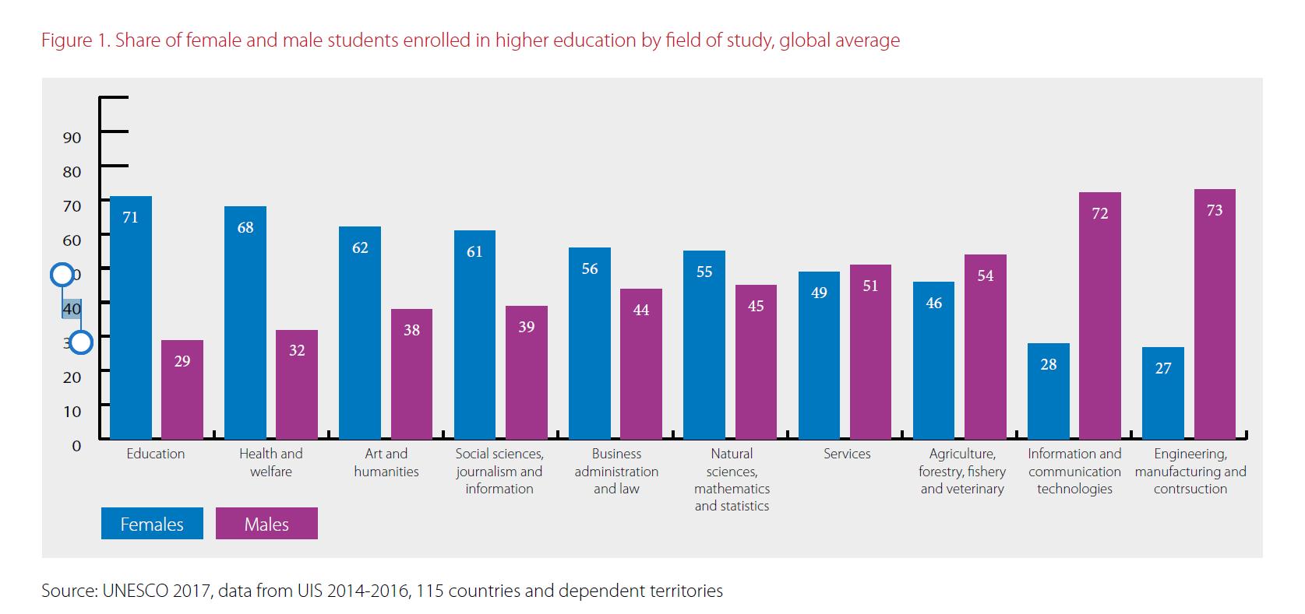
TVET study choices different
https://unevoc.unesco.org/pub/boosting_gender_equality_in_science_and_technology.pdf
Notes:
The much greater difference is in what males and females choose to study, shown here by global average. Males dominate in engineering, manufacturing, construction and ICT, and to a lesser degree in plant and animal sciences. Females dominate in education, health and welfare, and social sciences. Those women who choose science, such as myself who studied biochemistry many years ago, are more likely to choose natural sciences or mathematics.

Slide 9

Leaky pipeline
Despite a very modest increase in recent years in female participation in STEM-related TVET, we can still see a strong leaky pipeline between STEM-related TVET and STEM-related occupations or STEM-related higher levels of education.
Boosting gender equality in science and technology: A challenge for TVET programmes and careers. UNESCO-UNEVOC (2020)
https://www.geograph.org.uk/photo/3248091
Notes:
However, the story does not stop there. Studying vocational courses is not enough. The aim in studying is to move into the workforce and find decent work. Women are less likely than men to gain employment in the area in which they studied, particularly if they study STEM TVET. Of girls who study STEM TVET subjects in school, only 10% continue to the next level of study, compared to 60% of boys. Of those who choose to study STEM TVET after school, by 25 years old, 20% of the females, as compared to 40% of males are working in careers related to their study. Reasons for this difference include bias by employers, difficulty gaining experience, no jobs where they live combined with an unwillingness to travel, and no money to set up a workshop.

Slide 10
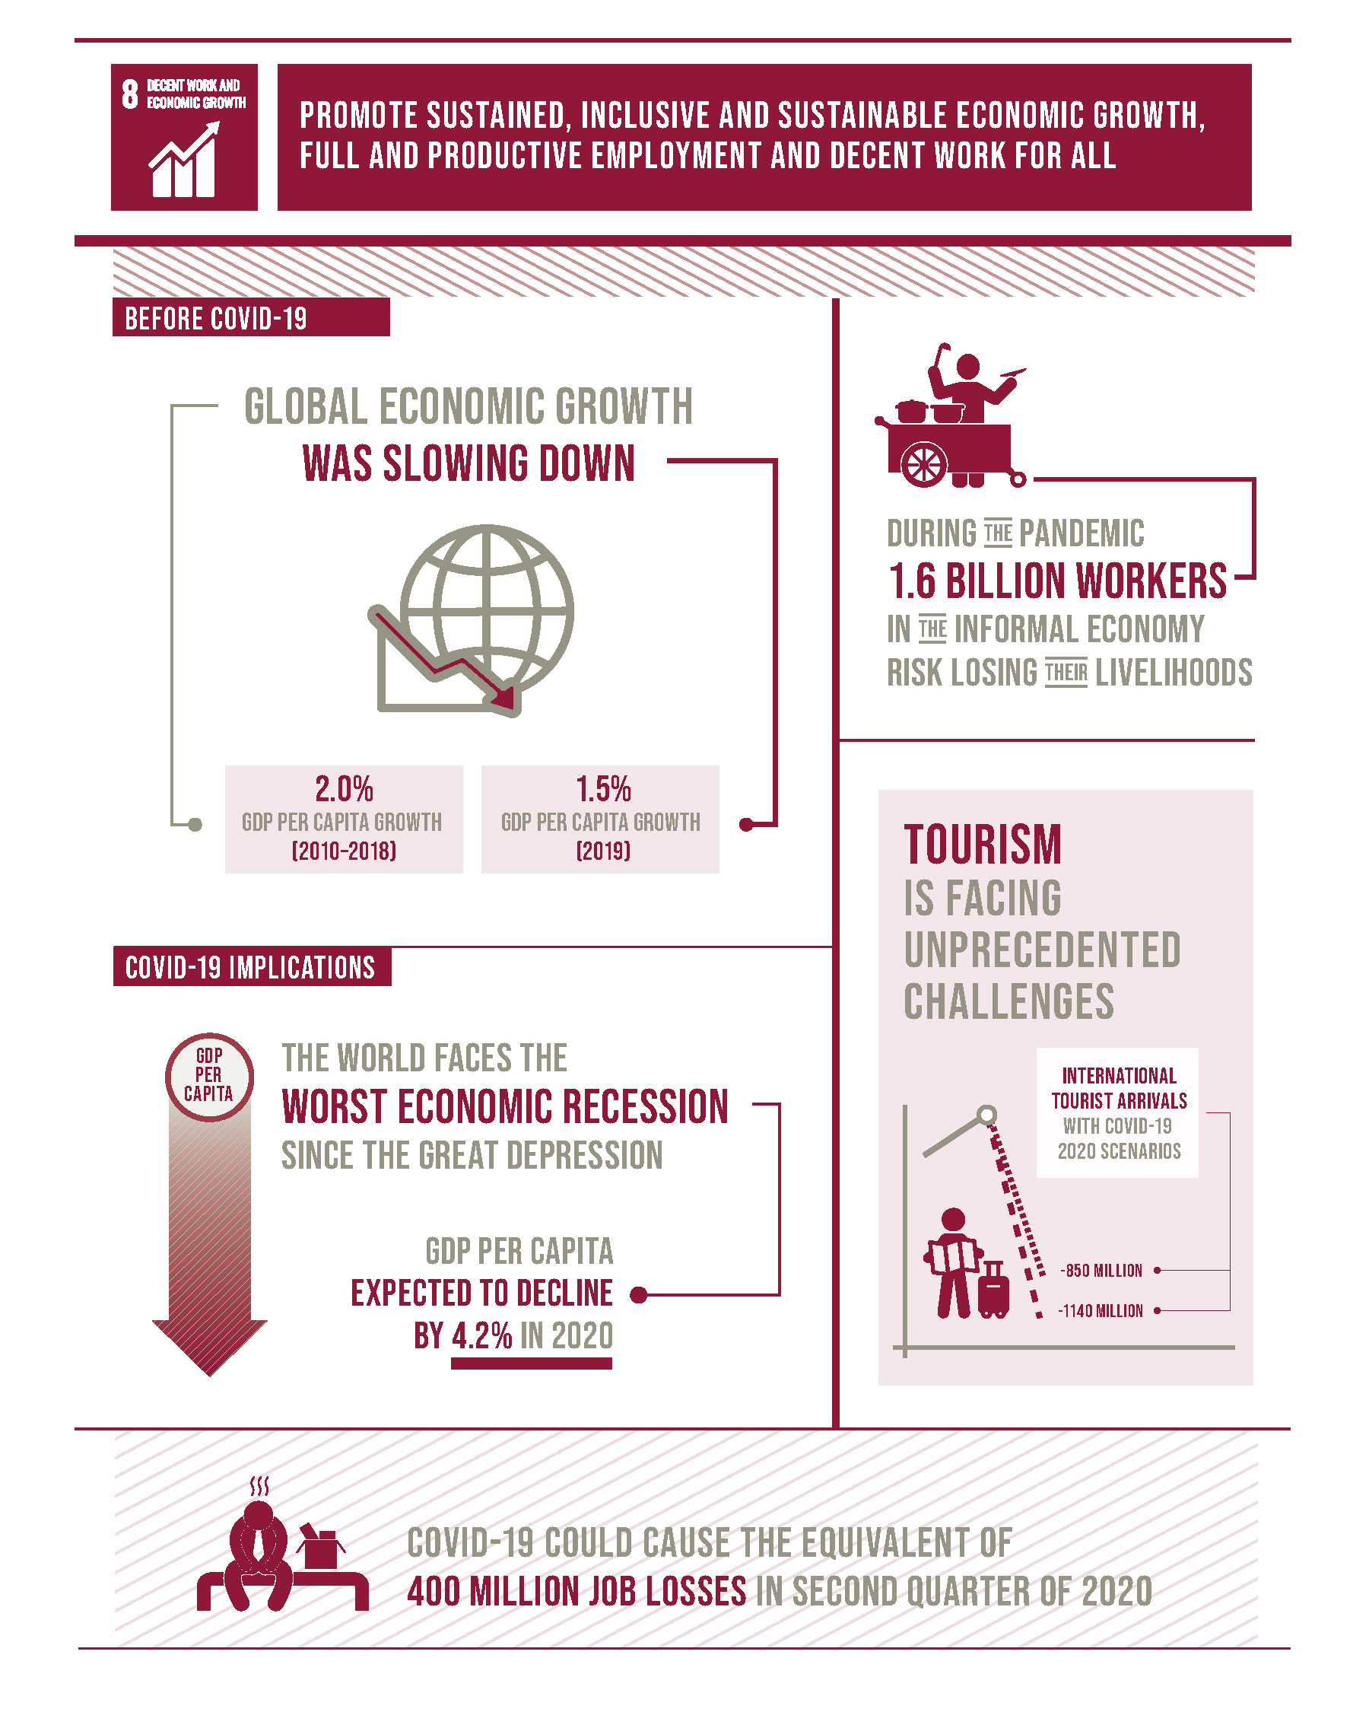
SDG 8 and COVID
Rolling back gains in female participation in the labour market
Higher percentage in front line healthcare and social assistance roles, so more at risk of getting COVID
Higher percentage in jobs that are affected – retail, hospitality and tourism
More likely to be taking on extra responsibilities for childcare with educational institutions closed
Less likely to have access to digital devices and internet to study online
https://sdgs.un.org/goals/goal8
Notes:
And this inequity has been exacerbated by COVID. Gains that had been made in female participation in both the labour market and TVET have been set back for the four reasons outlined here – which link back to the different TVET choices women make, stereotypic views of women’s roles at home as well as in the workplace, and broader discrimination.

Slide 11
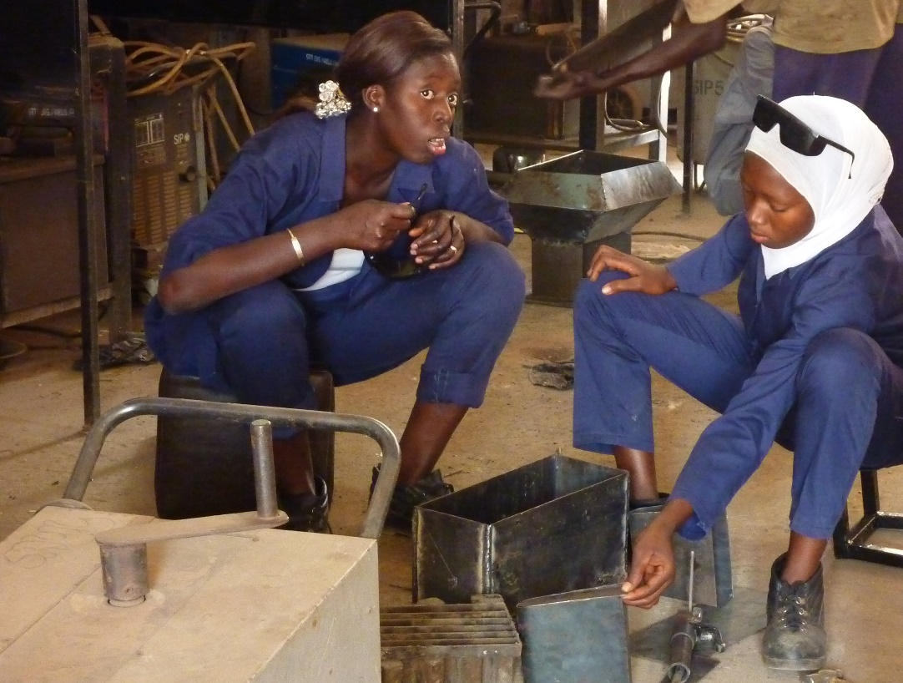
Why does this matter?
Country level
Achieve the sustainable development goals
TVET, especially STEM TVET contribute to innovation and productivity
Economic success and innovation linked to diversity
Inclusive and sustainable societies
Individual level
Women missing out on
  existing lucrative careers (EU – average almost 20% higher income )
  predicted emerging careers - 12% versus 3% growth predicted
Notes:
Does this matter? Do we need women involved in jobs that men traditionally do? It matters at both the country and individual level. My answer is a resounding yes!
It matters at the country level - as we move in to the fourth industrial revolution and the internet of things, and increasingly rely on technology, countries, including Nigeria, need more STEM TVET graduates in engineering, construction and ICT to be internationally competitive. They cannot afford to only be recruiting from half the population. Also, the complex problems we need to solve to achieve the sustainable development goals require innovative solutions, and as a world we are learning that innovation is easier and better when we bring together diverse teams – and including both genders I sone way of achieving this diversity.
And it also matters at the individual level. Right now females are missing out on the more lucrative careers, The European Union estimates that on average, men earn 20% more because of these differences. I don’t know what the difference would be in Nigeria. This difference in careers is a big factor in why women earn less than men across the globe, which leads to an inequitable society. On top of this, STEM TVET careers are predicted to grow at four times the rate of other jobs, because of the importance I mention above, meaning that it will become harder than it already is for women to have decent work if they do not move into these types of roles.

Slide 12
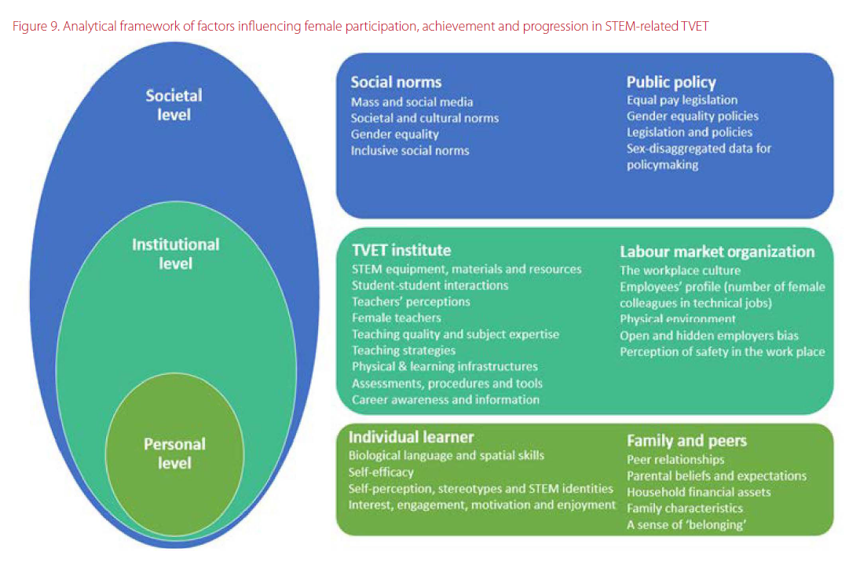
https://unevoc.unesco.org/pub/boosting_gender_equality_in_science_and_technology.pdf
Notes:
What is driving these differences? This framework outlines factors influencing female participation in STEM related TVET – STEM TVET being where the majority of the high status, high income, high demand jobs sit - at three levels – personal, institutional and societal.

Slide 13
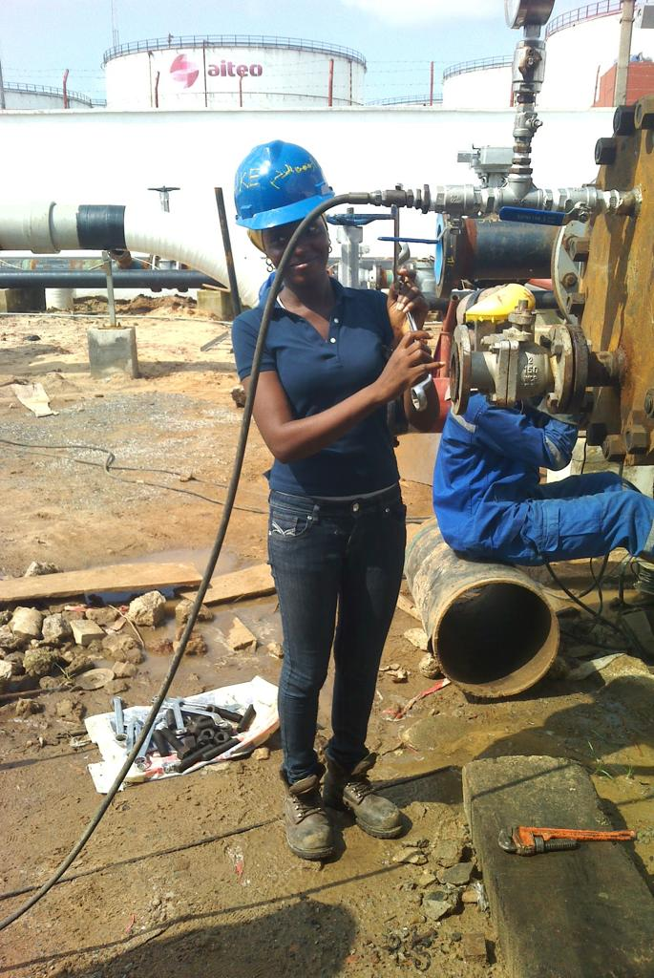
Personal level
No evidence of biological differences affecting ability
Psychological factors
Fewer female role models in TVET
Perception that TVET STEM roles are female unfriendly – dirty, physical, outdoors
General negative attitude to TVET
Girls’ sense of belonging
Family expectations
Examples of personal interventions
Hackathon ‘Girls in ICT’ (Jamaica)
Digital storytelling for mothers and daughters (Costa Rica)
Ms Geek competition (Rwanda)
Awareness raising with parents (Netherlands)
Notes:
At the personal level, there is NO evidence that biological differences mean that women cannot do STEM TVET jobs as well as men can.
However, there are significant differences in psychological factors, linked to how girls and their families perceive themselves and perceive the suitability of certain jobs for women. Examples of interventions seeking to address these factors are giving girls, and sometimes their mothers, the chance to play and compete using technology in a female only environment, and seeking to raise parents’ awareness of the suitability of, and opportunities within, male dominated careers for their daughters.

Slide 14
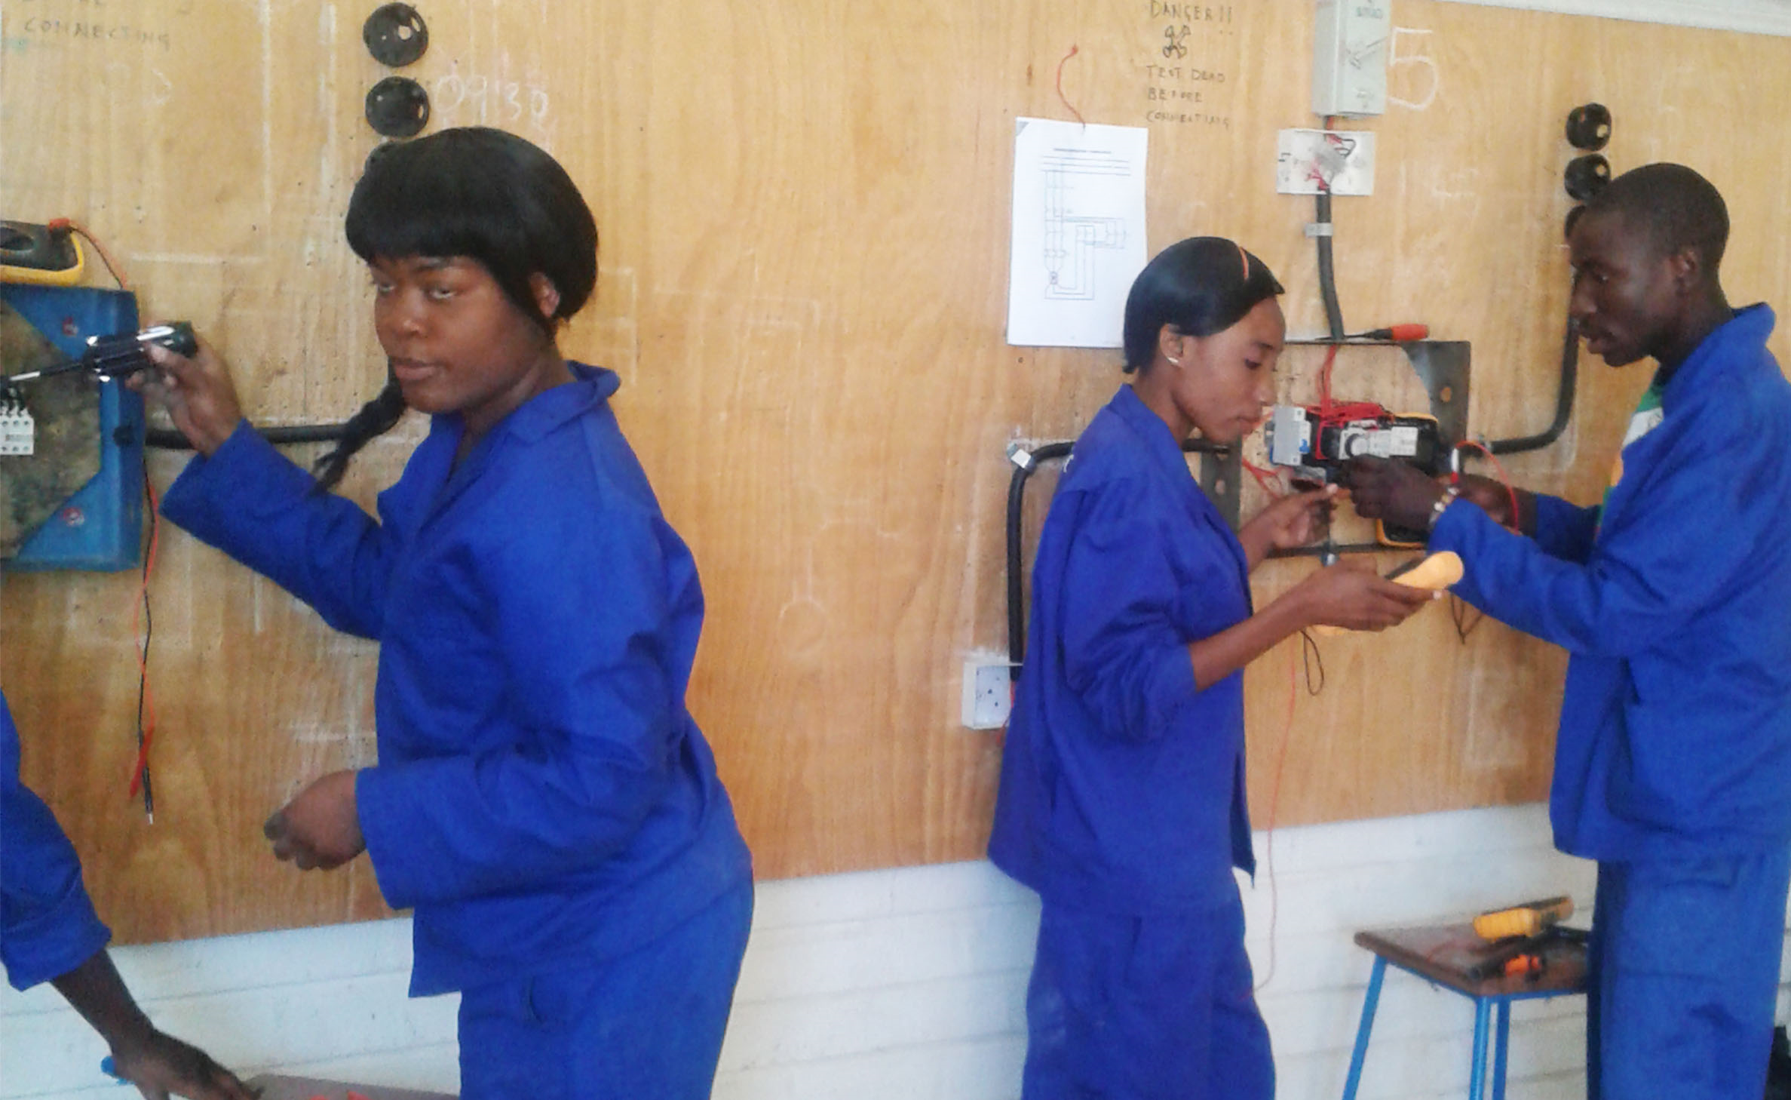
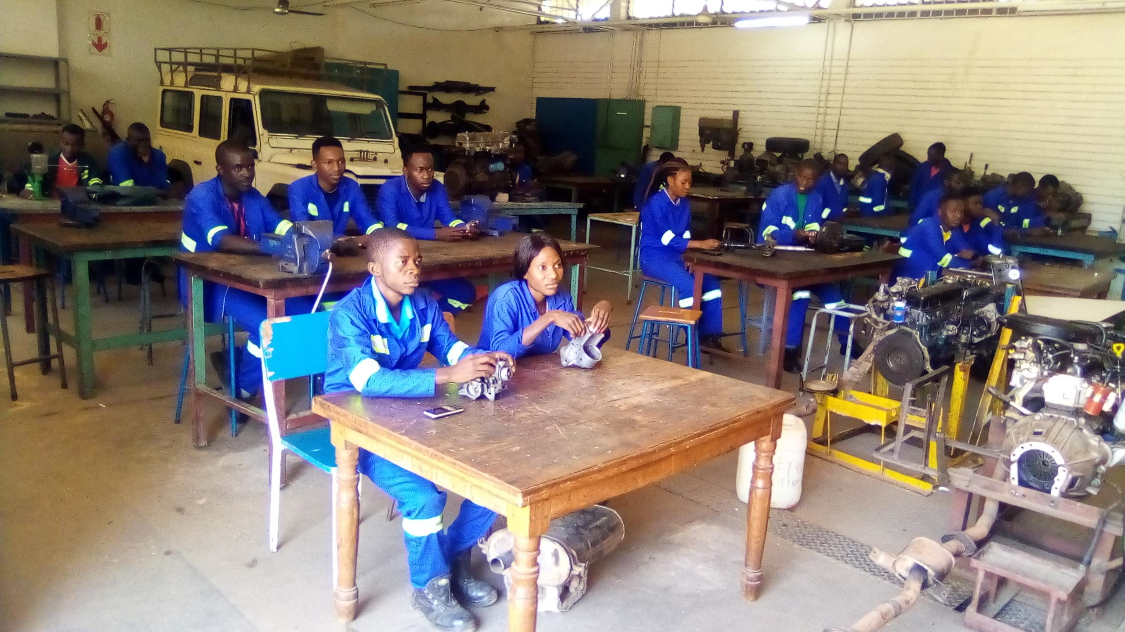
Institutional level
Employer, principal and teacher bias -where men and women ‘belong’
Lack of career advice for females, or discouraging advice
Few female teachers or supervisors as role models
Lack of female colleagues or peers
Limited flexibility - long modules, campus based, full time
Lack of second chance learning
Unsafe environment - sexist culture, including sexual harassment, bullying
Female unfriendly infrastructure eg learning materials, machines
Lack of quality sanitary facilities and childcare options
Examples of institutional interventions
Teacher training in gender awareness, including engineering and ICT specific module (Mozambique)
Electronic labs in girls only school (Ghana)
TVET institution facilitate internship to ensure fit and safety, monitor and blacklist unsuitable companies (Netherlands)
Notes:
Institutional factors influencing lower female participation are similar across educational institutions and workplaces – bias from those with influence across the recruitment, study and employment pathway, lack of female examples and support, inflexible training courses, and study and work environments that are physically unfriendly for females.
Examples of interventions being trialed to overcome these factors include training and sensitization to help teachers understand and change their bias, girl only environments for STEM TVET subjects, and TVET institutions using women friendly criteria to select which industries they will partner with.

Slide 15

Societal level
Relationship between gender equality and wider societal norms and culture
Effects of mass and social media
Polices and legislation
Examples of societal interventions
Public campaign targeting women and companies (Costa Rica)
My TVET campaign, with activities targeting females (Ghana)
National strategies to increase female participation in STEM TVET
Specific organisations, scholarships, mentoring schemes, targeted career advice, promoting female images, awareness raising for male leaders
https://www.thebluediamondgallery.com/wooden-tile/p/policy.html
Notes:
Societal factors include deeply embedded norms regarding roles of men and women, and governments not recognising the importance of leading efforts to change these perceptions at national level. Some countries are running national campaigns to try to change societies’ views and developing national strategies to try to increase female participation in STEM related TVET.

Slide 16

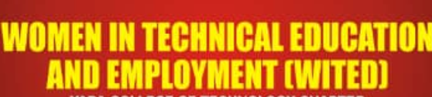

CAPA WITED COL project
Assumptions
WITED Chapters are a key strategy to increasing female involvement in TVET, including STEM TVET
Want to start new chapters
Want to improve existing chapters
Share experience of chapters and others
Method
Online capacity building
COL consultant work with CAPA advisory group
Monitoring and evaluation
Notes:
And closer to home - COL and CAPA have just agreed to work together on an intervention of our own which will involve you. We want to build on the great work that WITED chapters such as yours are doing and co-design and develop an online learning experience to build the capability of existing chapters to continually improve what they are doing at and help institutions set up new chapters.

Slide 17
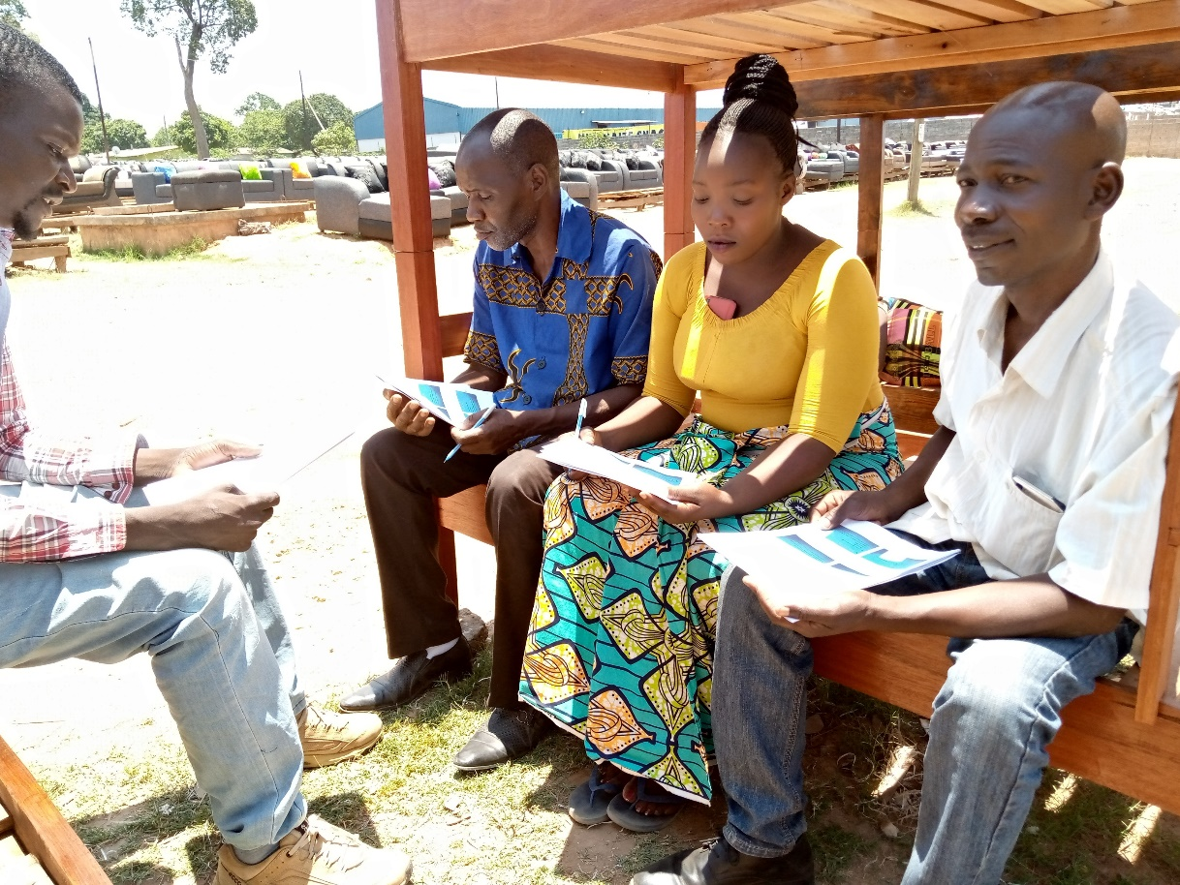
Conclusion
Globally, including Africa, we are making progress in women’s participation in TVET, but
Female participation is low in higher status, higher paid, higher demand STEM TVET
Female participation in STEM TVET related jobs is low, even for those who study those areas
COVID has more adversely affected females
There are encouraging examples from around the world at personal, institutional, labour market agency and societal levels
COL and CAPA are working together to make a difference in Africa.
Notes:
So in conclusion, across the world, including Africa, we are making good progress in women’s participation in TVET. Our focus needs to be on increasing their involvement in STEM related TVET, and better supporting them into those workplaces. Our job has got harder since COVID but there are encouraging examples that I hope you feel inspired to imitate. And COL and CAPA are joining hands to support you to do this – so that together we can all help achieve the fourth target of the fourth SDG and see equal access for women across the different types of TVET, so that women become as well off as men and countries like yours become as well off as developed nations.

