Slide 1



Digital transformation of education for the future
Professor Asha Kanwar
President & CEO, Commonwealth of Learning
2022 Global MOOC and Online Education Conference
Tsinghua University, Beijing, China | 9 December 2022

Slide 2

Closure of campuses
220 million Higher Education
students globally affected
Source: UNESCO COVID-19 response, UNESCO, 2021

Slide 3




Digital technologies are here to stay

Slide 4
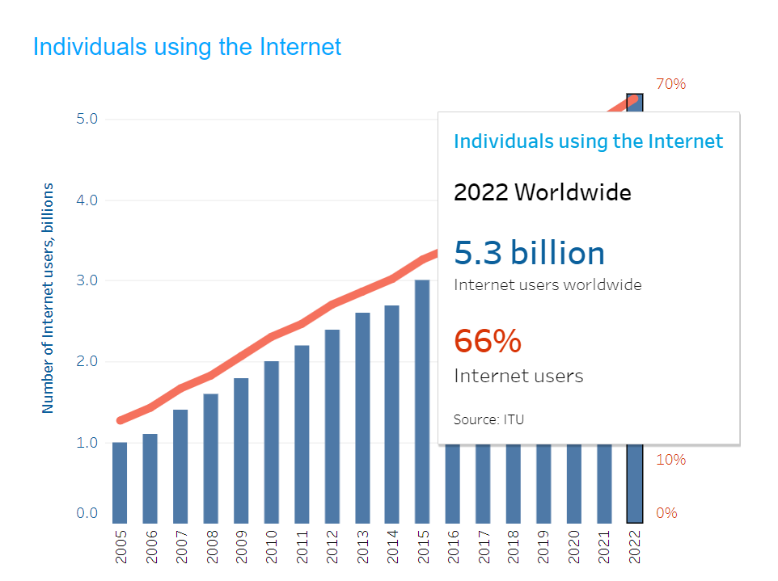
Digital Connectivity
Source: https://www.itu.int/en/ITU-D/Statistics/Pages/stat/default.aspx

Slide 5
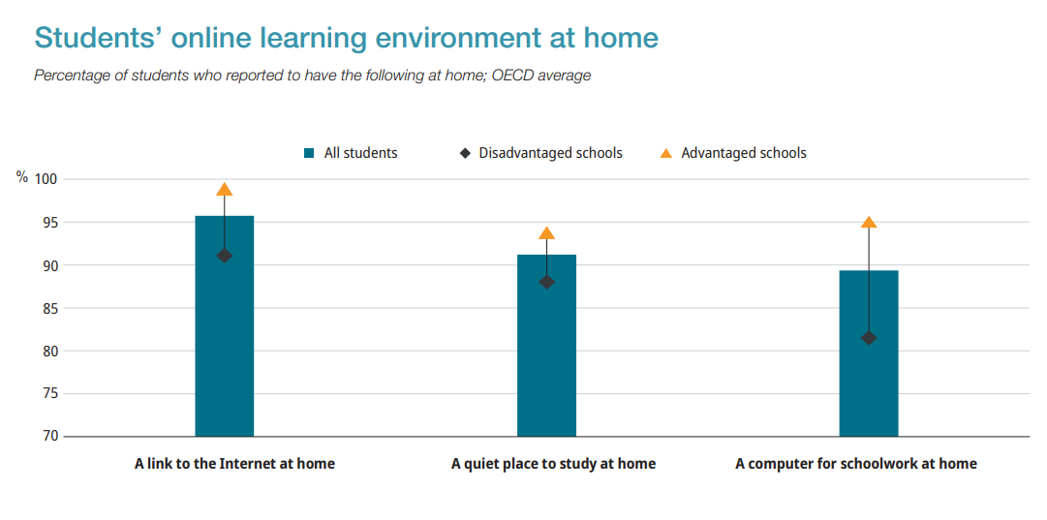
Digital Divide
Source: OECD. https://www.oecd-ilibrary.org/docserver/4bcd7938-en.pdf?expires=1668797535&id=id&accname=guest&checksum=FFEF34230E57CEA21179C2DFA3BA0FEE

Slide 6
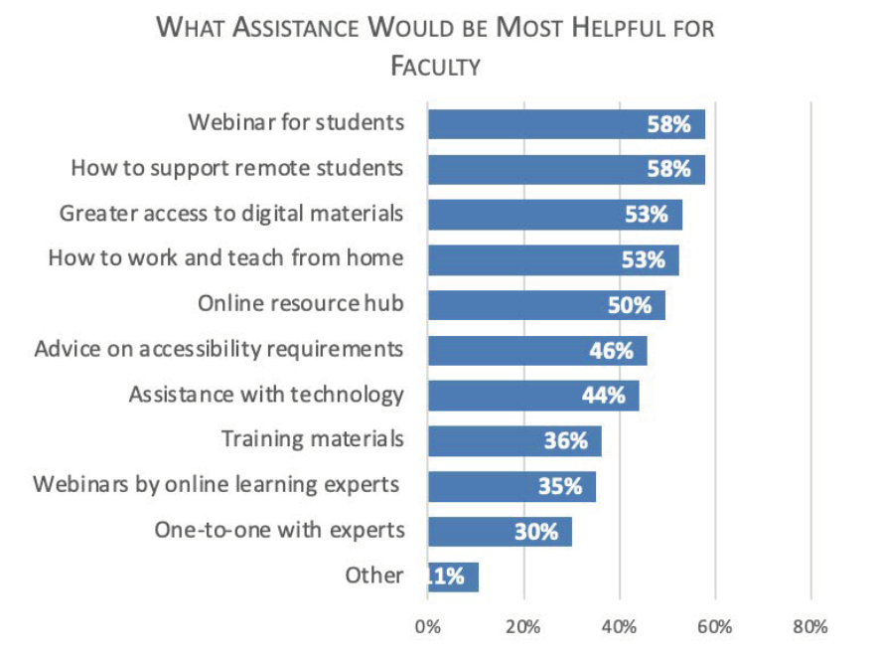
Teacher
Capacities
Teachers needed more assistance during pandemic
Source: Johnson, et al. (2021). Teaching during pandemic. Bayview Analytics
Notes:
A study on teaching during pandemic in USA and Canada revealed that over 50% of teachers required support on how to support remote students, and increased access to digital materials. Many also indicated the need for advice on accessibility requirements and 44% indicated assistance with technology.

Slide 7
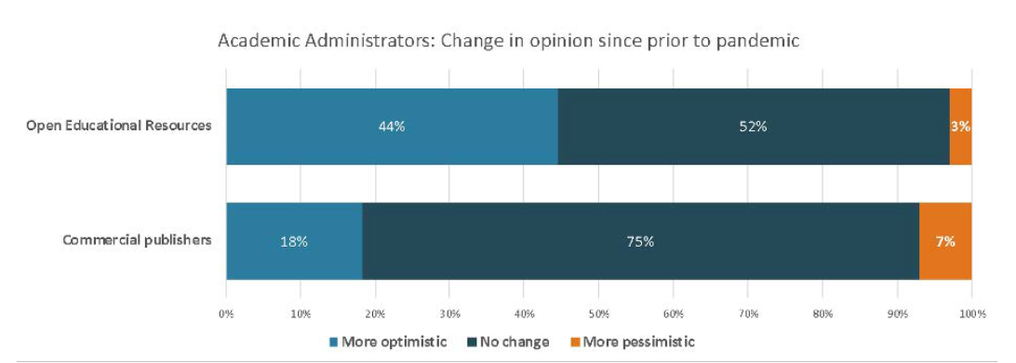
Increased use of OER
Source: Johnson, et al. (2021). Teaching during pandemic. Bayview Analytics

Slide 8


Growing inequalities need urgent attention

Slide 9
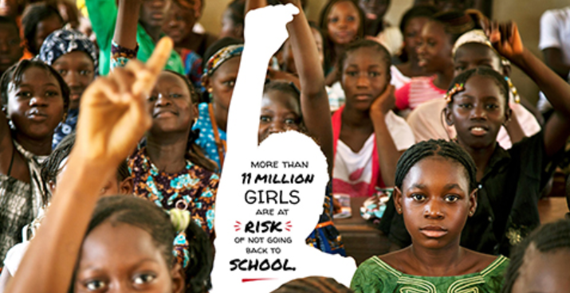
The vulnerable become even more vulnerable
Source: https://en.unesco.org/covid19/educationresponse/girlseducation

Slide 10
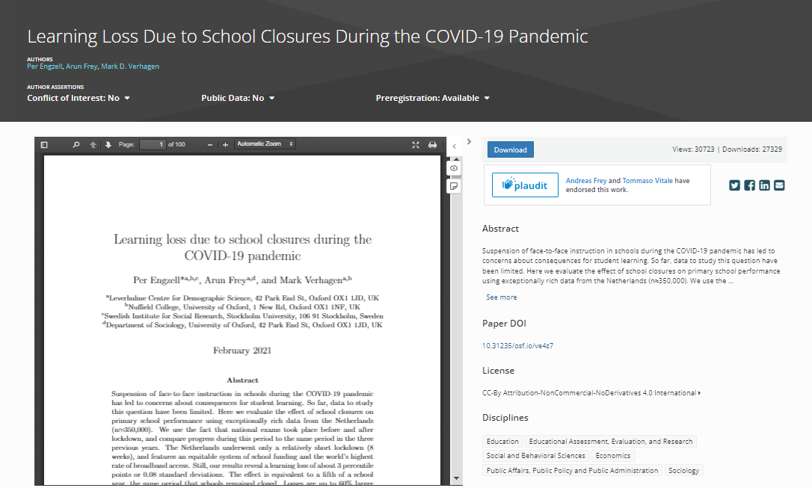
Learning inequality during Covid-19
Learning loss of about three percentile points
Learners from less educated home 55% more prone to learning loss
Source: https://osf.io/preprints/socarxiv/ve4z7/
Notes:
In Netherlands, during the COVID19 pandemic, learning loss of about 3 percentile points or 0.08 standard deviations was recorded in a study. Losses are up to 55% larger among students from less-educated homes.

Slide 11

Children with disabilities spent very little time on formal learning
31% reported to not be studying at all
45% spending less than an hour studying
24% spent more than an hour studying at home
Source: Impact of Covid-19 on the education of children with disabilities in Malawi: reshaping parental engagement for the future. https://www.tandfonline.com/doi/full/10.1080/13603116.2021.1965804
Notes:
A study in Malawi showed…

Slide 12


Phenomenal growth of self-directed learning

Slide 13
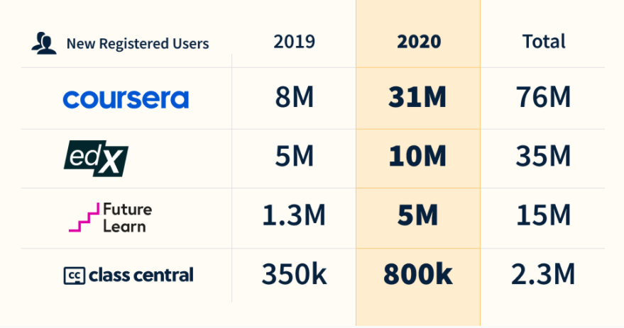
A range of new online courses
Universities started many online courses
Increased adoption of online distance education
Increased acceptability of online training for professional development
Source: https://www.classcentral.com/report/the-second-year-of-the-mooc/

Slide 14

Limitations of MOOCs
Poor completion rates
Learners not returning after year 1
Reaching those who already have a degree
Many not available as open educational resources

Slide 15
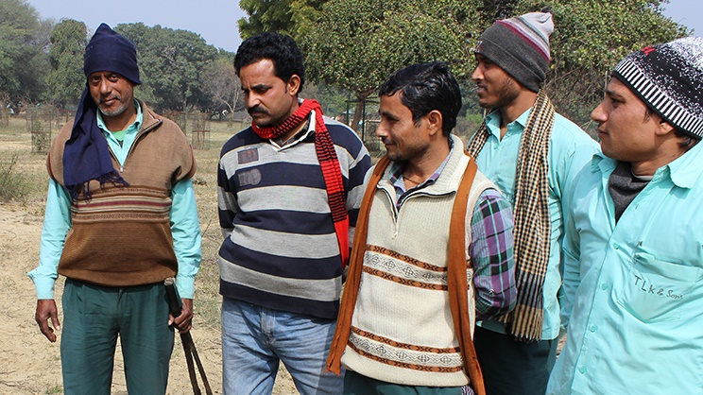

MOOC4D
Online learning (agMOOCs) - Food and Agriculture sector underserved. A consortium conceptualised by COL, supported by NPTEL

Slide 16
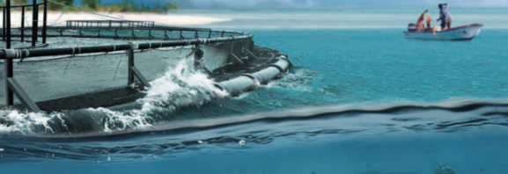

Need for sustainable systems

Slide 17





Impact of the climate crisis on education
Infrastructural damage
Damage to resource and materials
Loss of data and records
Collapse of systems = Out of school youth
Notes:
Climate related natural disasters have major, detrimental impacts on education. Events such as hurricanes, storms and floods can have catastrophic effects on the infrastructure, resources and systems of the education sector. Entire schools can be destroyed or irreparably damaged, leading to thousands of displaced students, unable to continue their education. Critical data and student records may be wiped out entirely, leaving the system in shambles, and learners and institutions in the dark. These impacts can effectively lead to the collapse of the education system in disaster affected areas.

Slide 18



Education contributes to climate change
DIRECT
Emissions from construction of schools/infrastructure
Emissions from energy use in schools
Learner emissions
INDIRECT
Emissions from ‘development’ and economic growth associated with higher levels of education in a country
Notes:
The education sector, from primary to tertiary, contributes to both direct and indirect emissions, which impact on climate change, and environmental degradation, as well as incur associated economic costs. If we look strictly at contributions to emissions, the achievement of SDG4, under the current paradigm, could potentially worsen the climate crisis.
Climate related natural disasters have major, detrimental impacts on education. Events such as hurricanes, storms and floods can have catastrophic effects on the infrastructure, resources and systems of the education sector. Entire schools can be destroyed or irreparably damaged, leading to thousands of displaced students, unable to continue their education. Critical data and student records may be wiped out entirely, leaving the system in shambles, and learners and institutions in the dark. These impacts can effectively lead to the collapse of the education system in disaster affected areas.

Slide 19

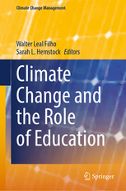





Lower carbon footprint
3x less carbon emissions
Travel – greatest contributor
Mode of delivery - determinant
Source: Carr et.al. Delivery Mode and Learner Emissions: Comparative Study from Botswana. W. Leal Filho and S. L. Hemstock (eds.), Climate Change and the Role of Education, Springer Nature. In Production.
Notes:
Perhaps the most comprehensive project assessing the environmental impacts of different modes of delivery in higher education is the SusTEACH project, supported by the Open University, UK. The project compared the carbon emissions of ICT-enhanced courses with online courses and mainly face to-face taught courses. The findings showed that online and blended ICT-enhance distance teaching models had significantly lower environmental impacts than face-to-face teaching modes (Caird et al. 2013; Caird et al. 2015). This study used a comprehensive methodology that considered multiple contributors to emissions for both students and the institutions.
Using the SusTeach methodology COL conducted a study in Botswana, to determine whether there was a difference between the carbon emissions of CD-based ODL and face-to-face learners, as well as the main sources of learners’ emissions.
The comparison of learner carbon emissions data from both face-to-face and CD based students in Botswana revealed that the average learning-related carbon footprint of the face-to-face group is nearly three times greater than that of the ODL group, and the difference was statistically significant. Within the overall carbon footprint, emissions from travel were by far the greatest contributor to this disparity. This suggests that regardless of the exact mechanism of delivery, ODL or blended modes can decrease emissions by reducing face-to-face contact hours. Institution, as a proxy for delivery mode, was the most significant predictor of learning related emissions.

Slide 20
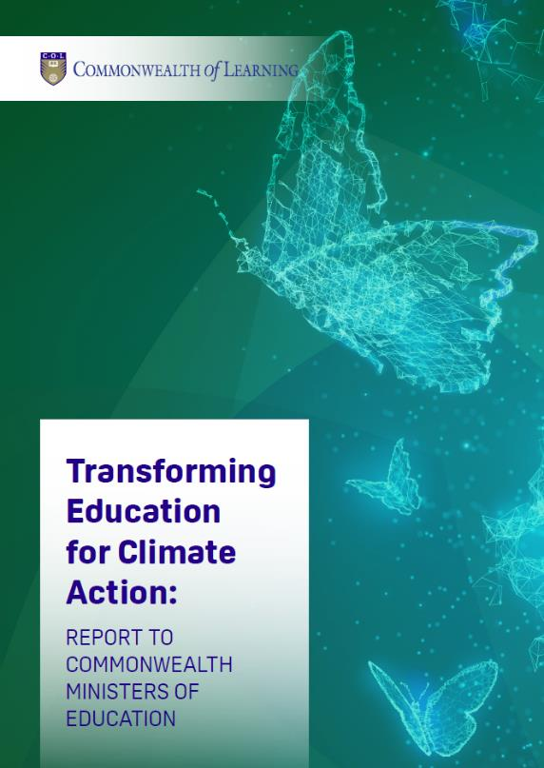

Adaptation is key
Build resilient infrastructure
Skills for the blue and green economies
Promote climate justice
Notes:
Urgent action required
Need for behavioural change for climate action
Engage and empower youth
Promote disaster response and recovery through education and lifelong learning
Promote collaboration especially with the private sector

Slide 21


Education for the future

Slide 22


The future is blended
Appropriate technologies to create blended learning opportunities
Multiple pathways to acquire qualifications
Using technology to personalise learning

Slide 23

Leaving No One Behind
For persons with disabilities
Women and disadvantaged groups
People in remote areas

Slide 24

Promote lifelong learning
Learning to learn online
Creating an ecosystem for lifelong learning
Providing just-in-time on-site training

Slide 25
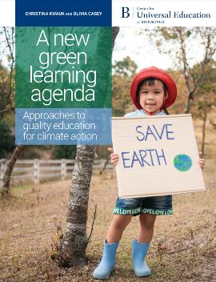

Develop a green learning agenda
Skills for green jobs
Green life skills
Skills for a green transformation
Skills aimed at fulfilling the requirements of green jobs and supporting the transition to a low-carbon green economy
Cross-cutting skills that serve both technical, instrumental, and adaptive, transformative ends
Adaptive skills aimed at transforming unjust social and economic structures
Source: https://www.brookings.edu/wp-content/uploads/2021/01/Brookings-Green-Learning-FINAL.pdf

Slide 26

Is affordable and accessible quality education for all
Uses blended
learning options according to context
Model sustainable behaviours for the people and the planet

Slide 27

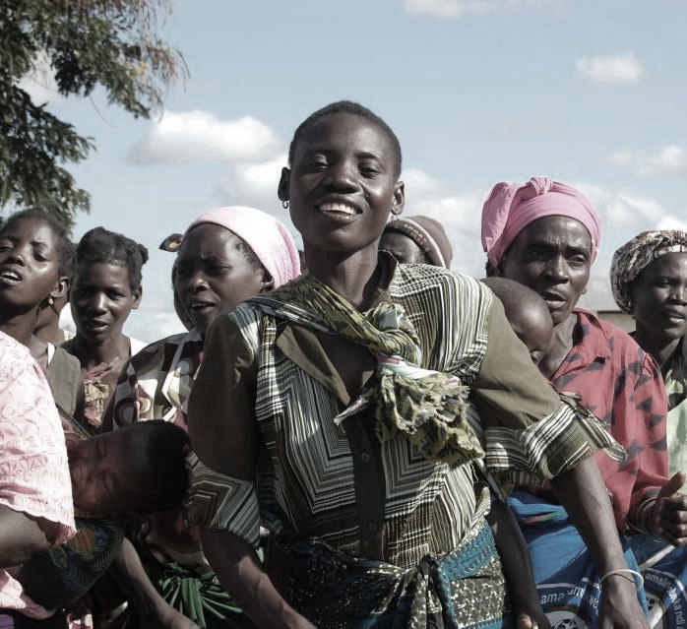
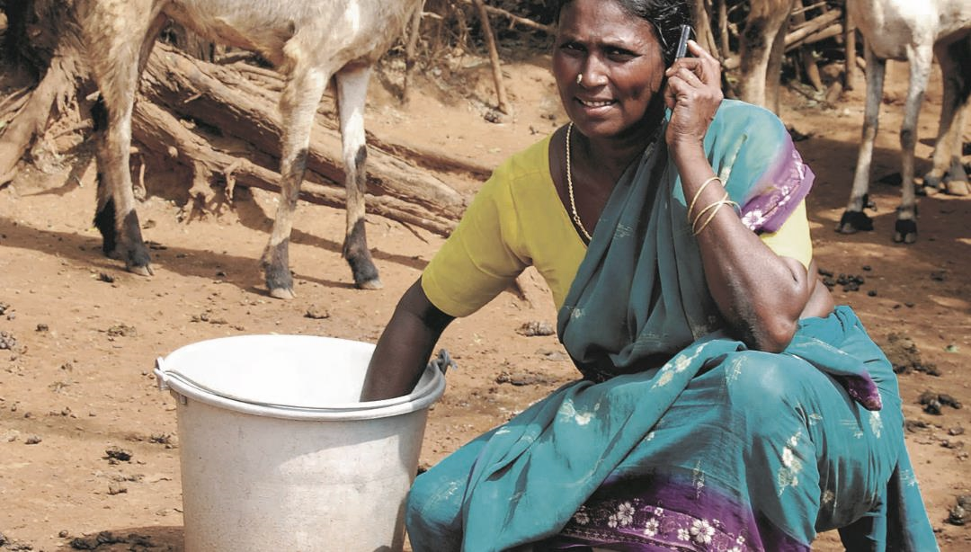

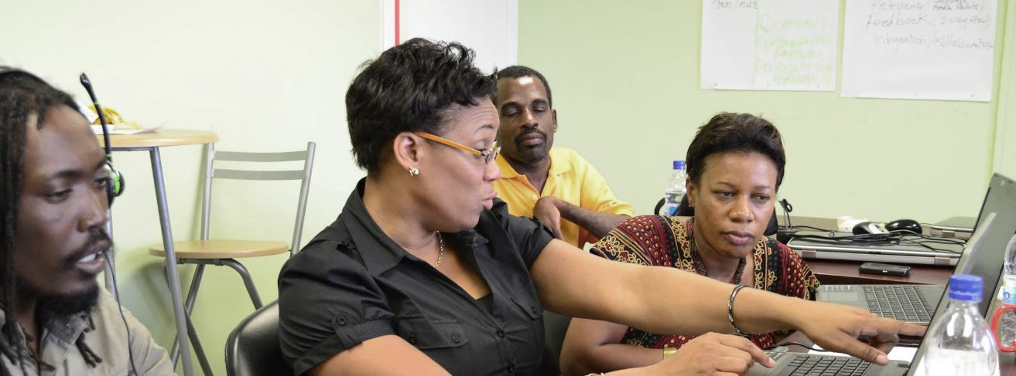

Thank you
www.col.org
The contents of this presentation, with the exception of logos and graphics which are the property of the respective owners, is made available under Attribution-ShareAlike 4.0 International (CC BY-SA 4.0).

