Slide 1

ODeL Research: Beyond the Usual Suspects
Theme: Emerging Research Approaches in ODeL
Tony Mays
Education Specialist: Open Schooling
Managing Associate Editor: Journal of Learning for Development
ODeL e-conference, Unisa

Slide 2
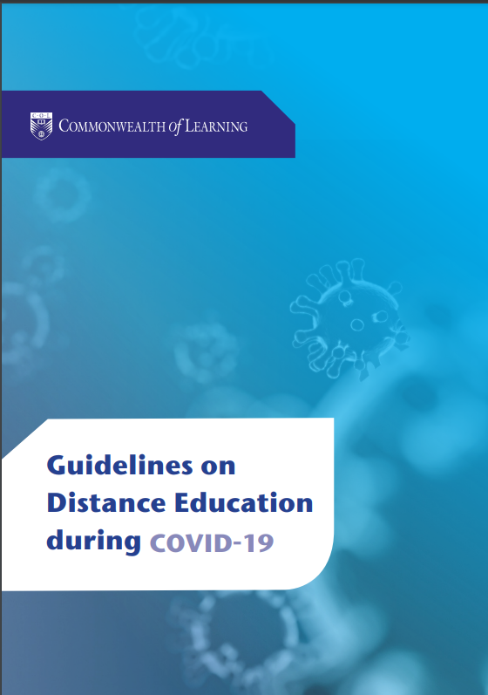

Slide 3
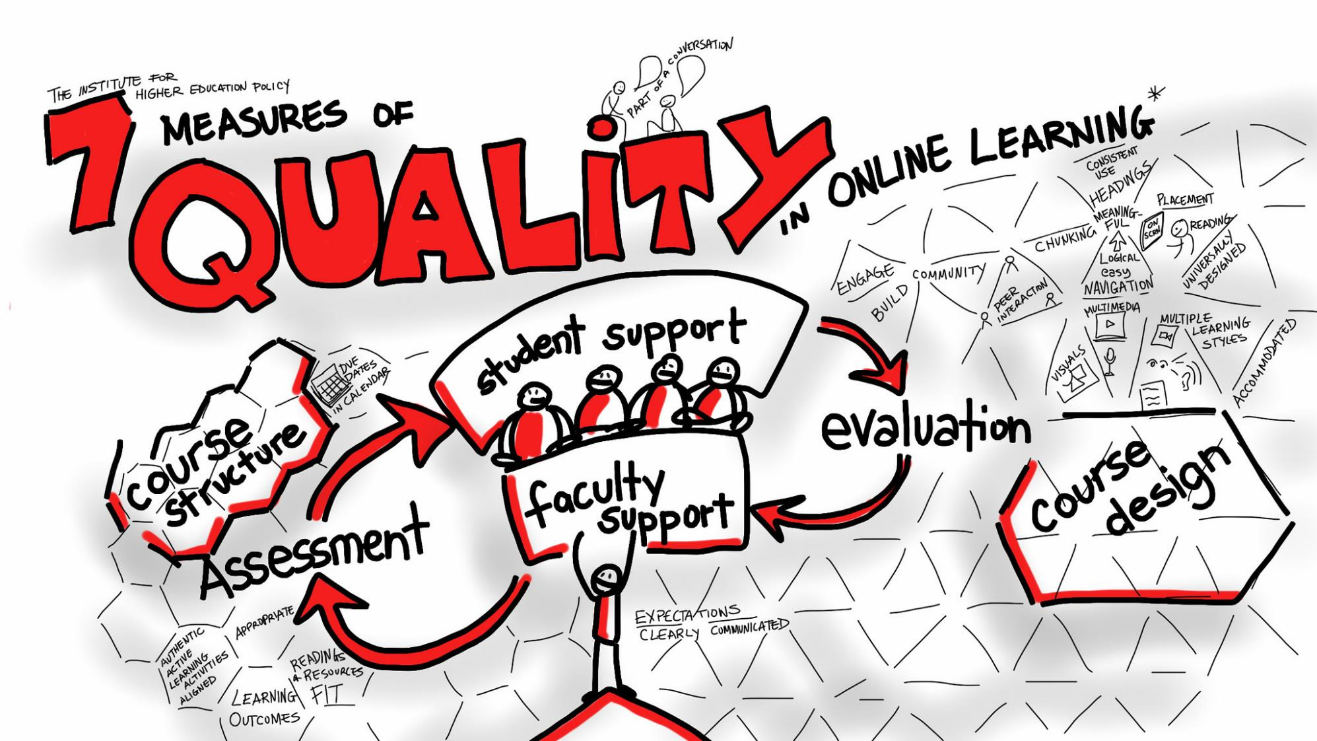

Slide 4
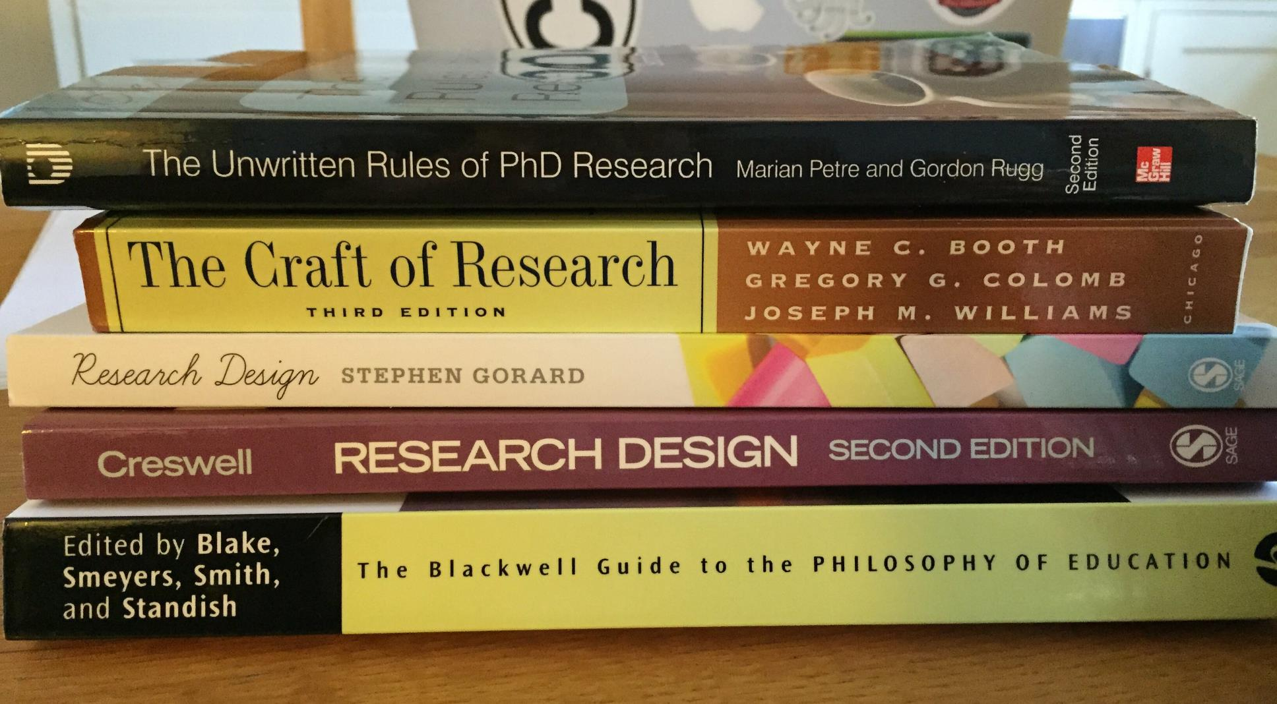

Slide 5
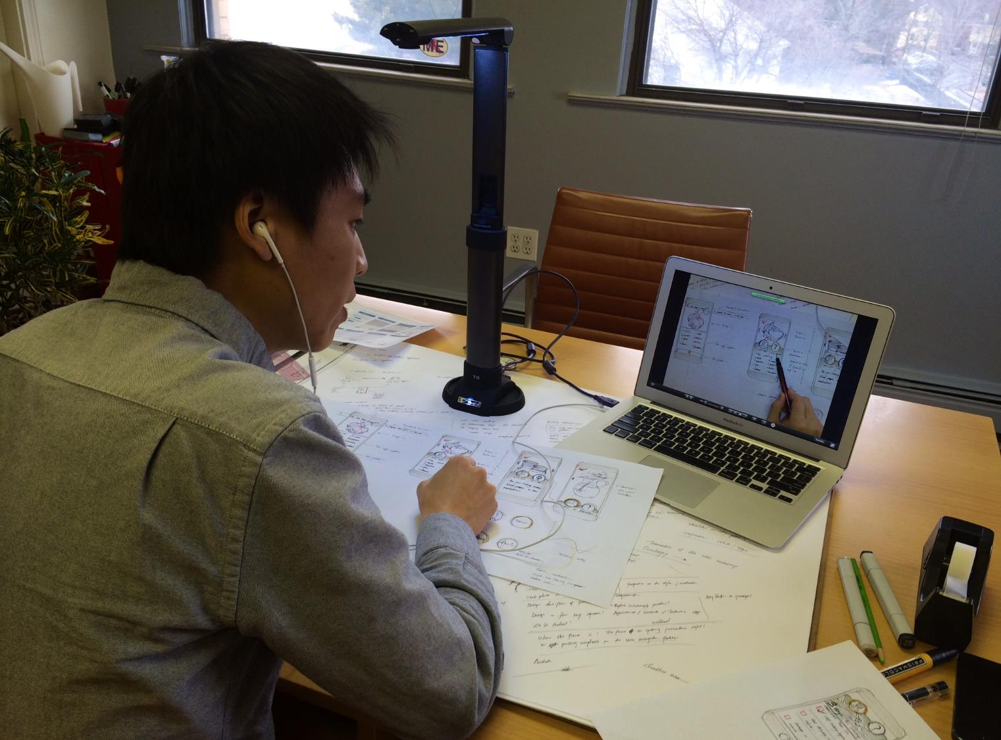

Slide 6
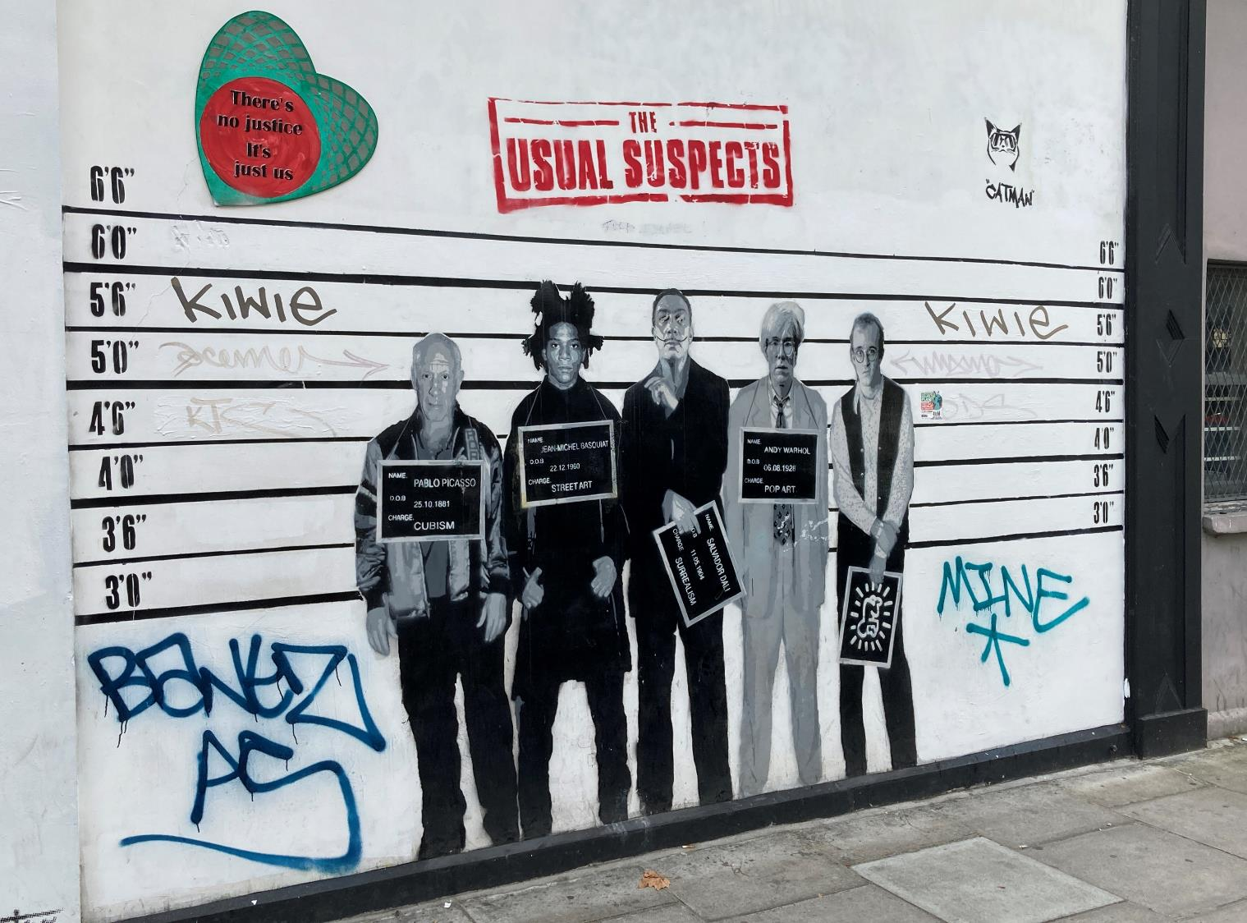

Slide 7
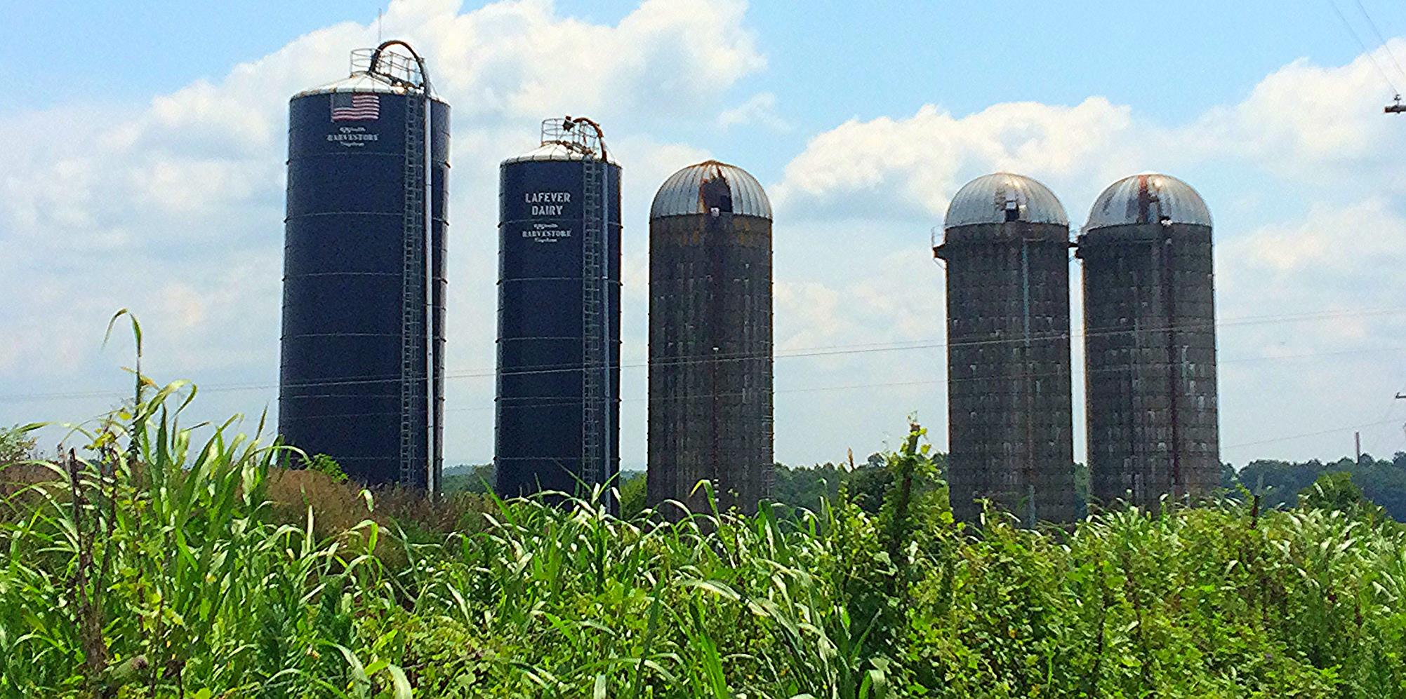

Slide 8
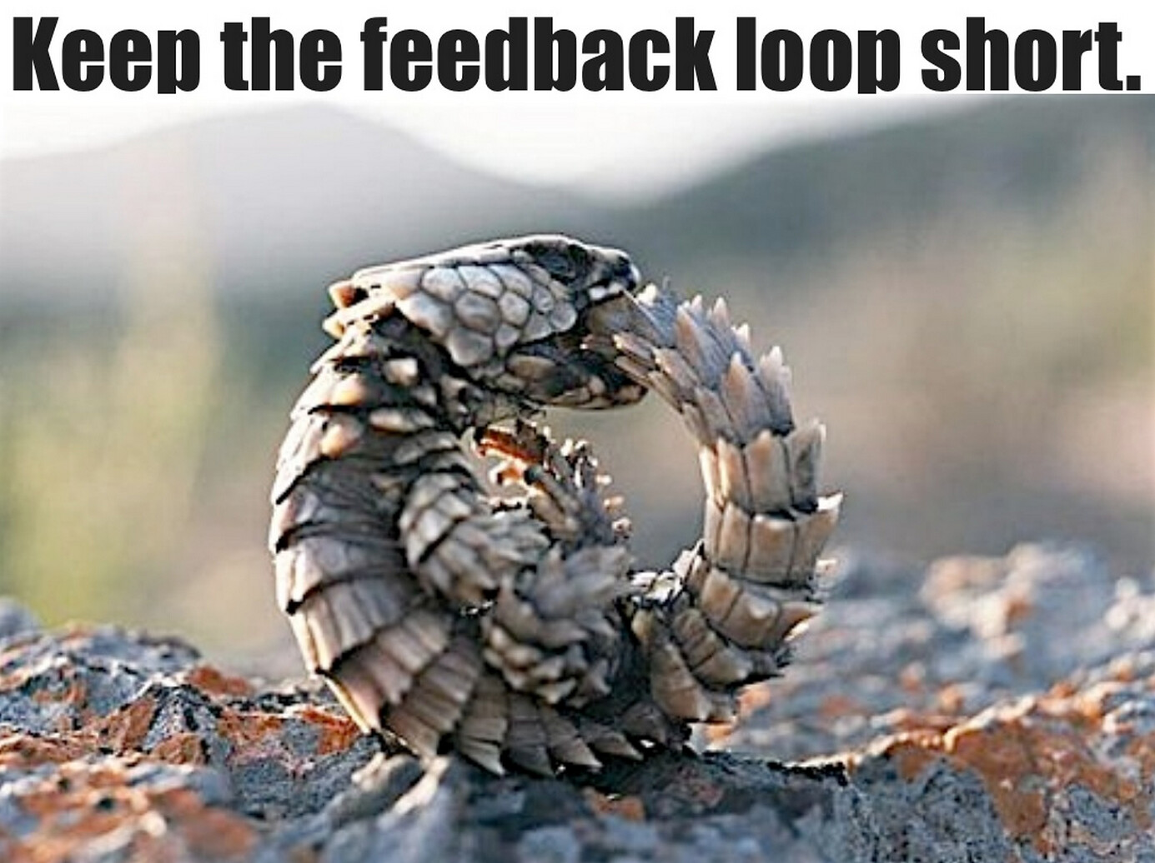

Slide 9
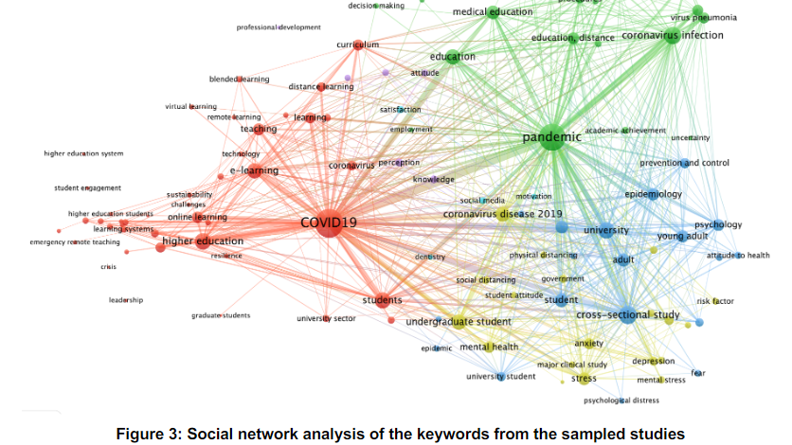
Bozkurt, 2022, pdf p.9

Slide 10
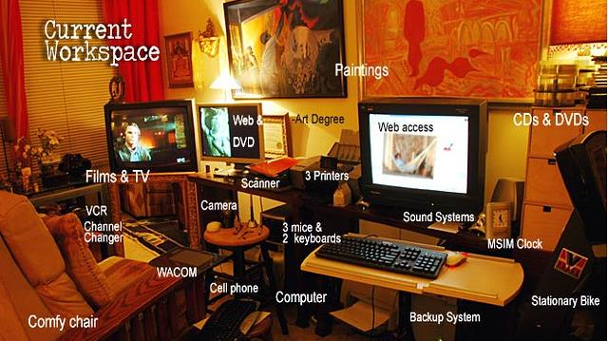

Slide 11
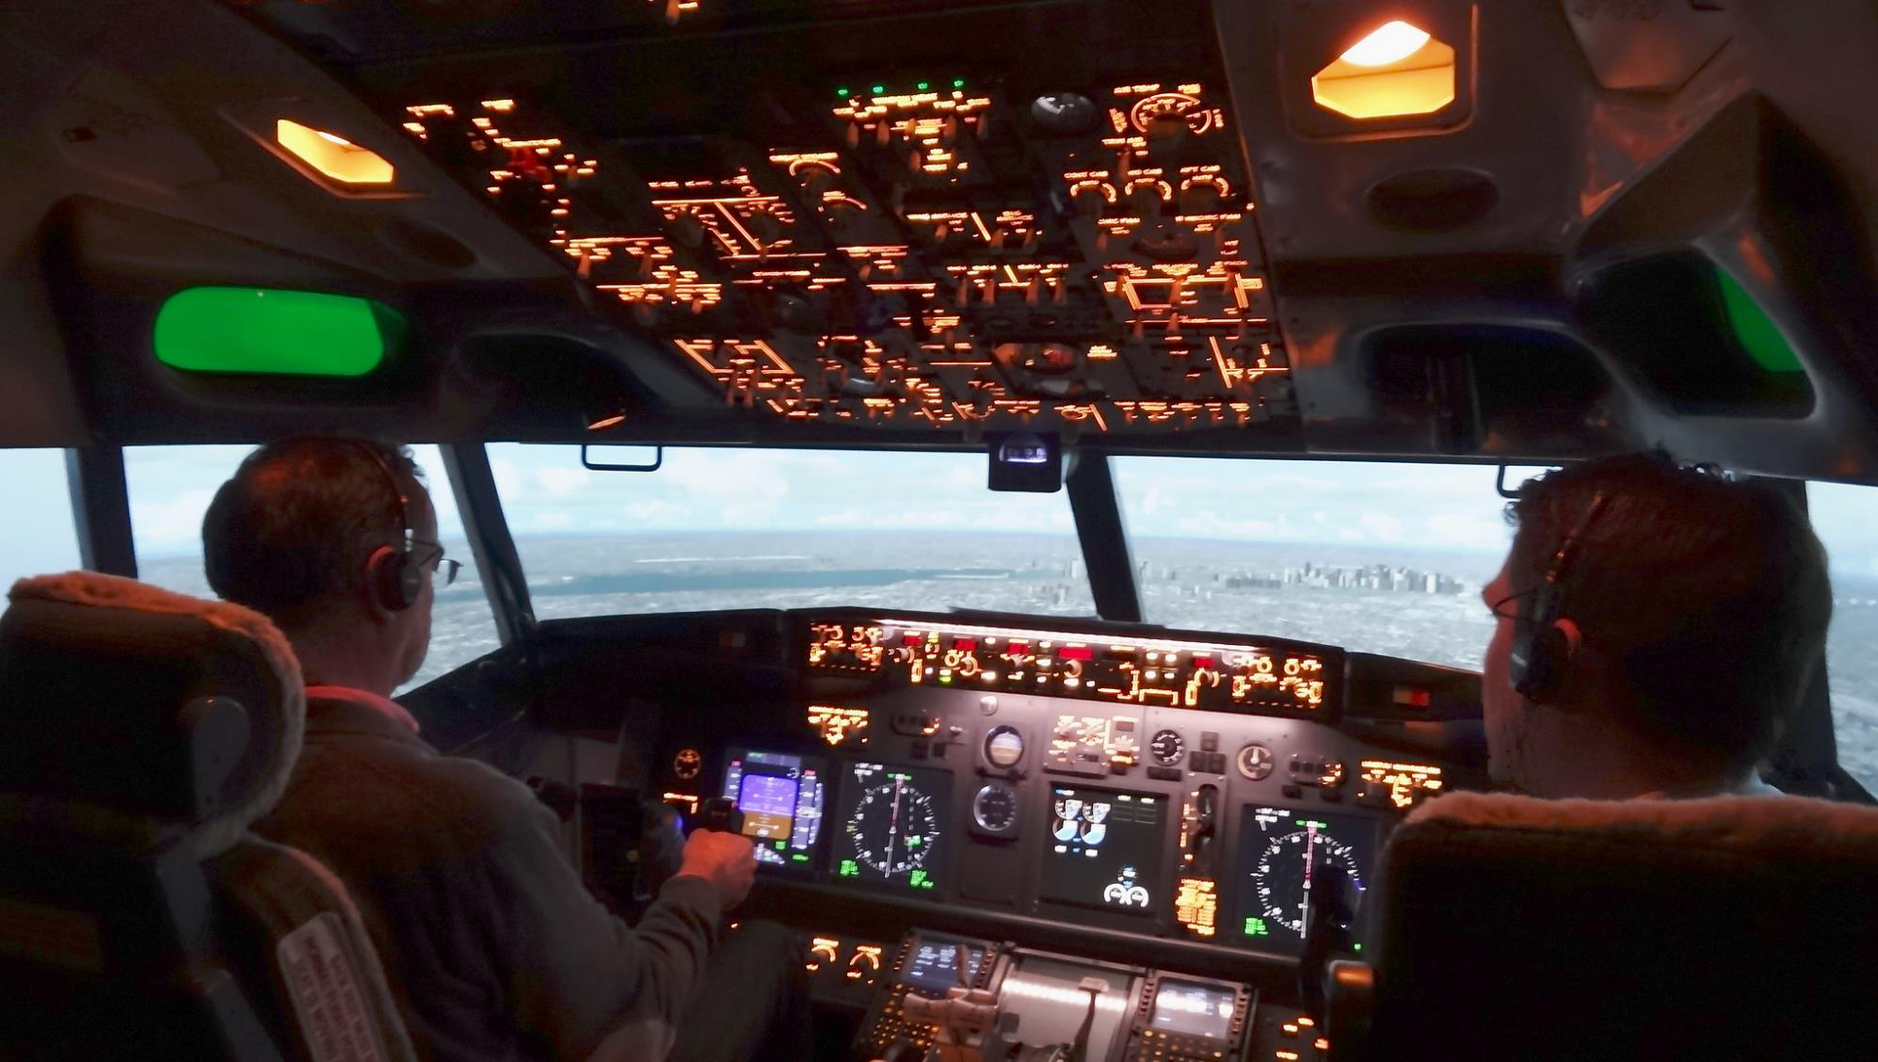

Slide 12
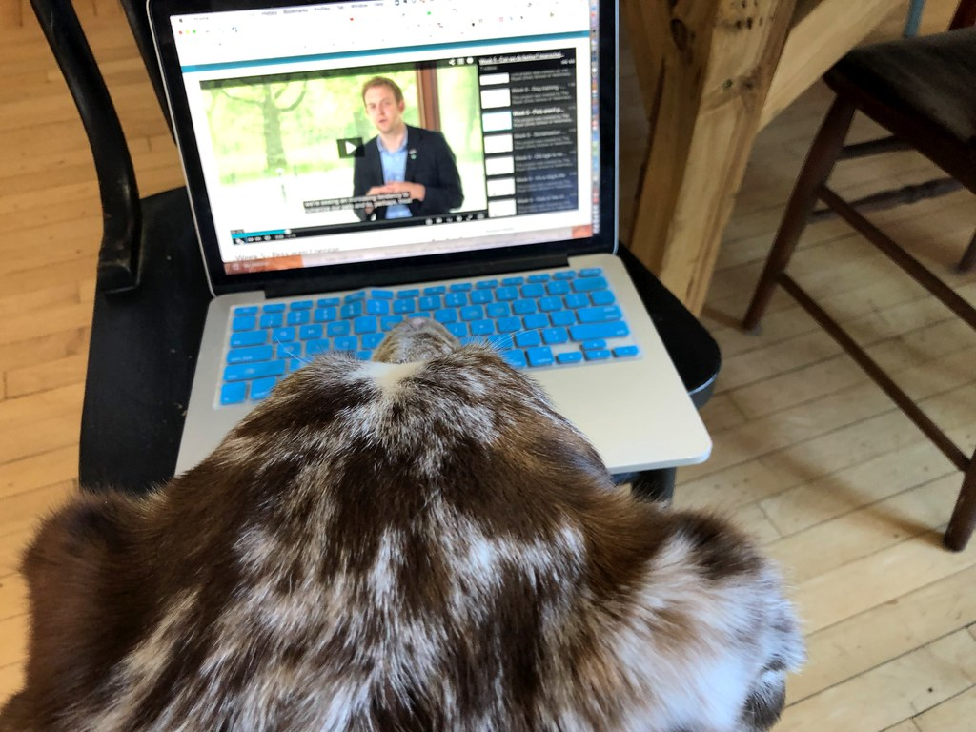

Slide 13
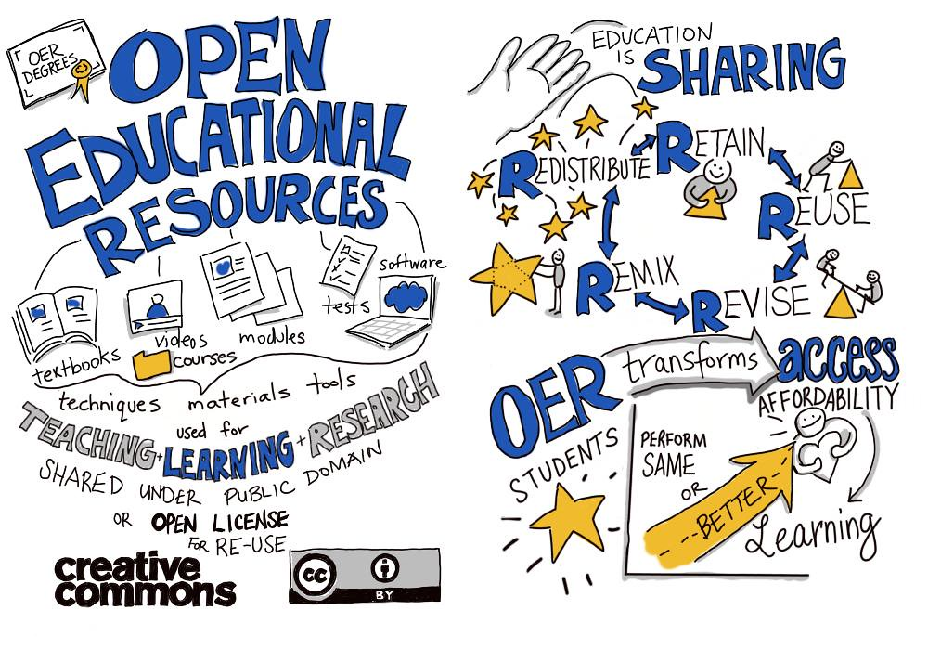

Slide 14

Issues for Education
Connectivity, costs and electricity
Quality Content/Practice/Research
Capacity of teachers

Slide 15
References
Baas, M., Schuwer, R., van den Berg, E. et al. (2022). The role of brokers in cultivating an inter-institutional community around open educational resources in higher education. High Educ (2022). https://doi.org/10.1007/s10734-022-00876-y
Bozkurt A. (2022). Resilience, adaptability, and sustainability of higher education: a systematic mapping study on the impact of the coronavirus (Covid-19) pandemic and the transition to the new Normal. Journal of Learning for Development , 9(1), 1-16. Retrieved from https://jl4d.org/index.php/ejl4d/article/view/590
Marvez, G. R., Zheng, T., Littenberg-Tobias, J., Hillaire, G., O’Biren, S., & Reich, J. (2022). Work in Progress. L@S ’22: Proceedings of the Ninth ACM Conference on Learning @ Scale, June 2022, 364-367. https://doi.org/10.1145/3491140.3528327
Medynska, N. N., Sovtys, N. M., Halatiuk, M. Y., Symonovych, N. V. & Shuryn, O. I. (2020). The analysis of alternative distance learning implementation into the system of general professional training of teachers. International Journal of Higher Education, 9(4), 339-347. https://files.eric.ed.gov/fulltext/EJ1263368.pdf
Prinsloo, P., & Kaliisa, R. (2022). Learning analytics on the Africa continent: an emerging research focus and practice. Journal of Learning Analytics, Early Access Articles, 1-18. https://doi.org/10.18608/jla.2022.7539
Walji, S., Deacon, A., Small, J., & Czerniewicz, L. (2016). Learning through engagement: MOOCs as an emergent form of provision. Distance Education, 37(2), 208-223. https://doi.org/10.1080/01587919.2016.1184400
Weller, M., Jordan, K., DeVries, I., & Rolfe, V. (2018). Mapping the Open Education Landscape: Citation network analysis of historical open and distance education research. Open Praxis, 10(2), 109-126. https://doi.org/10.1080/17439884.2020.1761641
Wyse, D., Brown, C., Oliver, S., & Pobleté, X. (2021). People and practice: defining education as an academic discipline. British Educational Research Journal, 47(6), 1512-1521. https://doi.org/10.1002/berj.376 2
Yavuz, M., Kayalı, B. & Tutal, Ö. (2021). Trend of distance education research in the covid-19 period: A bibliometric and content analysis. Journal of Educational Technology & Online Learning, 4(2), 256-279. http://doi.org/10.31681/jetol.922682
Notes:
In case you are interested in some of the papers cited, here are active links …

Slide 16
Picture credits
Slide 3:: 7 measures of quality in online learning by Giulia Forsythe is licensed Public Domain 1.0
Slide 4:: today's reading by Catherine Cronin is licensed CC-BY-SA 2.0
Slide 5:: distance learning by Juhan Sonin is licensed CC-BY 2.0
Slide 6:: The usual suspects mural taken by Matt Brown is licensed CC-BY 2.0
Slide 7: Silos by Rex Hammock is licensed CC-BY-SA 2.0
Slide 8:: Feedback loop by Noah Sussman is licensed CC-BY 2.0
Slide 10: Linda Lane's habitat by Wonderlane is licensed CC-BY 2.0
Slide 11: 737 Simulation by Eric Salard is licensed CC-BY-SA 2.0
Slide 12: Into the MOOCs by Alan Levine is licensed Public Domain
Slide 13: OER is sharing by Giulia Forsythe is licensed Public Domain 1.0
Notes:
And in case you might be interested to re-use some of the openly-licensed images, here are active links to them too.

Slide 17



Thank you
www.col.org
The contents of this presentation, with the exception of logos and graphics which are the property of the respective owners, is made available under Attribution-ShareAlike 4.0 International (CC BY-SA 4.0).
Notes:
Thank you. I hope you have a lively discussion.

