Slide 1
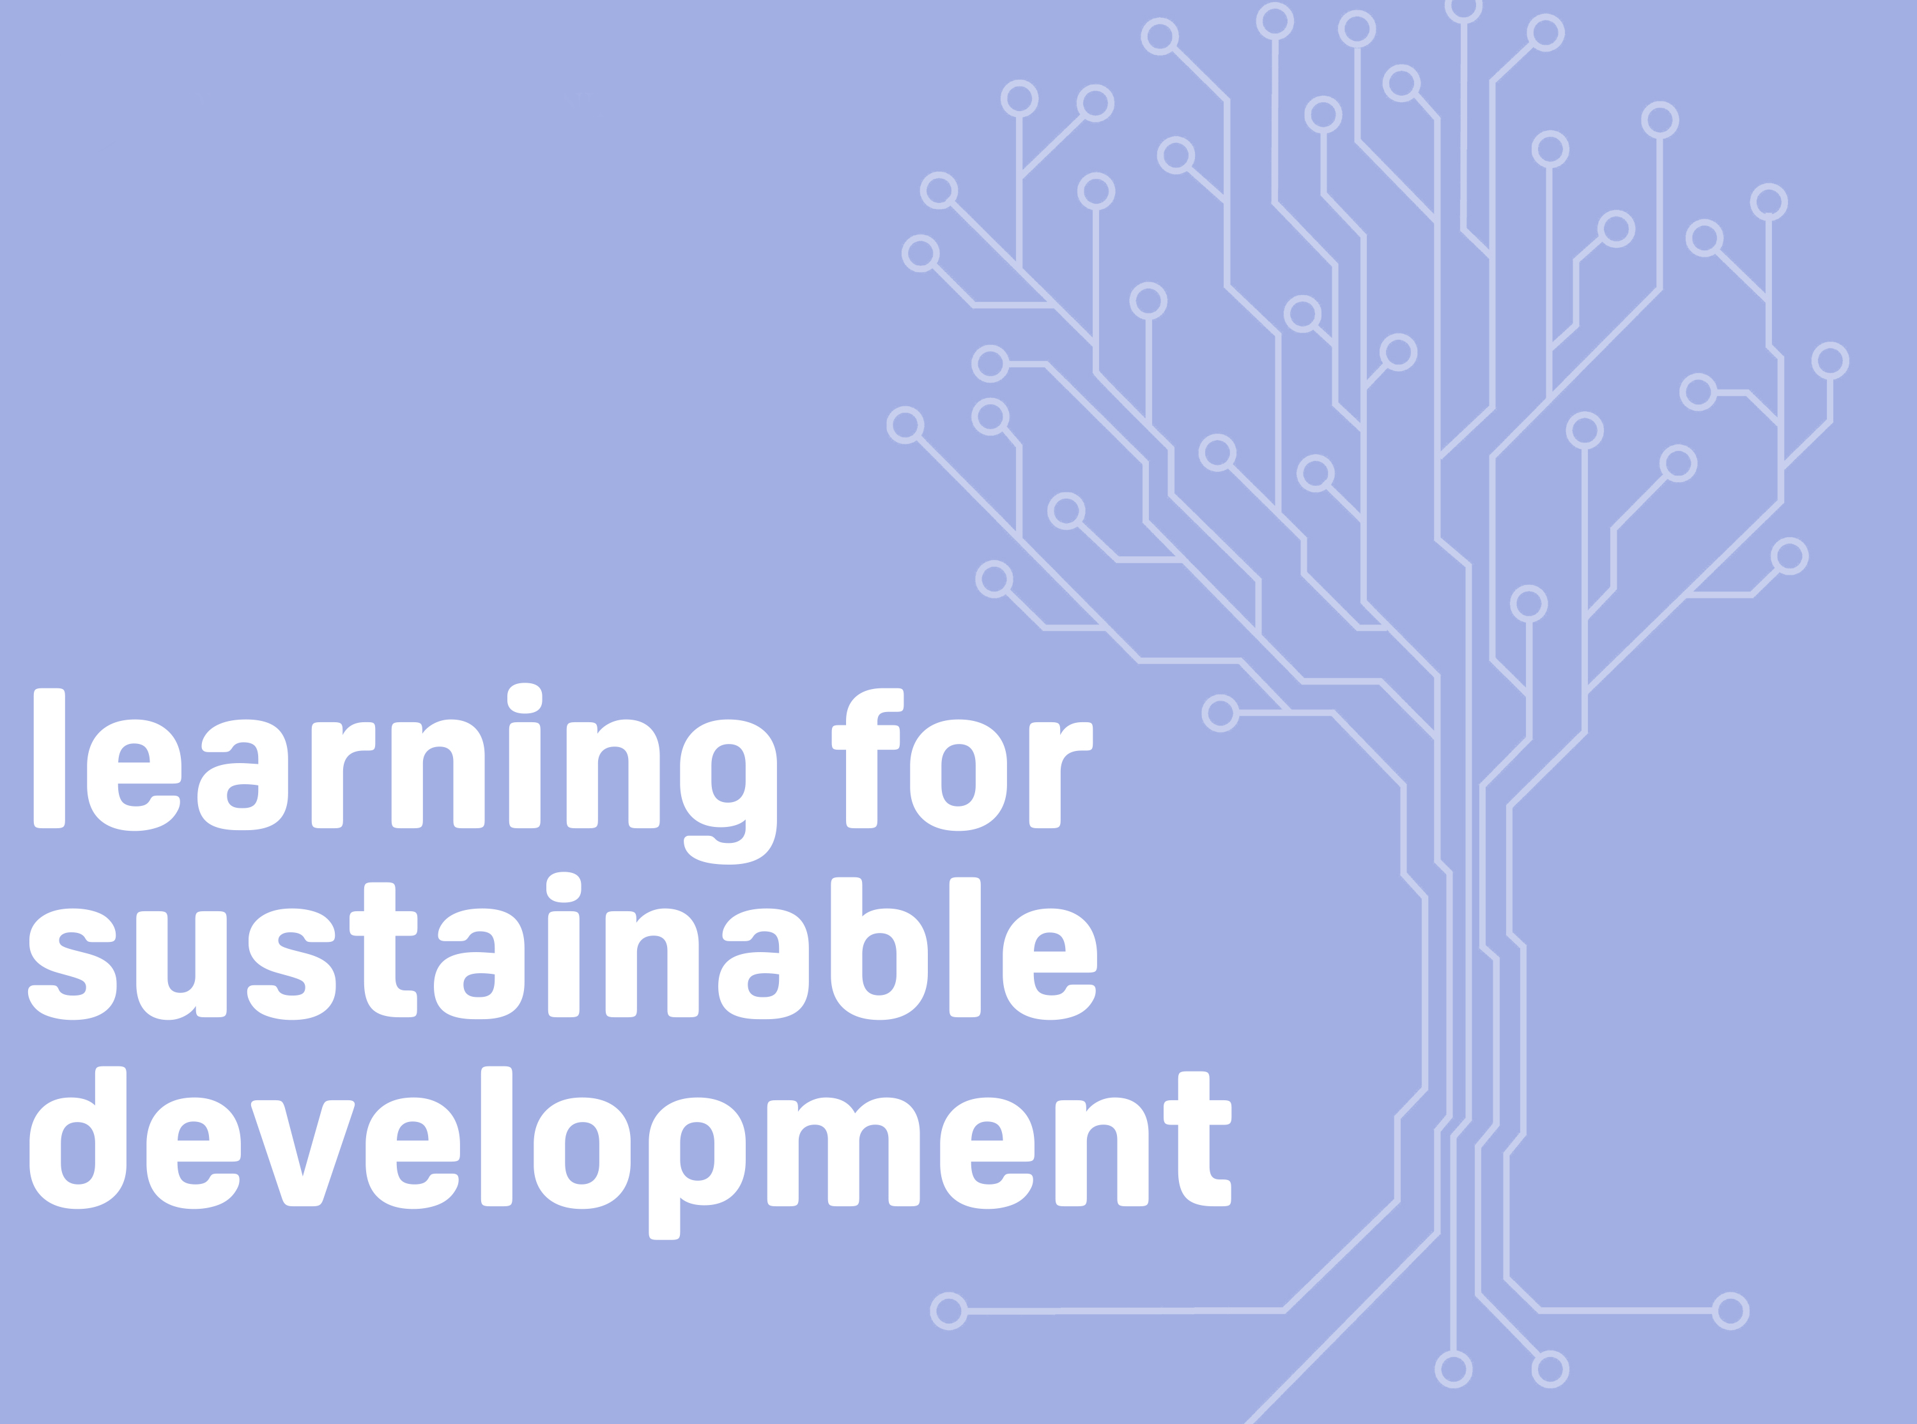
Professor Asha Kanwar
COL President & CEO
38th Commonwealth Diplomats Induction Programme
8 March 2022

Slide 2
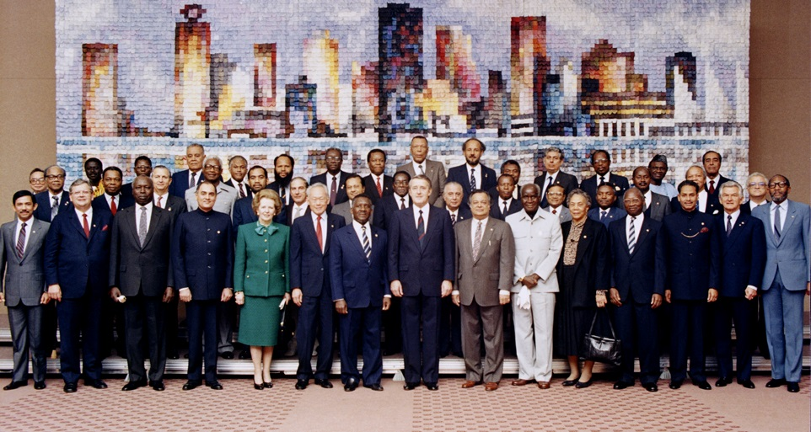
To help Commonwealth governments and institutions use technologies to improve and expand access to education and training
Commonwealth Heads of Government Meeting
Vancouver, 1987

Slide 3
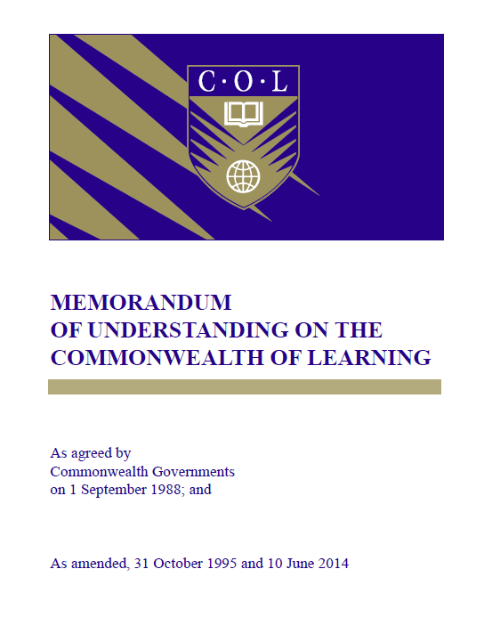
Signed on 1 September 1988

Slide 4

Regulatory Framework in Canada
Headquarters’ Agreement
Foreign Missions and International Organizations Act of Canada
Income Tax Act of Canada

Slide 5

The purpose of COL is
“…to create and widen access to opportunities for learning, making use of the potential offered by distance education and by the application of communication technologies to education. COL’s activities will…strengthen member countries’ capacities to develop the human resources…”
MOU, CHOGM 1988, amended 1995

Slide 6
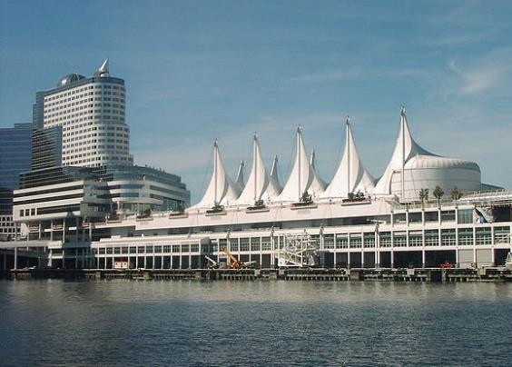
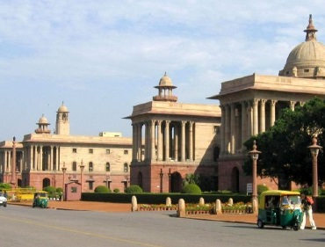

Where is it?
Metro Vancouver
(HQ)
New Delhi
(CEMCA)

Slide 7







Who supports COL?
Canada
India
UK
Australia
New Zealand
Nigeria
South Africa
The number of countries contributing increased from 23 in 2003-06 to 47 currently

Slide 8























































ACCOUNTABILITY
ANTIGUA & BARBUDA
AUSTRALIA
BAHAMAS
BANGLADESH
BARBADOS
BELIZE
BOTSWANA
BRUNEI DARUSSALAM
CAMEROON
CANADA
CYPRUS
DOMINICA
ESWATINI
FIJI
THE GAMBIA
GHANA
GRENADA
GUYANA
INDIA
JAMAICA
KENYA
KIRIBATI
LESOTHO
MALAWI
MALAYSIA
MALDIVES
MALTA
MAURITIUS
MOZAMBIQUE
NAMIBIA
NAURU
NEW ZEALAND
NIGERIA
PAKISTAN
PAPUA NEW GUINEA
RWANDA
ST KITTS & NEVIS
SAINT LUCIA
ST VINCENT & GRENADINES
SAMOA
SEYCHELLES
SIERRA LEONE
SINGAPORE
SOLOMON ISLANDS
SOUTH AFRICA
SRI LANKA
TONGA
TRINIDAD & TOBAGO
TUVALU
UGANDA
UNITED KINGDOM
TANZANIA
VANUATU
ZAMBIA
Reports to
COL Board of Governors
COMSEC Board
Education Ministers: CCEM
Foreign Ministers: CHOGM

Slide 9
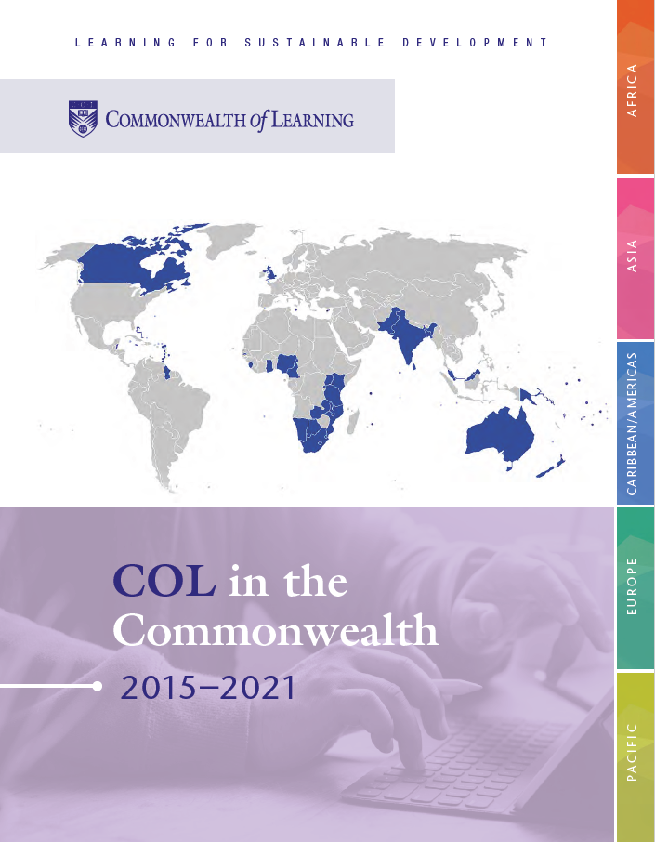

Slide 10
COL Regional Support
CCCL
Europe
RETRIDOL
West Africa
In partnership with the regional centres, COL:
Develops regional and national gender-responsive policies in ODL and flexible and blended learning
Supports research and innovations to advance access to quality education and skills training
PACFOLD Pacific
SADC-CDE
Southern Africa

Slide 11

COL Focal Points
our direct link to each country
Cyprus
Malta
United Kingdom
Bangladesh
Brunei Darussalam
India
Malaysia
Maldives
Pakistan
Singapore
Sri Lanka
Antigua & Barbuda
Bahamas; Barbados
Belize
Canada
Dominica
Grenada
Guyana
Jamaica
St Kitts & Nevis
St Lucia
St Vincent & The Grenadines
Trinidad And Tobago
Botswana
Cameroon
Eswatini
Gambia, The
Ghana
Kenya
Lesotho
Malawi
Mauritius
Mozambique
Namibia
Nigeria
Rwanda
Seychelles
Sierra Leone
South Africa
Tanzania
Uganda
Zambia
Australia
Fiji
Kiribati
Nauru
New Zealand
Papua New Guinea
Samoa
Solomon Islands
Tonga
Tuvalu
Vanuatu

Slide 12

COL Strategic Plan 2021-2027

Slide 13

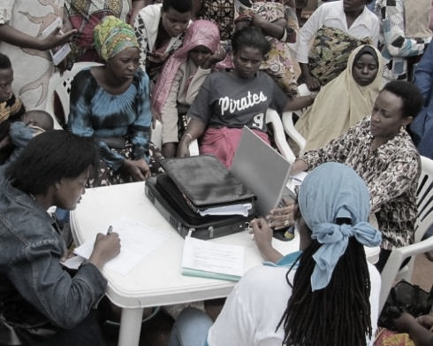
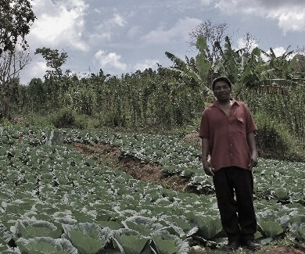

ECONOMIC EMPOWERMENT
SOCIAL
INCLUSION
ENVIRONMENTAL CONSERVATION
$
Notes:
COL continues to promote ‘learning for sustainable development’. Learning must lead to economic growth, social inclusion and environmental conservation.

Slide 14

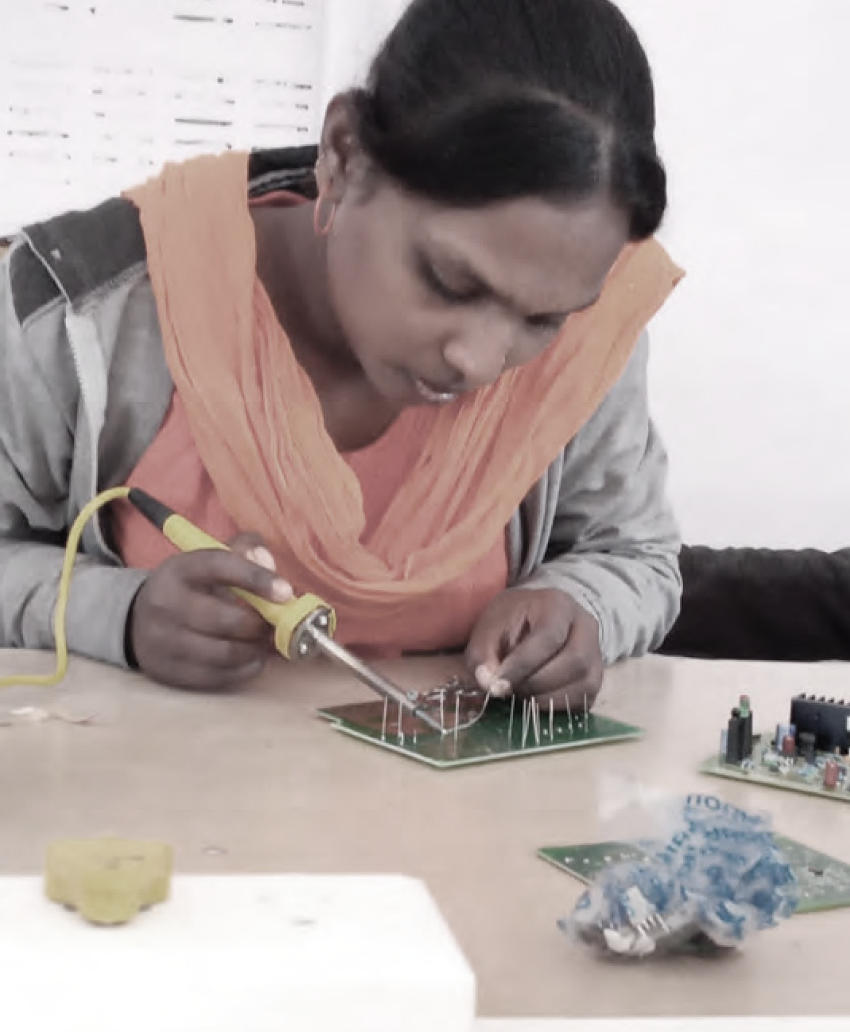
PROGRAMME SECTORS
Education
Skills
Gender Equality | Technology-Enabled Learning

Slide 15
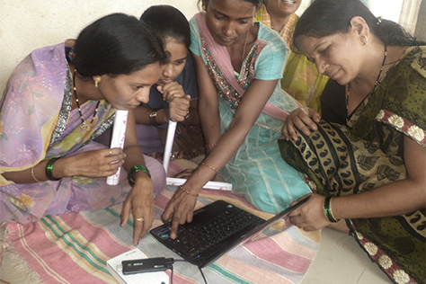
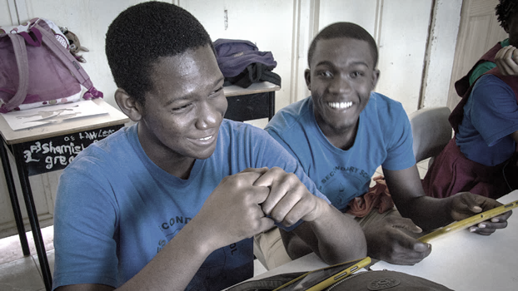
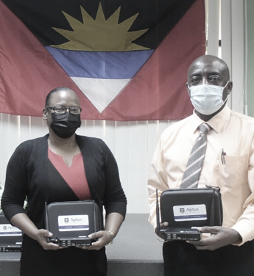
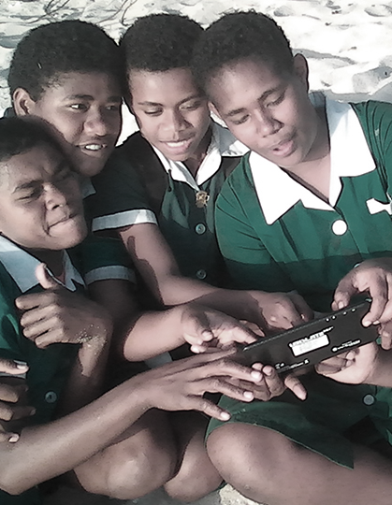
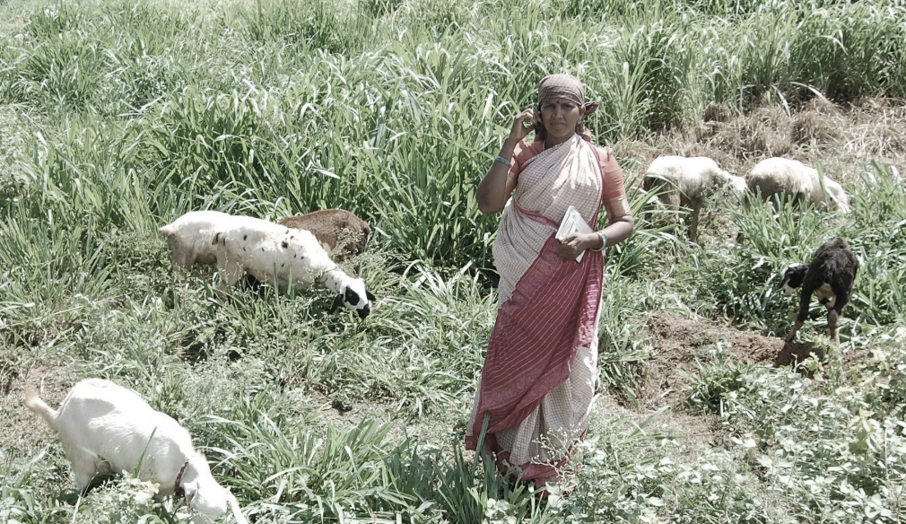
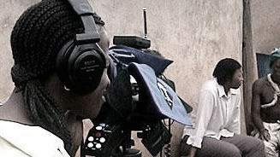
Leveraging new and existing technologies

Slide 16

COL’s Six Paradigm Shifts

Slide 17


1
If the child cannot go to school,
the school comes to the child
PARADIGM
SHIFT

Slide 18
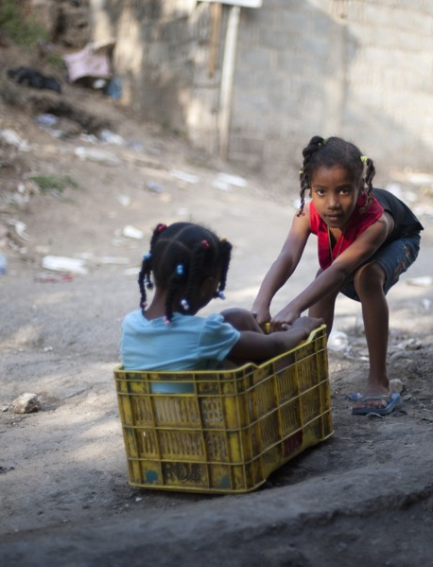
Education in the Commonwealth
22 million primary aged children not in school
20.7 million lower secondary youth out of school
4% more boys than girls enrolled in primary schools
but boys underrepresented
and underperforming at the secondary level
Source: Compiled with latest data available from UNESCO UIS, retrieved on 25 February 2022.
This Photo by Unknown Author is licensed under CC BY-SA
Notes:
1.Compiled with latest available data from UNESCO UIS. Missing data from the following countries: Pakistan, Jamaica, Bahamas.
2. Compiled with latest available data from UNESCO UIS. Missing data from the following countries: Zambia, Uganda, Trinidad and Tobago, Pakistan, Nigeria, Kiribati, Bahamas.
3. Compiled with latest available data from UNESCO UIS. Missing data from the following countries: Pakistan, Jamaica, Canada, Bahamas, Grenada, Kiribati, Malta, St Vincent and Grenadines, Samoa, Seychelles and Tonga.

Slide 19



Open Schools: Access and Equity
INDIA
2.7 million students in 5 years: 31% female
BANGLADESH
165,000 in 3 years: 40% female
NAMIBIA
80.806 in 3 years: 65% female

Slide 20
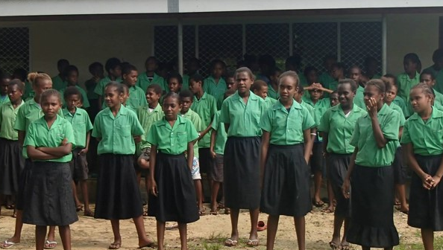
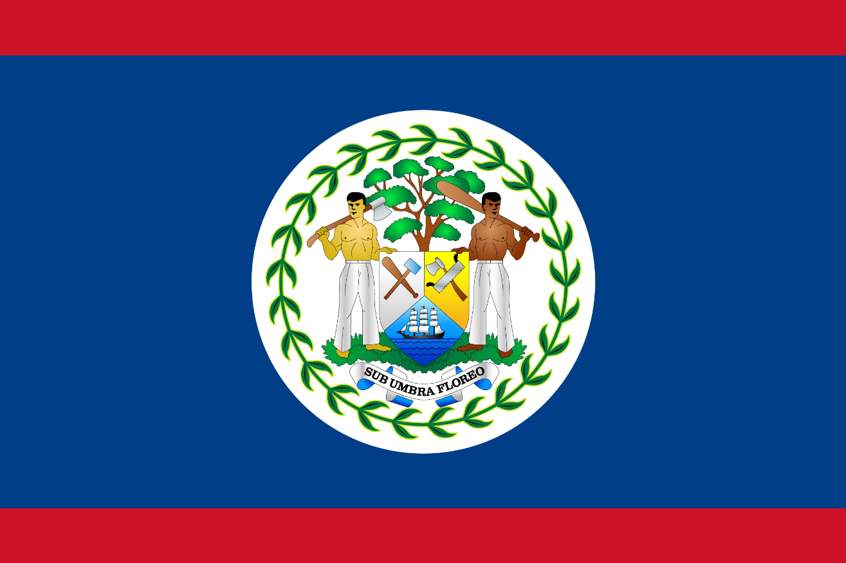
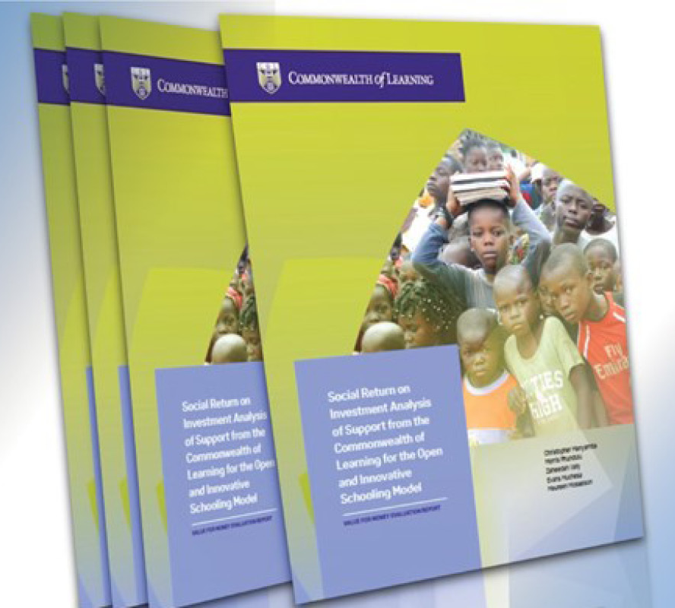
In Belize, Social Return on Investment in open schooling showed that every US$ invested resulted in US$8 worth of benefits to students.
http://hdl.handle.net/11599/3934
Notes:
Belize
Benefits: skills, expected income
Social Return on Investment of an Open School showed that every US$ invested resulted in US$8 worth of benefits to students.

Slide 21
2
Technology-enabled learning can break open the ivory towers of tertiary education
PARADIGM
SHIFT

Slide 22
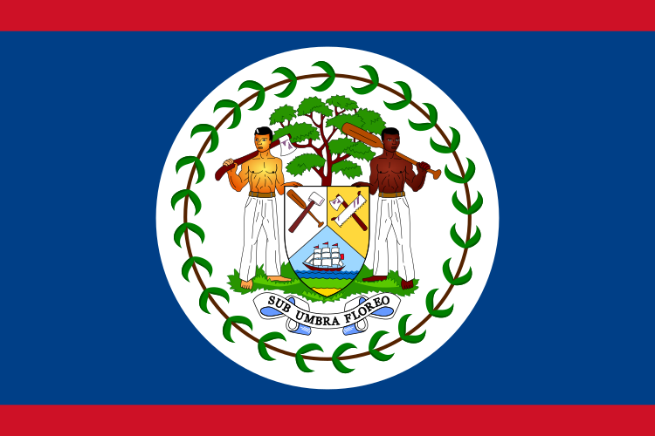


Access to Higher Education
70%
60%
50%
40%
Australia
51.6%
30%
20%
10%
Belize
21.2%
Pakistan
8.7%
Gambia
8%
Samoa
15.3%
HIGHER EDUCATION
Source: World Bank Open Data, Educational attainment, at least completed post-secondary, population 25+, total (%), retrieved on 25 February 2022.
Notes:
https://data.oecd.org/eduatt/population-with-tertiary-education.htm
https://data.worldbank.org/indicator/SE.SEC.CUAT.PO.ZS
Australia 51.6 (2020)
Canada 60.4 (2016)
Asia:
Bangladesh 22.4 (2020)
Pakistan 8.65 (2017)
Malaysia 22.6 (2019)
Africa:
The Gambia 8.0 (2015)
Ghana 11.3 (2010)
Kenya 7.9 (2010)
Cameroon 13.5 (2010)
Pacific
Samoa 15.3 (2011)
Fiji 15.9 (2007)
Tonga 16.8 (2011)
Caribbean
Belize 21.2 (2020)
Jamaica 14.0 (2011)
St Lucia 15.3 (2019)

Slide 23
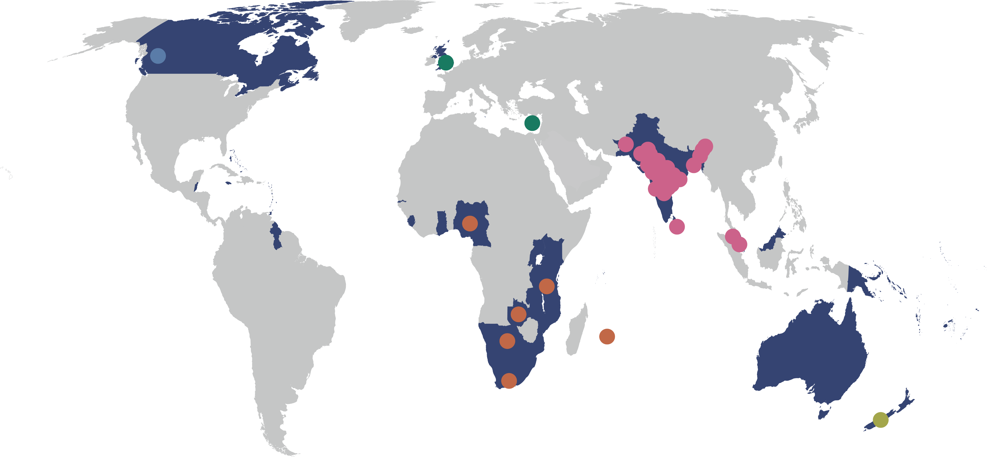
BANGLADESH
  Bangladesh Open University
INDIA
  Dr. Babasaheb Ambedkar Open University
  Dr. B.R. Ambedkar Open University
  Indira Gandhi National Open University
  Jagat Guru Nanak Dev Punjab State Open University
  Karnataka State Open University
  Krishna Kanta Handiqui State Open University
  Madhya Pradesh Bhoj University
  Nalanda Open University
  Netaji Subhas Open University
  Odisha State Open University
  Pandit Sundarlal Sharma (Open) University
  Sreenarayanaguru Open University
  Tamil Nadu Open University
  Uttarakhand Open University
  Uttar Pradesh Rajarshi Tandon Open University
  Vardhman Mahaveer Open University
  Venkateshwara Open University (Private)
  Yashwantrao Chavan Maharashtra Open University
MALAYSIA
  Open University Malaysia
  Wawasan Open University
PAKISTAN
  Allama Iqbal Open University
SRI LANKA
  Open University of Sri Lanka
CYPRUS
Open University of Cyprus
UNITED KINGDOM
The Open University
CANADA
Athabasca University
33 Commonwealth Open Universities
(2021)
BOTSWANA
Botswana Open University
MAURITIUS
Open University Mauritius
NIGERIA
National Open University of Nigeria
SOUTH AFRICA
University of South Africa
TANZANIA
Open University of Tanzania
ZAMBIA
Zambian Open University
NEW ZEALAND
Open Polytechnic of New Zealand

Slide 24



Benefits of CEMBA/MPA: Allama Iqbal Open University (AIOU), Pakistan
Graduates saw on increase of
38% in monthly income
For every $1 invested, learners received
$3.40 in direct returns
1:3.4
Notes:
Belize
Benefits: skills, expected income
Social Return on Investment of an Open School showed that every US$ invested resulted in US$8 worth of benefits to students.

Slide 25
3
Open Educational Resources (OER) are the answer to closed and costly textbooks
PARADIGM
SHIFT

Slide 26
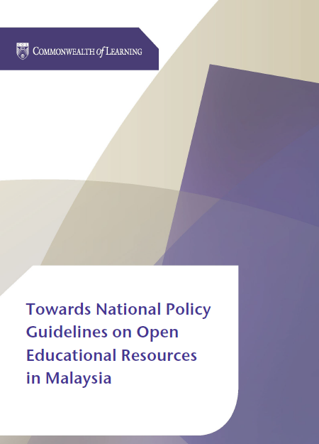

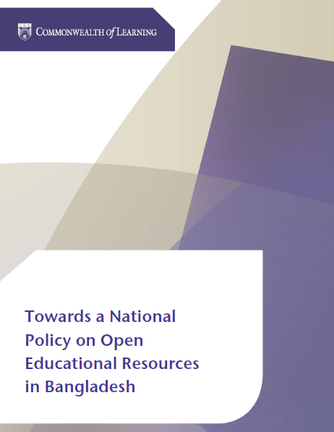
The Need: Problem of Cost
In Malaysia, 76.4% students did not buy a textbook because it was expensive
73% students in Bangladesh depended on photocopied materials, as the cost of textbooks is prohibitive
Notes:
Malaysian students spend about 190 MYR per year, which is over MYR 234,871,160 annually.
Student spend on average BDT 1,850 per year, which is over 258 million BDT per year in Bangladesh

Slide 27
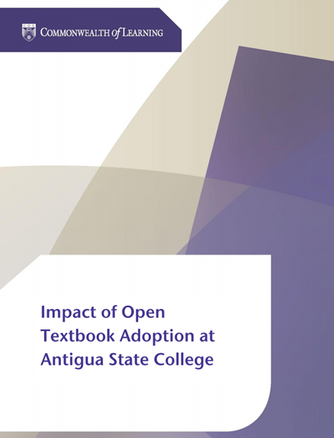

Antigua and Barbuda
Students saved between 75 to 88 ECD per course per semester by using open textbooks
Supplementing textbooks with OER improved student performance by 5.5%

Slide 28

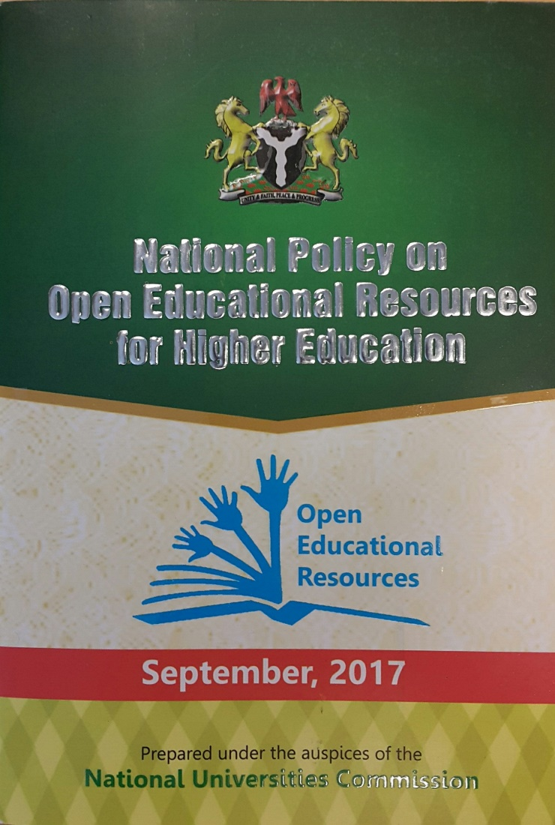

Impact of OER Policy
Over 200 Nigerian universities to participate in OER curation, development and sharing with an impact on millions of students

Slide 29
4
The digital divide can be transformed into a digital dividend
PARADIGM
SHIFT

Slide 30
Internet Connectivity in the Commonwealth Countries
Source: compiled with data from World Bank Open Data , retrieved on 23 February 2022.

Slide 31
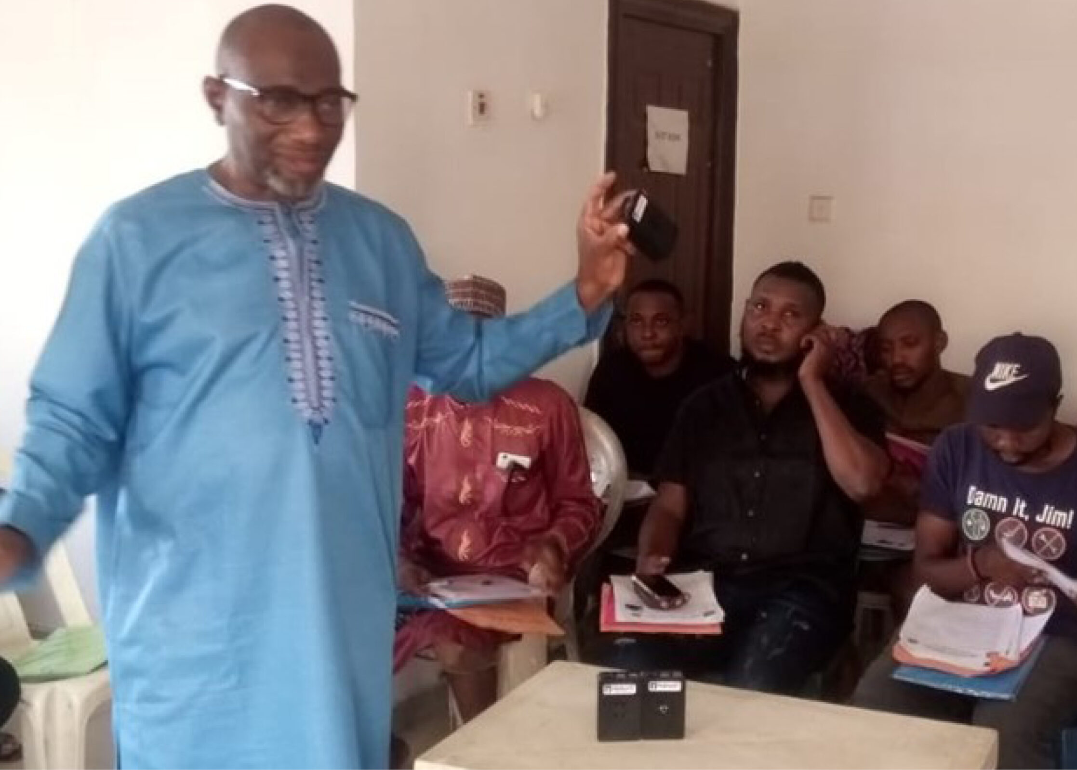
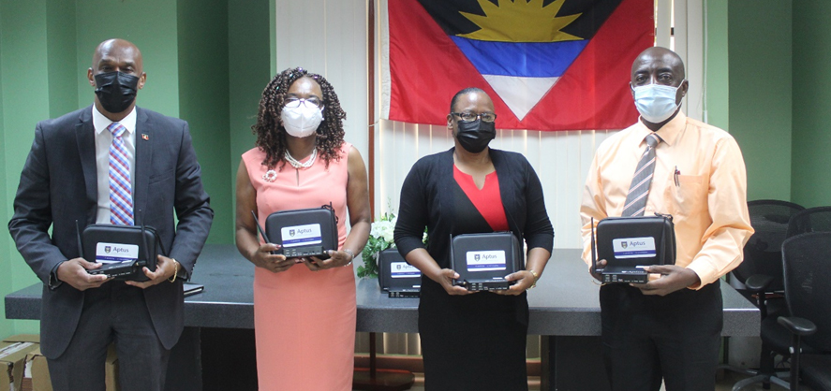
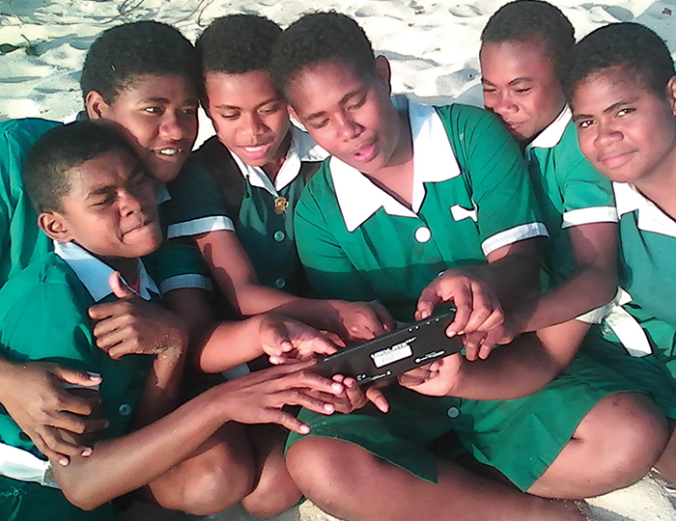






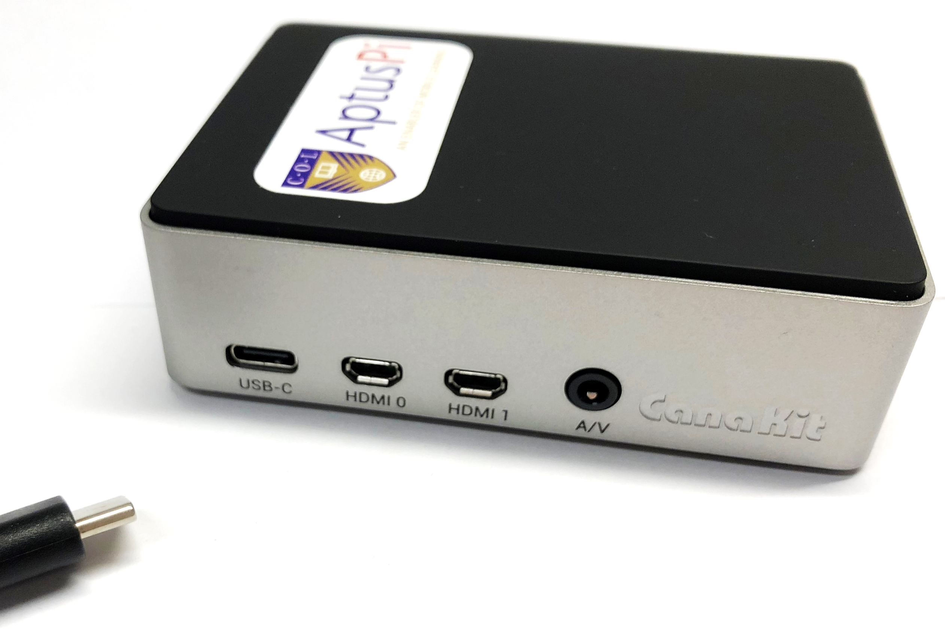

ANTIGUA & BARBUDA
BAHAMAS, THE
FIJI
INDIA
KIRIBATI
MALDIVES
MOZAMBIQUE
NIGERIA
PAKISTAN
SAMOA
TONGA
VANUATU
ZAMBIA
A low-cost device that allows educators and learners to connect to digital learning platforms and content without the need for grid electricity or Internet access.
Notes:
COL developed Aptus a low-cost offline virtual classroom that provides learners in remote locations with access to digital resources. It’s a server that works with a solar charger and a wireless router and costs approximately $ 150.
Maldives (2021)
Zambia, Ministry of General Education (2021)
Antigua and Barbuda, Ministry of Education, Sports and Creative Industries (2021)
Bahamas, Ministry of Education (2020)
Mozambique, Ministry of Education and Human Development (2018)
Tonga, Ministry of Education/Tonga Institute of Higher Education (2018)
Samoa, Ministry of Education (2018)
India, Mann Deshi Foundation (2016)
Samoa, National University Samoa (2016)
Pakistan, Qatar Foundation/ROTA (2016)
Fiji, Ministry of Education (2015)
Vanuatu, Ministry of Education (2015)
Kiribati, Ministry of Education (2015)

Slide 32

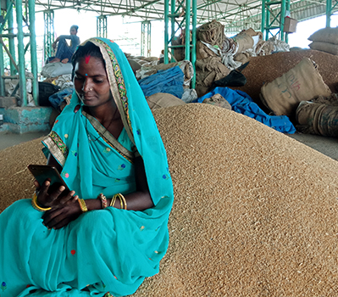
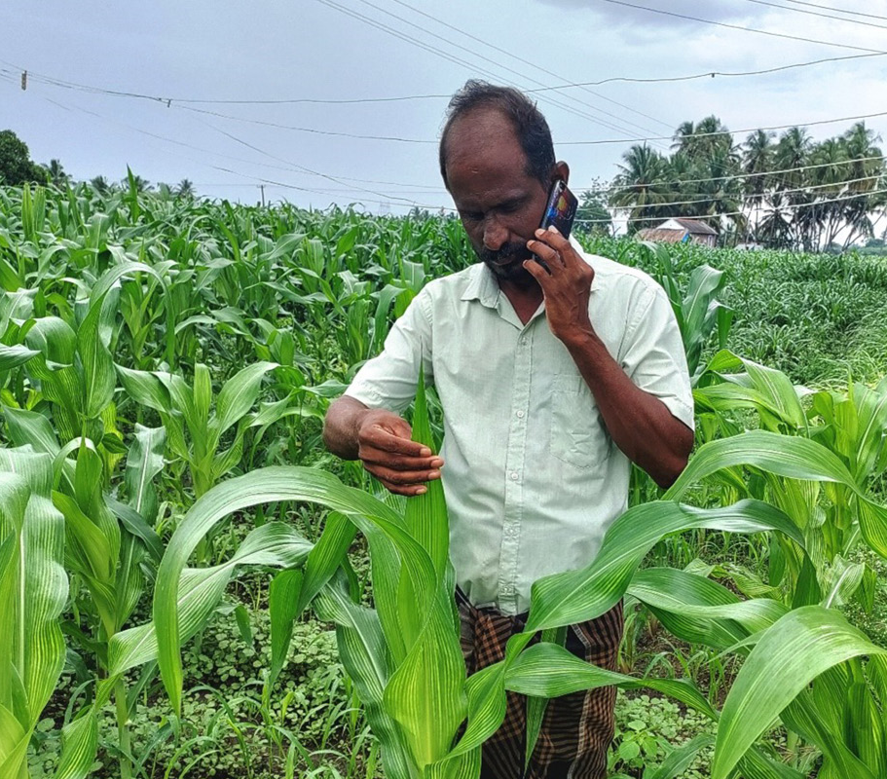
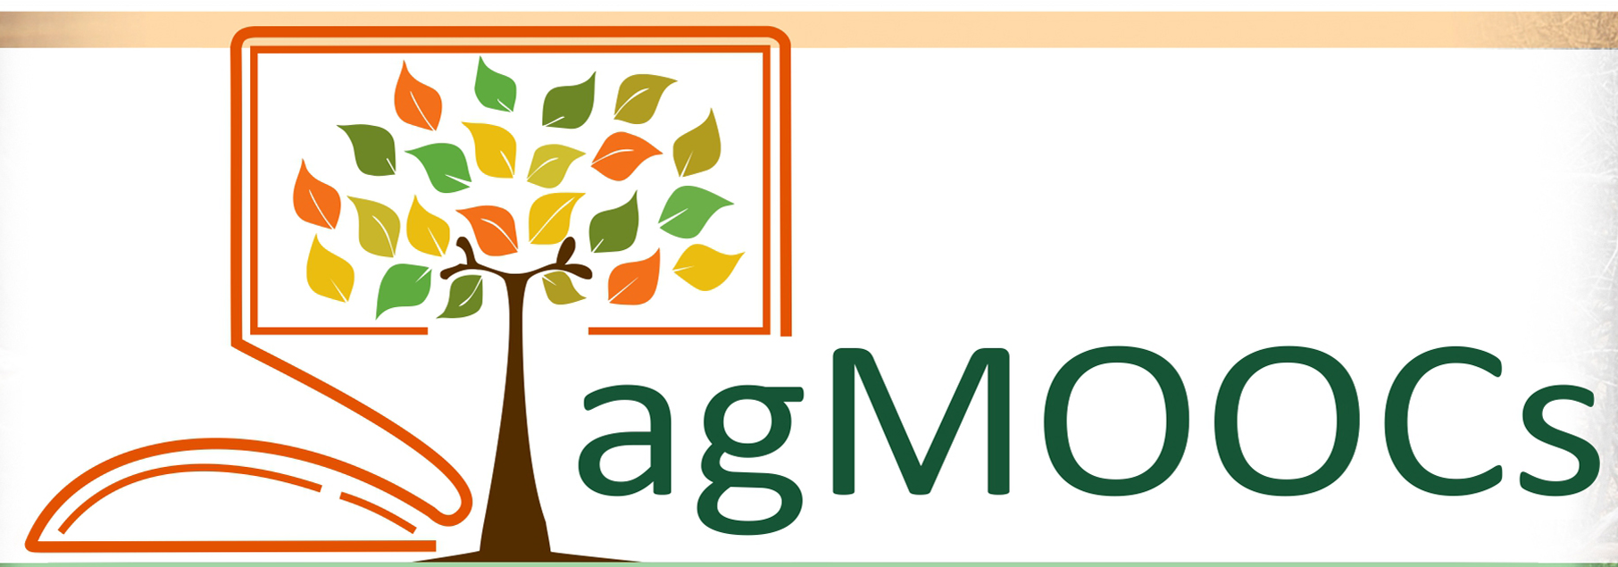
MOOC4D - Online learning (agMOOCs) - Food and Agriculture sector underserved. A consortium conceptualised by COL, supported by NPTEL
Notes:
Belize
Benefits: skills, expected income
Social Return on Investment of an Open School showed that every US$ invested resulted in US$8 worth of benefits to students.

Slide 33
5
Literacy is not always a precondition for learning
PARADIGM
SHIFT

Slide 34

400 million illiterate adults in the Commonwealth
Source: Commonwealth Secretariat, Bringing education goals within reach, published on 7 February 2018.
Notes:
Of the 750 million illiterates in the world about 400 millions are in the Commonwealth
Source: https://thecommonwealth.org/news/bringing-education-goals-within-reach

Slide 35
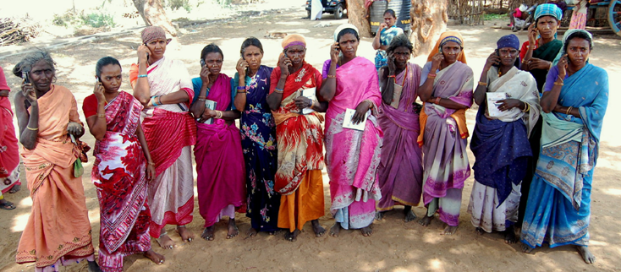
Every $1 invested resulted in $16 worth of income and assets.
Notes:
Belize
Benefits: skills, expected income
Social Return on Investment of an Open School showed that every US$ invested resulted in US$8 worth of benefits to students.

Slide 36

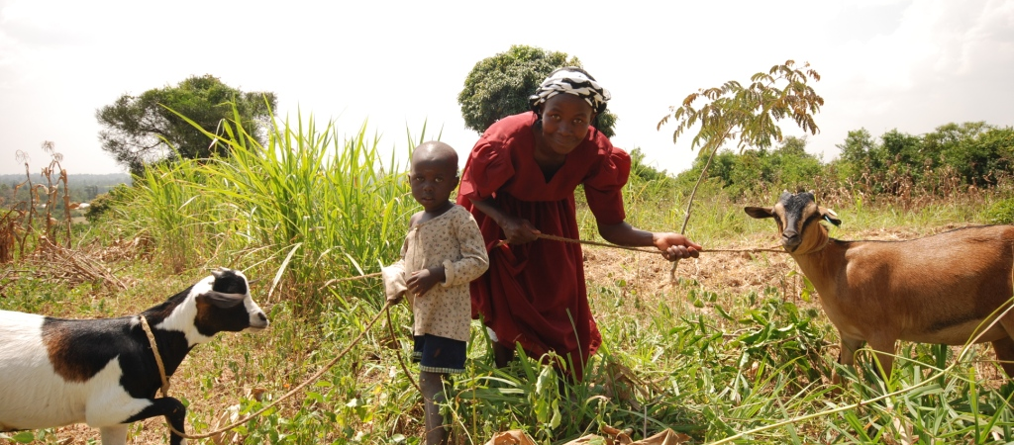


Lifelong Learning for Farmers (Kenya, Tanzania, Uganda):
1% increase in empowerment 2.3% increase in profit
Notes:
Belize
Benefits: skills, expected income
Social Return on Investment of an Open School showed that every US$ invested resulted in US$8 worth of benefits to students.

Slide 37
6
The social capital of the mother is the most important determinant in bringing girls to school
PARADIGM
SHIFT

Slide 38
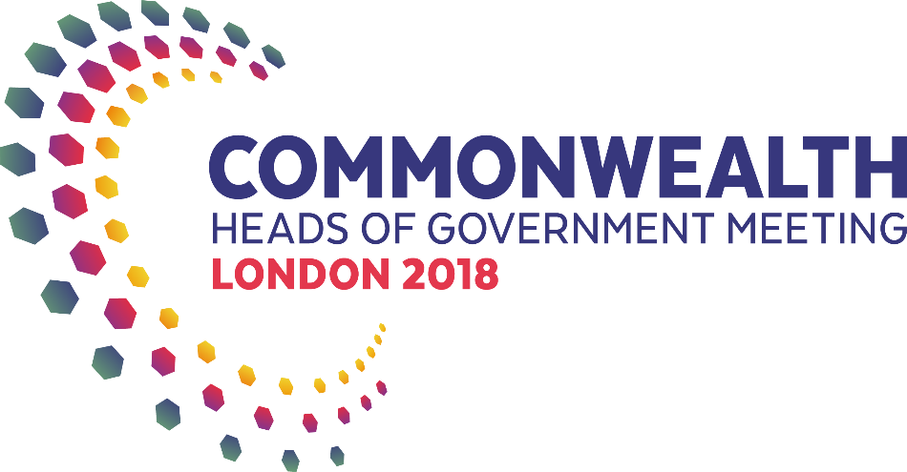


Slide 39
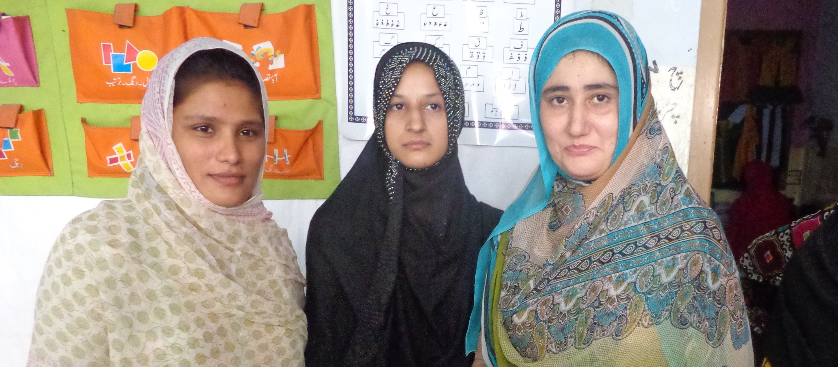
Samina, a mother from Pakistan
“When I was young, my parents used to beat me to go and labour with them. So, I could not get education, but now a new hope is developed in me…. And I will send my daughter to the nearest school.”
Notes:
Belize
Benefits: skills, expected income
Social Return on Investment of an Open School showed that every US$ invested resulted in US$8 worth of benefits to students.

Slide 40









Empowering Women

Slide 41

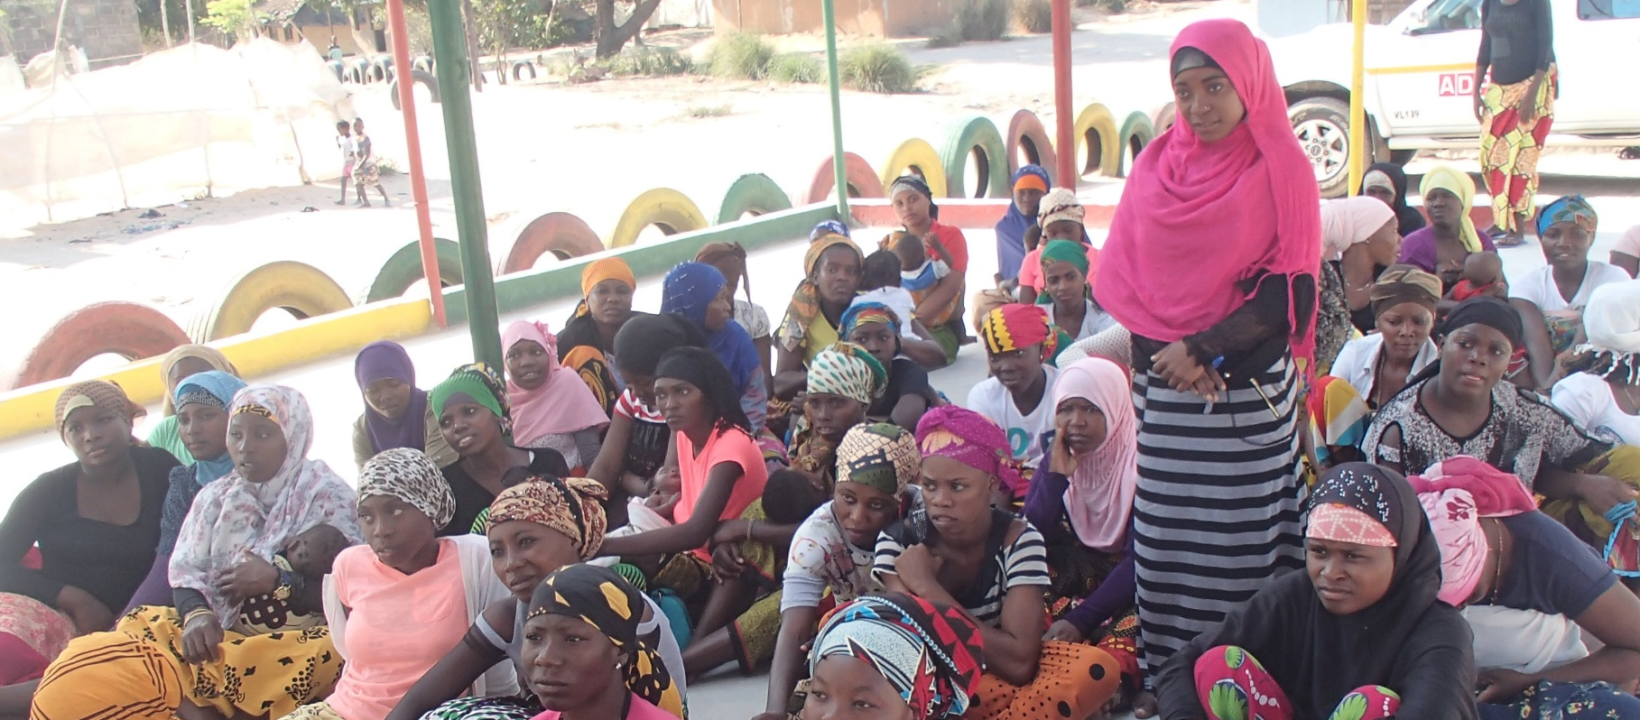
Community involvement prevented Fatima’s early marriage in Mozambique
Notes:
Belize
Benefits: skills, expected income
Social Return on Investment of an Open School showed that every US$ invested resulted in US$8 worth of benefits to students.

Slide 42
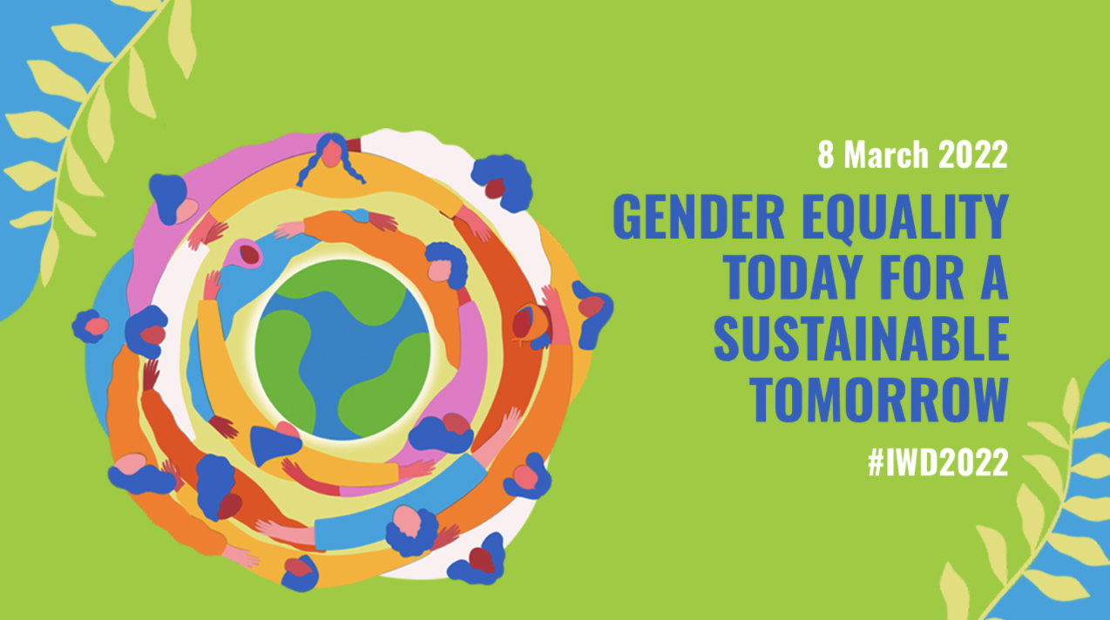

Slide 43

Paradigm Shift Lies In…
Harnessing the potential of ICTs for education and lifelong learning
Moving beyond conventional pedagogy
Fostering innovations
Involving the community

Slide 44
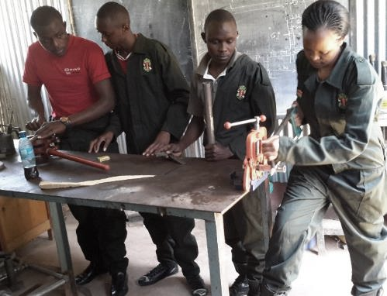
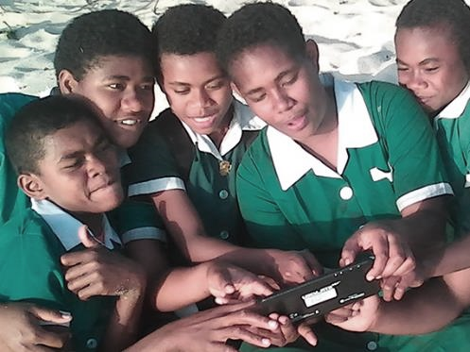

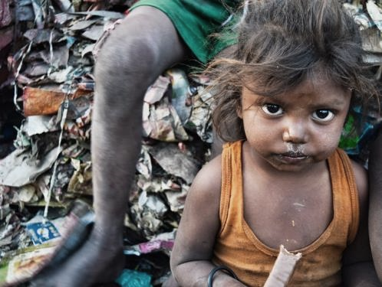
Promotes ‘learning for sustainable development’
Supports innovations for affordable and accessible technologies
Serves the last person
in the queue
CC0 1.0 Universal - Pixabay
Notes:
We invite you to engage us; tap into our thought leadership, expertise, networks and resources

Slide 45

Thank you
www.col.org
The contents of this presentation, with the exception of logos and graphics which are the property of the respective owners, is made available under Attribution-ShareAlike 4.0 International (CC BY-SA 4.0).

