Slide 1
Indian Higher Education Teachers and Open Educational Resources
Sanjaya Mishra, PhD
Education Specialist, eLearning
Commonwealth of Learning, Canada

Slide 2

Background
Access to quality educational materials
Prohibitive costs of textbooks
Slow adoption of OER
Teachers as producers of educational materials
Why many teachers do not share with others?

Slide 3
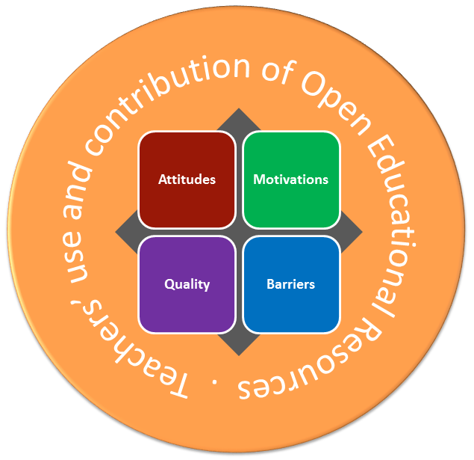
Conceptual Framework
Background

Slide 4
Activity Theory
Background
Notes:
The third-generation Activity Theory (AT) framework (Engeström, 1987) can be used to discuss the whole process from OER creation to consumption, as it includes the four dominant aspects of human activity — production, distribution, exchange and consumption. Figure 2.1 presents an overview of the issues within this approach. To complement the AT framework, we also use Vygotsky’s (1978) idea of a mediating tool. Along with subject and object these are: the rules — the “norms, conventions and values” that “represent a way of minimizing conflicts in an activity system” and “affect how the subjects move towards the object and how they interact within a community”; the community, “a larger group including the subject,” where “learning is situated” and participants “share the same objects, are governed by rules and divide tasks”; and the division of labour, which “is related to the organisation of the community,” “comprises roles, tasks and power relationships in an activity system” and “mediates between the objects and the community” (Buchem, Attwell, & Torres, 2011, p. 8). In this study, a broad view of AT is applied with respect to OER creation, distribution, exchange and consumption, as it is relevant in the context of OER to incorporate the different perspectives of user, non-user, contributor and non-contributor.

Slide 5
Research Questions
How are teachers’ attitudes towards OER situated in the context of teaching and learning?
Is there any difference in attitude towards OER between teachers according to different demographic variables?
What are teachers’ motivations for using OER and sharing their work as OER?
Is there any difference in motivations between groups of teachers?
What barriers to using OER do teachers perceive?
How do teachers perceive the quality of OER?
Are there relationships between teachers’ attitudes, motivations and perceptions of quality when it comes to them using and adapting OER?

Slide 6
Methods, Instruments and Data Sources
Qualitative and quantitative
Survey, interviews and workshops
Questionnaire
ATOER Scale (0.897 reliability coefficient Cronbach’s α)
Interview schedule (Activity theory based)
WikiEducator India group and participants in 4 workshops

Slide 7
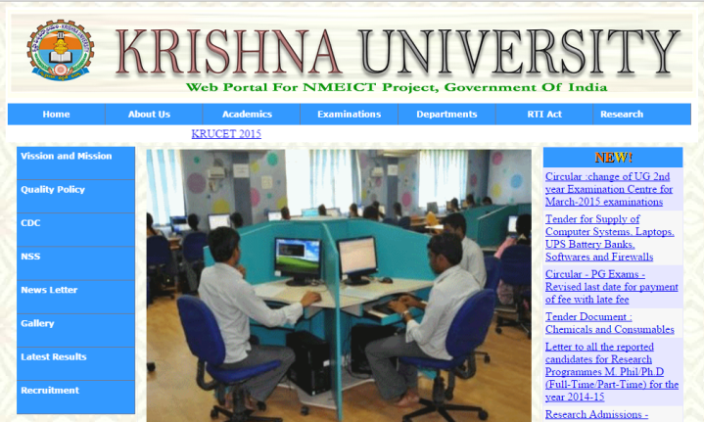
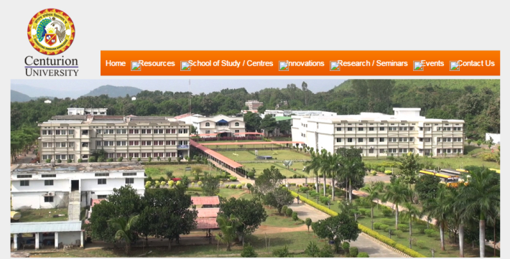
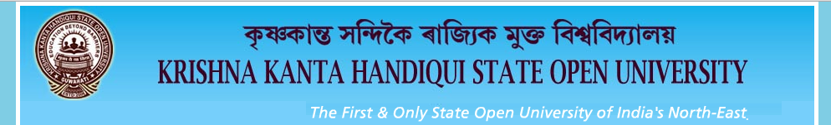
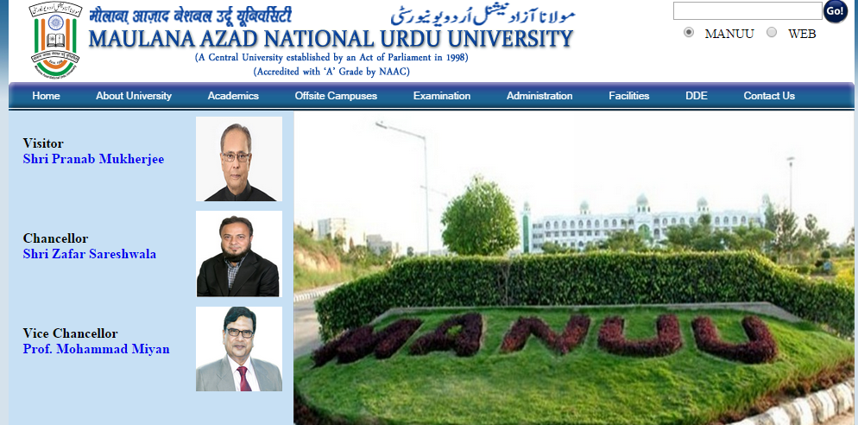
Workshop at Institutions
Dual-mode University
Single-mode Open University
University in rural setting
Private, multi-campus University
Notes:
Workshop as a modified FGD

Slide 8
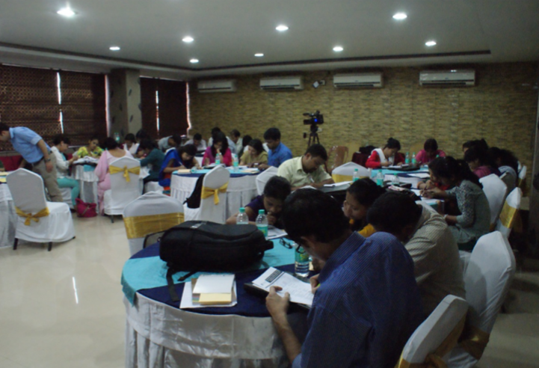
Workshop Objectives
Assist the participants to understand history and development of OER;
Enable them to relate the need of OER in their work environment;
Facilitate appreciation of the importance of open license in educational materials; and
Collect data on the research.

Slide 9
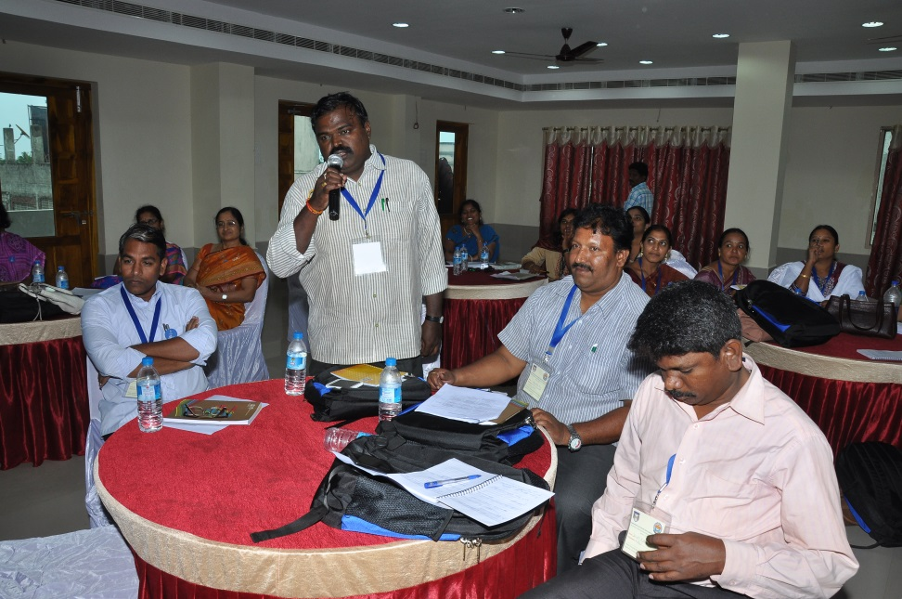
Workshop strategies
Just a minute (JAM) Session

Slide 10
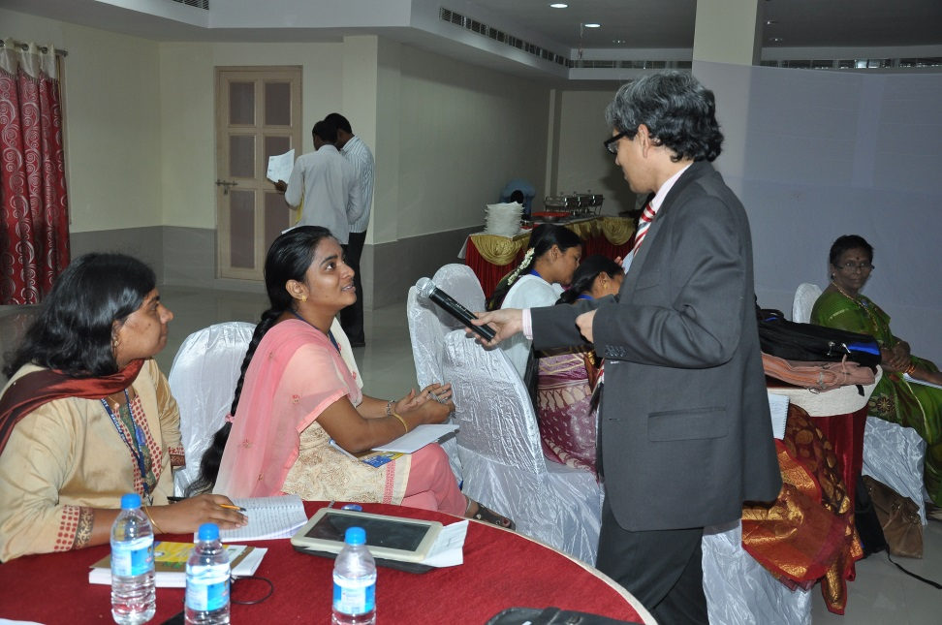
Workshop strategies
Interactive Q & A session on Motivations

Slide 11
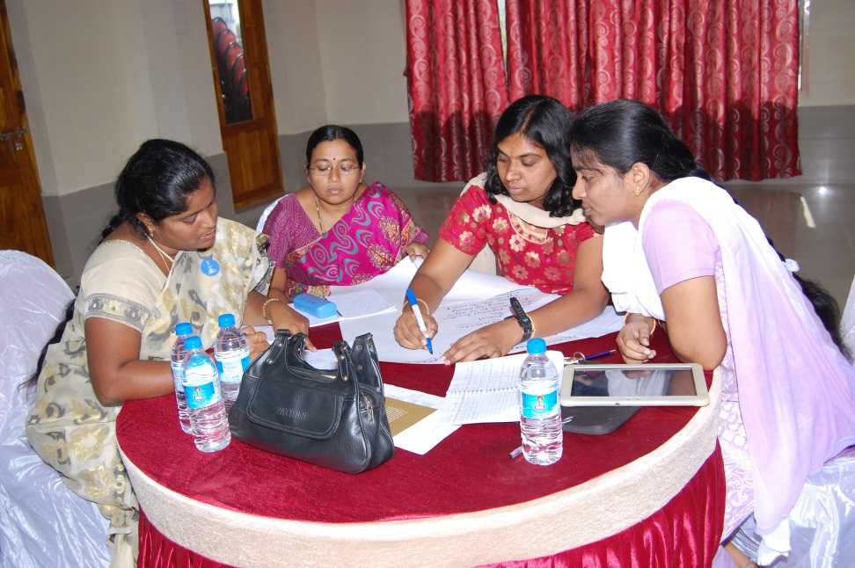
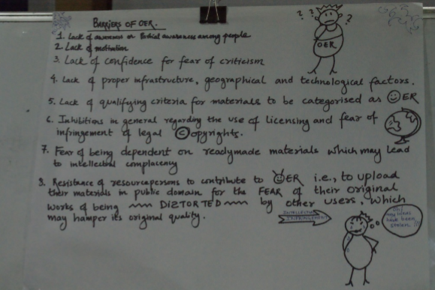
Workshop strategies
Group Discussion on Barriers to OER

Slide 12
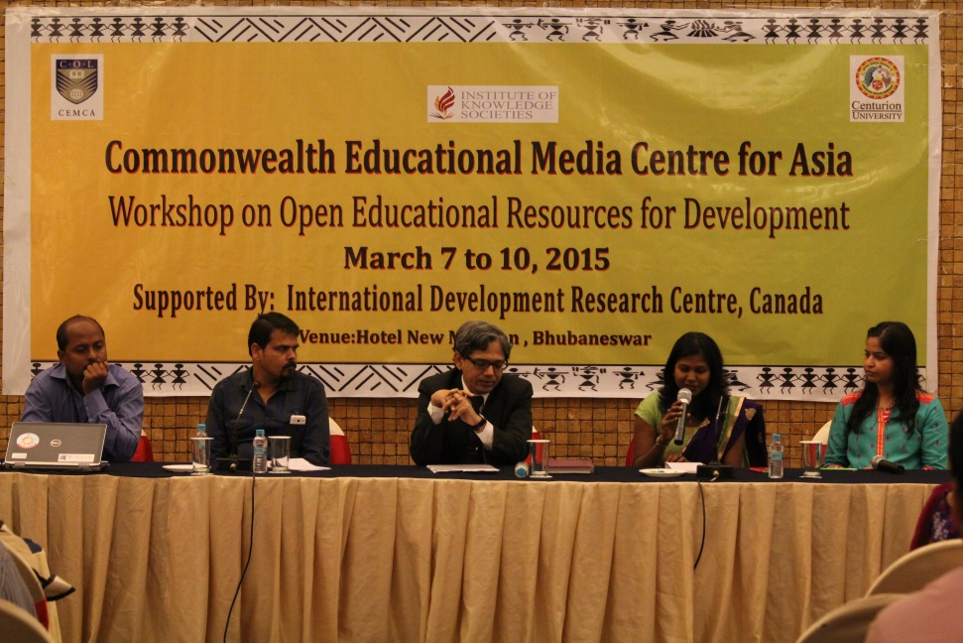
Workshop strategies
Debate on Quality
Audio recording of views of participants

Slide 13

Data Sample
28 Participant interviews recorded post workshop
Survey of 227 teachers including 107 WikiEducator India members; with 117 usable responses
42.7% were female respondents and 57.2% male

Slide 14
ANALYSES and RESULTS

Slide 15
How are teachers’ attitudes towards OER situated in the context of teaching and learning?

Slide 16
Attitudes towards OER
Sharing Attitudes | Mean
It gives me pleasure if someone adopts/adapts my educational resources. | 4.65
Sharing helps me to get feedback. | 4.58
Sharing of educational resources improves my professional respect. | 4.54
Sharing enhances my personal and organizational reputation. | 4.5
Sharing enhances my confidence, as I see myself as part of a larger community. | 4.46
OER increase my network and sphere of influence. | 4.42
OER improve my chance of recognition at a global level. | 4.41
When others use my OER, it improves my sense of achievement. | 4.4
Sharing of educational resources increases my profile amongst peers and others. | 4.33
OER help to disseminate my ideas. | 4.29
I believe that sharing educational materials as OER will encourage others to do so as well. | 4.27
OER promote collaboration and consortia. | 4.25
As a teacher, it is my responsibility to share all educational resources created by me. | 4.06

Slide 17
Attitudes towards OER
Adaptation attitudes | Mean
My own competencies and knowledge towards OER help me to participate or adopt OER. | 4.19
I adopt OER for my teaching as they fulfil academic requirement of my students. | 4.12
I am efficient in information communication technology (ICT) skills to adopt and use OER. | 4.09
I have knowledge of intellectual property rights to understand OER. | 3.72

Slide 18
Key Findings on Attitudes
Teachers had positive attitudes towards OER, and their attitudes did not differ significantly across demographic variables
Attitude towards sharing was stronger than towards adapting materials developed by others
Share for the pleasure of sharing and to disseminate their ideas to others.
Sharing is a responsibility for teachers, and they felt happy to share their work and receive feedback from others
Sharing would lead to reciprocal behaviour
Teachers were not strongly positive towards adaptation of OER
Notes:
They thought sharing would increase their sphere of influence and their network, leading to recognition at a global level. Sharing would thereby help them be part of a larger community and provide opportunities for improving their professional standing and their individual and institutional reputations.
This was probably due to the sample, most of whom were users and had never contributed OER. It is also possible that these teachers wanted to share their expertise but did not want to adapt materials developed by others for other reasons, or due to the “not-invented-here” syndrome.
However, they believed that knowledge of and competency in OER, understanding intellectual property rights and Creative Commons licensing, and proficiency in ICT skills would help with the adaptation of OER that would fulfil the academic requirements of their learners.

Slide 19
What are teachers’ motivations for using OER and sharing their work as OER?

Slide 20
Motivation for OER
Statements (Motivation to Use and Adapt OER) | Mean
Social/Altruistic
Sharing knowledge is a basic academic value. | 4.7
OER will help developing countries increase access to education. | 4.55
Learning
OER give me opportunities to learn new things. | 4.51
OER cater to the innate desire to learn, improve and progress. | 4.48
Access, Cost and Time
OER provide access to the best materials and teachers. | 3.9
OER are less expensive. | 4.4
OER save my time. | 4.27
Collaboration
OER provide us with opportunities to establish new partnerships. | 4.25
I like to be involved in peer production of OER. | 4.22
Individual Benefits
OER improve professional image. | 4.18
OER increase my self-confidence. | 4.11
Involvement in OER will bring me recognition. | 4.05
Significant difference in motivation found amongst different age groups, and qualifications.
Notes:
Higher qualified respondents had stronger motivation to use OER; Respondents in the age group of 36-50 had stronger motivation to sue OER.

Slide 21
Key Findings on Motivation
Teachers are highly motivated to share educational materials as OER
Largely motivated to use and share for altruistic reasons
Motivated to use OER due to the learning opportunities offered by OER, and the possibility of saving money and time
Collaboration opportunities for OER work is also a motivating factor
Other motivating factors include: opportunities for improving self-confidence, recognition and professional image.
Motivations not significantly different across different groups of variables, except for age and highest qualification.
Notes:
We found that younger teachers were more motivated than older teachers, and PhD holders were more motivated than those holding simply a master’s degree.

Slide 22
How do teachers perceive OER quality?

Slide 23
Perceptions of Quality OER
Statements | Mean
If OER are appropriate in their content, I prefer to use them. | 4.46
OER are free resources available through open licences. | 4.41
OER bring down the cost of learning materials. | 4.37
I prefer to use OER from trustworthy sources. | 4.37
OER saves teachers’ time. | 4.23
Open licensing of OER enables continuous quality improvements. | 4.17
I use trustworthy OER from reputed institutions. | 4.09
I often use OER, which fulfil the pedagogical needs of the teaching–learning process. | 4.07
OER help developing countries obtain quality materials. | 4.05
OER need localisation. | 3.97
I don’t need permission to reuse OER. | 3.76
Lack of peer review of OER makes them susceptible to poor quality. | 3.74
The quality of OER is questionable. | 3.49
Significant difference in perceptions of quality between contributors and non-contributors
Notes:
This indicates that non-contributors were more concerned about OER quality than contributors, although both groups largely agreed on quality concerns.

Slide 24
Key Findings on Quality
Personal criteria of appropriateness to measure OER quality
Trustworthiness of OER sources and reputation of the source are important consideration when deciding about quality
To be considered quality materials, OER should support the pedagogical needs of the teaching and learning processes
An open licence is itself an indicator of quality, as it provides the opportunity for continuous improvement of the resource
OER need to be localised and adapted to specific contexts to be fit for purpose
OER should undergo the rigour of peer review to be considered quality materials
Quality assurance of OER should be the responsibility of those who prepare the materials, and institutions should create mechanisms to assure quality

Slide 25
What barriers to using OER do teachers perceive?

Slide 26
Top 5 Barriers
Lack of understanding of intellectual property licences, copyright and Creative Commons licences. (47%)
Current workload. (43.59%)
Lack of recognition and rewards system for developing OER. (40.17%)
Lack of technological support to resolve my problems. (32.48%)
Lack of financial resources at the institution to invest in OER. (29.91%)

Slide 27
Barriers and Gender
Rank | Male | Female
1 | Lack of recognition and reward (43.28%) | Lack of knowledge of copyright and licensing issues (54%)
2 | Lack of time (41.7%) | Lack of time (46%)
 | Lack of knowledge of copyright and licensing (41.7%)
No significant difference statistically

Slide 28
Barriers and Age
Rank | <35 Years | 36-50 Years | 51and above Years
1 | Lack of knowledge of copyright and licensing to be the top barrier (58.33%) | Bandwidth issues (50%) | Current workload (90%)
2 | lack of recognition and reward (48.33%) | Lack of ICT Skills (36.36%) | Lack of knowledge about using OER for teaching and learning (60%)

Slide 29
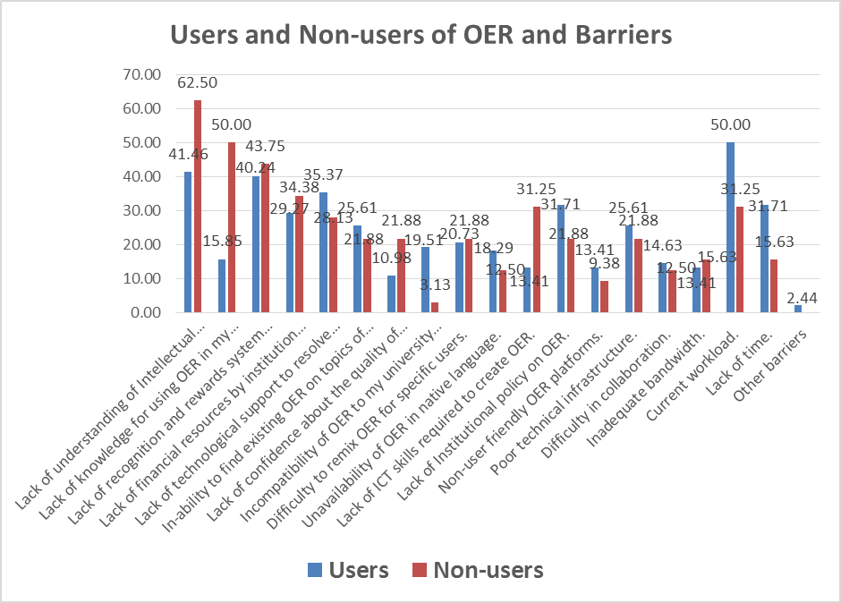
Barriers and Users
Notes:
Those who use OER know that it takes time to use OER effectively.

Slide 30
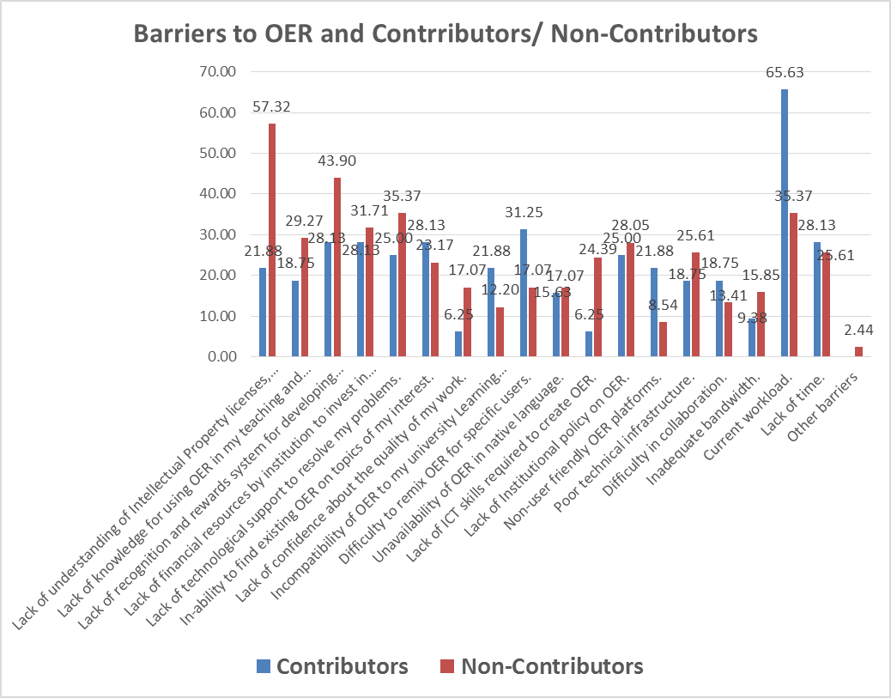
Barriers and Contributors
Notes:
Those who contribute know well that OER work takes time

Slide 31
Key Findings on Barriers
Poor understanding about licensing and copyright issues
Current workload
OER not integrated into work practice and seen as additional burden
Lack of recognition and reward system for OER
No OER policy in institutions
Poor technical support and bandwidth

Slide 32
Are there relationships amongst teachers’ attitudes, motivations and perceptions of OER quality?

Slide 33
Regression Findings
Only motivation and attitudes are moderately correlated (r = 0.45), not significant at 0.05 level
Multiple and step-wise regression indicated several items of motivations and quality correlated to attitudes towards OER

Slide 34
Items related to positive attitudes
Motivation Items:
  OER provides us with opportunities for establishing new partnerships.
  OER gives me opportunities to learn new things.
  Involvement in OER will bring me recognition.
  I like receiving comments and feedback from experts and senior colleagues on OER I have created.
  I know about my intellectual property rights under Creative Commons licences.
  Through OER, I can reach disadvantaged communities.
  OER will help developing countries increase access to education.
Quality Items:
  OER saves teachers’ time.
  I do not need permission to use OER.
Notes:
Both altruistic and practical motivations shape positive attitudes. However, two non-important quality that can be attributed as characteristics of OER have influence on attitudes towards OER.

Slide 35
Activity Theory

Slide 36
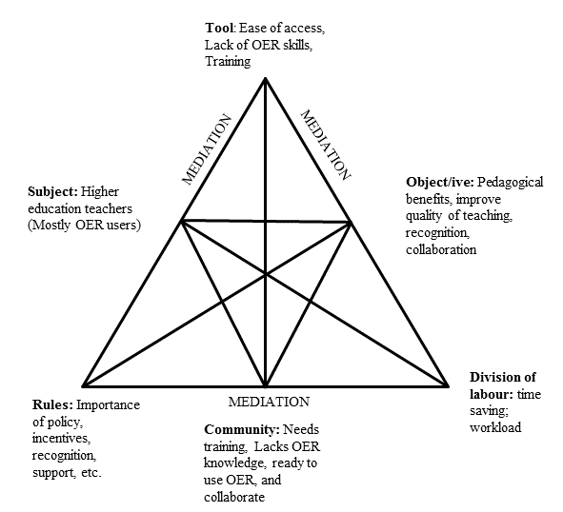
Analysis of Triads

Slide 37
Model for OER Adoption

Slide 38
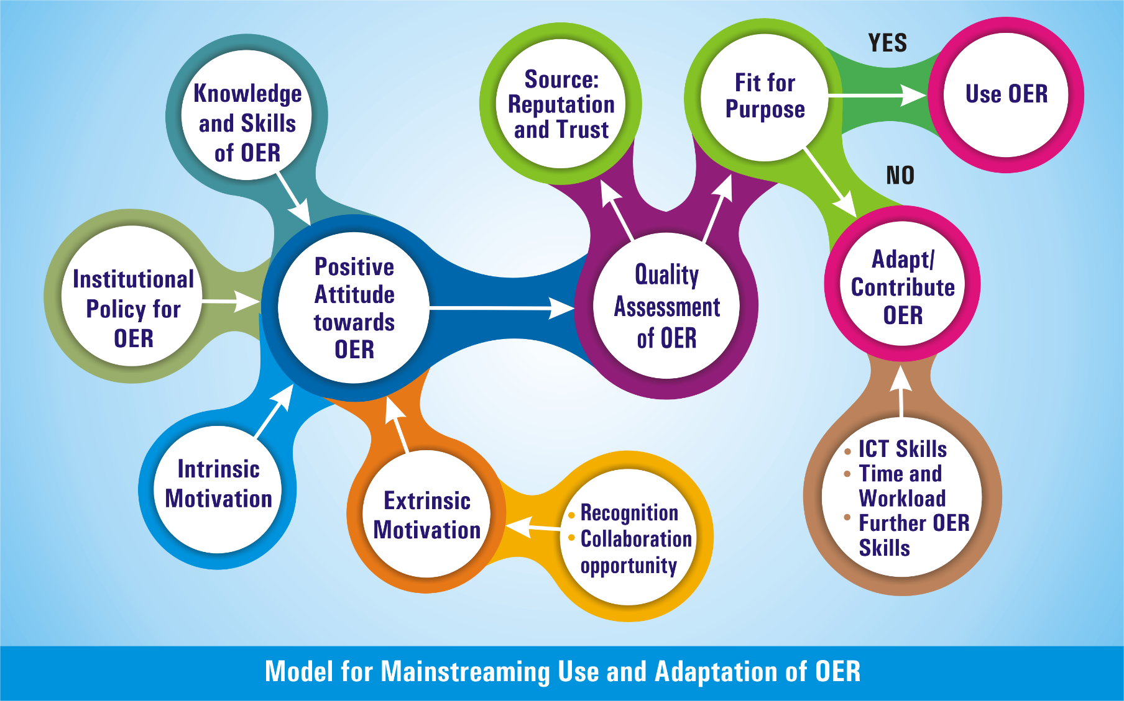
Proposed Model

Slide 39
Recommendations

Slide 40
Five Action Points
Advocacy and awareness
Adopt policies
Provide incentives and release time
Create QA mechanism
Provide continuous professional development opportunities

Slide 41
THANK YOU

