Slide 1
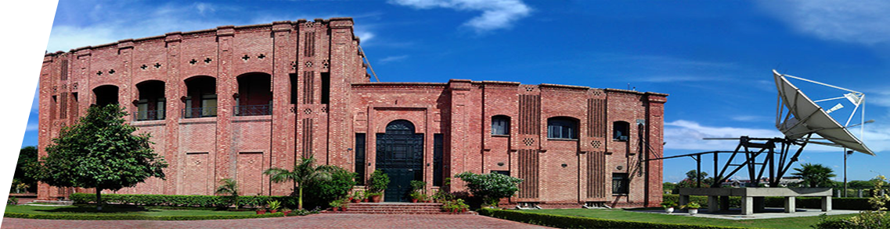


Virtual University of Pakistan
An Overview
Professor Naveed Malik
Special Adviser: Technology & Innovation, Commonwealth of Learning
Founder/ Former Rector, VUP
Institute of Distance Education (IDE)
University of Eswatini
4 March 2020

Slide 2

WHY A VIRTUAL UNIVERSITY
Lack of Capacity in traditional Institutions
  Pakistan: population: 200 million
  Only 9.5% of 18-25 years age group in HE

Slide 3

WHY A VIRTUAL UNIVERSITY
Dearth of Qualified Faculty
  Institutions have very few “quality” Professors
  The deficiency leads to poor quality output

Slide 4

WHY A VIRTUAL UNIVERSITY
Barriers to entry into Higher Education
  High cost of conventional education
  Concentrated in major cities only
  Limited enrolment capacity

Slide 5

THE APROACH
Collectively, Pakistani Universities have excellent faculty; why not use them to teach all aspirants?

Slide 6

THE MODEL
To target Highly qualified faculty with established credentials to:
  Drive the content development process
  Develop content locally

Slide 7

THE MODEL
To use Technology as a force multiplier
To Deliver/interact via Television and Internet
To provide uniform education across Pakistan

Slide 8
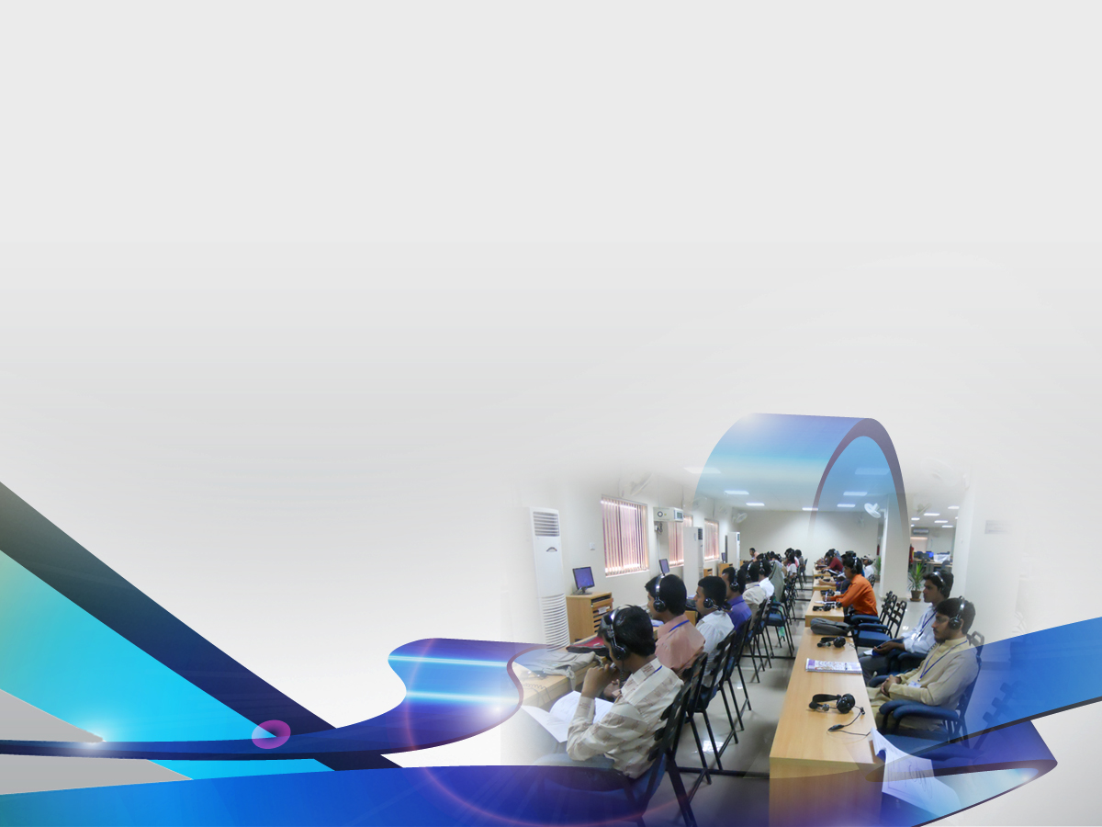
Mission Statement
To provide extremely affordable world-class education to aspiring students all over the country being the only Pakistani university based purely on modern information communication technologies (ICTs)

Slide 9
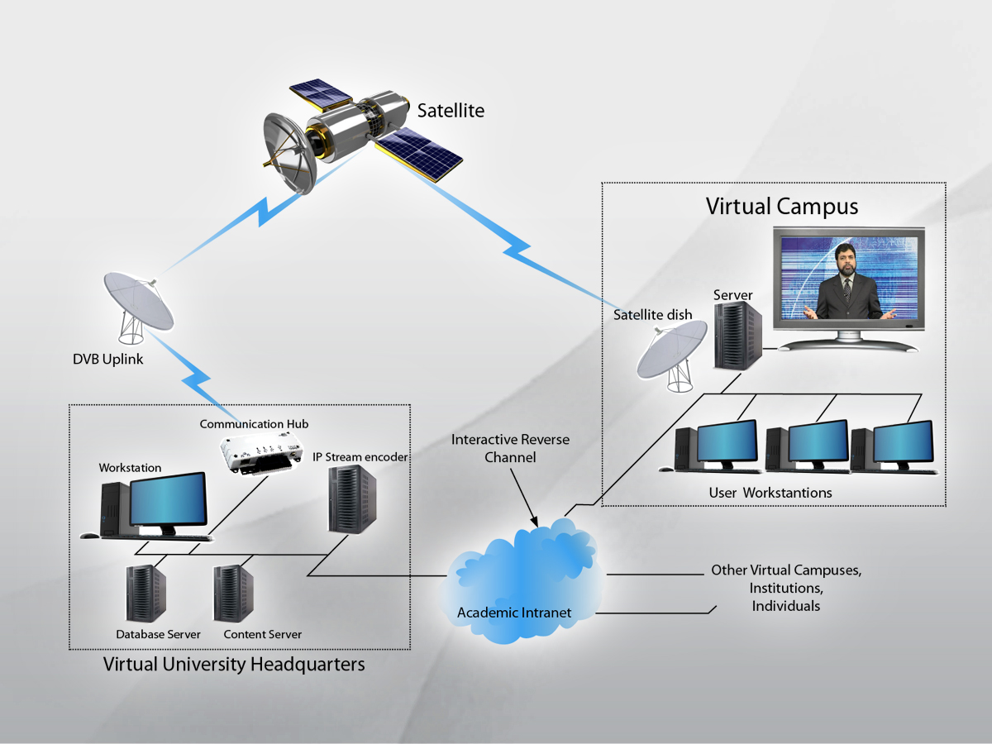

Slide 10
Milestones
Milestone | Date
Inauguration | Mar-02
Selected to Lead Asia-Wide DE Research Projects | Mar-05
VU goes global - All Video Lectures placed on YouTube | Jun-08
Launch of Unique Examination System | Oct-08
Launch of VU Open Courseware | Oct-11
VU Open Course Ware Site wins International Award for being the best site of the year in the world | Apr-12
National University of Sciences & Technology (NUST) opts VU’s examination system | Jul-12

Slide 11
Milestones
Milestone | Date
The Quality Assurance Agency (QAA) of HEC, ranked VU Quality Enhancement Cell rated "W" category | Mar-13
VU partners with University of the Punjab and Technical University Kaiserslautern, Germany to launch B.Ed. in Technical Education | Sep-14
University of Education Lahore opts VU’s University Management System Software | Sep-16
MoU with National Information Technology Board (NITB) to conduct Basic IT Training Test of Federal Government Employees | Mar-17
Awarded DigiSkills Training Project to train One million students | Dec-17
Pakistan Ordinance Factory opts VU’s Recruitment & Testing Software | Sep-18

Slide 12

PROGRAMS OFFERED
4-year BS programs: 19
2-year BA/BSc programs 22
Masters programs: 23
MS programs: 10
Ph.D. 02
Diplomas 17
Certificates 174

Slide 13
Major Disciplines
Computer Science
Business Management
Bio-Technology
Humanities
Education
Mathematics

Slide 14
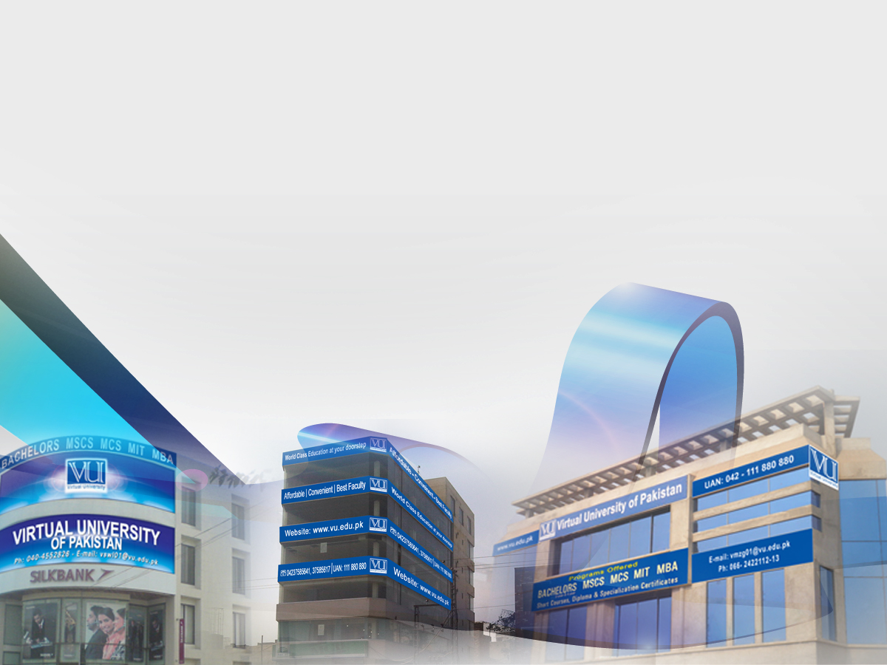
CURRENT OUTREACH
Over 100 cities
  200+ active Virtual campuses
    VU Operated: 28
    Public-private partnership: 175+
    Overseas Countries: 50+
Overall Enrolment 74,600+
Overseas Enrolment 16,00+
Graduates to date 63,500+

Slide 15
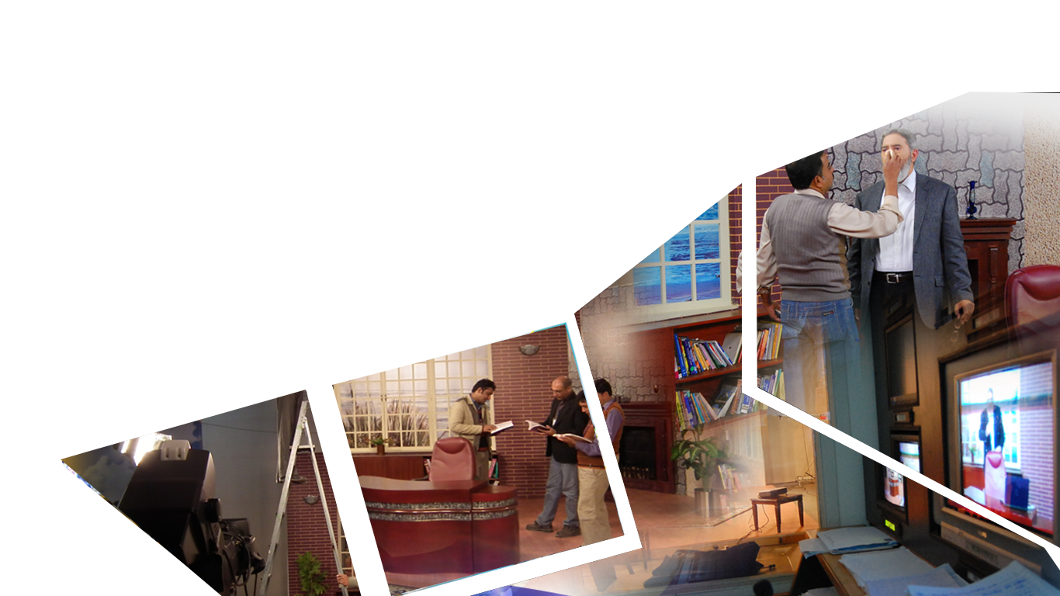
Content Development
Educational Content development Powerhouse
State of the art latest production facility
All facilitates available under one roof

Slide 16




University Software Solutions
Comprehensive University & Learning Management Systems developed by in-house IT Team
Providing software solutions to other institutions
Highly trained and capable team to manage large scale software systems

Slide 17
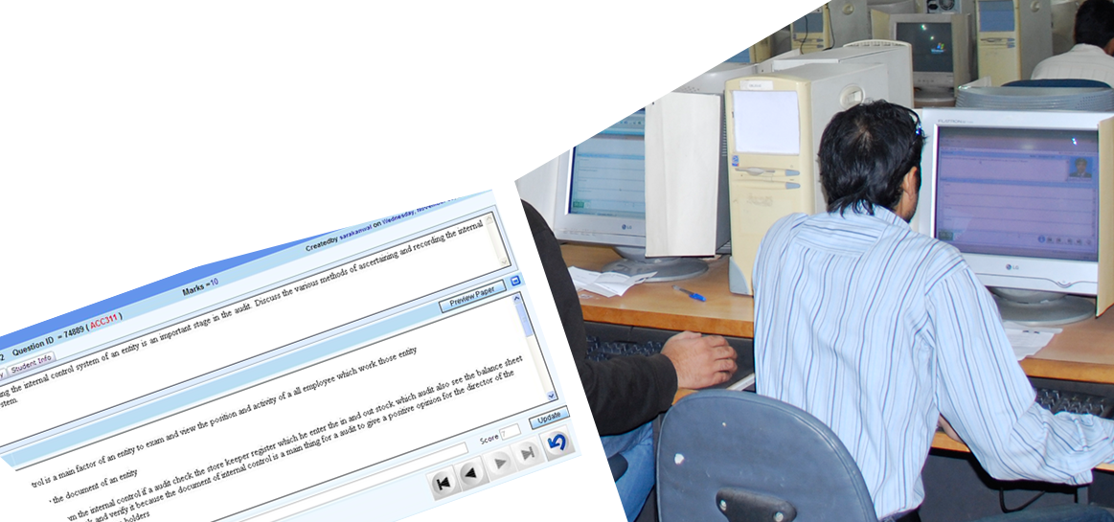
Unique Examination System
IT enabled most sophisticated system
Unique paper for every student
Question bank approach

Slide 18
Highlights – VU-CPL
  VU-Computer Proficiency License
  Basic IT training in Microsoft Office
  Self-paced, self-teaching structure – no need for a teacher
  http://cpl.vu.edu.pk

Slide 19
Highlights – Mobile Laboratory
  VU has Biology wet laboratories at:
    Peshawar, Rawalpindi, Lahore, Faisalabad
    Multan, Karachi
  In order to facilitate students from smaller towns a concept of a “Lab on wheels” has been launched

Slide 20
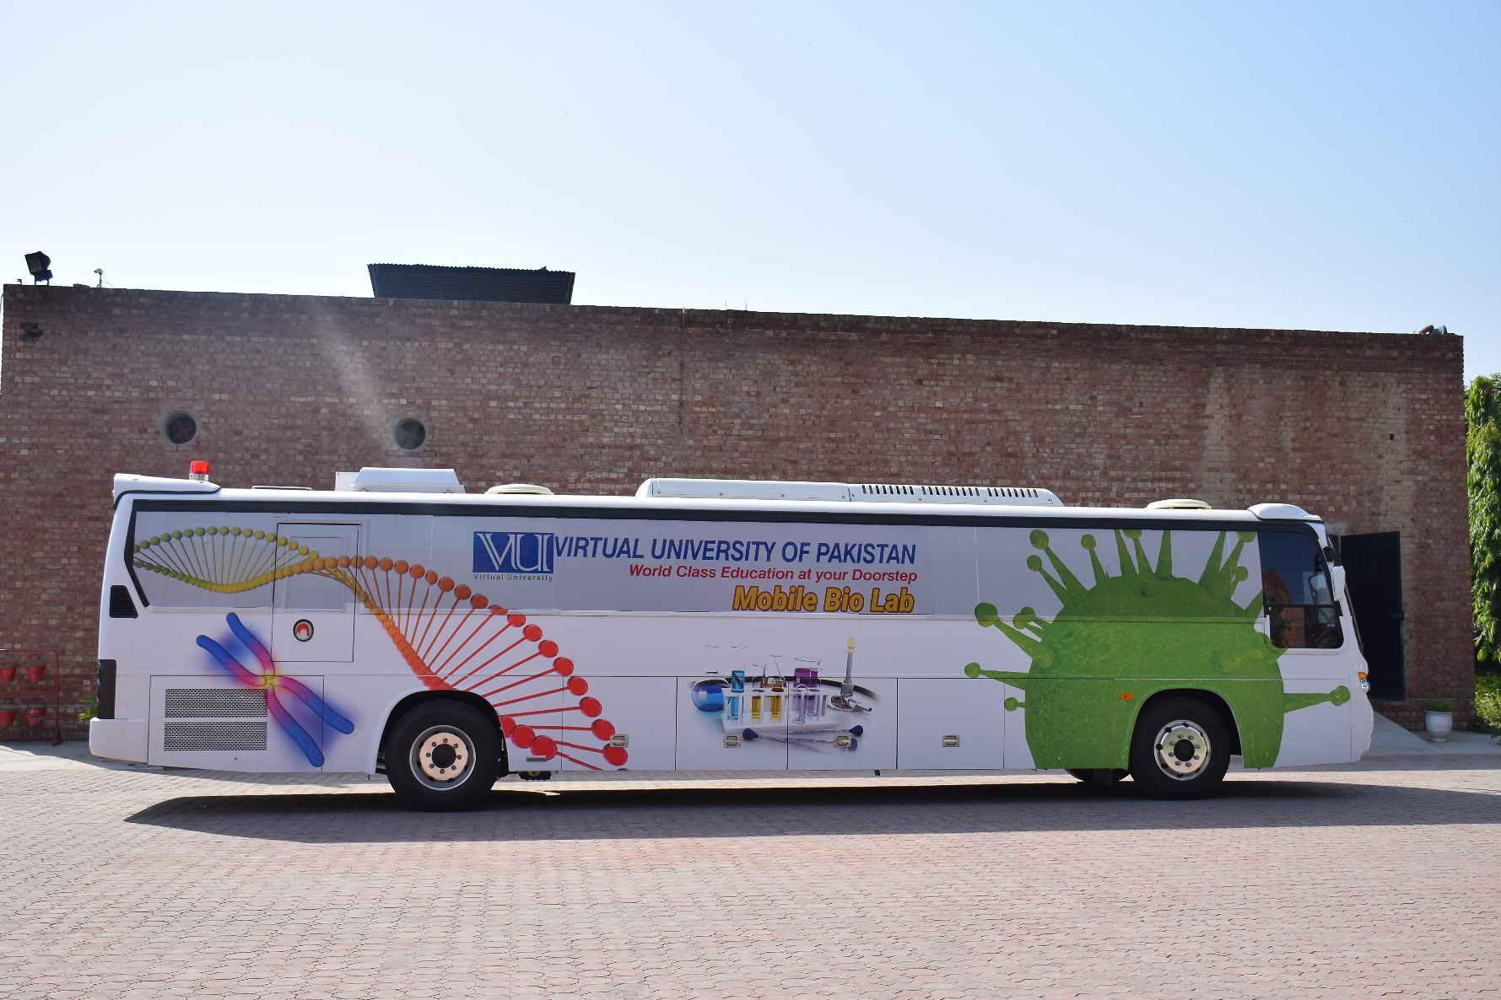
Highlights – Mobile Laboratory

Slide 21
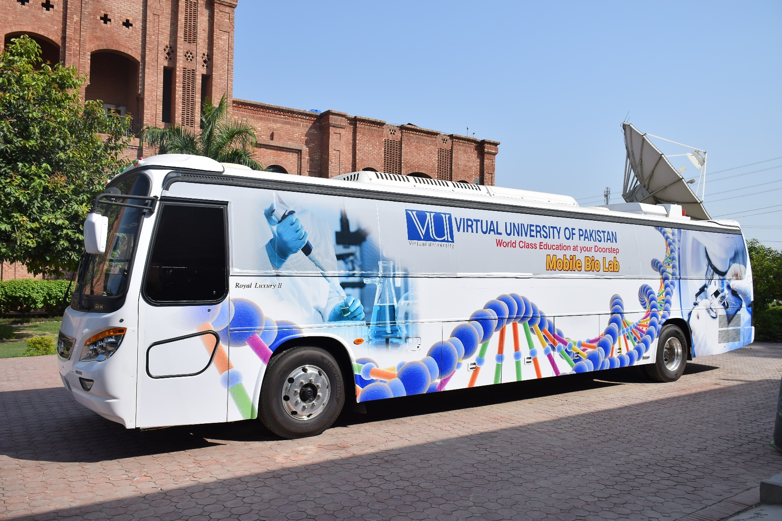
Highlights – Mobile Laboratory

Slide 22
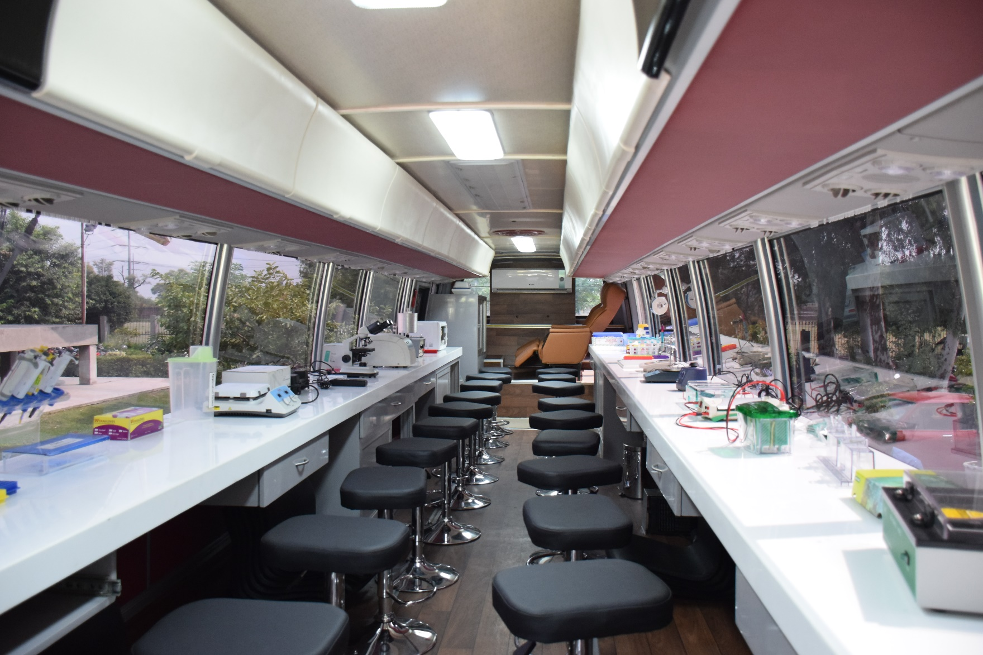
Highlights – Mobile Laboratory

Slide 23
Highlights – Mobile Laboratory
  Concept of Smart Lab has been developed
    Transport instruments to location and set up
    Train and examine students
    Pack up and move to next location
    Optimum utilization!

Slide 24
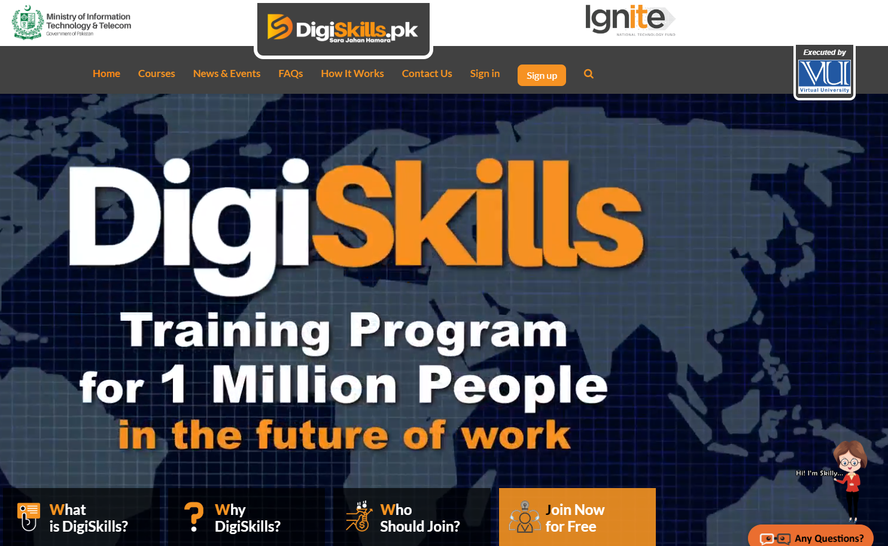

Slide 25
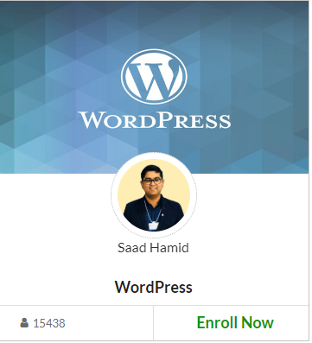


DigiSkills.pk
Courses Offered
Enrolments

Slide 26
Thank You

