Slide 1



Smart Education for
Transforming Lifelong Learning
Prof. Asha Kanwar
President and CEO
Commonwealth of Learning, Canada
August 18, 2023. Beijing

Slide 2

‘The illiterate of the 21st century will not be those who cannot read and write, but those who cannot learn, unlearn, and relearn.’
- Alvin Toffler

Slide 3




Plan
Perspectives on Lifelong Learning
Understanding SMART Education
SMART Education for Transforming Lifelong Learning

Slide 4

Perspectives on lifelong learning

Slide 5
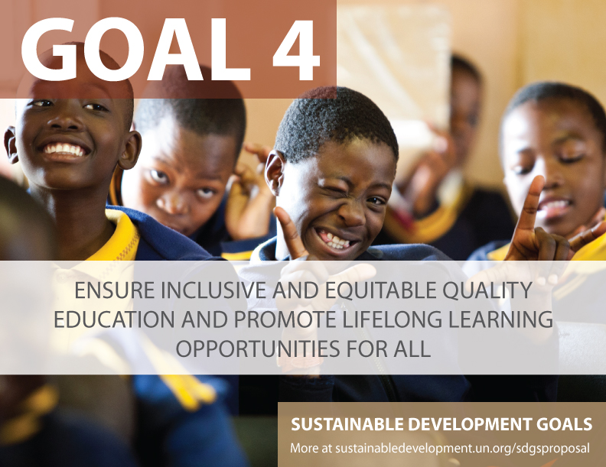


Slide 6

Transforming Education Summit 2022
Ensure the right to quality education throughout life….embrace the concept of lifelong learning with more flexible pathways and financial policy incentives to allow people to re-engage with education systems several times throughout their lives….calls for qualifications that recognize skills, work experiences and knowledge throughout life, and beyond formal education….
Vision Statement of Secretary General Antonio Guiterres on Transforming Education
Notes:
UNESCO has moved the discourse from education to learning, from formal to more flexible pathways for learning throughout life within the context of a rights-based approach.

Slide 7

‘A lifelong learning system must reach large segments of the population, including people with diverse learning needs. It must be competency driven rather than age related….The lifelong learning model enables learners to acquire more of the new skills demanded by the knowledge economy as well as more of the traditional academic skills.
LLL in the global Knowledge Economy, pp28-29
Notes:
Very similar to the UNESCO approach but moves in the direction of supporting a knowledge economy.

Slide 8

…individual workers will have to engage in life-long learning if they are to achieve fulfilling and rewarding careers. For companies, reskilling and upskilling strategies will be critical…to contribute to socially responsible approaches to the future of work. For policy-makers, reskilling and retraining the existing workforce are essential levers to fuel future economic growth….
Towards a Reskilling Revolution (January 2018) https://www.weforum.org/reports/towards-a-reskilling-revolution
Notes:
The WEF looks at lifelong learning within the context of the 4th Industrial Revolution and the imperative of economic growth and individual careers.

Slide 9
Two competing versions of lifelong learning
‘the one visionary and all-encompassing, the other driven by narrower interests related to training, competency and the world of work’.
Aitchison (2004, p.2)
Photo: http://enewsletter.ukzn.ac.za/Newsletter.aspx?id=83
Notes:
Is there a third way?

Slide 10

Understanding Smart Education

Slide 11
What is Smart Education?
‘heightened learning experience, continuous learning content adaptation and teaching efficiency’. (Huang, 2014)
‘...application of latest or smart technologies in collaboration with advanced pedagogical practices, tools and techniques’ (Gabriela et al, 2018)
‘smart education goes beyond the use of new technologies and involves the adoption of new teaching and learning approaches, with students being autonomous…and teachers becoming facilitators’ (Maria Jose Sa et al, 2022)
Notes:
How is SMART education different from online, blended and distance learning?

Slide 12
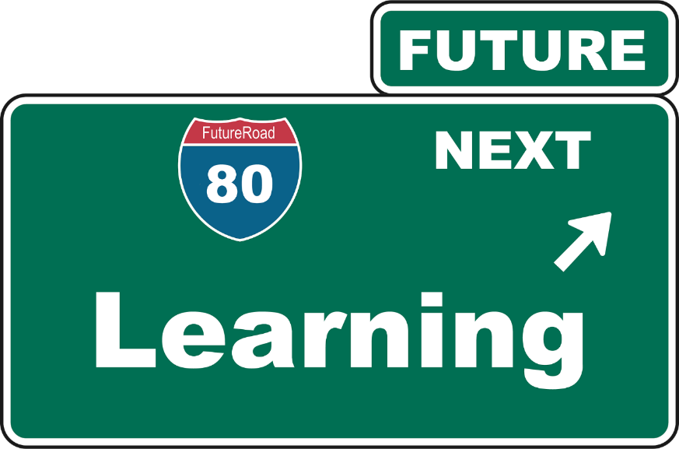
Smart Education is
enjoyable, leading to the retention and transfer of knowledge to long-term memory;
engaging, with innovative application of technologies;
efficient, in terms of just-in-time learning and availability for right resources;
effective, in leading to the earning livelihoods and development of responsible citizenship; and
ethical, to address issues of privacy, cybersecurity and equity.
(Kanwar, 2021)
Notes:
Smart Education is about the 5Es – Education that is enjoyable, engaging, efficient, effective, and ethical. First, enjoyable learning helps the retention and transfer of knowledge to long-term memory. Second, making learning engaging requires pedagogy as well as innovative applications of technology such as gamification. Third, learning needs to be efficient in terms of time and resources. Fourth, Smart Education must be effective not only for achievement but must focus on accomplishment, which means going beyond individual success to make the world a better place. Fifth, Smart Education is ethical, for it addresses issues of privacy, cyber security and equity.

Slide 13
SMART Education for Transformation
Sustainable
Meaningful
Accessible
Resilient
Transformative
Notes:
Pandemic, climate crisis and developments in technology

Slide 14

Sustainable: Impact of Education on Climate
1
DIRECT
Emissions from construction of schools/infrastructure
Emissions from energy use in schools
Learner emissions
INDIRECT
Emissions from ‘development’ and economic growth associated with higher levels of education in a country

Slide 15

Five biggest emitters of carbon
Construction: Cement, steel plastic: 31%
Electricity: 27%
Farming: plants and animals. 19%
Travel and transport: 16%
Airconditioning: 7%

Slide 16

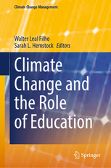





Research on Emissions and ODL/ICT
3x less carbon emissions
Travel – greatest contributor
Mode of delivery - determinant
Source: Carr et.al. Delivery Mode and Learner Emissions: Comparative Study from Botswana. W. Leal Filho and S. L. Hemstock (eds.), Climate Change and the Role of Education, Springer Nature. In Production.
Notes:
Perhaps the most comprehensive project assessing the environmental impacts of different modes of delivery in higher education is the SusTEACH project, supported by the Open University, UK. The project compared the carbon emissions of ICT-enhanced courses with online courses and mainly face to-face taught courses. The findings showed that online and blended ICT-enhance distance teaching models had significantly lower environmental impacts than face-to-face teaching modes (Caird et al. 2013; Caird et al. 2015). This study used a comprehensive methodology that considered multiple contributors to emissions for both students and the institutions.
Using the SusTeach methodology COL conducted a study in Botswana, to determine whether there was a difference between the carbon emissions of CD-based ODL and face-to-face learners, as well as the main sources of learners’ emissions.
The comparison of learner carbon emissions data from both face-to-face and CD based students in Botswana revealed that the average learning-related carbon footprint of the face-to-face group is nearly three times greater than that of the ODL group, and the difference was statistically significant. Within the overall carbon footprint, emissions from travel were by far the greatest contributor to this disparity. This suggests that regardless of the exact mechanism of delivery, ODL or blended modes can decrease emissions by reducing face-to-face contact hours. Institution, as a proxy for delivery mode, was the most significant predictor of learning related emissions.

Slide 17
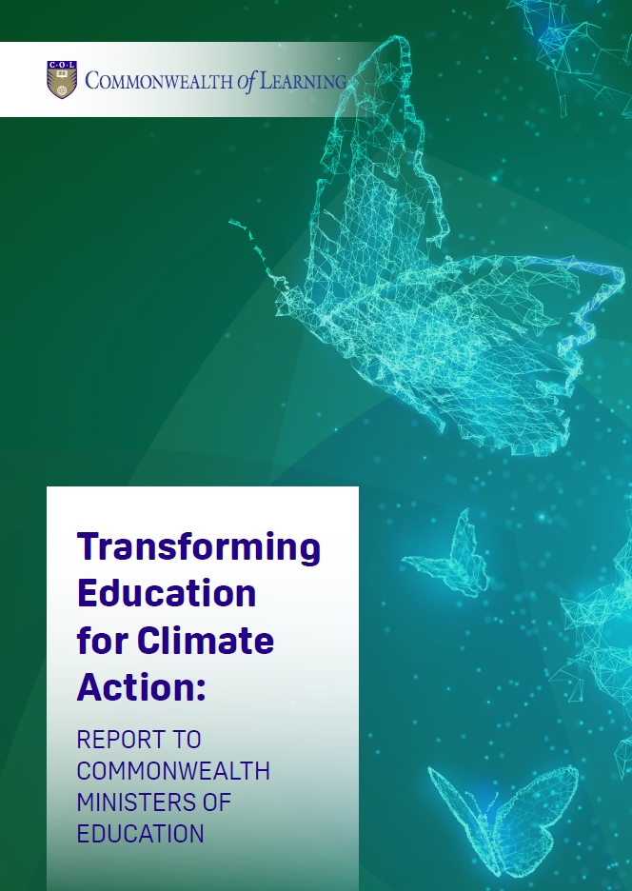
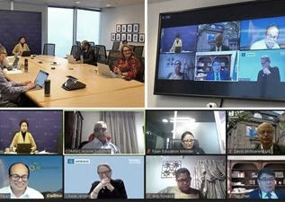
Recommendations
Resilient infrastructure
Skills for the blue and green economies
Promote climate justice

Slide 18

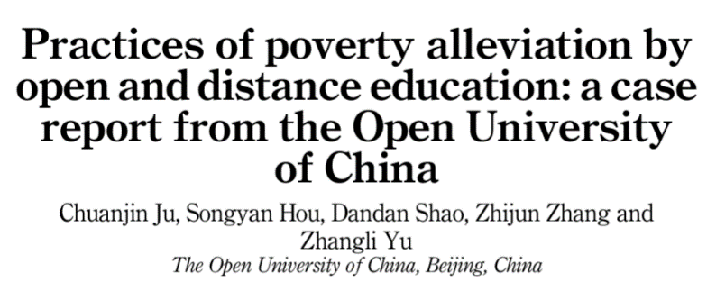
Meaningful: ICTs for poverty alleviation
2
Targeted to 50,000 rural villagers
Evidence of increase in income, enterprise profit, employment opportunities
Source: https://www.emerald.com/insight/content/doi/10.1108/AAOUJ-09-2021-0110/full/html

Slide 19
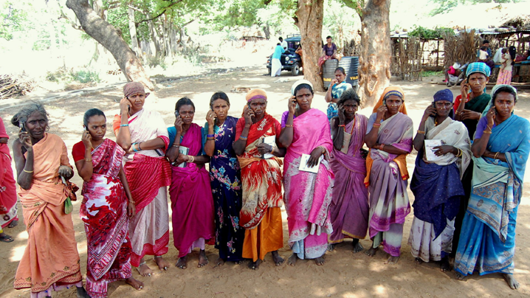

Every $1 invested resulted in $8 worth of income and assets

Slide 20

Accessible: Leaving no one behind
3
For persons with disabilities
Women and disadvantaged groups
People in remote areas
Source: Policy by Nick Youngson CC BY-SA 3.0 Alpha Stock Images

Slide 21
ODL for Persons with Disabilities
CONVENIENT
Study at your own pace, place, time
FLEXIBLE
Option to listen, watch or read lecture in different formats
AFFORDABLE
ANONYMOUS
Don’t require to travel to campus or accommodation
Costs less than F2F
Engage with professors and classmates without feeling discriminated
Notes:
People with disabilities are often disadvantaged in terms of access to tertiary education. Of the 18 countries for which data is available, 15 report disability prevalence under 3 per cent and half report rates under 2 per cent.
No info on students with disabilities in tertiary education.

Slide 22

Resilience:
Parents as co-educators
4
Ghana: Family and intergenerational learning
Liberia and Sierra Leone:
A hotline number for parental feedback
Rwanda: Radio lessons supported by parents

Slide 23

Social Emotional Learning
Teachers social and emotional skills are key
Years after students participated in SEL, their academic performance was an average of 13 percentile points higher than students who didn’t participate.
Source: https://casel.org/fundamentals-of-sel/what-does-the-research-say/, retrieved on 1 June 2023
Notes:
Department of Education (UK) https://files.eric.ed.gov/fulltext/EJ1145076.pdf
Hundreds of studies involving more than 1 million students worldwide across PreK-12 offer consistent evidence that SEL has a positive impact on students’ academic achievement.
SEL interventions that addressed the five core competencies increased students’ academic performance by 11 percentile points, compared to students who did not participate.
The positive impact on academics lasts long-term: Years after students participated in SEL, their academic performance was an average of 13 percentile points higher than students who didn’t participate.
SEL enhances young people’s coping skills, resiliency, and emotion identification, which can help reduce symptoms of depression and anxiety in the short term.
SEL contributes to reductions in bullying and aggression.

Slide 24

Transformative Learning
5
“ to make our own interpretations rather than act on the purposes, beliefs, judgements, and feelings of others. … Transformative learning develops autonomous thinking.”
Mezirow
Mezirow, J. (1997). "Transformative Learning: Theory to Practice". New Directions for Adult and Continuing Education, 74, 5–12.
Notes:
Transformative learning is the transformation of one’s “basic worldview and specific capacities of the self”; transformative learning is facilitated through critical analysis

Slide 25
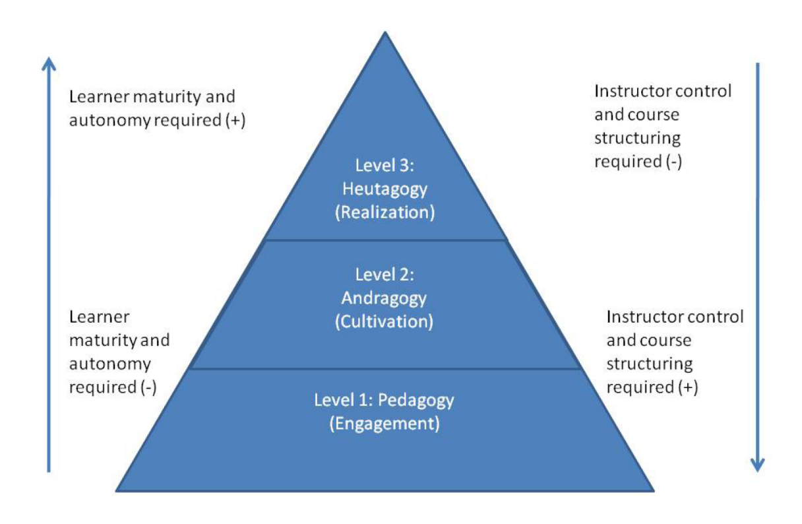
Integration of Three Approaches
Blaschke, Lisa Marie. (2012). Heutagogy and Lifelong Learning: A Review of Heutagogical Practice and Self-Determined Learning .International Review of Research in Open and Distance Learning. January. Retrieved from http://www.irrodl.org/index.php/irrodl/article/view/1076/2113

Slide 26
SMART education is
A broader concept than online learning
A comprehensive approach that integrates technology, data analytics, innovative teaching, social inclusion and environmental conservation for a more effective and engaging experience
Goes beyond formal learning to include non-formal and informal learning
Notes:
Uses technology and pedagogy effectively to transform formal and non-formal learning at all levels throughout life to develop global citizens who contribute to the peace and prosperity of the people and the planet

Slide 27
SMART Education for Transforming Lifelong Learning
Notes:
Can Smart education help implement LLL?

Slide 28



Present Approach to Lifelong Learning
Focused more on acquiring skills and competencies
Helping to adapt to changing circumstances
Emphasis on formal learning

Slide 29

SMART Approach to Lifelong Learning
Move beyond acquiring skills and competencies and focus on Transformative Learning
Not just adapting to changing circumstances but acquiring ability to change circumstances

Slide 30

Lifelong Learning
Should not be perceived as a mere course or a programme
It is a culture which needs to be integrated in every aspect of life
Lifelong learning means different things to different stakeholders
Policies and programmes should focus on promoting a ‘learning culture’.

Slide 31

1. Sustainable:
Green learning agenda
Skills for green jobs
Green life skills
Skills for a green transformation
Skills aimed at fulfilling the requirements of green jobs and supporting the transition to a low-carbon green economy
Cross-cutting skills that serve both technical, instrumental, and adaptive, transformative ends
Adaptive skills aimed at transforming unjust social and economic structures

Slide 32
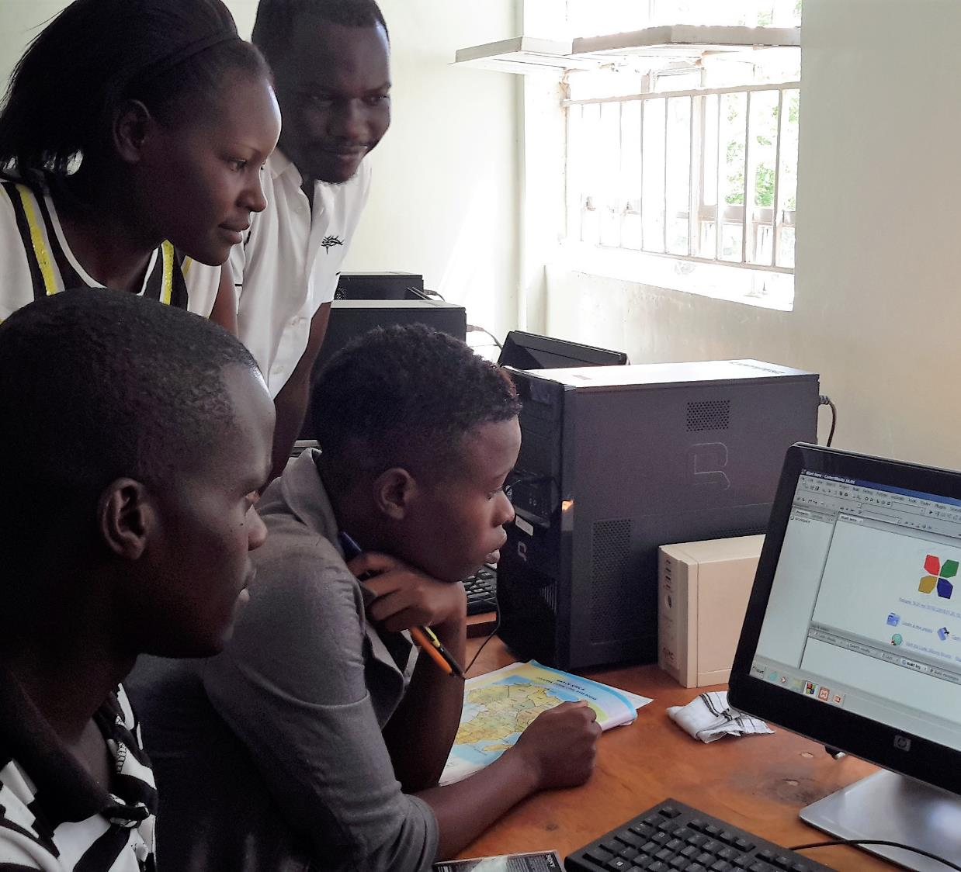
2. Meaningful: Real, World-Improving Projects
"Projects that produce actual...changes in our kids' local and global communities"
- Marc Prensky
Source: Prensky, M. 2016. Education to Better Their World. Teachers College Press, New York.

Slide 33


REACHING THE BOTTOM BILLION
3. Accessible: MOOC4D
Use technologies that are
appropriate and affordable
Content designed for delivery in low bandwidth situations
Open Content in local languages ie. OER
Social media integration

Slide 34
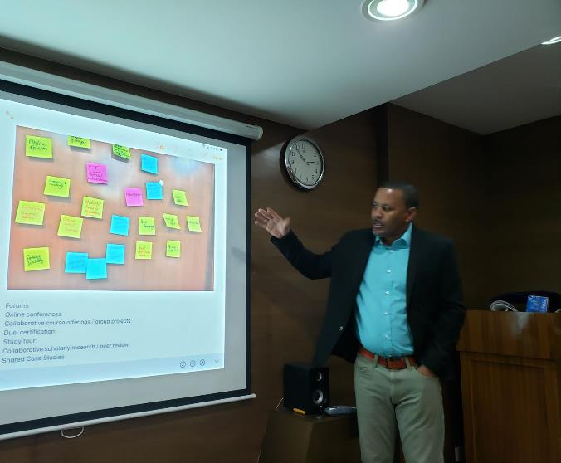
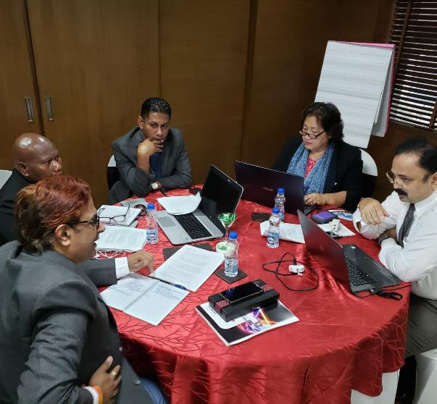
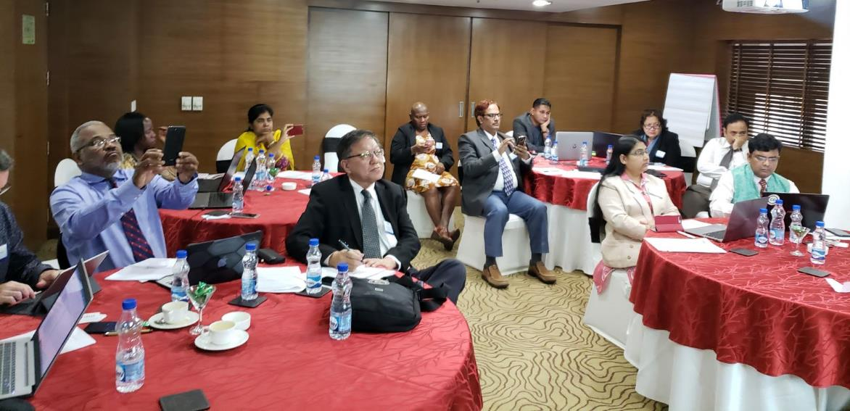
4. Resilient:
Strengthening capacity
Building capacities of policy-makers
Developing capacity of teachers
Preparing learners

Slide 35

5. Transformative pedagogy
Typical Approach:
Skills /Competencies
Employability and Entrepreneurship
Achievement
Transformative Approach:
Empowerment for Change
Environmental Conservation and Global Citizenship
Accomplishment
Notes:
According to Marc Prensky, the dominant educational paradigm emphasizes individual achievement, which is defined as “A person doing something that benefits only (or principally) him or her (=an achievement).” In the current paradigm, the focus is on the Acquisition of Skills and Competencies as well as Employability and Entrepreneurship – individualistic goals.
Under a transformative approach, the focus is on bettering soceity as a whole, what Prensky calls “real, world-improving accomplishment”. In contrast to an achievement an accomplishment is “A person doing something (or being a part of something) that benefits others and the world outside of that person (=an accomplishment).”
And Prensky claims that this model “is far better for us because it liberates huge amounts of unused potential – the potential of our students – to improve our communities and our planet.
Under the transformative approach, the focus is on Empowerment, Environmental Conservation, and Social Cohesion/Peace.

Slide 36
Intergovernmental Agencies
Inter-governmental
Agencies
Institutions
Governments
Advocacy for integrating Smart Education into LLL policies
Frameworks for implementing and monitoring progress
Share best practices
Promote regional and global partnerships

Slide 37
Governments
Inter-governmental
Agencies
Institutions
Governments
Implement and monitor lifelong learning policies with a focus on transformative learning
Accreditation mechanisms for recognition and mobility
ICT infrastructure and governance for SMART Education

Slide 38
Educational Institutions
Inter-governmental
Agencies
Institutions
Governments
Provide seamless pathways between formal, non-formal, informal learning
Adopt SMART Education framework
Innovations for recognition and credentialing
Use ODL, OER and TEL

Slide 39


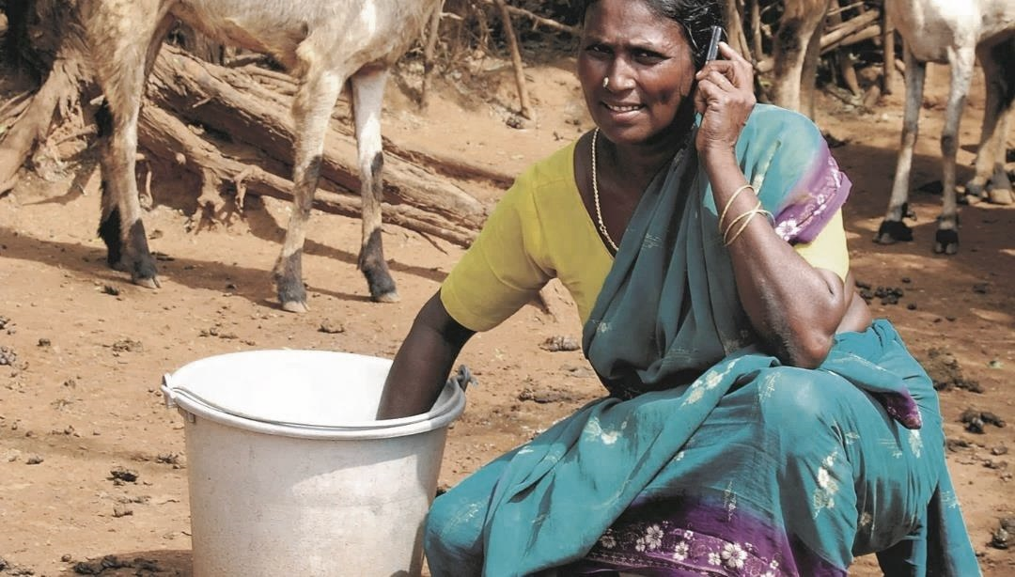

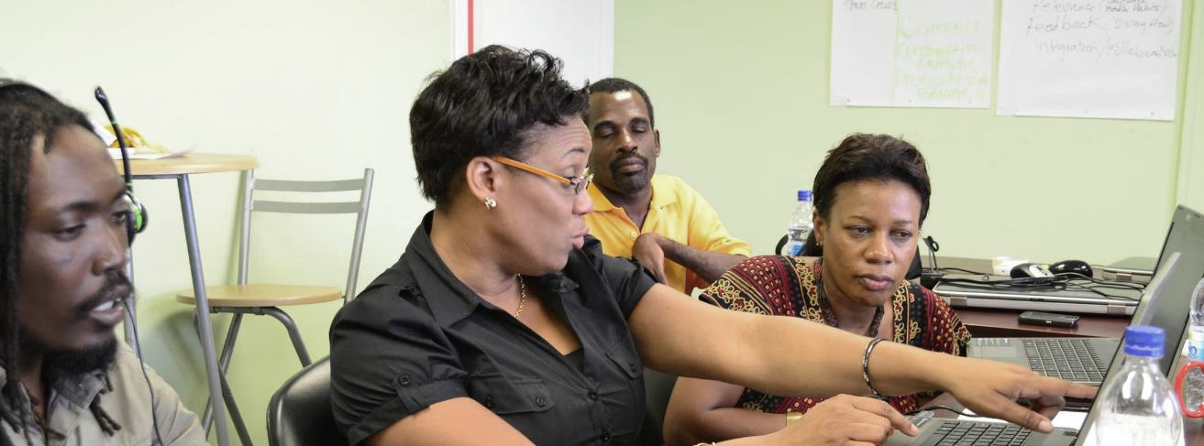

Thank you
www.col.org
The contents of this presentation, with the exception of logos and graphics which are the property of the respective owners, is made available under Attribution-ShareAlike 4.0 International (CC BY-SA 4.0).

