Slide 1
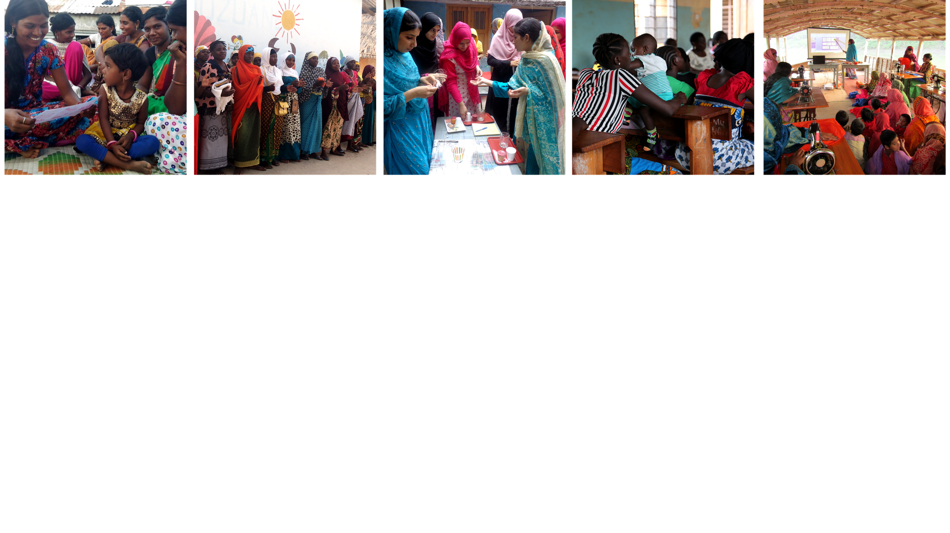



Empowering girls to prevent Child, Early and Forced Marriage
Professor Asha Kanwar, President & CEO
Women Deliver Conference 2019 | June 6

Slide 2
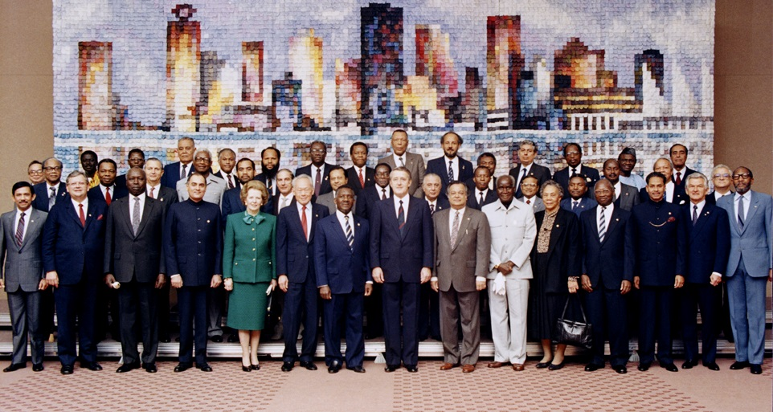
Commonwealth Heads of Government Meeting
Vancouver, 1987
Notes:
We invite you to engage us; tap into our thought leadership, expertise, networks and resources

Slide 3

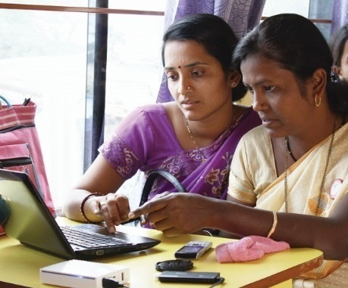
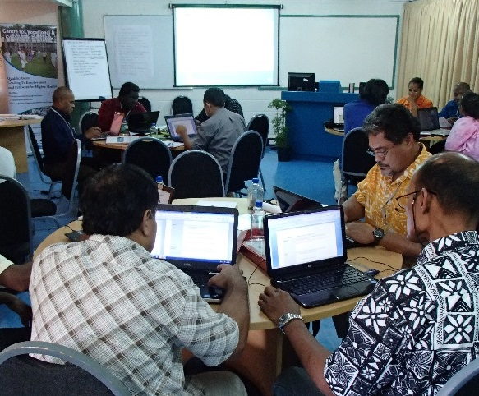
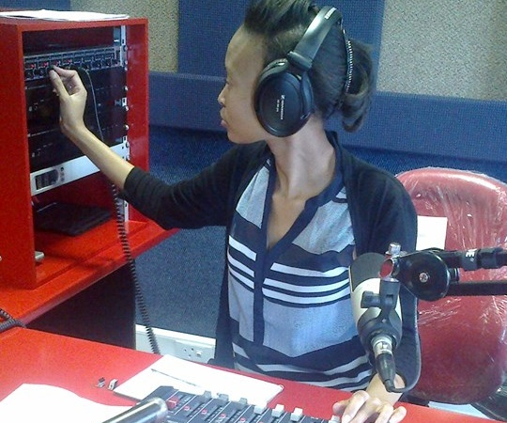
To help Commonwealth governments and institutions use technologies to improve and expand access to education and training

Slide 4

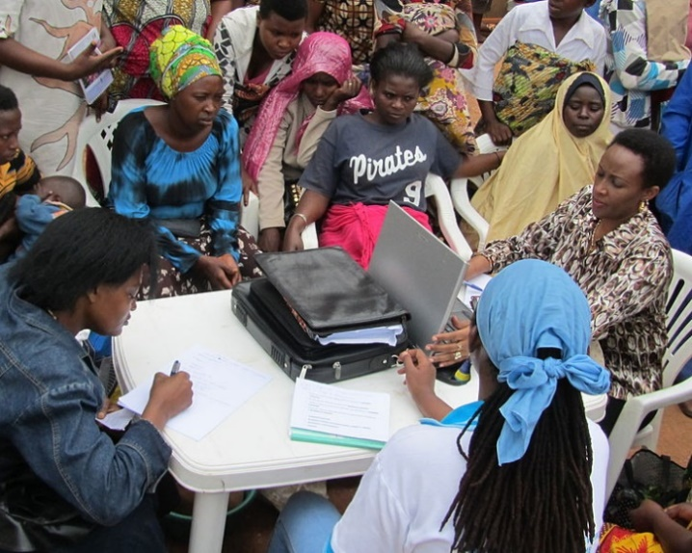
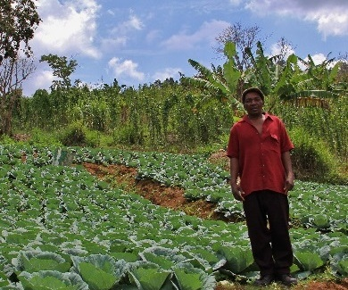
Learning for Sustainable Development
ECONOMIC GROWTH
SOCIAL INCLUSION
ENVIRONMENTAL CONSERVATION
$

Slide 5
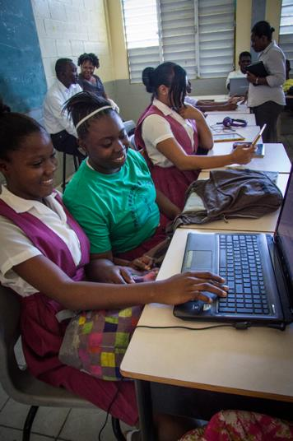
COL Strategic Plan 2015-2021
COL recognizes that advancing the goals of both women’s empowerment and gender equality are central to ‘Learning for Sustainable Development’

Slide 6
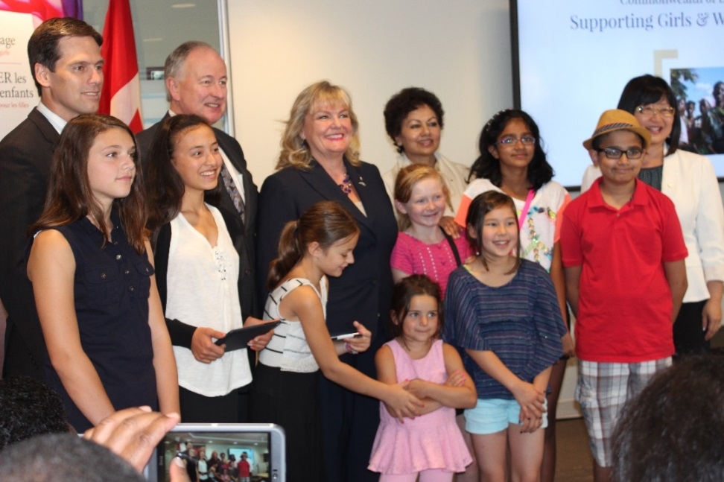

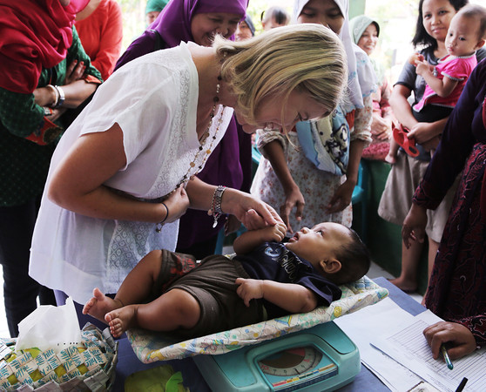

Empowering Women and Girls
Photo credit: Joshua Estey, DFAT Gallery

Slide 7
High Rates of Child Marriage
Countries & Regions | Child marriage (%) 2010 - 2017*
 | Married by 15 | Married by 18
Bangladesh | 22 | 59
Pakistan | 3 | 21
India | 7 | 27
Mozambique | 14 | 48
Tanzania | 5 | 31
Source: Percentage of women aged 20 to 24 years who were first married or in union before ages 15 and 18, UNICEF, March 2018

Slide 8
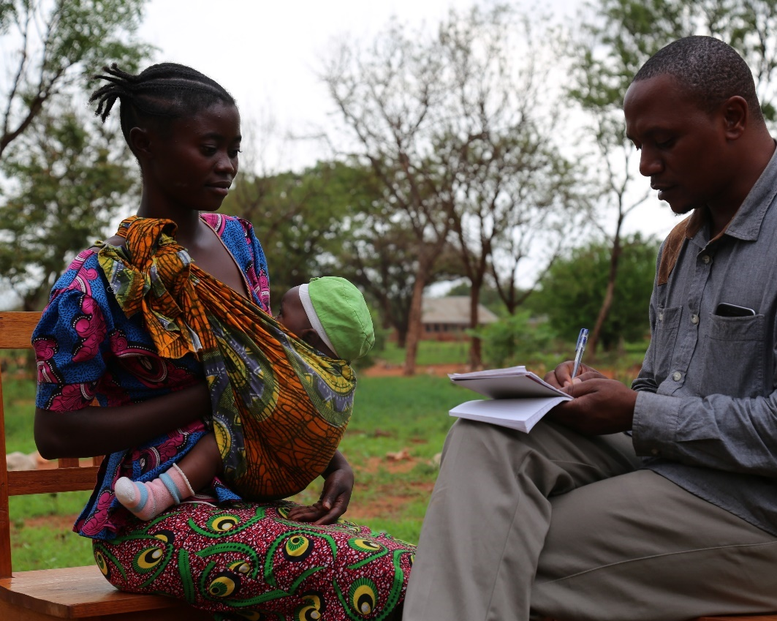
Costs of Early Marriage
Girls who marry/dropout have:
Poor health
Larger families
Earn less as adults
Face violence
Lack decision-making power
Source: Wodon, Quentin T; Jesse Cornelia; Bilhaj Nadia; Mayengo Pancras Kafonogo; Yoshino Yutaka; Munganasi Emmanuel A. Tanzania Economic Update: The power of investing in girls—educating girls and ending child marriage in Tanzania. Washington DC: World Bank, 2019

Slide 9
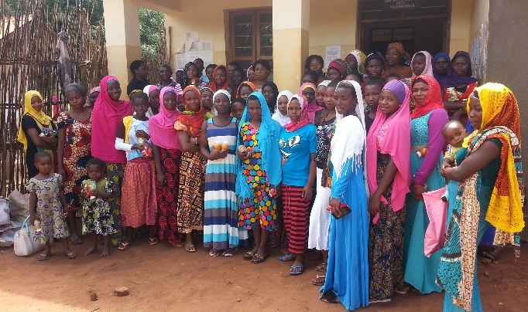
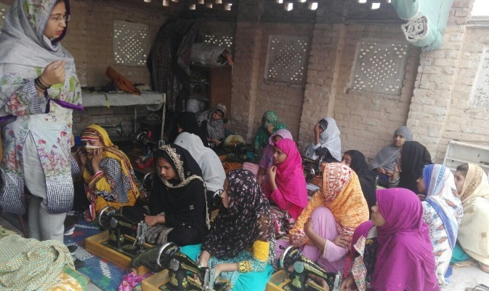
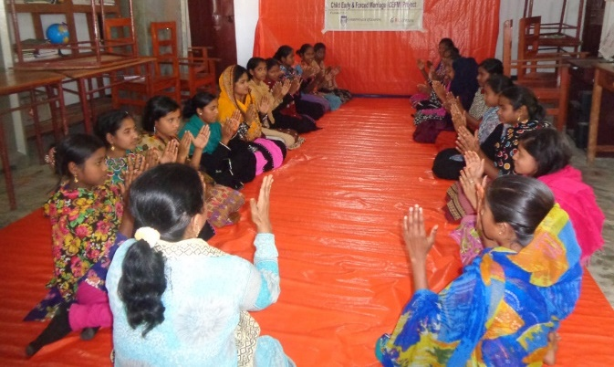
Keeping Girls in School
Inclusive, well-resourced and safe schools in remote communities
Role models and female teachers
Schools close to where girls reside
Improved opportunities for local employment
Community engagement
Source: Wodon, Quentin T; Jesse Cornelia; Bilhaj Nadia; Mayengo Pancras Kafonogo; Yoshino Yutaka; Munganasi Emmanuel A. Tanzania Economic Update: The power of investing in girls—educating girls and ending child marriage in Tanzania. Washington DC: World Bank, 2019

Slide 10
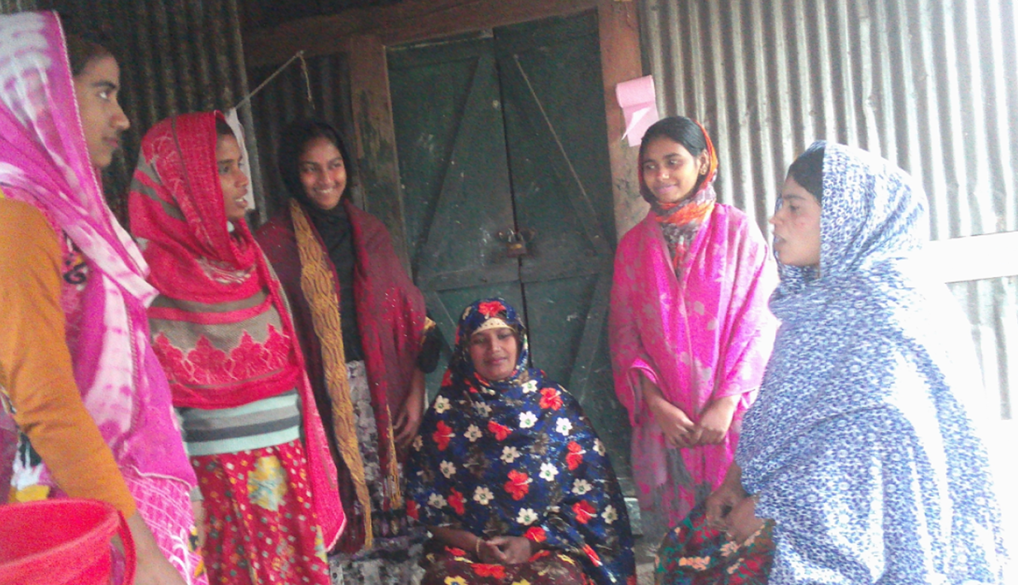



14 year old Sumaya Khatun’s marriage prevented: in Bangladesh
Notes:
Sumaiya Khatun is 14 years and lives in the Mollahpara Village in the Jhalkathi district in Bangladesh.
Sumaiya is the youngest of 5 children and completed grade 8.She was enrolled in CMES;s classes, but was absent for several days. The technical trainer and gender facilitator went to her house and found out that she was kept under ‘house-arrest’, because her parents arranged her marriage and stopped her from going to the training.LSG members were delegated to go to Sumaiya's parents to convince them not to marry her at the age of 14. At first Sumaiya's father was angry, but then the LSG members told him that he can be sentenced to two years imprisonment or 100,000 BDT fine and even both, according the latest Child Marriage restraint law of Bangladesh, if he continues with his plans.
Then her father seems to be intimidated somewhat. The gender facilitator gave him all the details of the negative consequences of CFEM. After a long discussion, Sumaiya's parents promised that she will continue her training and they gave permission for her to be enrolled in class 9 in January 2019.

Slide 11
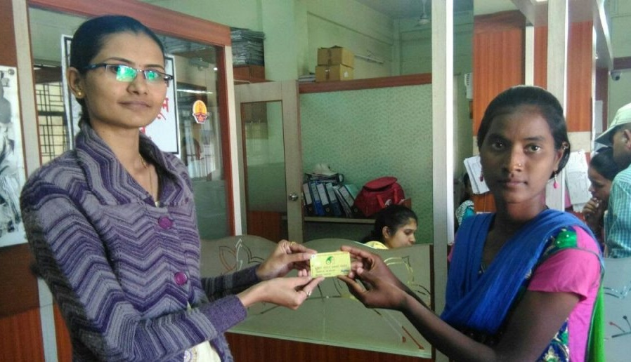

Rupali went through the advanced financial literacy training.
Notes:
Rupali dropped out of school when she was in grade 9.She enrolled in the financial literacy classes and after completing the course she opened her own savings account. She also enrolled in the livelihood training where she learned about goat rearing and insemination. She took goat rearing to earn her livelihood. She believes a smartphone could be much more than just a communication device for her. It could change her future as she will use it for marketing her services and finding information.

Slide 12
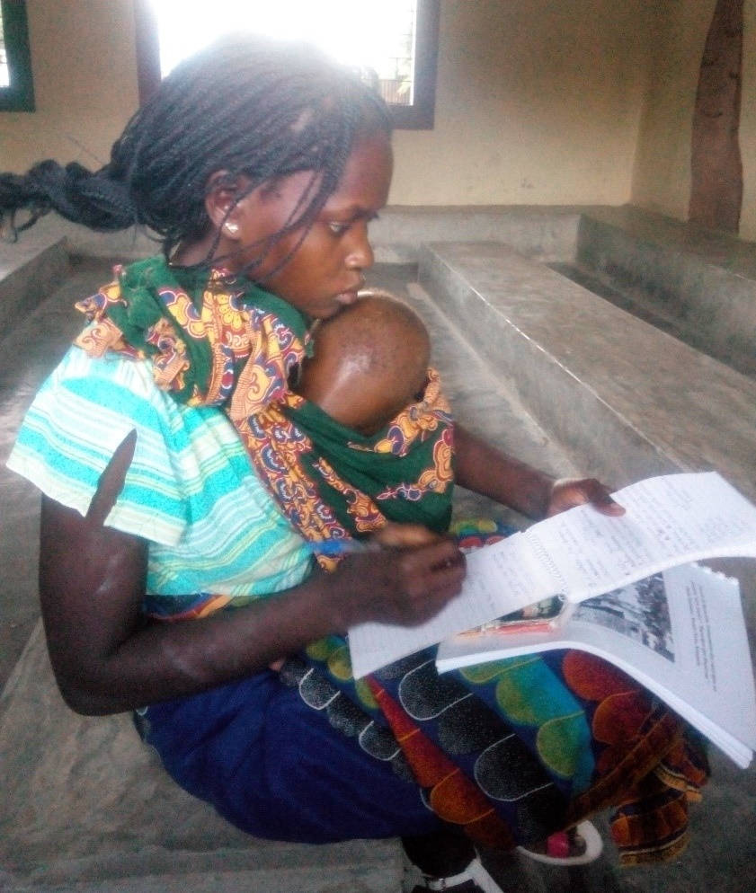

“The day GIRLS Inspire project was introduced was one of the happiest days of my life.”
--Natalia
Notes:
I heard that it would be offering training to women and girls the majority of whom were victims of CEFM. I jumped for joy as I believed deep down my heart that this project was an answer to my prayers. My parents were very poor and could not send me to school. When I was 9 years old a very well-off man “offered” to put me through school until I completed grade 10 and train as a teacher. In my 7th grade, the ADPP primary school was closed due to government policies on private schools. When I was 17 years old, the man who had been paying my school fees, came to my parents and asked them to return all the money and goods that he spent on me during the years I was studying. Having no money or assets to pay back with, my parents decided to marry me off to this man.
My parents agreed and after the birth of our first child, my husband’s behavior changed. He did not allow me to leave the house. He controlled what I ate, how I dressed and none of my former school friends could visit me or talk to me. He was violent towards me, beat me up, called me names, humiliated me and worse, denied me money to buy groceries in the house. I thought of going back to my parents’ house, but they refused to allow me back and told me to persevere, marriage was like that. Fearing for my health and my life, I left him and took my two children with me. With the savings I had managed to scrap together, I looked for and found a room to rent. I had very little and he did not support me and our children.. When Maria Amade selected me to be part of the training program, I could hardly believe my luck. I was asked to select a course of choice and was told that the project will help me secure employment and or start a small business. This was exactly what I was dreaming of, “to get trained, look for a job and take care of my family!”. This was my opportunity to give my children a future better than mine.The training has built up my problem solving skills, conflict resolution skills and I have learnt how to cook a balanced and nutritious meal using local ingredients. I am confident that I will positively influence the lives of my children who I will raise up differently from the way my parents raised me thinking that marriage is the solution to poverty for girls.

Slide 13
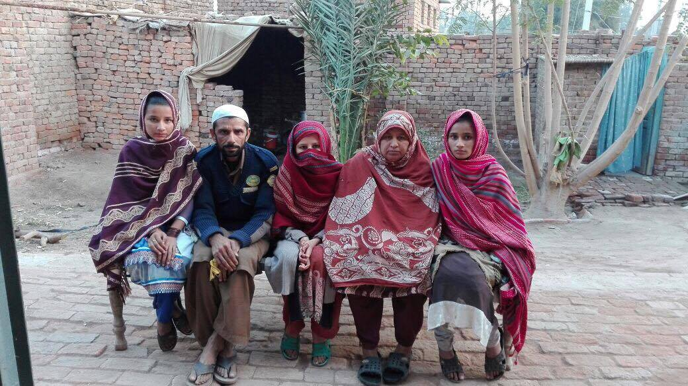

“Throughout my marriage I was a victim of severe sexual and domestic violence and I was unaware of that because I was too young to understand.” --Ramsha (middle)
Notes:
Ramsha was just 14 years when Bedari met her during a self-growth session.
She was married, two years back on 28th September 2015, when she was just 12 years old to her 23 year old husband. Being an innocent child, she was unaware of the many tortures she went through, thinking them as a part of married life. When Ramsha’s father came to know about it, he brought her back home. Unfortunately, after reconciliation, Ramsha went back to Azam’s house.
The torture did not end and due to the severity of her sexual, domestic and psychological abuse , her parents supported her to file for a divorce “Khula” (divorce sought by the wife), Azam did not appear in any of the court’s hearing and the court gave one-sided decision.
Her mother said, “I believe it is our mistake that our daughter is in this condition. She was innocent, but we were sensible. We should have thought about the consequences before marrying her off at an early age. I will not let this happen to my remaining other 2 little daughters.”
She completed the beautician course and attended self-growth workshops to restart her life with new goals and determination. Ramsha is now connected to the Open school at the Allama Iqbal Open University to pursue her education and career. Bedari is providing her with psychological aid she will be one of Bedari’s “Volunteers for change”.

Slide 14
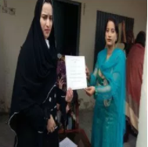
Rukhsana participated in the Municipal Committee General Elections and was elected as a ‘General Lady Councilor Municipal Committee Jatoi. She is the first lady councilor in Tehsil Jatoi.
Notes:
Ramsha was just 14 years when Bedari met her during a self-growth session.
She was married, two years back on 28th September 2015, when she was just 12 years old to her 23 year old husband. Being an innocent child, she was unaware of the many tortures she went through, thinking them as a part of married life. When Ramsha’s father came to know about it, he brought her back home. Unfortunately, after reconciliation, Ramsha went back to Azam’s house.
The torture did not end and due to the severity of her sexual, domestic and psychological abuse , her parents supported her to file for a divorce “Khula” (divorce sought by the wife), Azam did not appear in any of the court’s hearing and the court gave one-sided decision.
Her mother said, “I believe it is our mistake that our daughter is in this condition. She was innocent, but we were sensible. We should have thought about the consequences before marrying her off at an early age. I will not let this happen to my remaining other 2 little daughters.”
She completed the beautician course and attended self-growth workshops to restart her life with new goals and determination. Ramsha is now connected to the Open school at the Allama Iqbal Open University to pursue her education and career. Bedari is providing her with psychological aid she will be one of Bedari’s “Volunteers for change”.

Slide 15
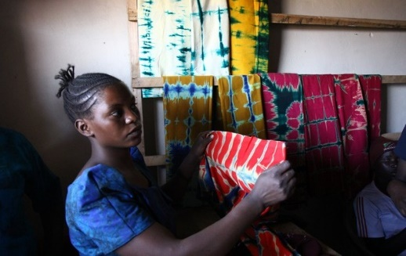

Rhodasia is the chairperson of a self-help group in Mzanzi whose major produce is Maize flour, Batik and Peanut butter.
Notes:
At the age of 17 she dropped out of the school as she failed in the exam and the current system required her to repeat a year. At the age of 18 she was married . She attended GIRLS Inspire training . And today she is the Chairperson of a selfhelpgroup inMzanzi. They could start their business with a loan from SIDO(small industries development organsation)
‘She believes that as a self-help group, they need to diversify their products, increase the sales to cover the entire nearby community. She would also like to train other young girls as she wishes to start a large-scale production house in the future.

Slide 16
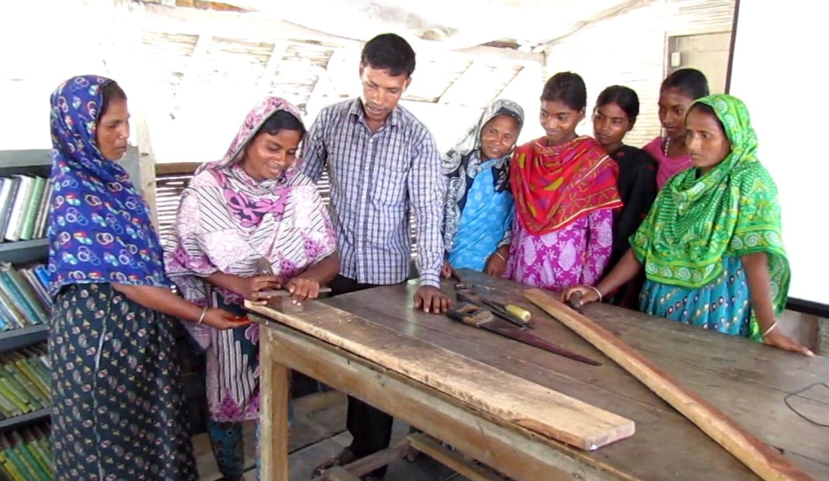
Rupali…
Carpentry training with Shidhulai Swanirvar Sangstha in Bangladesh

Slide 17
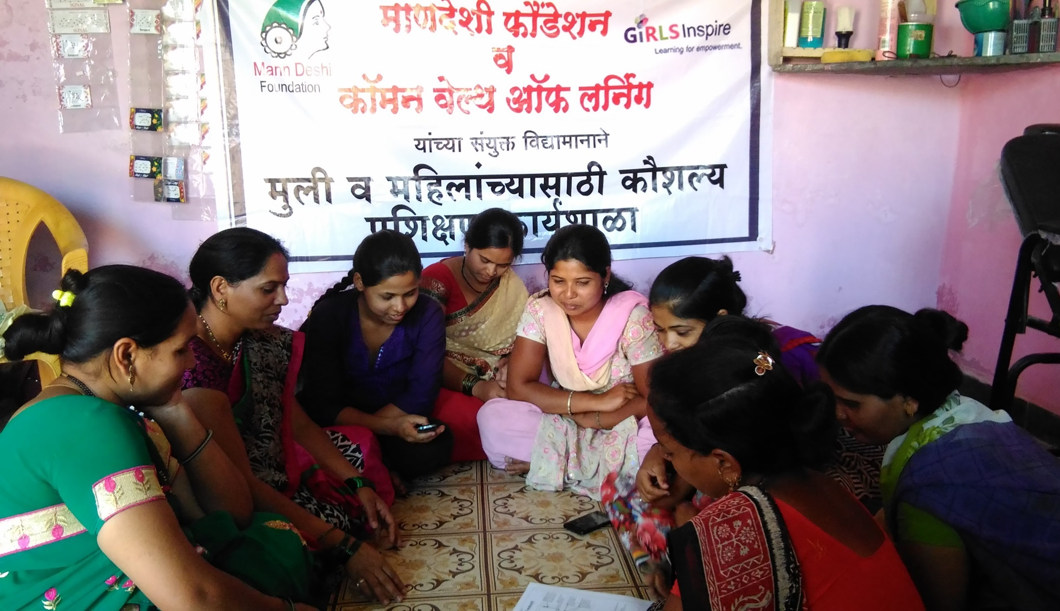
Mobile phone technology training with
Mann Deshi in India

Slide 18
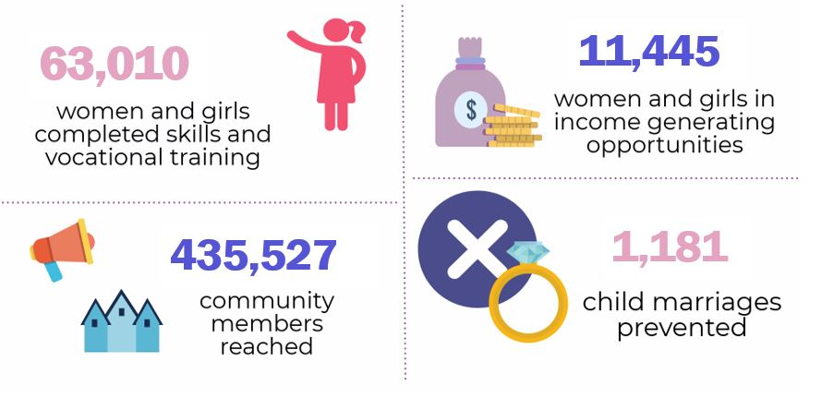
GIRLS Inspire: Results

Slide 19





Education Strategy
Boat Schools in Bangladesh
Pop-Up Learning Centres in Pakistan
Mobile Learning Centres in India and Mozambique
Safe Learning Environments
Vocational Skills Training
Notes:
GIRLS Inspire worked with various stakeholders to improve girls’ and women’s access to quality education in supportive communities.

Slide 20





Capacity Building
Learning about legal and social rights
Acquiring life skills, including health care
Understanding their choices
Instil confidence for making decisions
Gaining the support of fathers, spouses and brothers

Slide 21



Health and Safety Strategy
Access to Health Resources
Accessible, safe, hygienic learning environments
Support Networks for family- and health-related issues

Slide 22





Strategy for Employment
Financial literacy
Career counselling
Job Fairs
Internships and Employment Placement
Microloans

Slide 23
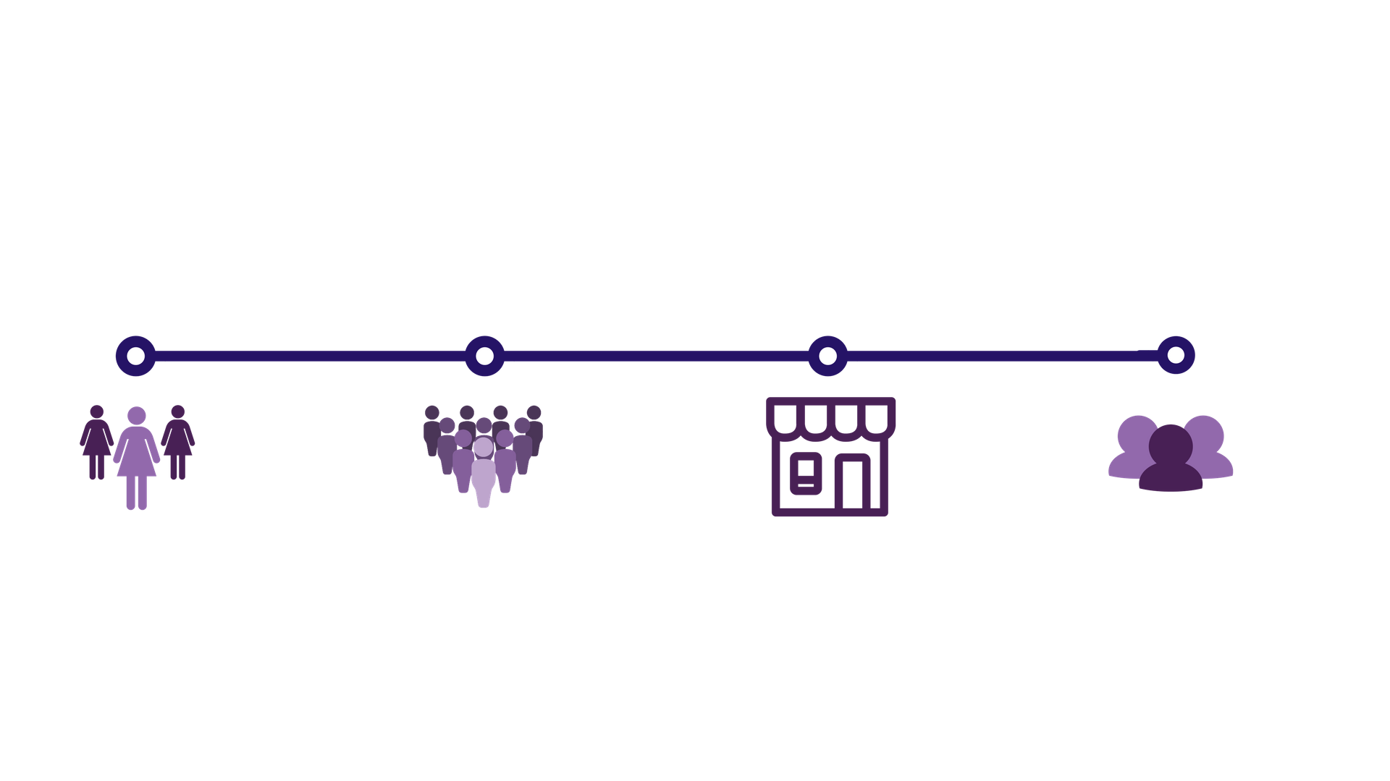
Model
Women & Girls
Communities
Local Employers
In-Country Partners

Slide 24
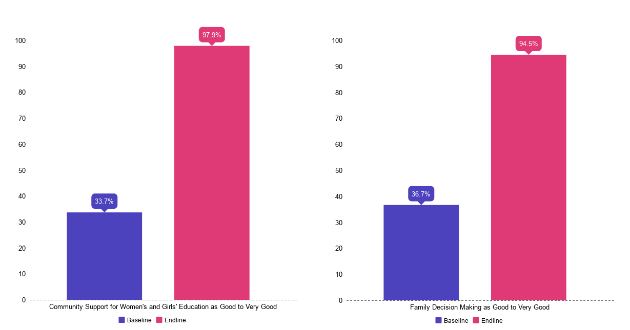
Changing Social Norms
Support for Women’s and Girl’s Education
Perceptions of Decision Making in the Family

Slide 25
Social Return on Investment
Likelihood of being employed increased by 50 %
Average number of hours of paid work per week increased by 11 hours
Fivefold increase in income
10 % increase in the probability of females being decision makers

Slide 26

Lessons Learned
Building trust in the community
Establishing safe learning environments
Establishing multi-stakeholder partnerships
Creating linkages with the labor market and financial institutions

Slide 27

Integrate and Mainstream
Digitize training programs in local languages
Create skill-based value chains
Engage governments to effect policy change

Slide 28
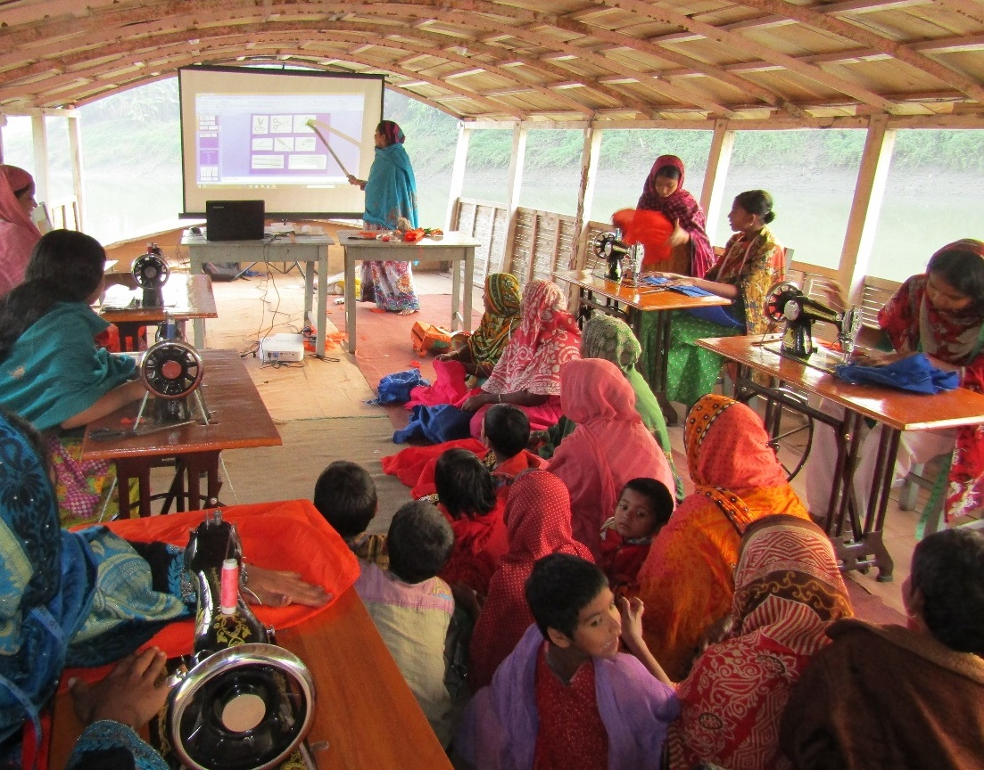
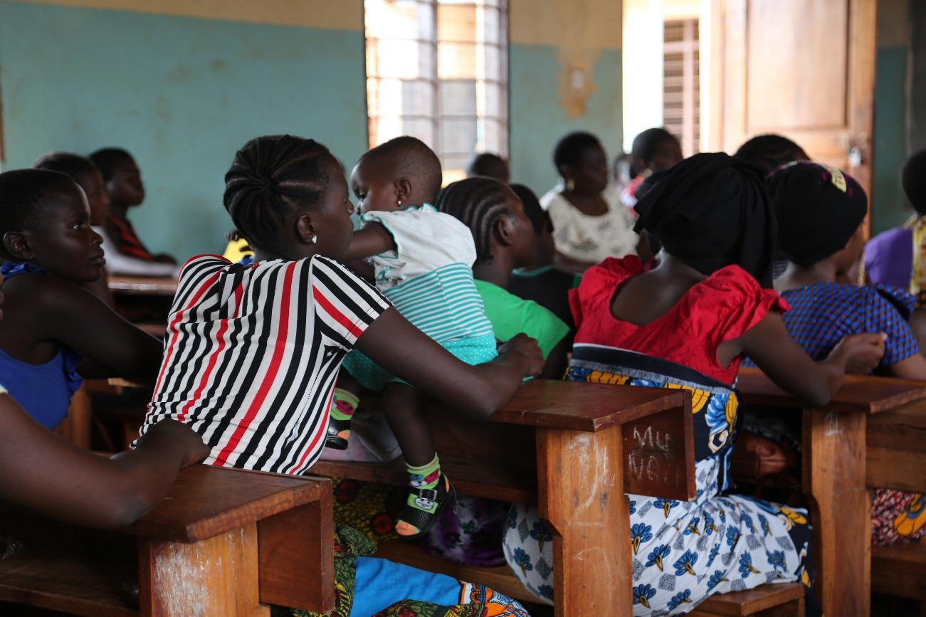
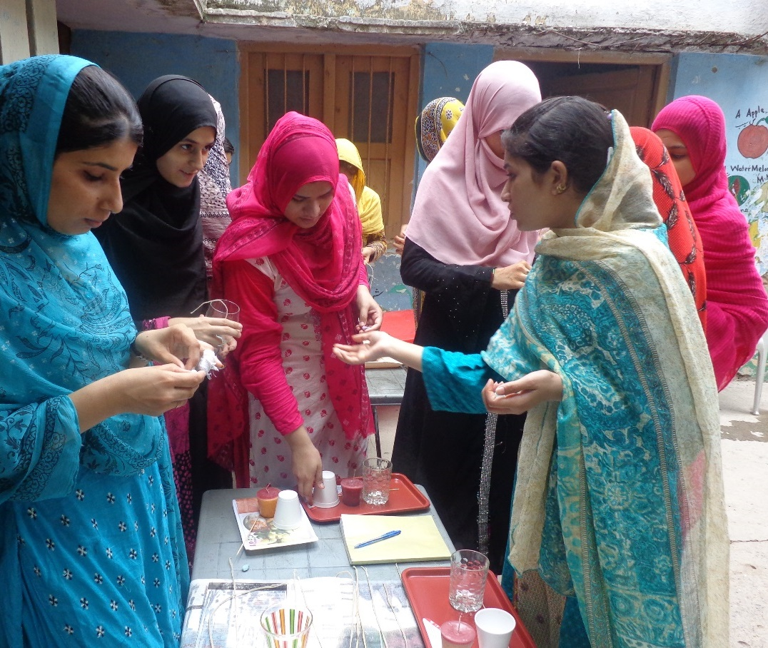
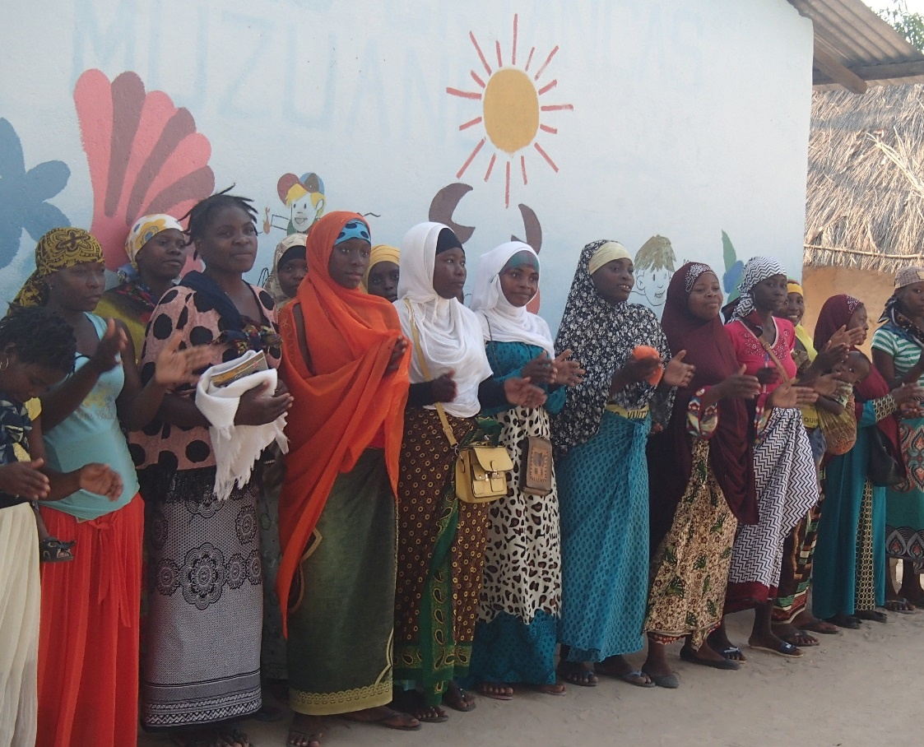

Thank You
www.col.org
This presentation is licensed under Creative Commons BY-SA 4.0 and can be freely downloaded for reuse and adaptation with attribution to COL.
Notes:
We invite you to engage us; tap into our thought leadership, expertise, networks and resources

