Slide 1


Realigning open and distance learning:
The quest for employability in a digitally divided world
International LET-IN 2023 Conference
October 7, 2023
Jako Olivier
Adviser: Higher Education
Commonwealth of Learning, Canada
Notes:
November 11, 2022

Slide 2
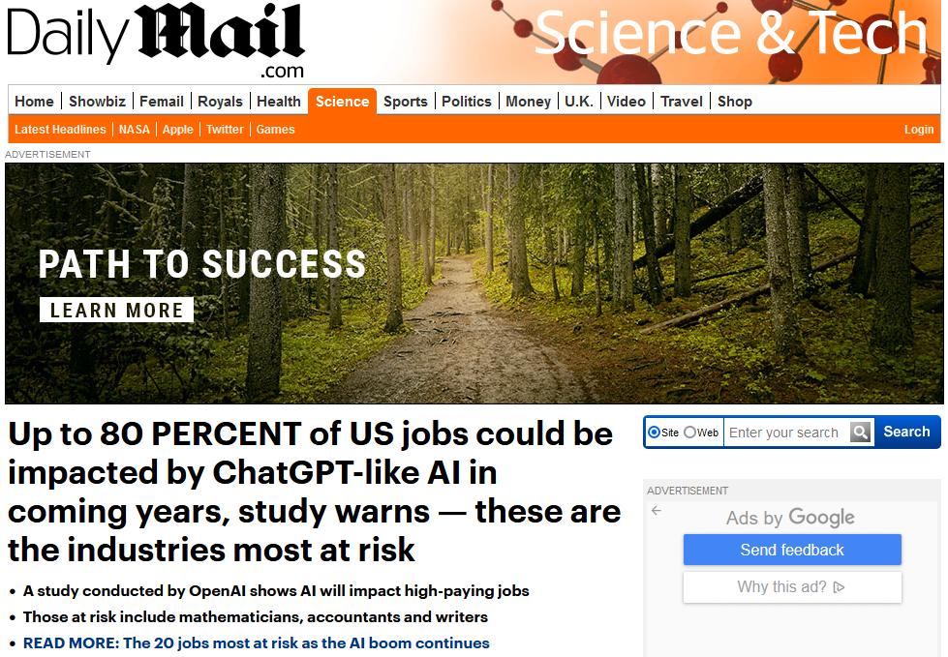
https://www.dailymail.co.uk/sciencetech/article-11907527/Up-80-PERCENT-jobs-impacted-ChatGPT-like-AI-coming-years-study-warns.html

Slide 3
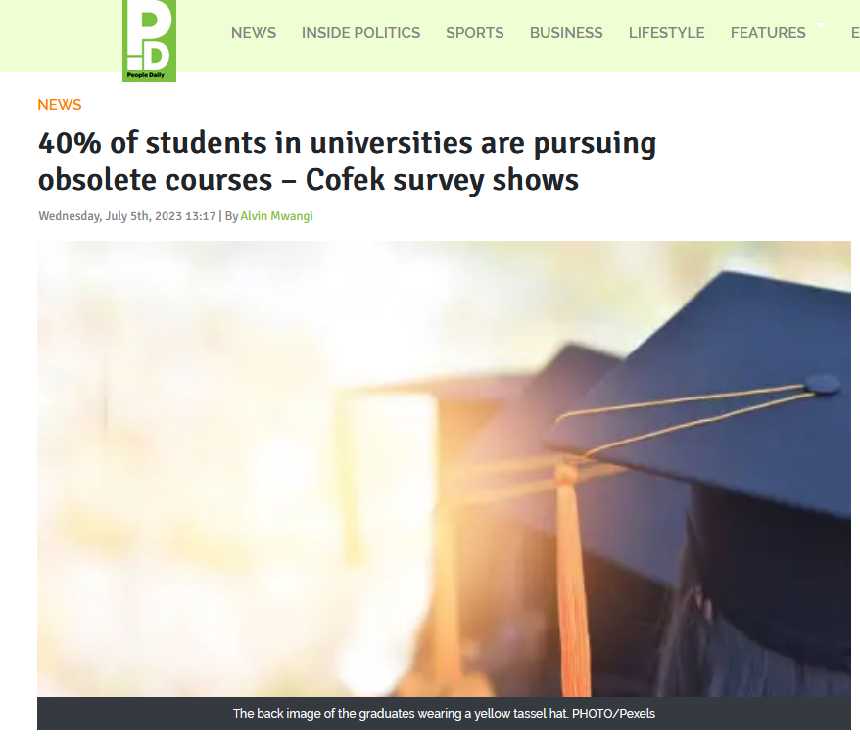
https://www.pd.co.ke/news/40-of-students-in-universities-are-pursuing-obsolete-courses-189248/

Slide 4


https://www.dailymail.co.uk/femail/article-5680597/University-degrees-obsolete-decade-changes-arent-made.html

Slide 5
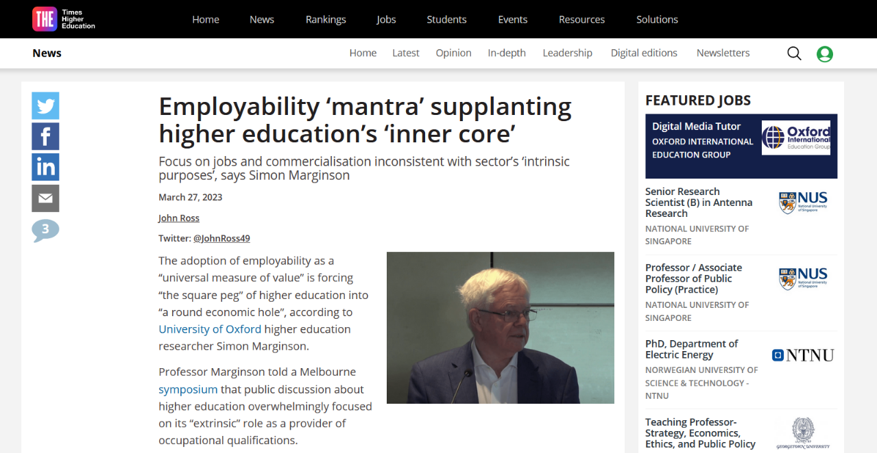
https://www.timeshighereducation.com/news/employability-mantra-supplanting-higher-educations-inner-core

Slide 6

Graduate unemployment
Great losses during COVID-19 for those aged between 15 and 24
Rise in youth unemployment by around 4 million in 2020 is only part of the issue
Graduates are underprepared
Longer-term transformative policies and approaches needed
https://www.ilo.org/global/publications/books/WCMS_853321/lang--en/index.htm

Slide 7
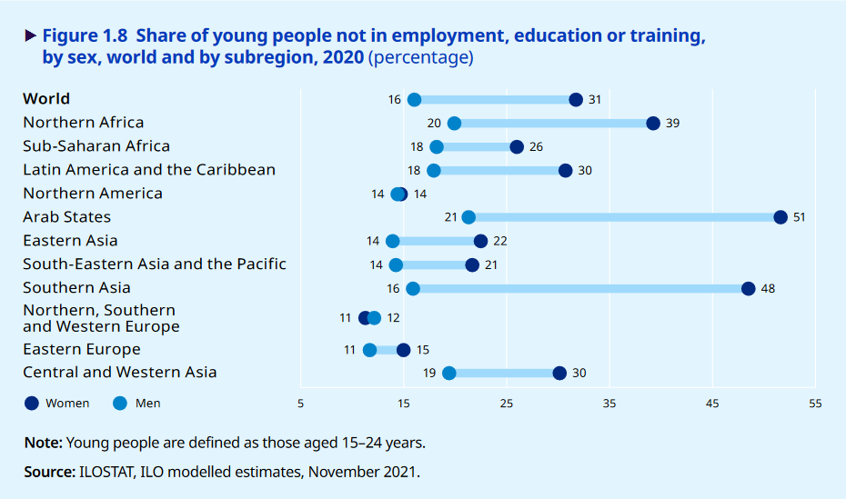
Graduate unemployment
https://www.ilo.org/global/publications/books/WCMS_853321/lang--en/index.htm

Slide 8

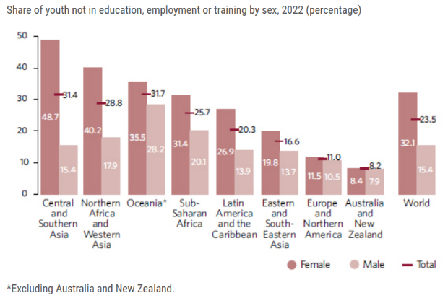
Graduate unemployment
https://unstats.un.org/sdgs/report/2023/Goal-08/

Slide 9
What does supporting employability in digitally divided world look like for open and distance learning?
Requirements of the labour market
Student attendance
Artificial intelligence
Convenience
Cost and value for money

Slide 10
Open and distance learning (ODL)
Open
Open as to people,
Open
Open as to places,
Open
Open as to methods, and, finally,
Open
Open as to ideas
Lord Crowther, first Chancellor of The Open University

Slide 11

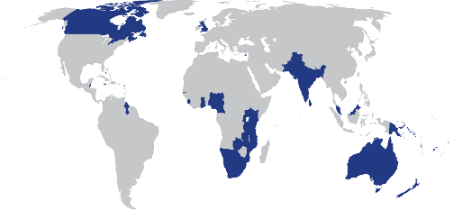
The Commonwealth of Learning (COL) was established in 1987 by Commonwealth Heads of Government “… to create and widen access to opportunities for learning, making use of the potential offered by distance education and by the application of communication technologies to education.”

Slide 12


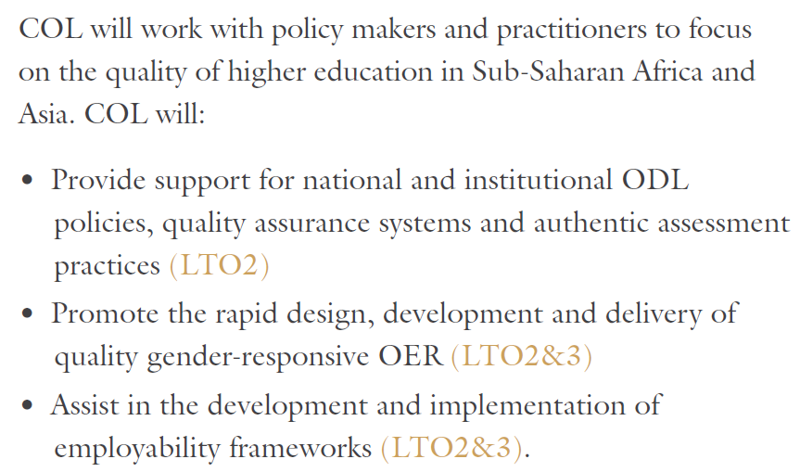

Slide 13

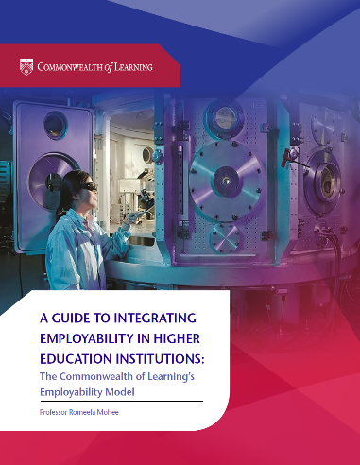

http://hdl.handle.net/11599/3123
http://hdl.handle.net/11599/3251
http://hdl.handle.net/11599/3599

Slide 14
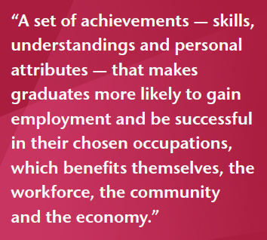
Employability
Why is this needed?
  Universities can show the value of higher education
  Be responsive to the needs of the job market
  Foster students who are adaptable and ready for a changing world of work
What about ODL?
Localised solutions
Mantz Yorke in Mohee (2019)

Slide 15
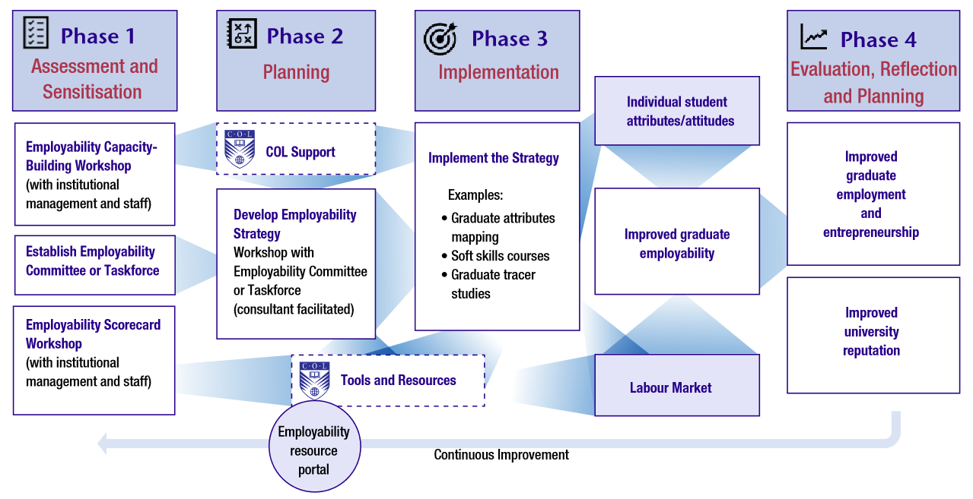
Employability model

Slide 16
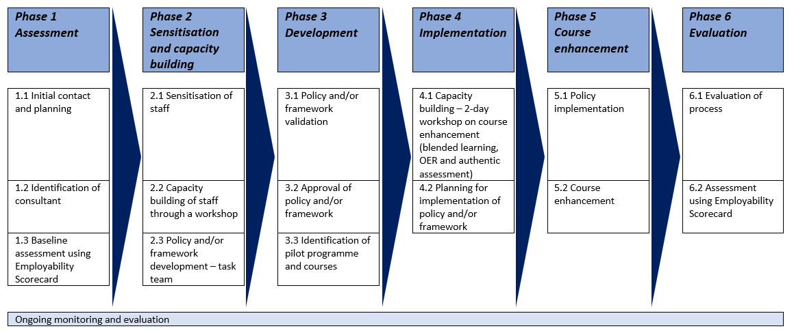
Revised employability support process

Slide 17
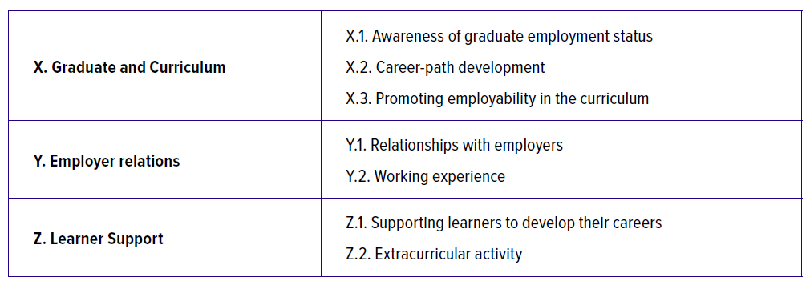
Employability scorecard categories
http://hdl.handle.net/11599/3251

Slide 18
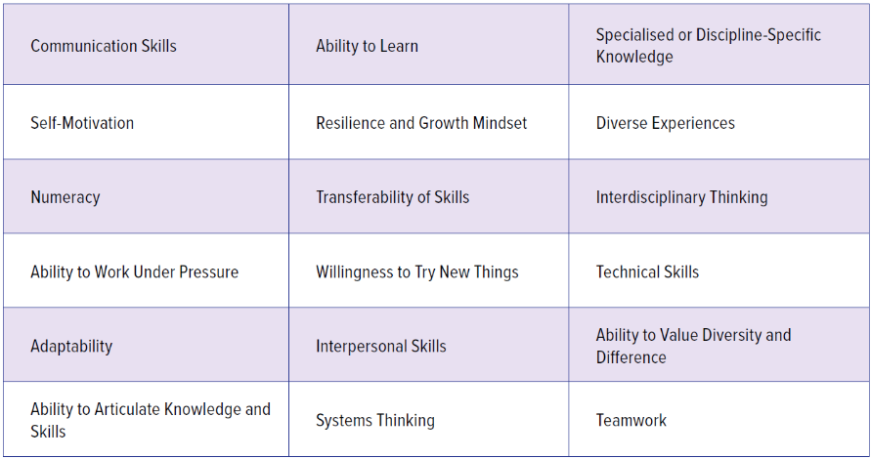
Employability attributes
http://hdl.handle.net/11599/3251

Slide 19
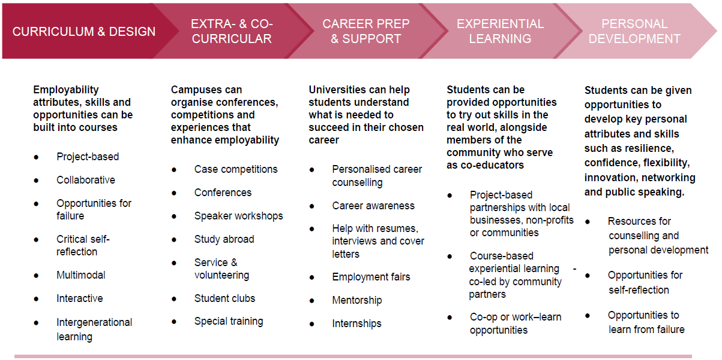
Developing employability skills
http://hdl.handle.net/11599/3251

Slide 20

Commonwealth countries
Sierra Leone
Nigeria
Cameroon
Rwanda
Kenya
Zambia
Malawi
Namibia
Mauritius
Eswatini
Lesotho

Slide 21
Methodology
Inductive qualitative content analysis of concept notes, workshop feedback and consultant and institutional reports.
Sample: All 11 higher educational institutions supported by COL in terms of employability
Over 20 workshops and institution-based interventions

Slide 22
Some workshop attendee feedback

Slide 23
Issues identified by institutions
Inadequate or no buy-in from management and some lecturers
Limited time and funds for course enhancement support for lecturers
Lecturer subject and employability knowledge
Bureaucracy around policy approval
Employability skills are sometimes limited to a subject or to the mandate of a single department
Digital literacy and ODL skills of lecturers
Technical challenges

Slide 24
Recommendations
Localised institutional solutions for local graduate employability challenges
Staff should be capacitated in appropriate digital literacy and ODL skills
Assessments should be more authentic and should also relate to what could be expected in the workplace
Holistic institution-wide approach rather than a separate add-on subject needed
Graduate employability skills should be a matter of both policy and practice

Slide 25
Conclusion
As the world is changing in terms of jobs and the role of AI, so should universities prepare students to be flexible and resilient
Universities need to be supported in order to have sufficient policies and implementation frameworks in place
Staff development in terms of employability and especially supporting skills, such as digital skills, are essential
Any such interventions should build and be embedded in existing work experience/experiential/work-integrate learning activities

Slide 26

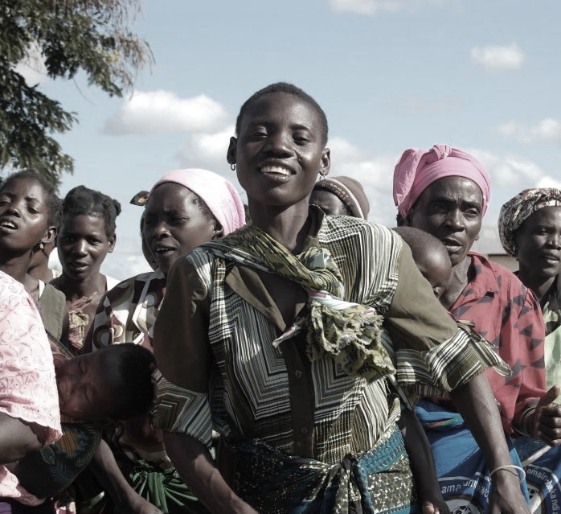
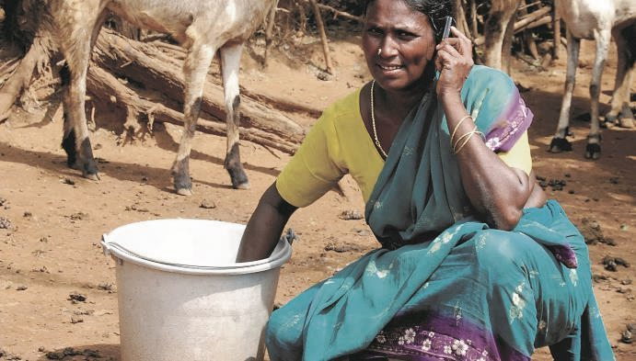
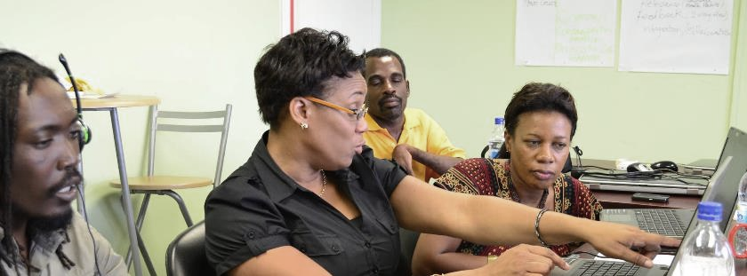


Thank you
www.col.org
The contents of this presentation, with the exception of logos and graphics which are the property of the respective owners, is made available under Attribution-ShareAlike 4.0 International (CC BY-SA 4.0).

