Slide 1
7th Africa Agricultural Science Week (7AASW)
FARA
Mainstreaming IAR4D and IP as a Lever for the Transformation of Smallholder farmers to Business Farmers in Africa: Institutional and Financial Strategy
Smallholders’ Transformation to Business Enterprise in Africa:
A Reality or a Mental Illusion?
14th June 2016
Presented by
K.Balasubramanian
Commonwealth of Learning

Slide 2
Based on a study
by
Carr,Alexis M., Tenzin Yindok**, Rosemary Atieno*, James Onyango and K. Balasubramanian
in Lifelong Learning for Farmers (L3F) Programme facilitated by Kenya Aids Intervention and Prevention Project (KAIPPG); Makerere University, Uganda; Siaya Seed Savings and Credit Cooperative Society, Kenya; Ugunja Community Resource Centre, Kenya; Matumaini Mapya, Tanzania and Ghana Agricultural Workers Union (GAWU).
* University of Nairobi. ** Consultant. Others are from COL

Slide 3
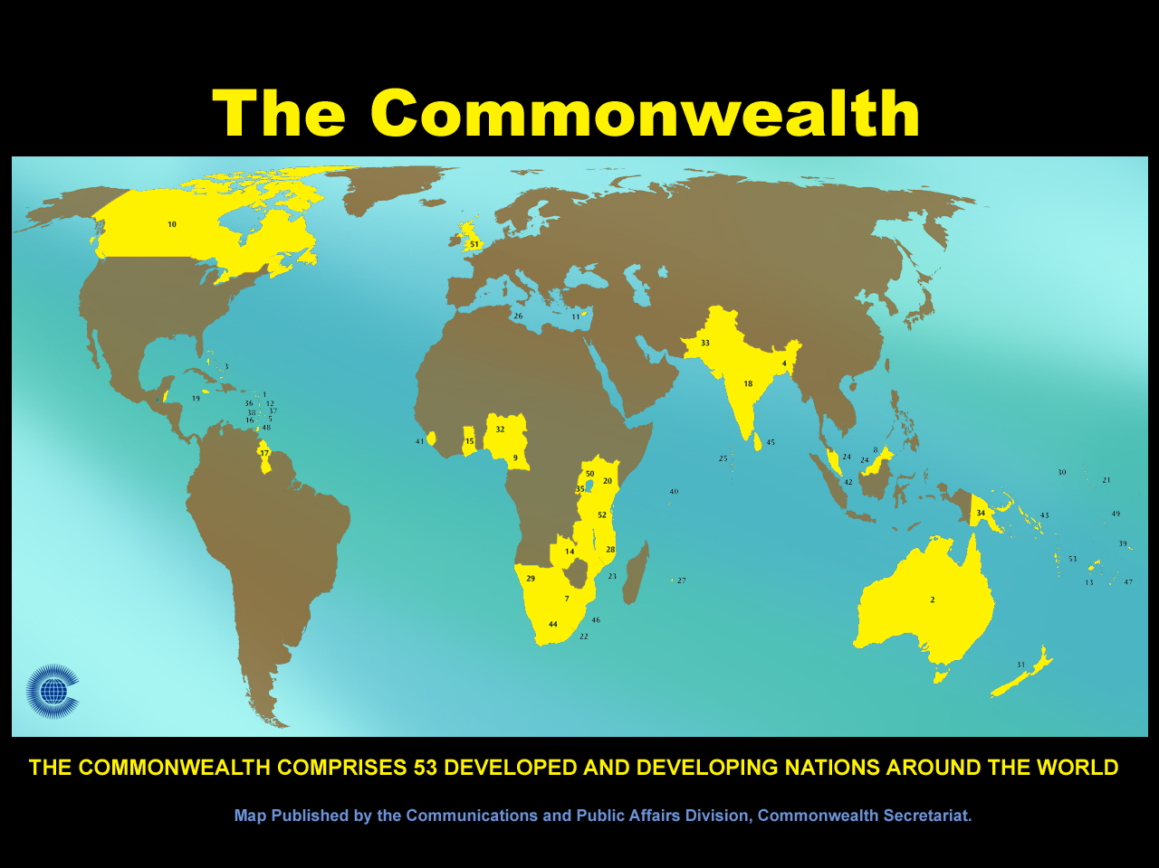

Slide 4
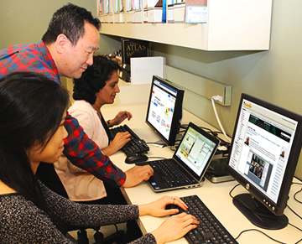
COL: An Intergovernmental Organization
To help Commonwealth governments and institutions use various technologies to improve access to learning leading to sustainable development.

Slide 5
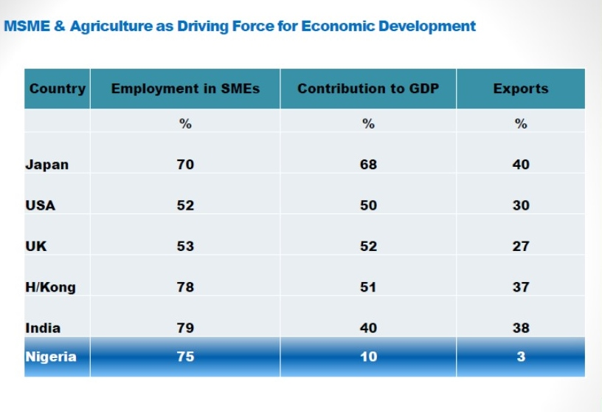
Business Enterprises among Smallholders
Africa has a long history
But now……..
Eluhaiwe, Paul N. (2013). Access to finance: Challenges of Lending to MSMEs &
Agricultural Enterprises. Presentation made in the Niger Delta Development Forum.
Retrieved on 1, June 2016 from
http://www.nddforum.org/images/files/Background-Paper-1-on-Access-to-Finance-Challenges-of-Lending-to-MSMEs-Agricultural-Enterprises-by-Paul-Eluhaiwe-CBN.pdf

Slide 6
Who is an entrepreneur?
a person who combines the factors of production such as land, labour, capital and organisation for producing and marketing goods and services to maximise profit.

Slide 7
Who is a smallholder?
A subsistence farmer focusing on loss-minimisation strategies rather than on profit-maximization
Hence transition to profit maximization requires substantial support system

Slide 8
Support System for the Transition
Capital mobilization
Capacity Building
Infrastructure Support
Value-Chain Linkages

Slide 9
Are they enough???

Slide 10
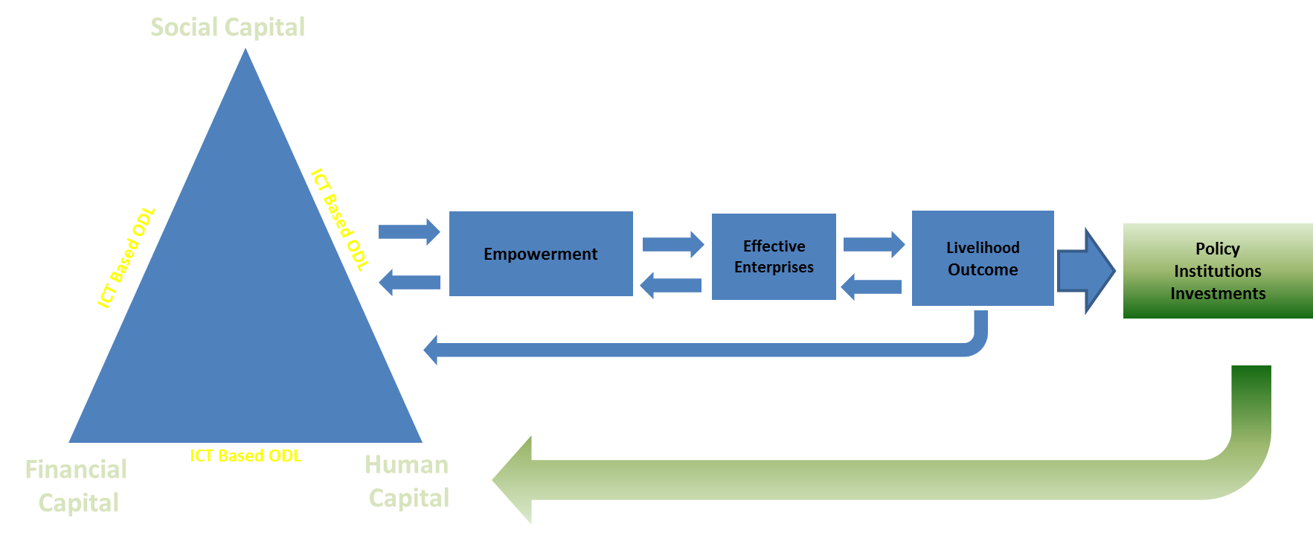
COL’s
Lifelong Learning for Farmers ( L3F)

Slide 11
L3F: Win-Win Situation
for Secondary Stakeholders
Financial Institutions | Lower NPA-Enhanced credit umbrella
Marketing Institutions | Scale advantage-Lesser transaction cost
ICT Institutions | Larger Usage of ICT-enhances business
Universities and research institutions | Strengthens the third role-translate research into field reality
Knowledge Infomediaries | Less dependent on external support- self-sustainability-Towards social enterprise

Slide 12
L3F and Financial Institutions
COL proposed the following hypothesis to the Financial Institutions:
If rural agricultural credit is blended with appropriate capacity building the performance of rural credit would be much better vis-à-vis productivity, returns and non-performing assets (NPA) levels.
Capacity building would also enlarge the market for bank credit among small and marginal farmers and among other marginalized section of the rural poor.
The modern ICT though structures such as rural internet kiosks, rural telecentres, mobile phones, community radios etc can facilitate the capacity building process in a spatial-temporal context which are financially viable, economically feasible and socially acceptable.

Slide 13
L3F Approach :
Come together, learn, then borrow, run profitable enterprise, repay, & expand
Federation or SACCO
Group 1
Group 2
Group n
Table Banking
Group Based Learning from experts using ICT
Member to Member Learning
Group based & Individual based Agri-enterprises
F
I
N
A
N
C
E
L
E
R
N
I
N
G
From
Commercial Banks
From
Expert System
From Micro to Macro

Slide 14
Empowerment as an Outcome
Empowerment-“the expansion in people’s ability to make strategic life choices” in terms of three interrelated dimensions—resources, agency and achievements. (Naila Kabeer, 1999)
Kabeer, N. (1999). Resources, agency, achievement: Reflections on the measurement of women's empowerment.
Development and Change, 30(3), 435-464.

Slide 15
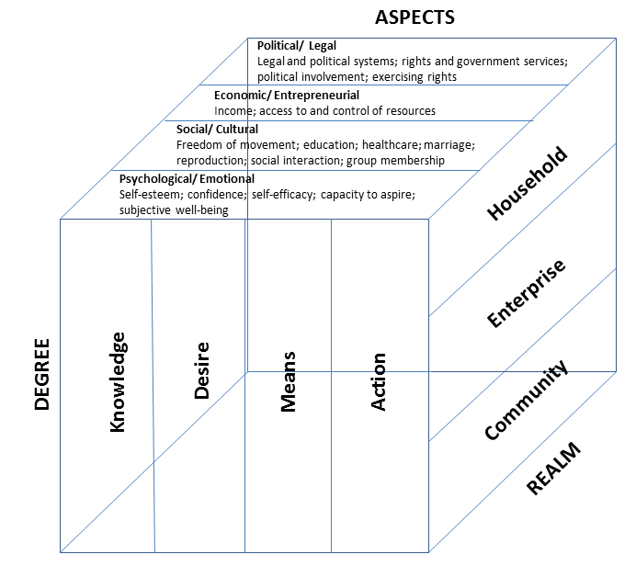
COL’s 3 Dimensional Model of Empowerment
Index: 0 to 1
0: Disempowered
1: Fully Empowered

Slide 16
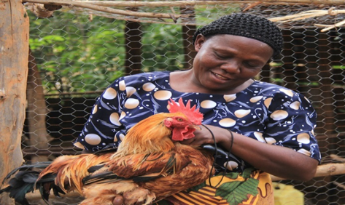
The Study: Among the Backyard Poultry Enterprises in Western Kenya
Sample | Capitals
L3F Group | Social + Financial + Human Capital
In SACCOs But Not in L3F | Social + Financial but no structured Human capital
Neither in SACCOs Nor in L3F | Partly Financial- No structured social-No structured Human Capital
Within the same socio-economic and agro-ecological background

Slide 17
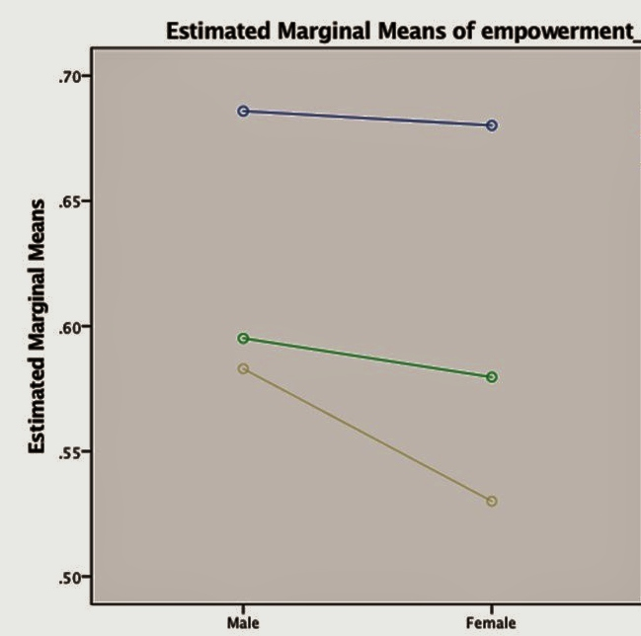
Male
Members with L3F
Female
Male
Male
Female
Members without L3F
Female
Neither in L3F nor in SACCO
Multiple Regression Analysis shows the determining role of L3F in empowerment

Slide 18
Profit of the Enterprises

Slide 19
Profit Efficiency by Groups
Predicted profit efficiency | Log profit approach
Average | 65.8%
Average - L3F farmers | 67.0%
Average – In SACCO but not in L3F | 64.7%
Average – non-L3F/SHG | 64.0%
Statistically Significant differences

Slide 21
COL’s
Lifelong Learning for Farmers ( L3F)

Slide 22
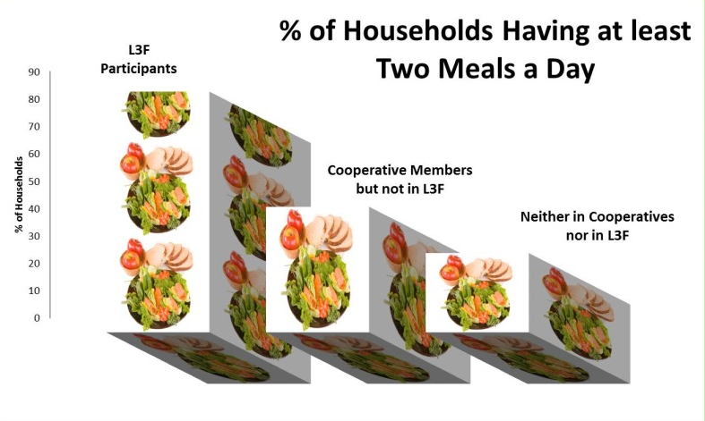
Outcomes & Impacts in Last Six Years
In India
Every $1 invested in learning, facilitation and networking resulted in $9 worth of income and assets
100% Prompt Repayments to Financial Institutions which earned 8 times more income from L3F farmers for the same product compared to non L3F farmers in the same region
Cost of Training and Capacity Building: Six time Lesser than that of the agricultural extension and bank trainings
Banks & Mobile companies beginning to invest in L3F
Improved Food Security in Kenya & Uganda

Slide 23
From Mental Illusion to Reality
The Problem
Holistic Perspectives of Communities
Vs
The sectoral approaches (in spite of systems framework) of knowledge and development agencies
The Solution
Holistic Perspectives of Communities
+
Holistic Approach in Development

Slide 24
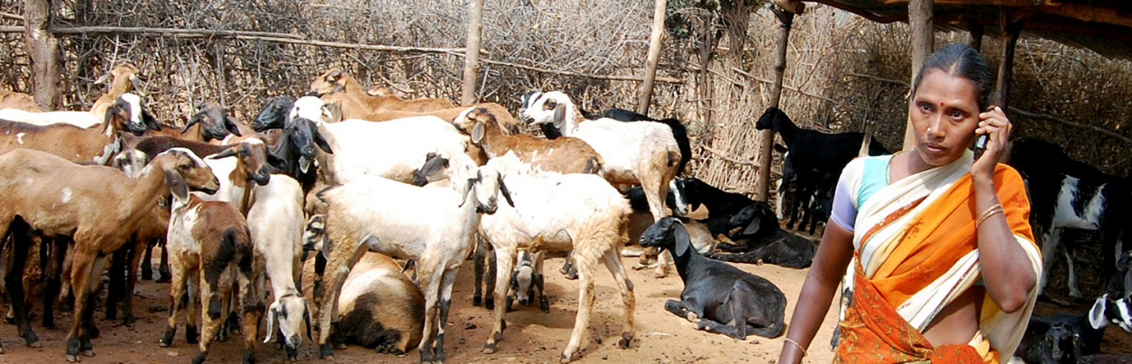
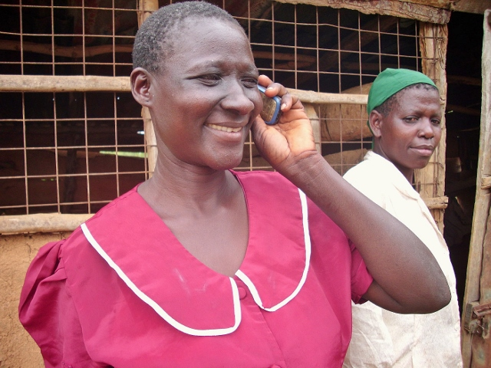
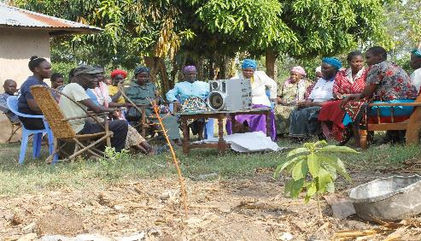
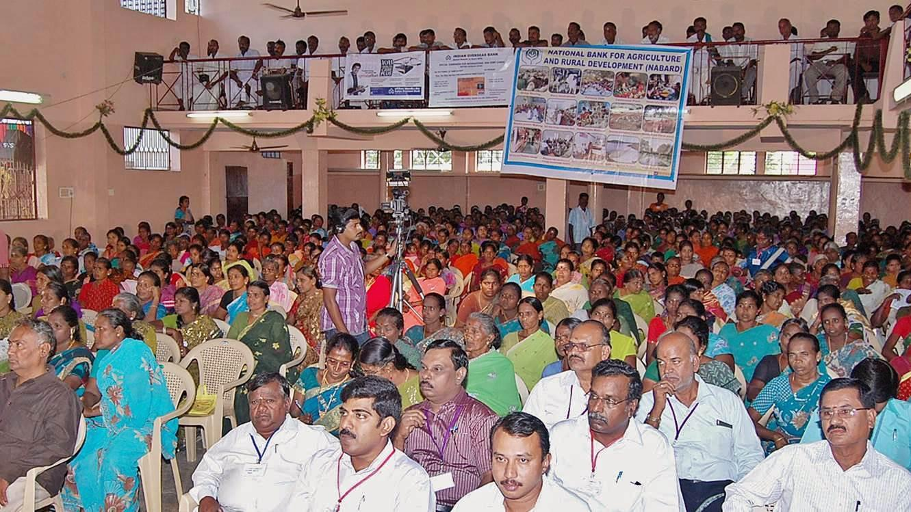
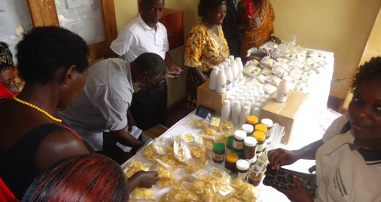
Indian farmer learning through mobile phone
Kenyan farmer learning through mobile phone
Group based learning in Kenya
L3F farmers together to negotiate with banks-India
L3F enterprise in Uganda

Slide 25
THANK YOU

