Slide 1


All Things Research
in Open Distance and eLearning
Professor Asha Kanwar, COL President & CEO
Dr Sanjaya Mishra, Director: Education
UNISA ODeL e-Conference, South Africa
August 2022

Slide 2
THIS PRESENTATION
Understanding Open, Distance and eLearning
Status of ODeL research
What research tells us
Way Forward
All Things Research
in Open Distance and eLearning

Slide 3
Understanding Open, Distance and eLearning

Slide 4
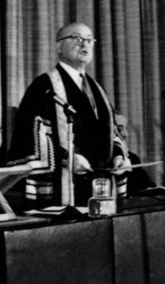

Philosophy of ‘Open-ness’
Open as to people,
Open as to places,
Open as to methods, and, finally,
Open as to ideas
Lord Geoffrey Crowther
First Chancellor to The Open University, UK

Slide 5
‘Open-ness’ in Practice
Open admission (no entry qualifications)
Multiple open channels (radio, TV, etc.)
Open curriculum
Open access (Anytime, anywhere)
Open participation
Open accreditation
(Wedemeyer, 1973)

Slide 6
Distance Education
separation of teacher and learner
educational institution plan, designs and delivers learning resources and opportunities
media used for delivery of learning content
two-way communication between student and teacher, and student and students
Limited in person interaction
Source: Keegan, 1996.

Slide 7
Open and Distance Learning
Synchronous learning not the only option (Anytime, anywhere)
Duration of learning hours insignificant (outcomes-oriented curriculum)
Options for work-integrated learning (internships)
experiential learning (Recognition of Prior Learning)
Notes:
Flexibility for what? – empowering of students, global citizens, leaving no one behind
Work integrated learning

Slide 8
Generations of Distance Education: J Taylor
Models of Distance Education | Flexibility
 | Time | Place | Pace
Gen 1: Correspondence model (print) | Yes | Yes | Yes
Gen 2: Multimedia model (print, audio, video, computer-based) | Yes | Yes | Yes
Gen 3: Tele-learning model (broadcast TV/Radio, interactive TV/ Videoconferencing) | No | No | No
Gen 4: Flexible learning model (Interactive multimedia online, Internet-based courses, computer mediated communications) | Yes | Yes | Yes
Gen 5: Intelligent flexible learning model (Gen 4 plus, automated response system, automated portal access) | Yes | Yes | Yes
Source: Taylor, J. (1998). Flexible Delivery: The Globalisation of Lifelong Learning. Indian Journal of Open Learning, 7(1), 55-66.
Notes:
Way back in 1990s, Jim Taylor talked about flexible learning model and intelligent flexible learning. Distance education provided flexibility in terms of time, place and pace. But as synchronous delivery mechanism such as broadcast came into picture flexibility was lost. The Internet provides us the opportunity to deliver better interactive asynchronous learning that is flexible. New developments in AI and bid data helps us create the Gen 5 learning environment providing personalized learning.

Slide 9

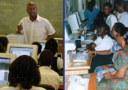
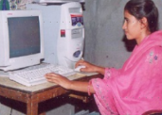
Blended Learning
Face-to-Face Courses
Blended Courses
Distance/Online Courses
ICT integration in teaching and learning
MOOC
Mobile learning
Open and Distance Learning
Notes:
Blended and hybrid modes will provide opportunities for learning to those who cannot access purely online provision. ODL has always adopted a blended approach keeping in mind issues of social justice.

Slide 10
Status of ODeL
Research

Slide 11


Status of Research in ODL
Massive volume of amateur, unsystematic and badly designed research producing information of very little value
M. G. Moore
Moore, M. G. (1985). Some observations on current research in distance education. Epistolodidaktika, 1, 35-62.

Slide 12
Status of Research in ODL
“Lack of Theoretical Underpinning”
An examination of existing research shows that it is often atheoretical and predominantly descriptive
Saba, F. (2000). Research in distance education: A status report. International Review of Research in Open and Distance Learning, 1(1).
Perraton, H. (2000). Rethinking the research agenda. International Review of Research in Open and Distance Learning, 1(1).
http://www.irrodl.org/index.php/irrodl/article/view/5/338

Slide 13
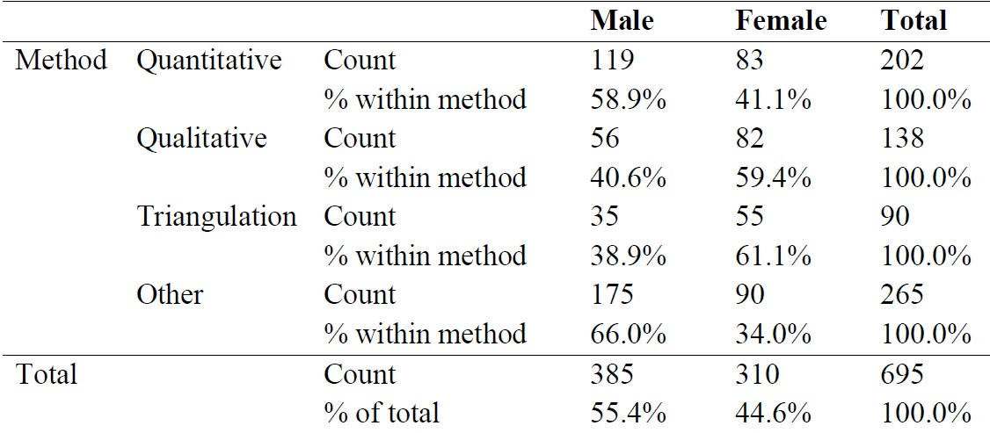
Gender & Research in ODL
(based on analysis of 675 articles in 5 Journals fro m UK, USA, Canada and Australia)
“Confirms the stereotypical view that female researchers
are more likely to use qualitative methods”.
Olaf Zawacki-Richter, Eva Maria Bäcker, and Se bstian Vogt (2009, Review of Distance Education Research (2000 to 2008): Analysis of Research Areas, Methods, and Authorship Patterns in International Review of Research in Open and Distance Learning Volume 10, Number 6.

Slide 14
Distance Education: 35 years
1980–1984
professionalization and institutional consolidation
1985–1989
instructional design and educational technology
1990–1994
quality assurance
1995–1999
student support and early stages of online learning
2000–2004
emergence of virtual universities
2005–2009
collaborative learning and online interaction
2010–2014
MOOCs and OER
Zawacki-Richter, O., & Naidu, S. (2016) Mapping research trends from 35 years of publications in Distance Education, Distance Education, 37:3, 245-269, DOI: 10.1080/01587919.2016.1185079
Notes:
Covered papers published from 1980-2014

Slide 15
Research Trends during Covid-19
68% post-secondary focus, only 10% K-12
Subject category focus: social science (64%), medicine and health science (32%), computer science (31%).
Over one-third of papers descriptive; 43% adopted quantitative approach
Mishra, S., Sahoo, S., & Pandey, S. (2021). Research trends in online distance learning during the COVID-19 pandemic. Distance Education, 42(4), 494-519.
Notes:
Of the 330 peer reviewed papers analysed…
Research carried out in 88 countries
Technologies for teaching and learning:
Psychosocial issues in teaching and learning:
Impact on Learners:

Slide 16
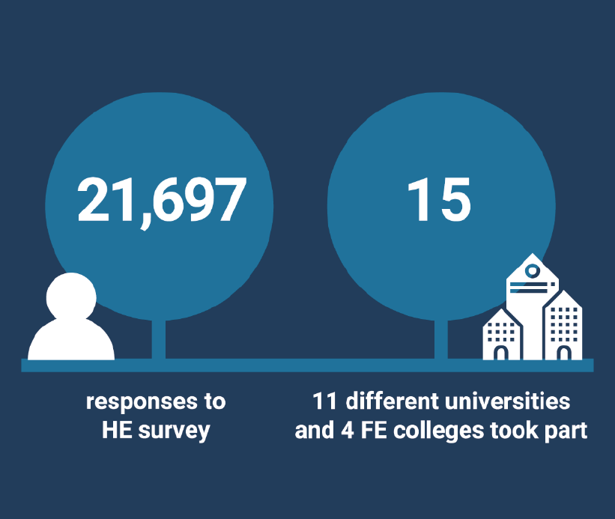
Silver Lining
81% of students were learning online
68% of students rated the quality of online digital learning as ‘best imaginable’, ‘excellent’ or ‘good’
62% also rated the support they received for online learning equally highly.
Source: JISC (2021). Student digital experience insights survey 2020/21https://repository.jisc.ac.uk/8338/1/DEI%20P1%202021%20student%20data%20for%20HE-FINAL.pdf
Notes:
UK study shows positive rating for online learning.

Slide 17
UBC’s pivot to ERT
Faculty and Student response on satisfactory transition to ERT
 | Disagree | Neutral | Agree
Faculty | 1.9 | 9.4 | 88.7
Students | 10.8 | 8.4 | 82.0
Faculty and Student response on “lower quality of learning experience”
 | App Sc/ Science |  | Arts
 | Faculty | Students | Faculty | Students
Disagree | 17 | 20 | 09 | 19
Neutral | 22 | 21 | 23 | 19
Agree | 44 | 59 | 69 | 62
Notes:
Average 60% students agree that the experience was not at par with face-to-face learning.

Slide 18
Key Research
Trends
(2014-2019)
Issues related to open education
Design, support, and quality assurance of online DE
Implementation and use of educational technology, media, and digital tools
Bozkurt, A., & Zawacki-Richter, O. (2021). Trends and Patterns in Distance Education (2014–2019): A Synthesis of Scholarly Publications and a Visualization of the Intellectual Landscape. The International Review of Research in Open and Distributed Learning, 22(2), 19-45. http://www.irrodl.org/index.php/irrodl/article/view/5381/5517

Slide 19
What ODeL research
tell us

Slide 20


Increased Access and Equity
India: 4.2 million (11.1%) enrolment in distance higher education in 2020: 44.5% female
South Africa: 34.5% students study through distance education in 2019: 68.5% female

Slide 21
Cost Per Unit Effectiveness
Training modes | Cost per completing participant | Total effectiveness points per completing participant (total 300 points) | Cost per unit Effectiveness
Face-to Face | US$1,614 | 244 | US$6.7
Online | US$ 901 | 242 | US$3.7
Source: Jung, I. (2005). Cost‐effectiveness of online teacher training. Open Learning: The Journal of Open, Distance and e-Learning, 20(2), 131-146..

Slide 22

Using OER for Improving Learning Outcomes
Students saved between 75 to 88 ECD per semester
OER improved student performance by 5.5%
Source: http://oasis.col.org/handle/11599/2750

Slide 23
Effective Learning: 3 interactions
Student
Student
Student
Content
Student
Teacher
Source: Bernard, R. M., Abrami, P. C., Borokhovski, E., Wade, C. A., Tamim, R. M., Surkes, M. A., & Bethel, E. C. (2009). A meta-analysis of three types of interaction treatments in distance education. Review of Educational research, 79(3), 1243-1289.
Notes:
Meta-analysis by Bernard et al.(2009) shows
while building all three types of interaction improves learning, Student-Student, and Student-Content interaction were more effective than Student-Teacher interaction in online learning.
A strong association is found between achievement for asynchronous courses compared to courses containing mediated synchronous or face-to-face interaction.

Slide 24
Technology and Learning: meta-analysis
In-Class Technology Integration: estimated 11.5% improvement in knowledge/skills
Online Learning: “as good as” studying in-class; 2.4% improvement in learning outcomes.
Blended Learning: 10.7% average improvement in learning outcomes compared to face-to-face instruction.
Source: Technology Application in Teaching and Learning: Second-Order Review of Meta-analyses. (In press)
Notes:
“The meta-analysis found that, on average, students in online learning conditions performed modestly better than those receiving face-to-face instruction. The advantage over face-to-face classes was significant in those studies contrasting blended learning with traditional face-to-face instruction but not in those studies contrasting purely
online with face-to-face conditions.”

Slide 25







Research on Emissions and ODL
3x less carbon emissions
Travel – greatest contributor
Mode of delivery - determinant
Source: Carr et.al. Delivery Mode and Learner Emissions: Comparative Study from Botswana. W. Leal Filho and S. L. Hemstock (eds.), Climate Change and the Role of Education, Springer Nature. In Production.

Slide 26
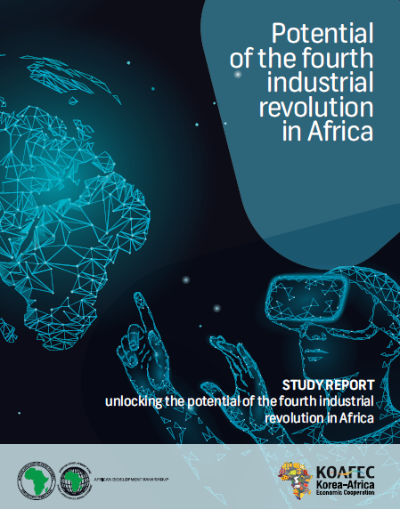
Taking ODeL Research to the next level
Technologies | Implications
Artificial intelligence | Big data supported learning analytics to customize and improve student learning
Blockchain | Tamper proof certification of skills for mobility
AR/VR | Master skills using technology before actually applying in real life.
Robotics | As teaching assistants to scale training
Notes:
This has three implications for teaching and learning as the future of jobs are more or less dependent on these technologies: (i) everyone in the workforce needs to be trained to use some of these technologies; (ii) prepare teachers who can teach with the technologies of 4th IR, and (iii) prepare technologists who can support these.

Slide 27
Missing links

Slide 28
Missing links
Social role of distance education
Inadequate training
Channels for disseminating research

Slide 29


OUUK: Mission Statement
We promote educational opportunity and social justice by providing high quality university education…. Through academic research, pedagogic innovation and collaborative partnership we seek to be a world leader in the design, content and delivery of supported open learning

Slide 30

Inadequate capacity

Slide 31
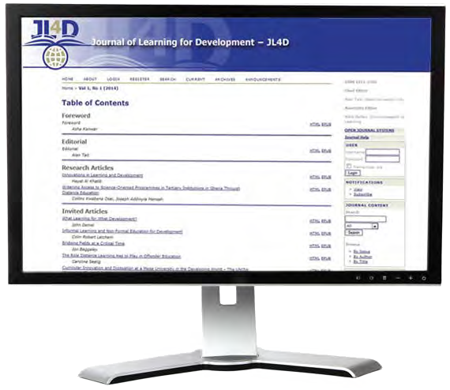

COL’s Journal of Learning for Development

Slide 32

Research on ODeL the missing link

Slide 33
Way forward

Slide 34
What drives research and innovation in industry?
http://www.arcusgroup.ca/CEO_view_strategic_planning.html

Slide 35
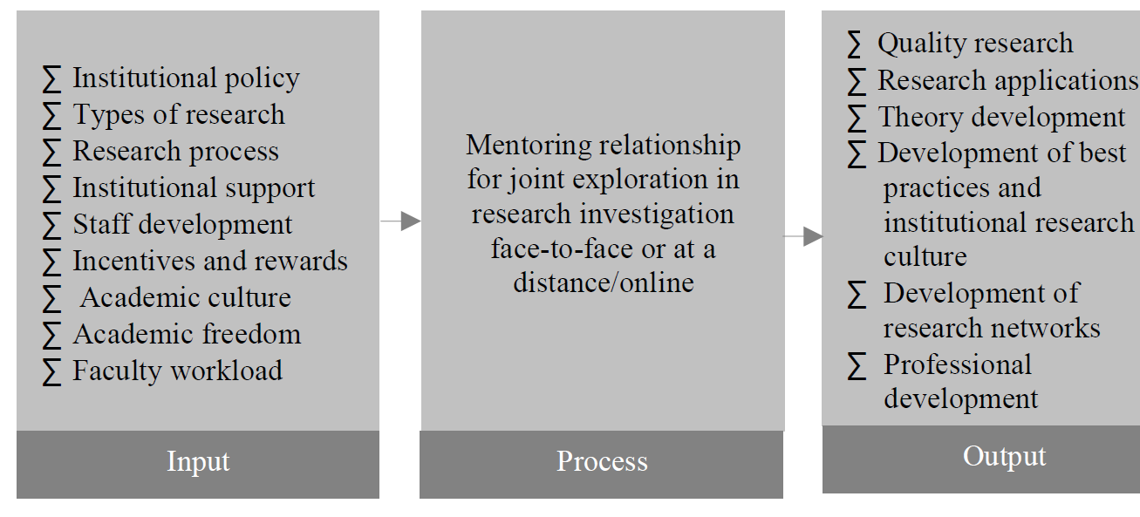
Research Through Mentoring
Panda, Santosh (2005), Research as Professional Development in Distance Education , Indian Journal of Open Learning, 14(3)

Slide 36
Institutional Characteristics for Promoting Research - German model
Importance of collegiality
Sufficient time for research
Identify and build on existing strengths
Building a culture of research: recommended practices’, Hanover Research, 2014

Slide 37

A culture of research:
Fosters an environment of creativity and innovation
Values and rewards research
Research informs both policy and practice

Slide 38

Way Forward
Govt policy and financial support critical for research
Technology infrastructure and connectivity key
New research required in curriculum and pedagogy for ODeL
Targeted research on social inclusion and sustainable development

Slide 39


Thank you
www.col.org
The contents of this presentation, with the exception of logos and graphics which are the property of the respective owners, is made available under Attribution-ShareAlike 4.0 International (CC BY-SA 4.0).

