Slide 1



COL in the Commonwealth
Promoting Learning for Sustainable Development
Professor Asha Kanwar
President & CEO
20CCEM | Nadi, Fiji | February 21, 2018

Slide 2
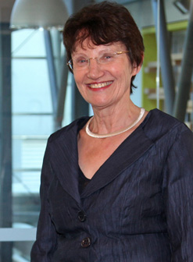
Dr. Linda Sissons, CNZM
Chair, COL Board of Governors

Slide 3
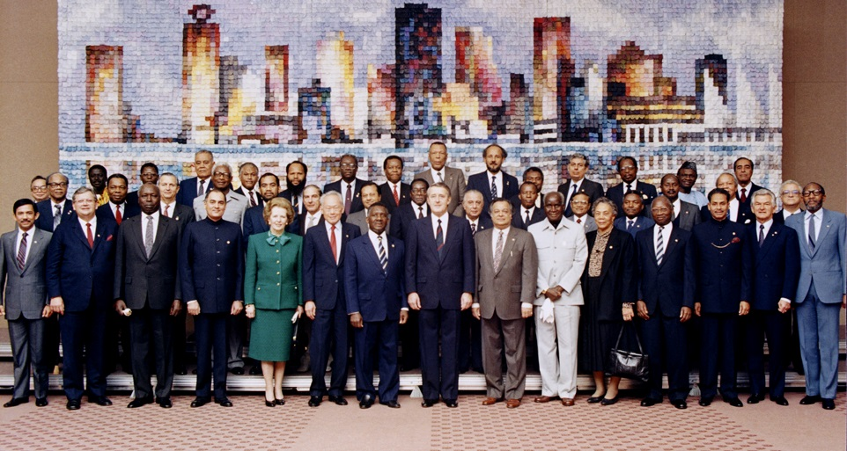
Commonwealth Heads of Government Meeting
Vancouver, 1987
Notes:
We invite you to engage us; tap into our thought leadership, expertise, networks and resources

Slide 4

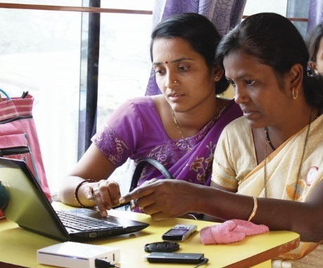
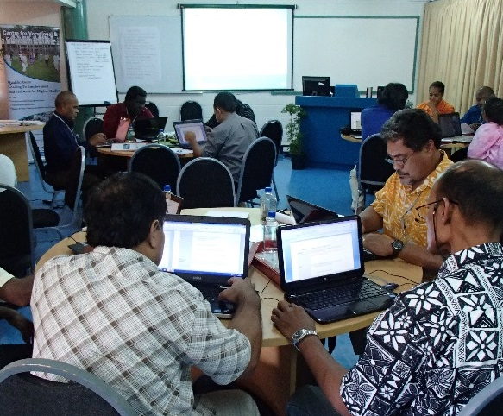
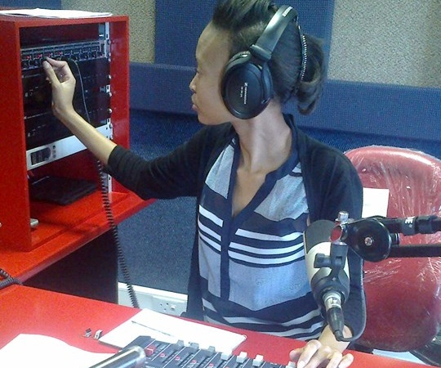
To help Commonwealth governments and institutions use technologies to improve and expand access to education and training

Slide 5
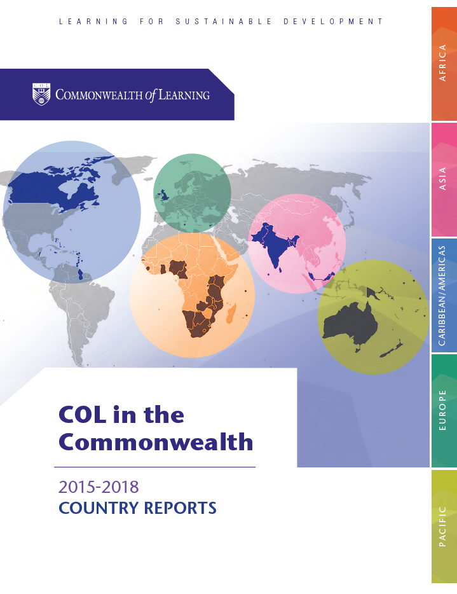

Slide 6




Shared Challenges
Access
Quality
Equity
Cost

Slide 7
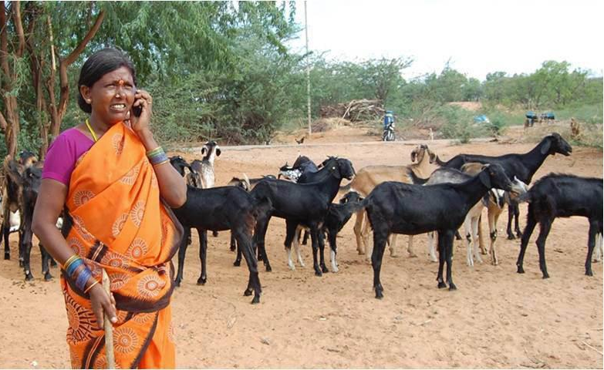
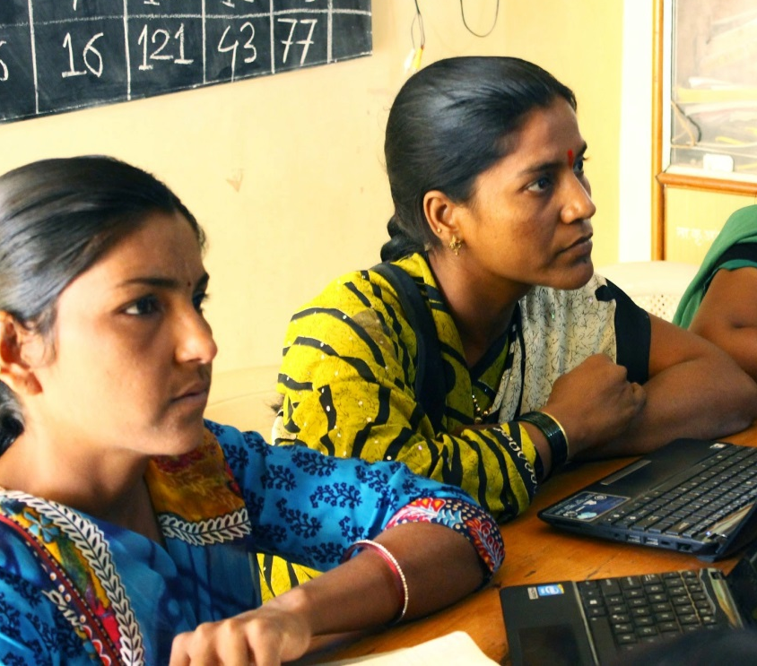
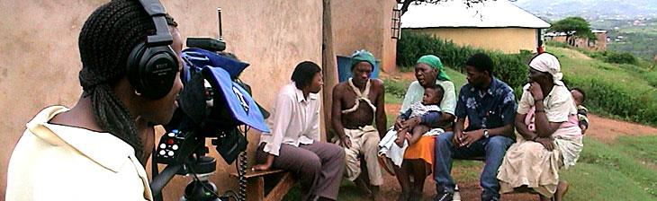

Leveraging
New & Existing Technologies

Slide 8
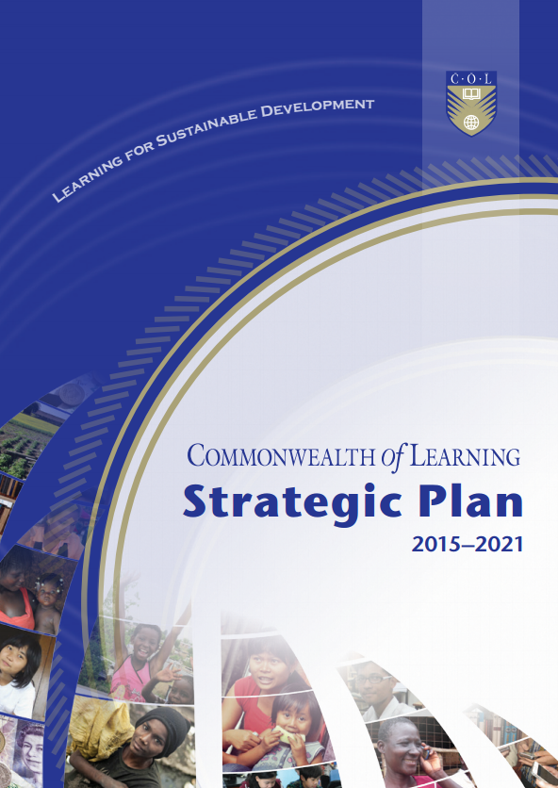

Slide 9
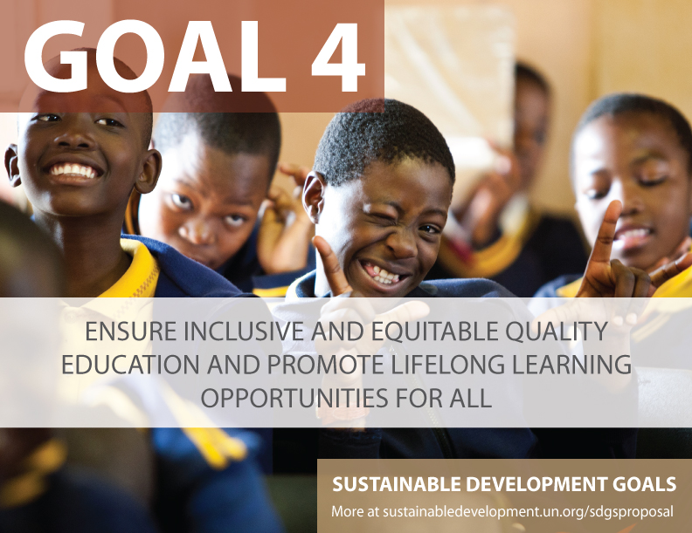

Slide 10
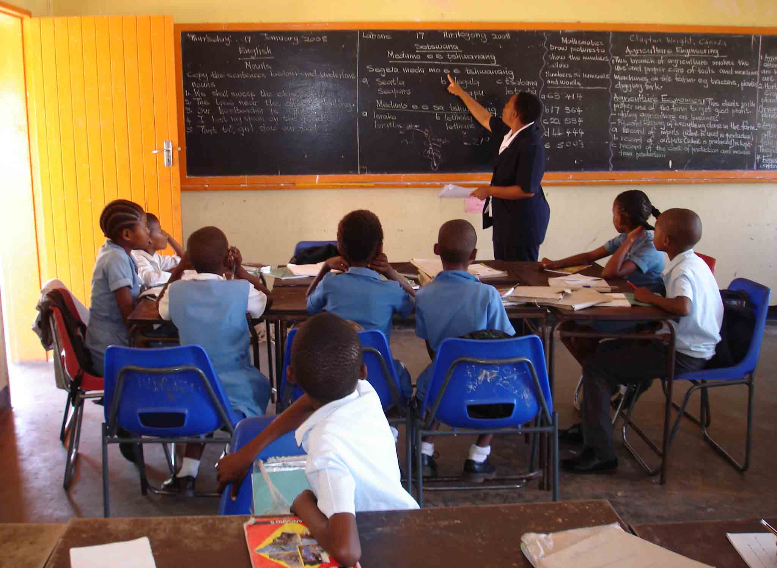
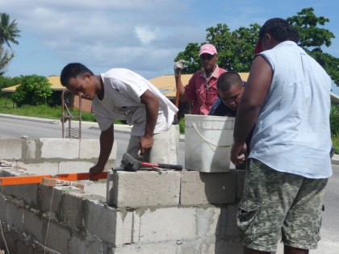
Two Sectors
Education
Skills
Gender

Slide 11

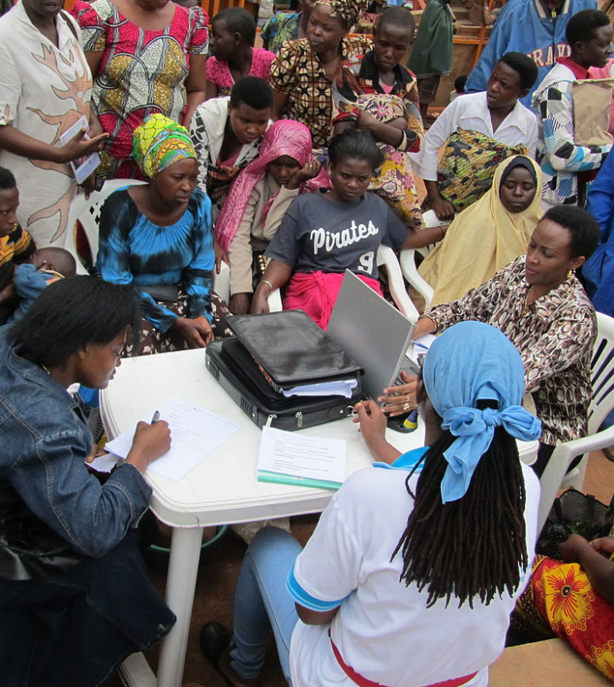
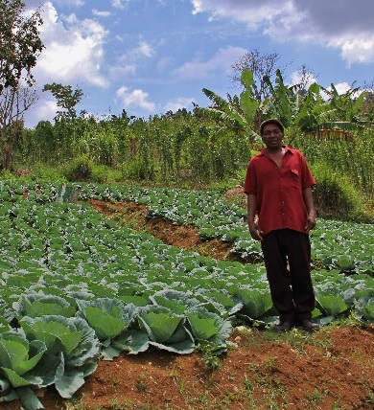



Learning for Sustainable Development
ECONOMIC
GROWTH
SOCIAL
INCLUSION
ENVIRONMENTAL CONSERVATION

Slide 12
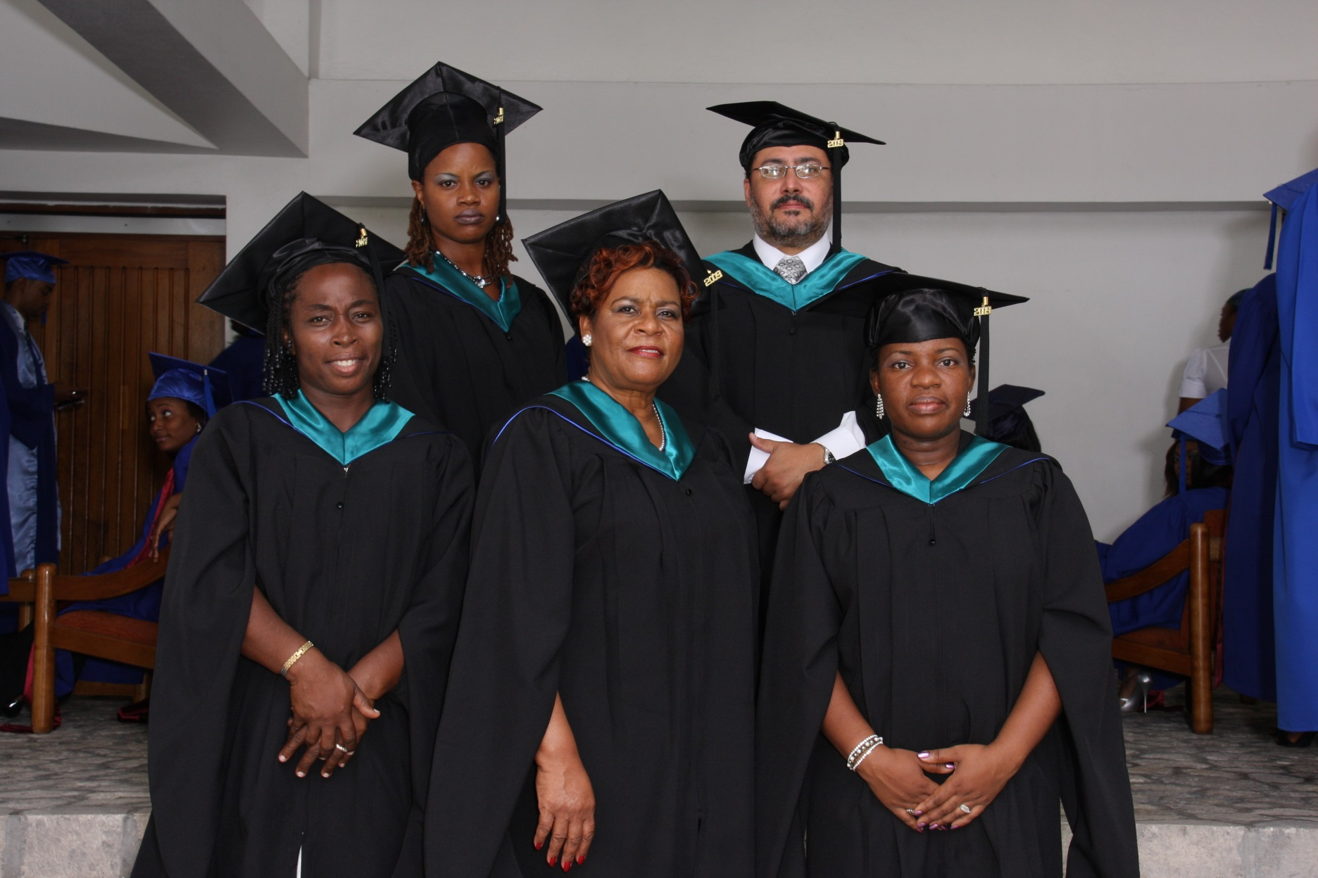

Commonwealth Executive MBA/MPA
11 partner institutions
Enrolment of over 30,000
14,000 graduated
ECONOMIC GROWTH
Notes:
10 countries/flags?

Slide 13





Benefits
Graduates saw on increase of 38% in monthly income
An increase of 28.5 % points in the probability of being promoted
For every $ 1 invested, learners received $ 3.40 in direct returns
1:3.4
ECONOMIC GROWTH
Notes:
Based on a conservative scenario where impact is expected to last 5 years, with a discount rate of 6% and decay rate of 70%

Slide 14
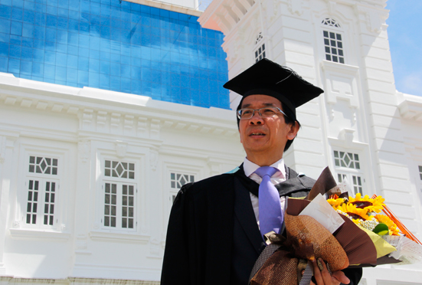


Raymond Loh: CEMBA Graduate - “…offering moving and relocation services to clients in over 40 countries.”
ECONOMIC GROWTH

Slide 15

































Virtual University for Small States of the Commonwealth

Slide 16
Reduced Costs/Increased Benefits
69% less direct cost to the VUSSC students in tuition fees
9%
77%
Majority work
$
Direct and indirect benefits per student in VUSSC
7,000 USD more
than the face-to-face-students per year while studying
ECONOMIC GROWTH
Notes:
77% of VUSSC students work while studying compared to
only 9% of campus-based students

Slide 17

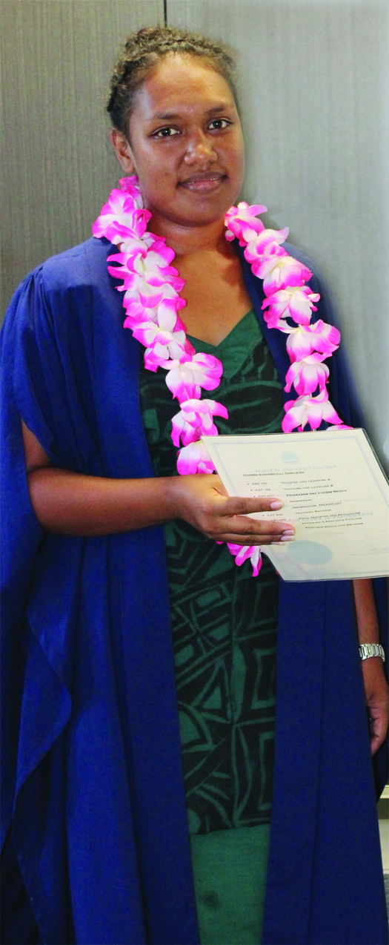

Graduation
Leafaitulagi Vaaelua,
a graduate of the Diploma in Sustainable Agriculture, Samoa is now in full time employment
ECONOMIC GROWTH

Slide 18
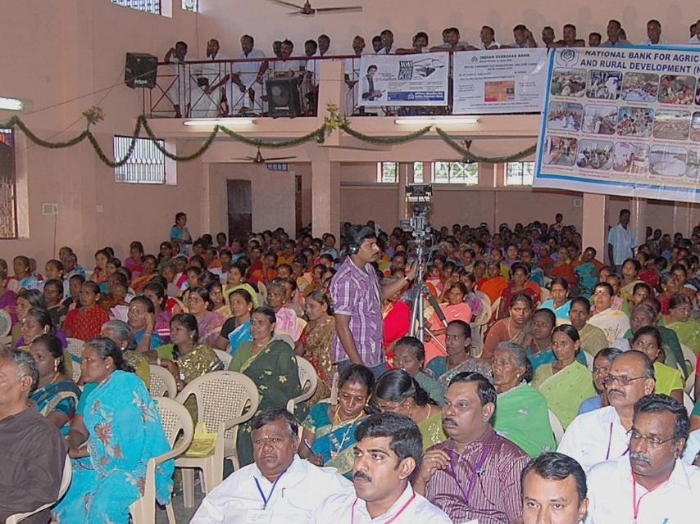

ECONOMIC GROWTH
Every $1 invested resulted in $9 worth of income and assets.
Notes:
These women are part of COL’s L3F under which they have learnt agriculture and enterprise development skills using basic mobile phones. Because of this they have established companies in agriculture and livestock in which they are shareholders. They have generated enough assets within a space of three years.
Economic Times, Aug 18, 2017, The Big Farm to Fork Idea that Cuts wastage , ups farmer income

Slide 19
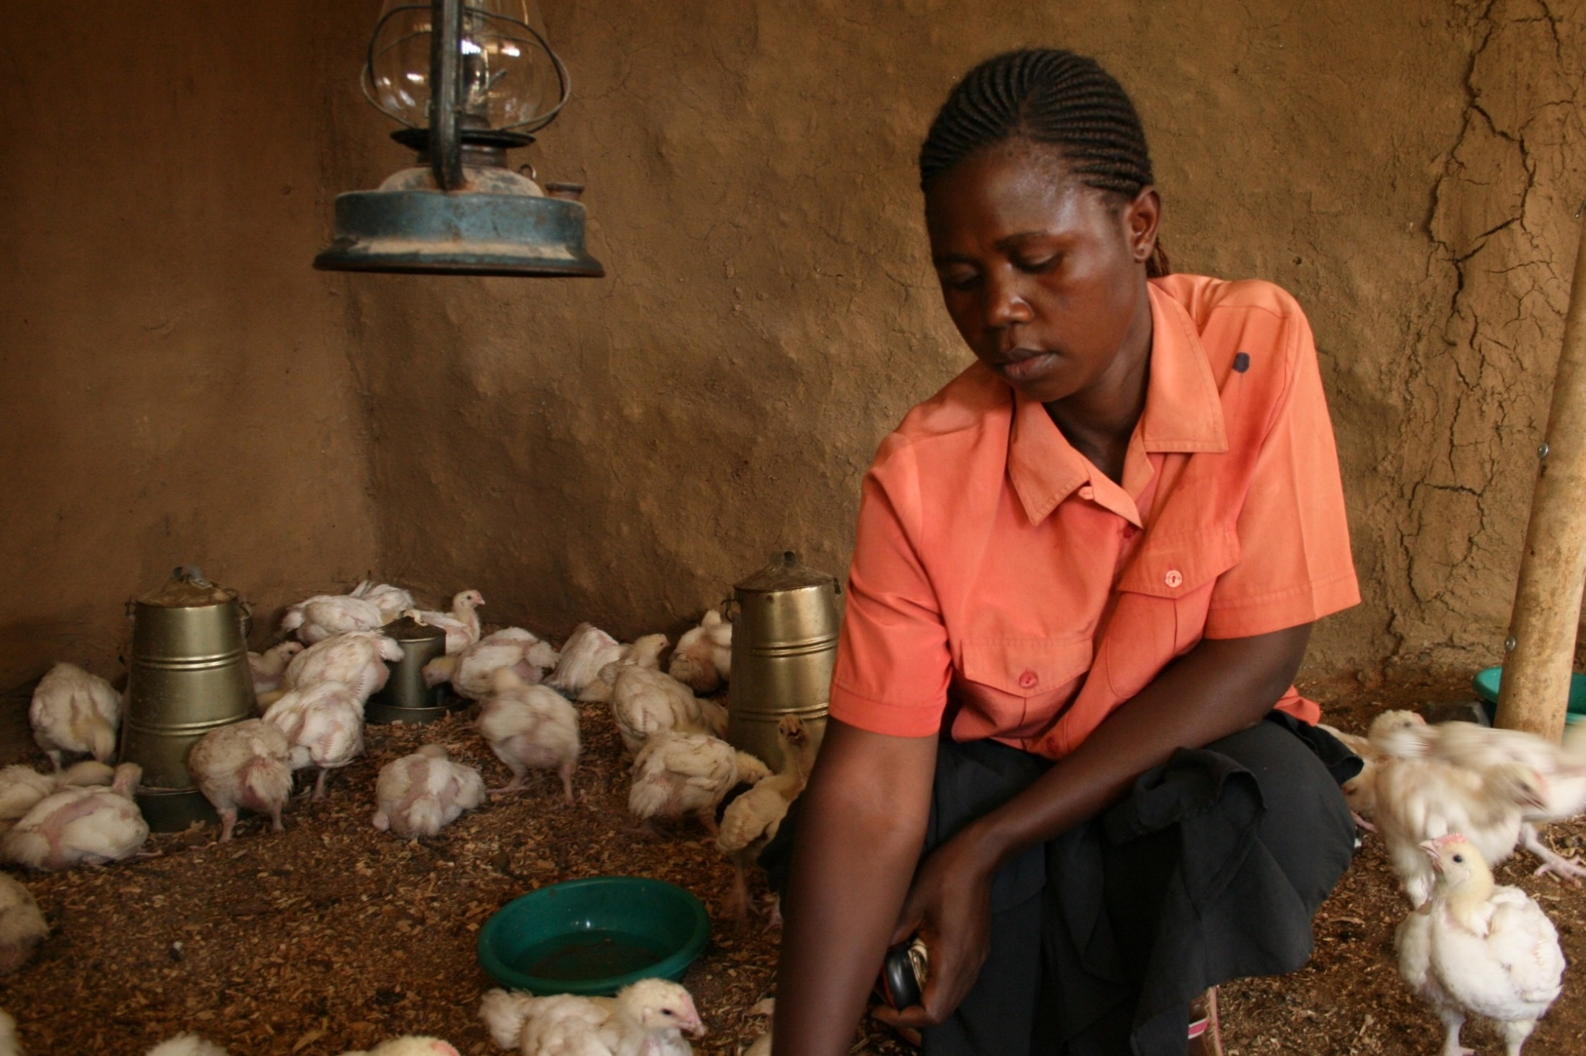

1% increase in empowerment
2.3% increase in profit
ECONOMIC GROWTH
Notes:
KENYA
This L3F project runs in 11 Commonwealth countries. Studies have found that learning leads to empowerment and that for 1% increase in women’s empowerment in Kenya, there was a 2.3% profit in agri-enterprises

Slide 20

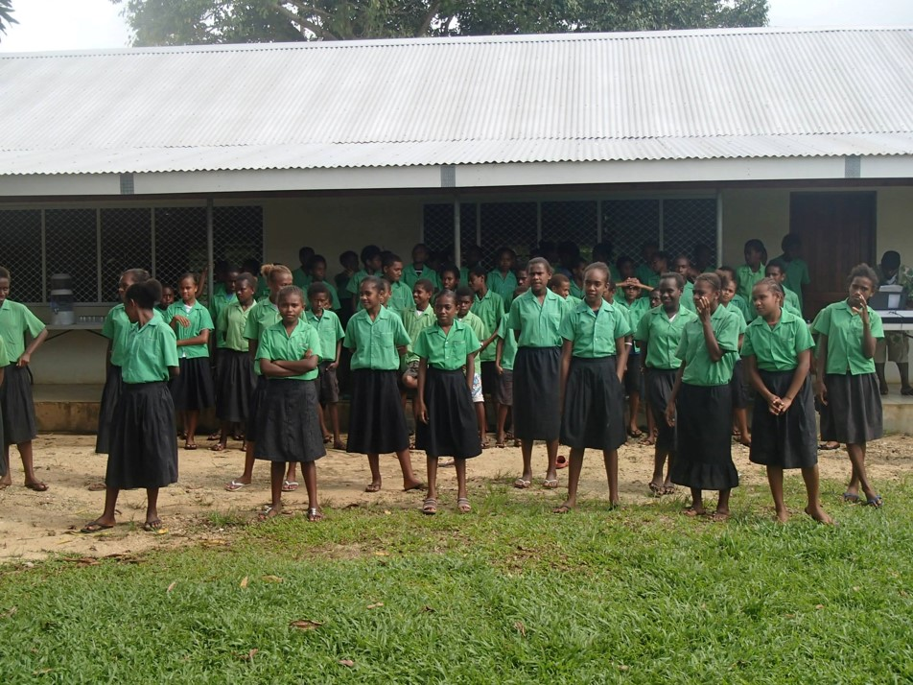

Social Return on Investment showed that every US$ invested resulted in US$8 worth of benefits to students.
SOCIAL INCLUSION
Notes:
Belize
Benefits: skills, expected income
Social Return on Investment of an Open School showed that every US$ invested resulted in US$8 worth of benefits to students.

Slide 21
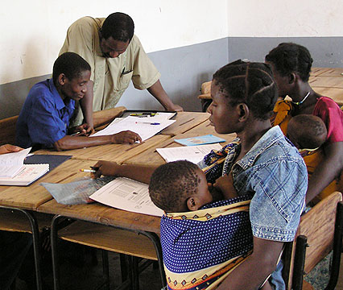


Unit Cost per Student
 | Formal Secondary School | Open School
India | INR 15,288 | INR 1,230
Namibia | ZAR 5,346 | ZAR 1,262
Source: Rumble, G., & Koul, B.N. (2007).
Notes:
Cost of open schooling in India as compared to Kendriya Vidyalaya (Central School) is 1:12, and in Namibia, it is approximately 1:4 for formal secondary school and NAMCOL.

Slide 22
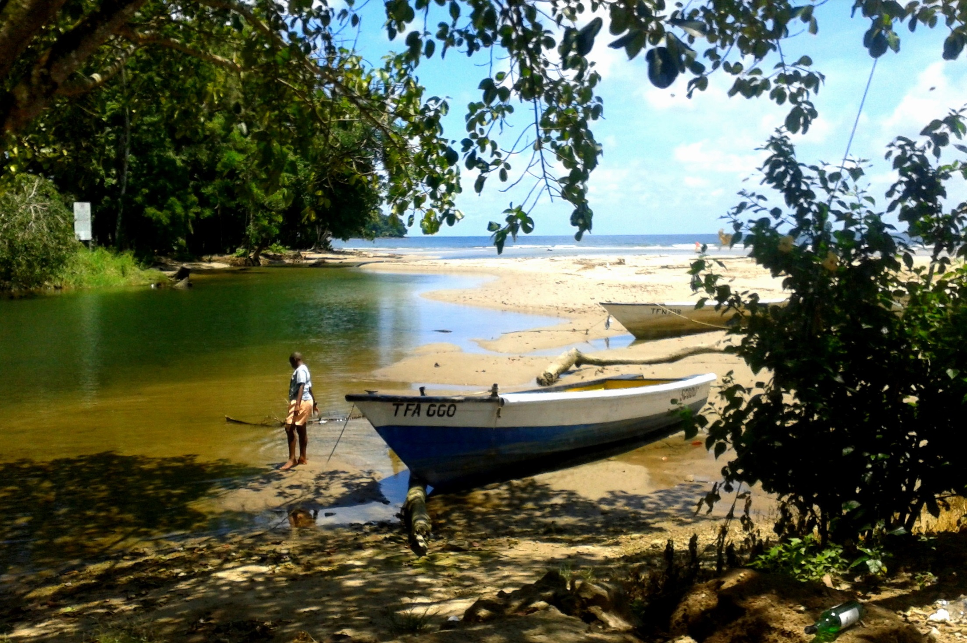

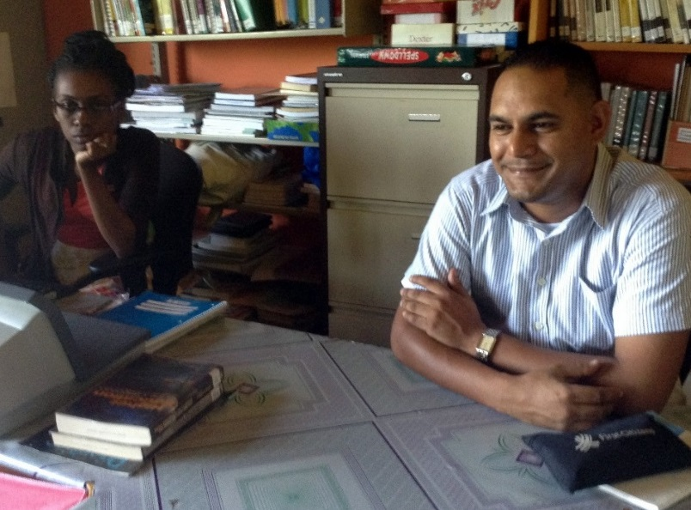
SOCIAL INCLUSION
Out-of-school youth in a remote fishing village graduate
Notes:
The first cohort of out of school youth in a remote fishing village in Trinidad & Tobago graduated through a COL-supported open school. The entire curriculum was structured around fisheries which was both interesting and relevant to the needs of the youth.
Photo: Staff Matelot

Slide 23
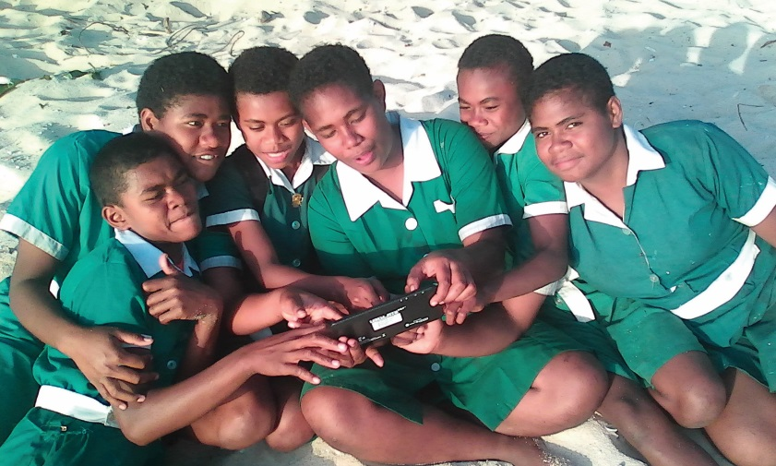
Aptus
An off-grid, off-line virtual classroom that allows learners in regions with no connectivity to benefit from digital resources and learning networks
SOCIAL INCLUSION
Now in deployment

Slide 24




ODL students have 1/3rd carbon footprint compared to campus-based students
ENVIRONMENTAL CONSERVATION
Notes:
A recent study conducted in Botswana showed that the carbon footprint of a distance learning student was only one tenth of that of a campus-based student, without a negative impact on learning outcomes.

Slide 25

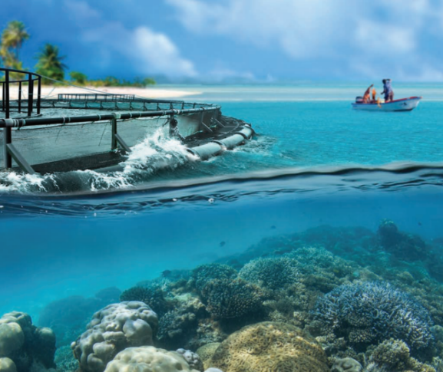

Blue Economy
Research Institute
Understanding the Blue Economy
ENVIRONMENTAL CONSERVATION

Slide 26

Massive Open Online Course (MOOC)
Notes:
Gender workshop Kenya 2014

Slide 27

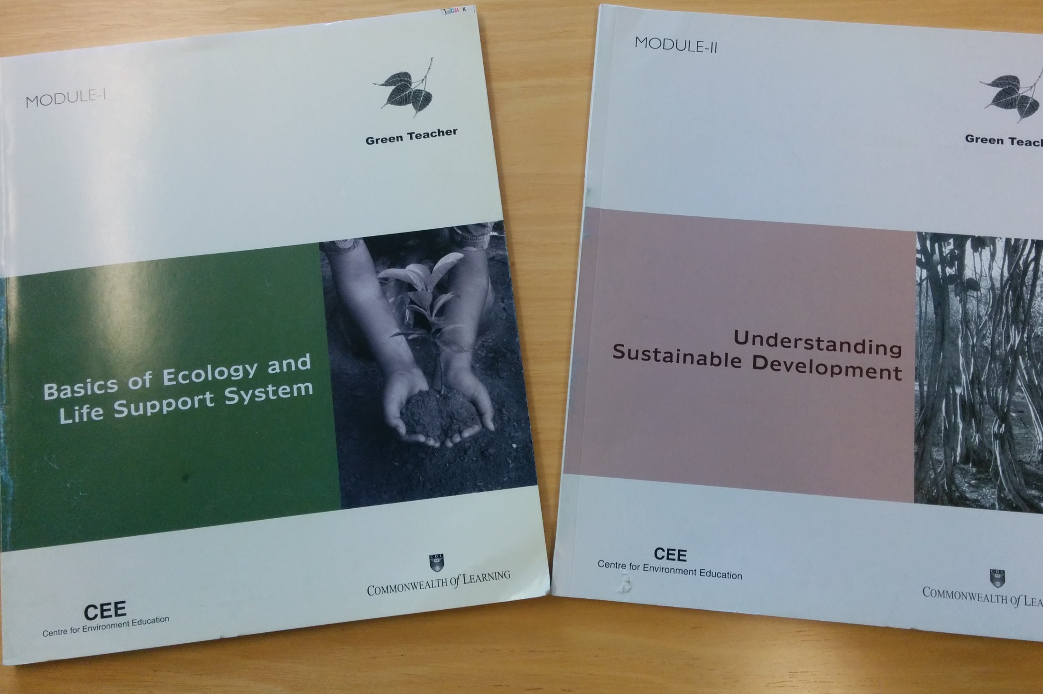

Green Teacher
ENVIRONMENTAL CONSERVATION
Notes:
COL is working with the National Teachers Institute, Nigeria, which has an annual enrolment of 50,000 trainee teachers, to develop a Green Teacher course which will help teachers to integrate environmental concerns into the classroom from a very early age.

Slide 28
COL Highlights
2015-2017
Notes:
Let me finally share three highlights of this year.

Slide 29



Open Online and Flexible Learning:
the key to sustainable development
Notes:
COL organized its triennial Pan Commonwealth Forum in partnership with the Open University of Malaysia, which attracted over 500 participants from 60 countries, including ministers of education. This resulted in the 2016 KL Declaration which provides a roadmap forCommonwealth Member States to implement the SDG 4 on education.

Slide 30






OER for Inclusive and Equitable Quality Education
From Commitment to Action
2nd World OER Congress| 18-20 September, 2017 | Ljubljana, Slovenia

Slide 31







Notes:
Thanks to grants from the governments of Australia and Canada, COL will train 45000 girls and women in five countries: Bangladesh, India Pakistan, Mozambique and Tanzania. You’ll be pleased to note that in the first eighteen months alone, over 29,000 girls have been trained in various skills and 5, 260 girls have found new sources of income generation.

Slide 32
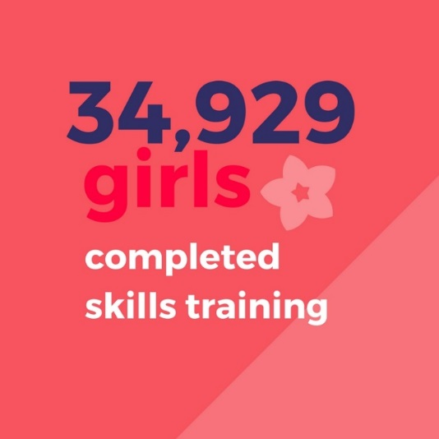
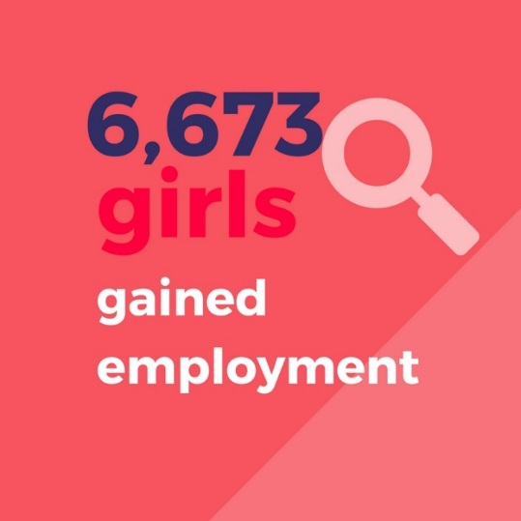
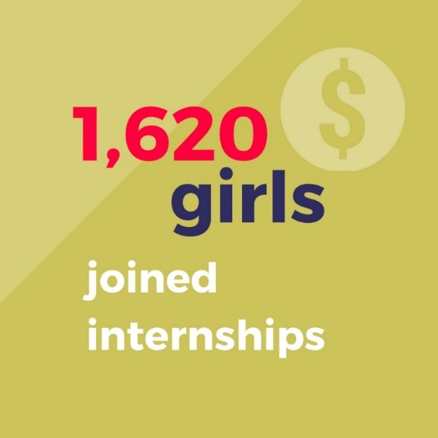
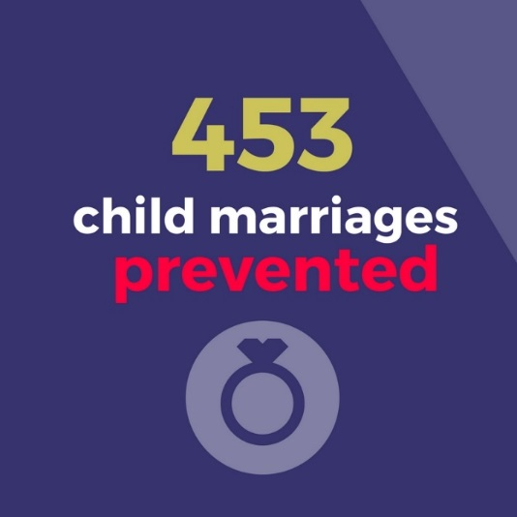
The probability of being employed increased by 50%
Income increased by 5 times

Slide 33
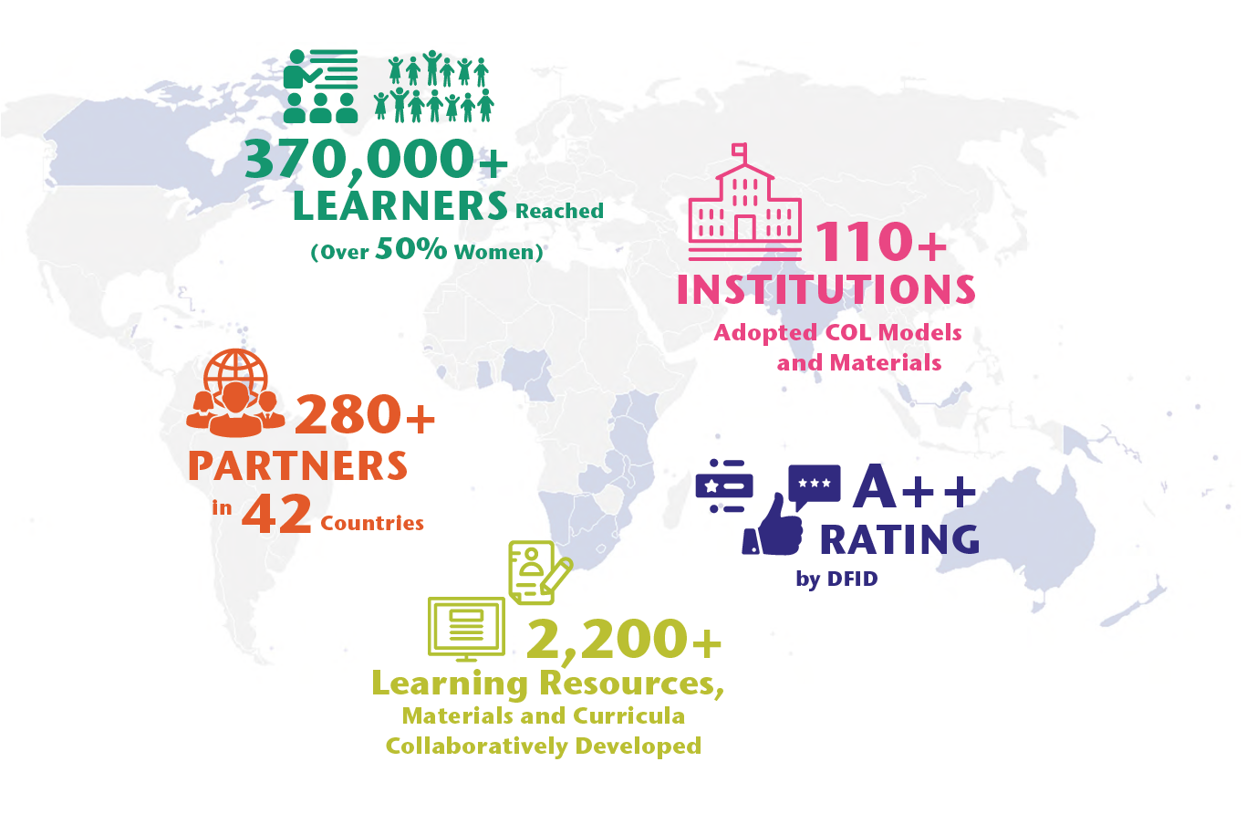
Results Achieved
Notes:
Results Achieved in 2016-17
Reached 372,600 learners, more than 50% women
Worked with 280 partners in 42 countries
102 institutions have adopted COL models and materials
Supported the development of 635 curricula and learning resources
DFID A++

Slide 34
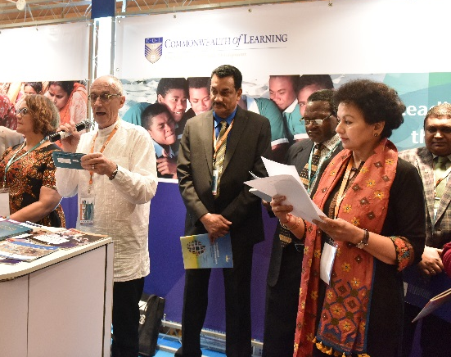
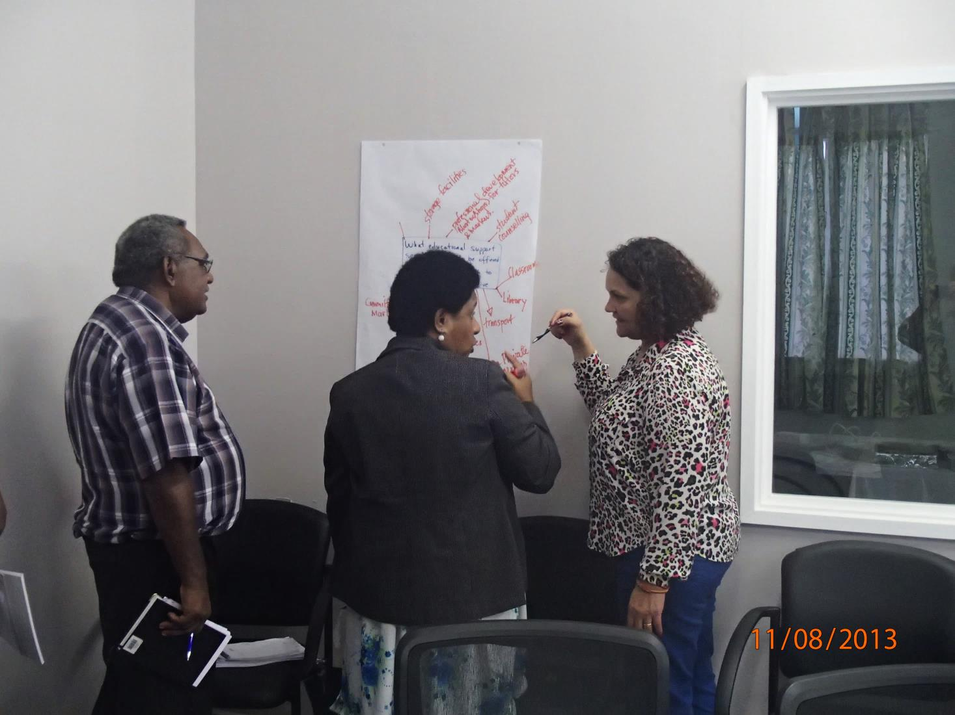
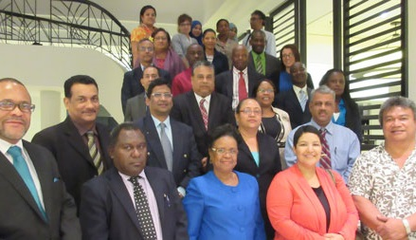
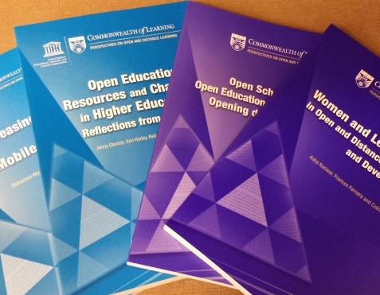




@30 COL Offers…
World Class Expertise
Innovative Models
Capacity Building
Resources
Notes:
We invite you to engage us; tap into our thought leadership, expertise, networks and resources

Slide 35
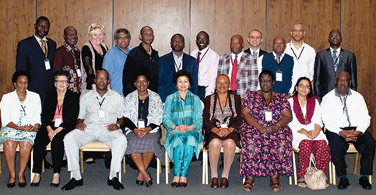
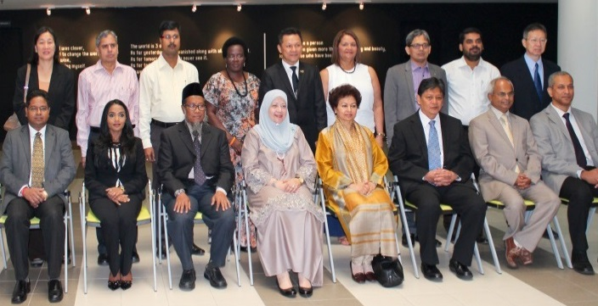
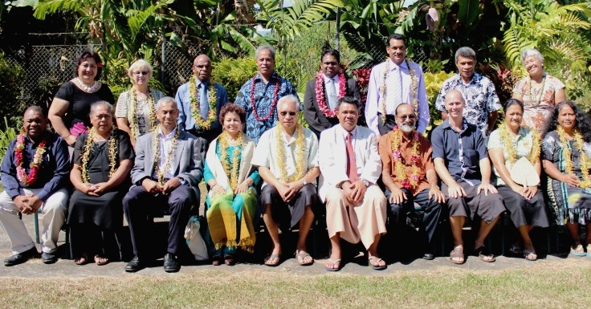
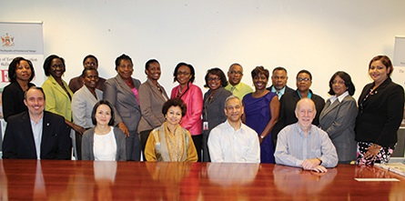
COL Focal Points
Our direct link to your country
Africa & the Mediterranean
Asia
Pacific
Caribbean

Slide 36
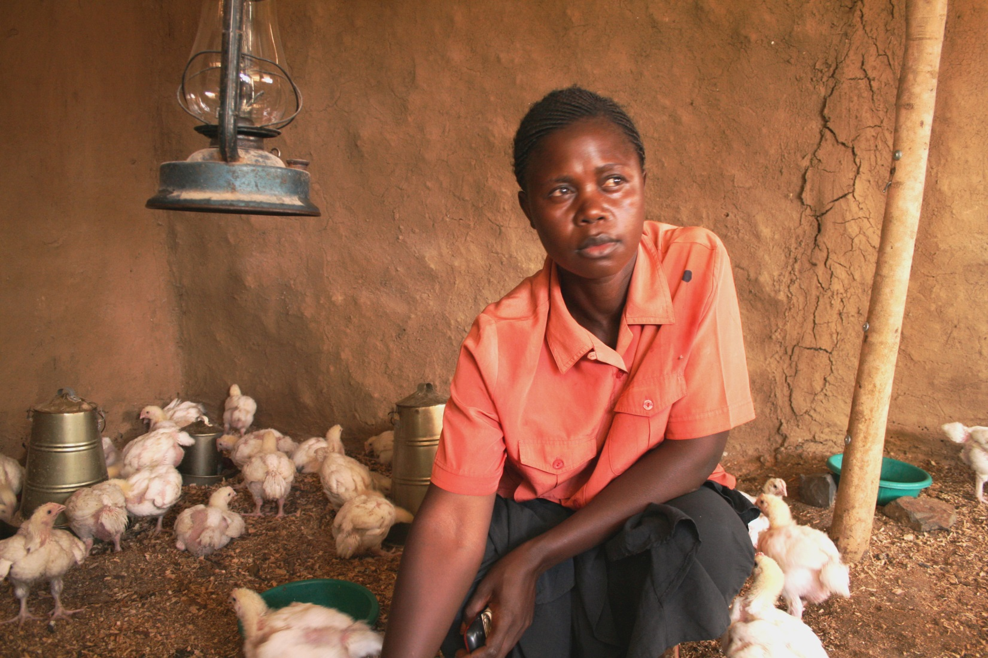
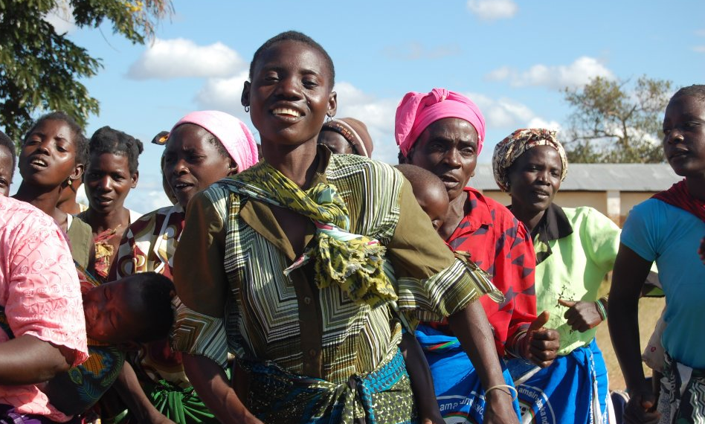
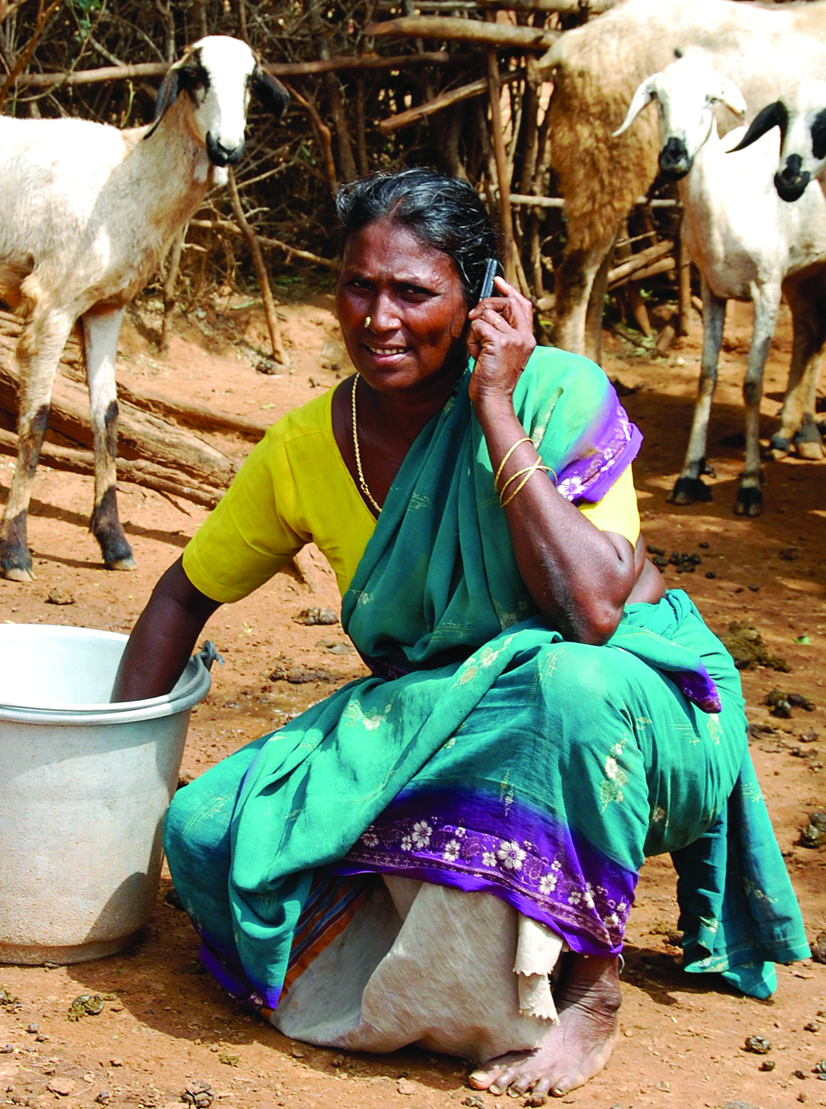
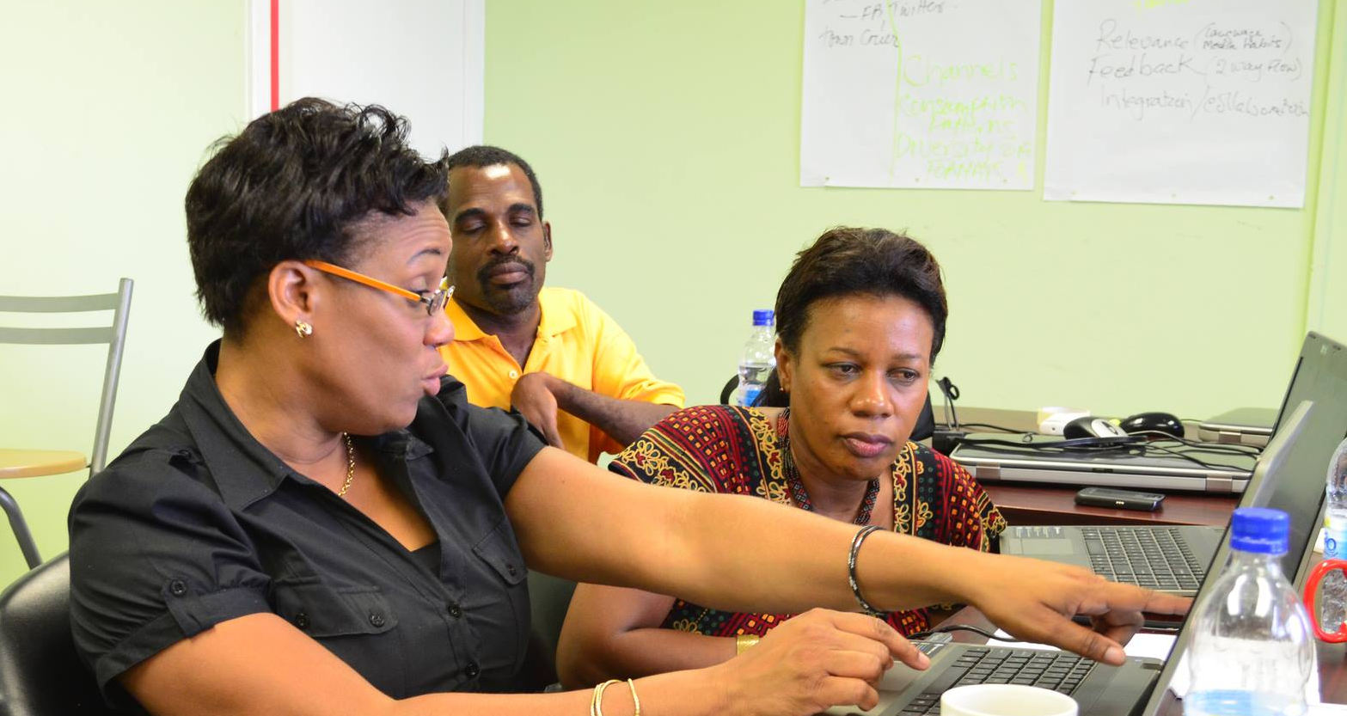
Thank You
www.col.org
Notes:
We invite you to engage us; tap into our thought leadership, expertise, networks and resources

