Slide 1

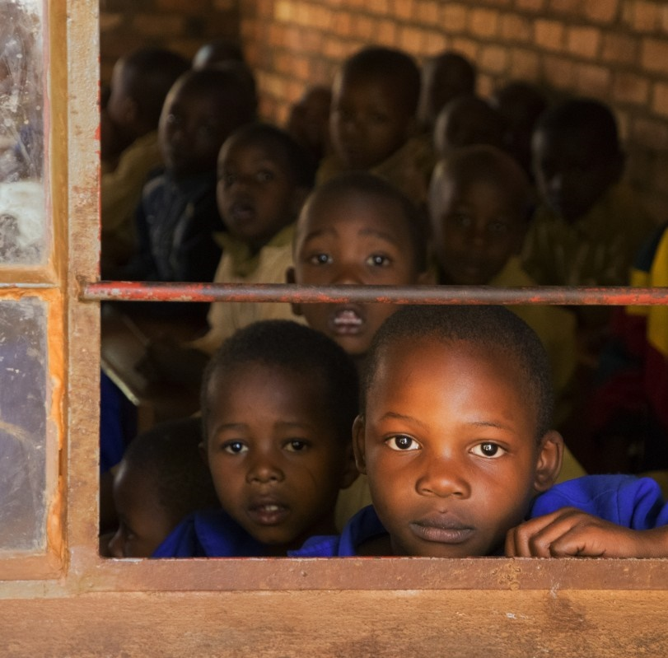

Educating the African Learner in an Era of Crises
What are the Options?
Professor Asha Kanwar President & CEO
Dr Betty Ogange, Adviser: Teacher Education
DETA Conference 2019 | 22-26 July

Slide 2
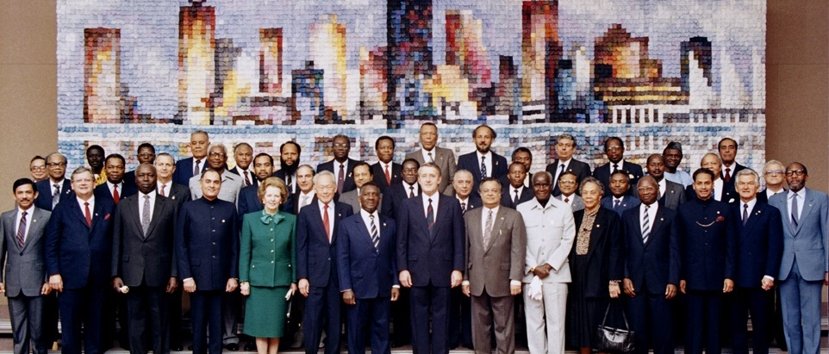
Commonwealth Heads of Government Meeting Vancouver, 1987
Notes:
COL was established by Commonwealth Heads of Government when they met in Vancouver for CHOGM 1987.

Slide 3

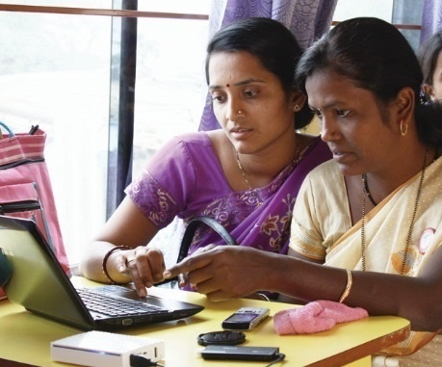
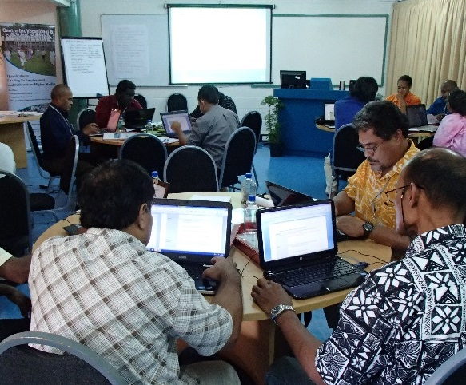
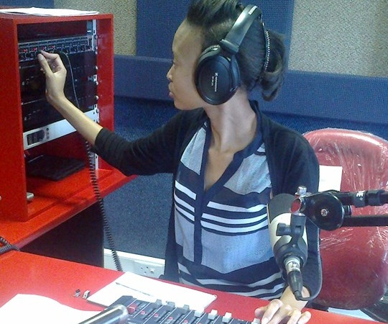
To help Commonwealth governments and institutions use technologies to improve and expand learning for sustainable development
Notes:
What do we do? Our mission is to help Commonwealth member states and institutions to use technologies for expanding access to quality education and training.

Slide 4

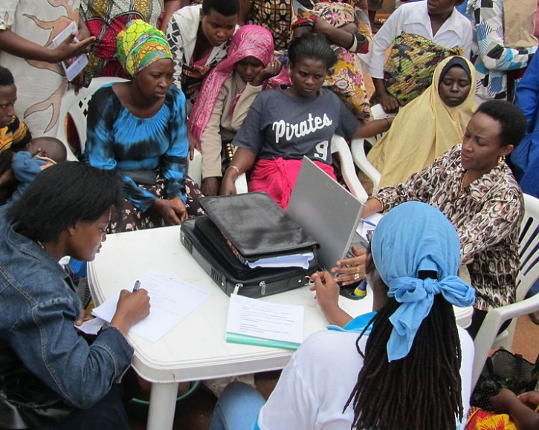
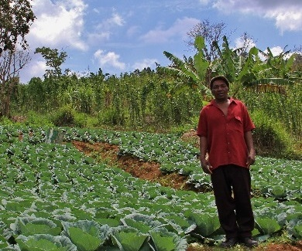
Learning for Sustainable Development
ECONOMIC GROWTH
SOCIAL INCLUSION
ENVIRONMENTAL CONSERVATION
$
Notes:
COL believes that learning is the key to sustainable development. Learning must lead to three things: one, economic growth, two, social inclusion and three, environmental conservation.

Slide 5
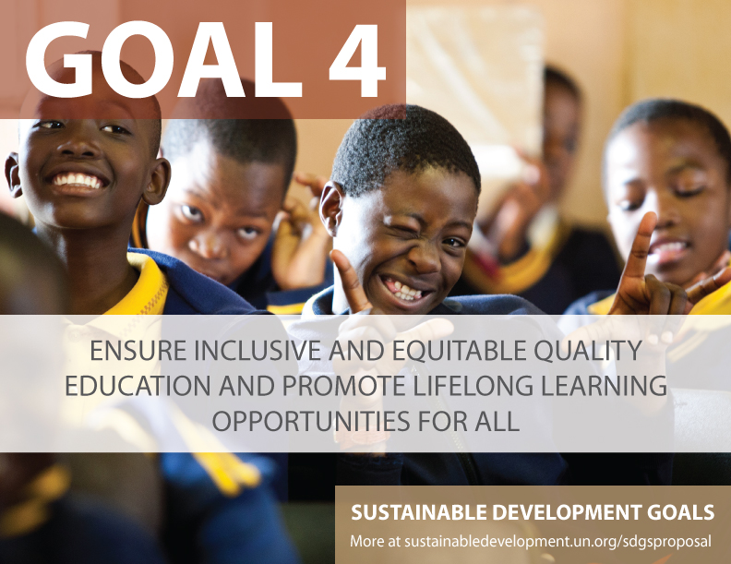

Slide 6

Plan
Crises
Who is the African learner?
Responding to the crises
The COL response
Looking ahead

Slide 7
Crises

Slide 8
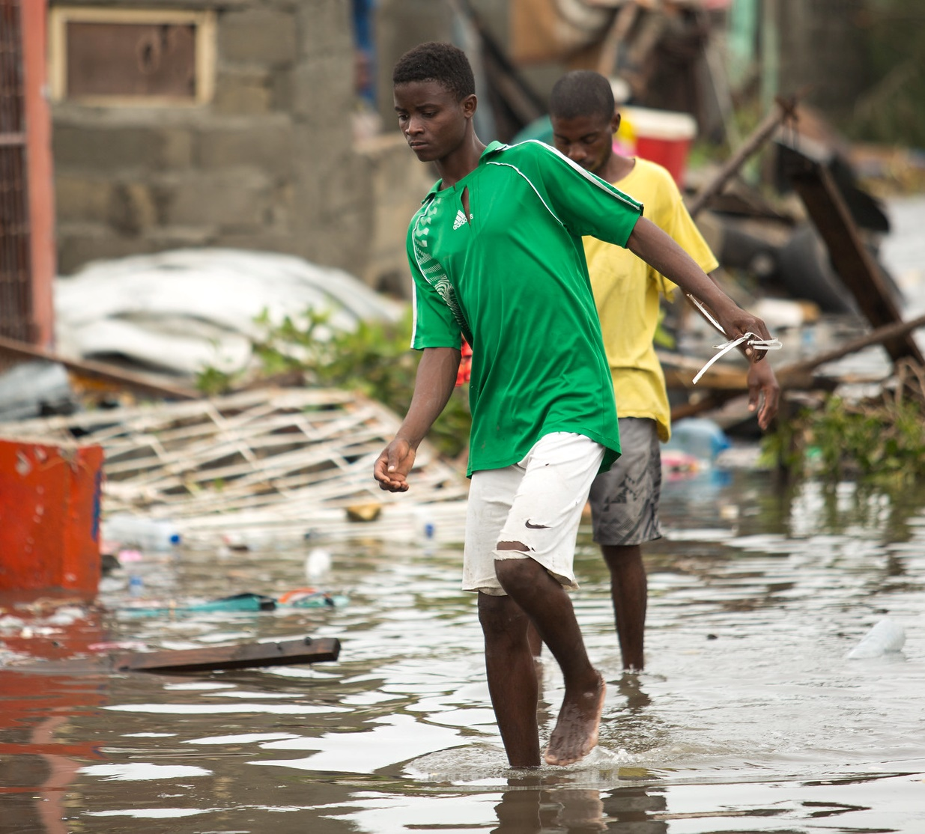
Crisis 1: Climate Change
Nearly 40 million children a year have their education interrupted by natural disasters
Cyclone Idai (March 2019)
Mozambique, Zimbabwe and Malawi
Photo Credit Denis Onyodi: IFRC/DRK/Climate Centre, CC BY-NC 2.0
Sources: https://theirworld.org/resources/detail/safe-schools-the-hidden-crisis | https://reliefweb.int/report/mozambique/when-disaster-strikes-how-education-and-childrens-futures-were-battered-cyclone
Notes:
The demographic crisis: More people on earth, more learners in schools, more chances of expending natural resources
Populations affected by climate change
Nearly 40 million children a year have their education interrupted by natural disasters such as earthquakes and disease outbreaks
Cyclone Idai in Mozambique, Zimbabwe and Malawi in March 2019
600 schools destroyed, 3,504 classrooms damaged or destroyed
335,000 children have had their education disrupted as a result of the cyclone.

Slide 9
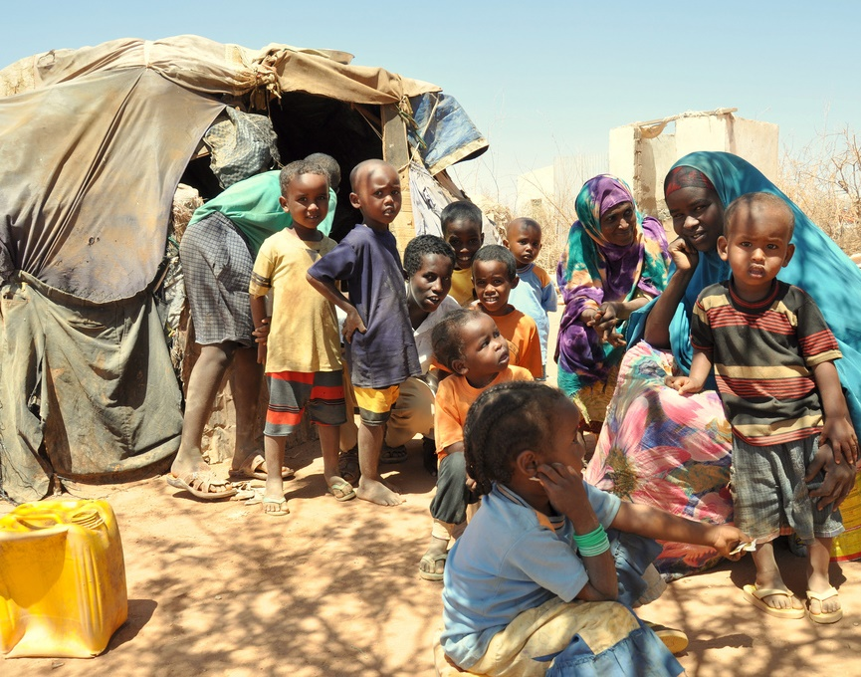
Crisis 2: Migration and Displacement
12.6 million internally displaced persons in Africa by end of 2016
Photo credit: https://en.wikipedia.org/wiki/File:Oxfam_Horn_of_Africa_famine_refugee_camp.jpg, CC BY-SA 3.0
Source: https://en.unesco.org/gem-report/report/2019/migration
Notes:
Many countries in Africa are struggling to fulfil the international commitment to respect the right to education for all
The educational needs of populations living nomadically or awaiting refugee status in temporary shelters have to be met
and Teachers may not be trained to address the challenges affecting displaced or nomadic learners
Teacher attrition hard to estimate and address in such communities
By end of 2016, there were 12.6 million internally displaced persons in Africa
Uganda requires 7000 additional primary school teachers for refugee education. (GEM Summary, 2019, p.27)
In Dadaab, Kenyan refugee camps, teacher pupil ratio is 1:120 in pre-primary and 1:56 in primary. Four students share a textbook
In Chad refugee camp, 30% of 6-14 year olds from CAR, Nigeria and Sudan are illiterate

Slide 10
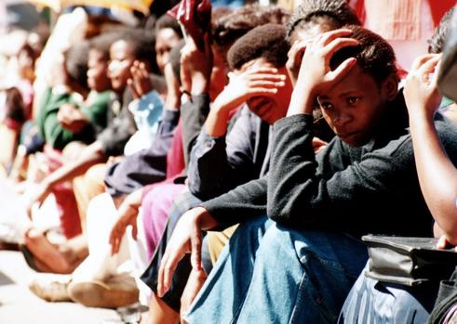
Crisis 3: Out-of-School youth
Sub-Saharan Africa
highest rate of out-of-school for all age groups
21% of children denied the right to education
Photo source: https://www.iol.co.za/news/politics/sas-ticking-time-bomb-1244433
63% of population resides in rural areas
Source: uis.unesco.org/sites/default/files/documents/reducing-global-poverty-through-universal-primary-secondary-education.pdf, Constance Berry Newman (2017) Equipping Africa’s Primary School Learners for the Future
Notes:
264 million children not in school (UNESCO) as at 2017
Sub-Saharan Africa
highest rate of out-of-school for all age groups
21% of children denied the right to education
63 percent of population a resides in the rural areas

Slide 11
Crisis 4: The ‘learning crisis’
In West and Central Africa, less than 45% students in Grade 6 achieved competency level in maths and reading
In South Africa, majority of Grade 4 students displayed the capacity of Grade 1
Teacher absenteeism and ‘presenteeism’
World Bank (2018). Learning: To Realize Education’s Promise. Washington: The World Bank. Retrieved from https://www.worldbank.org/en/publication/wdr2018
Notes:
According to estimates by UNICEF, in 2015, over 115 million children did not attend primary school
56% of children in school are not learning (World Bank)
In West & Central Africa, less than 45% students in Grade 6 achieved competency level in maths and reading
In SA, majority of Grade 4 students displayed the capacity of Grade 1 (World Bank, 2018)
Teacher absenteeism and ‘presenteeism’
World Bank (2018). Learning: To Realize Education’s Promise. Washington: The World Bank. Retrieved from https://www.worldbank.org/en/publication/wdr2018

Slide 12
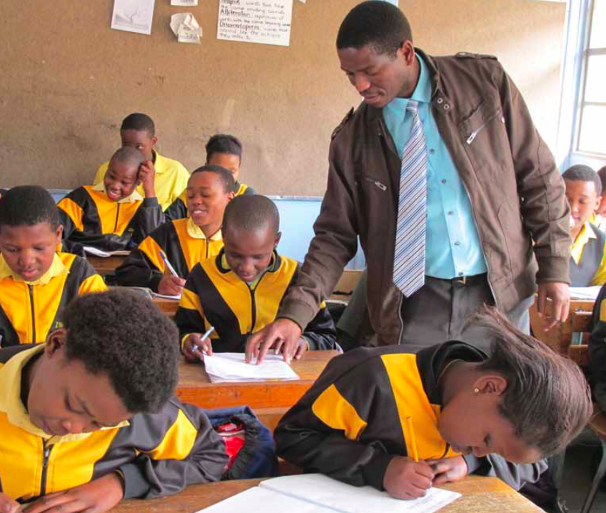
Crisis 5: Challenge of Pedagogy
Teacher education programmes tend to emphasize general knowledge over practical pedagogy
Prominence of teacher-centred lecture methods
6 countries in SSA - no capacity for differentiated instruction based on learner ability
40% teachers in SSA do not have mastery of concepts (World Bank, 2018)
Photo source: https://gemreportunesco.wordpress.com/2014/01/29/4067/, CC BY-SA 3.0
Notes:
Many studies show that teachers use the lecture style, and learners follow textbooks
Teacher education programmes tend to emphasize general knowledge over practical pedagogy. In SSA teacher education programmes are too short as to compared to Asian countries.
Prominence of teacher-centred lecture methods
In six countries in SSA, there was no capacity for differentiated instruction based on learner ability
40% teachers in SSA do not have mastery of concepts (World Bank, 2018)
World Bank (2018). Learning: To Realize Education’s Promise. Washington: The World Bank. Retrieved from https://www.worldbank.org/en/publication/wdr2018

Slide 13
Who is the African learner?

Slide 14

Africa’s Population
1.2 billion
By 2030, Africa's child population is projected to expand by about 170 million (UNICEF)

Slide 15
A Young Africa
Children under 18 – 47% of Africa’s overall population
By 2030, the number will have increased by 42%
Africa’s youth population will double by 2055
Source: Youth population trends and sustainable development https://www.un.org/esa/socdev/documents/youth/fact-sheets/YouthPOP.pdf
Notes:
The number of youth is growing rapidly. Potential challenges at school level include:
high classroom enrollment
high teacher-learner ratios
under-resourced classrooms

Slide 16
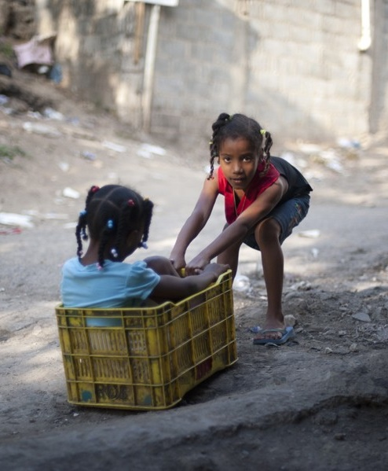
Of the 61 million primary school age children out of school globally in 2016, over ½ were in SSA
Globally, the 5 countries with the highest percentage of out-of-school children are in Africa (Liberia 62%, Eritrea 59%, Sudan 45%, Djibouti 43%, and Equatorial Guinea 42%)
Gender gap: 23% of all girls are out-of-school compared to 19% of all boys
Image Source: http://cronkite.asu.edu/buffett/dr/religion.html (CC BY-SA 3.0)
Jenny Perlman Robinson and Rebecca Winthrop, Millions Learning: Scaling Up Quality Education in Developing Countries, Brookings Center for Universal Education, April 2016, 8.
UNESCO, “Global Education Monitoring Report, Education for people and planet: Creating Sustainable Futures for All,” 2016, http://unesdoc.unesco.org/images/0024/002457/245752e.pdf, 222-236.
Theunynck, School Construction Strategies for Universal Primary Education in Africa
Notes:
Of the sixty-one million primary school age children out of school globally in 2016, over half were in sub-Saharan Africa
Globally, the five countries with the highest percentage of out-of-school children are in Africa. Liberia (62%), Eritrea (59%), Sudan (45%), Djibouti (43), and Equatorial Guinea (42).30
Gender gap: 23% of all girls are out of school compared to 19% of all boys. Fifteen million girls of primary school age will never learn to read in primary school, compared to approximately 10 million boys

Slide 17
For the African Learner: Language Matters
In most countries, learners are still introduced to new concepts using a language that is different from their own
Studies support the importance of mother tongue primary learning. Children instructed in a bilingual or multilingual setting that includes their mother tongue are more likely to enroll and remain in school
Parents are more likely to take an active role in their children’s education when conducted in their mother tongue
They are taught by mostly bilingual teachers, who may or may not be proficient in the second language
Unavailability of textbooks in the local language
Notes:
The introduction to core concepts in the child’s mother tongue should precede the introduction of a second language

Slide 18
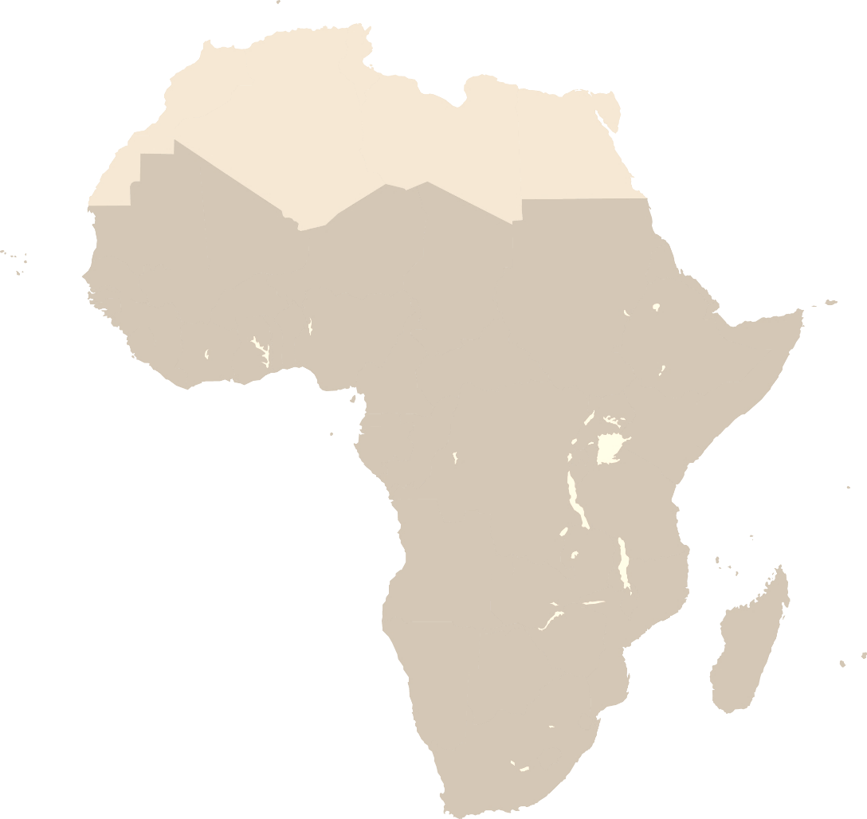
SSA: ICT Statistics 2000-2017
Source: data.worldbank.org, retrieved on July 12, 2019

Slide 19

The African Learner
Young
Out of school
Diverse (mostly rural and remote)
Resource poor
Learns in the second language
Limited access to technology
Schoolchildren in Sierra Leone Photo credit: bobthemagicdragon/Flickr
Notes:
The African Learner
Young
Out of school
Diverse (mostly rural and remote)
Resource poor
Learns in the second language
Limited access to technology
Image Source: Schoolchildren in Sierra Leone, photo credit: bobthemagicdragon/Flickr

Slide 20
Is the African Learner a “Millennial Learner”?
Doing is more important than knowing
Game-based learning
Multi-tasking; texting while doing another task is common
Instant gratification; zero tolerance for delays
Collaboration and team work
From consumers to producers
Source: Starlink. (2004). Educating the NetGen: Strategies that work. Participant Packet. http://www.starlinktraining.org/packets2004/packet129.pdf
Notes:
Typically born after early 1980s.

Slide 21
Responding to the Crises
Notes:
How can teachers be trained to address the needs of African Learners within the context of contemporary crises?

Slide 22

Increasing Numbers
2.2 million needed to deal with growing demand
3.9 million to replace those leaving the profession
Source: UIS Fact Sheet: The world needs almost 69 million new teachers to reach the 2030 education goals (2016)
Photo Credit: https://www.flickr.com/photos/brampitoyo/
Notes:
70% of countries face acute shortages of teachers, rising to 90% at secondary level
The continent needs a total of about 17 million teachers to achieve universal primary and secondary education by 2030

Slide 23





Improving Quality: Trained Teachers in Primary Education
Ghana 60.0% (2018)
Malawi 91.0% (2013)
Nigeria 66.0% (2010)
Rwanda 93.0% (2017)
Uganda 80.0% (2017)
Source: data.worldbank.org Retrieved on July 12, 2019

Slide 24
Can In-service Teacher Training Help?
One study shows that out-of-school, in-service training has limited, if any, impact and teachers are less likely to apply the knowledge and skills learnt to their classrooms when the training is conducted off-site
In a recent study, teachers report that professional development based on collaboration and collaborative approaches to teaching is among the most impactful
School-based teacher development could be an effective strategy
Pryor, J., Akyeampong, K., Westbrook, J., & Lussier, K. (2012). Rethinking teacher preparation and professional development in Africa: an analysis of the curriculum of teacher education in the
teaching of early reading and Mathematics. The Curriculum Journal, 23(4), 409–502.
OECD (2019), TALIS 2018 Results (Volume I): Teachers and School Leaders as Lifelong Learners, TALIS, OECD Publishing, Paris, https://doi.org/10.1787/1d0bc92a-en
Notes:
One study shows that out-of-school, in-service training has limited, if any, impact and teachers are less likely to apply the knowledge and skills learnt to their classrooms when the training is conducted off-site.
In a recent study, teachers report that professional development based on collaboration and collaborative approaches to teaching is among the most impactful
School-based teacher development could be an effective strategy

Slide 25
Research Shows
Class sizes; Uniforms; Streaming of ability in schools make no difference. What matters is teacher expertise and what the teacher does in the classroom.
John Hattie, University of Melbourne, 2015
Cited in The Economist, Vol 419, No 8993, July 11-17,2016, p. 24

Slide 26


Child Friendly Schools (UNICEF-COL Project)
Compulsory, 2-credit course on CFS was made part of the mandatory training received by all pre-service teachers in 150 colleges of education in Nigeria, with the first cohort graduating in 2015.
Notes:
Quasi-experimental design
CFS trained teachers in 4 treatment schools vs. non-CFS trained teachers in 4 schools (4 urban, 4 rural)
Classroom observation, student test scores, focus group discussions

Slide 27

2018 Research Study
Treatment:
CFS trained teachers from 2 urban and 2 rural schools; 20 teachers; 80 students
Control:
Non-CFS teachers from 2 urban and 2 rural schools; 20 teachers; 80 students
What was the impact?
CFS trained teachers showed better classroom teaching and pedagogy
There is no consistent evidence that the CFS training led to improved student performance in English tests, however there was a difference in Mathematics tests
Umar, A. (2018) Report on Tracer Study of Nigeria Certificate in Education (NCE) graduates trained on CFS. Burnaby: Commonwealth of Learning. Unpublished Report
Challenges
Class size
Dearth of teaching-learning resources
Classroom architecture
Lack of incentives and support for teachers
Notes:
Quasi-experimental design
CFS trained teachers in 4 treatment schools vs. non-CFS trained teachers in 4 schools (4 urban, 4 rural). 20 teachers from each group and 80 students, randomly selected.
“Archived” baseline of 2015 student test results in Maths and English and 2018 results, from both groups
Classroom observation, student test scores, focus group discussions

Slide 28
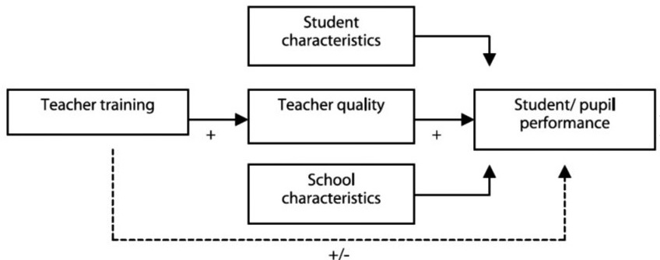
From Improved Teaching to Learning Outcomes
Academic performance is impacted by numerous factors, including student characteristics and school characteristics.
https://www.ou.nl/Docs/Expertise/RdMC/2007%20Working%20Papers/The_need_to_invest_230207_web.pdf
Notes:
Evidence from various studies conducted in Nigeria clearly (e.g. EDOREN 2018, EDOREN 2015, UNICEF 2013,) indicate that contextual factors such as lack of textbooks and other teaching learning materials, overcrowded classrooms, lack of adequate support for teachers, low teacher pay and unsatisfactory teachers’ condition of service are serious challenges and make it impossible to make significant improvements in learning outcomes or even improve subject content knowledge of pupils.

Slide 29
What Kind of Training?
‘New evidence shows that the proportion of certified teachers and professional development have a weak impact on student performance’
Montserrat Gomendio, (2017) ‘Empowering and Enabling Teachers to improve equity and outcomes for all’, OECD, p.13

Slide 30
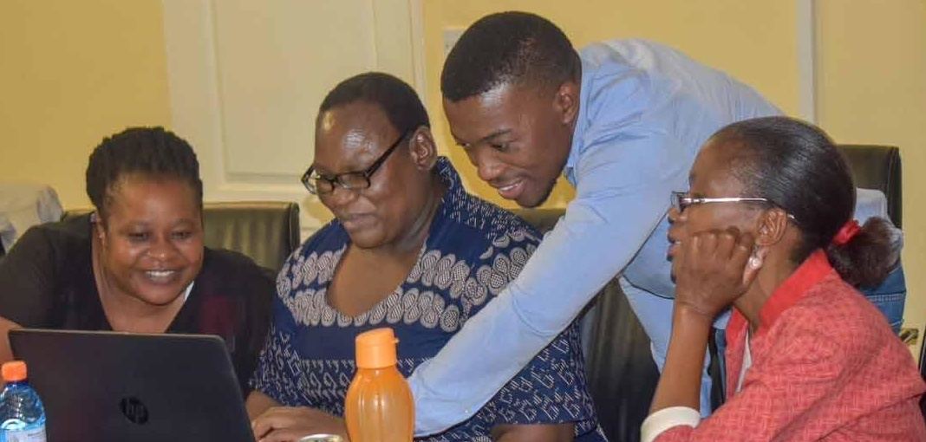
Teacher Professional Development
71% of teachers participate in courses and seminars
Teachers expressed a particularly high need for training in:
teaching students with special needs (39%)
teaching in a multilingual and multicultural setting (20%)
Popova, A., Evans, D. K., & Arancibia, V. (2016). Training Teachers on the Job: What works and how to measure it. Washington DC: World Bank Open Knowledge Repository.
OECD (2019), TALIS 2018 Results (Volume I): Teachers and School Leaders as Lifelong Learners, TALIS, OECD Publishing, Paris, https://doi.org/10.1787/1d0bc92a-en
Notes:
A recent study in South Africa suggests that …
71% of teachers participate in courses and seminars
Teachers expressed a particularly high need for training in teaching students with special needs (39%) and in teaching in a multilingual and multicultural setting (20%)

Slide 31
‘Managed Professional Development’
Teachers receive precise instructions
Regular feedback
Mentorship of a lead teacher
Roland Fryer, Harvard, 2016

Slide 32
The COL Response

Slide 33
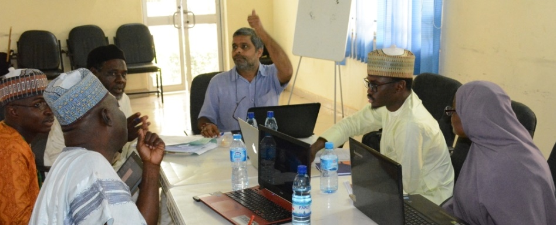
Addressing Climate Change
Green Teacher Programme
COL is working with partners to incorporate environmental education into the teacher development and formal school curricula in NTI, Kaduna
Training on Climate Change
Courses on climate change have been integrated into the pre-service and in-service training in Kiribati

Slide 34
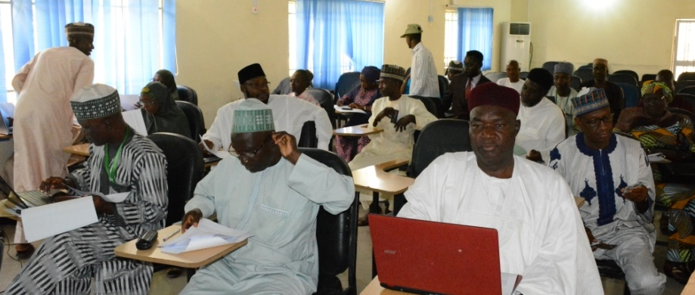
Supporting Nomadic Schools and Nomadic Youth
COL worked with partners in Nigeria to improve access and ensure the provision of quality basic education in nomadic schools as well as skills training and vocational education for nomadic youth
761 schools
209,731 pupils
4,001 teachers
Teacher training for nomadic teachers in Nigeria, Botswana

Slide 35
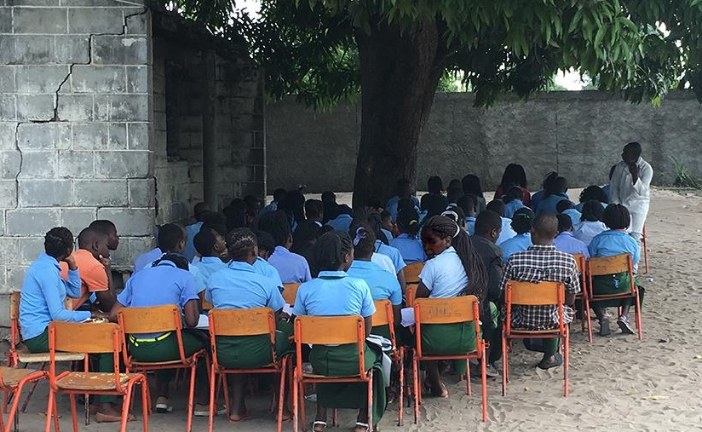
Increasing Access for Out-of-school Youth
Through its Open and Innovative Schooling initiative COL works with partners in Mozambique, Zambia, Malawi and Nigeria to train teachers on resource-based learning to be able to reduce the number of out-of-school youth

Slide 36
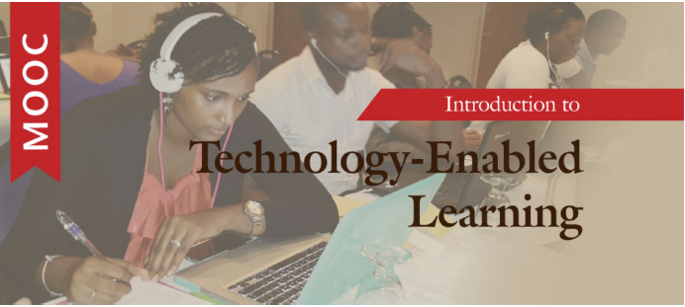

Addressing the ‘Learning Crisis’
COL’s teacher capacity development in adoption and use of OER
ORELT in Kenya, Uganda and Tanzania
TEL MOOC designed for teachers who want to build on their knowledge and practice in effective teaching and learning with technology
Notes:
ORELT aimed at training teacher educators and teachers on the use of Open Educational Resources to improve learning outcomes in English language in secondary schools

Slide 37

The Challenge of Pedagogy
Under its ‘Teacher Futures’ programme, COL is supporting partners towards improved pedagogic practice using learner-centred approaches in The Gambia, Sierra Leone, Rwanda and Kenya
Commonwealth Certificate for Teacher ICT Integration (CCTI)
Digital learning skills (C-DELTA) training for both teachers and learners in South Africa, Uganda and Kenya

Slide 38


Sierra Leone
KEY PARTNER: Freetown Teachers’ College (FTC)
Aims to improving teacher quality through school-based teacher development, enabled by technology
12 Junior Secondary schools; 300 teachers with an impact on over 3,000 learners
Blueprint and Toolkit provides resources and guidance
Capacity building of teacher mentors and school champions in 12 schools to lead and manage communities of practice
Notes:
What is “Teacher Futures”?
“A school-based teacher development model that uses eLearning, microlearning and technologies to support exchange of knowledge on pedagogical practice through in-school, national and cross-national Communities of Practice, for improved learning outcomes”
Junior Secondary School Teachers

Slide 39

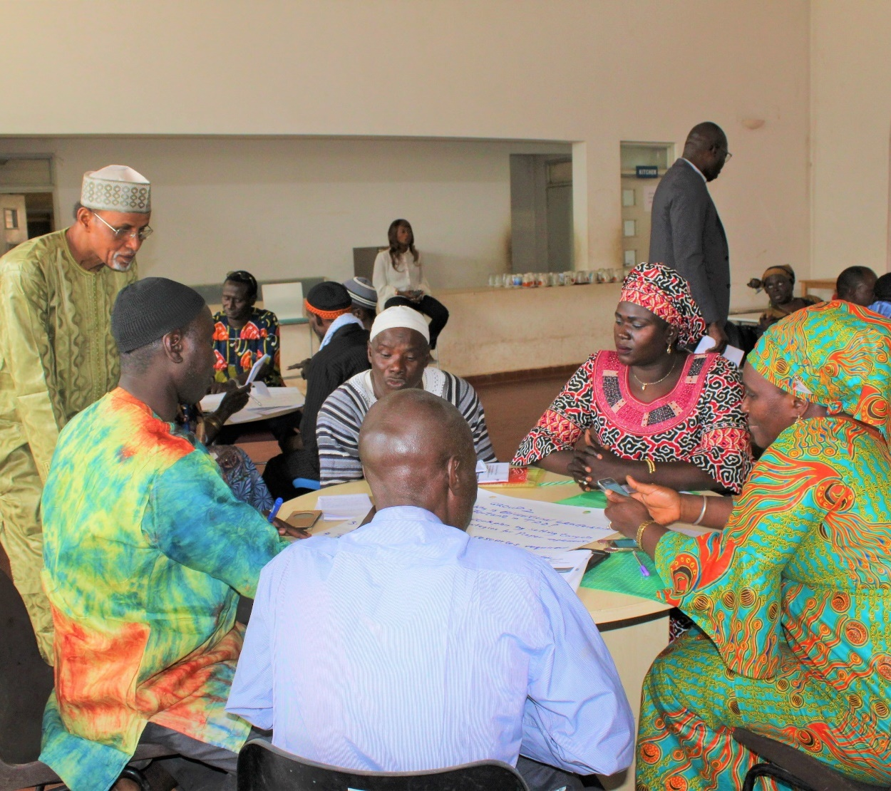
The Gambia
KEY PARTNER: The Gambia College
Focus is on learner-centred approaches
School champions and leaders trained in 20 schools
Resources being finalised for teacher professional development
Aims to reach more than 200 teachers and impact over 6,000 learners
Notes:
What is “Teacher Futures”?
“A school-based teacher development model that uses eLearning, microlearning and technologies to support exchange of knowledge on pedagogical practice through in-school, national and cross-national Communities of Practice, for improved learning outcomes”
Junior Secondary School Teachers

Slide 40

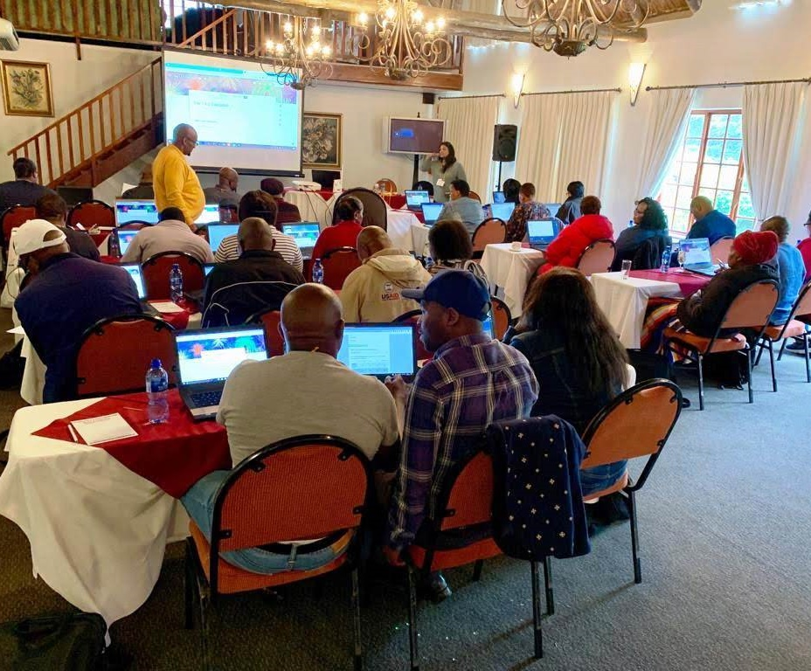
South Africa
KEY PARTNER: University of Forth Hare (UFH)
Capacity building of academic staff at Faculty of Education to provide mentorship to teachers
Teachers from 10 secondary schools in Eastern Cape province are involved
Workshops held for education officials, school leaders and teacher educators
Aims to reach 100 teachers and is expected to impact over 3,000 learners
Notes:
What is “Teacher Futures”?
“A school-based teacher development model that uses eLearning, microlearning and technologies to support exchange of knowledge on pedagogical practice through in-school, national and cross-national Communities of Practice, for improved learning outcomes”
Junior Secondary School Teachers

Slide 41

The COL Approach
Policy
Resources
Capacity building

Slide 42
Looking Ahead

Slide 43
Lifelong Learning for Teachers
1
Move beyond acquiring skills and competencies and focus on Transformative Learning
Not just adapting to changing circumstances but acquiring ability to change circumstances

Slide 44
Transformative Learning
“ to make our own interpretations rather than act on the purposes, beliefs, judgements, and feelings of others. … Transformative learning develops autonomous thinking.”
Mezirow
Mezirow, J. (1997). "Transformative Learning: Theory to Practice". New Directions for Adult and Continuing Education, 74, 5–12.
Notes:
Transformative learning is the transformation of one’s “basic worldview and specific capacities of the self”; transformative learning is facilitated through critical analysis

Slide 45
Digital Readiness: Implications for Teacher Professional Development
2
Source: https://www.pewinternet.org/2016/09/20/digital-readiness-gaps/
Notes:
Digitally Ready. They make up 17% of adults, and they are active learners and confident in their ability to use digital tools to pursue learning. They are aware of the latest “ed tech” tools and are, relative to others, more likely to use them in the course of their personal learning. The Digitally Ready, in other words, have high demand for learning and use a range of tools to pursue it – including, to an extent significantly greater than the rest of the population, digital outlets such as online courses or extensive online research.
Cautious Clickers comprises 31% of adults. They have tech resources at their disposal, trust and confidence in using the internet, and the educational underpinnings to put digital resources to use for their learning pursuits. But they have not waded into e-learning to the extent the Digitally Ready have and are not as likely to have used the internet for some or all of their learning.
The Reluctant, make up 33% of all adults. They have higher levels of digital skills than The Unprepared, but very low levels of awareness of new “education tech” concepts and relatively lower levels of performing personal learning activities of any kind. This is correlated with their general lack of use of the internet in learning.
Traditional Learners, and they make up of 5% of Americans. They are active learners, but use traditional means to pursue their interests. They are less likely to fully engage with digital tools, because they have concerns about the trustworthiness of online information.
A group of 14% of adults make up The Unprepared. This group has both low levels of digital skills and limited trust in online information. The Unprepared rank at the bottom of those who use the internet to pursue learning, and they are the least digitally ready of all the groups.

Slide 46

Leaving No Teacher Behind
Use technologies that are appropriate and affordable
Design content for delivery in low bandwidth situations
Promote OER in local languages
Social media integration
Online/blended peer-to-peer interactions

Slide 47
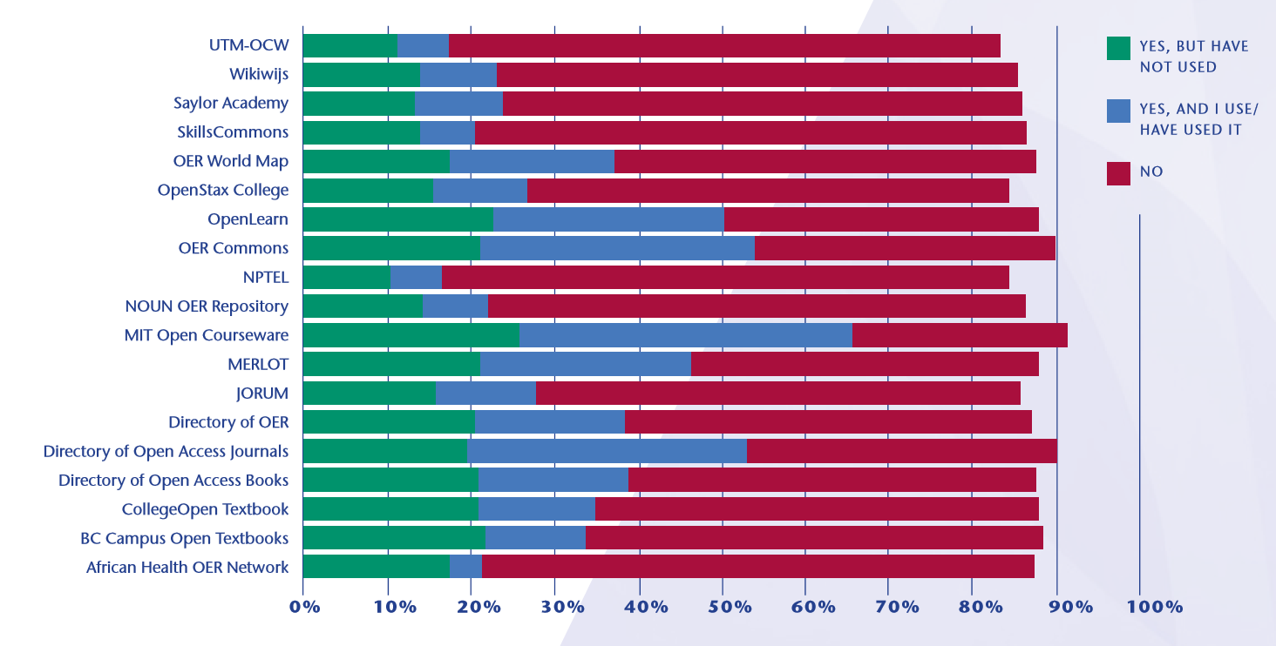
Awareness of OER Repositories & Platforms
Notes:
Awareness and use of repositories are below 40%, indicating lack of optimal use of existing provisions. If we build it, they will come is a myth. More advocacy and campaign to use available resources needed.

Slide 48
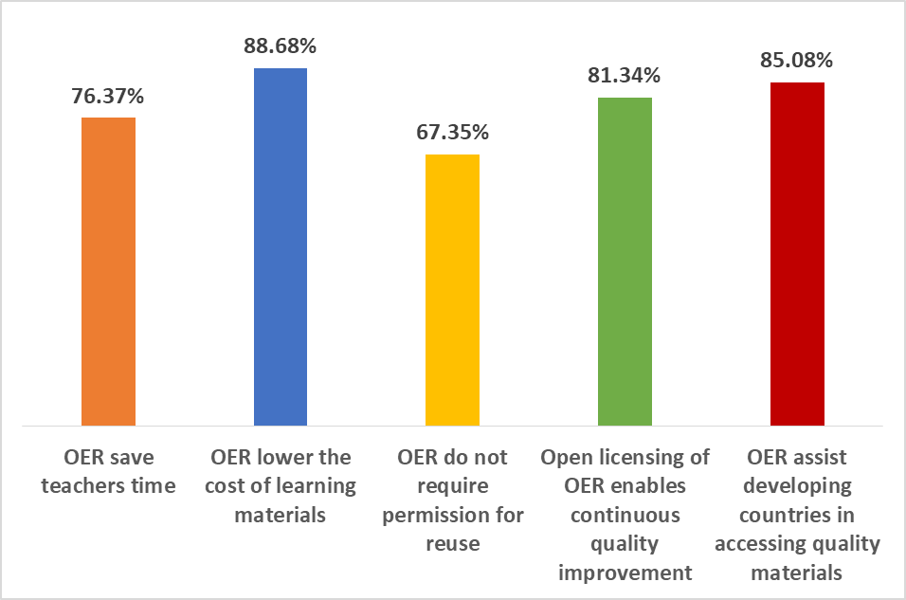
Stakeholder Responses: BENEFITS
Reduced costs
Access to quality materials
Continuous quality enhancement
Saves time

Slide 49








ICT in Education and OER in Africa
ICT in Ed Policy (Year)
Ghana | YES | 2008
Kenya | YES | 2006
Namibia | YES | 2005
Nigeria | YES | 2010
Rwanda | YES | 2008
Seychelles | YES | 2014
South Africa | YES | 2004
Tanzania | YES | 2007
Zambia | YES | 2007
Institutions with OER policies:
National OER policy HE, Nigeria
Mauritius and Zambia developing national OER policy
More institutional OER policy/ strategy in place

Slide 50

Communities of Practice
3
Respect for different views
Inclusive communities of practice / networks
Shared values
Willingness to share
Collegiality and trust

Slide 51
The Virtue of Collegiality
‘Collegiality derives from certain obligations that are in fact duties, not from camaraderie, fellowship, or even familial feeling. Only when the duties of collegiality are observed in a gracious, caring spirit of mutual respect, friendship, or family does duty become transformed into virtue’
Mangiardi & Pellegrini (1992)

Slide 52



Three Key Literacies
Human
Data
Technological
Source: Joseph Aoun (2017): Robot-proof, MIT Press, https://mitpress.mit.edu/books/robot-proof

Slide 53
Questions
What are the characteristics of African learners? How can we respond to their needs?
What types of professional development will lead to better learning outcomes?
Identify areas where capacity building is needed most for effective teaching.
What are we doing to use ICTs to support teaching-learning?
What strategies do we need for creating sustainable communities of practice?
As teachers, how are we dealing with the crises?

Slide 54


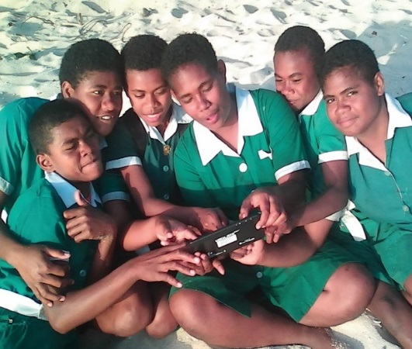
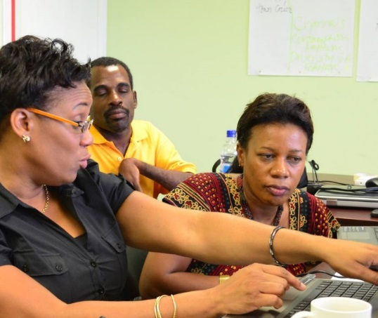
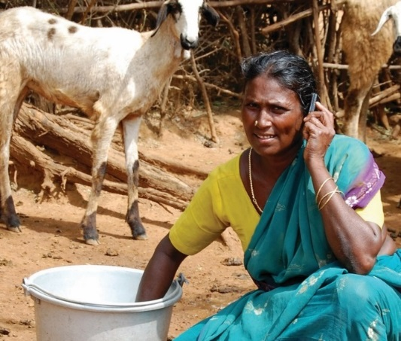
Thank You
col.org

