Slide 1


Quality Assurance tools
Romeela Mohee
Education Specialist: Higher Education
PEBL workshop
Nairobi, 17-20 April 2018

Slide 2
Overview
Institutional QA
  Quality management systems
  QA policy
  QA audit- Self assessment report
  COLRIM
TQF
Learning outcomes
  Define QA mechanisms and tools in Higher education systems
  Differentiate between QA tools at institution level

Slide 3
Quality Management System (ISO9001)

Slide 4
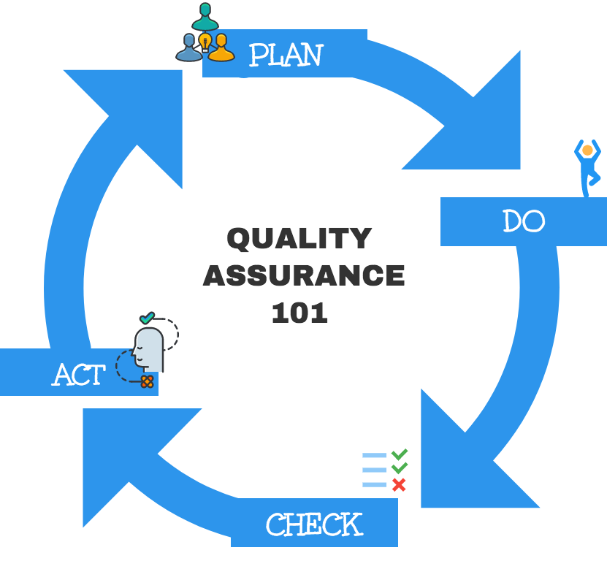
Quality Management system ( QMS)
  A QA system includes defined standards of achievement, documented procedures for all identified processes, established ways of responding to issues and clear accountability of outcomes (IS09000)

Slide 5

PLAN
The first step of a robust Quality Assurance program is planning.
Planning involves thinking through the entire life-cycle of a Quality Assurance program,
Effective Plan-ing requires detailed consideration of the major elements of Quality Assurance, including:
  (1) QA Policy,
  (2) Overall Institutional Infrastructure,
  (3) Training,
  (4) Implementation,
  (5) QA Audits and
  (6) QA Feedback Incorporation. In this step, organizations will need to build the tools, resources, trainings and protocols necessary to implement QA .

Slide 6

DO
Effective Do-ing requires QA structures, tools and policies to be in place and to be ready to be used.
Do-ing means actually using the protocols and practices developed in the QA planning stage. Thus, Do-ing may require a shift in work habits and procedures and necessitates training for instructors, course designers and administrators.

Slide 7

Check
Institution-wide Quality Assurance checks, where the effectiveness of an institutions overarching QA processes are evaluated, should also be performed at regular intervals.
Internal and external quality audits
External evaluators generally perform institutional QA checks.

Slide 8

ACT
Thus, responses to evaluations, or action plans, should be incorporated into course, program and institutional planning. In this way, Act is a precursor to Plan in the Quality Assurance cycle.
Act-ing is where institutions best demonstrate their commitment to quality. By showing stakeholders they are willing to use feedback in order to achieve or surpass their stated standards of quality, organizations display self-awareness and leadership in providing quality programming.

Slide 9
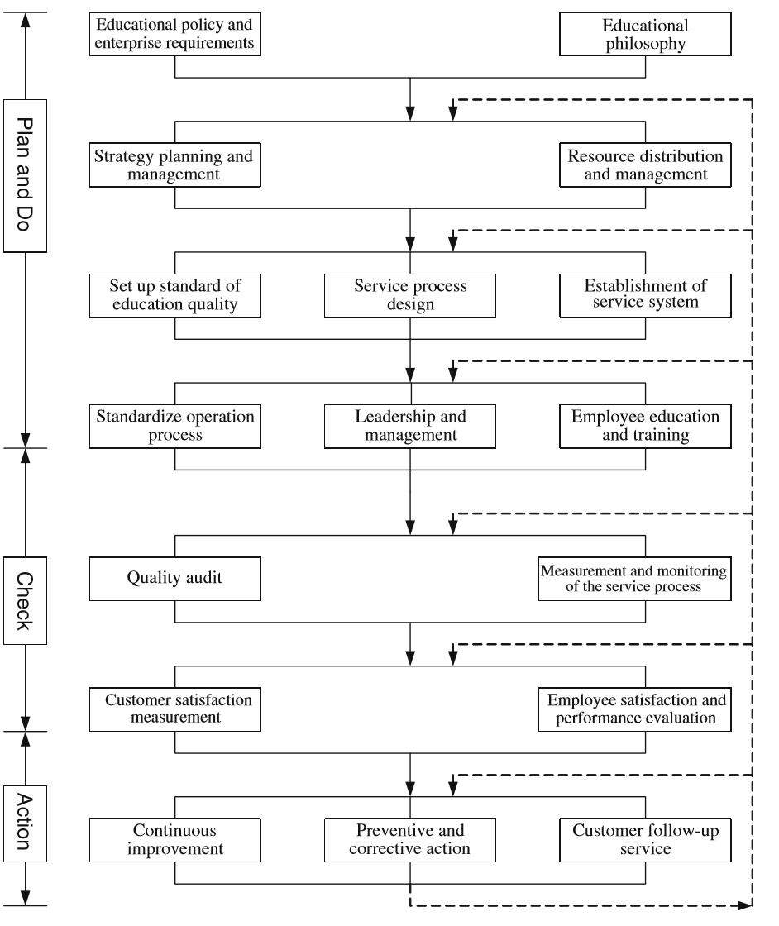
The Establishment of a Quality Management System for the Higher Education Industry. Shun Hsing Chen. Qual Quant (2012) 46:1279–1296

Slide 10
QA policy

Slide 11
Elements of QA policy
All activities that promote quality assurance should be documented in a university’s quality assurance policy.
A comprehensive policy allows a university to articulate in a single document its values, goals and objectives in the area of quality assurance as well as the activities that enable it to meet these goals and objectives.
It helps to ensure that there is a common terminology to support quality assurance, and that activities related to quality assurance are carried out consistently across programs, services, or units over time.
It facilitates communication and dialogue, and ultimately ensures an effective process.

Slide 12
QA policy
Institution policy in quality that defines the institution goal and standard and that reflects the values and principles of its mission statement
Develop an operational plan that describe the processes that will monitor quality and performance indicators and assigns responsibility for implementation
  Op plan –identifies analyses and maps critical functions. Describe steps in all procedures, standards of performance ( turnaround time for student assignments….)
It should describe the various review processes (academic and non-academic) and other related quality assurance activities, and include the lines of accountability and responsibility as well as timelines for key steps of each process.
Reference: From tools to an internal quality assurance system. University of Duisburg-Essen, Germany. http://www.iiep.unesco.org/

Slide 13
QA policy ( Open University of Mauritius)
The QA policy provides for transparent and more explicit quality assurance measures to promote effectiveness in the implementation of quality standards and criteria by;
  Establishing key QA management structures, including a quality assurance unit and corresponding committees to monitor and review quality assurance practices
  Developing a quality assurance manual and procedures
  Developing formal mechanisms or policy for development, approval, monitoring and review of programmes, courses and awards
  Designing and implementing a comprehensive learner support system, which ensures that tutorial, counselling, pastoral and academic support required by learners are considered in programme and course design, development and production of distance learning products and services
  Ensuring institutional compliance with national and international quality standards
Source: OUM policy document. T.Nhundu. April 2018.

Slide 14
QA manual/handbook
A QA manual/handbook will contain
  Glossary of key terms
  procedures for implementing, modifying, and terminating a study programme, using flowcharts and written descriptions;
  tools for internal quality assurance and their application in study programmes, departments, and faculties.
  Glossary of key terms
  Main QA tools used at the institution

Slide 15
Self Assessment
A Self- Assessment Report (SAR) is a formal tool used by institutions to assess the quality of a program, from the perspective of its’ instructors.
Self-Assessments give instructors the opportunity to provide their institutions with thoughtful, structured feedback about the strengths and weakness of program or course.
These reports are not intended to be disciplinary tools; instead, they are tools intended to support instructors, and institution as a whole, in their development as providers of quality education.
SARs are most effective when they include not only strengths and weaknesses, but also actionable suggestions about what is needed to improve. They should be filled out honestly, critically and at regular intervals.

Slide 16

Internal institutional audit
Common QA procedures in an audit are
  Self study/self evaluation
  Peer review by an expert panel
  Use of statistical indicators and performance indicators; completion rates, overall grades
  Surveys of key stakeholders such as students, graduate, employers, faculty
  UNISA trial audit (2007)
    29 Commendations and 5 recommendations
Reference: http://oasis.col.org/handle/11599/211

Slide 17
COL tools

Slide 18
COL tools
QA audit in Ghana and UNISA
COLRIM
QA toolkit for
TIPS framework for OER
Transnational Qualifications framework ( TQF)

Slide 19
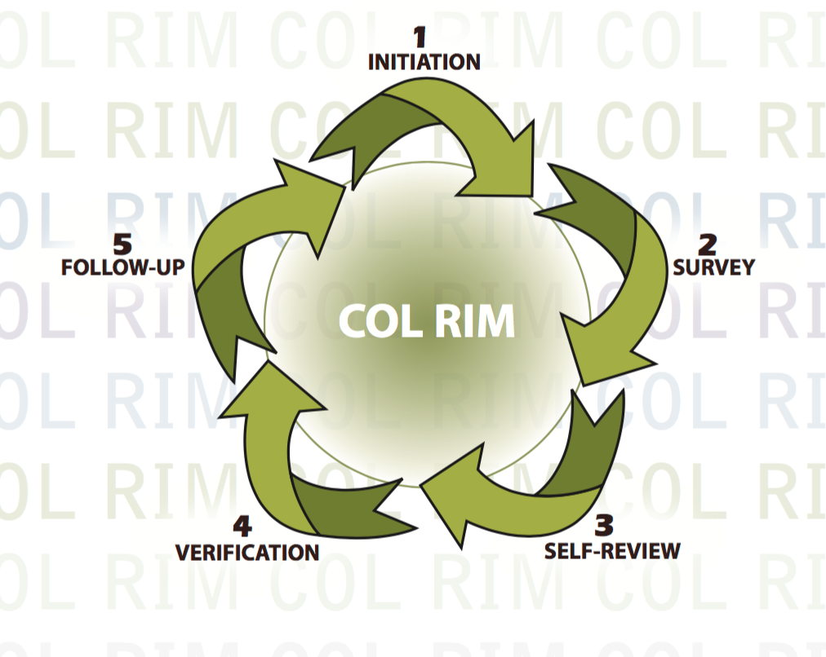
COL RIM – Commonwealth of Learning review and Improvement model
Combines internal and external quality assurance in a low-cost ‘do-it-yourself’ approach which does not require a panel of external experts
Develops systemic thinking and organizational learning
Offers credibility without high-stakes consequences for poor performance
Focuses on improvement and includes capacity building and developmental support
Reference: oasis.col.org/handle/11599/602

Slide 20
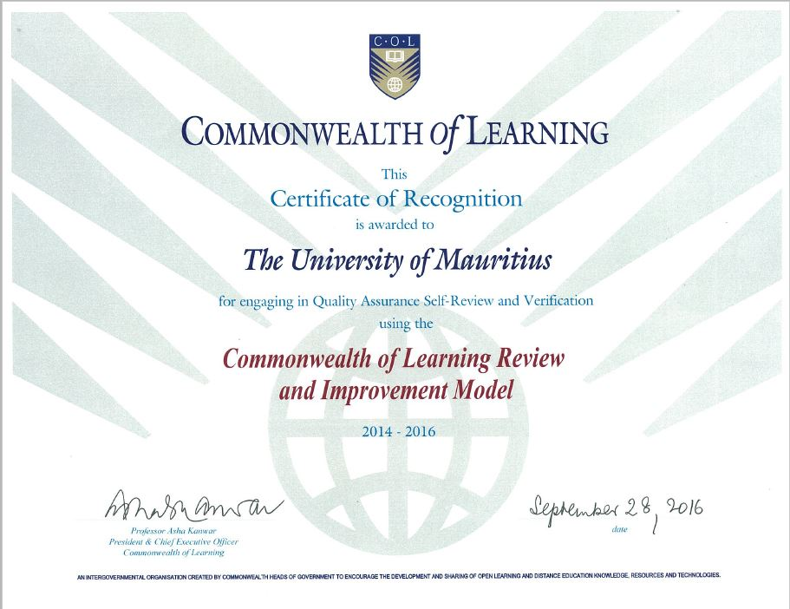
COL/RIM
COL/RIM certificate awarded to 10 institutions
  Bangladesh Open University
  Wawasan Open University, Malaysia
  Krishna Kanta Handiqui State Open University (KKSHOU), India
  NIHSS Seychelles
  The University of Jaffna in Sri Lanka
  Fatima Jinnah Women’s University Pakistan
  Allama Iqbal Open University (AIOU) Pakistan
  National University of Lesotho
  University of Mauritius

Slide 21
COLRIM process
“Quality is an emergent property of an institution’s own systematic review and improvement of its own performance”
Communication
• Needs orientation
• Capacity-building
• Quality management
• Engagement
• Innovation & Creativity

Slide 22
Self Review ( COLRIM)
How effectively does the institution communicate with its stakeholders?
How well does the institution provide the outcomes that its stakeholders need and value?
How effectively does the institution engage with local and international communities?
How effective are the institution’s innovative and creative responses to a changing environment?
How effectively does the institution develop the capacity of its people to provide valued outcomes for stakeholders?
How well does the institution monitor and improve its performance?

Slide 23
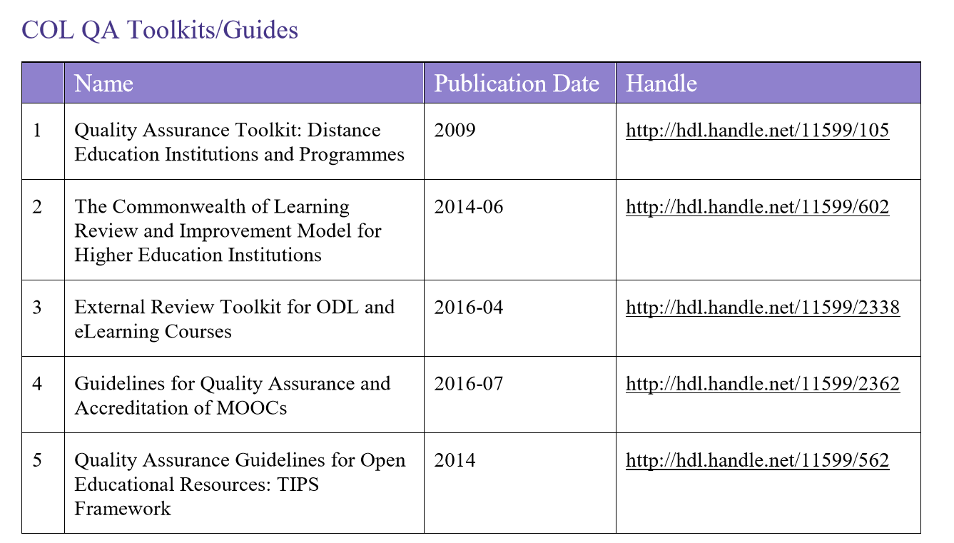
COL Resources on Quality
Notes:
23

Slide 24
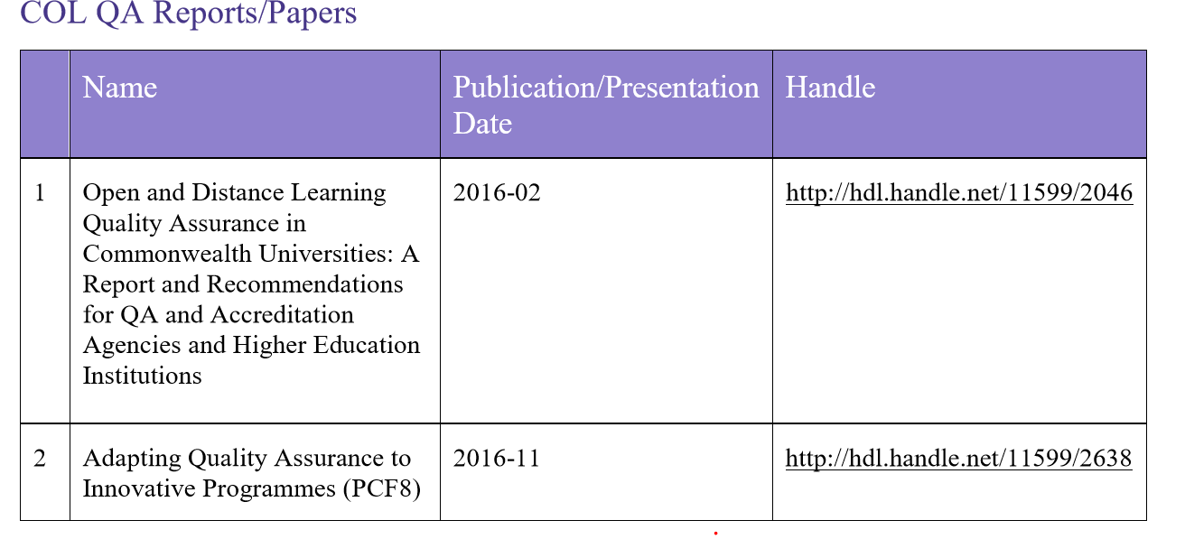
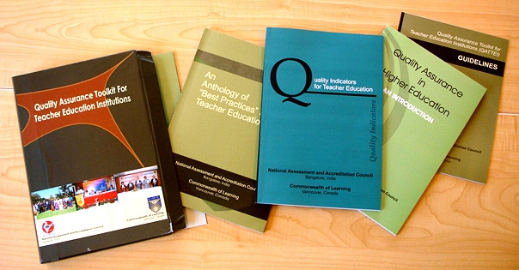

Slide 25
Transnational Quality framework
( TQF)
Courtsey: Dr Mairette Newman, Education Specialist, VUSSC, COL

Slide 26
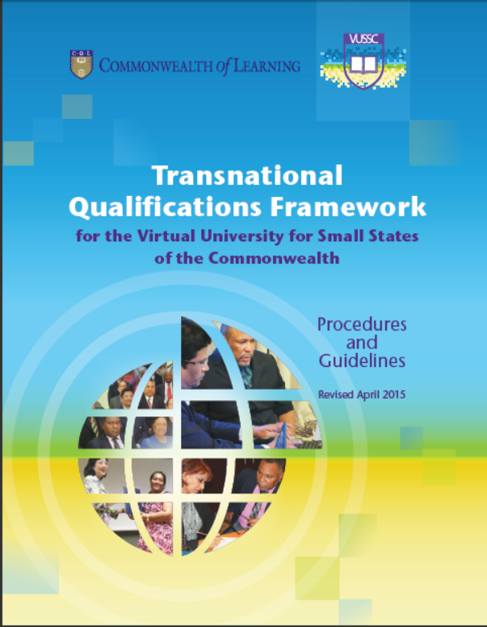
What is the Transnational Qualifications Framework (TQF)?
A reference system
  that links or connects national qualifications systems and frameworks from different small states
A mapping instrument
  that allows courses and qualifications to be compared
A translation tool
  for classifying qualifications according to a set of criteria for different levels of learning outcomes
Reference: Transnational qualification framework for the Virtual University for small states of the commonwealth. 2015. oasis.col.org/handle/11599/501
A manual with guidelines for registering and using the TQF has been developed and is available on the COL Oasis site.
Transnational Qualifications Framework 2015
Notes:
TQF is linked to the European Qualifications Framework, Pacific Registry of Qualifications and Standards, CARICOM, the Association of South East Asian Nations (ASEAN), and the Southern African Development Community. It provides a means through which courses offered within the VUSSC environment can be understood and compared, thereby paving the way for exchange and transfer of courses, learners and qualifications.

Slide 27
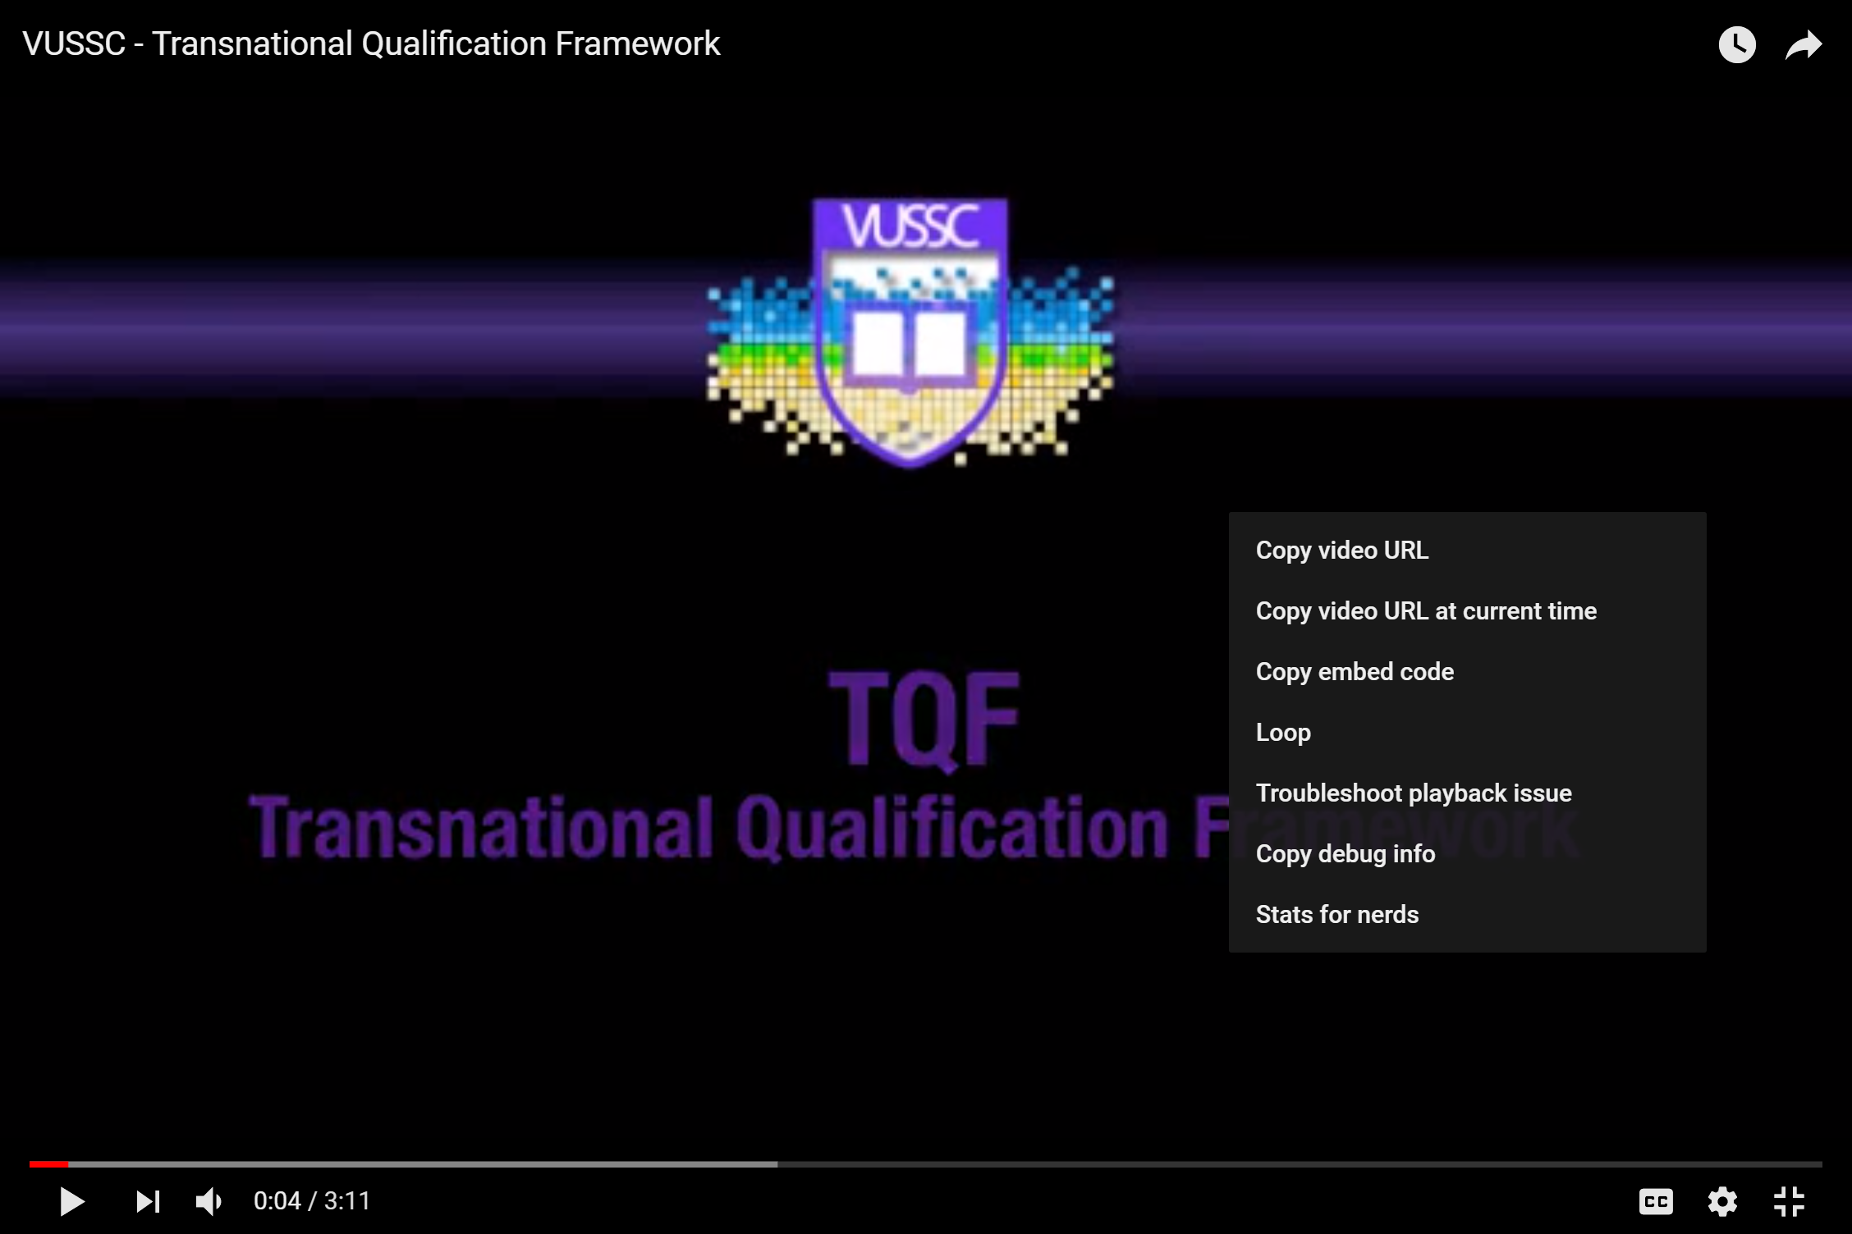
Watch a 3 minute video:
What is the TQF and how does it work?

Slide 28
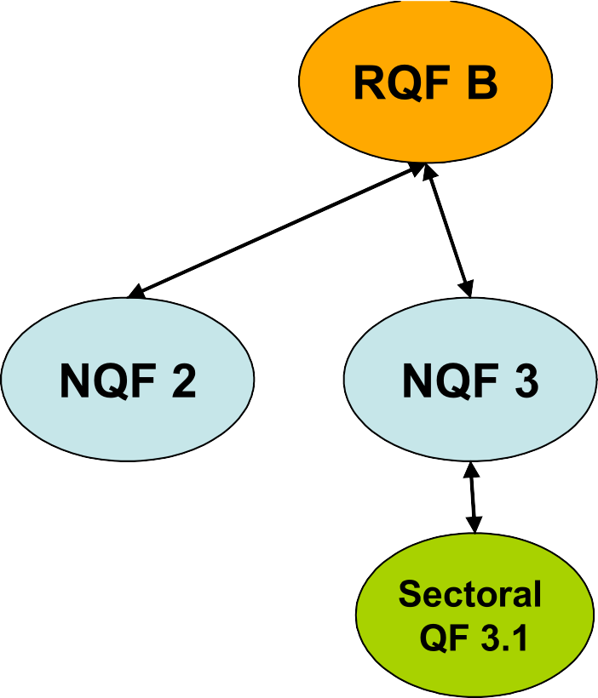


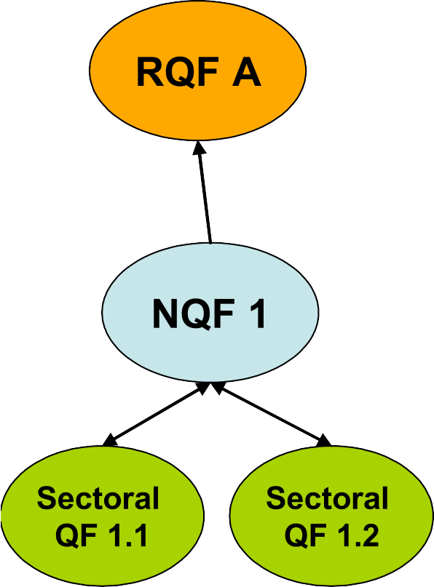
Transnational Qualifications Framework
NOTE:
TQF does not replace existing qualifications frameworks
TQF is non-regulatory
TQF is voluntary

Slide 29
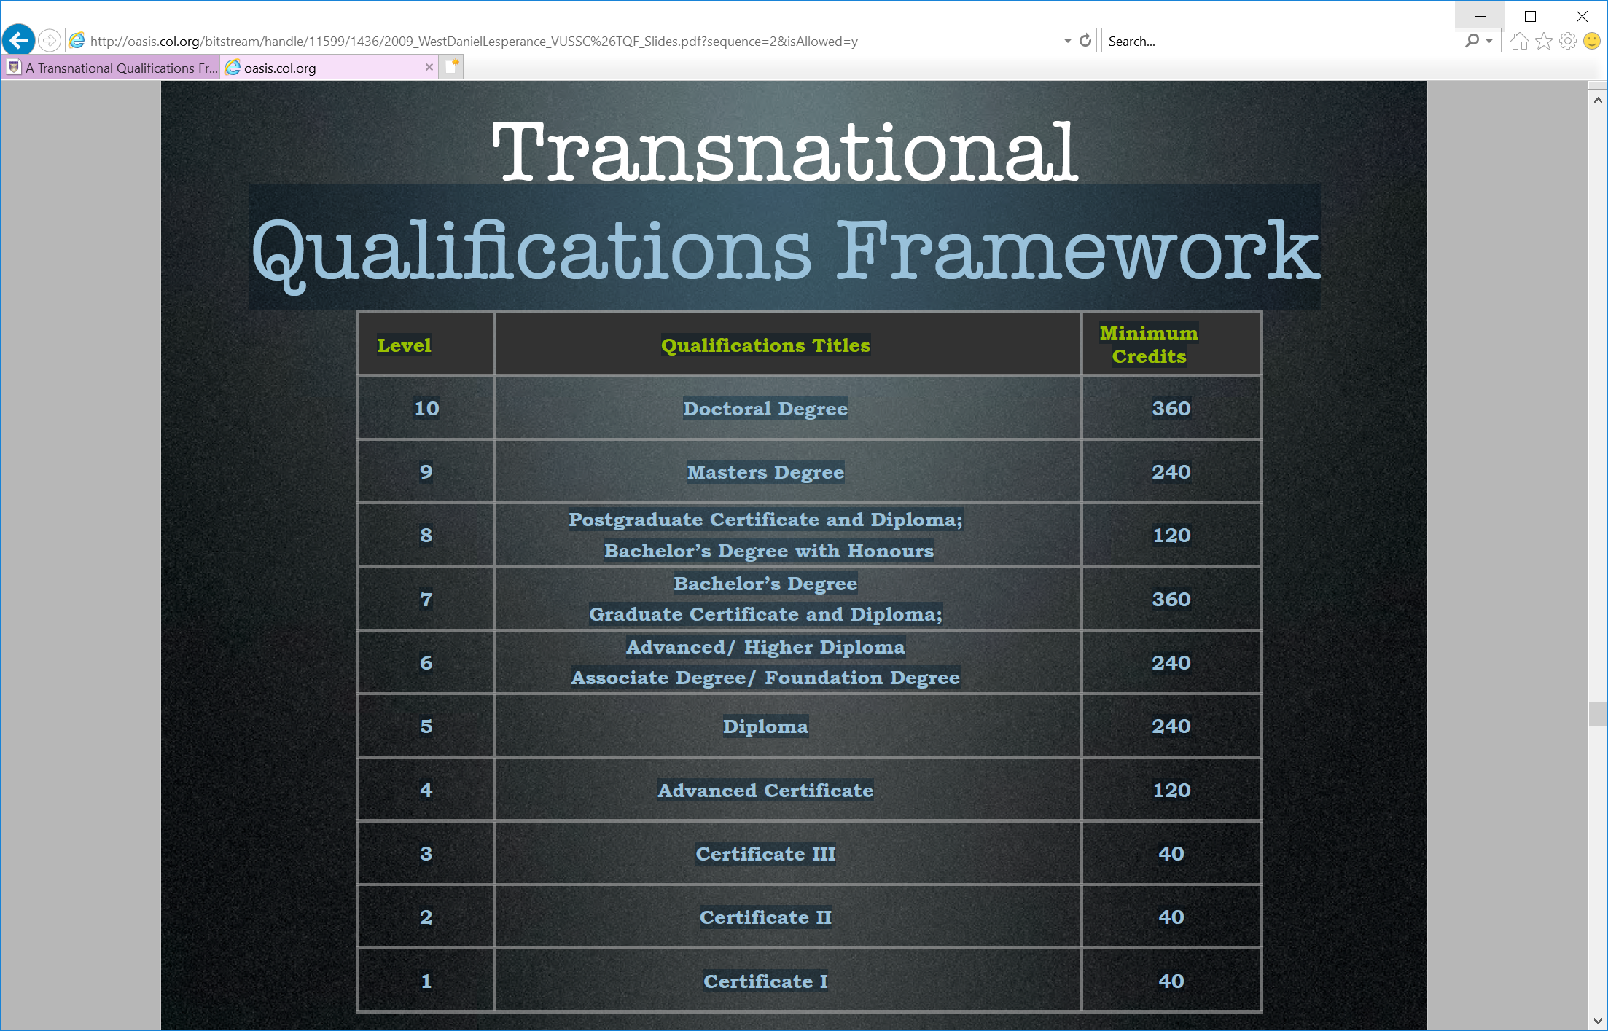

Slide 30
TQF Registration Process
A course can apply for TQF registration if
It is offered by an institution approved and recognised by the government
It has been approved within the institution
It has been approved by the national qualifications authority
It has been approved by the regional qualifications authority

Slide 31
Benefits of the TQF
Promotes mobility of courses, qualifications and learners among the 31 small states
Facilitates comparison of qualifications among the 31 small states
Supports credit transfer and articulation across the 31 small states
Increases transparency
Promotes common quality assurance mechanisms
Overall, TQF encourages and improves labour mobility; educational portability and international recognition of small states’ qualifications
Notes:
Think about dividing this into direct and indirect benefits

Slide 32
Qualifications Registered on TQF
Master in Educational Leadership
Bachelor in Business Entrepreneurship (Honours)
Bachelor in Business and Entrepreneurship
Bachelor in Environmental Science
Diploma in Sustainable Agriculture for Small States
Certificate in Tour Guiding
Notes:
Six qualifications registered by four countries

Slide 33
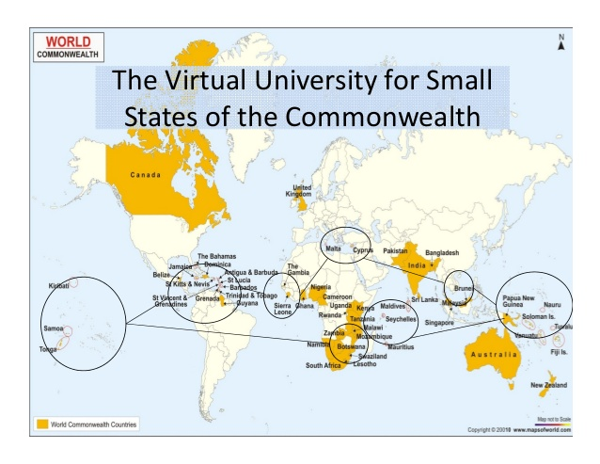
Virtual University for Small States of the Commonwealth (VUSSC)
A collaborative network or conduit NOT a traditional institution
Encourages and supports the development of open learning and distance education knowledge, resources and technologies
Strengthens the capacity of national institutions in small states
Helps small states collaborate
Notes:
Just in case you need something explain the concept of VUSSC

