Slide 1



Rethinking Education for Innovation, Growth and Sustainability post Covid-19
Professor Asha Kanwar
COL President & CEO
Commonwealth Education Ministerial Action Group,
11 May 2023

Slide 2
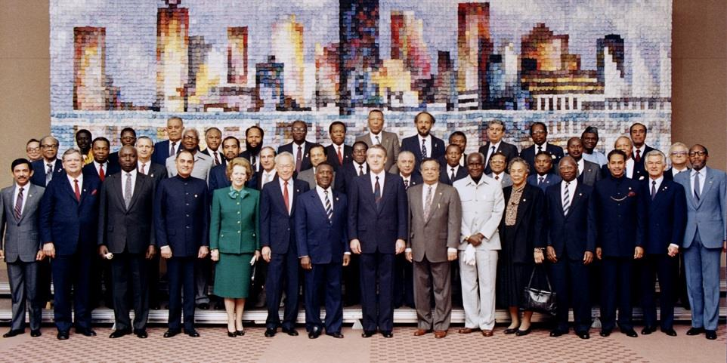

Commonwealth Heads of Government Meeting
Vancouver, 1987

Slide 3
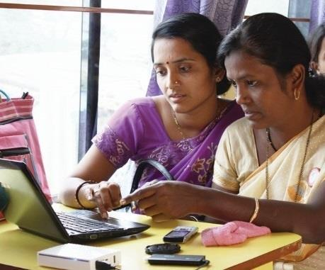
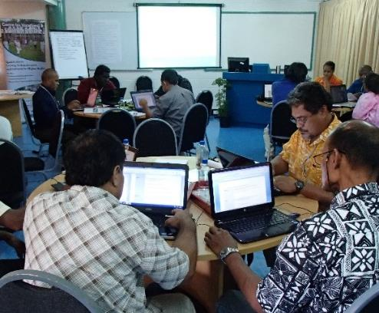
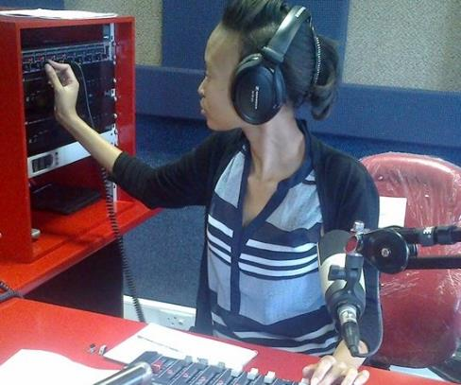
To help Commonwealth governments and institutions use technologies to improve and expand access to education and training

Slide 4

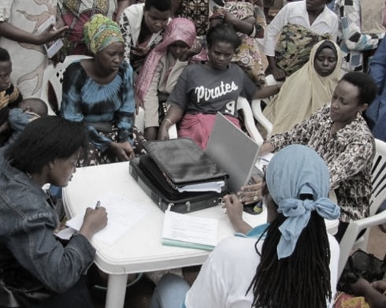
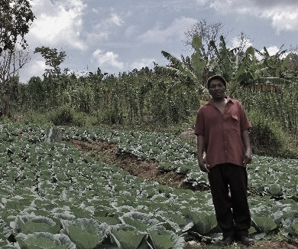


ECONOMIC EMPOWERMENT
SOCIAL
INCLUSION
ENVIRONMENTAL CONSERVATION
$
Notes:
COL continues to promote ‘learning for sustainable development’. Learning must lead to economic growth, social inclusion and environmental conservation.

Slide 5
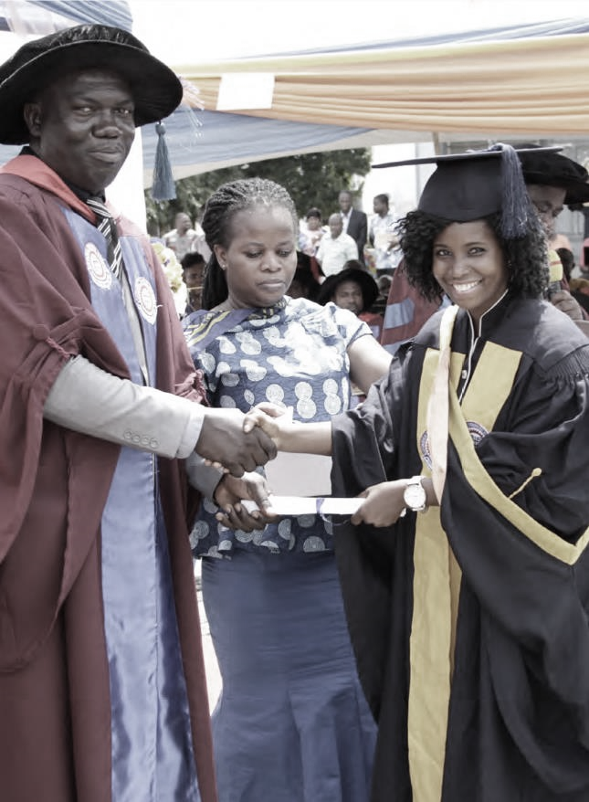
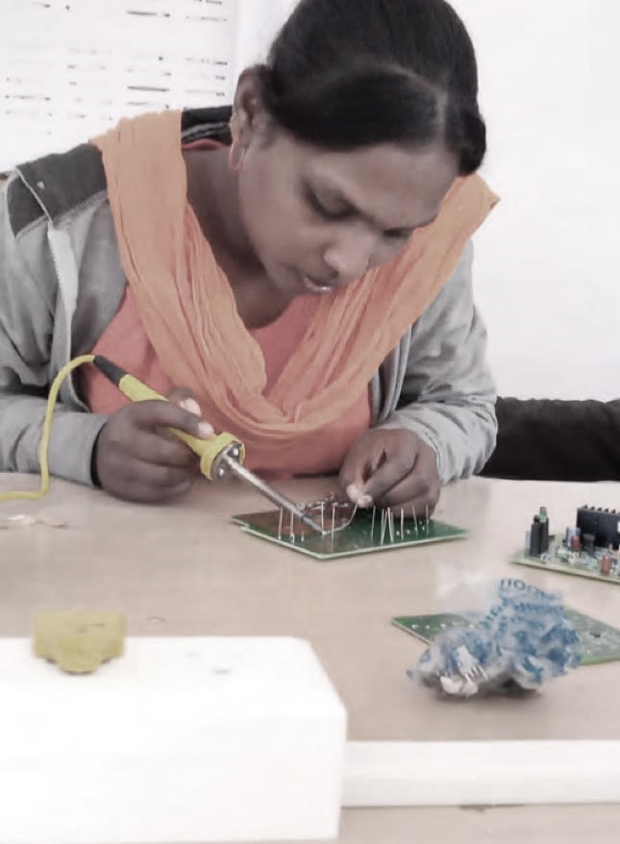
SECTORS
Education
Skills
Gender Equality

Slide 6
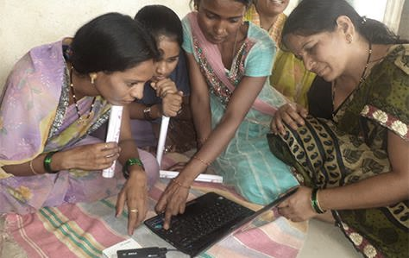
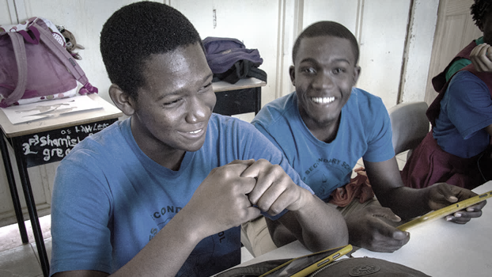
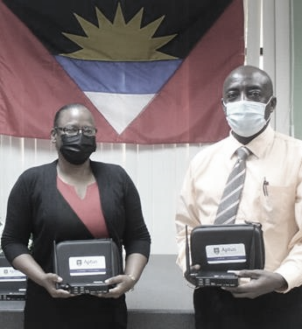
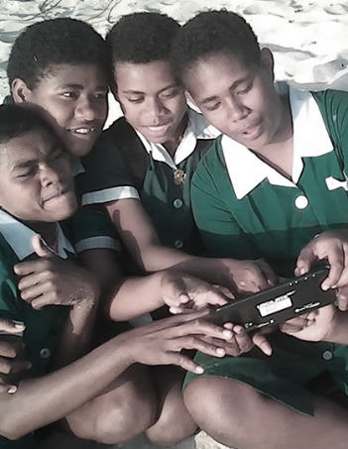
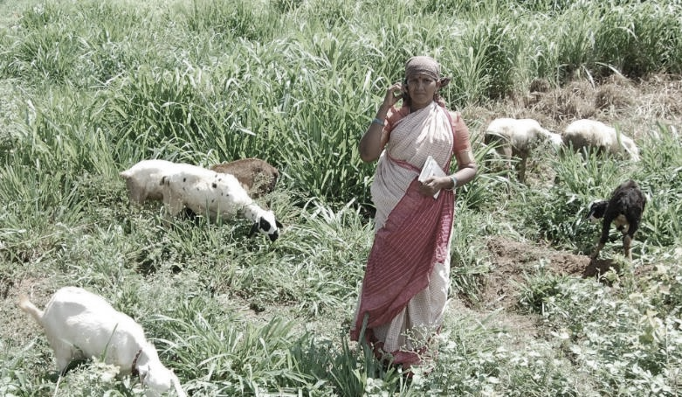
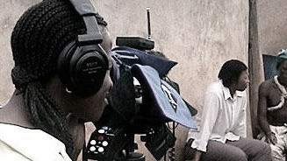
Leveraging new and existing technologies

Slide 7
Innovations

Slide 8

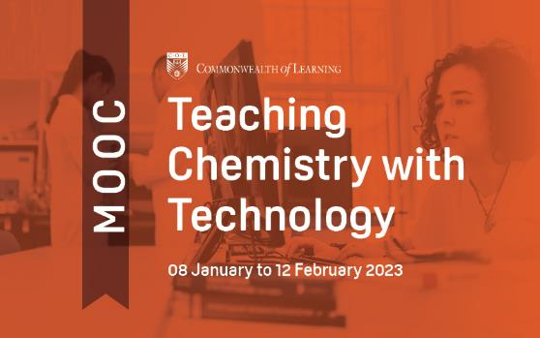
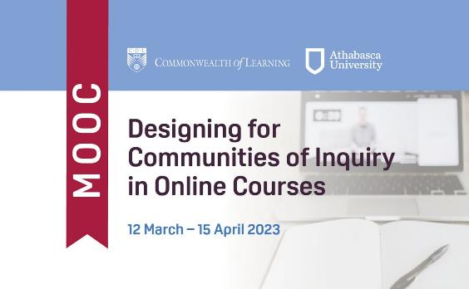
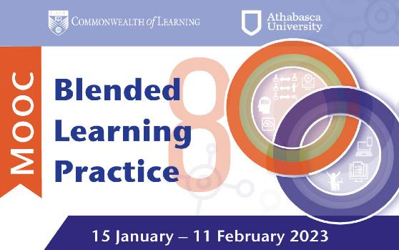
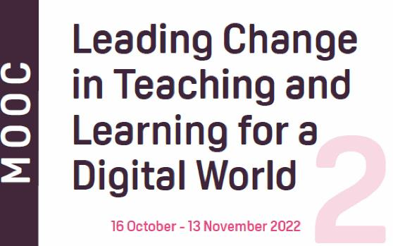
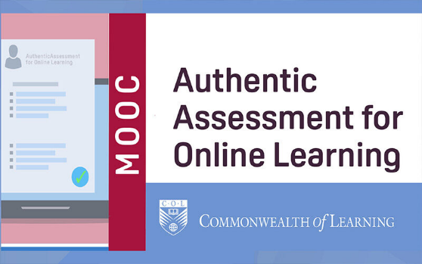
Massive Open Online Courses
M O O C

Slide 9
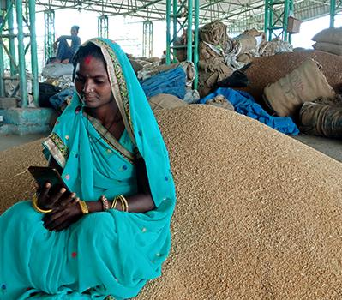
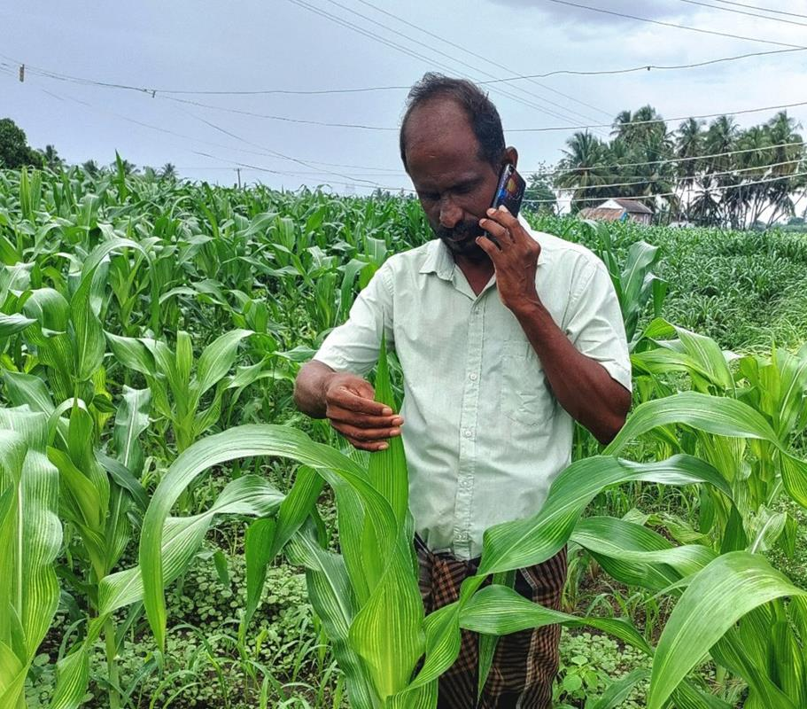


MobiMOOC Online learning - Food and Agriculture sector underserved. COL’s innovation helps farmers access learning using basic phones

Slide 10
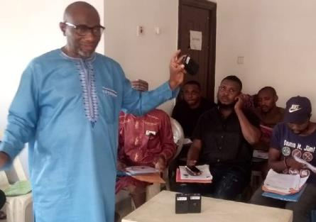
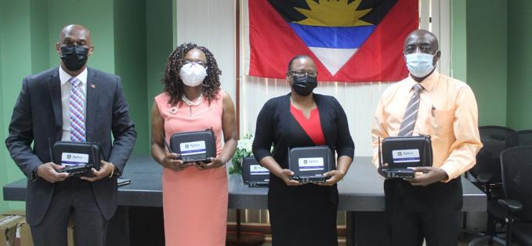
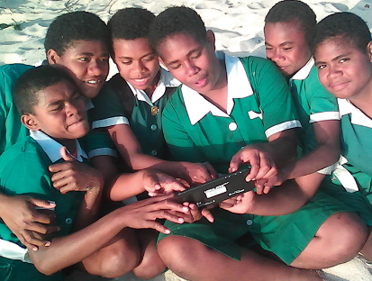






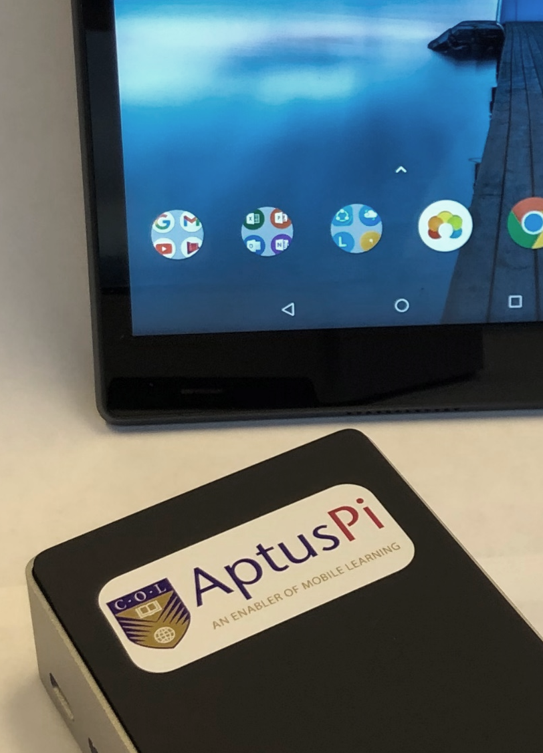








ANTIGUA & BARBUDA
BAHAMAS, THE
FIJI
INDIA
KIRIBATI
MALDIVES
MOZAMBIQUE
NIGERIA
PAKISTAN
SAMOA
TONGA
VANUATU
ZAMBIA
A low-cost device that allows educators and learners to connect to digital learning platforms and content without the need for grid electricity or Internet access.
Notes:
COL developed Aptus a low-cost offline virtual classroom that provides learners in remote locations with access to digital resources. It’s a server that works with a solar charger and a wireless router and costs approximately $ 150.

Slide 11

ICT Augmentation for Small States/LDCs
Addressing ICT resources and capacities
Build national resilience for education by supporting disaster preparedness in small states
Introduce and model the use of environmentally sustainable green technologies

Slide 12
Growth

Slide 13
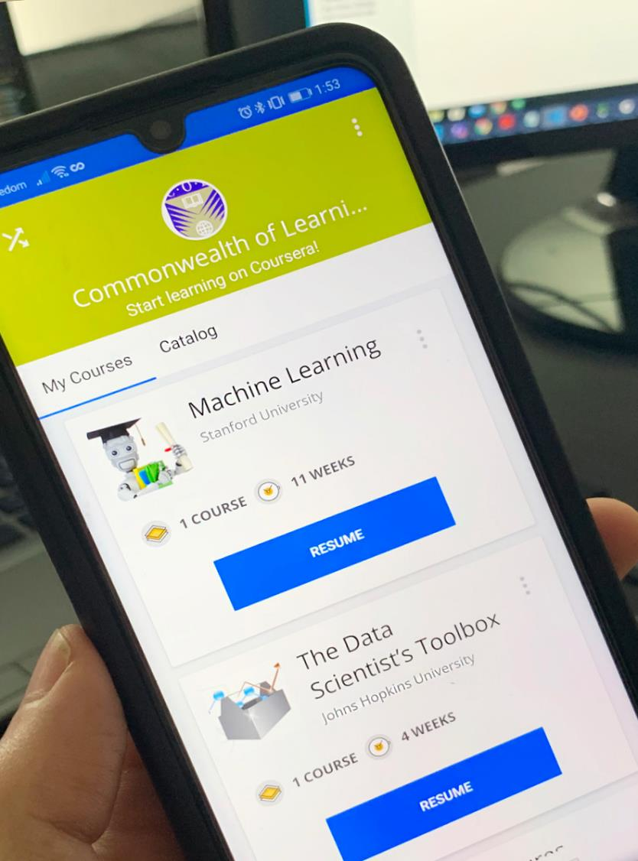



Economic growth:
Skilling and re-skilling
COL has admitted over 350,742 citizens
of the Commonwealth to gain skills for employability and entrepreneurship

Slide 14











EMPOWERING WOMEN AND GIRLS
126,895 trained
BANGLADESH | KENYA | MALAWI | MOZAMBIQUE | NAMIBIA | PAKISTAN | PAPUA NEW GUINEA | SOLOMON ISLANDS | SRI LANKA | UGANDA
Notes:
As of May 2023
We have trained 126,895 women and girls since we started in 2016
This number includes the following 10 countries:
Bangladesh
Kenya,
Malawi,
Mozambique
Namibia,
Pakistan,
PNG
Uganda
Solomon Islands
Sri Lanka

Slide 15
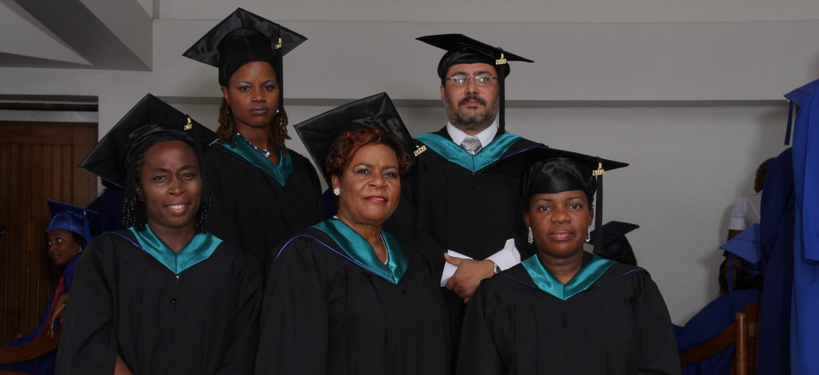


Commonwealth Executive MBA/MPA
Graduates saw on increase of 38% in monthly income
For every $1 invested, learners received $3.40 in direct returns
1:3.4

Slide 16
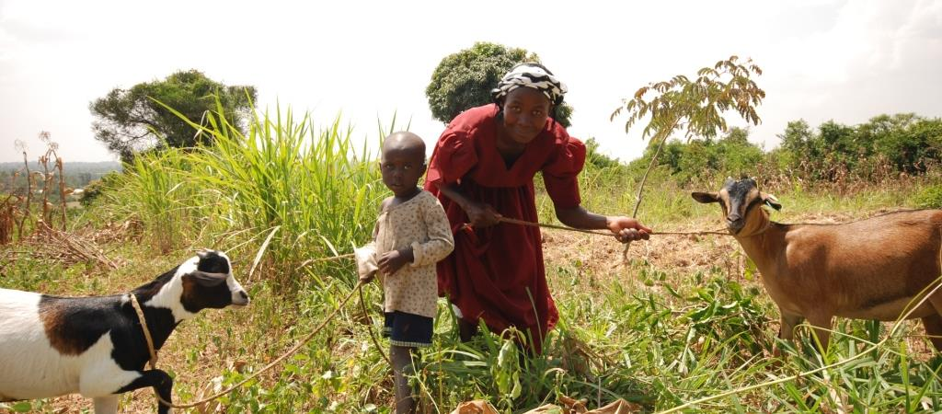



Lifelong Learning for Farmers (Kenya, Tanzania, Uganda)
1% increase in empowerment 2.3% increase in profit

Slide 17
Sustainability

Slide 18
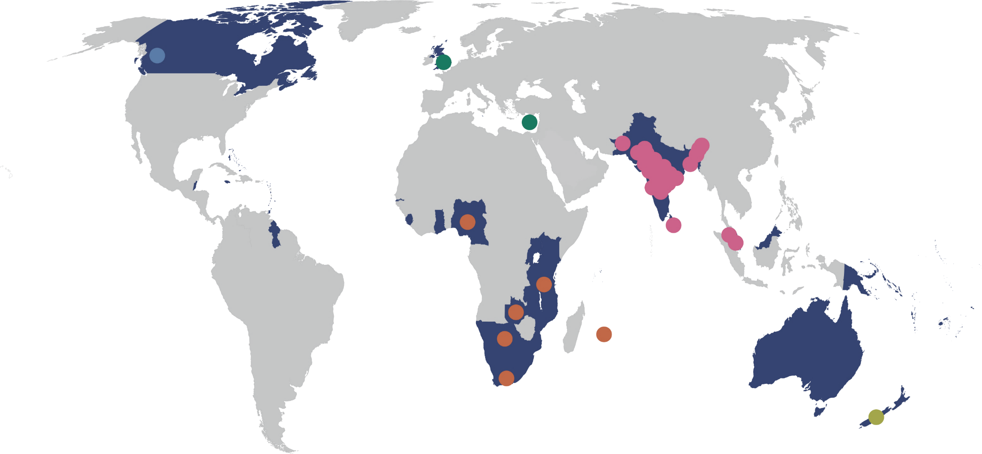
BANGLADESH
  Bangladesh Open University
INDIA
  Dr. Babasaheb Ambedkar Open University
  Dr. B.R. Ambedkar Open University
  Indira Gandhi National Open University
  Jagat Guru Nanak Dev Punjab State Open University
  Karnataka State Open University
  Krishna Kanta Handiqui State Open University
  Madhya Pradesh Bhoj University
  Nalanda Open University
  Netaji Subhas Open University
  Odisha State Open University
  Pandit Sundarlal Sharma (Open) University
  Sreenarayanaguru Open University
  Tamil Nadu Open University
  Uttarakhand Open University
  Uttar Pradesh Rajarshi Tandon Open University
  Vardhman Mahaveer Open University
  Venkateshwara Open University (Private)
  Yashwantrao Chavan Maharashtra Open University
MALAYSIA
  Open University Malaysia
  Wawasan Open University
PAKISTAN
  Allama Iqbal Open University
SRI LANKA
  Open University of Sri Lanka
CYPRUS
Open University of Cyprus
UNITED KINGDOM
The Open University
CANADA
Athabasca University
33 Commonwealth Open Universities
(2021)
BOTSWANA
Botswana Open University
MAURITIUS
Open University Mauritius
NIGERIA
National Open University of Nigeria
SOUTH AFRICA
University of South Africa
TANZANIA
Open University of Tanzania
ZAMBIA
Zambian Open University
NEW ZEALAND
Open Polytechnic of New Zealand

Slide 19

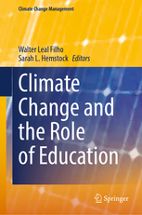






Research on Emissions and ODL
BOTSWANA
3x less carbon emissions
Travel – greatest contributor
Mode of delivery - determinant
Source: Carr et.al. Delivery Mode and Learner Emissions: Comparative Study from Botswana. W. Leal Filho and S. L. Hemstock (eds.), Climate Change and the Role of Education, Springer Nature. In Production.
Notes:
Perhaps the most comprehensive project assessing the environmental impacts of different modes of delivery in higher education is the SusTEACH project, supported by the Open University, UK. The project compared the carbon emissions of ICT-enhanced courses with online courses and mainly face to-face taught courses. The findings showed that online and blended ICT-enhance distance teaching models had significantly lower environmental impacts than face-to-face teaching modes (Caird et al. 2013; Caird et al. 2015). This study used a comprehensive methodology that considered multiple contributors to emissions for both students and the institutions.
Using the SusTeach methodology COL conducted a study in Botswana, to determine whether there was a difference between the carbon emissions of CD-based ODL and face-to-face learners, as well as the main sources of learners’ emissions.
The comparison of learner carbon emissions data from both face-to-face and CD based students in Botswana revealed that the average learning-related carbon footprint of the face-to-face group is nearly three times greater than that of the ODL group, and the difference was statistically significant. Within the overall carbon footprint, emissions from travel were by far the greatest contributor to this disparity. This suggests that regardless of the exact mechanism of delivery, ODL or blended modes can decrease emissions by reducing face-to-face contact hours. Institution, as a proxy for delivery mode, was the most significant predictor of learning related emissions.

Slide 20
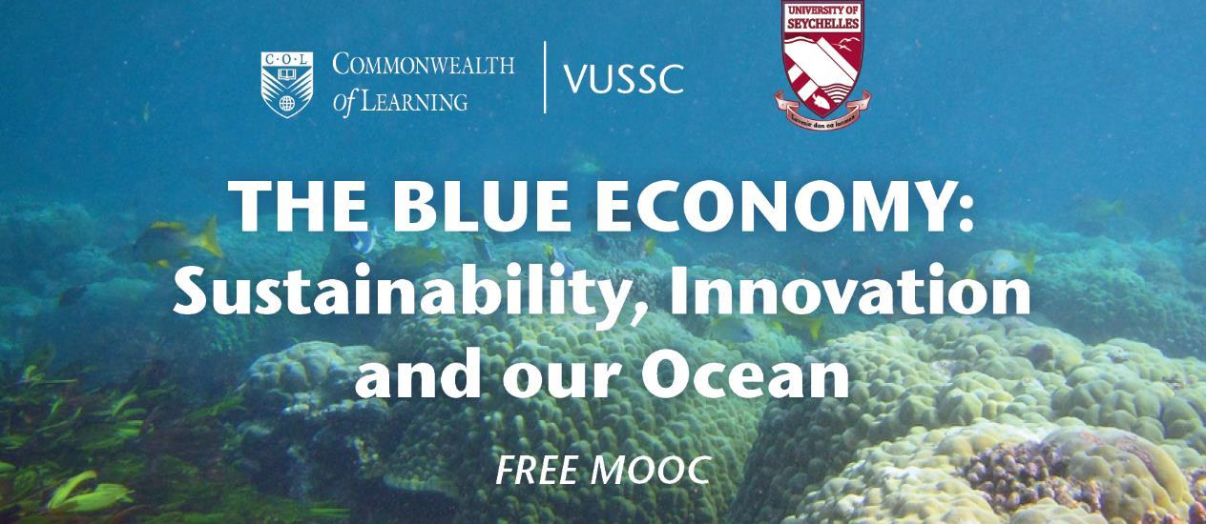

SEYCHELLES

Slide 21
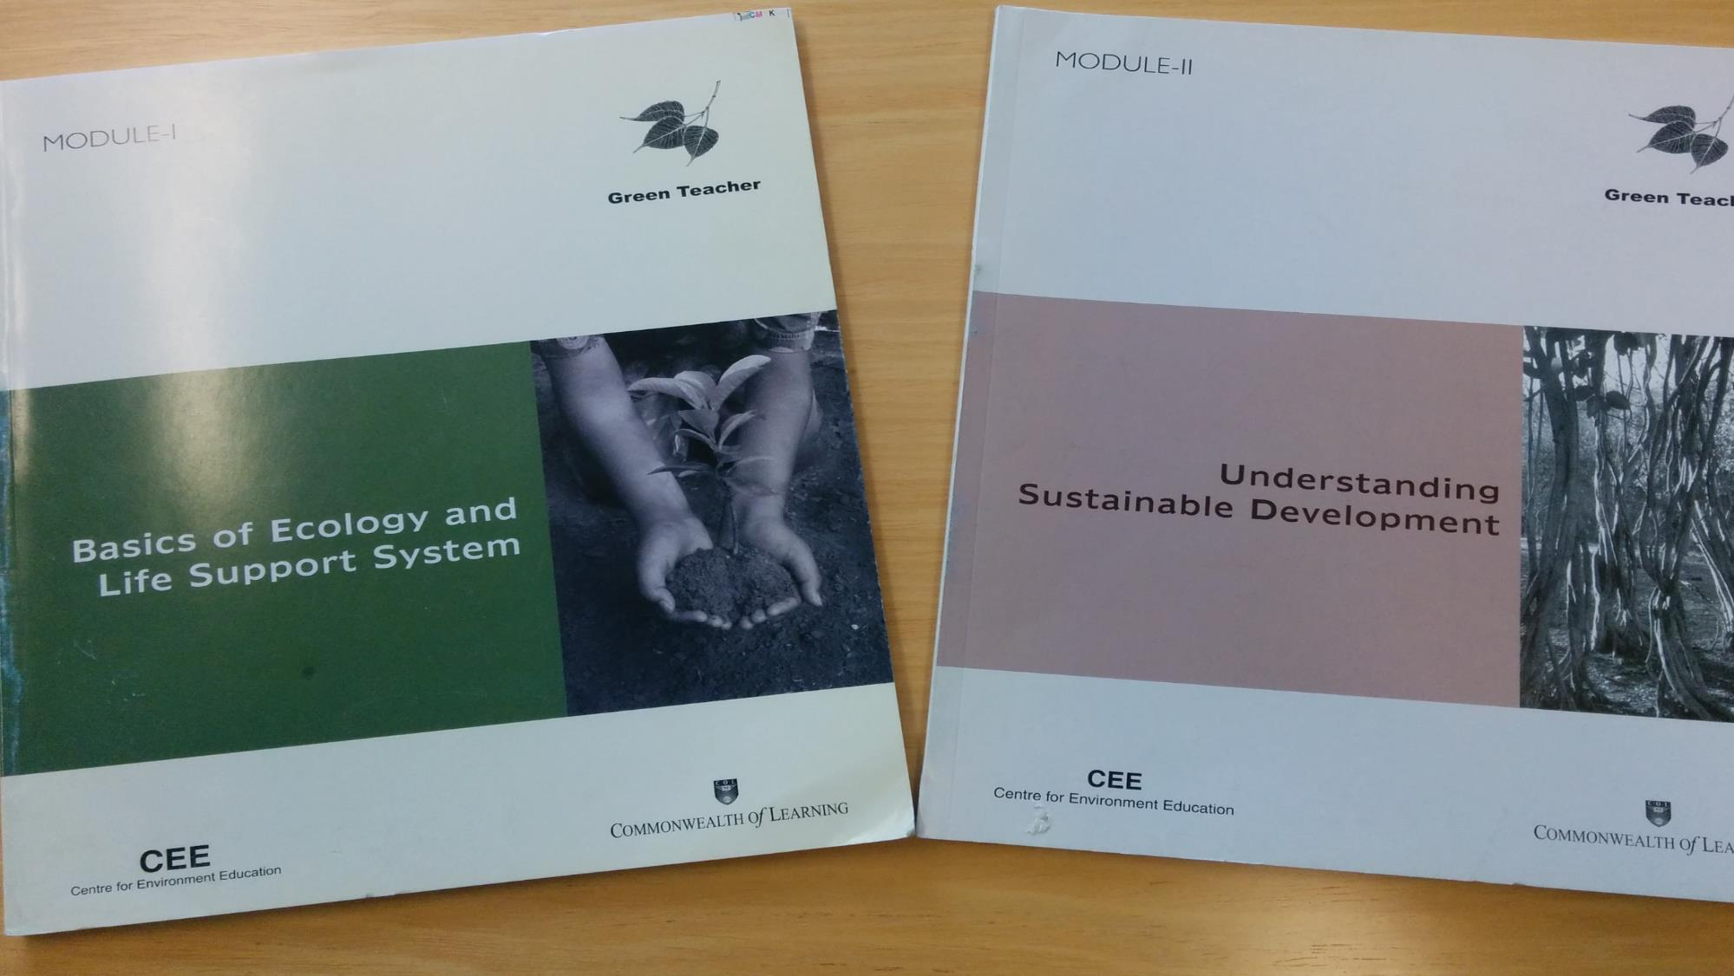


Green Teacher
NIGERIA
Notes:
COL is also supporting resilience of the education sector by developing the skills and capacities of teachers in environmental education.
COL supported the National Teachers Institute, Nigeria, which has an annual enrolment of 50,000 trainee teachers, to develop a Green Teacher programme to help teachers to integrate environmental concerns into the classroom from a very early age. This is now being offered online to teachers in the country.

Slide 22
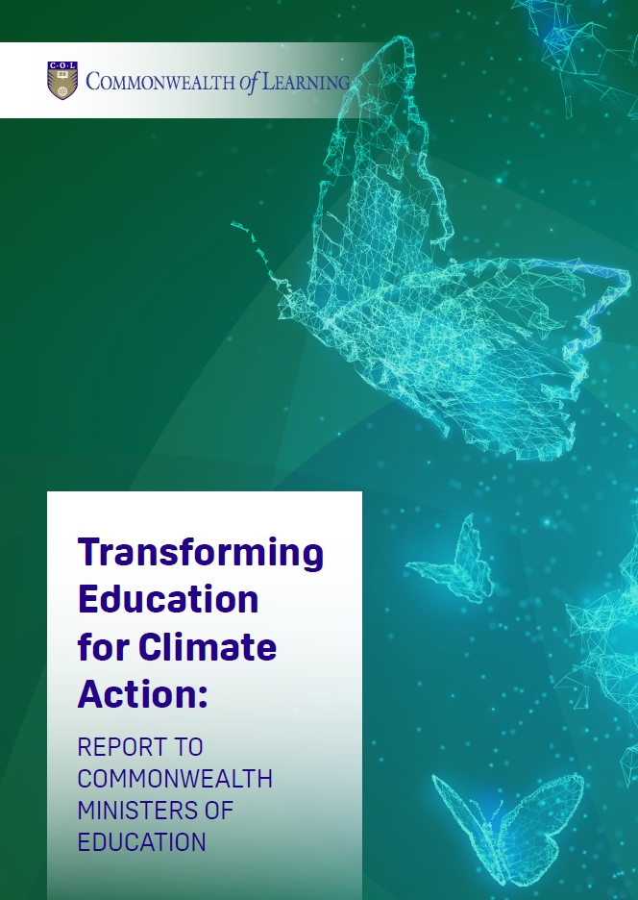
Pathways for Climate Resistant Education System
Climate proof the education infrastructure
Orient education organizational structures towards mitigating climate risk and achieving climate resilience
Build climate literacy and capacity across the education workforce

Slide 23
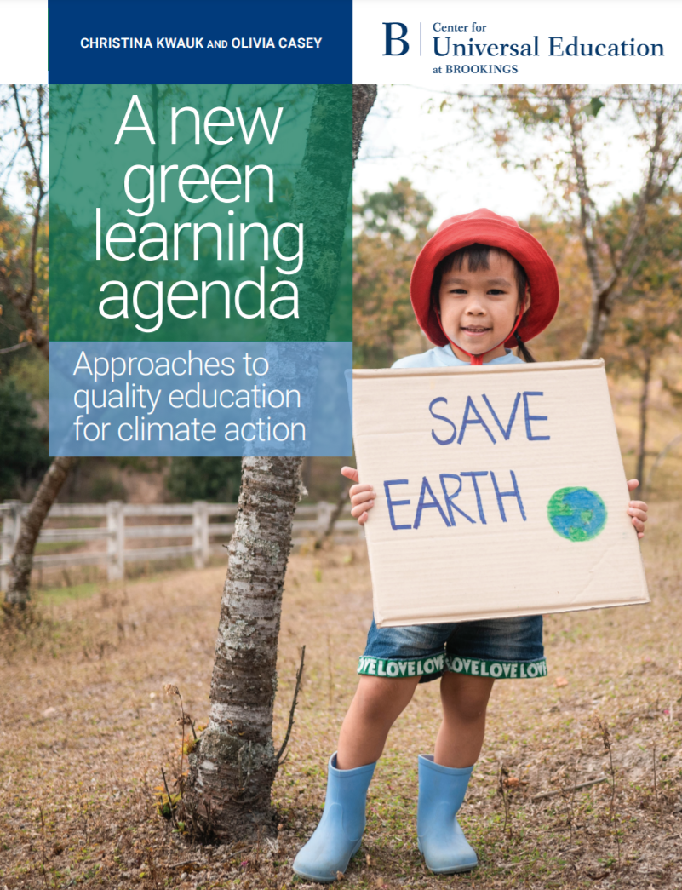
Green learning agenda
Skills for green jobs
Green life skills
Skills for a green transformation
Skills aimed at fulfilling the requirements of green jobs and supporting the transition to a low-carbon green economy
Cross-cutting skills that serve both technical, instrumental, and adaptive, transformative ends
Adaptive skills aimed at transforming unjust social and economic structures
Source: https://www.brookings.edu/wp-content/uploads/2021/01/Brookings-Green-Learning-FINAL.pdf
Notes:
Countries with harmful gender norms, gender discriminatory education policies are also countries with low levels of climate resilience and high levels of vulnerability to climate disasters.
Women and girls more vulnerable to disasters
Girls typically excluded from technical fields and STEM required by the green economy

Slide 24
Leadership for Climate Action
Build greater policy coherence and co-ordination for climate action
1
Create more climate change education champions within governments
2
Mobilise climate financing and partnerships towards strengthening education systems
3

Slide 25


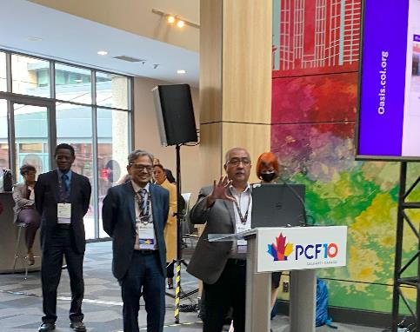
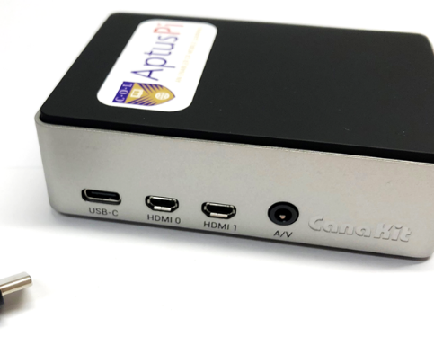
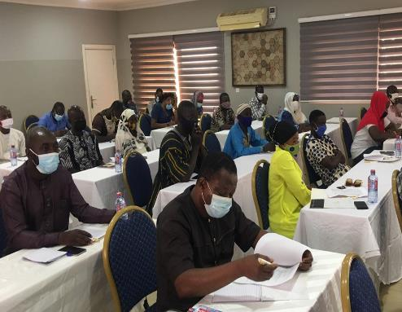
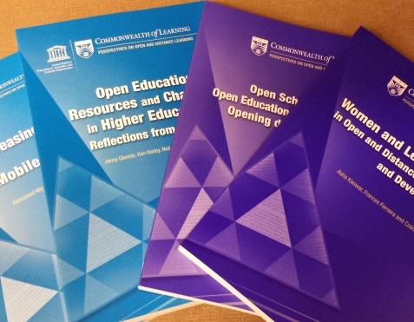

@35 COL offers
World Class Expertise
Innovative Models
Capacity Building
Resources
CC0 1.0 Universal - Pixabay
Notes:
We invite you to engage us; tap into our thought leadership, expertise, networks and resources

Slide 26


Thank you
www.col.org
The contents of this presentation, with the exception of logos and graphics which are the property of the respective owners, is made available under Attribution-ShareAlike 4.0 International (CC BY-SA 4.0).

