Slide 1



Smart Education: a policy perspective
Dr Sanjaya Mishra
Education Specialist, eLearning
Commonwealth of Learning, Canada

Slide 2
Contents
1
Key issues in education
2
What makes education smart?
3
Developing policies for smart education

Slide 3

1
Key issues in education
Notes:
First, key issues in.

Slide 4
Key issues in education
Access to educational opportunities (tertiary education)

Slide 5
Key issues in education
Cost of educational materials

Slide 6

Key issues in education
Quality of learning
Variation in quality across countries and within country
Mobility of learners
Employability of graduates

Slide 7
Key issues in education
The iron triangle of education
QUALITY
ACCESS
COST

Slide 8
2
What makes education smart?

Slide 9

What makes education smart?
Quality of learning
Low dropout/wastage
Student success/achievement
Joyful learning/ happiness

Slide 10

What makes education smart?
Preparing for work
Employment and livelihoods
Learning that is socially useful
Social return on investment
Photo by Leon on Unsplash

Slide 11

What makes education smart?
Flexible and learner-centred
Anytime, anywhere learning
Need-based curriculum
Lifelong and life-wide

Slide 12

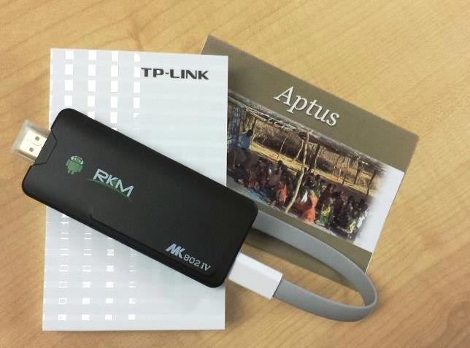

What makes education smart?
Technology-supported
Integrate appropriate technologies
Address device and bandwidth issues
Designed for learning

Slide 13

What makes education smart?
Cost-effective
Low cost-per learner
Less student debt
Uses open tools and technologies

Slide 14



What makes education smart?
Curricular focus
Global citizenship education
Gender equity
Persons with disabilities
Sustainable development

Slide 15
3
Developing policies for smart education

Slide 16
Developing policies for smart education
What works?
Evidence-based
Grassroot level involvement
Adequate funding
Clear pathways to change
Monitoring and evaluation
 | Technology | Policy | Capacity
Evidence-based
Participatory
Budget provision
Outcomes
Monitoring
Evaluation

Slide 17
Developing policies for smart education
Vision, Mission, Objective
Infrastructure and Connectivity
Curriculum development
Teaching and Learning
Equity and Inclusion
Human resource development
Organisation and Management
Policy areas

Slide 18
Developing policies for smart education
 | Latent | Emerging | Established | Advanced
Vision, Mission, Objective
Infrastructure and Connectivity
Curriculum development
Teaching and Learning
Equity and Inclusion
Human resource development
Organisation and Management
Connectivity
Content
Capabilities
Analysing policy

Slide 19

THANK YOU

